Slide 1
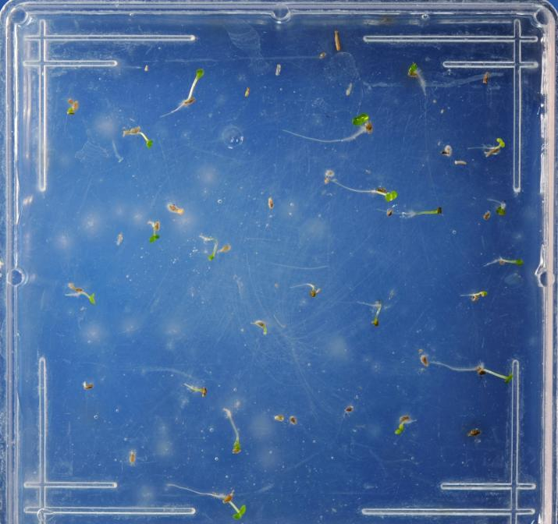
Wyoming Big Sagebrush
At first count

Slide 2
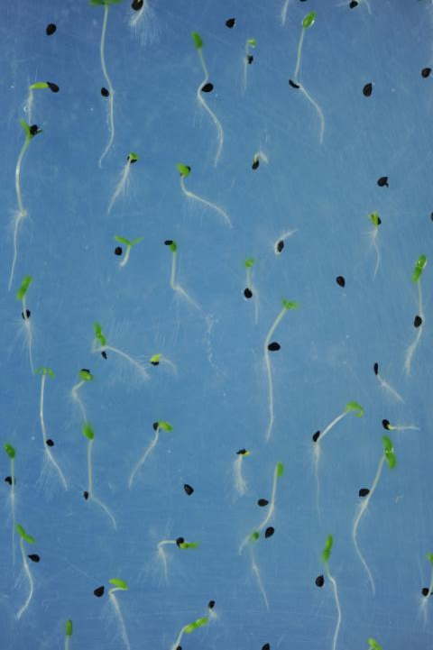
Dianthus

Slide 3
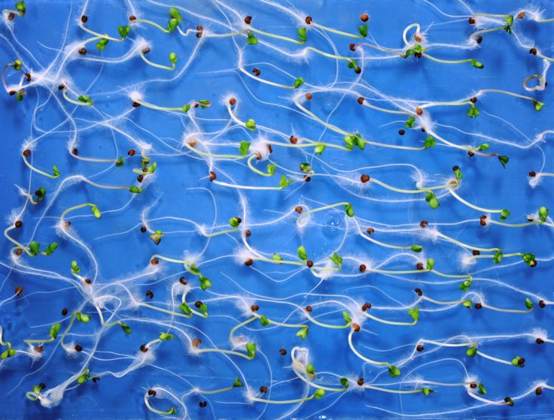
Broccoli

Slide 4
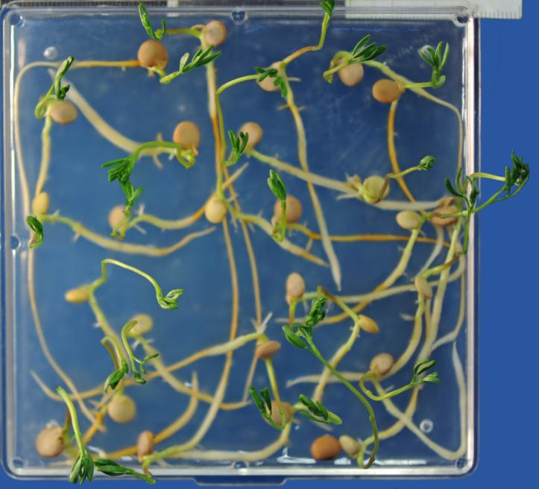
Lentils

Slide 5
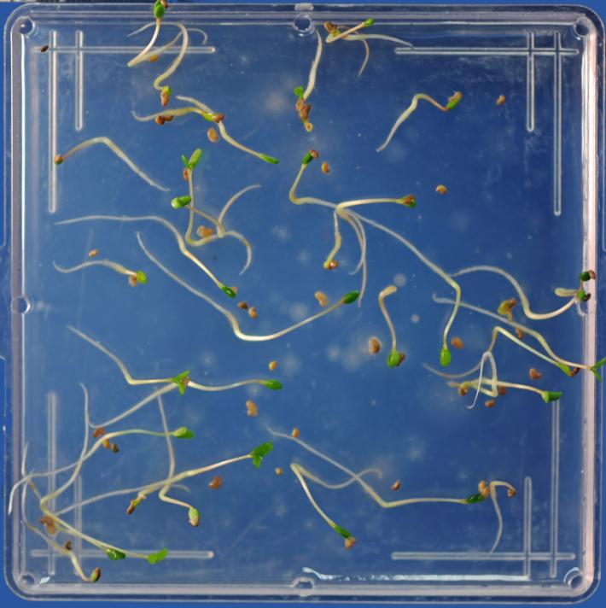
Prairie
Clover

Slide 6
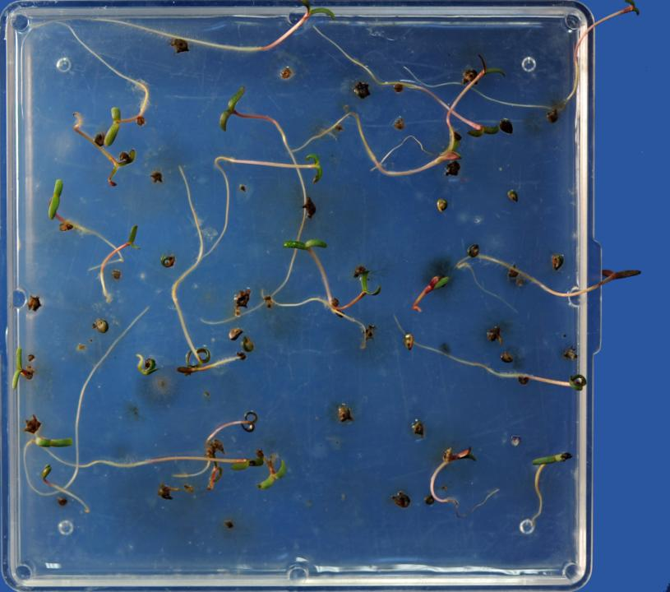
Forage
Kochia

Slide 7
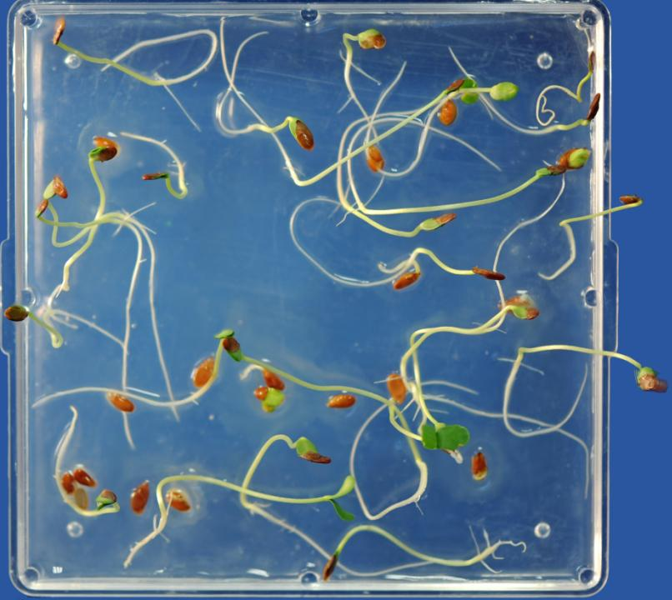
Flax

Slide 8
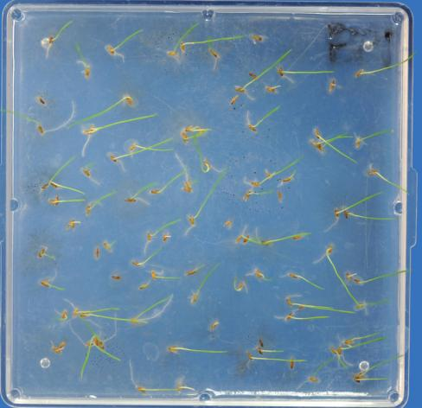
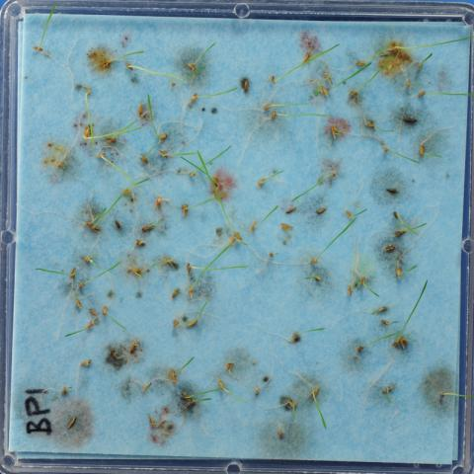
Kentucky Bluegrass
Prechill
At first count

Slide 9
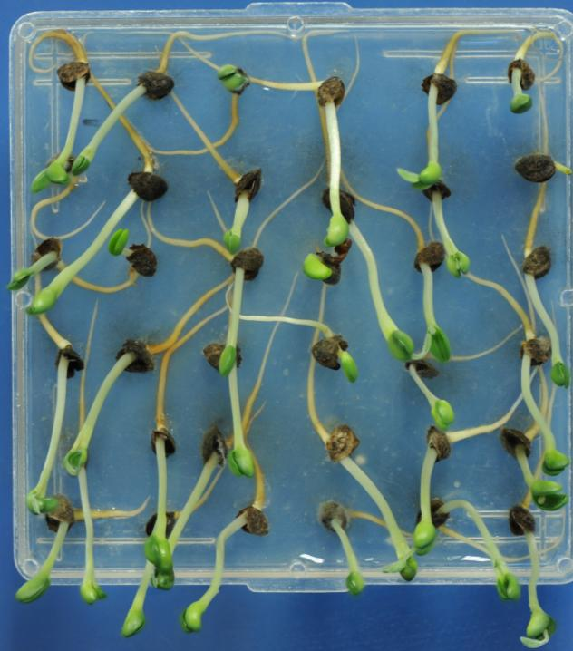
Sanfoin

Slide 10
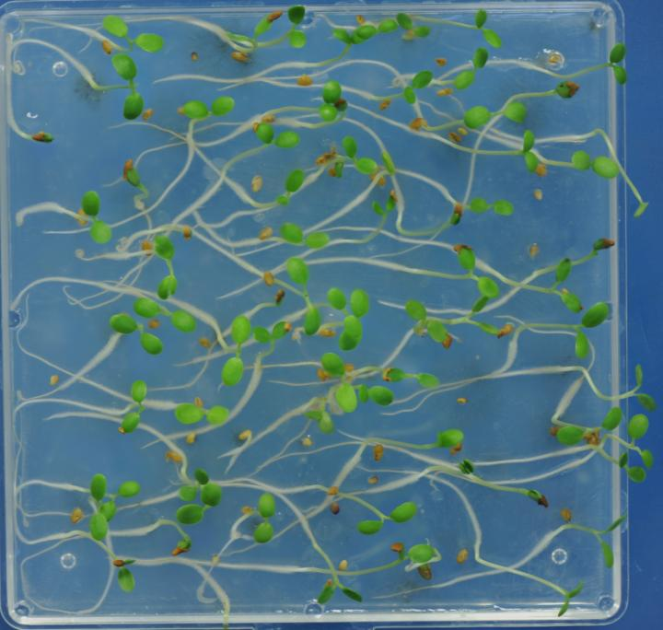
Red Clover

Slide 11
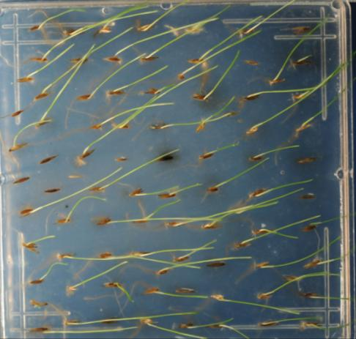
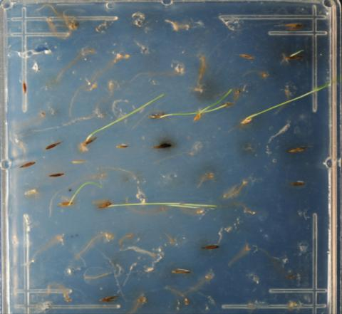
First Count
Post First Count
Blue Fescue

Slide 12
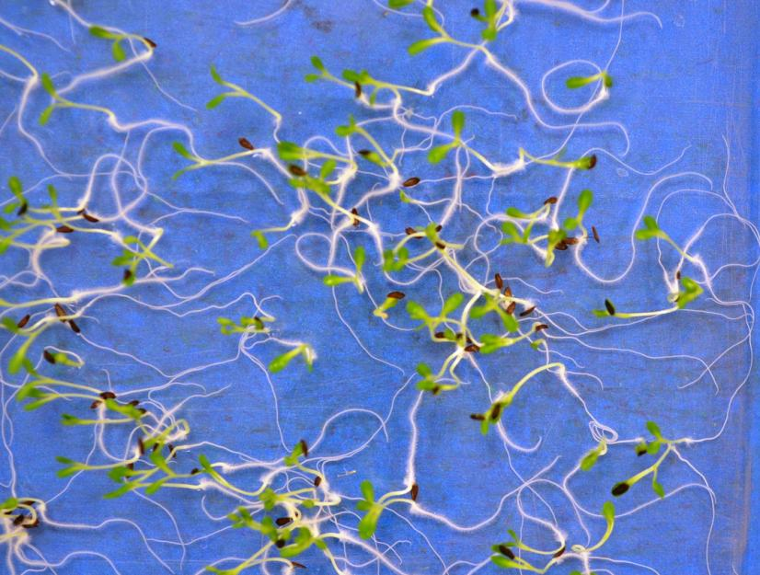
Lettuce

Slide 13
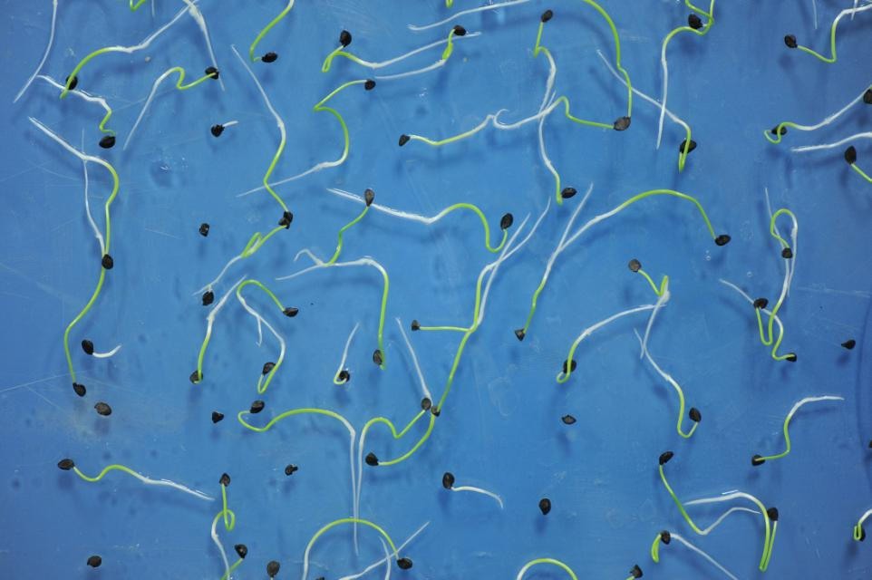
Onion

Slide 14
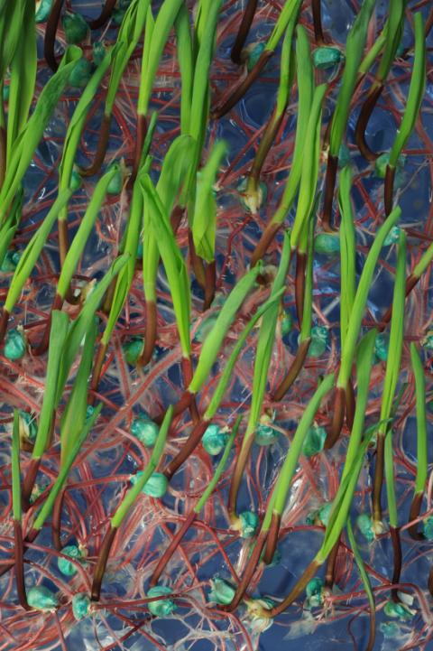
Corn

Slide 15
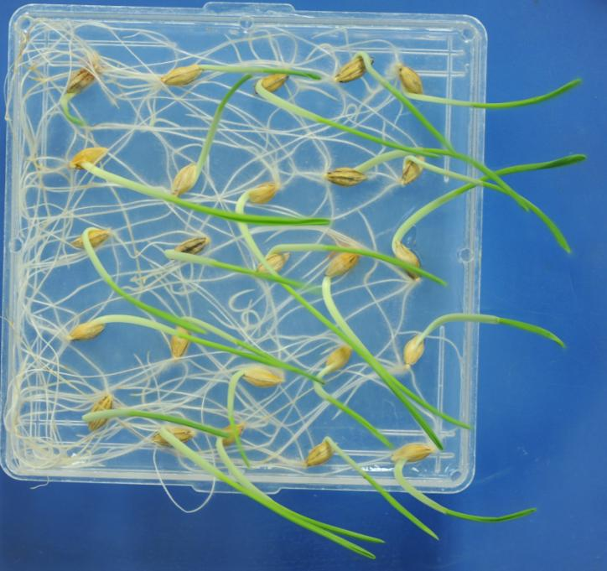
Barley

Slide 16
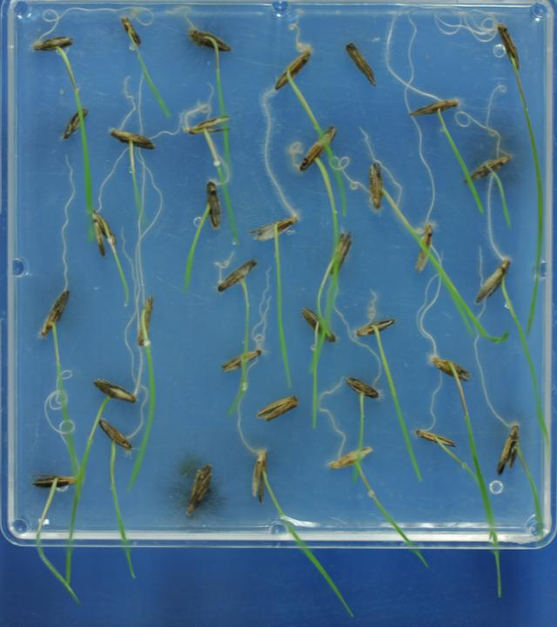
Tall Wheatgrass

Slide 17
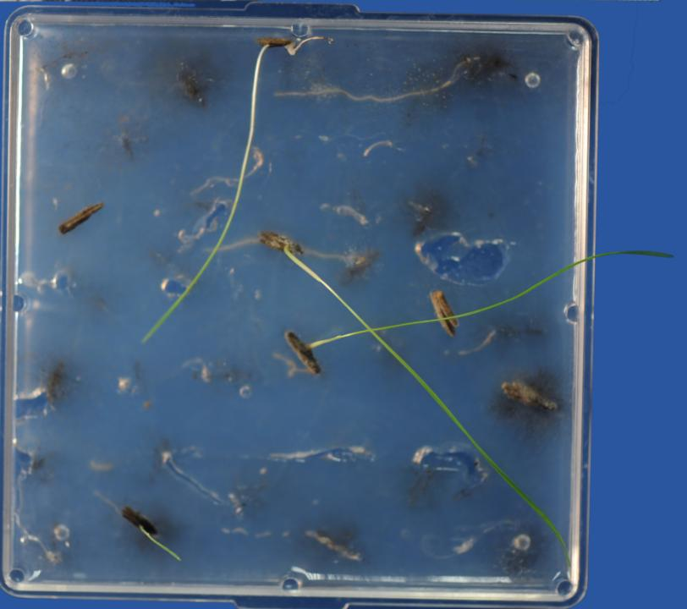
Tall
Wheatgrass
Final Count
21 days

Slide 18
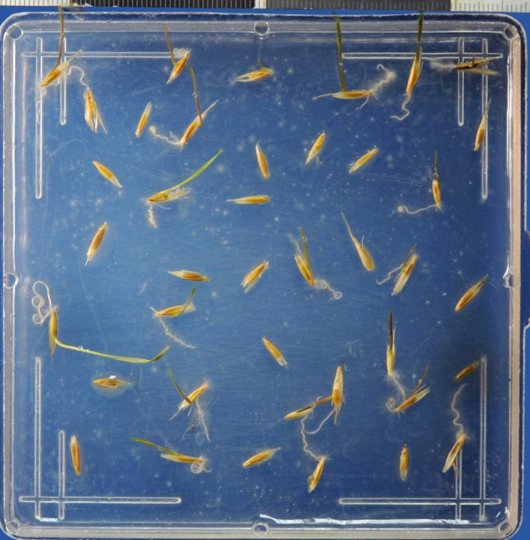
Blue Bunch
Wheatgrass

Slide 19
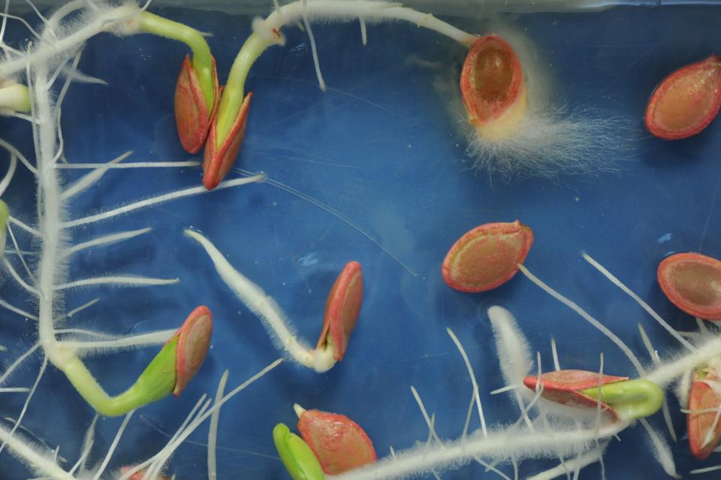
Squash

Slide 20
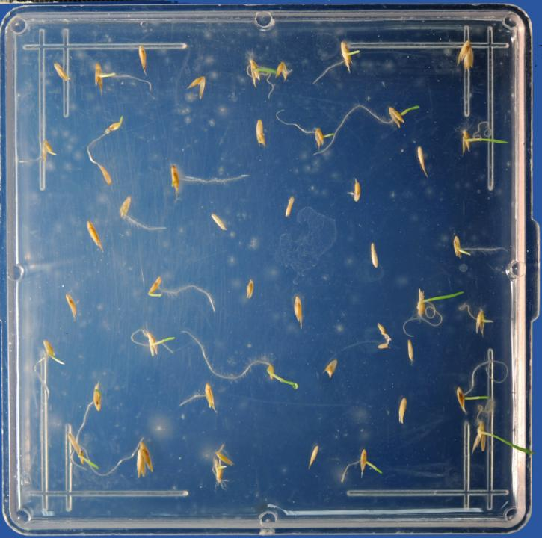
Orchard Grass
2nd count

Slide 21
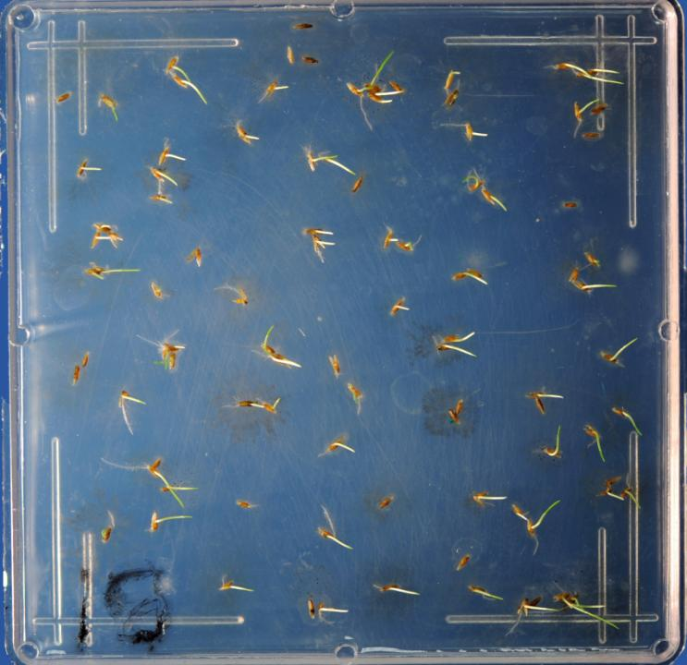
KBG

Slide 22
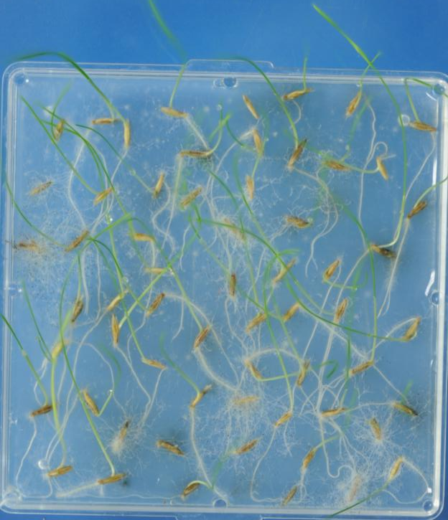
Russian Wild Rye

Slide 23
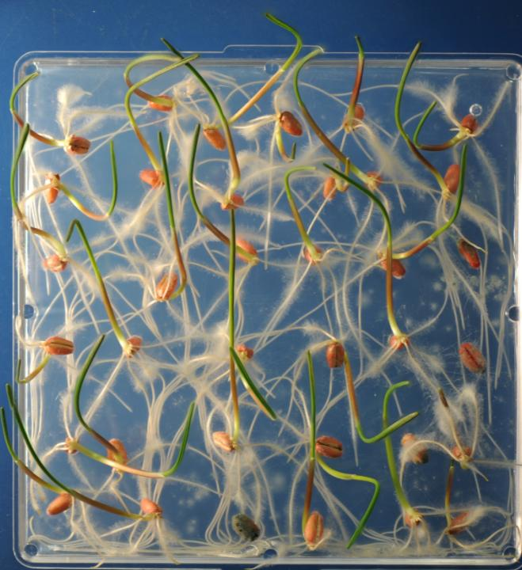
Wheat

Slide 24
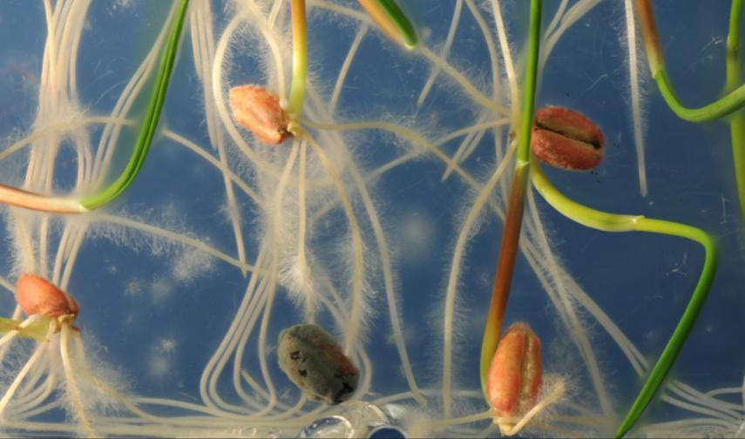
Penicillium did not spread from primary source

Slide 25
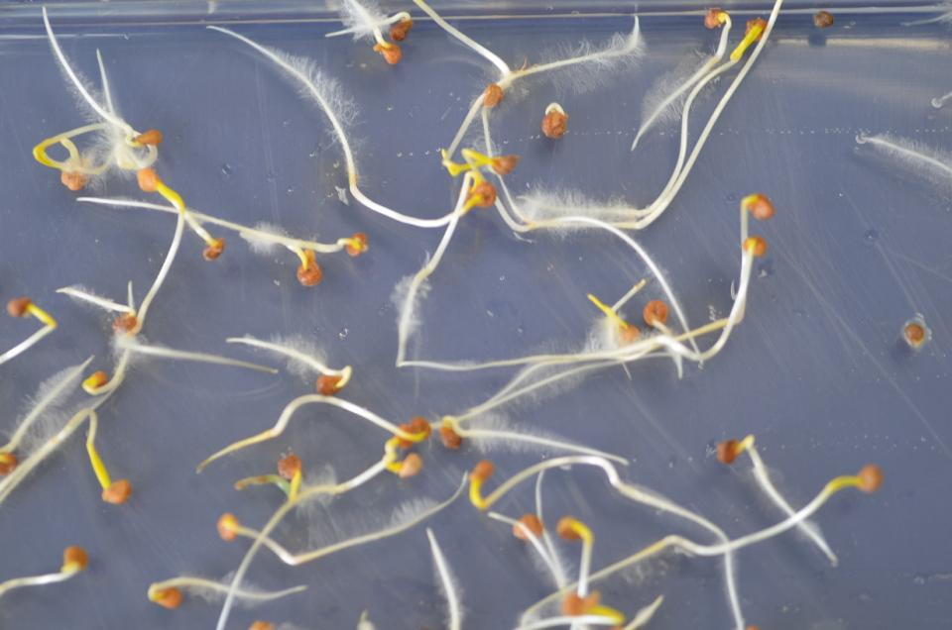
Spinach

Slide 26
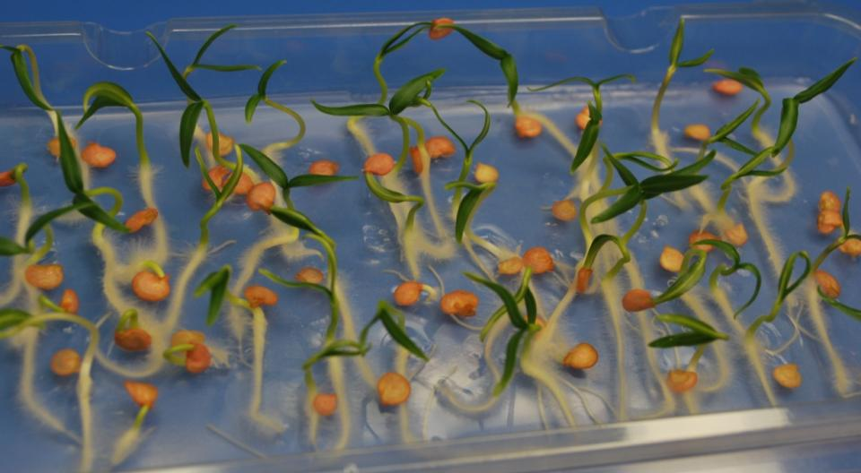
Pepper

Slide 27
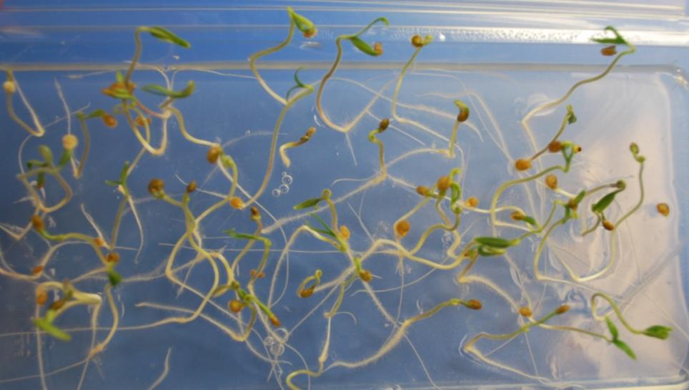
Tomato

Slide 28
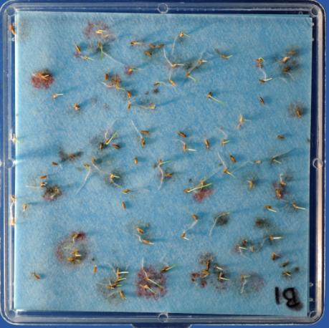
Kentucky Bluegrass on Agar and Blotter
At First Count

Slide 29
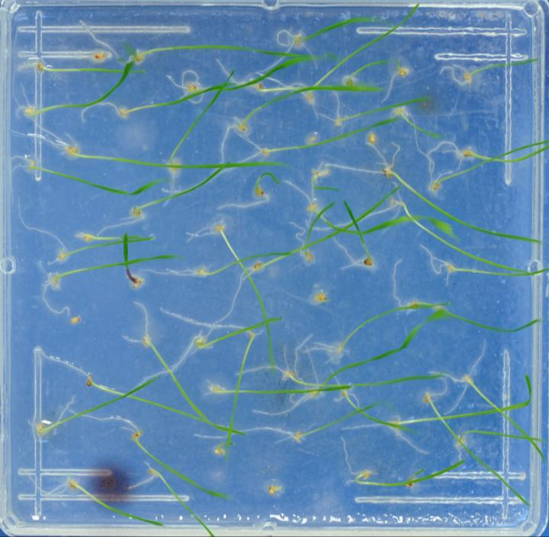
Timothy

Slide 30
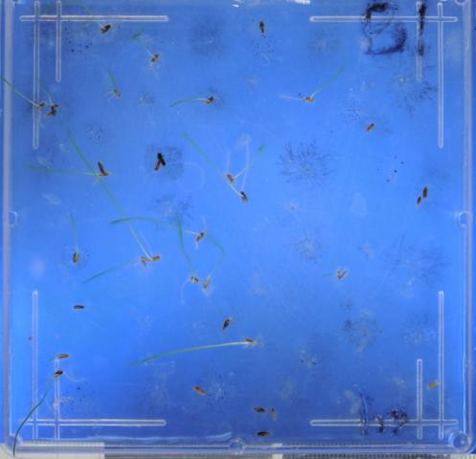
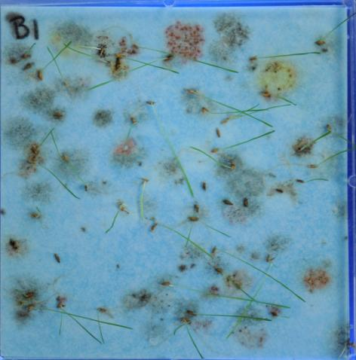
Kentucky Bluegrass
Prior to Second Count
Day 14

Slide 31
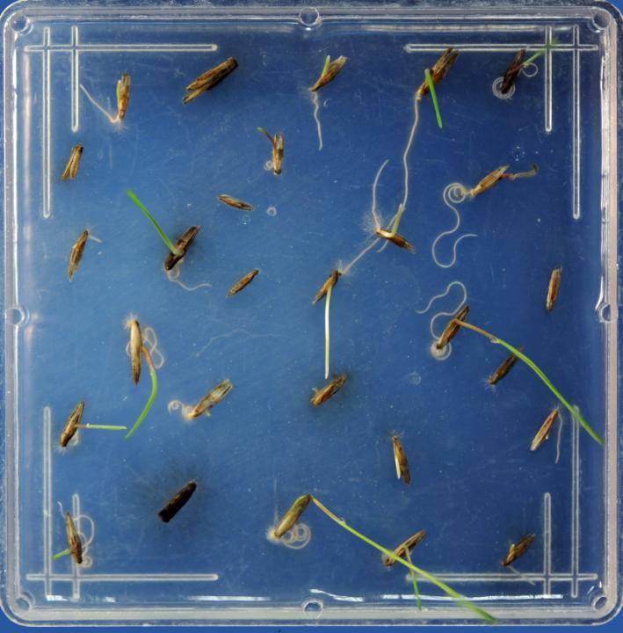
Basin
Wildrye

Slide 32
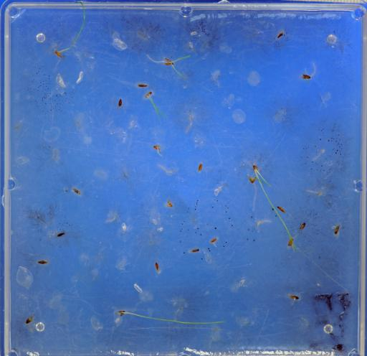
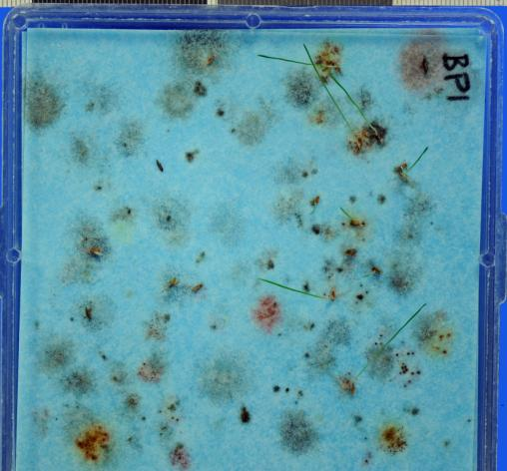
Kentucky Bluegrass
Prechill
post second count

Slide 33
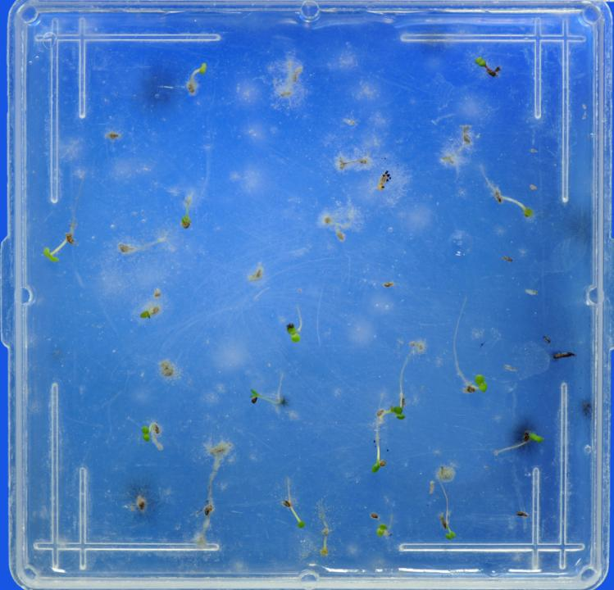
Big Sage Brush
Final

Slide 34
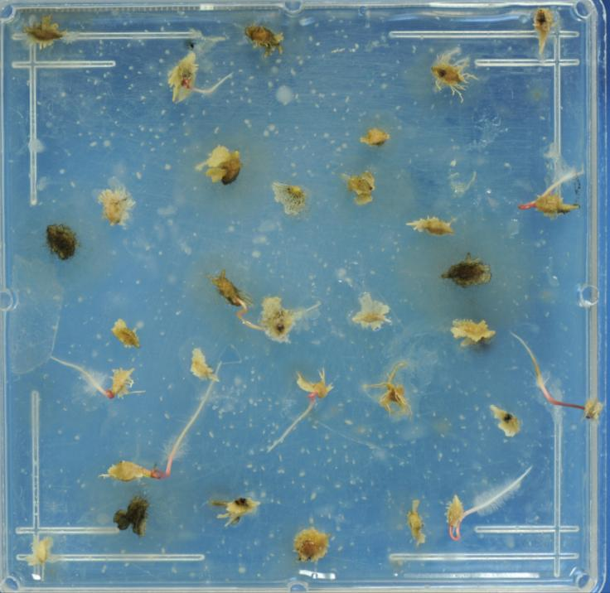
Four Wing
Salt Bush

Slide 35
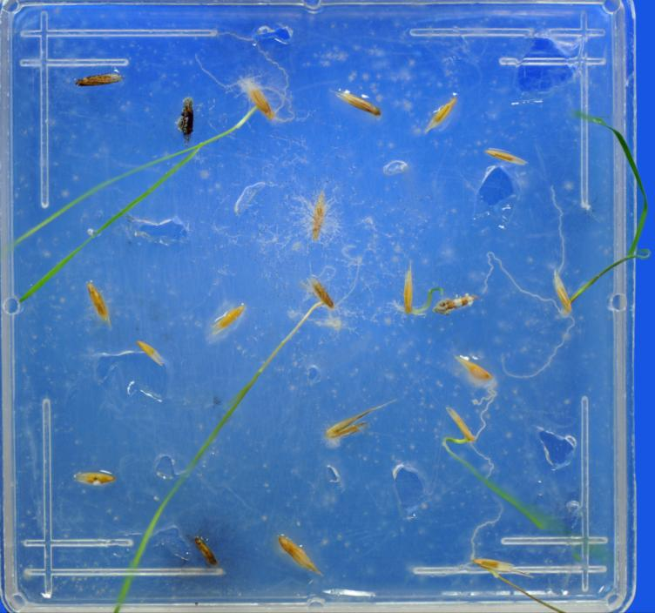
Blue Bunch
Final

Slide 36
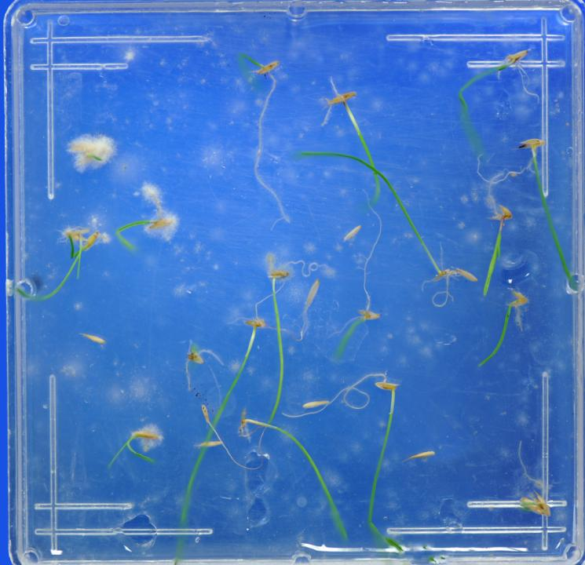
Orchard Grass
Final

Slide 37
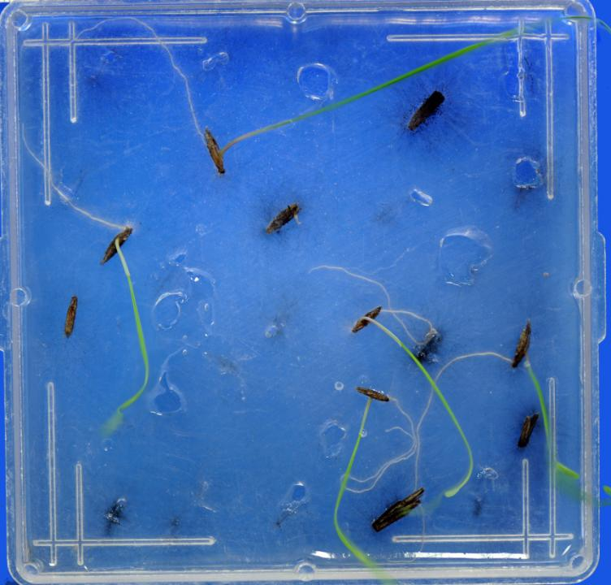
Basin Wild Rye
Final

Slide 38
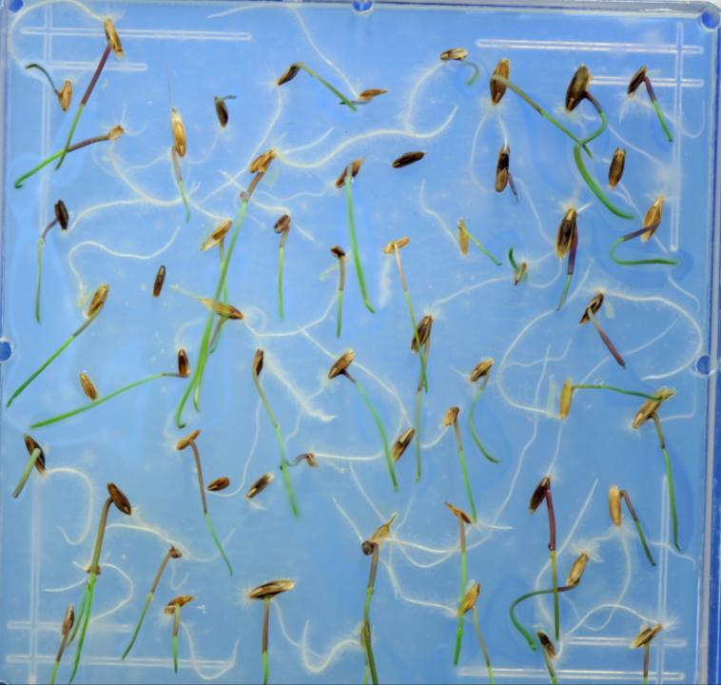
Ryegrass
Mix

Slide 39
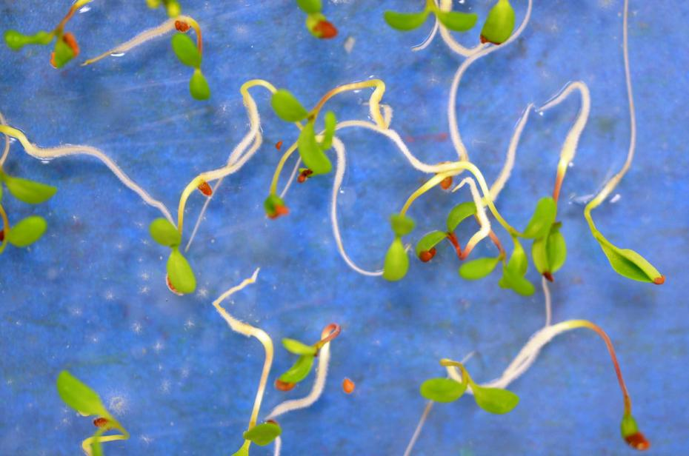
Alfalfa

Slide 40
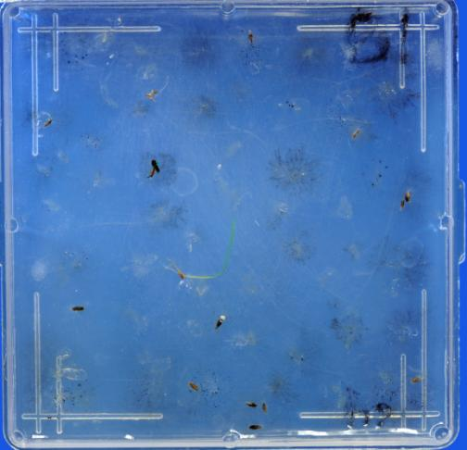
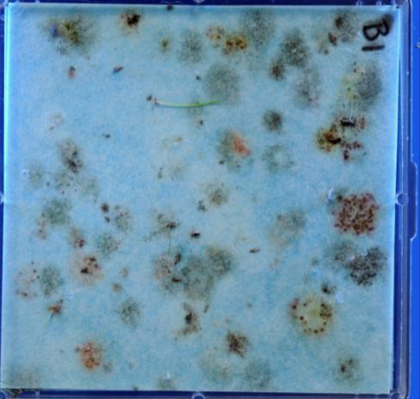
Kentucky Bluegrass
Final Count

Slide 41
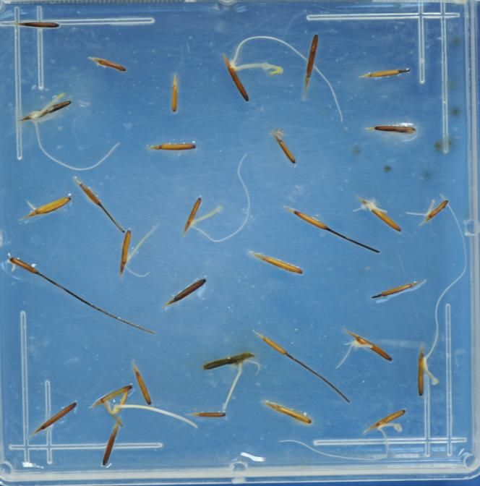
Needle and Thread
First Count

Slide 42
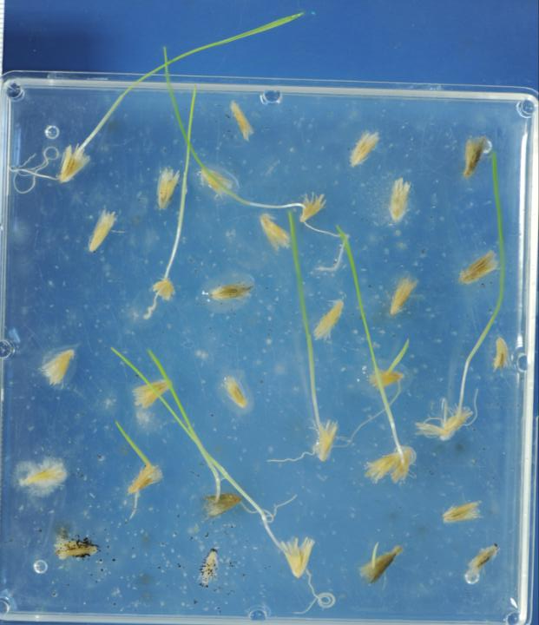
Galleta
Day 8

Slide 43
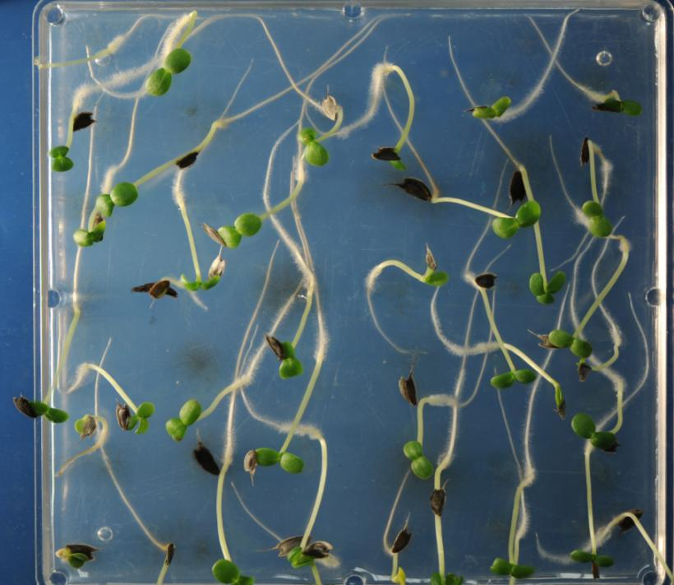
Zinnia

Slide 44
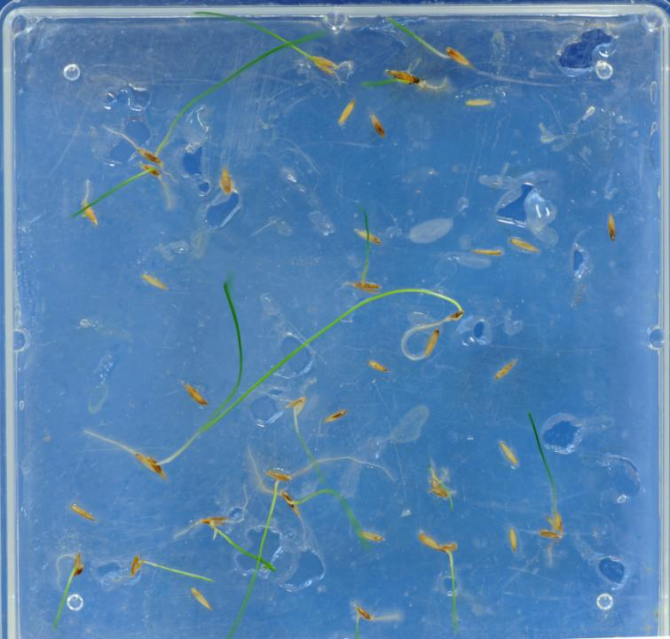
Hard Fescue
Final Count

Slide 45
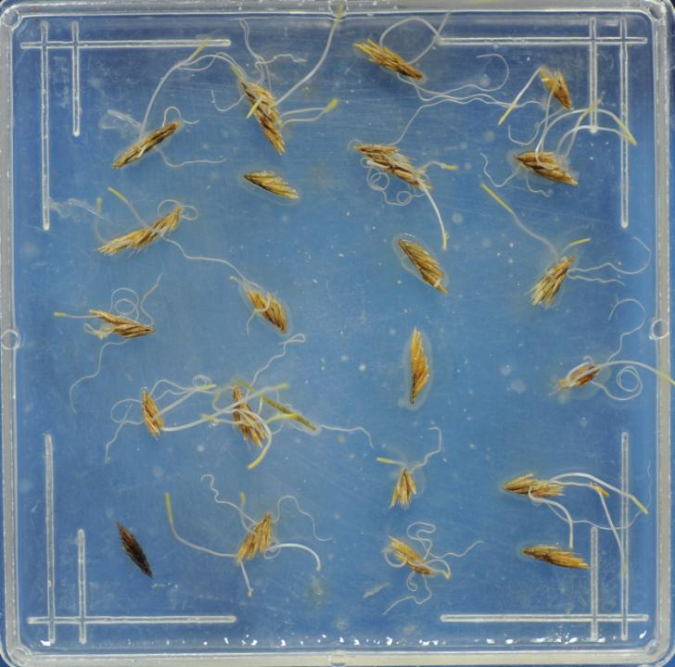
Side Oats Grama
First Count

Slide 46
Side Oats Grama
Final
Count

Slide 47
Perennial
Ryegrass

Slide 48
Squash

Slide 49
Jack Pine

Slide 50
Red Top

Slide 51
Black Jack
Bermuda

