Slide 1
Southwest Region Referee 2016
Evaluation of Physiological Necrosis of
Lettuce Seedlings
Donna Grubisic and Riad Baalbaki
Referee Coordinators

Slide 2
Introduction
United States is the second largest lettuce producing country (China #1).
Value of lettuce production totaled nearly $1.5 billion (2013).
More than 90% of United States lettuce production is located in California and Arizona.
In 2013 head lettuce production in California was 71% and in Arizona 29%. Both states produced over 98% of leaf lettuce.`
On the central coast of California (Salinas Valley) iceberg lettuce production cost was $8,999 per acre (2009). In 2011, lettuce was grown on 206,000 acres in California.

Slide 3
Referee of Lettuce Seedlings with Physiological Necrosis
The survey includes 10 photos showing different percentages of physiological necrosis on a lettuce seedling. The participant is asked to evaluate the seedling as normal or abnormal according to AOSA Rules Volume 4. Also a brief reason why that classification is given to the seedling.
The survey was taken by 56 different analysts within the United States and Canada.

Slide 4
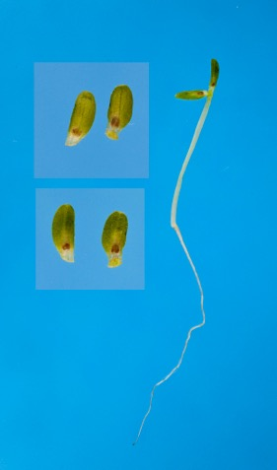
Photo 1
Normal – 55 (98.2%)
< 50% p.n.
Abnormal – 1 (1.8%)
appearance of
seedling

Slide 5
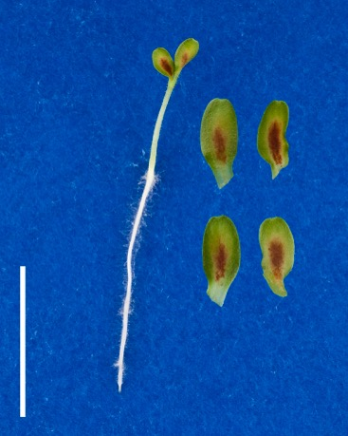
Photo 2
Normal – 15 (26.8%)
< 50% p.n.
Abnormal – 41 (73.2%)
> 50% p.n.

Slide 6
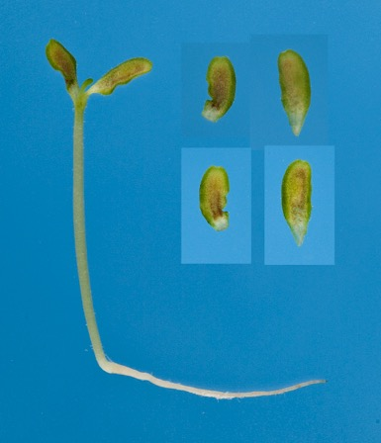
Photo 3
Normal – 9 (16.1%)
< 50% p.n.
natural pigmentation
discolored areas on cots.
Abnormal – 46 (82.1%)
> 50% p.n.
Undecided – 1 (1.8%)
p.n. or pigmentation

Slide 7
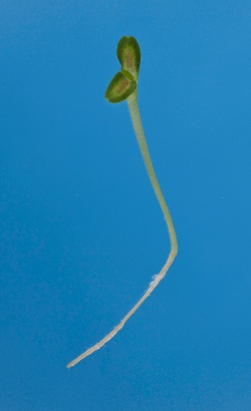
Photo 4
Normal – 23 (41.1%)
< 50% p.n.
natural pigmention/
no necrosis
Abnormal – 31 (55.3%)
> 50% p.n.
Undecided – 2 (3.6%)
photo not clear

Slide 8
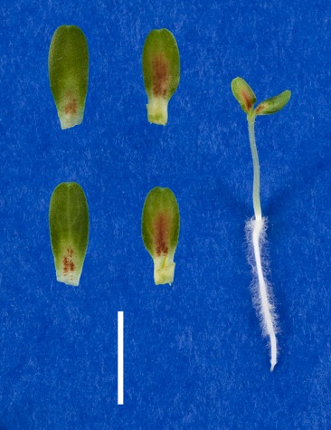
Photo 5
Normal – 31 (55.4%)
< 50% p.n.
Abnormal – 25 (44.6%)
> 50% p.n.
grainy/watery hypocotyl
deformed root/split

Slide 9
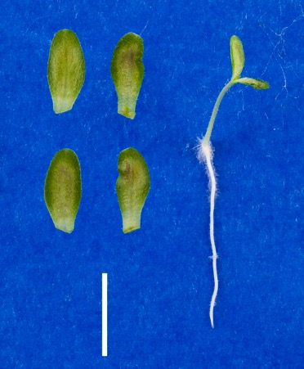
Photo 6
Normal – 37 (66.1%)
< 50% p.n.
free of necrosis
Abnormal – 18 (32.1%)
> 50% p.n.
Undecided – 1 (1.8%)
p.n. or pigmentation

Slide 10
Photo 7
Normal – 33 (58.9%)
< 50% p.n.
Abnormal – 23 (41.1%)
> 50% p.n.

Slide 11
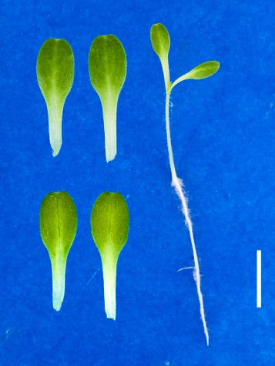
Photo 8
Normal – 56 (100%)
no p.n.
perfect seedling
Abnormal - 0

Slide 12
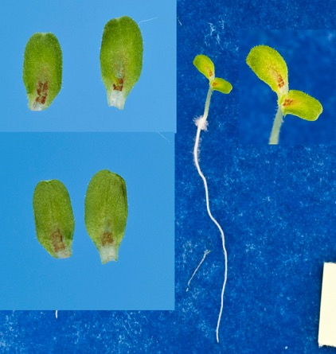
Photo 9
Normal – 38 (67.8%)
< 50% p.n.
shorten hypocotyl
Abnormal – 17 (30.4%)
> 50% p.n.
shorten/watery hypocotyl
essential structure impaired
Undecided – 1 (1.8%)

Slide 13
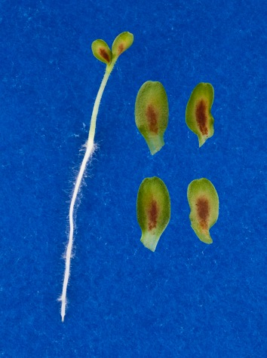
Photo 10
Normal – 10 (17.9%)
< 50% p.n.
Abnormal – 46 (82.1%)
> 50% p.n.

Slide 14
In Conclusion
Lettuce production in the United States is of great importance and demand.
A large lettuce grower in California (Salinas Valley and Imperial Valley) and Arizona discards the seed lot when a report of analysis shows beginning and/or severe physiological necrosis.
In the survey, photo #8 showed total evaluation uniformity and #1 a very close second (98.2% uniformity). Photos 2, 3, 6, 9 and 10 showed some non-uniformity in evaluation based on the degree of physiological necrosis on the cotyledons. Photos 4, 5 and 7 (same) showed non-uniform evaluation due to the degree of physiological necrosis that was close to 50%.
The cost of lettuce production is high. In evaluating lettuce seedlings in the lab, evaluation of physiological necrosis should be more conservative. A lower percentage (10%, 25%?) needs to be used for evaluating the seedling as normal or harmonize with Canadian Methods and Procedures in which no physiological necrosis is allowed to be evaluated as normal.
A Thank You to All Participants of the Lettuce Survey Referee !

Slide 15
References
UC Cooperative Extension
2009 Lettuce (Iceberg) Costs and Returns Study
Central Coast – California
Keep California Farming
Which Foods Come from California? / Lettuce
(http://keepcaliforniafarming.org/produce/california-lettuce)
Lettuce Production in California
Daniel Geisseler and William R. Horwath
(http://apps.cdfa.ca.gov/frep/docs/Lettuce_Production_CA.pdf)
March 2013

