Slide 1
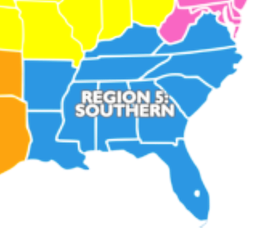
Zone 5 Southern 2016 Bahiagrass Referee Results
Notes:
Region 5: AL, AR, FL, GA, KY, LA, MS, NC, SC, TN, VA

Slide 2
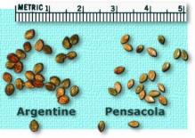
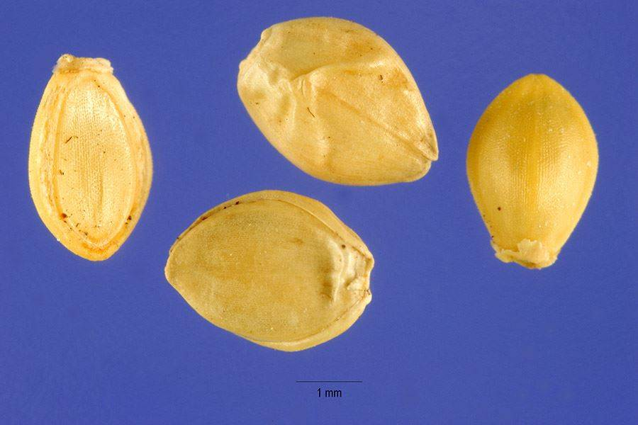
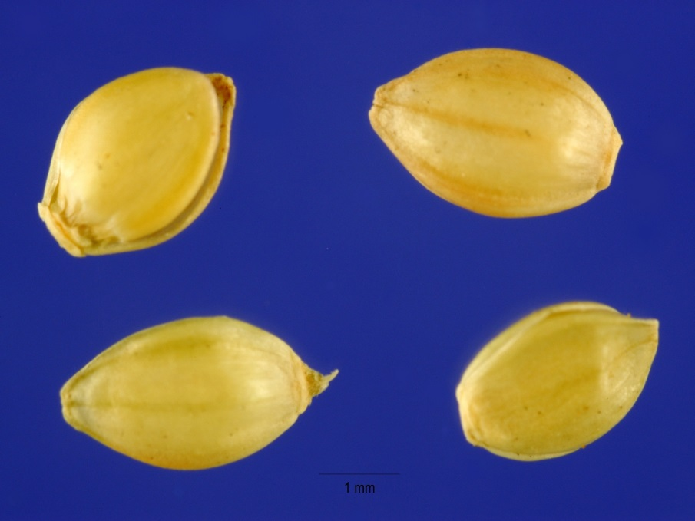
Paspalum notatum - Bahiagrass
Argentine Bahiagrass
Pensacola Bahiagrass
Notes:
Images comparing Argentine with Pensacola. Argentine tends to be a slightly larger seed and typically has a wrinkled lemma whereas Pensacola tends to have a smooth lemma.

Slide 3
Background
Pensacola and Argentine Bahiagrass (Paspalum notatum Flugge) are forage grasses commonly grown in the Southeastern U.S.
Thick outer seed coats that cause difficulty determining endosperm presence, high occurrence of ergotized seed and subsequent high percentages of inert matter present unique seed testing concerns when conducting purity analysis on these species.
Recent coating or encrusting of Bahiagrass has only added to testing challenges and lack of uniformity between labs.
The occurrence of a species of Paspalum (Brunswickgrass; Paspalum nicorae) which is undesirable as forage to cattle and commonly misidentified in Southeastern fields has also created concern in the Seed Industry and the need for uniform identification of this objectionable weed species.
Notes:
Background
Pensacola and Argentine Bahiagrass (Paspalum notatum Flugge) are forage grasses commonly grown in the Southeastern U.S. Thick outer seed coats that cause difficulty determining endosperm presence, high occurrence of ergotized seed and subsequent high percentages of inert matter present unique seed testing concerns when conducting purity analysis on these species. Recent coating or encrusting of Bahiagrass has only added to testing challenges and lack of uniformity between labs. The occurrence of a species of Paspalum (Brunswickgrass; Paspalum nicorae) which is undesirable as forage to cattle and commonly misidentified in Southeastern fields has also created concern in the Seed Industry and the need for uniform identification of this objectionable weed species.

Slide 4
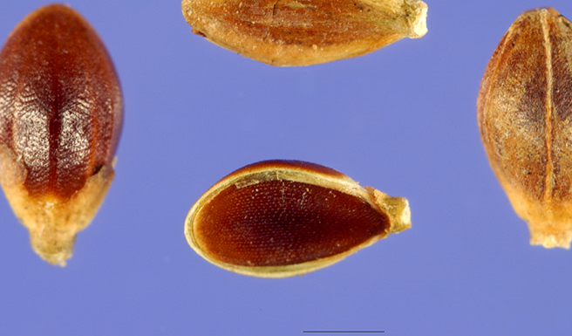
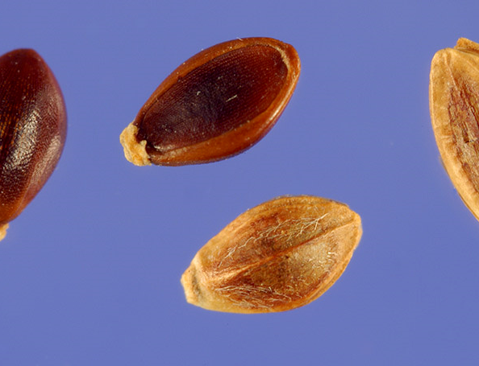
Brownseed Paspalum
Typical feature used to distinguish these two species is the presence of the light colored margin of the lemma and palea on the Brownseed Paspalum. Glumes must be removed to expose the lemma and palea of the seed for more accurate ID.
Brunswickgrass
Notes:
Primary feature used to distinguish these two species is the presence of the light colored margin of the lemma and palea on the Brownseed Paspalum. Glumes must be removed to expose the lemma and palea of the seed.

Slide 5
Proposal
Addressing the concerns outlined in the Background Section, it was proposed by the Zone 5 Southern referee committee to initiate a referee consisting of four samples of Bahiagrass, two Pensacola and two Argentine, one coated and one raw.
Each sample contained Brunswickgrass as the purity referee. A germination test was also conducted by each participating seed lab as a referee project.
Notes:
Proposal
Addressing the concerns outlined in the Background section it is proposed by the Zone 5 Southern referee committee to initiate a referee consisting of four samples of Bahiagrass, two Pensacola and two Argentine, one coated and one raw each containing Brunswickgrass for Purity and Germination testing by participating seed laboratories.

Slide 6
Procedure
Each participating lab was sent four Bahiagrass samples for Purity and Germination testing.
There were two 25g. coated samples and two 10g. raw samples one each Pensacola and Argentine.
The AOSA Rules for Testing Seeds Volume 1 section 6.8 b. special procedures for Argentine instruct to remove the enclosing structures (glumes, lemma & palea) commonly known as a hand peel, to expose caryopsis for germination testing. Chemical (aka acid) scarification could also be used if that was your normal testing method.
Notes:
Procedure
Each participating lab were sent four Bahiagrass samples for Purity and Germination testing. There were two 25g. coated samples and two 10g. raw samples one each Pensacola and Argentine. The AOSA Rules for Testing Seeds Volume 1 section 6.8 b. special procedures for Argentine instruct to remove the enclosing structures (glumes, lemma & palea) commonly known as a hand peel to expose caryopsis for germination testing (chemical scarification can also be used if that is your normal method).

Slide 7
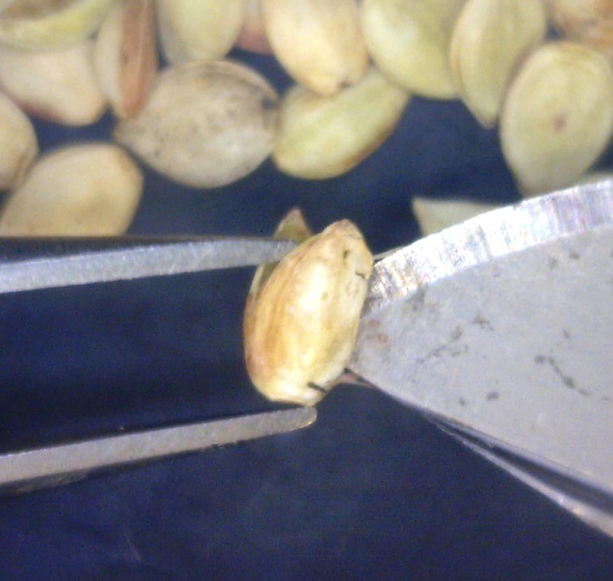
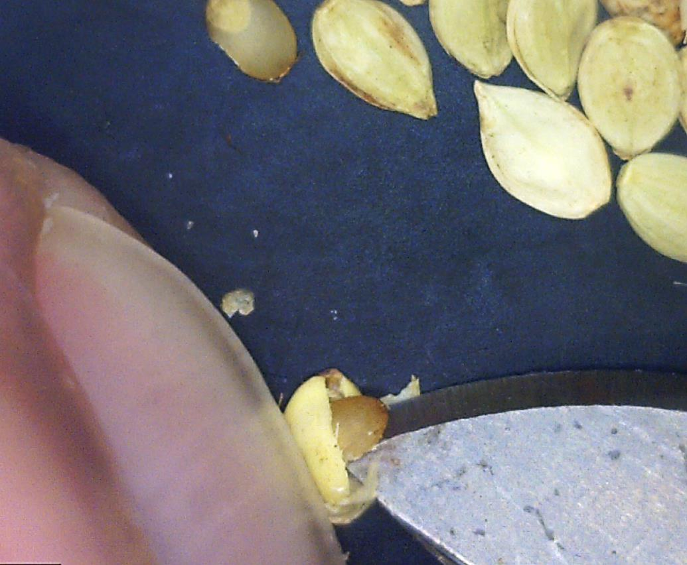
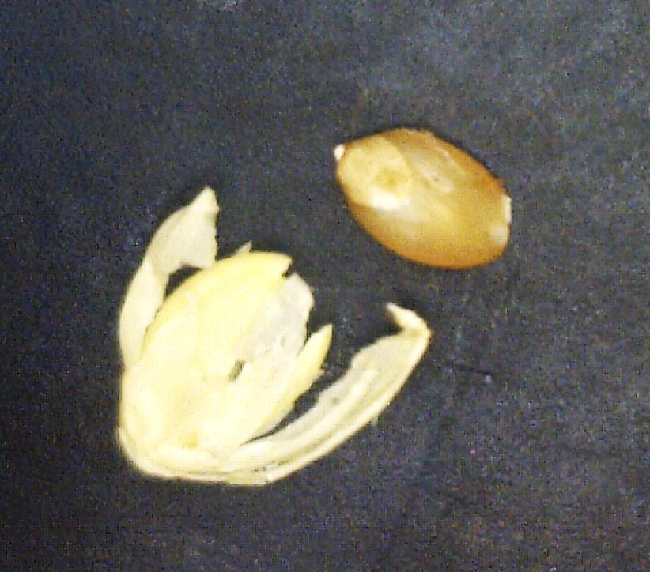
AOSA Rules Vol. 1 Section 6.8.b – Hand Peel/Scalpel
Carefully use scalpel tip to pry apart lemma and palea at the side or apex end of the seed to release enclosed caryopsis. Extreme caution must be used to avoid damaging the caryopsis embryo area and your finger.
Notes:
Procedure
The AOSA Rules for Testing Seeds Volume 1 section 6.8 b. special procedures for Argentine instruct to remove the enclosing structures (glumes, lemma & palea) commonly known as a hand peel to expose caryopsis for germination testing. Place the seed palea-side down. Carefully use scalpel tip to pry apart lemma and palea at the side or apex end of the seed to release enclosed caryopsis. Extreme caution must be used to avoid damaging the caryopsis embryo area and your finger. It is best to use forceps instead of your finger.

Slide 8
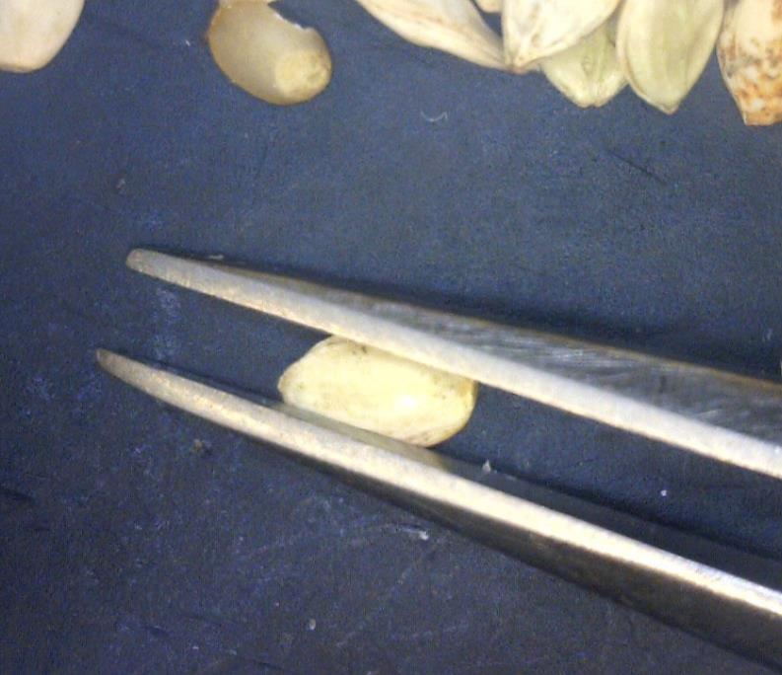
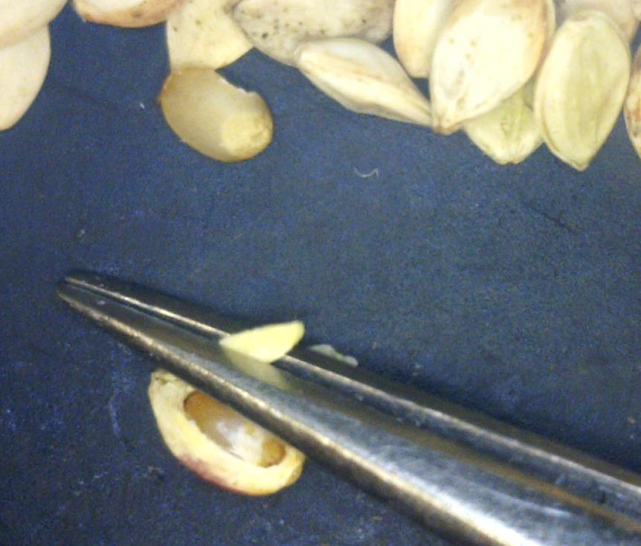
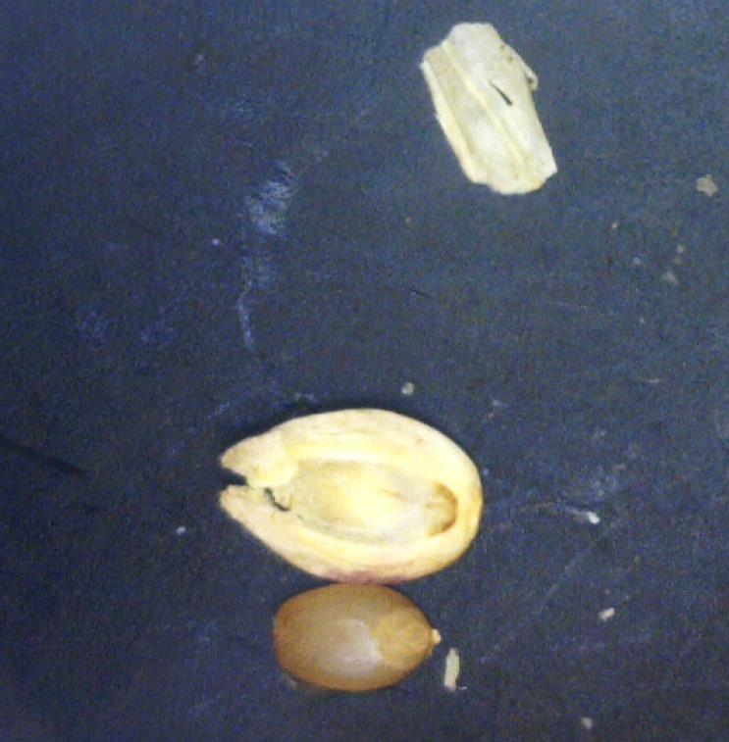
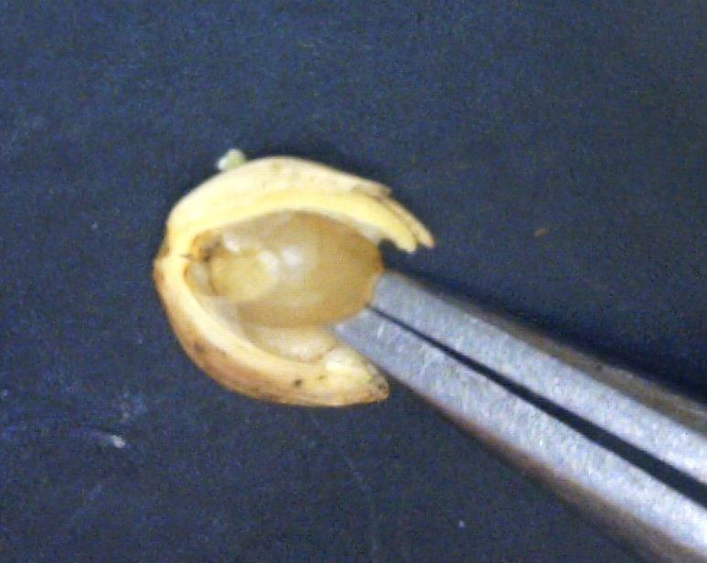
AOSA Rules Vol. 1 Section 6.8.b – Hand Peel/Forceps
Alternate peeling method is to place the seed palea-side down. Use forceps to slightly peel/pinch away a portion of the lemma to expose the caryopsis. Carefully insert the point of the forceps at the apex end of the seed to gently release the caryopsis from the lemma.
Notes:
Procedure
The AOSA Rules for Testing Seeds Volume 1 section 6.8 b. special procedures for Argentine instruct to remove the enclosing structures (glumes, lemma & palea) commonly known as a hand peel to expose caryopsis for germination testing. Alternate peeling method is to place the seed palea-side down. Use forceps to slightly peel/pinch away a portion of the lemma to expose the caryopsis. Carefully insert the point of the forceps at the apex end of the seed to gently release the caryopsis from the lemma.

Slide 9
Procedure
The coated Bahiagrass samples were tested coated for germination and de-coated prior to purity testing to determine coating percentage as a portion of the inert matter.
Included in the Zone 5 referee were seeds of Brunswickgrass (Paspalum nicorae Parodi), a common weed frequently misidentified as Brownseed Paspalum (Paspalum plicatulum Michx.). This species is undesirable to cattle and has become prevalent and problematic in Bahiagrass fields in the Southeastern USA.
The intent of including Brunswickgrass in this referee was to familiarize analysts with this objectionable weed species and to create uniform occurrence reporting as number per pound on all Bahiagrass samples tested from this point forward.
Notes:
Procedure
The coated Bahiagrass samples were tested coated for germination and de-coated prior to purity testing to determine coating percentage as a portion of the Inert matter. Included in the Zone 5 referee were seeds of Brunswickgrass (Paspalum nicorae Parodi) a common weed frequently misidentified as Brownseed Paspalum (Paspalum plicatulum Michx.) that is undesirable to cattle and has become prevalent and problematic in Bahiagrass fields in the Southeast. The intent of including Brunswickgrass in this referee was to familiarize analysts with this objectionable weed species and to create uniform occurrence reporting as number per pound on all Bahiagrass samples tested from this point forward.

Slide 10
RESULTS

Slide 11
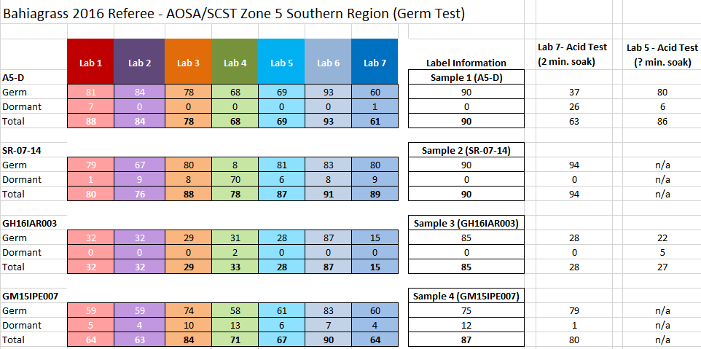
(Argentine)
(Pensacola)
(Argentine – Coated Seed)
(Pensacola – Coated Seed)
Notes:
As you can see, there is a significant range for the germ and dormant seed results across the labs.

Slide 12
(Argentine)
(Pensacola)
(Argentine – Coated Seed)
(Pensacola – Coated Seed)
Notes:
As you can see, there is a significant range for the germ and dormant seed results across the labs.

Slide 13
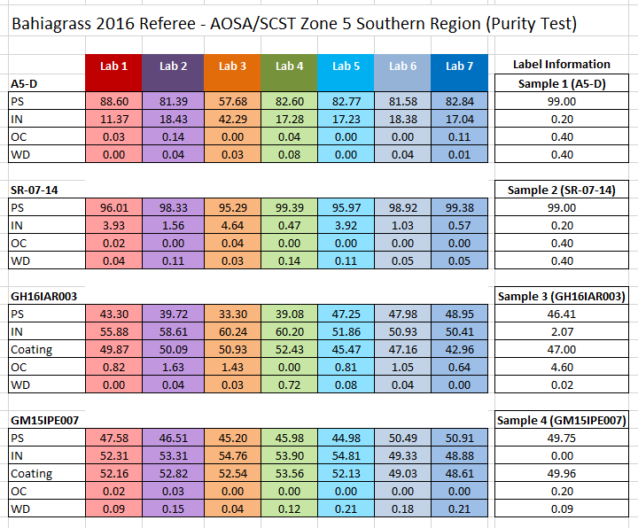
(Argentine)
(Pensacola)
(Argentine
– Coated Seed)
(Pensacola - Coated Seed)
Notes:
Interesting to note the range of PS and IN among the data set for lot A5-D.

Slide 14
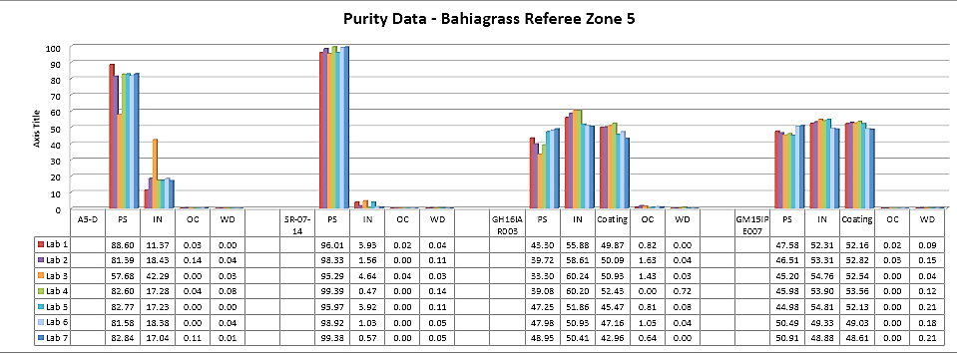
(Argentine)
(Pensacola)
(Argentine – Coated Seed)
(Pensacola – Coated Seed)
Notes:
Interesting to note the range of PS and IN among the data set for lot A5-D.

Slide 15
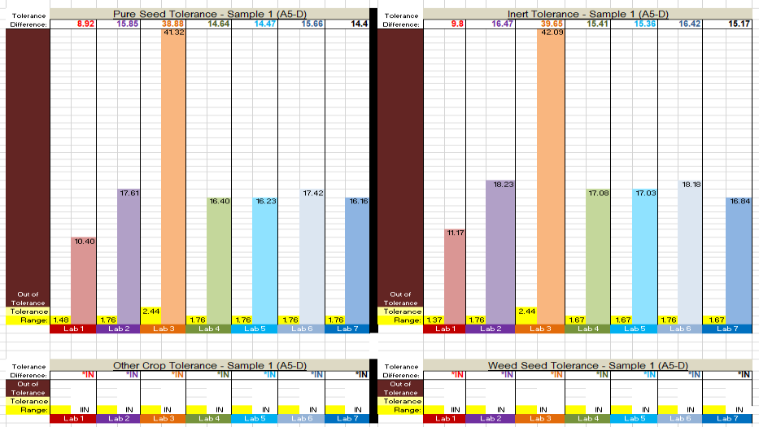

Slide 16
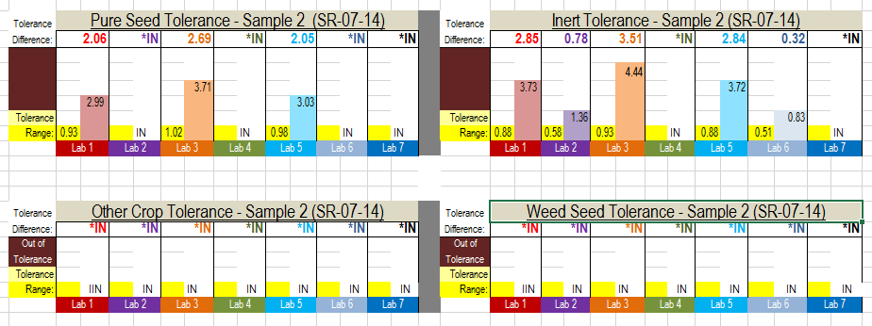

Slide 17
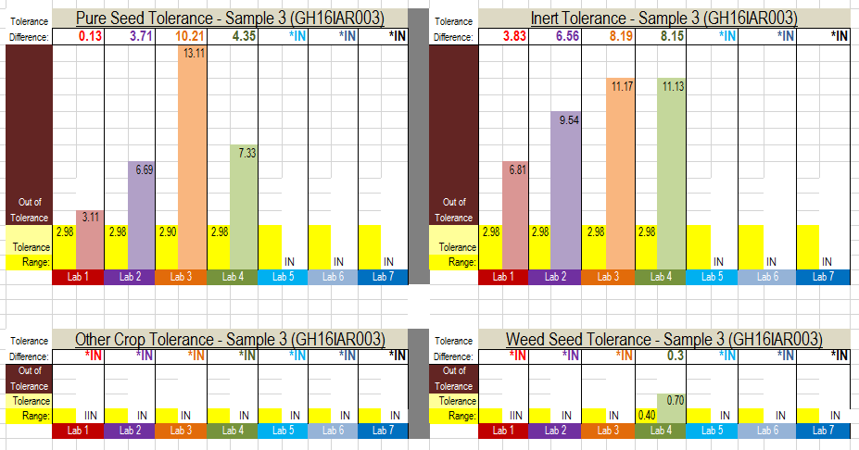

Slide 18
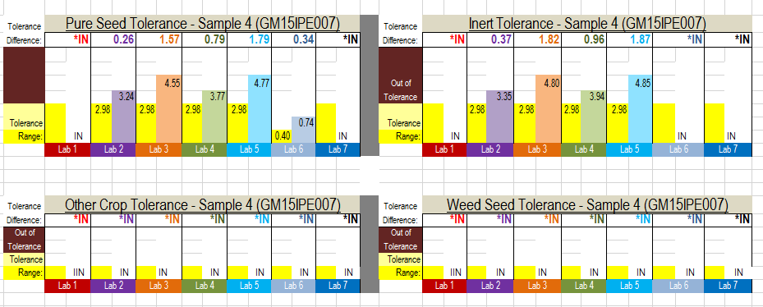

Slide 19
Retrieval of Brunswickgrass/Brown Paspalum Results
Results (BG=Brunswick and BP=Brown paspalum)
Sample # (Raw Seed) | Lab 1 | Lab 2 | Lab 3 | Lab 4 | Lab 5 | Lab 6
SR-07-14(#14) | 5 BG | 2 BG/BP | --- | 4 BG | 3 BG/BP | 2 BG
A5-D(D) | 2 BG | 3 BG | 2 BG | 2 BG | --- | ---
Sample SR-07-14(#14) was intentionally contaminated with 4 BG/BP
Sample A5-D (D) was intentionally contaminated with 2 BG/BP
Note: Samples may have already contained incidental BG/BP seeds and thus more of these seeds were found during the purity exam than were actually placed into the samples.
Notes:
At the time the samples were prepared for this referee, seeds that were positively identified as Brunswick and Brown paspalum were not available for use as intentional contamination seeds.

Slide 20
Germ Test Conclusions/Observations
The currently required “Peel Method” to remove the caryopsis of the Argentine cultivar for germination testing is difficult and time consuming.
Need to investigate the history of this required procedure and consider other germination testing options (i.e. post germ test TZ) or elimination of this requirement.
Conduct additional referee germination projects on Bahiagrass to improve uniformity among labs.
Notes:
Thank you

Slide 21
Purity Test Conclusions/Observations
Need to further investigate the difference in the PS and IN results among the labs
Need to confirm that labs testing Bahiagrass are using the Pensacola Bahiagrass Master Calibration sample to determine the blower setting.
Need to confirm that the blowing point is used only for Pensacola Bahiagrass and not for Argentine.
Conduct additional referee purity projects on Bahiagrass to improve uniformity among labs.
Locate/develop keys for Brunswickgrass and Brown Paspalum to assist analysts with ID of these seeds
Notes:
Thank you

Slide 22
Thank you!!!
Thank you for the hard work of all of the analyst.
Notes:
Thank you

Slide 23
The following slides contain individual lab results and other data to be published in the referee report.

Slide 24
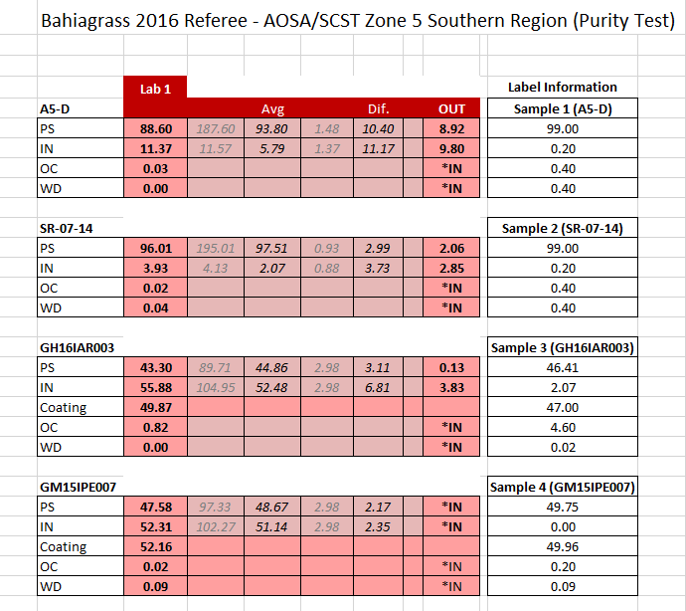

Slide 25
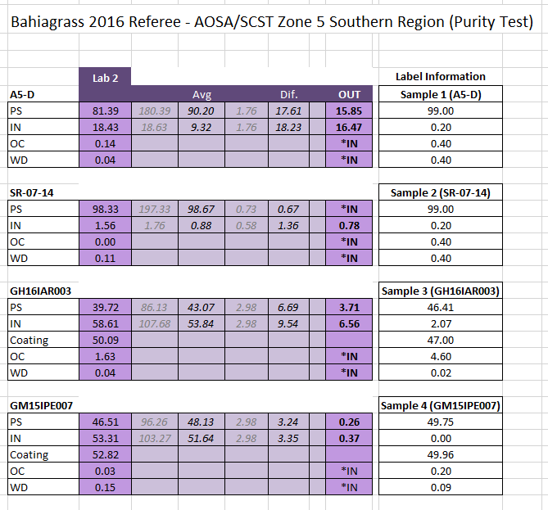

Slide 26
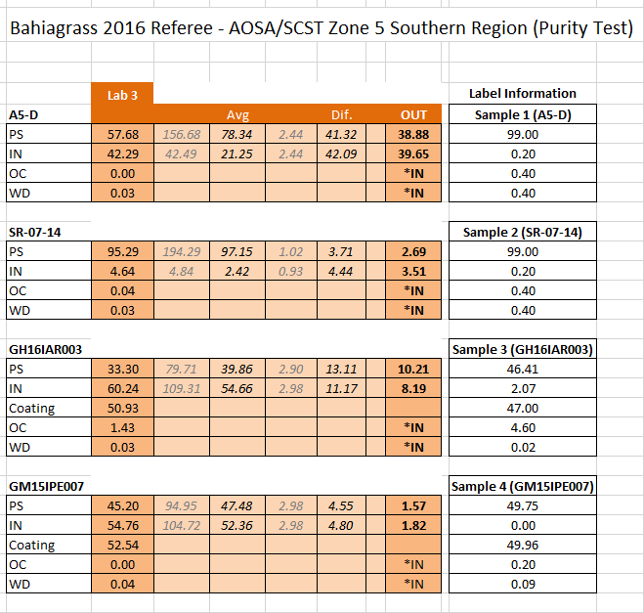

Slide 27
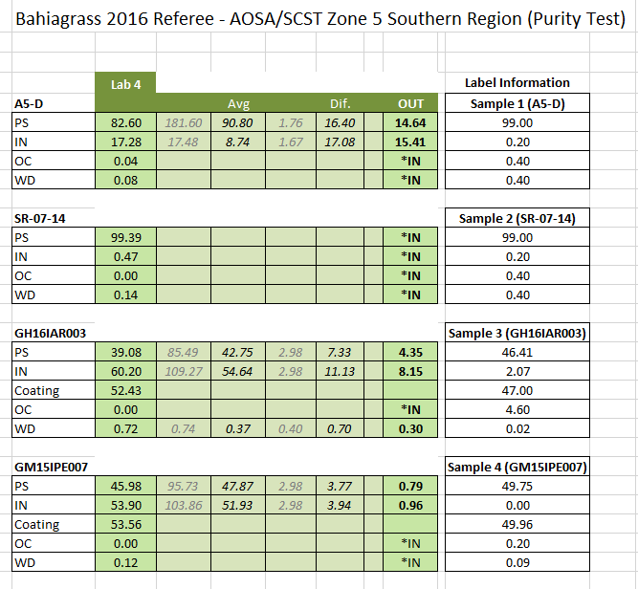

Slide 28
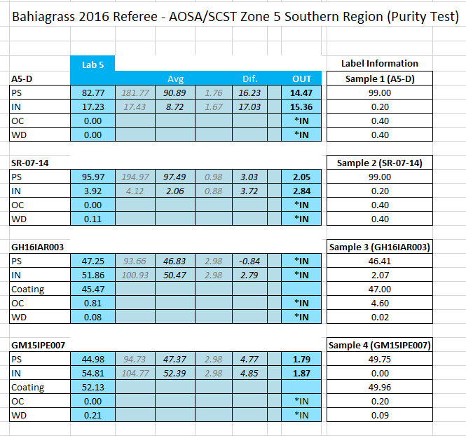

Slide 29
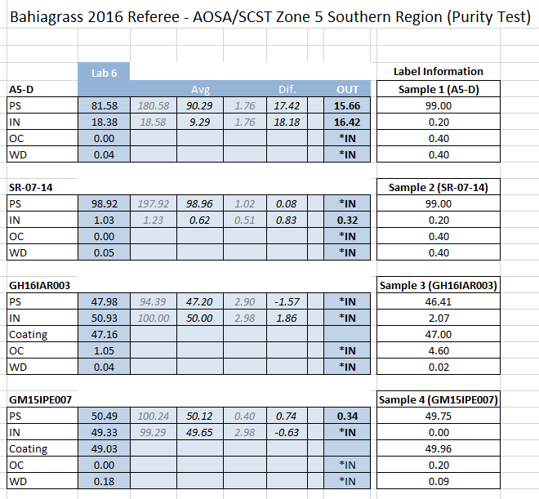

Slide 30
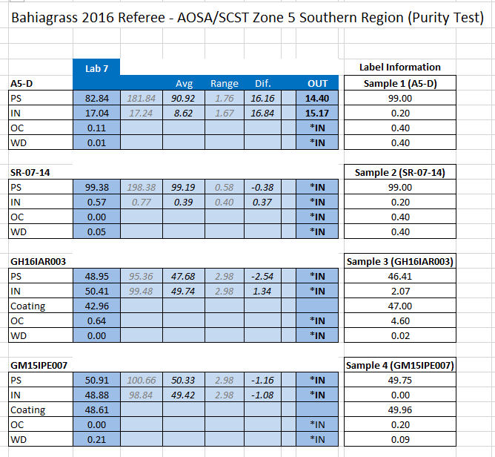

Slide 31
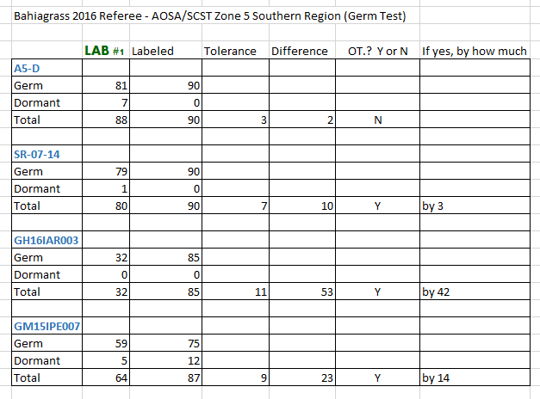
Notes:
Lab 1

Slide 32
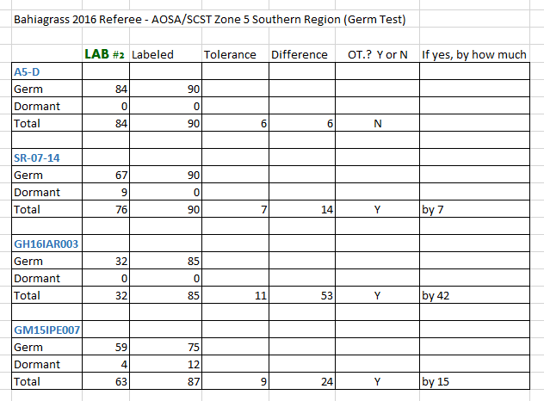
Notes:
Lab 2

Slide 33
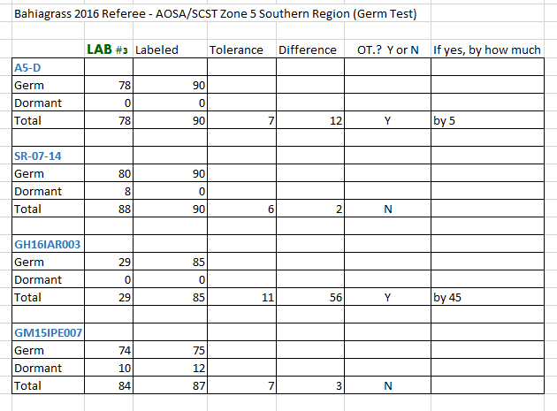
Notes:
Lab 3

Slide 34
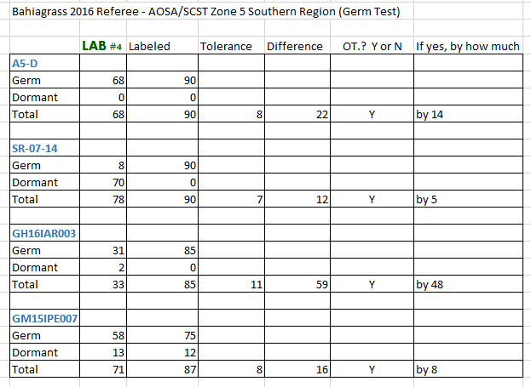
Notes:
Lab 4

Slide 35
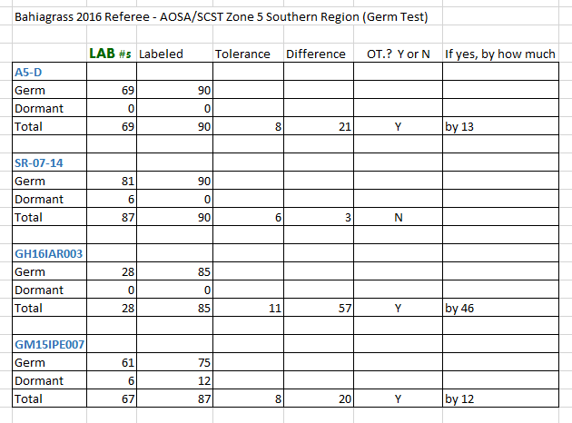
Notes:
Lab 5

Slide 36
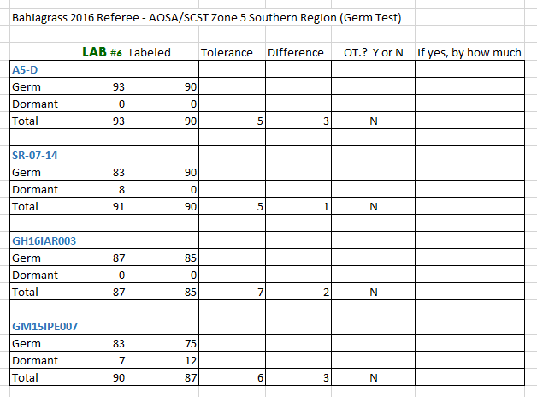
Notes:
Lab 6

Slide 37
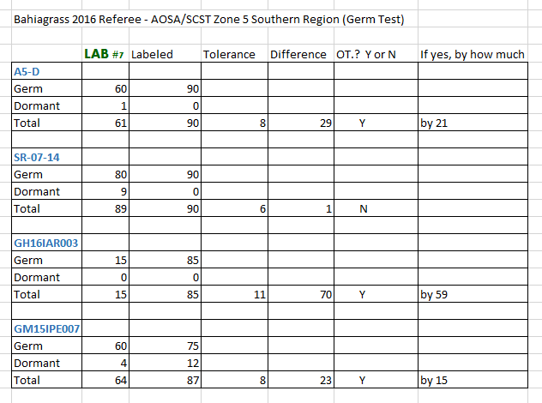
Notes:
Lab 7

