Slide 1

AOSA/SCST 2019 Rule Proposal 25
Reducing count days on Spinach for 15C from 21d to 14d
Terry Dunfield RST –Eurofins BDI, Longmont CO
Romi Wilson Ph.D – Syngenta Seeds, Nampa ID

Slide 2
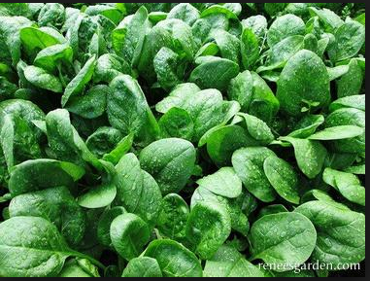
Background
In California and Arizona “baby leaf” spinach is becoming a more common commodity where bunch or freezer spinach used to dominate.
Baby leaf spinach varieties are “planted in 80 inch beds and harvested within 21 to 40 days” (University of California Agriculture and Natural Resources).
It is important for producers of baby leaf spinach to know that the seed will germinate within a 14 day window.
As spinach types have been developed over the years, it appears the germination period for them has been reduced.
Laboratories reported that saprophytes and mold became more of a problem at the later count days. Reducing count days would also diminish secondary decay
A referee was set up through the help of STRF to determine if there was still a significant difference between the 14 day and 21 day counts

Slide 3
Analytical Method
Four commercial samples of spinach was sent to six participating referee laboratories four times over the course of three months.
Lab 2
Referee laboratories were instructed to record normal, abnormal and dead seed numbers for each replication at 7 day, 14 day, and 21 day after sowing.
All participating referee laboratories performed testing under all media type and temperature combination listed in the AOSA rule.
Lab 1
Rep 1
Rep 2
Sample A
Sample B
Sample C
Sample D
Sample A
Sample B
Sample C
Sample D
Rep 3
Sample A
Sample B
Sample C
Sample D
Rep 4
Sample A
Sample B
Sample C
Sample D
Lab 2
Rep 1
Rep 2
Sample A
Sample B
Sample C
Sample D
Sample A
Sample B
Sample C
Sample D
Rep 3
Sample A
Sample B
Sample C
Sample D
Rep 4
Sample A
Sample B
Sample C
Sample D
Lab 3
Rep 1
Rep 2
Sample A
Sample B
Sample C
Sample D
Sample A
Sample B
Sample C
Sample D
Rep 3
Sample A
Sample B
Sample C
Sample D
Rep 4
Sample A
Sample B
Sample C
Sample D
Lab 4
Rep 1
Rep 2
Sample A
Sample B
Sample C
Sample D
Sample A
Sample B
Sample C
Sample D
Rep 3
Sample A
Sample B
Sample C
Sample D
Rep 4
Sample A
Sample B
Sample C
Sample D
Lab 5
Rep 1
Rep 2
Sample A
Sample B
Sample C
Sample D
Sample A
Sample B
Sample C
Sample D
Rep 3
Sample A
Sample B
Sample C
Sample D
Rep 4
Sample A
Sample B
Sample C
Sample D
Lab 6
Rep 1
Rep 2
Sample A
Sample B
Sample C
Sample D
Sample A
Sample B
Sample C
Sample D
Rep 3
Sample A
Sample B
Sample C
Sample D
Rep 4
Sample A
Sample B
Sample C
Sample D
Temperature | Blotter | Towel
10ºC | Blotter-10ºC | Towel-10ºC
15ºC | Blotter-15ºC | Towel-15ºC

Slide 4
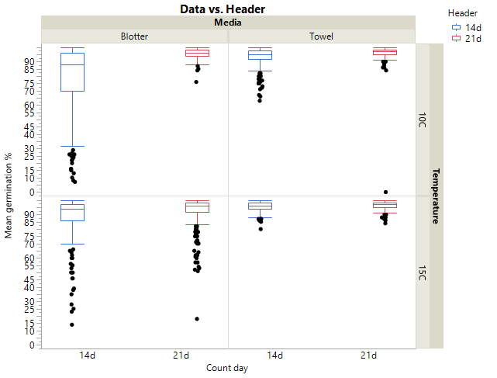
Referee Results
Results from the study indicate there is no significant difference between 14d germ and 21d germ for Towel-15◦C.
For all other combination of media and temperature (Towel-10◦C, Blotter-15◦C, Blotter-10◦C) there was significant difference between14d and 21d germ
Towel-10◦C and Blotter-15◦C, the 14d germ and 21d germ were in tolerance
The distribution (spread of the data) for Blotter-15◦C was wider compared to the results for Towel-15◦C, which suggests that repeatability of Blotter-15◦C is lower compared to Towel-15◦C.
This trend was observed in both 14d and 21d data, which indicates that the repeatability of the test result in blotter is lower compared to the towel.
Figure 1. Mean germination by two media types (blotter and towel) and two temperature regimes (10◦C and 15◦C).
 | Media
Count Days/ Temperature | Blotter |  | Towel
 | 14d | 21d | 14d | 21d
10ºC | 79.17 ^{D} | 95.99 ^{A} | 93.01 ^{B} | 96.32 ^{A}
15ºC | 88.97 ^{C} | 92.15 ^{B} | 95.47 ^{A} | 96.37 ^{A}
Table 1: Mean germination by media types (blotter and towel), temperature regimes (10C and 15C) and count days (14d and 21d). Letter not connected are significantly different

Slide 5
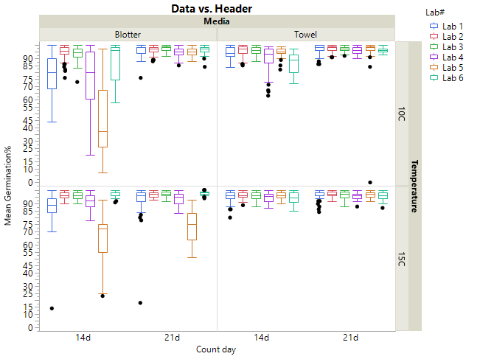
Referee Results
When results are analyzed by participating laboratories, it indicates that distribution of the data is highly dependent on the laboratory that performed the testing.
This suggests that some laboratories are more proficient running some media over others.
The data distribution was tighter for all the participating laboratories for the towel media, which indicates that towel has higher consistency in the results compared to the blotter.
14 day germination and 21 day germination for the Towel-15◦C showed the least variability relative to other media-temperature combination.
Figure 2. Mean germination by two media types (blotter and towel) and two temperature regimes (10 ◦C and 15 ◦C) by six participating referee laboratories.

Slide 6
Supplemental Information (Syngenta-2011)
Method/ Procedure
  Germination data from 559 commercial batches performed in lab during 2011 was collected and used for this study.
  Testing was performed in towel at 15C
  Germination counts were performed at three points: 7, 14 and 21 days after sowing.
  During the last count defective seedlings and ungerminated seeds are reported as “abnormal”.
Figure 1. Germination % means at 7, 14 and 21 days after sowing.
Average germination values for days 7, 14 and 21 were 88.9%, 91.3% and 91.4% respectively.
The data indicates that at 7 days after sowing 97% of all normal seedlings have already germinated while by day 14 almost the totality of the normal seedlings have germinated (99.9%).
Extending the incubation time from 14 to 21 days increases total germination by 0.1%.

Slide 7
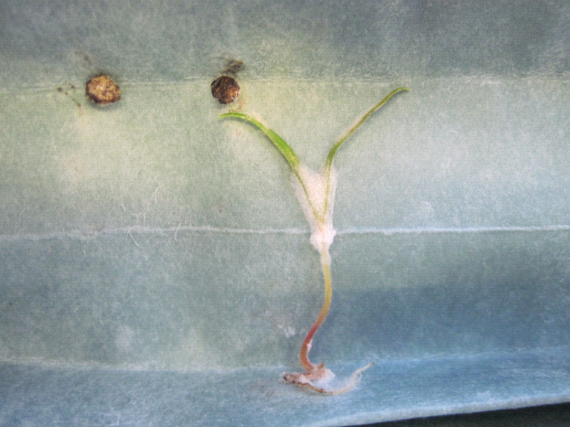
Secondary infection-
In addition, incubation beyond day 14 increases the incidence of saprophytic fungal growth and seedling decay.

Slide 8

Thank you!
All participating labs
Terry Dunfield for coordinating the project
AOSA/SCST
  Rule committee
Research was funded in part by STRF

