Slide 1
Determine appropriate germination methods for Malabar Spinach spp. (Basella alba and Basella rubra L.)
Dr. Roopa Anantareddy,
CSA (Germination)

Slide 2
Difference between three Spinach
S No. | Characters | Malabar Spinach | New Zealand spinach | Spinach
1 | Genus Scientific Name | Basella spp. Basella alba Basella rubra | Tetragonia Tetragonia tetragonoides | Spinacia Spinacia oleracea
2 | Family | Basellaceae Perennial vine | Aizoaceae Perennial-grown as warm weather annual (60-75 ⁰F) | Amaranthaceae Annual plant
3 | Origin | Indian subcontinent Southeast Asia, China, and Africa. | New Zealand | Persia or today’s Iran and surrounding countries. Central& Western Asia
4 | Seed pictures

Slide 3
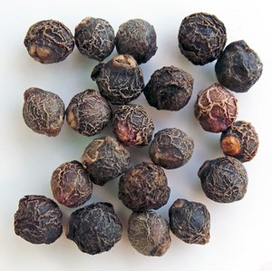
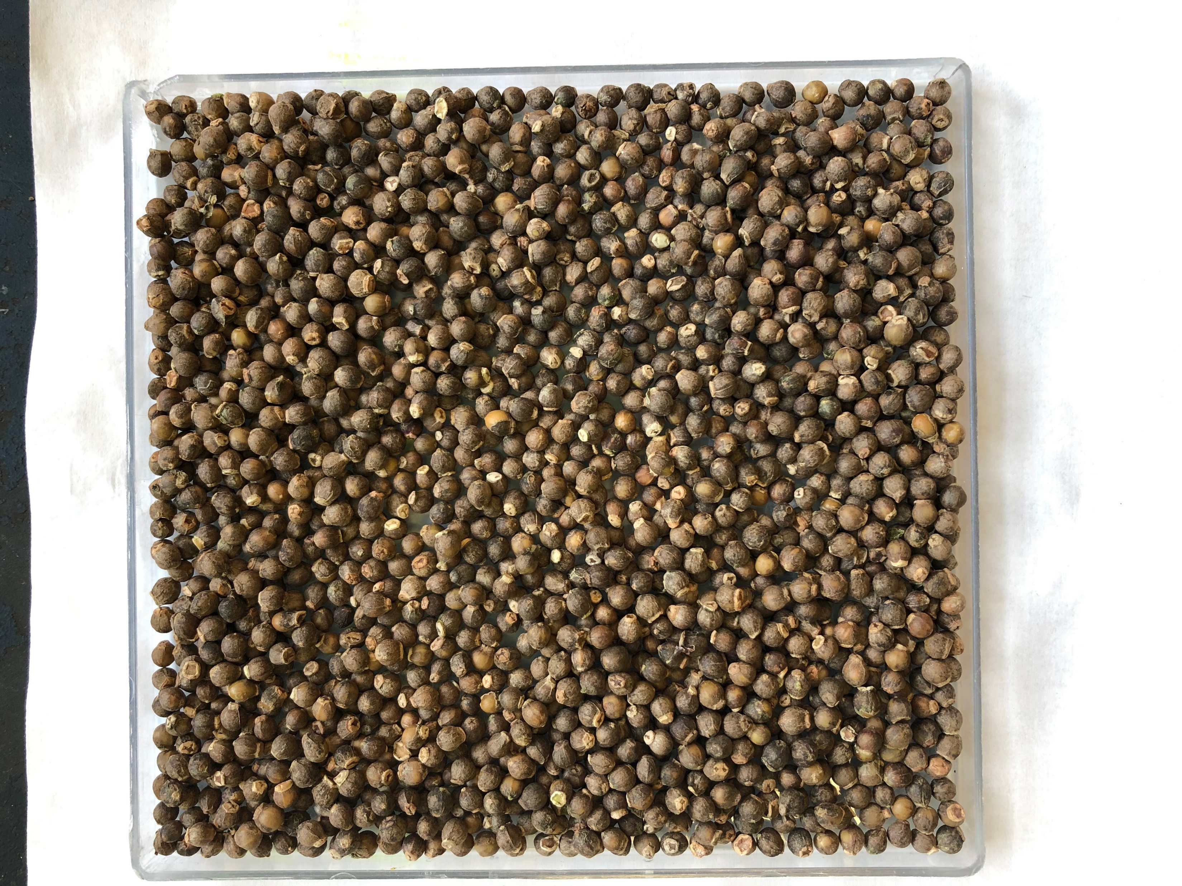
General Information -Basella alba L.- Ceylon spinach- USDA plants database
Symbol: BAAL2
Group: Dicot
Family: Basellaceae
Duration: Perennial
Growth Habit: Forb/herb, Vine
Native Status:
Red Malabar seed
Green Malabar seed
HI | Hawaii Introduced
PB I | Pacific basin Introduced
PR I | Puerto Rico Introduced

Slide 4
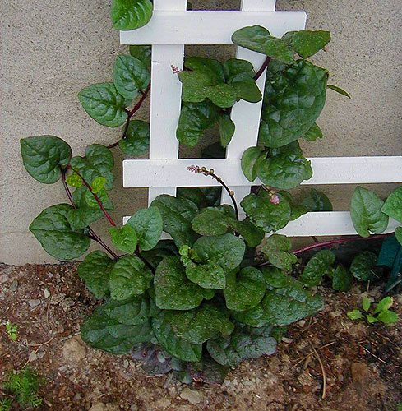
Malabar Spinach Family - Basellaceae
Introduction
Vine, Vegetable (Warm Season) - Salad Greens
Also known as Indian spinach, Ceylon spinach, basella, vine spinach
Family: Basellaceae
The leaves from this heat-loving vine have a mild flavor and are used like spinach in salads and cooking.
Extremely frost-sensitive.
It creeps when temperatures are cool, but leaps when the mercury hits 90 F.
Special Considerations
Special characteristics: not native to North America , East Asia origins.
Special uses: Edible landscaping

Slide 5
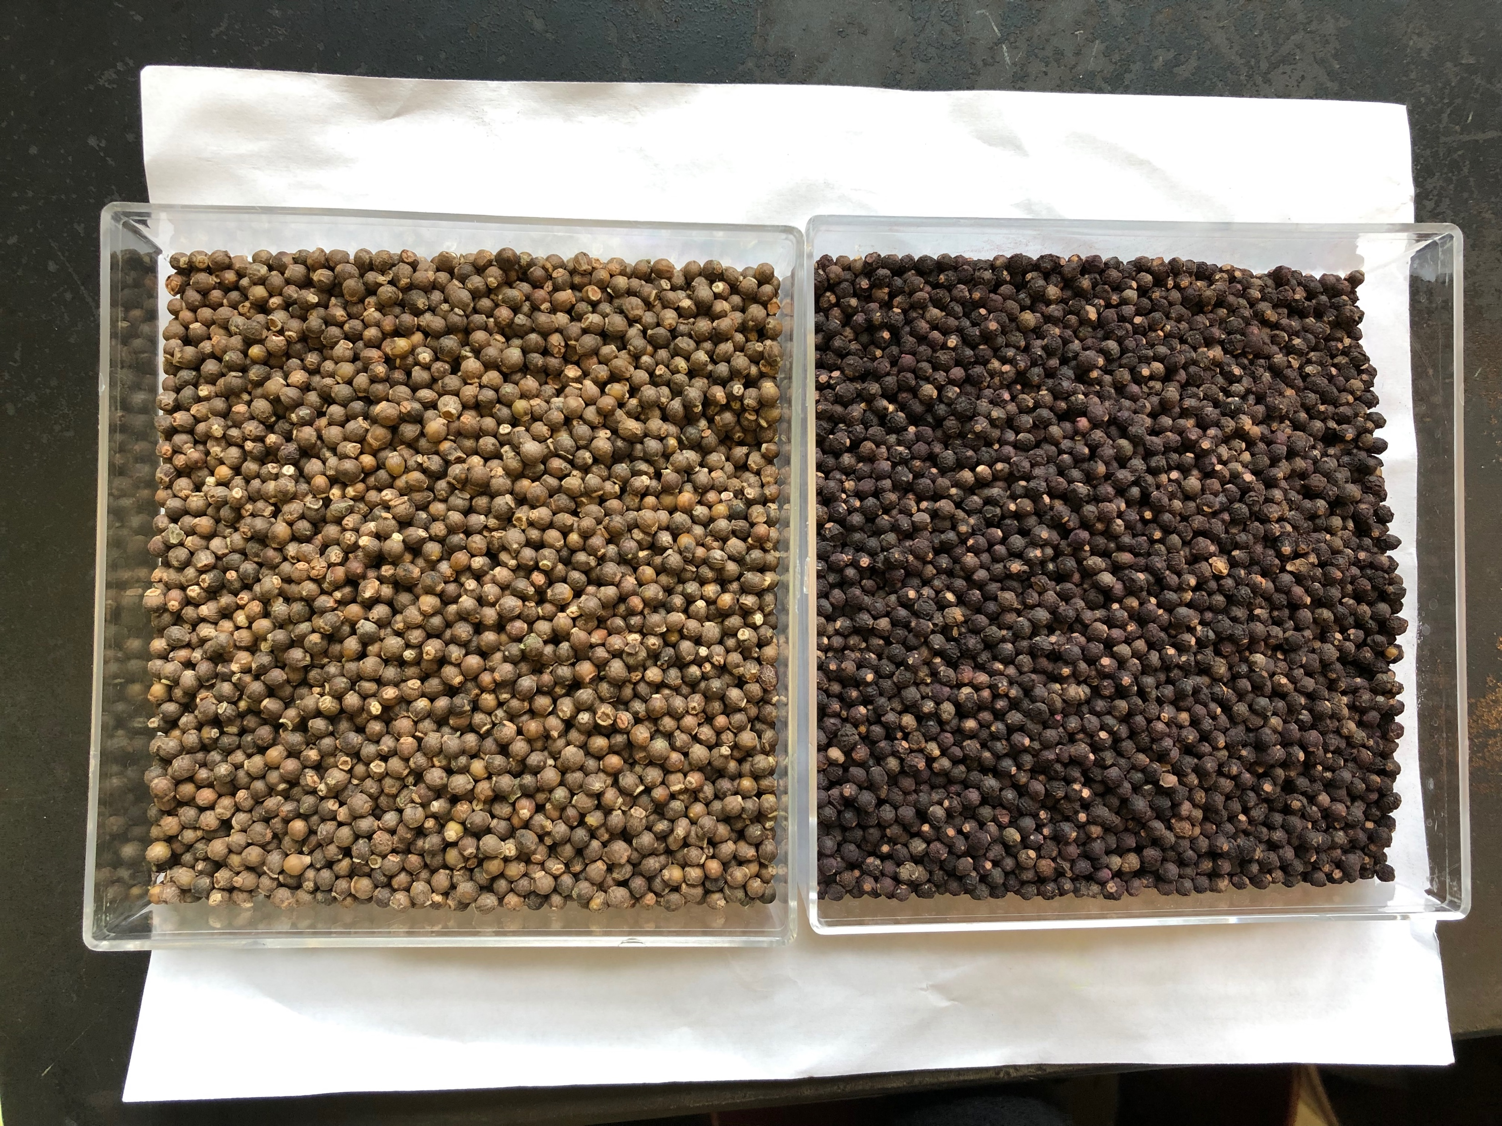
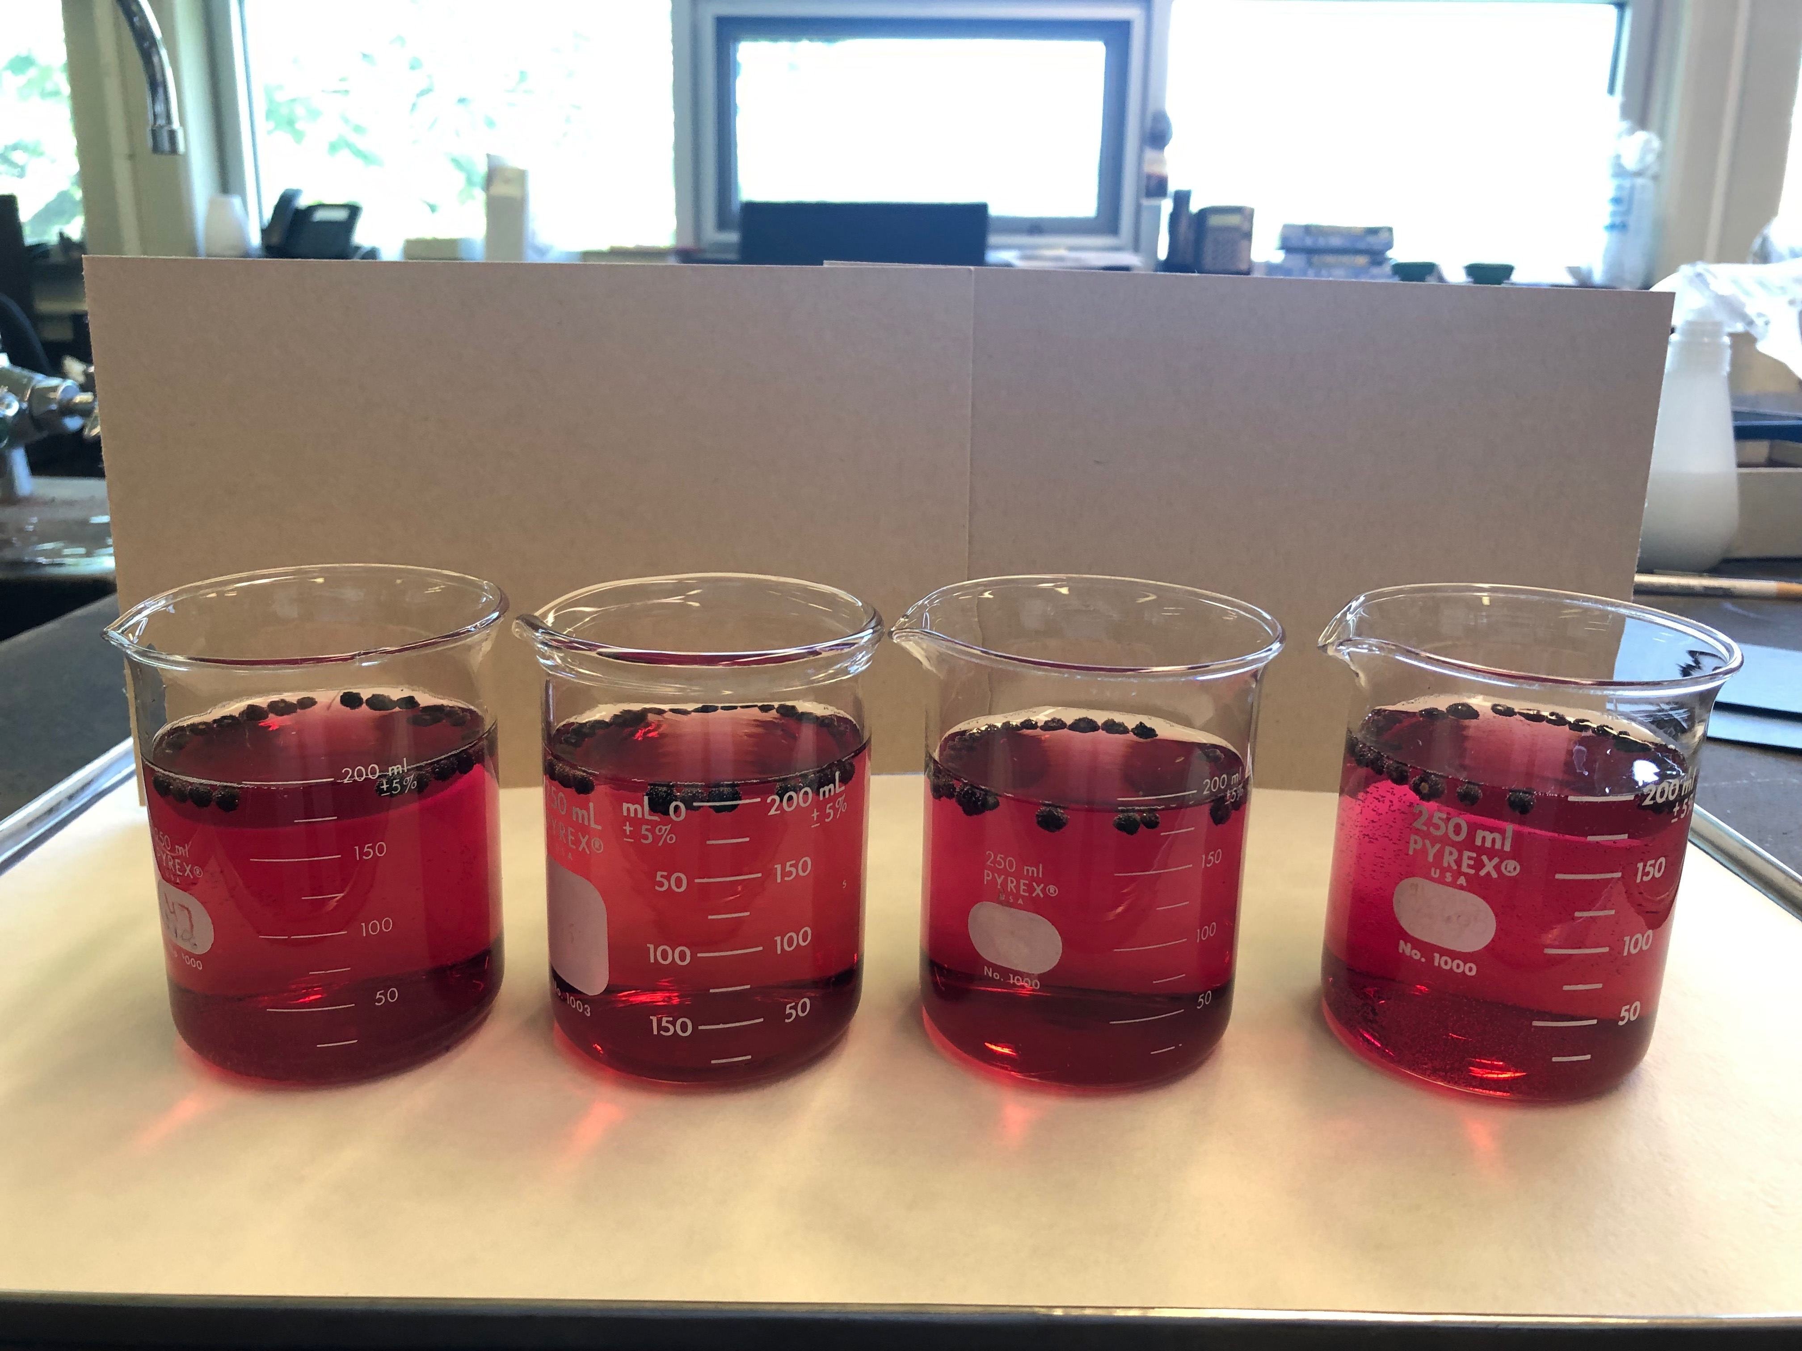
Morphological difference between the red stem and green varieties
S No. | Characters | Red Stem- Basella Rubra | Green Stem-Basella Alba
1 | Seeds | Dark Black color | Green color
2 | Flower | Pink color | White color
Presoaked Green and Red stem seed
Red stem –Malabar Spinach

Slide 6
Objective of the Referee :
1)To standardize the germination standards ,seedling evaluation procedure for Malabar spinach - Family: Basellaceae
varieties: Basella Alba
varieties: Basella Rubra
a) To standardize the best germination substrata , temperature, first count and final count for Malabar spinach
2) To determine ideal dormancy (if any) breaking procedure in Malabar spinach (scarification, chemicals-GA₃, KNO₃ and control test)
3) To introduce and determine a standard method to produce uniform results for Malabar spinach species, in the AOSA rule and ISTA rule book

Slide 7
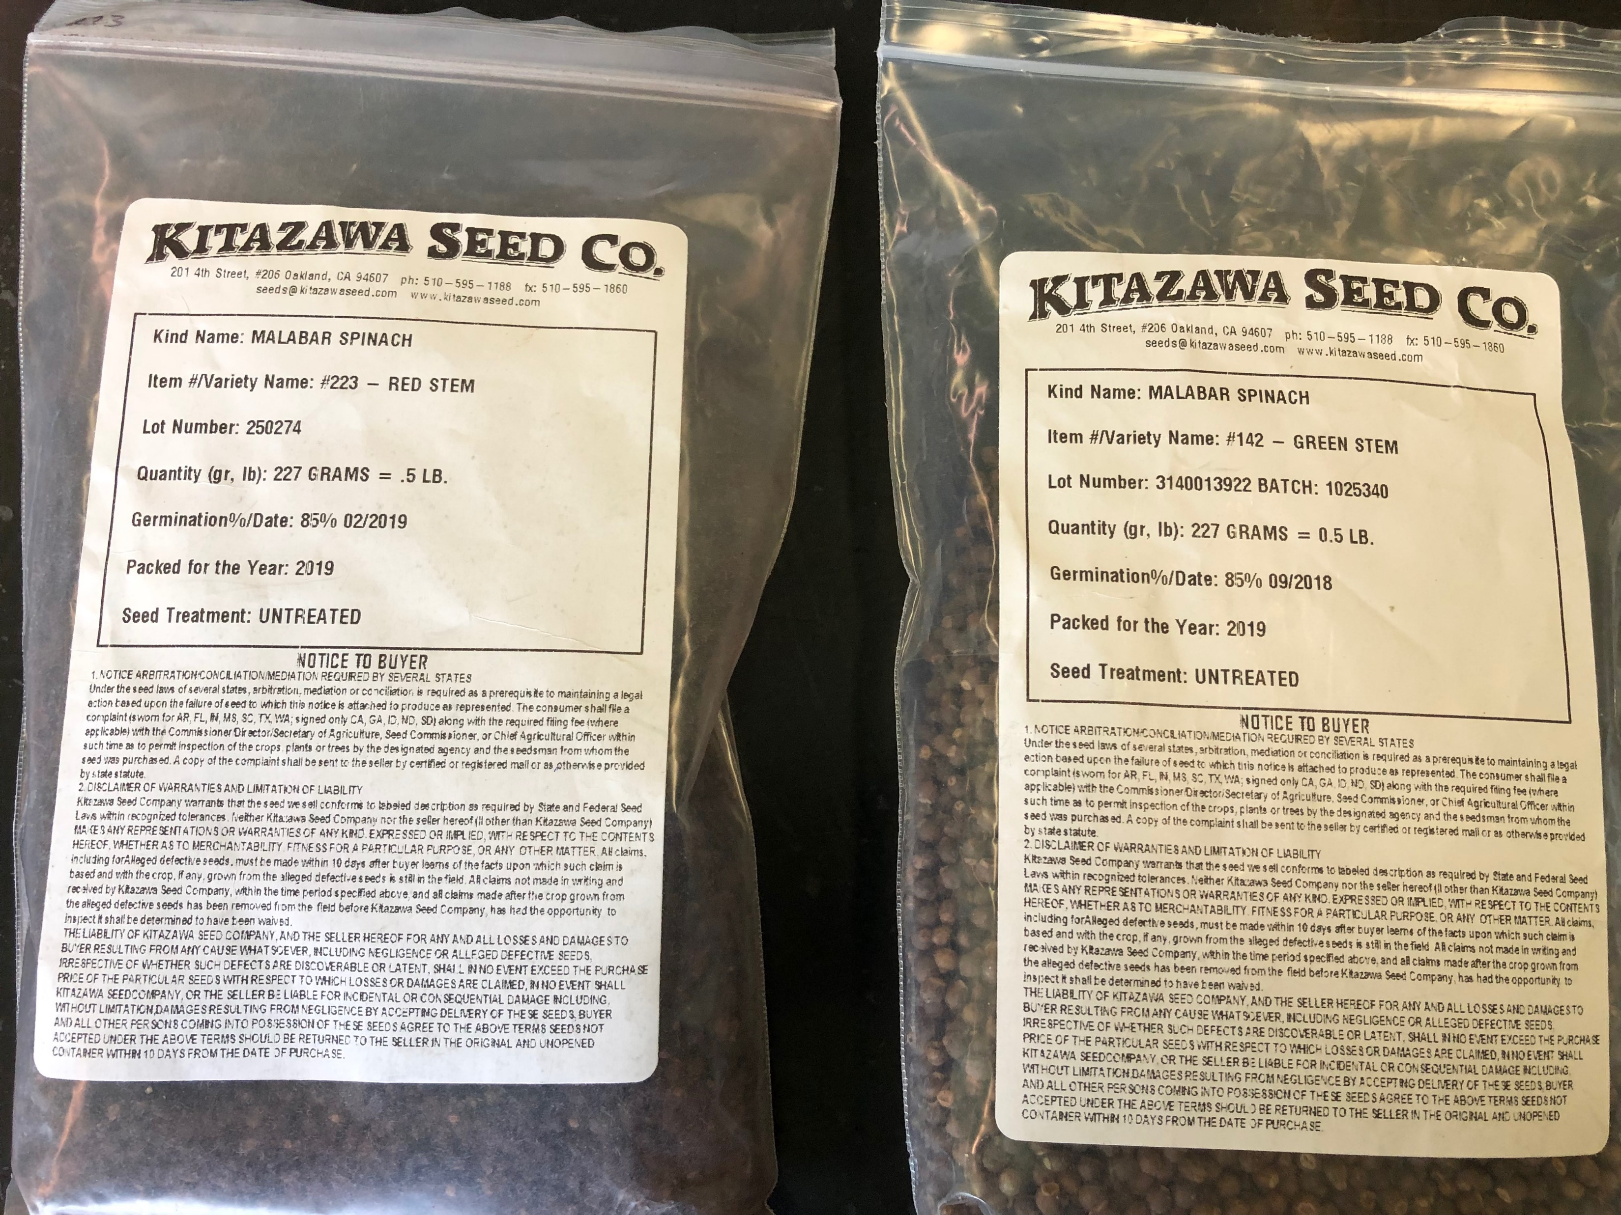
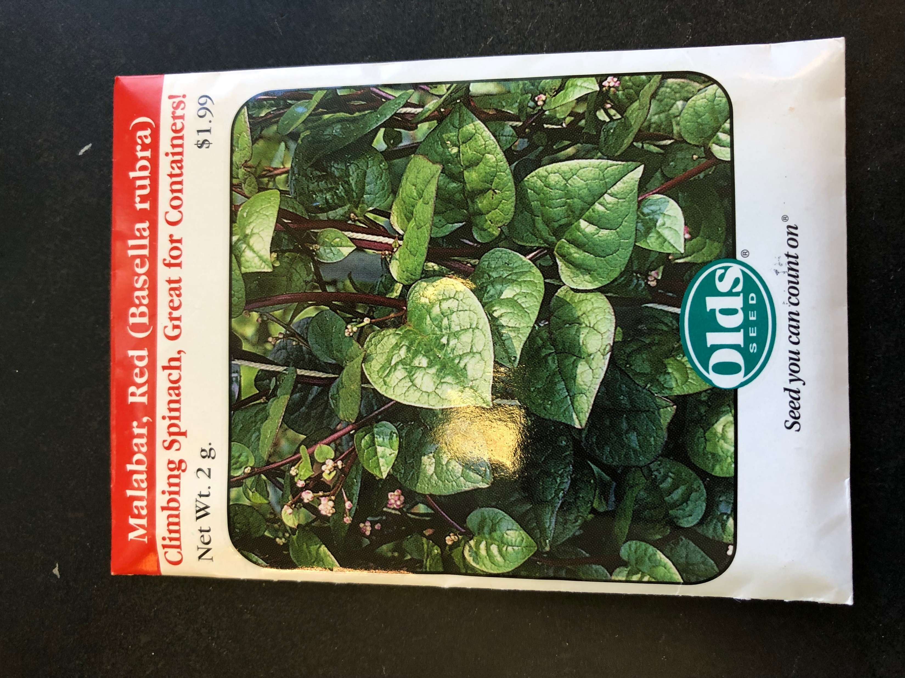
Material and Methods
In house study was made in the Seed laboratory-PA and data was collected using commercial Malabar spinach samples from three different seed companies.
1)Burpee Seed Company-Green stem& Red stem
2) Kitazawa seed company-Red stem and Green stem
3) Seed way-Green stem and Red stem
Contd…

Slide 8
Observations recorded were recorded as follows: Pure seed units (grams) Weight of 2500 seeds (for the purity analysis)- (grams) Weight of 25000 seeds (for bulk/noxious weed examination) NWS/BWE (grams) Initial seed quality-Germination (%), MC (%) Preliminary study was conducted and based on the best results Seeds were tested for following parameters- (4 replicates of 100 seeds) 1)Temperature-20-30 ⁰ C light 2)Substratum - Rolled towel, Between Blotter (BB) 3)Dormancy breaking procedure using Mechanical scarification (sand paper), Different chemicals viz.,- GA_{3,} KNO_{3 ,} water and control. 4) Spacing- 100 seeds-4 replicates, 50 seeds-8 replicates

Slide 9
Table 2A. Determination Pure Seed Units for Malabar Spinach
Pure Seed Unit | Chaffy /super chaffy | Kind of Seed | Minimum weight of purity analysis (g) | Minimum weight for NWS/ Bulk examination (g) | Appropriate number of seeds per gram | Appropriate number of seeds per ounce
1 (Similar to Okra) | NA | Basella Alba (L.) | 25 | 250 | 40 | 1134
Pure seed working weight-PSU determined by Non Mechanical seed
Pure Seed Unit for Malabar Spinach | Green stem | Red stem
Weight of 2500 seeds (for the purity analysis) | 25g (25.0347g) | 35g (34.8961g)
Weight of 25000 seeds (for Bulk/noxious weed examination) NWS/BWE | 250g (250.347g) | 350g (348.961g)
Number of seeds per gram | 40

Slide 10
Vol. 3 - Uniform classification of weed and crop seeds
S No | Species | Common Name | Family | Species class | Contaminating classification
1 | Basella Alaba | Malabar Spinach | Basellaceae | Vegetable | A | F | H | R | S | T | V
 |  |  |  |  | C | C | C | C | C | C | C
Similar-Okra, Newzeland spinach

Slide 11
Moisture determination
Table 11A. Air oven method parameters for determining seed moisture content
*Note: Seed size is similar to okra
Seed Moisture varied from (6-10%)
S No | Species | Common Name | Sample Preparation | Sample Size | Temperature (⁰) C | Drying Period
1 | Basella Alaba | Malabar Spinach | Whole seed | 10g | 130 ⁰C | 3 hr.

Slide 12
Table 1. Initial Seed Quality of Malabar Spinach
Seed vigor quality –Malabar Spinach
Low vigor (2 samples) | <75% | Old's RS, Kitawaza GS
Medium vigor (2 samples) | 75-80% | Burpee GS, Kitawaza RS
High vigor (2 samples) | >80% | Olds GS, Burpee RS

Slide 13
Table 2. Standardization of effect of temperature on media Malabar Spinach Olds -var. green stem
Treatments | Between Blotter (Normal) | Between Blotter (Dead) | Top of Blotter (Normal) | Top of Blotter (Dead)
15Dark/Light | 0 | 100 | 15.00 | 85.00
20 Light | 85 | 15.00 | 73.75 | 26.25
15/25 Light | 83.75 | 16.25 | 71.25 | 28.75
20/30 Light | 88.75 | 11.25 | 86.25 | 13.75
20/30 Dark | 80.50 | 19.50 | 70.15 | 29.85
Mean
F value | 140.34 | F critical | 2.80
Standard Deviation ----------20/30 light------ -2.06
Standard Deviation----------- 15 Dark/light----- NA

Slide 14
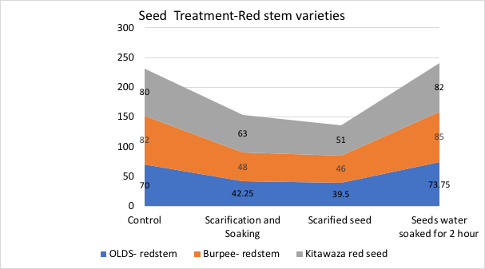
3. Effect of different seed treatment on Malabar Spinach var., Red stem

Slide 15
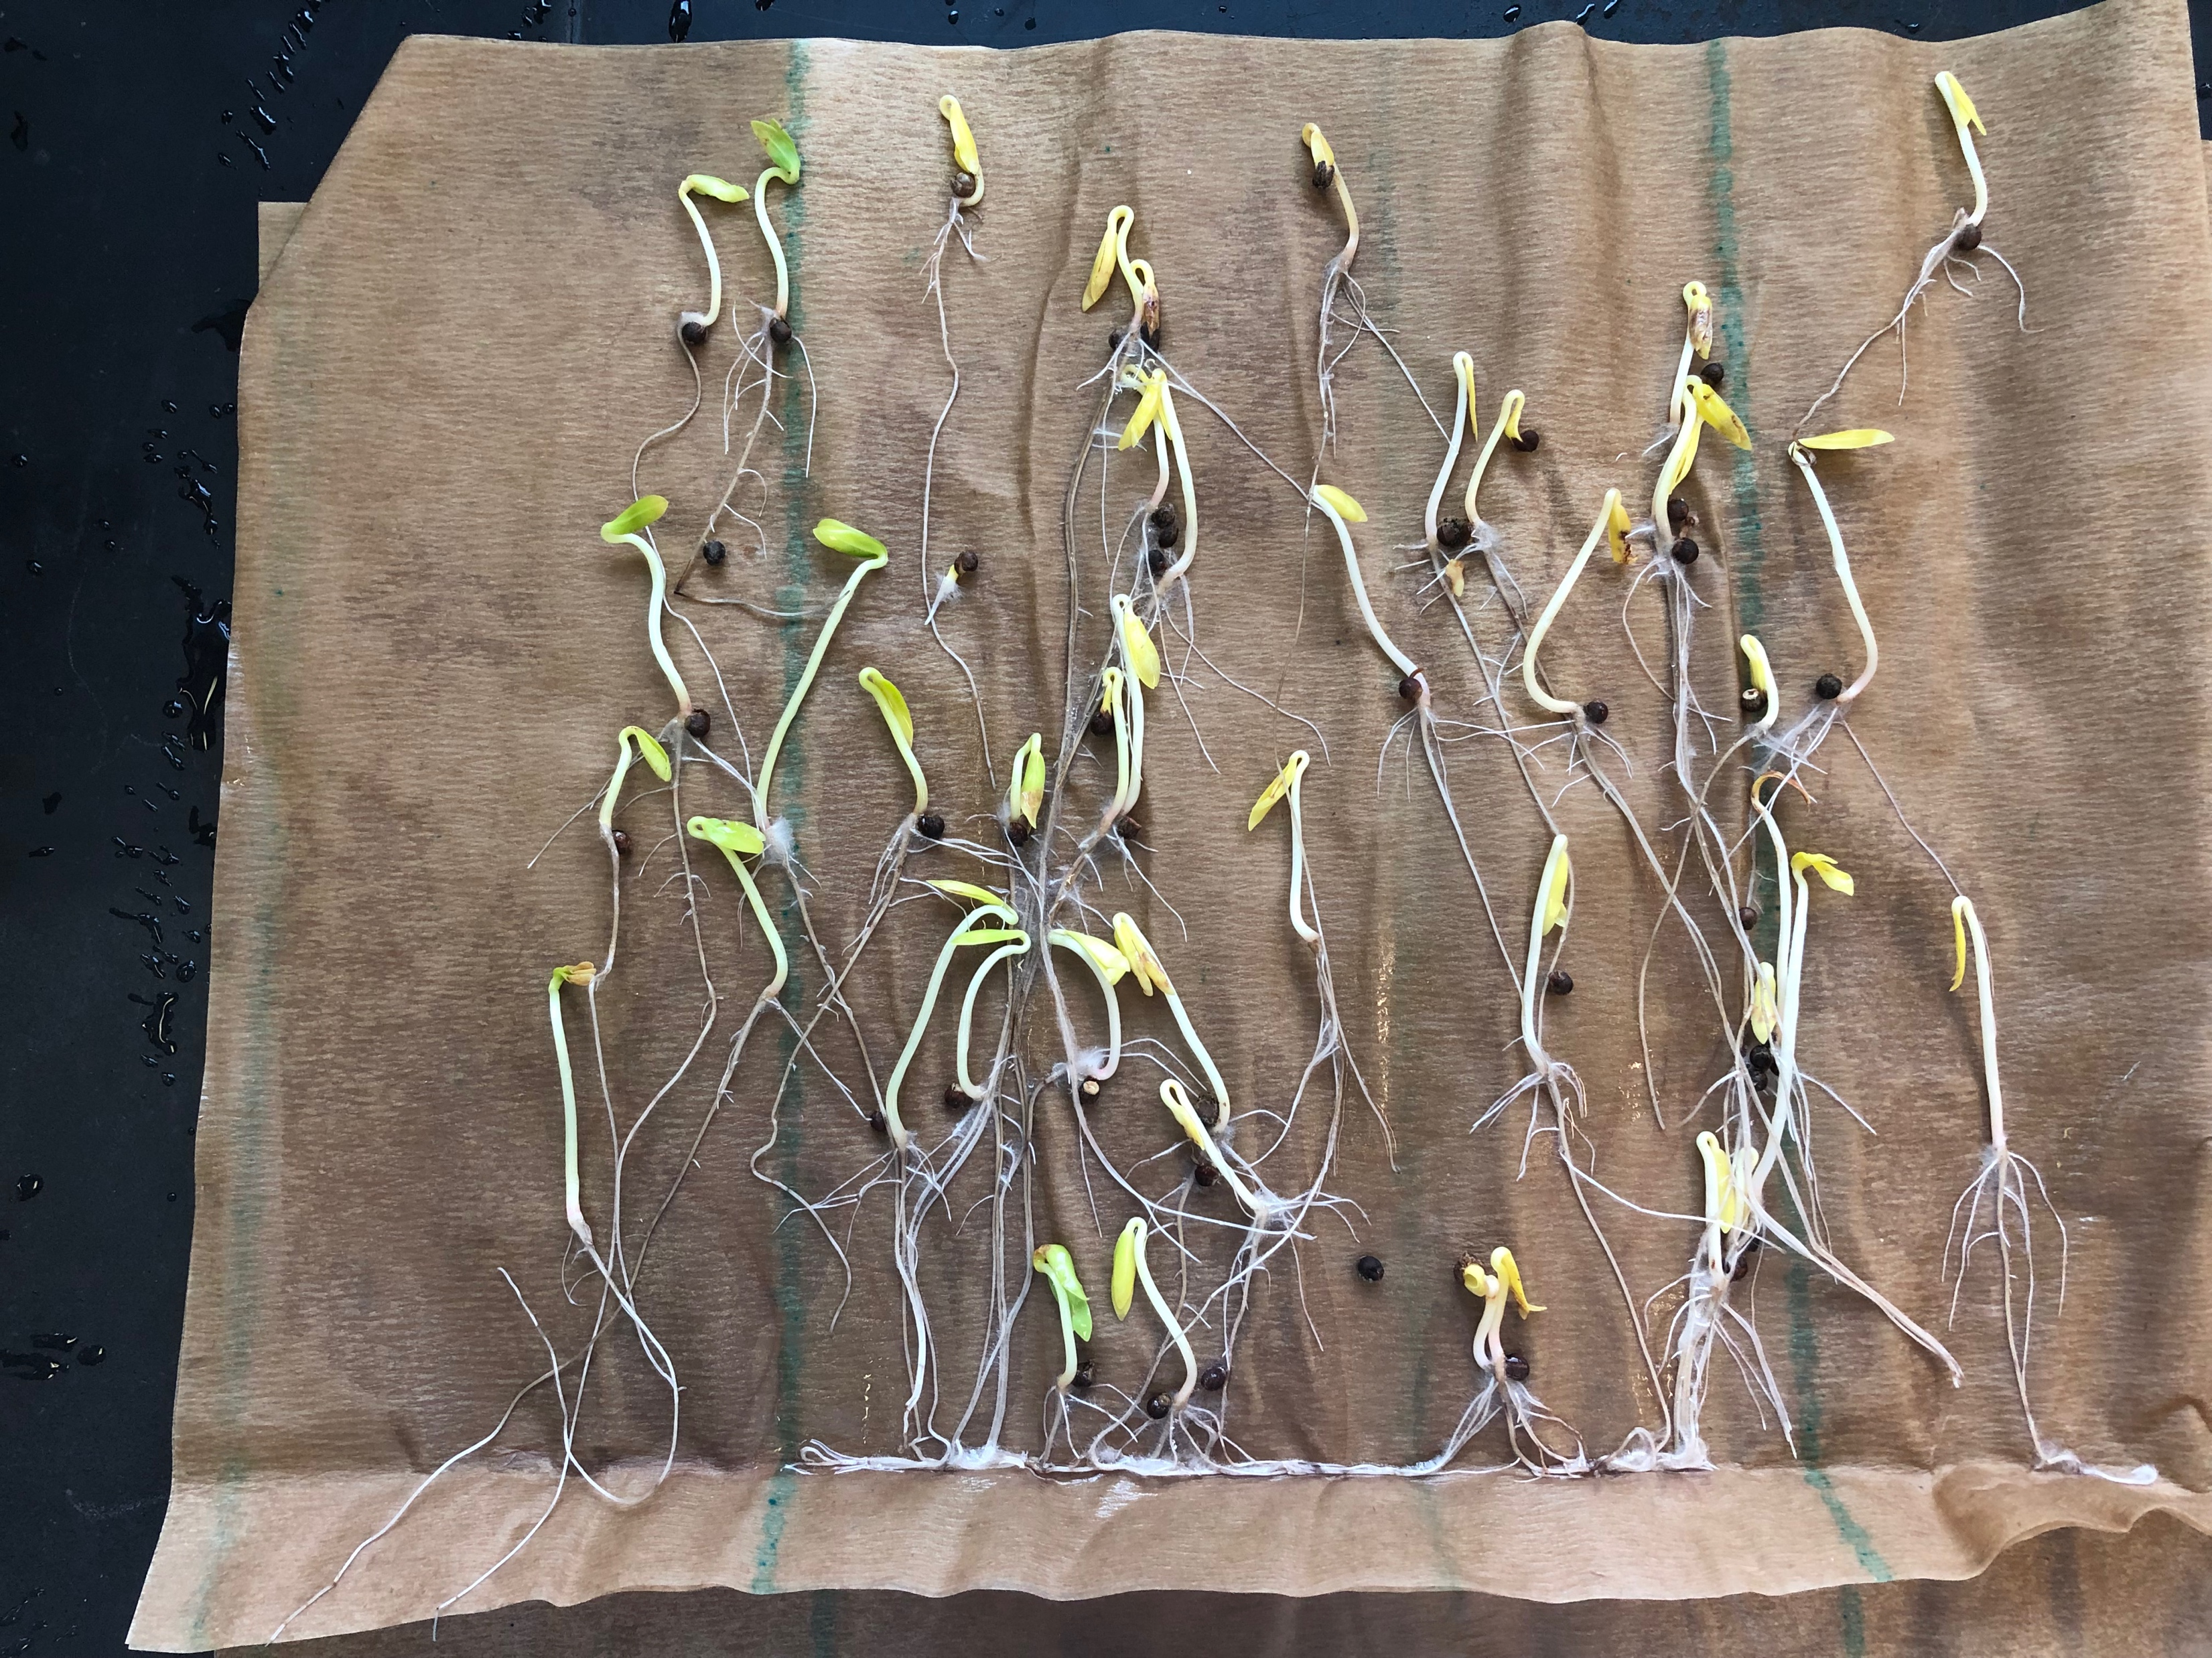
Normal Seedlings of Malabar Spinach
Normal of Green stem Malabar spinach (No MSU)
Green stem
Red stem

Slide 16
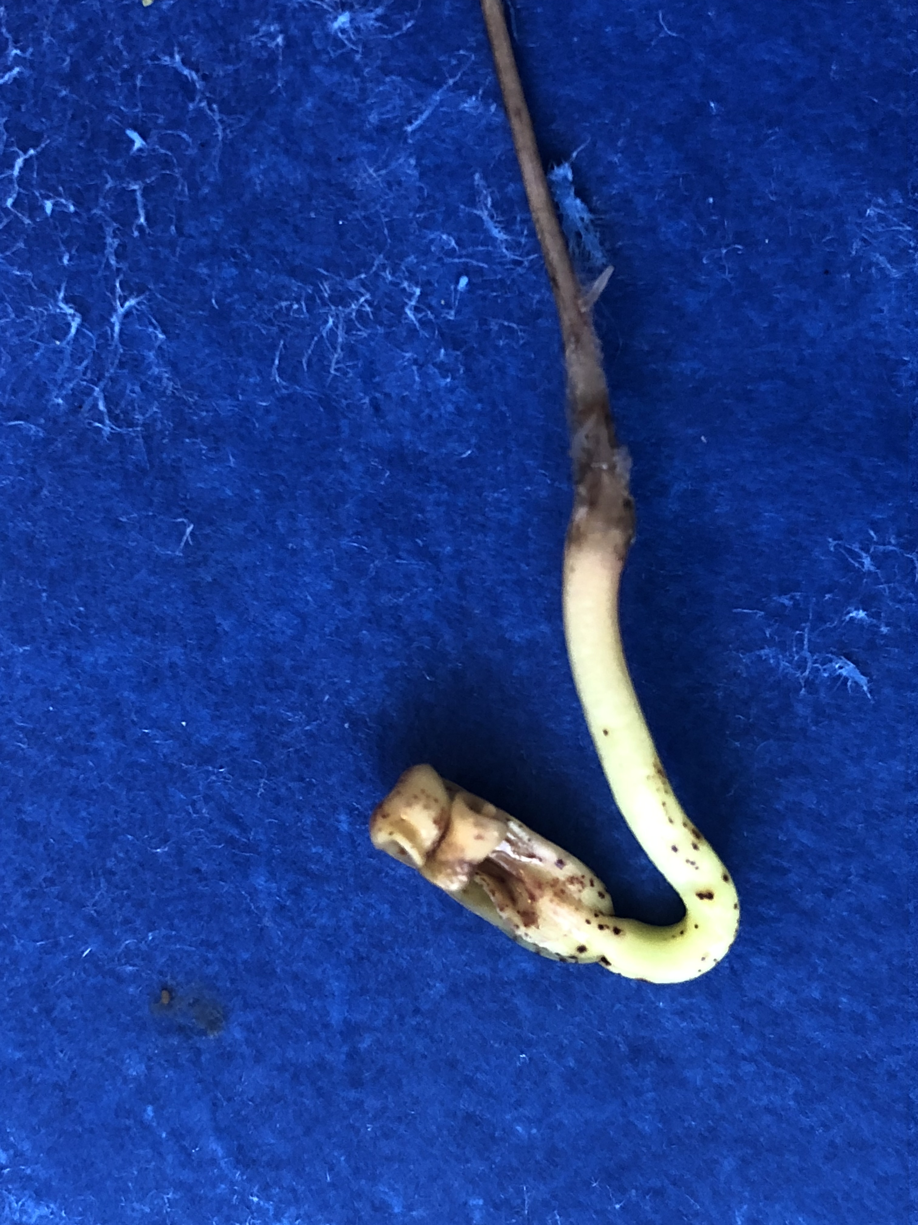
Red stem germination in Between Blotter (BB)
50X8 replicates is ideal to avoid the secondary infection

Slide 17
Seedling infection- Between Blotter (BB)
Tight Seed coat -Cotyledon Infection
Seedling root decay

Slide 18
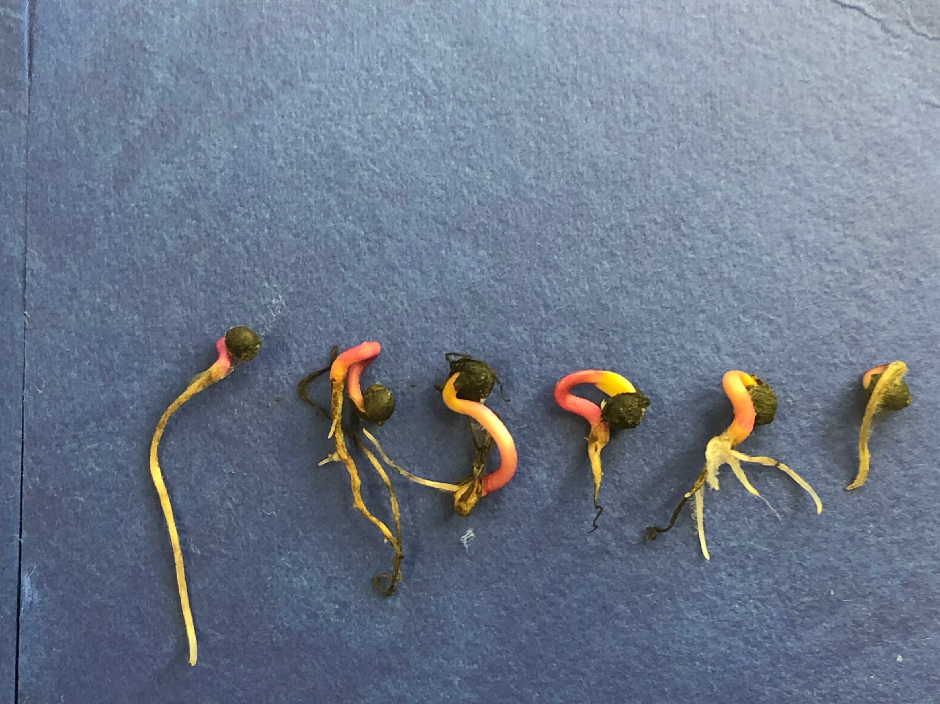
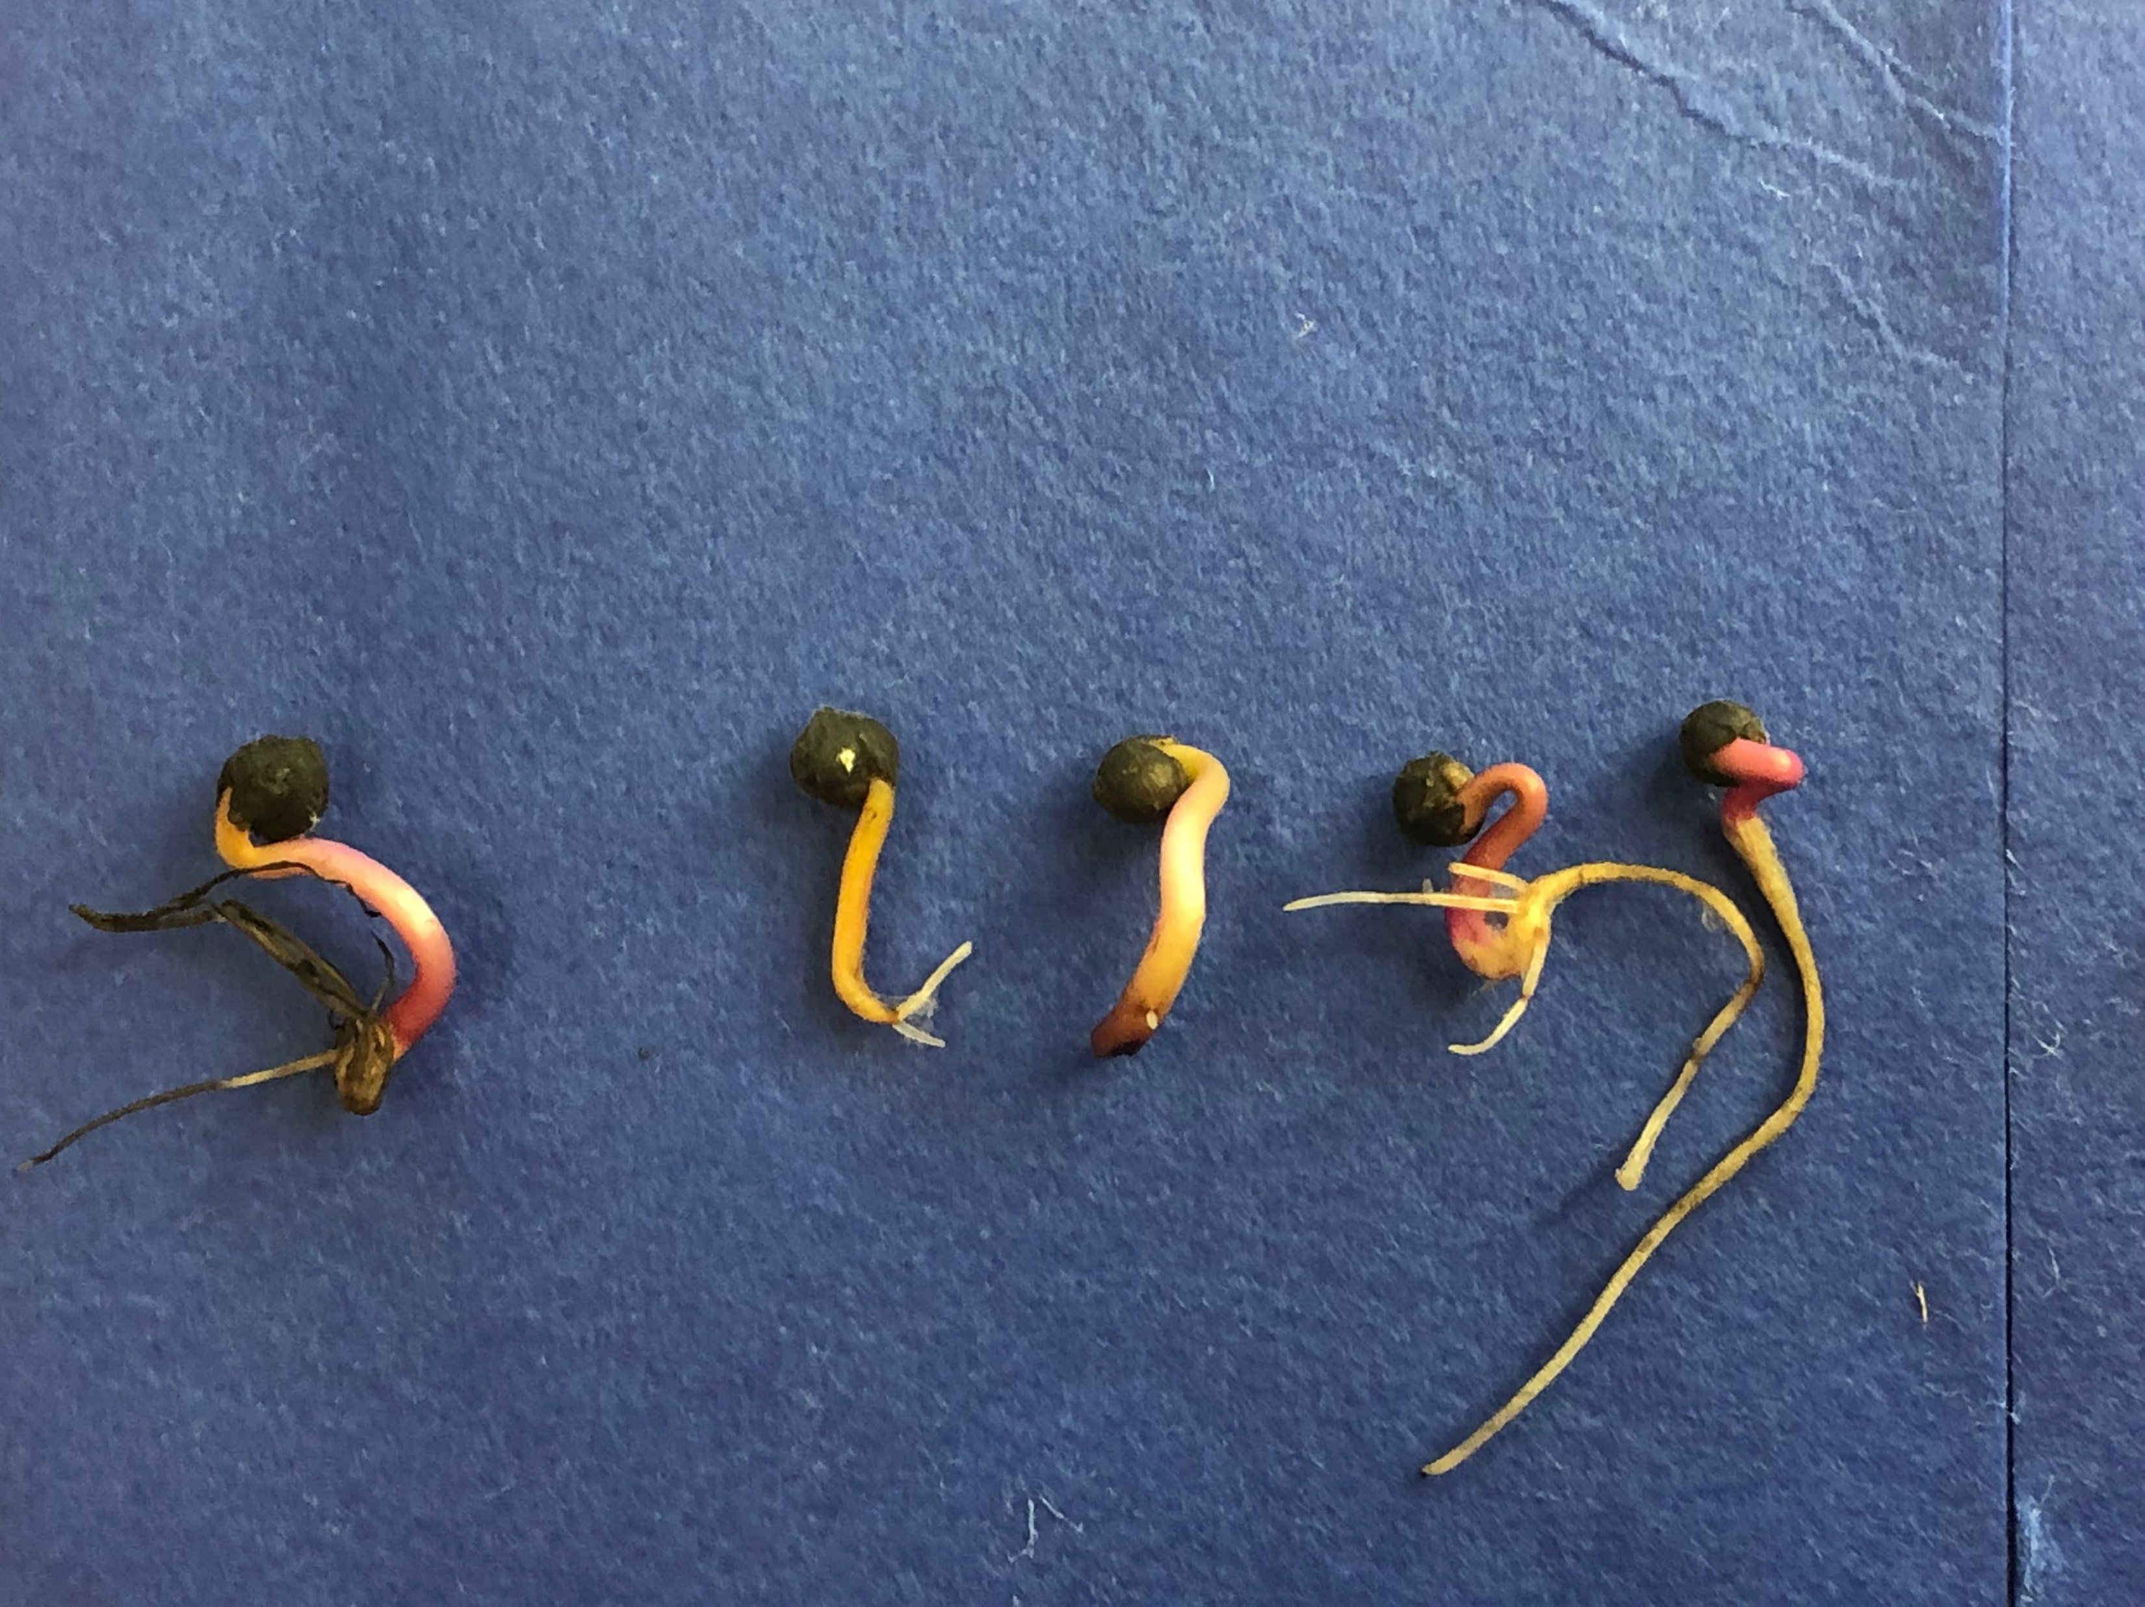
Abnormal Seedlings of Malabar Spinach
Abnormal of Red stem Malabar spinach

Slide 19
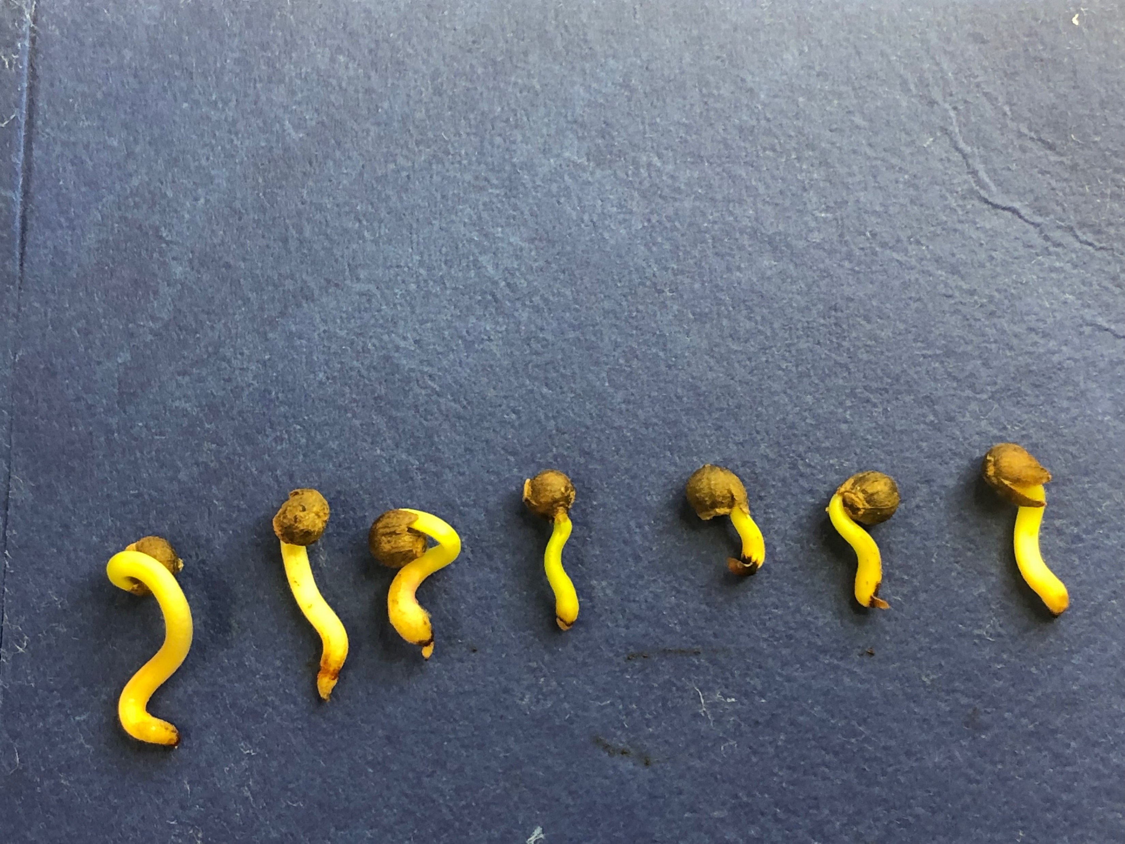
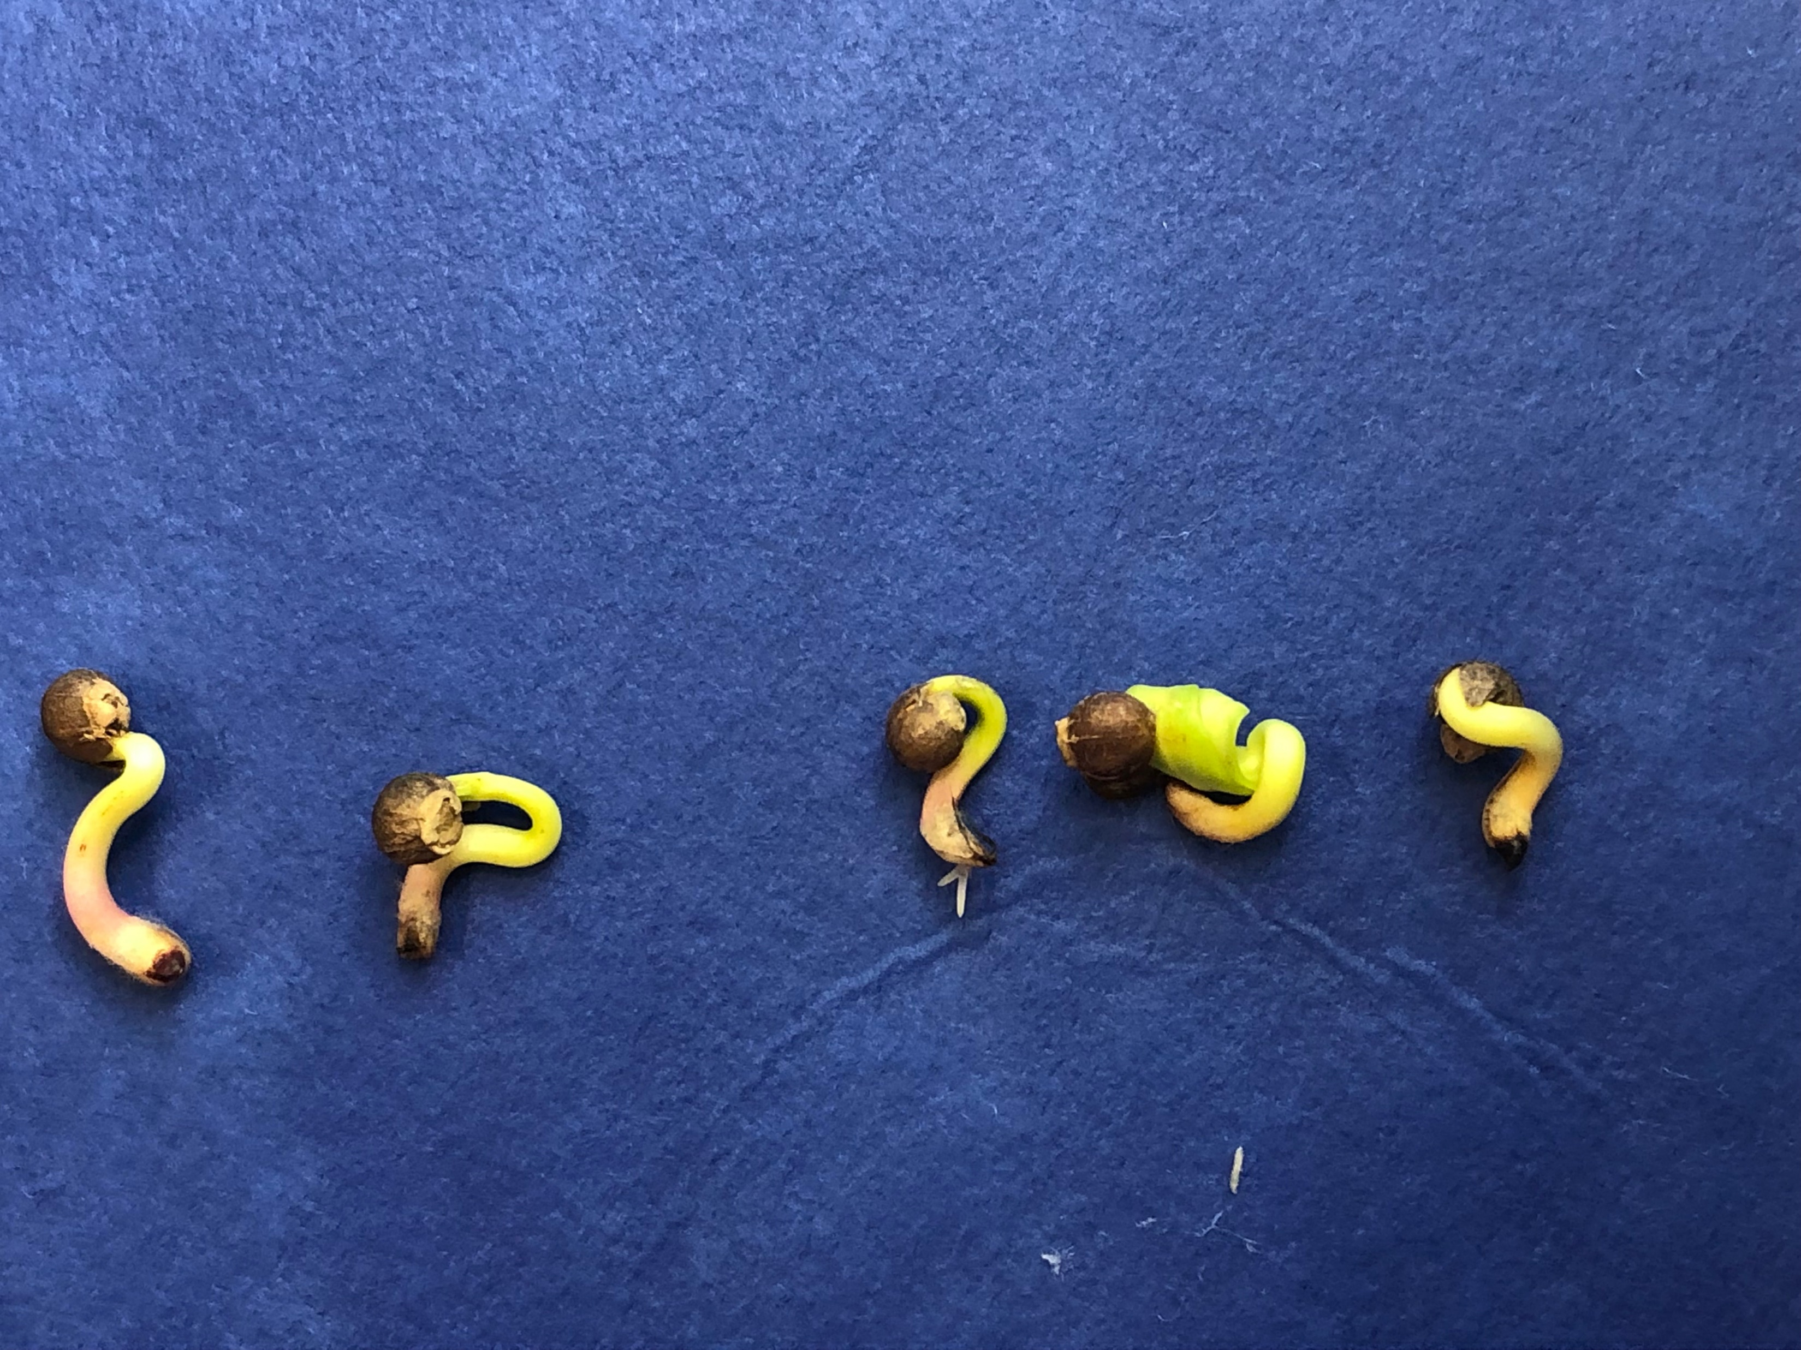
Abnormal Seedlings of Malabar Spinach
Abnormal of Green stem Malabar spinach

Slide 20
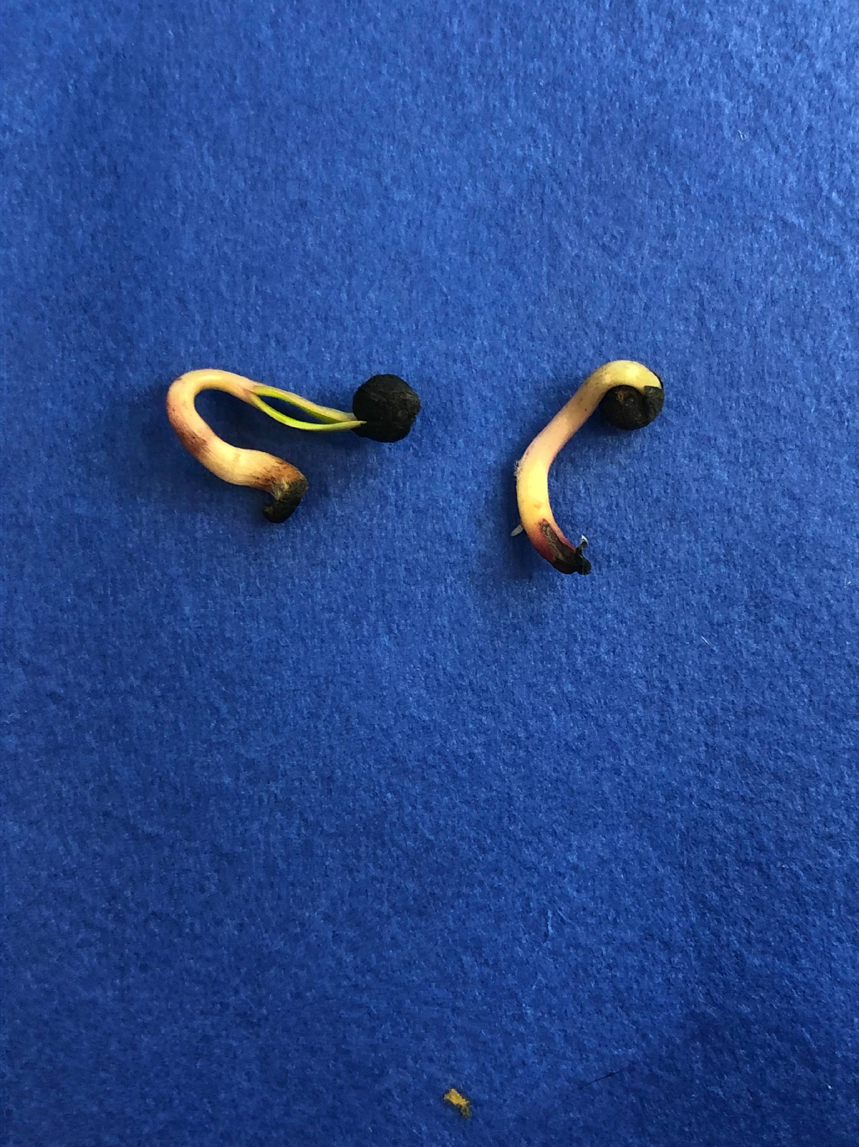
Abnormal Seedling
Abnormal:
-Seed Coat is tightly adhered to seedling

Slide 21
Conclusion
Best Substrata is Rolled towel (RT) followed by Between blotter (BB) with a optimum temperature- 20-30 light ,First count -10 days (Since the seed coat shedding takes extra 2 days), Final count -14 days
Soaking in water (2hr) noticed best result than Mechanical scarification using sand paper in red stem variety.
50 seeds-8replicates is best than 100 seeds in Between Blotter in 20-30 light condition
The above findings need to be referee tested for AOSA and validated for ISTA(collaboratively validated method) to introduce in both the organization rule book. (Future line of work for 2019-2020 study).

Slide 22
Future line of work
Proposal for inclusion of new species in the AOSA& ISTA Rules VZ., includes (scientific name of proposed species)
Lot and sample weights
Pure seed definition-distinguishing characteristics of the species
Validated germination test methods
Validated tetrazolium test procedure
Validated moisture test methods
1000 seed weight
Validated varietal identification method

Slide 23
Acknowledgement
My supervisors- Nishit Patel, Johnny Zook
Seed Material- Seed way
Technical advise-Dr. S. Elias, David J, Dr. R. Baalbaki

