Slide 1
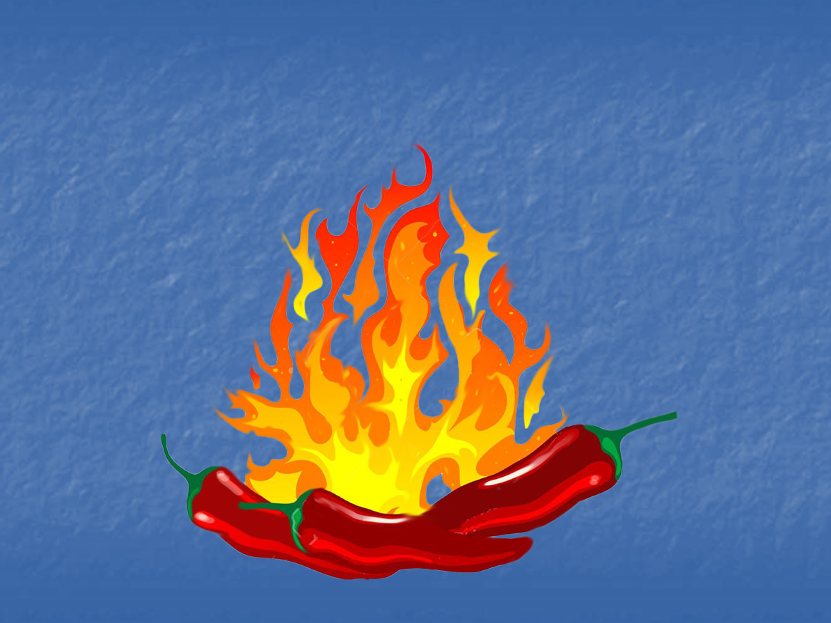
Hot Pepper Germination
Region IV (Southwest) Referee 2019

Slide 2
Introduction
Region IV, Southwest, conducted a referee concerning the germination of extremely hot Pepper varieties.
Some varieties that show low germination rates and dormant tendencies under standard test conditions will germinate at a high rate when tested in a solution containing both KNO3 (Potassium Nitrate) and GA3 (Gibberellic Acid, gibberellin A3)
Most of the knowledge regarding this method is more anecdotal than verifiable – several labs and analysts have found it to be effective in promoting the germination of stubborn hot pepper seeds.

Slide 3
The AOSA Rules currently have prescribed methods for testing fresh and dormant Pepper seeds using KNO3 or GA3 individually, but there is little, if any, documented testing using both chemicals concurrently
This experiment does concur with stated methods of other dormancy breaking procedures in that sometimes a combination of factors is required to effectively break dormancy

Slide 4
KNO3 and GA3 are both effective for inducing germination in dormant seeds, but they act on the seeds in different ways:
KNO3 aids in breaking dormancy associated with seed coat impermeability. It helps break down the seed coat to allow for imbibition and gas exchange
GA3 is a naturally occurring plant hormone that promotes cell division and growth in the seed. It is effective with embryo based dormancy, where the embryo is in a physiological state which does not allow germination, even when fully imbibed
Hypothetically, the two chemicals used concurrently could be more effective in breaking dormancy in some species.

Slide 5
Objective
The purpose of this study was to was to determine whether or not combining KNO3 and GA3 has an advantage in inducing germination in Pepper seeds, over either one used separately.

Slide 6
Materials and Methods
Two different samples of Pepper seeds were sent to fifteen laboratories
Both samples were known to have low germination under standard test conditions. One sample was known to respond very well when tested in a solution with both KNO3 and GA3
Both samples were tested using four different methods:

Slide 7
Method #1: Test substrate moistened with water only. May be tested in any manner in accordance with AOSA Rules
Method #2: Test substrate moistened with KNO3 solution (0.2%), with light
Method #3: Test substrate moistened with GA3 solution (500 ppm), with light
Method #4: Test substrate moistened with both KNO3 and GA3, with light

Slide 8
Method #1 tests were conducted in the manner that the lab would normally test pepper seed in accordance with AOSA Rules
Methods #2, 3 and 4 were tested with exposure to light, so that they reflect the fresh and dormant instructions in the AOSA Rules
The tests were all to be 21 days in duration, as 14 days is rarely enough for these varieties
All tests were to be handled like normal germination tests, and evaluated using AOSA Rules evaluation standards

Slide 9
Results
...
...............
............................................................................................
Can we talk about something else…?

Slide 10
Results
...
...............
............................................................................................
Can we talk about something else…?

Slide 21
Discussion/observations
Many labs reported that fungal infection was an inhibiting factor in the tests. This may account for many of the lower-end results, but probably did not affect the overall outcome
Although there was reasonably good consistency within the labs, the outcomes of the standard tests were, in most cases, as high as any other method. This shows that dormancy had ceased to be a factor
The objective was to isolate the chemical additives as much as possible as contributing factors in germination results. However, the samples used proved to not be effective for this experiment

Slide 22
The unavoidable conclusion is that this experiment did little or nothing to either support or disprove the hypothesis… Not having fresh, dormant seeds to work with all but negated the effects of the chemical additives – sorry!

Slide 23
Questions, Comments?
Thank you for your time!

Slide 24
2019 AOSA/SCST Annual Meeting June 3, 2019
Southwest Region Referee Test
Scott Taylor, RST
AMM Seed Testing, Inc.
2064 Alameda Padre Serra, Suite 110
Santa Barbara, CA 93103
805.564.2155

Slide 25
