Slide 1
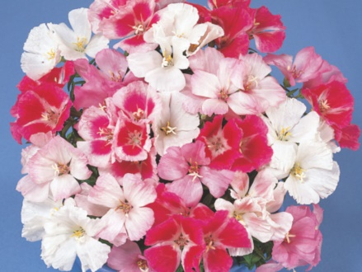
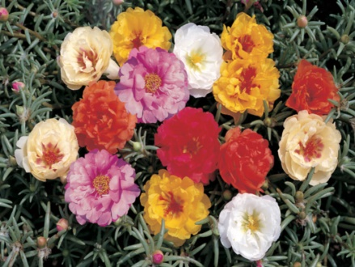
2018-19 FLOWER SEED Germination Referee
REGION IV SOUTHWEST
Sue Alvarez, Ransom Seed Laboratory
Linda Barbosa, Sakata Seed Company

Slide 2
Purpose of referee
To compare the AOSA and ISTA final counts of three flower seed species.
Results could be used for AOSA Rules change proposals.
One possible outcome would be to harmonize the ISTA and AOSA rules for germination testing on these species.

Slide 3
Background
The final counts for many flower seed species are considerably earlier for AOSA than they are for ISTA.
Some flower seed species do not appear to reach the maximum potential given the final count days listed in AOSA.
The coordinators of this referee compared AOSA and ISTA Rules for 17 species of flower seeds.
After review, we decided to conduct a referee with three species: Godetia (Clarkia amoena), Portulaca (Portulaca grandiflora), and Snapdragon (Antirrhinum majus). These three species have a common germination temperature and media requirement for AOSA and ISTA and differ only in the number of days for the final count.
A similar referee was conducted on three different flower seed species in 2017-2018, which resulted in a Rules change proposal for 2019.

Slide 4
Background, cont.
A call for referee participants was sent out to all AOSA and SCST members.
Potential participants were asked to fill out a survey with the following questions:
1. How many years’ experience do you have in seed testing?
2. How many samples of the following species do you evaluate for germination each year?
a. Godetia___
b. Portulaca___
c. Snapdragon___

Slide 5
Survey Results
Analysts from eight labs responded to the survey – the following are the responses:
1. How many years’ experience do you have in seed testing?
Range from 4 years (one lab) to 18-35 years (7 labs)
2. How many samples of the following species do you evaluate for germination each year?
a. Godetia___ Range from 8 to 460; average 86
b. Portulaca___ Range from 0 to 130; average 27
c. Snapdragon___ Range from 1 to 90; average 28
Two labs did not fill out the survey but did participate in the referee.

Slide 6
Materials and Methods
Three flower seed species were selected for comparison of AOSA and ISTA Rules: Godetia, Portulaca, and Snapdragon.
Three lots of each species from Sakata Seed Company were selected, of varying quality.
Samples from the nine lots were prepared and sent out to ten laboratories, in six different states. Participants were asked to test each sample using 4 replicates of 100 seeds, using only white blotters which were provided; testing Godetia at 15°C, Portulaca at 20-30°C, and Snapdragon at 20-30°C

Slide 7
Count Days
Participants were asked to do a final count as they would for AOSA and then to extend the test to the final count for ISTA. The participants were instructed to use the Miscellaneous agricultural and horticultural seedling descriptions page 125, Volume 4 of the AOSA Rules for Godetia, and the guidelines for Scrophulariaceae on p. 111 for Snapdragon. For Portulaca, sheets from the ISTA Handbook on Flower Seed Testing were provided.
Final counts:
Godetia AOSA 8 days ISTA 14 days
Portulaca AOSA 7 days ISTA 14 days
Snapdragon AOSA 12 days ISTA 21days

Slide 8
Results
All ten participating laboratories reported results.
The results are summarized in the following slides.

Slide 9
Snapdragon: Summary of results Germination percent on 12 vs. 21 days

Slide 10
Portulaca: Summary of results Germination percent on 7 vs. 14 days

Slide 11
Godetia: Summary of results Germination percent on 8 vs. 14 days

Slide 12
Summary of all results
Species | Average % germination over 9 lots and 10 labs
 |  | AOSA | ISTA | Average Difference
Snapdragon | Lot A | 93.2 | 95.8 | 2.83%
 | Lot B | 75.1 | 77.8
 | Lot C | 81.9 | 85.0
Portulaca | Lot D | 83.3 | 88.9 | 5.02%
 | Lot E | 87.3 | 91.8
 | Lot F | 64.7 | 69.6
Godetia | Lot G | 92.2 | 95.2 | 8.72%
 | Lot H | 65.6 | 87.2
 | Lot I | 91.0 | 92.6

Slide 13
Discussion
For Snapdragon, the additional 9 days in test yielded an average 2.83% increase in germination.
For Portulaca, the increase was 5.02% with an additional 7 days in test.
For Godetia, an additional 8.72% germination was obtained with 6 additional days in test.
The evidence supports the idea of harmonizing with ISTA in using their final counts for all three species tested, especially for the lower quality lots used in this referee.

Slide 14
Discussion, cont.
Additional statistical analysis will be conducted on the data, and a decision will be made as to whether any AOSA Rules change proposals will be submitted in the next year.
Godetia (Clarkia amoena) Portulaca (Portulaca grandiflora) Snapdragon (Antirrhinum majus)

Slide 15
Thanks to participating laboratories
Precision Seed Testing
Incotec
Pan American Seed
Louisiana Dept. of Ag and Forestry
Iowa State Seed Laboratory
Ransom Seed Lab
Sakata Seed Company
SGS Brookings
Illinois Crop Improvement
Harris Seeds, Rochester, NY

Slide 16
Special thanks to Sakata Seed Company for providing and preparing the samples.
Thanks also to Rita Zechinelli and the ISTA Flower Seed TCOM for providing ISTA Portulaca grandiflora evaluation guidelines.
Questions?
Contact:
Sue Alvarez SueRSL@silcom.com
Linda Barbosa lbarbosa@sakata.com

