Slide 1
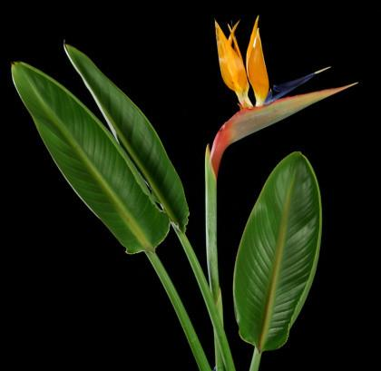
Bird of Paradise TZ Referee
Southwest Region #4
Michael Aberle RST
Ransom Seed Lab 2019

Slide 2
Reasons for a TZ method
Currently a method for the tetrazolium testing of Strelitzia reginae is not in the AOSA TZ handbook
The germination of Strelitzia can take up to 60 to 90 days with a high proportion of dormant seeds
Scarification methods to break the dormancy can lead to the deterioration of the seed
They are large seeds and take up space in the germinator

Slide 3
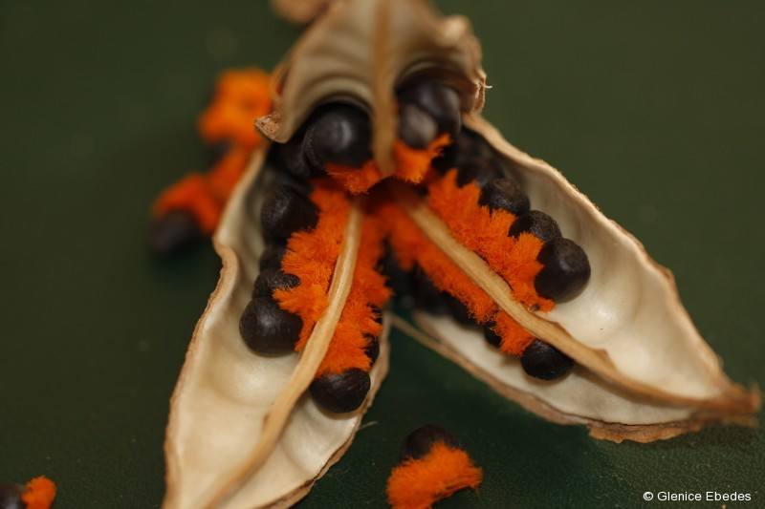
The fruit is a leathery capsule containing numerous small seeds, each with an orange aril and an oil body, possibly attractive to birds which may help to distribute the seeds.

Slide 4
Referee
Two samples of 100 seeds with 99% (#1) and 90% (#2) viabilities provided to us by Mistletoe Seeds in Goleta CA
Enough seed from our customer to provide 10 labs with two samples
Provided instructions for TZ testing method I currently use to test Strelitzia reginae

Slide 6
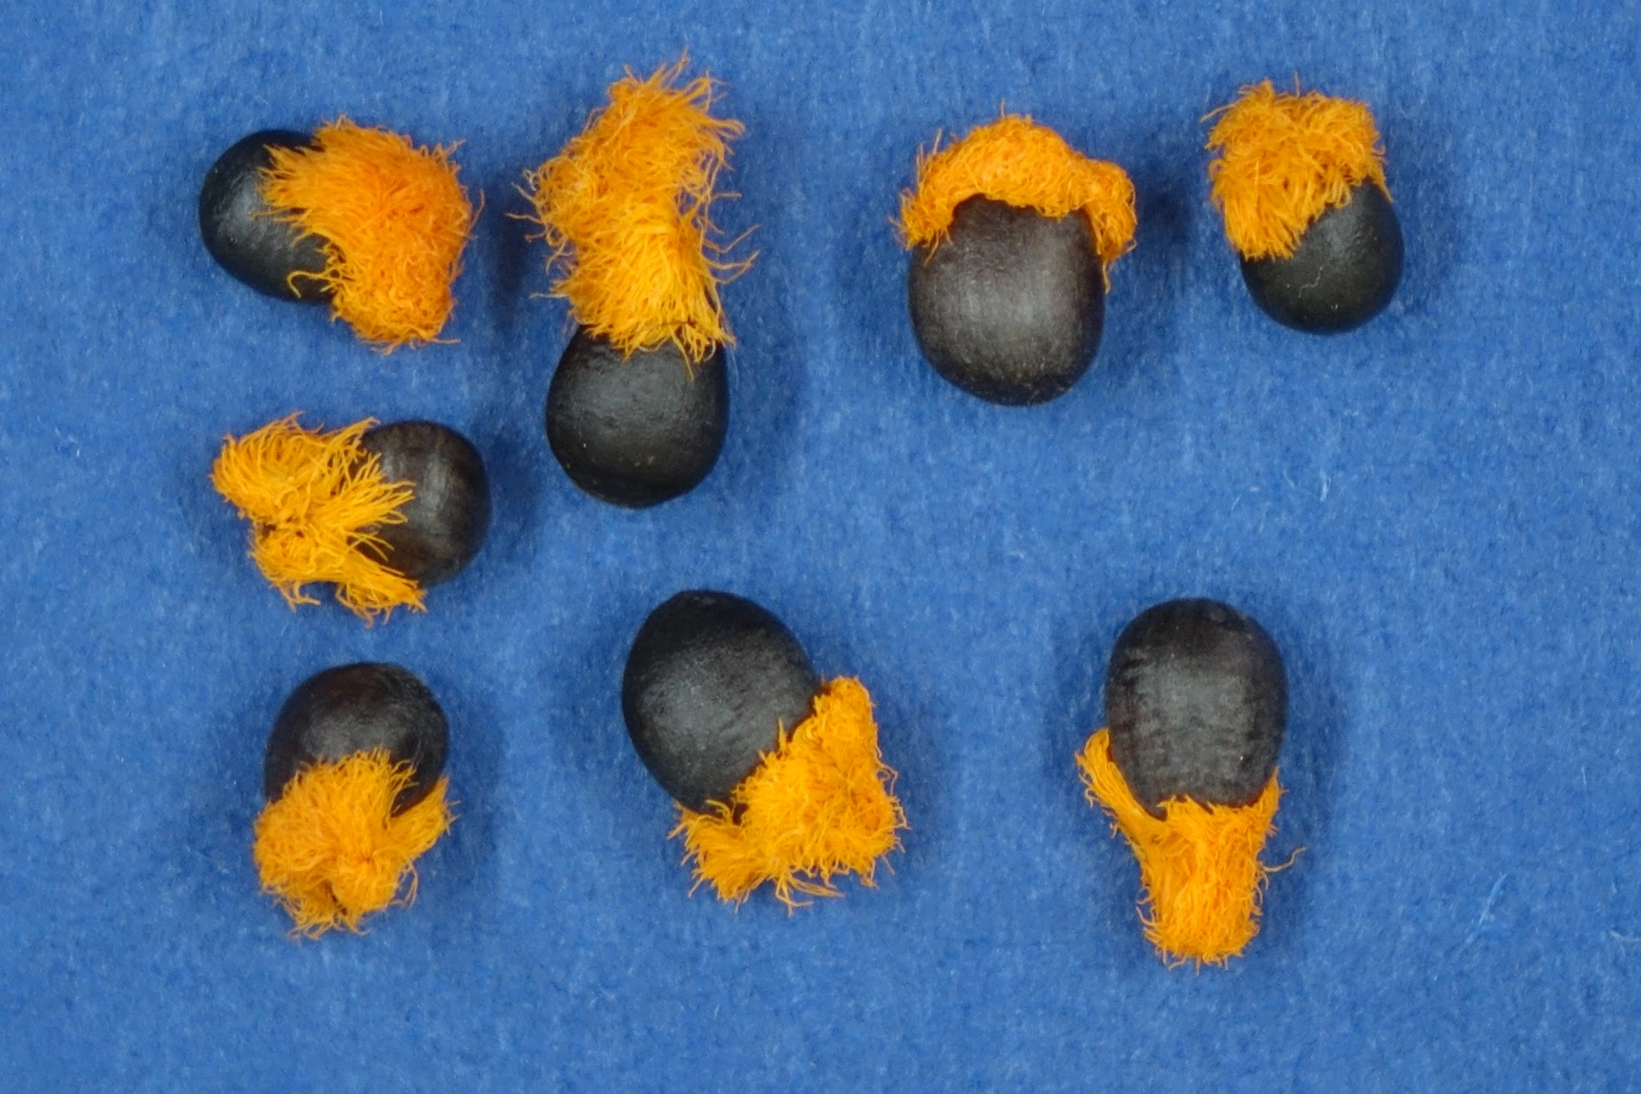

Slide 8
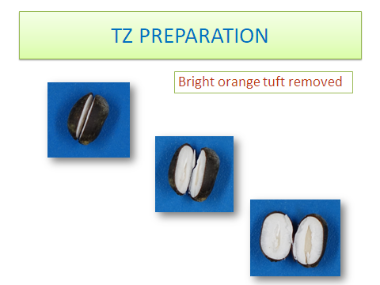

Slide 10
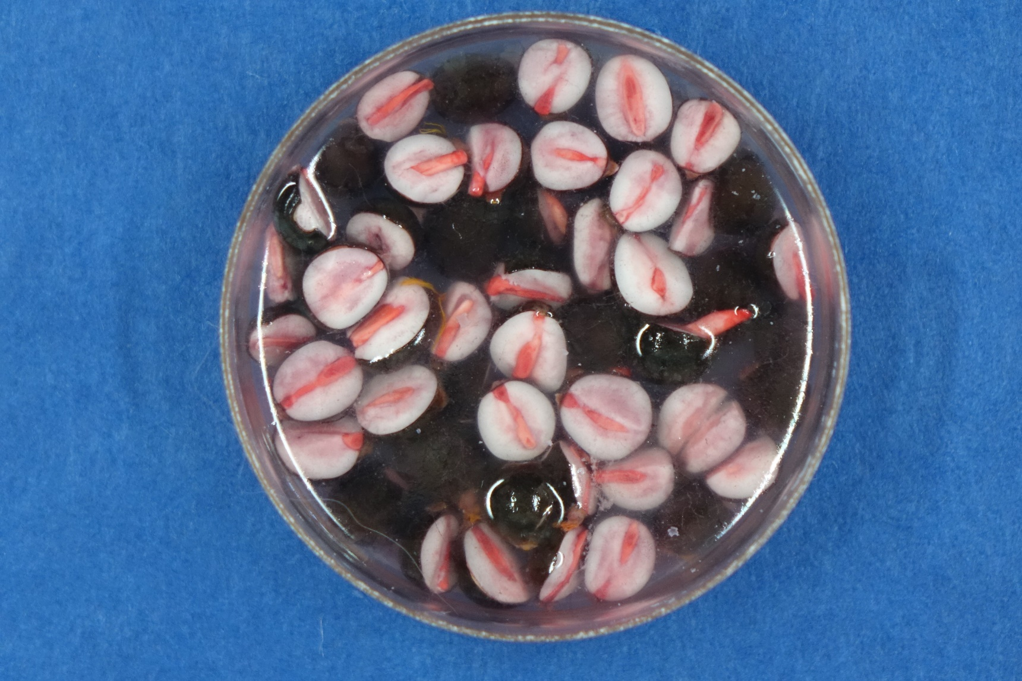

Slide 12
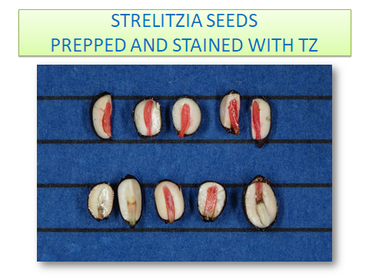

Slide 13
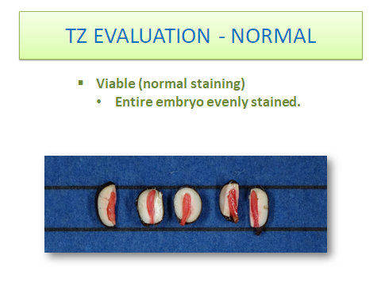

Slide 14
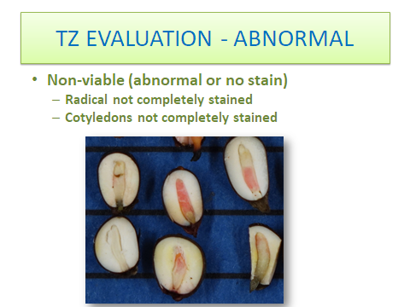

Slide 15
Strelitzia TZ Referee

Slide 16
Feedback on TZ Evaluation
“ I followed your directions for the preconditioning of the seed but I thought they needed more time to stain so I evaluated them in the afternoon instead of right away in the morning.”
“It seemed like the cuts from the razor blade caused a bit of damage to the embryos but when I pulled them out and flipped them over they were easier to evaluate.”
“I tried to stick pretty closely to your pictures of what was viable vs. non-viable so anything that had partial staining I called non-viable.”

Slide 17
Participant’s photos of results
#1 showing artifact damage on cut side
#2 embryo’s reverse side showing normal stain
#3 and #4 artifact damage or non-viable stain?

Slide 22
My photos of results
#1 Normal stain without artifact damage
#2 and #3 stain inhibited by endosperm
#4 artifact damage from razor blade cut
#5 and #6 damage at radical end or viable stain?

Slide 23
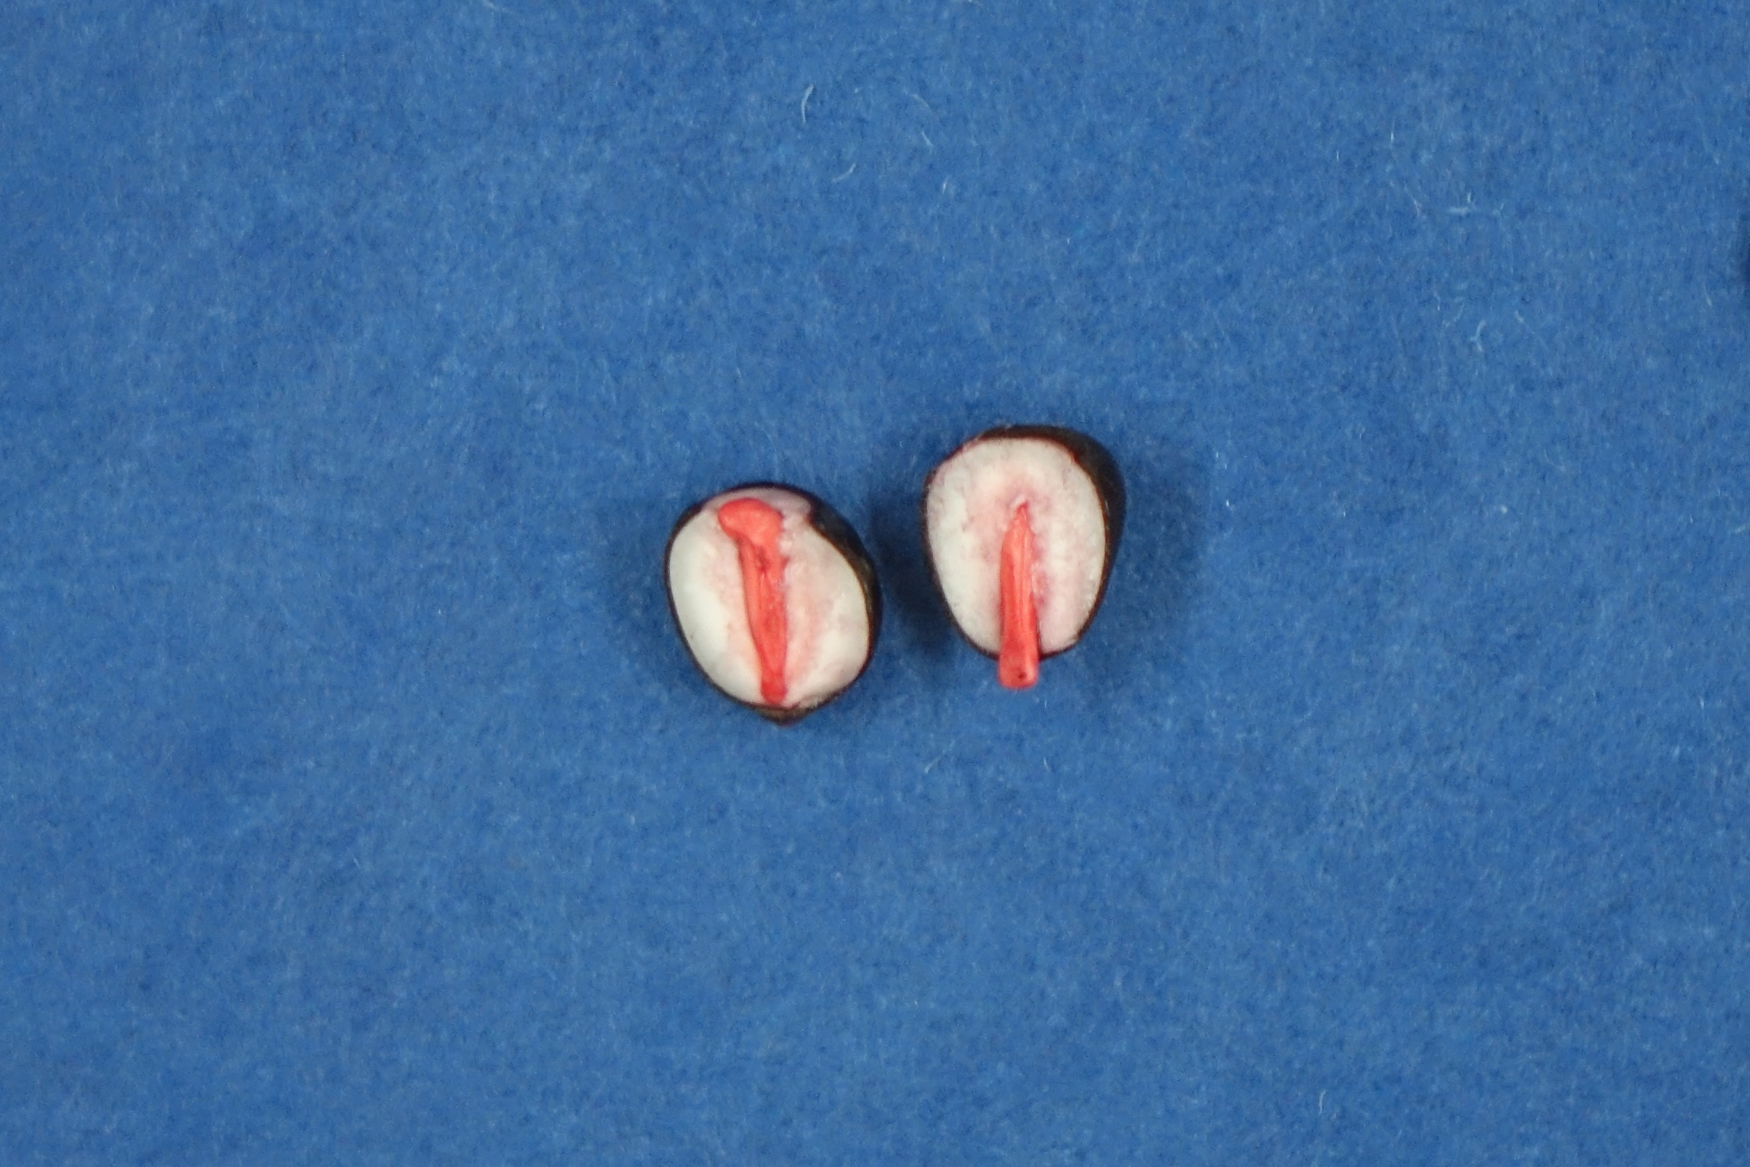

Slide 24
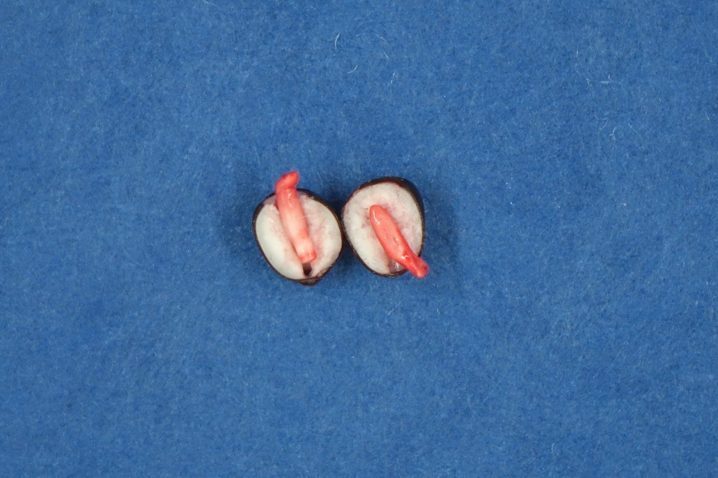

Slide 25
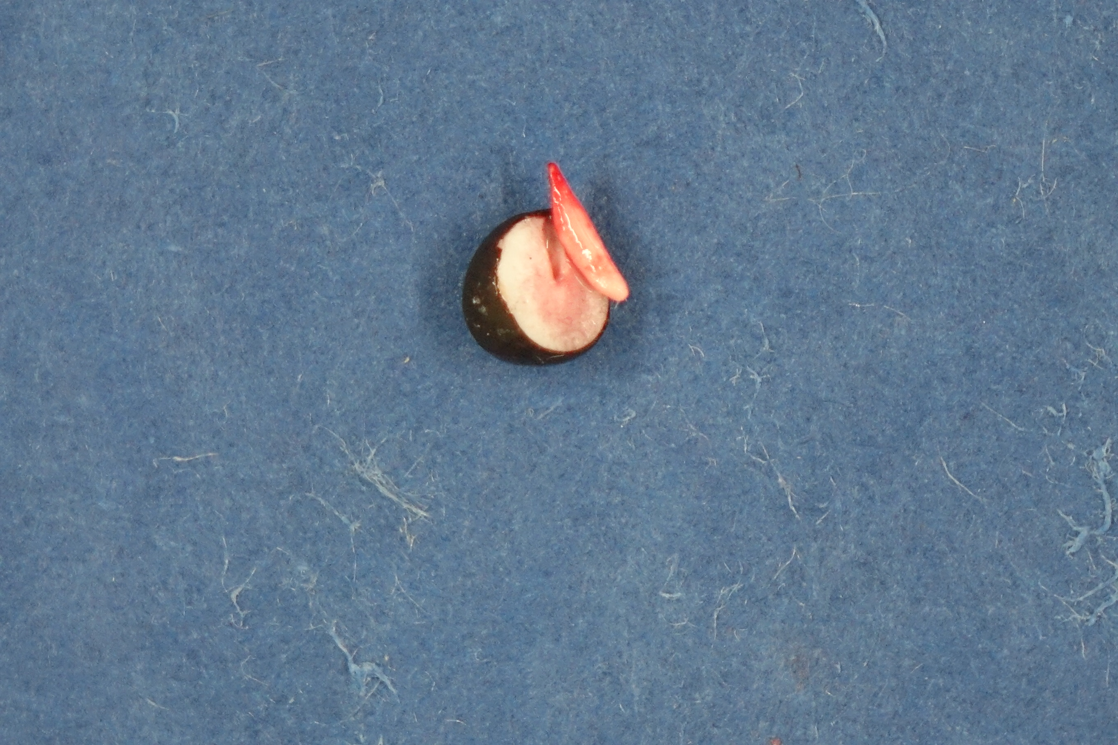

Slide 26
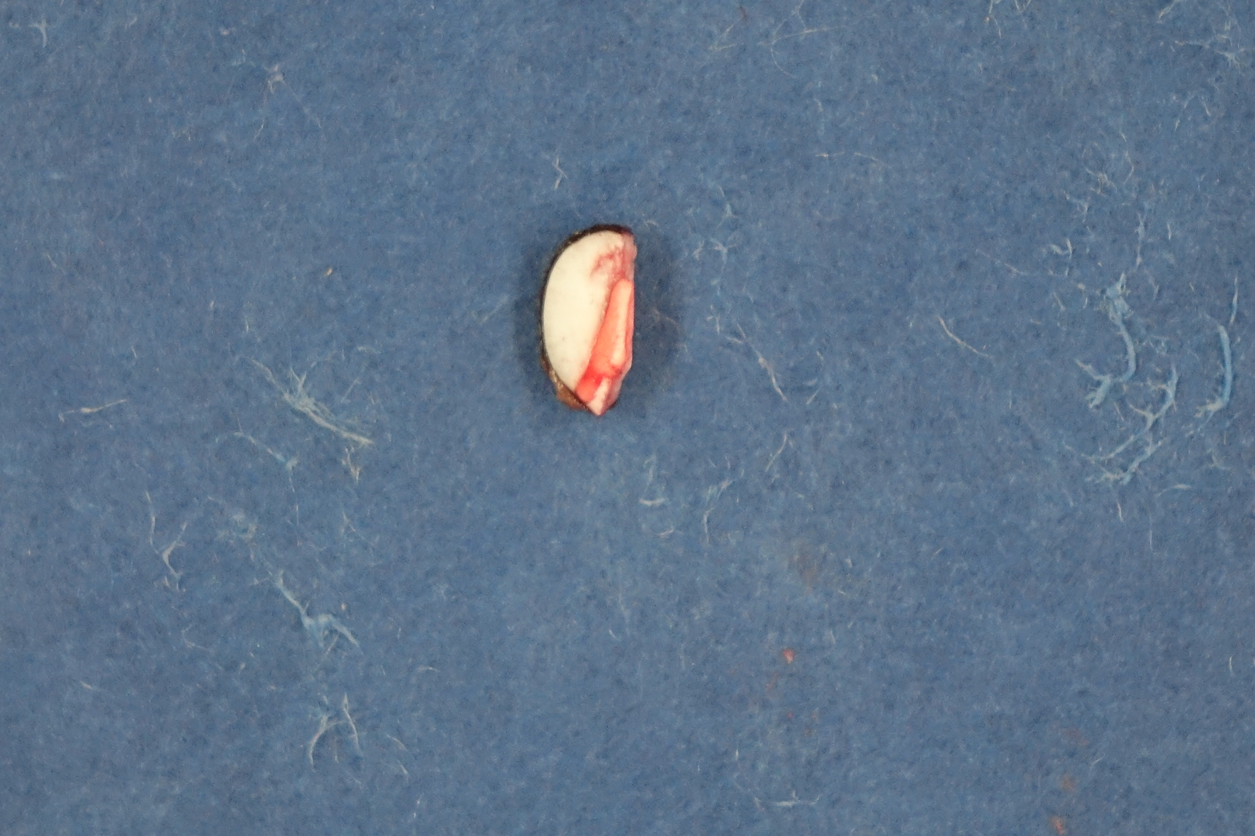

Slide 27
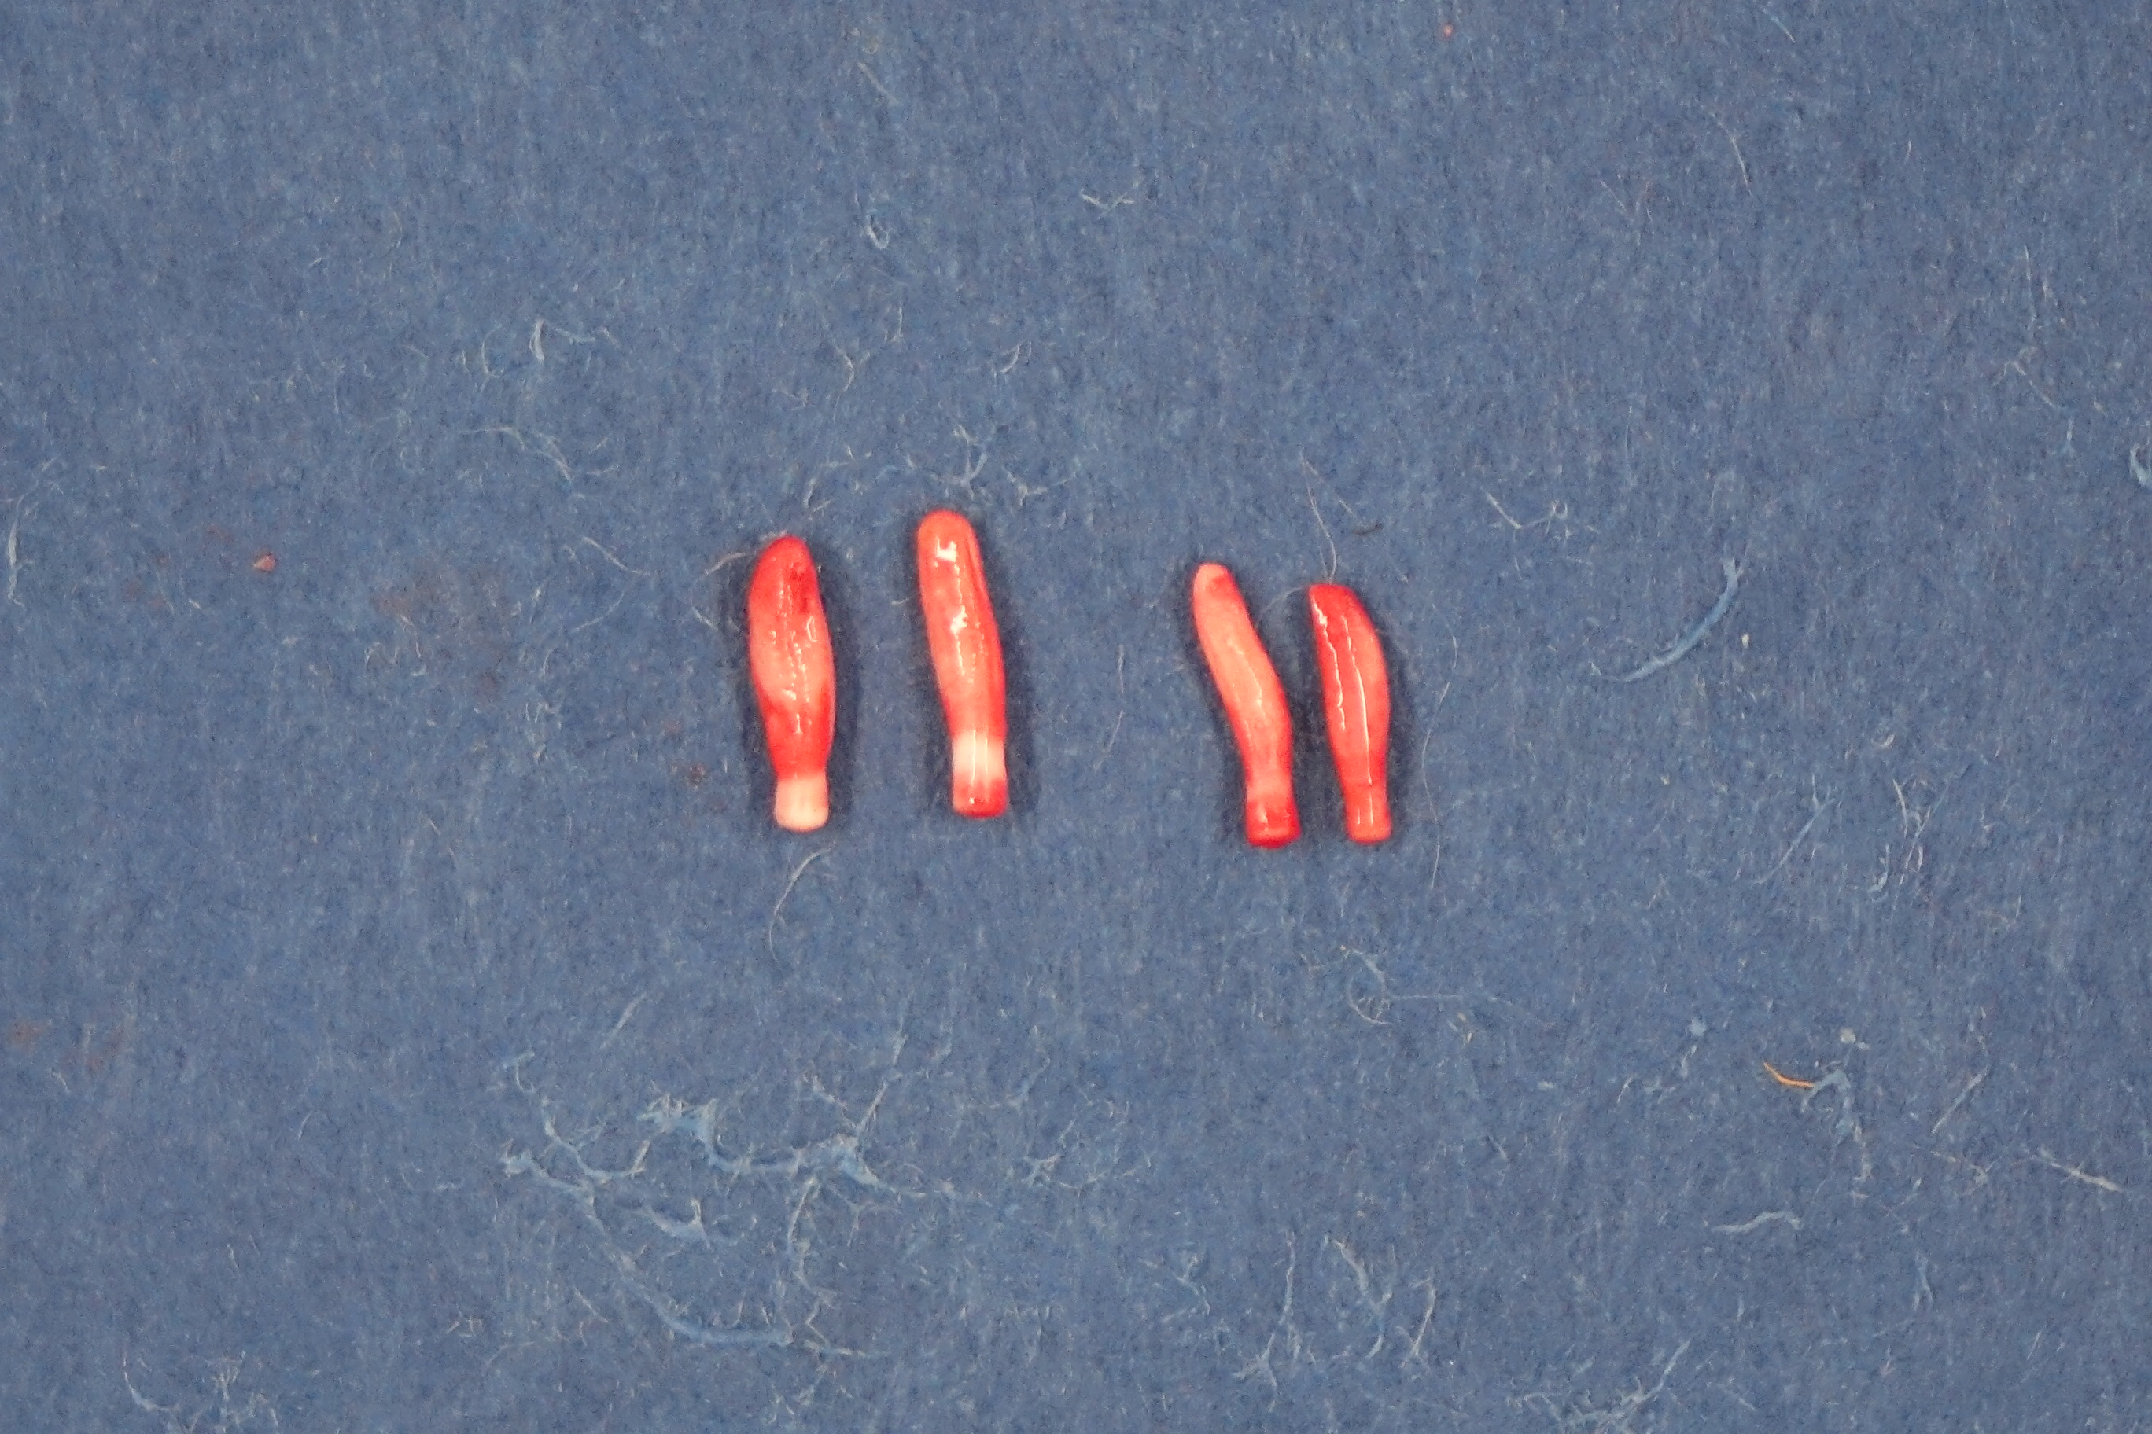

Slide 28
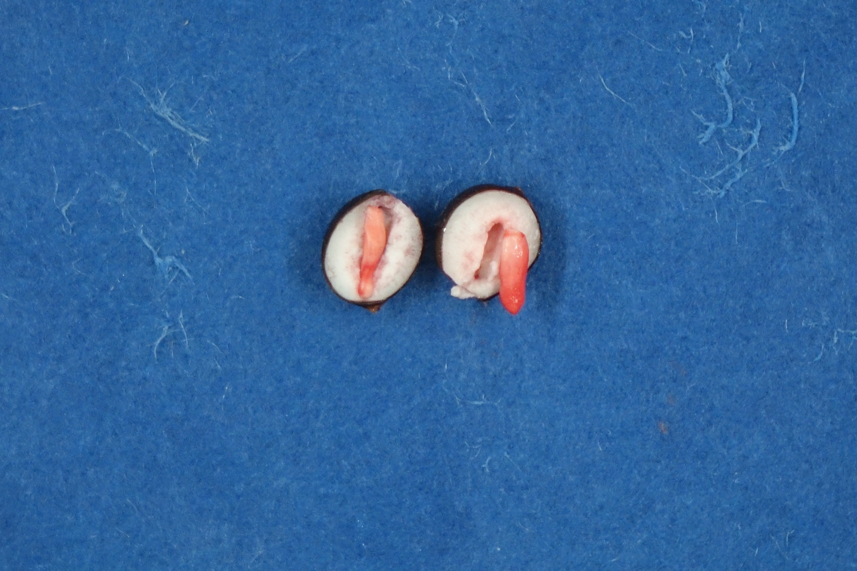

Slide 29
Recommendations
Longer preconditioning time to soften the endosperm to minimize damage to the embryo. In 5 C to avoid deterioration.
Sharp razorblades.
Off-centered cuts to avoid cutting much of the embryo.
Longer staining time.

Slide 30
Future Experiments
Using 1% TZ solution
Correlate with germination tests.
Fine tune requirements for handbook entry for large seeded expensive crops

Slide 31
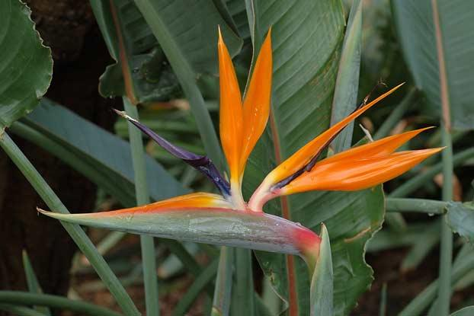
Thank you participants and Mistletoe Seed!

