Slide 1
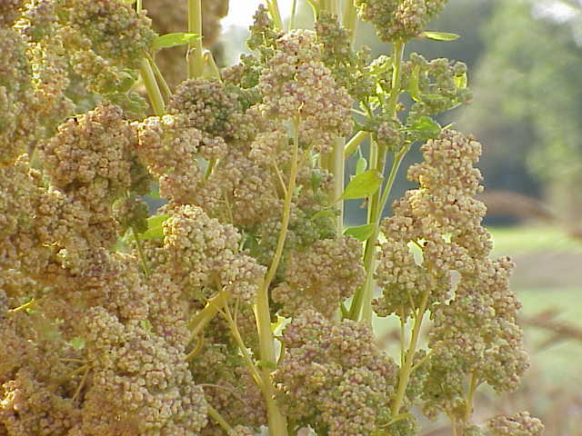
2021 Quinoa Referee
Southwest Region 4
Linda Barbosa, RST
Sue Alvarez, RST
Photo from Wikipedia , by Kurt Stueber

Slide 2
Introduction and Background
Quinoa (Chenopodium quinoa) is an edible grain or pseudocereal which is increasing in use and therefore being tested in seed laboratories. This species originated in the Andean region of northwestern South America.
In 2021 the testing procedures were added to the ISTA Rules following the annual Ordinary General Meeting, and analysts in the US were interested in trying to add quinoa to the AOSA Rules as well.
ISTA methods (effective 2022) are as follows:
Minimum weights – purity: 10 g; Other seeds: 100g
PSD 2 (achene)
Germination – TP, BP 20°C, 4 day first count, 7 day final count

Slide 3
Purpose
The purpose of this referee was to compare two temperature regimes (20°C and 15°C) for quinoa, Chenopodium quinoa.
The results should provide useful data in order to add germination methods for quinoa to the AOSA Rules.
NOTE: In addition to the germination referee, seed count information on 13 quinoa seed lots was also obtained in order to add purity weights to the AOSA Rules.

Slide 4
Organization
The organizers of this referee acquired 7 lots of quinoa seeds (Chenopodium quinoa) from three different companies. In preliminary in-house testing, none of the seed lots available were of very high germination. The four highest performing seed lots were chosen for this referee.
A survey was sent out to the AOSA and SCST membership, with the purpose of finding volunteers for the referee with experience in seed laboratory germination and who were interested in participating.

Slide 5
Survey of Participants
The following survey was sent out to the membership looking for referee participants:
1. How many years’ experience do you have in seed testing?
2. How many samples of quinoa (Chenopodium quinoa) do you evaluate for germination each year?
3. Do you have both 20°C and 15°C germinators available for this study?
4. Are you interested in participating in a referee comparing two germination temperatures for quinoa, a species not yet included in the AOSA Rules?

Slide 6
Results of Survey
Analysts from 12 labs responded to the survey. Here is a summary of the results:
1. How many years’ experience do you have in seed testing?
Range 3 to 40 years, average of 19 years’ experience
2. How many samples of quinoa (Chenopodium quinoa) do you evaluate for germination each year?
Range 0 to 20, Average 4
3. Do you have both 20°C and 15°C germinators available for this study?
All responded yes

Slide 7
Methods
In August 2021, samples from four lots of quinoa were prepared and sent out, along with germination media (white blotters). The following are the specific directions given to the referee participants:
For each sample:
1. Plant 4 replicates of 100 seeds on top of white blotters (two layers) and place in 20°C germinator.
2. Record 4 day first count (normal sprouts) – Please use the seedling evaluation guidelines for Chenopodiaceae in the AOSA Rules Volume 4 (p. 38-2019).
3. Record 7 day final count (normal seedlings, abnormal and dead).
4. Repeat steps 1-3 but place replicates in 15°C germinator.

Slide 8
Results
All twelve laboratories completed the germination testing and sent in results by the end of October 2021.
Results from one lab were not included, as the results were not reported correctly. The results from the other 11 laboratories were included in the final analysis.
The results are summarized in the next two slides.

Slide 9
Average germination results for quinoa from 11 laboratories:
Sample | Tested at 20°C | Tested at 15°C
1 | 45.23 | 47.52
2 | 47.75 | 49.98
3 | 71.82 | 72.00
4 | 59.14 | 55.41
Overall Average | 55.99% | 56.23%

Slide 10
20°C
15°C

Slide 11
Final (7 day) Count - % Normal

Slide 12
% Abnormal
% Dead

Slide 13
Overall results across 4 lots and 11 labs:
Final (7 day) counts | 20°C | 15°C
% Normal | 55.99 | 56.23
% Abnormal | 15.26 | 17.73
% Dead | 28.76 | 26.04

Slide 14
Statistical Analysis
A statistical analysis on the raw data from this referee was performed by Dr. Riad Baalbaki of the California State Seed Laboratory. The following is a summary of the results, with the most important points underlined:
Percentage germination (first and final count), as well as abnormal and dead seeds, significantly differed among samples. Samples had a range of quality.
Using either 15 or 20ºC as test temperature had no effect on final percentage germination, when averaged over all other factors. Abnormal and dead seed differences were minimal, although significant.
With a single exception (Lab 9, sample 4), no lab produced significantly different results when germination was evaluated at 15 and 20ºC .
Results among labs, within the same sample and temperature, showed a wide range of variation, but the extent of variability among labs depended on the sample being tested, and was not affected by temperature.

Slide 15
Seed Count Information
13 lots of quinoa seeds were obtained and sampled for seed count information.
7 of the lots were commercial samples and 6 of the lots were germplasm obtained from the USDA North Central Regional Plant Introduction Station at Iowa State University.
The following table is a summary of the seed count information obtained from these samples.

Slide 16
Seed Count Data
Sample Number | Origin | 1000 seeds (g) | Number of seeds per gram | Number of seeds per ounce
1 | Pacific Grain | 2.999 | 333 | 9,453
2 | Pacific Grain | 2.782 | 360 | 10,192
3 | Pacific Grain | 3.029 | 330 | 9,359
4 | Pacific Grain | 2.798 | 357 | 10,133
5 | Country Creek Acres | 2.420 | 413 | 11,716
6 | Botanical Interests | 2.952 | 339 | 9,602
7 | Botanical Interests | 3.072 | 326 | 9,230
8 | Chile | 1.960 | 510 | 14,464
9 | Colorado, USA | 2.373 | 421 | 11,946
10 | Chile, Maule | 2.660 | 376 | 10,659
11 | Chile, Pichilemu | 2.371 | 422 | 11,955
12 | Chile, Faro | 3.953 | 253 | 12,360
13 | Chile | 3.015 | 332 | 9,402
Average |  | 2.799 | 367 | 10,805

Slide 17
Suggested Purity Weights
Using the seed count data, the following is suggested for quinoa, Chenopodium quinoa, if it is added to the AOSA Rules:
2,500 seeds = 6.998 grams
25,000 seeds = 69.98 grams
Suggested minimum purity weights:
7 grams purity / 70 grams noxious
Use PSU 38; chaffy

Slide 18
Discussion
A Rules Proposal for next year will be developed as a result of this referee. Suggested additions:
Table 2A. Weights for working samples.
Pure Seed Unit # | Chaffy Seed ª | Kind of seed | Minimum weight for purity analysis ^{b} | Minimum weight for noxious-weed seed or bulk examination | Approximate number of seeds per gram ^{c} | Approximate number of seeds per ounce ^{d}
 |  |  | Grams | Grams | Number | Number
38 | C | Chenopodium quinoa Willd. quinoa | 7 | 70 | 367 | 10,805
Table 6A. Methods of testing for laboratory germination.
Kind of seed | Substrata | Tempera-ture (°C) | First count (days) | Final count (days) | Specific requirements and notes | Dormant seed
Chenopodium quinoa quinoa | TB | 20; 15 | 4 | 7

Slide 19
Acknowledgements
Thanks to Pacific Grain and Food of Fresno, California for donating four of the lots used in this referee.
Also thanks to Botanical Interests of Broomfield, Colorado for donating two of the lots.
Sue Alvarez purchased one of the quinoa lots used in the referee online from Country Creek Acres.
Thanks to Dr. Roopa Anantareddy for ordering 6 lots of germplasm from the USDA.
Special thanks to Sakata Seed for preparing and sending out all of the samples and the germination media used in the referee.
Extra special thanks to Riad Baalbaki for the data analysis.

Slide 20
Participating Laboratories
And thanks to all of the participating laboratories:
Incotec (CA), MD Seed Analysis (CA), Ransom Seed Lab (CA), Sakata Seed (CA),USDA-ARS North Central Regional Plant Introduction Station (Iowa), North Dakota State Seed Lab, Ohio Seed Improvement Association, Oregon State University Seed Lab, Pennsylvania Dept. of Agriculture, South Dakota State Seed Testing Lab, CFIA SSTS (Saskatoon, Canada), and Eurofins Biodiagnostics (WI)

Slide 21
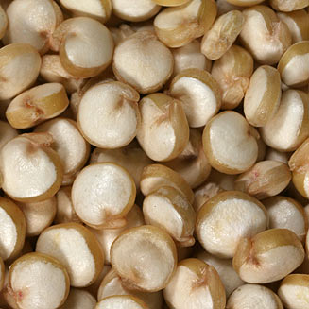
Questions?
Linda Barbosa, Sakata Seed Company lbarbosa@sakata.com
Sue Alvarez, Ransom Seed Lab sue.alvarez@ransomseedlab.com
THANK YOU!
photo by H. Robertson,
http://www.biodiversityexplorer.info/plants/amaranthaceae/chenopodium_quinoa.htm

