Slide 1
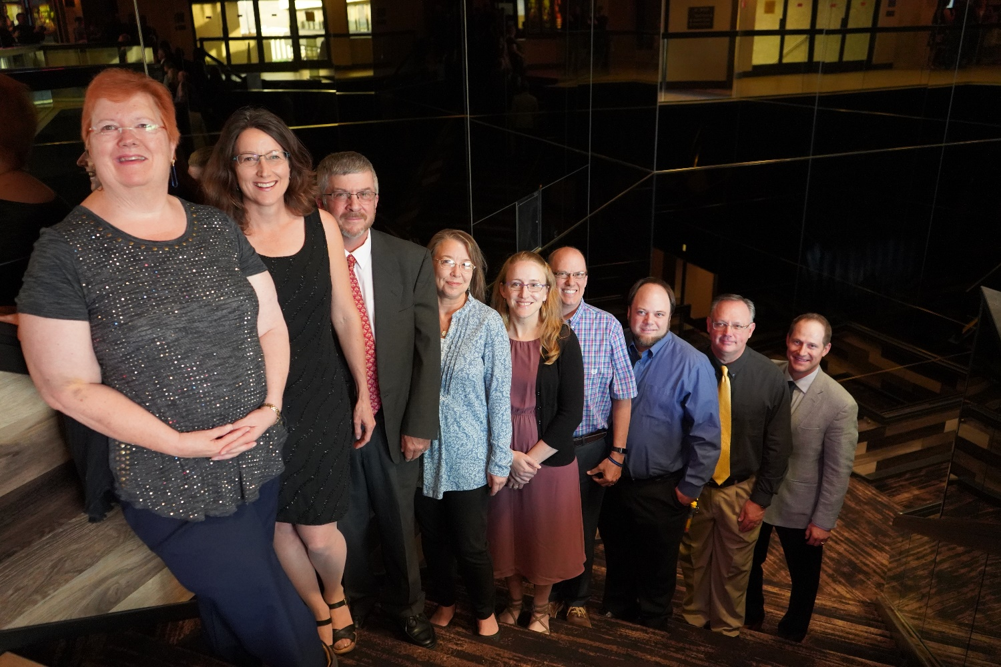
Association of Official Seed Analysts

Slide 2
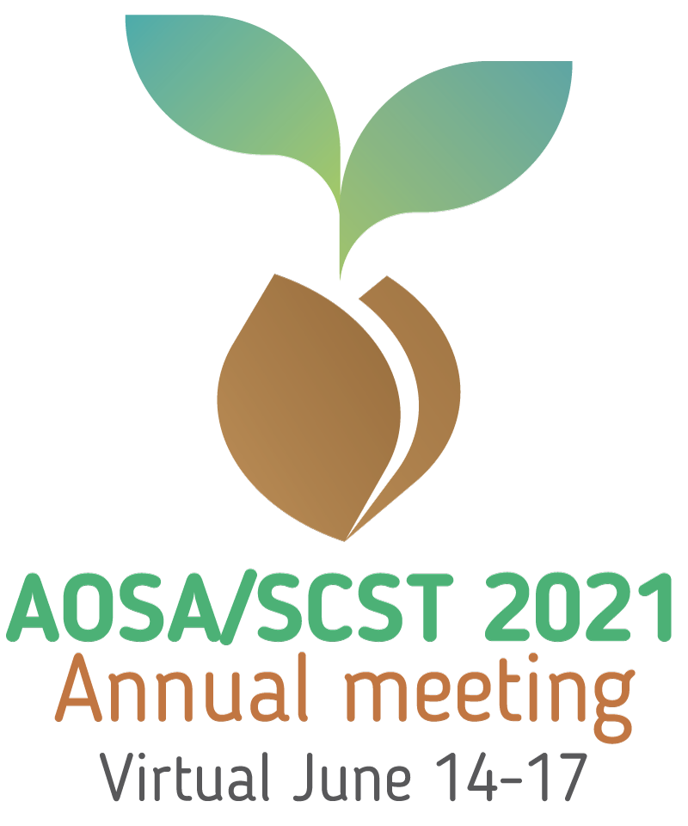
2021 AOSA
State of the Association

Slide 3
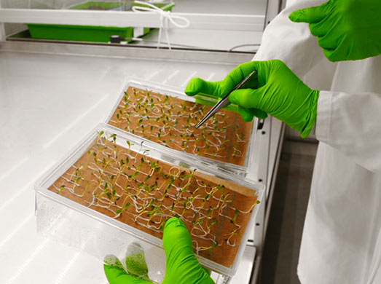
2020 & 2021 Year in Review

Slide 4
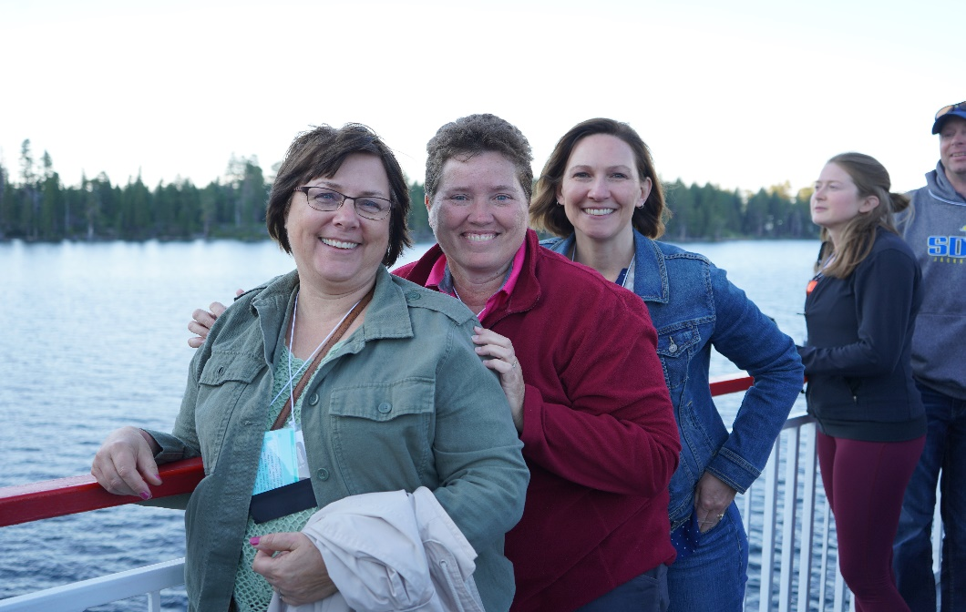
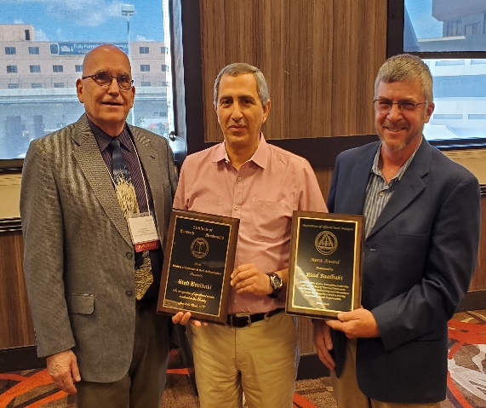
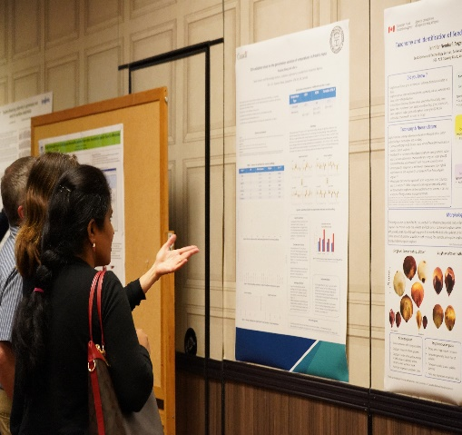
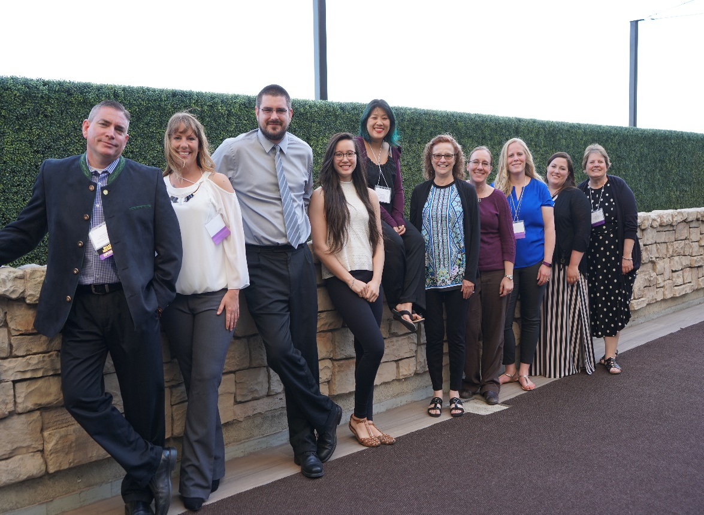
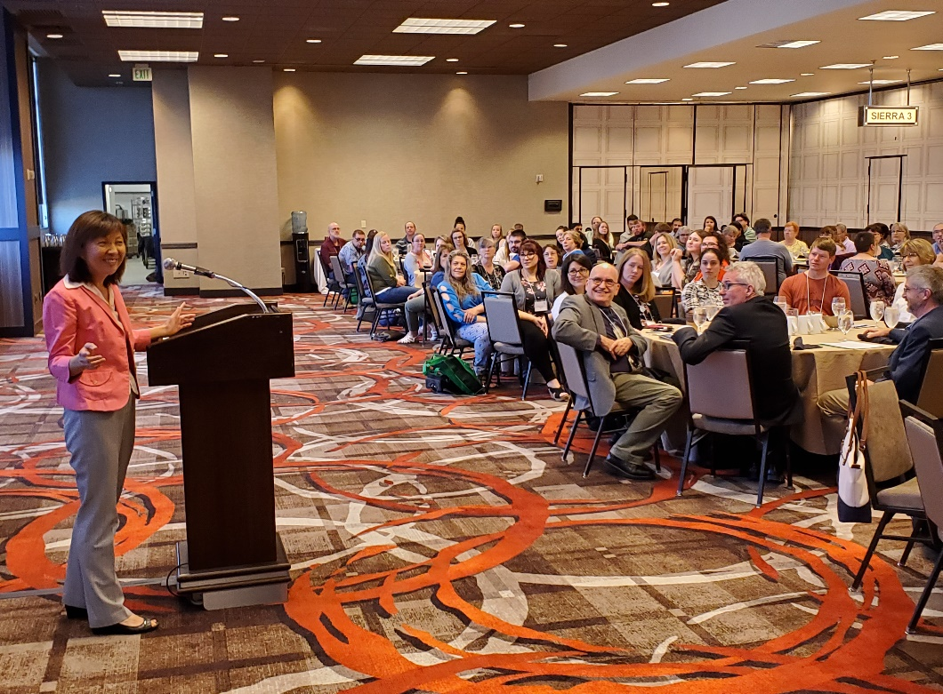
2019 AOSA/SCST Annual Meeting
Sparks, Nevada

Slide 5
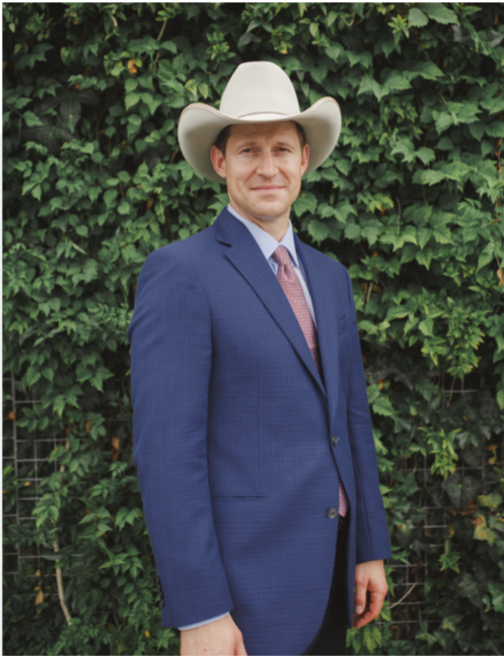
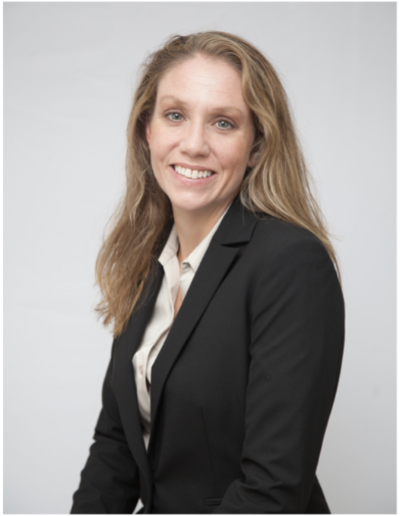
AOSA Executive Office report
Jess Peterson - AOSA Executive Director
Oversees AOSA operations
Implements Programs and Policies
Annual Meeting Management
Ensures Budget Compliance
Outreach and Public Relations
Admin Support to Elected Officers
Kelly Polzin - AOSA Director of Membership Services
Maintains Membership Services
Manages and Updates AOSA Rules for Seed Testing
Processes and Tracks Publication Orders
Manages Social Media and Email Inquiries
Manages Committee Activities
Maintains Exam Candidate Database

Slide 6
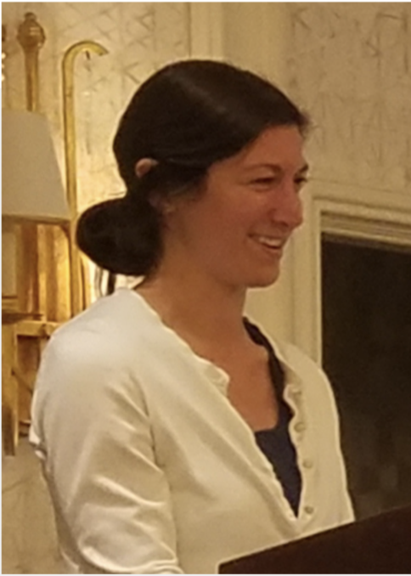
AOSA Executive Office report Cont.
Kristin Albers - AOSA Director of Finance
Oversees AOSA operations
Implements Programs and Policies
Annual Meeting Management
Ensures Budget Compliance
Outreach and Public Relations
Admin Support to Elected Officers
Keith Sullivan - Website Manager
Maintains analyzeseeds.com websites
Regulate and Manage Access Rights
Manage Online Membership Services
Troubleshoot Performance Issues and Ensure Functionality
Manage Publication Store
Liaison Between Hosting Company and Organization

Slide 7
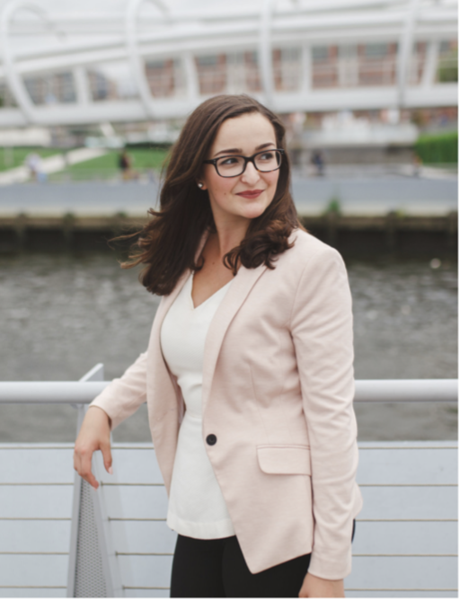
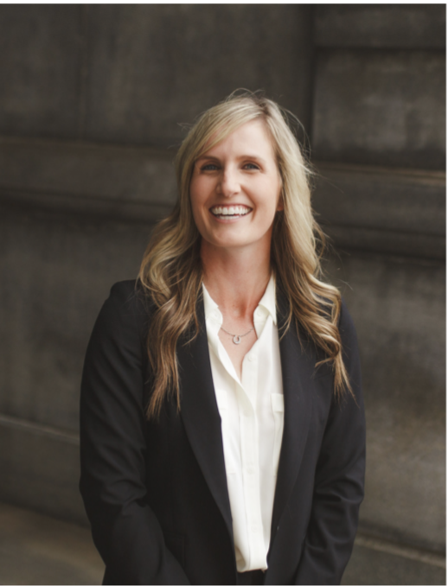
AOSA Executive Office report Cont.
Lia Biondo - AOSA Membership & Public Outreach
Maintain Active Presence on Social Media
Job Posting Advertisement
Oversee Membership Communications
Draft Membership Announcements
Design Public Relations Materials
Draft Press Statements
Kelly Fogarty - AOSA Event Operations
Act as Liaison to Host/Local Planning Committees
Manage Negotiations and Requests From Host
Act as Liaison to Hotel Negotiator
Point of Contact for Annual Meeting
Provide Insight in Preparing Bids
Provide Consulting for Annual Meeting Tours

Slide 8
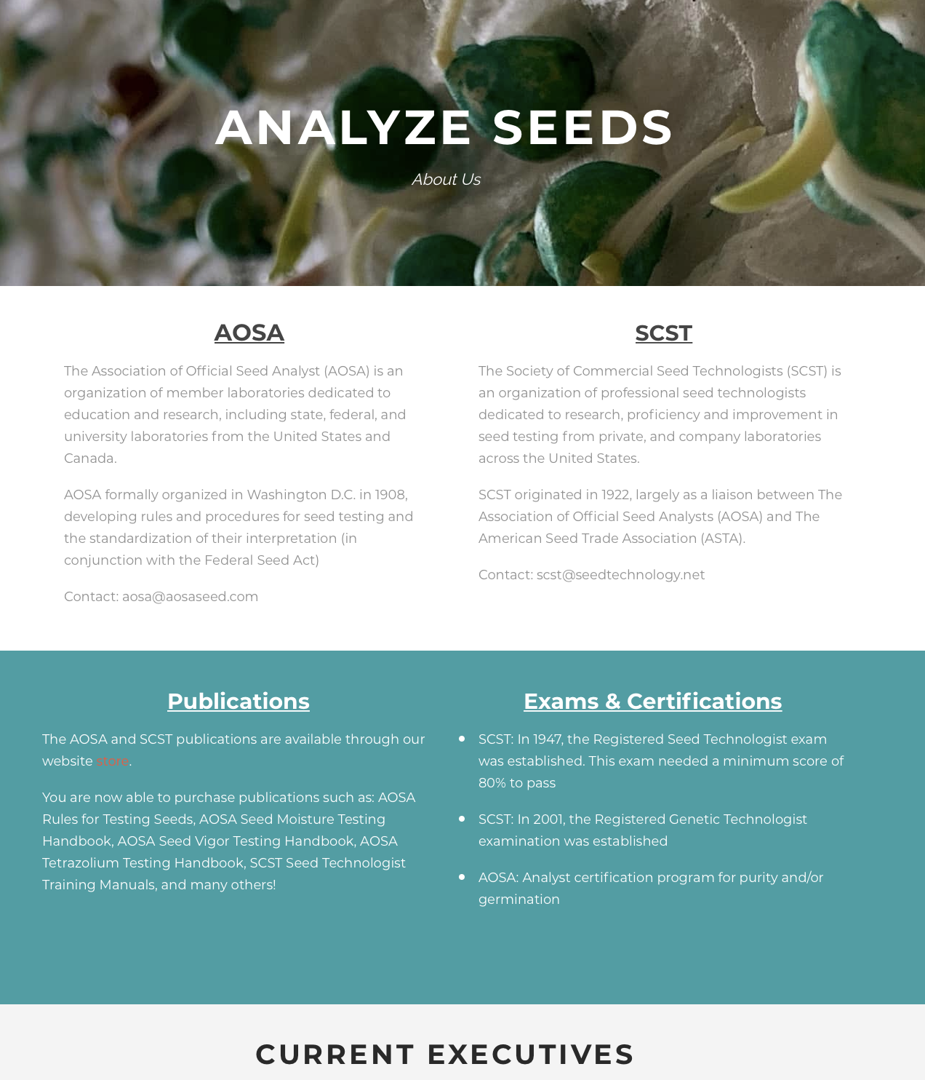
www.analyzeseeds.com
Recent Changes to the AOSA/SCST Website
Server upgrade to enhance the possibilities of more growth and visitation
Home Page houses all announcements, quick links and the latest newsletter
Complete update and revitalization
Ease of use for both members and non-members
More interactive with better ergonomics
Current & Ongoing Outreach
Online Membership
Translations of Manuals and Rules
International Membership Outreach

Slide 9
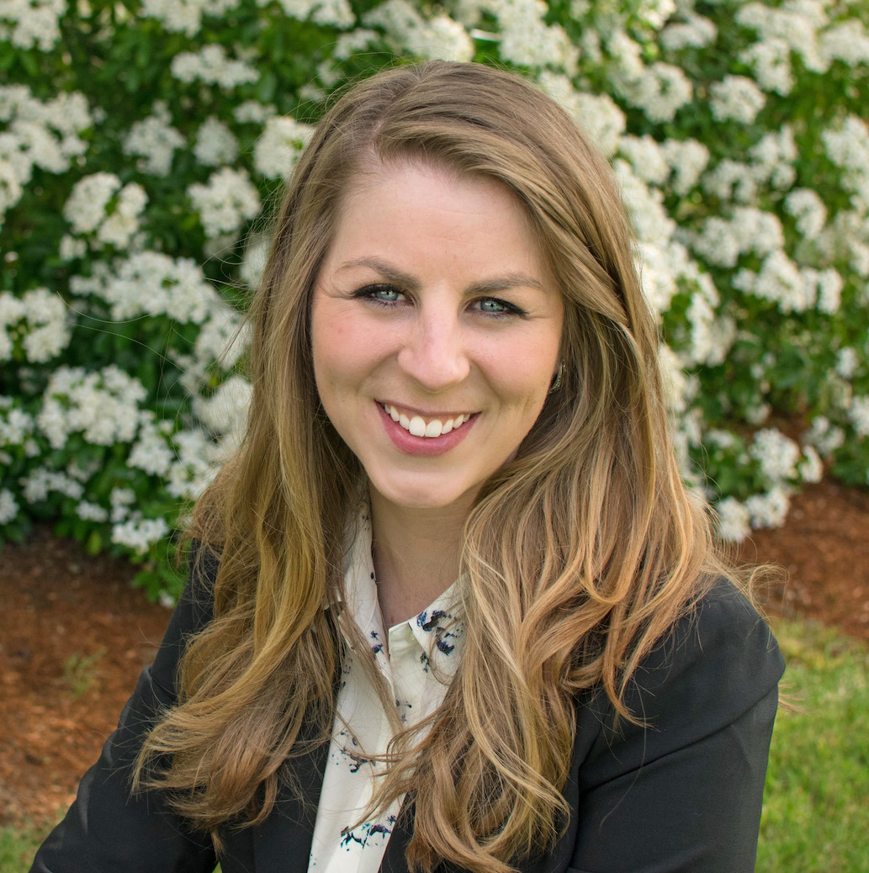
Launch of Educational Short Films
Communication and outreach is crucial for building awareness and understanding of the value of seed testing and the service that AOSA/SCST provides to it
Creating modernized communications is essential for viewer interest and engagement, especially younger audiences
Advancing training of seed testing methods
The launch of these short films will lend themselves to furthering the recognition and realization of the value of AOSA/SCST through up-to-date modes of communication
AOSA/SCST Staff, Mary Jo Foley-Birrenkott

Slide 10
Short Films
Visit us on YouTube for Understanding Seed Testing
AOSA and SCST
www.youtube.com
and search Seed Analysts
57 subscribers to date. There are four different episodes on Seed Testing including Germination, Purity and Dividing.

Slide 11
United Seed testing organization
USTO - Working Group
Currently focusing on the Uniformity Working Group and will reconvene soon.
We appreciate all the hard work that has been done on this!!

Slide 12
Uniformity Working Group
Germination
Developing a seedling image database to be used for training purposes
The memberships are participating in multiple surveys to determine the interpretation of seedlings
Purity & Contamination
A survey was sent to the memberships to better understand reporting purity & noxious weed examination results
Currently looking at the result of the survey and determining what the next steps are
Report of Analysis
An ROA guide was created as a useful resource
Provides an explanation of what information is needed on a seed label
Currently working on possible AOSA Rule proposals
Tetrazolium
Developing a TZ image database
To compile images and send a family or couples species out to the membership for their interpretation of viable or nonviable

Slide 13
AOSA Membership
2019
38 State lab members
4 USDA lab members
1 Canadian or CFIA Lab member
5 Associate lab members
2021
38 State lab members
4 USDA lab members
1 Canadian or CFIA Lab member
5 Associate lab members
VS

Slide 14
AOSA Publications
2019
2021
VS
Processed over 120 publication orders
to 7 different countries (Australia, Canada, South Korea, Philippines, Germany, China & Uruguay)
Processed over 103 publication orders to 5 different countries (Canada, New Zealand, Germany, South Africa & Australia)
2018 AOSA Rules: 55
2019 AOSA Rules: 14
Seed Moisture Testing Handbook: 9
2019 AOSA Rules Spanish: 1
Seed Vigor Testing Handbook: 6
Tetrazolium Testing Handbook: 12
Seed Moisture Testing Handbook: 2
Seed Vigor Testing Handbook: 9
Purity Testing Handbook: 58
Additional Print/Network Licenses: 39
Tetrazolium Testing Handbook: 9
Additional Print/Network Licenses: 3

Slide 15
Seed Today & Seed World
Shout out to Seed Today and Seed World for the collaboration with AOSA and communicating the importance of our Seed Analysts and what they do for not only our food supply but the forests, rangelands, grasslands and backyards.

Slide 16
Seed Today Article
A big Thank You to President Johnston for the outstanding column on who is AOSA and our partnerships.
“Protectors of the Promise”
“In 1908, a group of delegates from 16 states, the USDA, and the Canada Department of
Agriculture met in Washington, D. C. to consider standardization of seed testing methods
and the framing of a model seed law. One significant result of this meeting was the formation of
an organization known today as the Association of Official Seed Analysts.”
“So, who exactly is AOSA? Well, simply put, AOSA is a voluntary organization of government
agencies and institutions engaged in seed analysis, seed research, teaching, agricultural
extension, and/or crop certification.”
“An active seed regulatory compliance program is vital to protect and serve farmers and the
Seed Industry.”

Slide 17
NASDA 2020 Report
Submitted by President David M. Johnston, CSA/RST
Current AOSA membership numbers
United Seed Testing Organization (USTO)
AOSA/SCST publications available including the Spanish version of the AOSA Rules
Generous grants from the USDA AMS being used to develop short films to increase the
awareness of the important function of seed testing
Working to create a special bylaw provisions to address future situations when the
annual meeting cannot be held in person

Slide 18
2021 and Beyond
AOSA will participate in the following upcoming events/meetings:
Association of Seed Certifying Agencies (AOSCA)
June 22-23, 2021 - Virtual Annual Meeting
Seeds Canada
July 9-16, 2021 - Virtual Meeting
Association of American Seed Control Officials (AASCO)
July 13-14, 2021 – Virtual Annual Meeting
International Seed Testing Association (ISTA)
May 4-6, 2022, Seed Symposium Congress Christchurch, New Zealand
American Seed Trade Association (ASTA)
Dec 6-9, 2021, CSS & Seed Expo Chicago, Illinois
Jan 28-Feb 1, 2022, Vegetable & Flower Seed Conference San Diego, California
Western Seed Association Conference
Nov 3, 2021, Kansas City, Missouri

Slide 19
Sneak Peak…
Future Annual Meetings
2022 Evanston, Illinois (100th Anniversary for SCST)
June 4th-9th
Hilton Orrington/Evanston
1710 Orrington Ave; Evanston, IL 60201
2023 Saskatoon, Saskatchewan, Canada
June 10th-15th
Delta Hotels Saskatoon Downtown
405 20th Street East, Saskatoon, SK, S7K 6X6
2024 and Beyond: no locations are set yet due to COVID

Slide 20
Job Postings
Visit us on LinkedIn for industry related job postings
AOSA and SCST
www.linkedin.com/analyzeseeds
25 Job posts were utilized on the AOSA/SCST Website and LinkedIn from June 2020 to present. Each post is $130.00 split profit to both AOSA & SCST.

Slide 21
You’re Invited…
When: June 4-9, 2022
Where: Evanston, Illinois
Hilton Orrington/Evanston
Who: AOSA/SCST
2022 Annual Meeting

Slide 22
Keep up with AOSA
Follow/Like/Share/Watch!
AOSA and SCST
www.linkedin.com/analyzeseeds
AOSA and SCST
AOSA and SCST
www.youtube.com
Seed Analysts
@analyzeseeds
Connect with us via Twitter and Facebook to stay updated on events, news, job postings and more. In 2017, SCST and AOSA merged into one social media account.

