Slide 1
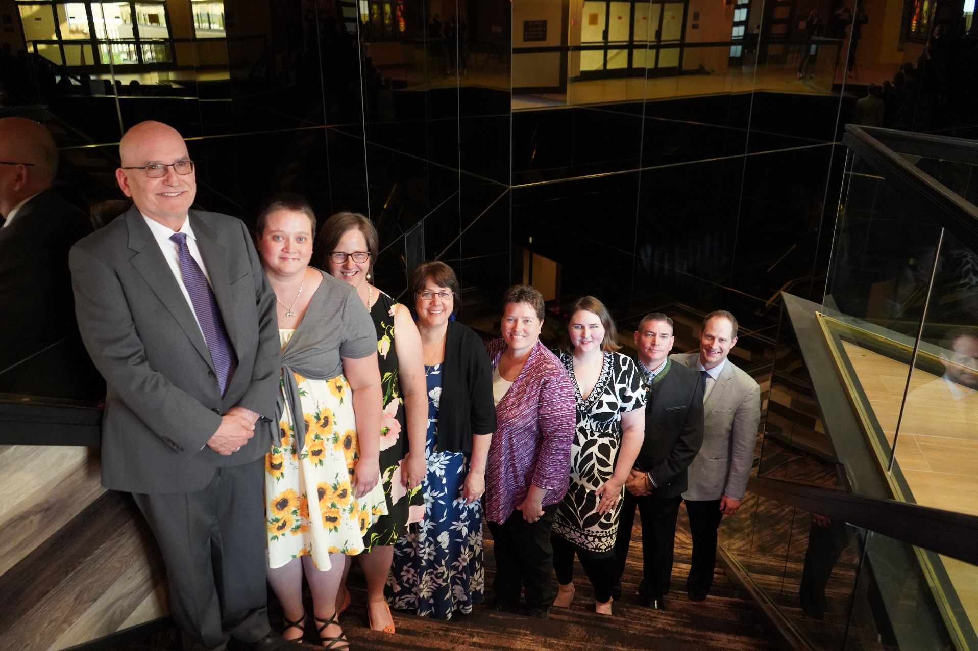
Society of Commercial
Seed Technologists
Notes:
Put picture of SCST in here.

Slide 2
2021 SCST
State of the Society

Slide 3
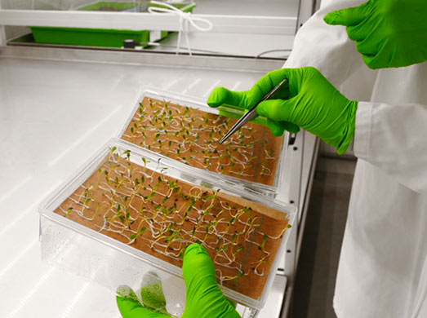
2020 & 2021 Year in Review

Slide 4
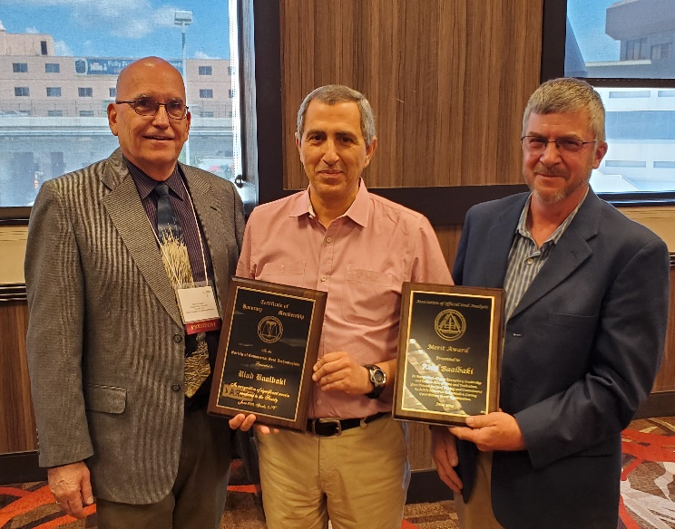
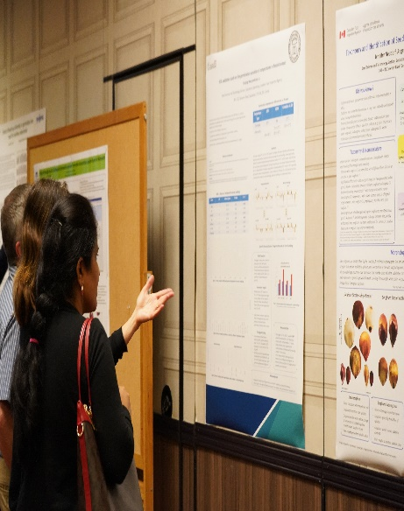
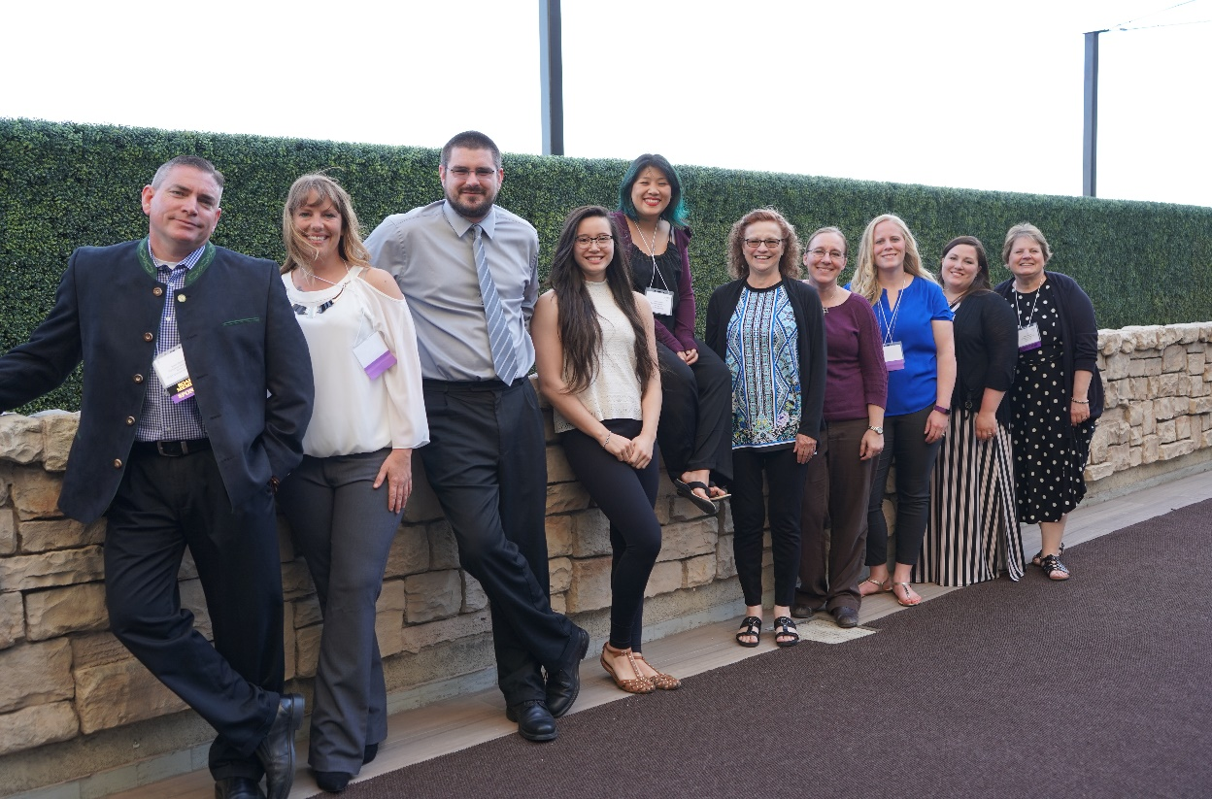
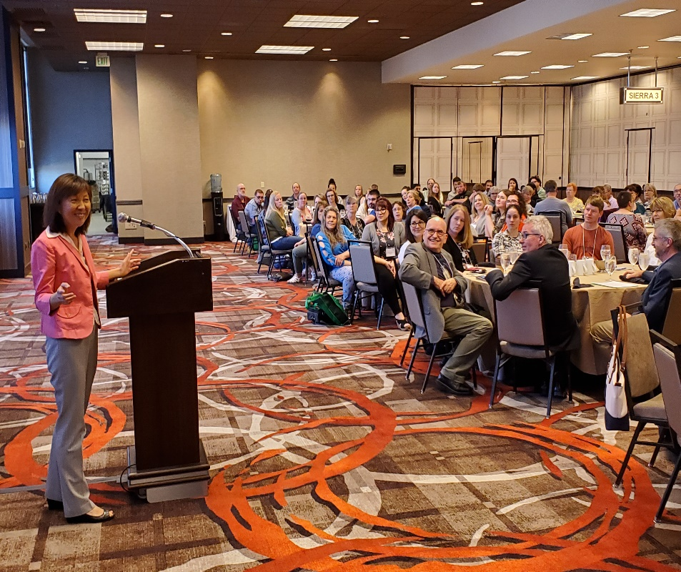
2019 AOSA/SCST Annual Meeting Sparks, Nevada

Slide 5
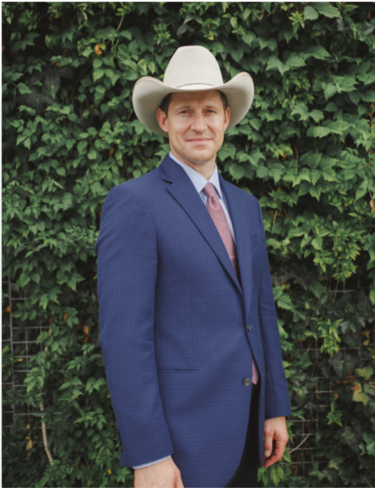
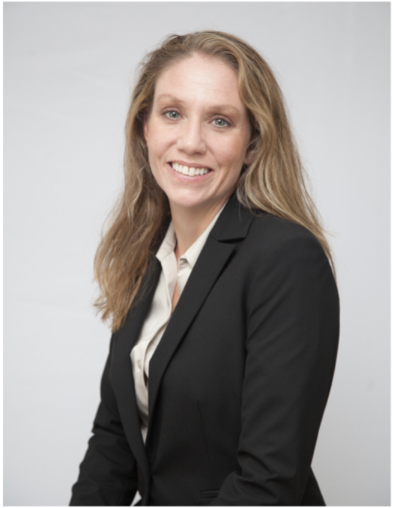
SCST Executive Office Report
Jess Peterson - SCST Executive Director
Oversees SCST Operations
Implements Programs and Policies
Annual Meeting Management
Ensures Budget Compliance
Outreach and Public Relations
Admin Support to Elected Officers
Kelly Polzin - SCST Director of Membership Services
Maintains Membership Services
Manages and Updates Seed Technologists Training Manual
Processes and Tracks Publication Orders
Manages Social Media and Email Inquiries
Manages Committee Activities
Maintains Exam Candidate Database

Slide 6
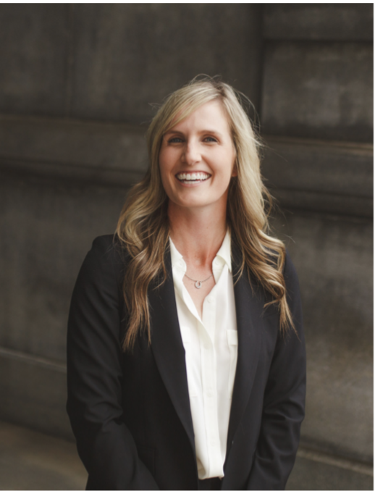
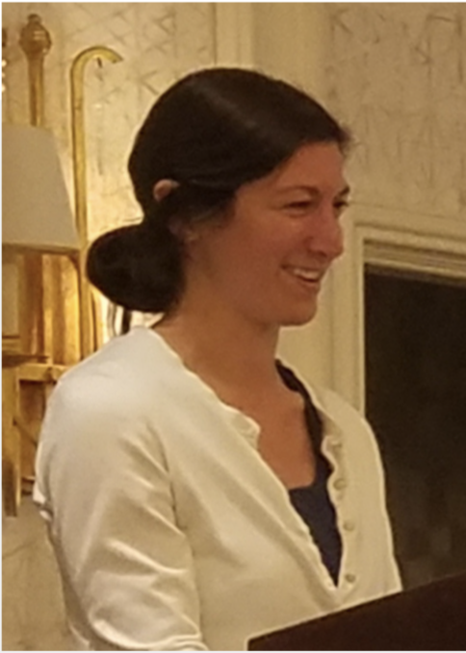
SCST Executive Office Report Cont.
Kelly Fogarty - AOSA Event Operations
Act as Liaison to Host/Local Planning Committees
Manage Negotiations and Requests From Host
Act as Liaison to Hotel Negotiator
Point of Contact for Annual Meeting
Provide Insight in Preparing Bids
Provide Consulting for Annual Meeting Tours
Kristin Albers - SCST Director of Finance
Manages Online Accounts Payable System
Manages Expense Reports
Scheduling of Outside Audits
Manages Cash Flow
Maintains Payment Information
Vendor Point of Contact

Slide 7
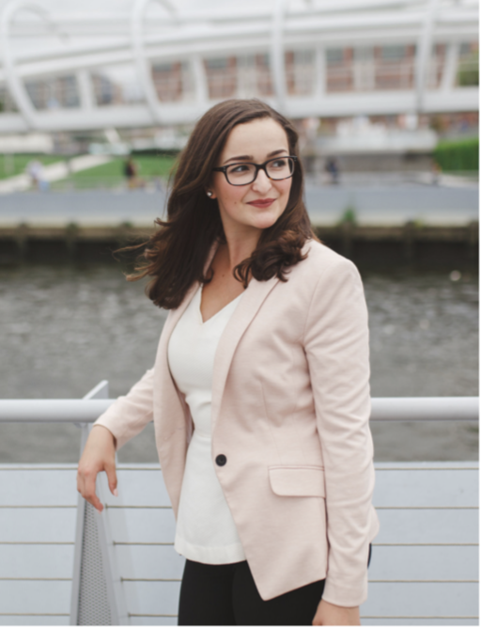
SCST Executive Office Report Cont.
Lia Biondo - SCST Membership & Public Outreach
Maintain Active Presence on Social Media
Job Posting Advertisement
Oversee Membership Communications
Draft Membership Announcements
Design Public Relations Materials
Draft Press Statements
Keith Sullivan - Website Manager
Maintains analyzeseeds.com websites
Regulate and Manage Access Rights
Manage Online Membership Services
Troubleshoot Performance Issues and Ensure Functionality
Manage Publication Store
Liaison Between Hosting Company and Organization

Slide 8
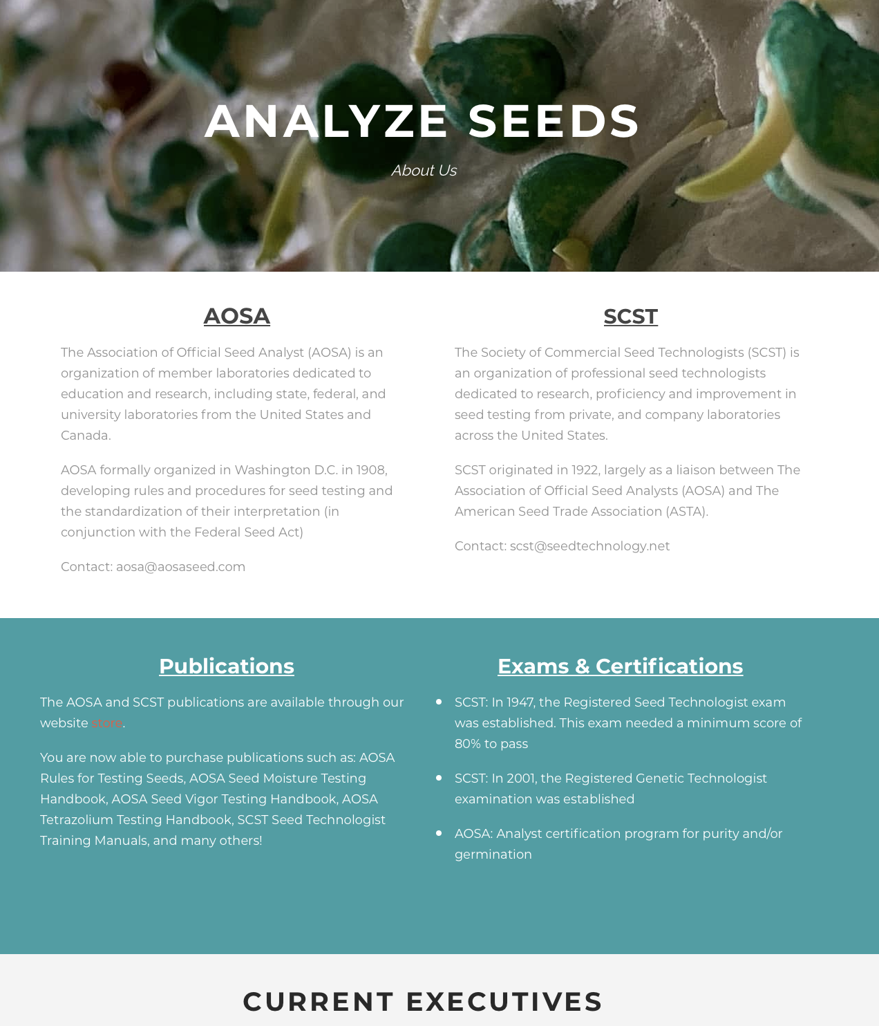
www.analyzeseeds.com
Recent Changes to the AOSA/SCST Website
Server upgrade to enhance the possibilities of more growth and visitation
Home Page houses all announcements, quick links and the latest newsletter
Complete update and revitalization
Ease of use for both members and non-members
More interactive with better ergonomics
Current & Ongoing Outreach
Online Membership Management
Translations of Manuals and Rules
International Sales

Slide 9
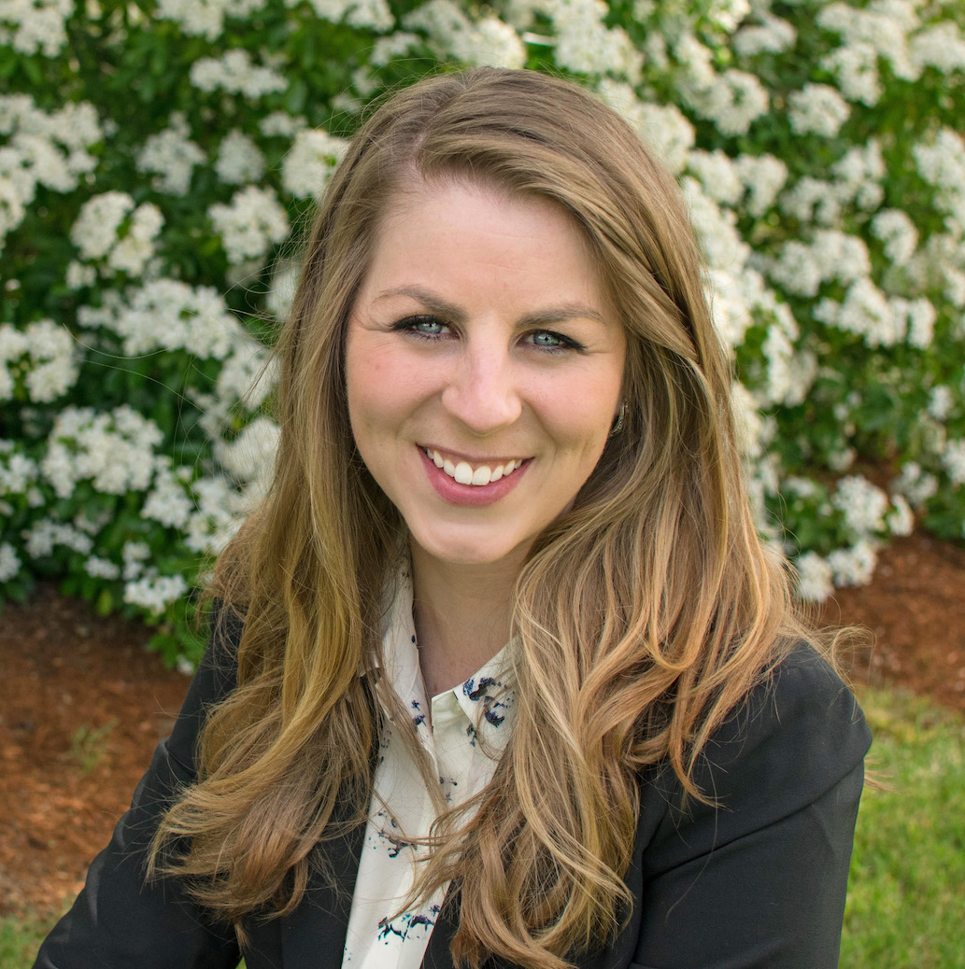
Launch of Educational Short Films
Communication and outreach is crucial for building awareness and understanding of the value of seed testing and the service that AOSA/SCST provides to it
Creating modernized communications is essential for viewer interest and engagement, especially younger audiences
Advancing training of seed testing methods
The launch of these short films will lend themselves to furthering the recognition and realization of the value of AOSA/SCST through up-to-date modes of communication
AOSA/SCST Staff, Mary Jo Foley-Birrenkott

Slide 10
Short Films
Visit us on YouTube for Understanding Seed Testing
AOSA and SCST
www.youtube.com
And search Seed Analysts
57 subscribers to date. There are four different episodes on Seed Testing including Germination, Purity and Dividing.

Slide 11
United Seed Testing Organization
USTO - Working Group
Currently focusing on the Uniformity Working Group and will reconvene soon
We appreciate all the hard work that has been done on this!!

Slide 12
Uniformity Working Group
Germination
Developing a seedling image database to be used for training purposes
The memberships are participating in multiple surveys to determine the interpretation of seedlings
Purity &
Contamination
A survey was sent to the memberships to better understand reporting purity & noxious weed examination results
Currently looking at the result of the survey and determining what the next steps are
Report of Analysis
An ROA guide was created as a useful resource
Provides an explanation of what information is needed on a seed label
Currently working on possible AOSA Rule proposals
Tetrazolium
Developing a TZ image database
To compile images and send a family or couples species out to the membership for their interpretation of viable or nonviable

Slide 13
SCST Membership
2019
VS
2021
124 RST
16 CVT
26 RGT
10 CGT
4 Research Members
4 Professional Members
86 Associate Members
110 RST
9 CVT
17 RGT
9 CGT
3 Research Members
3 Professional Members
102 Associate Members

Slide 14
SCST Publications
2019
VS
2021
2002 What Is Seed Vigor CD: 0
2016 Seed Technologist Training Manual Chapter 14: 0
(No manuals were sold due to the chapter being added to the 2018 edition)
2018 Seed Technologist Training Manual: 10
(This included a price increase from $185 to $300 due to the large content and information this edition holds)
2002 What Is Seed Vigor CD: 0
2016 Seed Technologist Training updated Manual Chapter 14: 1
2018 Seed Technologist Training Manual: 11
2018 Seed Technologist Training Manual Spanish: 1

Slide 15
Seed Today & Seed World
Shout out to Seed Today and Seed World for the collaboration with SCST and communicating the importance of our Seed Technologists and what they do for not only our food supply but the forests, rangelands, grasslands and backyards.

Slide 16
Seed Today Article
A big Thank You to President Larson for the outstanding column focusing on support in uniformity industry wide.
“All four organizations (ASTA, AASCO, AOSA & SCST) are continuing to support each other down this adventure and will continue to support each other for the years to come”

Slide 17
2021 AND BEYOND
SCST will participate in the following upcoming events/meetings:
Association of Seed Certifying Agencies (AOSCA)
June 22-23, 2021 - Virtual Annual Meeting
Seeds Canada
June 9-16, 2021 - Virtual Meeting
Association of American Seed Control Officials (AASCO)
July 13-14, 2021 – Virtual Annual Meeting
International Seed Testing Association (ISTA)
May 4-6, 2022, Seed Symposium Congress Christchurch, New Zealand
American Seed Trade Association (ASTA)
Dec 6-9, 2021, CSS & Seed Expo Chicago, Illinois
Jan 28-Feb 1, 2022, Vegetable & Flower Seed Conference San Diego, California
Western Seed Association Conference
Nov 3, 2021, in Kansas City, Missouri

Slide 18
Sneak Peak…
Future Annual Meetings
2022 Evanston, Illinois (100th Anniversary for SCST)
June 4th-9th
Hilton Orrington/Evanston
1710 Orrington Ave; Evanston, IL 60201
2023 Saskatoon, Saskatchewan, Canada
June 10th-15th
Delta Hotels Saskatoon Downtown
405 20th Street East, Saskatoon, SK, S7K 6X6
2024 and Beyond: no location are set yet due to COVID

Slide 19
Job Postings
Visit us on LinkedIn for industry related job postings
AOSA and SCST
www.linkedin.com/analyzeseeds
25 Job posts were utilized on the AOSA/SCST Website and LinkedIn from June 2020 to present. Each post is $130.00 split profit to both AOSA & SCST.

Slide 20
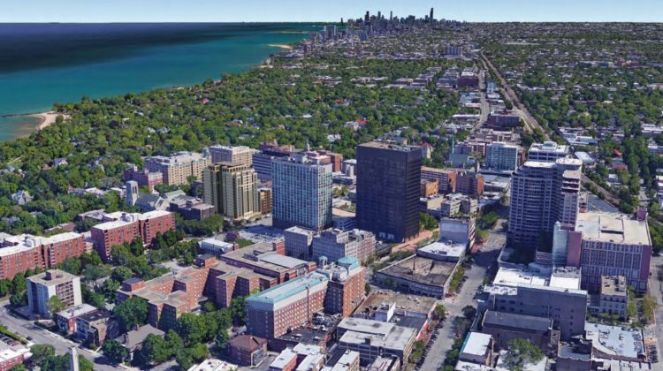
You’re Invited…
When: June 4-9, 2022
Where: Evanston, Illinois
Hilton Orrington/Evanston
Who: AOSA/SCST
2022 Annual Meeting

Slide 21
Keep up with SCST
Connect with us via Twitter and Facebook to stay updated on events, news, job postings and more.
Follow/Like/Share/Watch!
AOSA and SCST
AOSA and SCST
www.linkedin.com/analyzeseeds
@analyzeseeds
AOSA and SCST
www.youtube.com
Seed Analysts

