Slide 1
Society of Commercial Seed Technologists

Slide 2
2015 SCST State of the Society
Neal Foster
President
2015 SCST Annual Meeting
Tampa Bay, Florida
Notes:
Will add more space in the PowerPoint to showcase any specific numbers, numbers, or other types of timelines and specifications

Slide 3
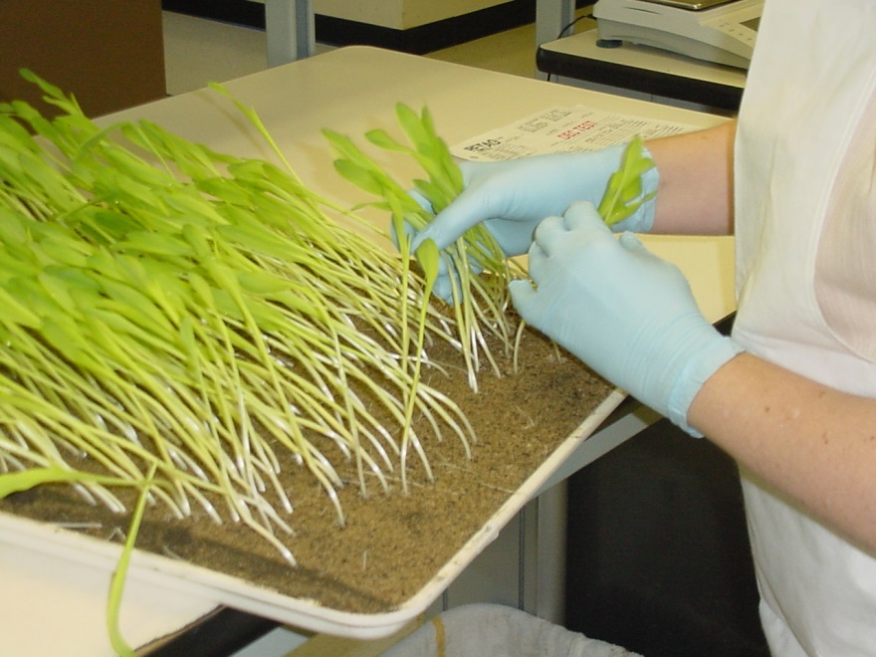
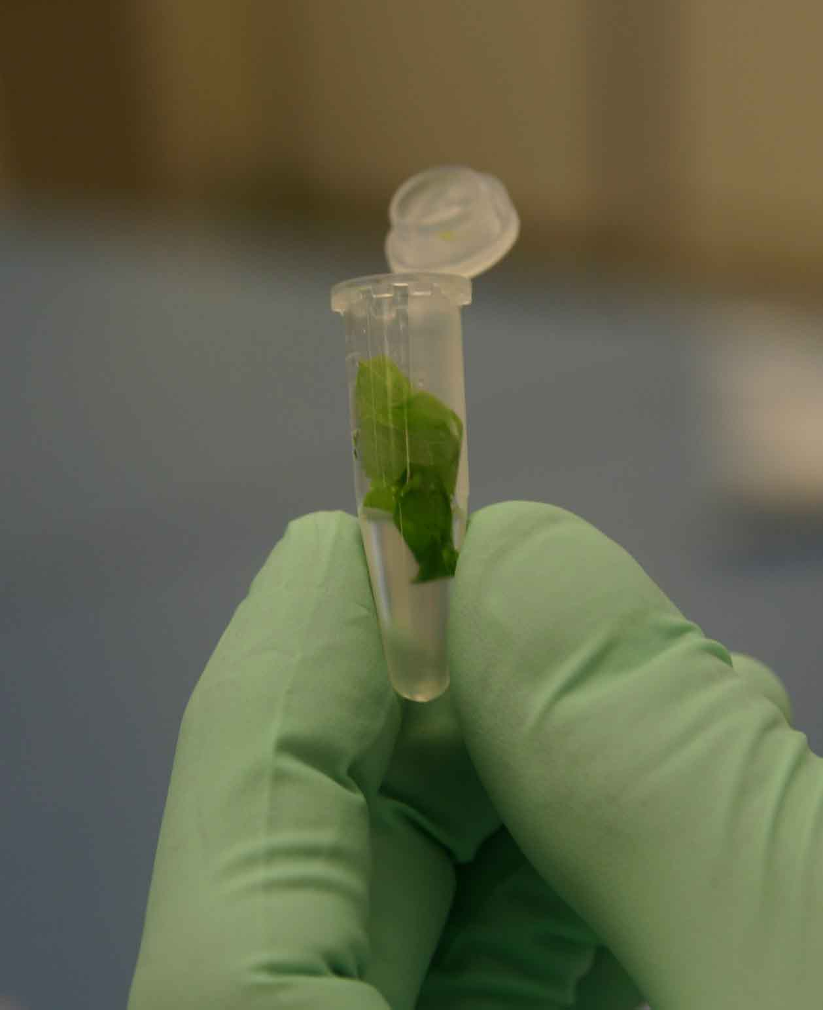
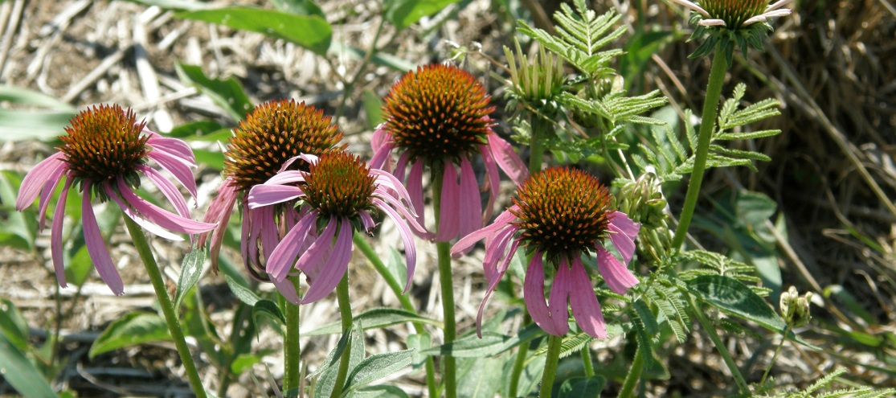
2014 in Review

Slide 4
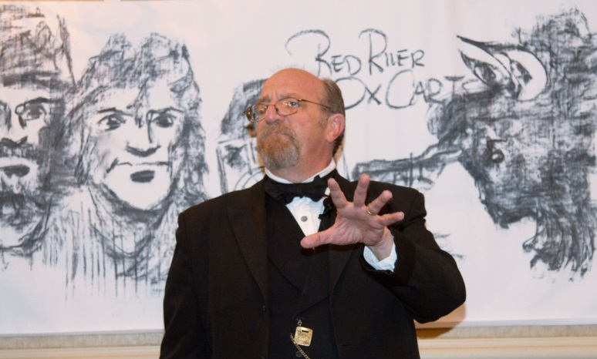
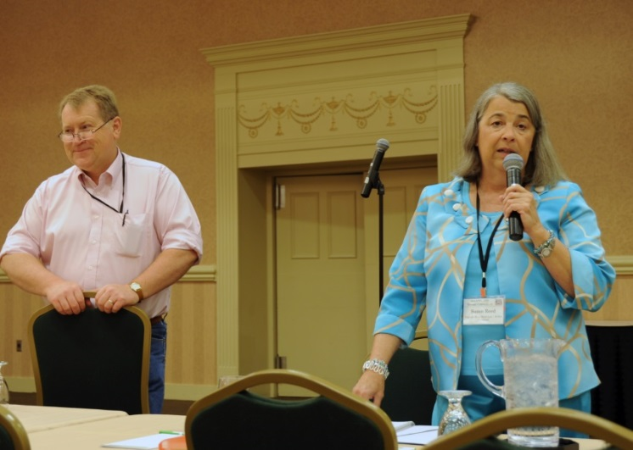
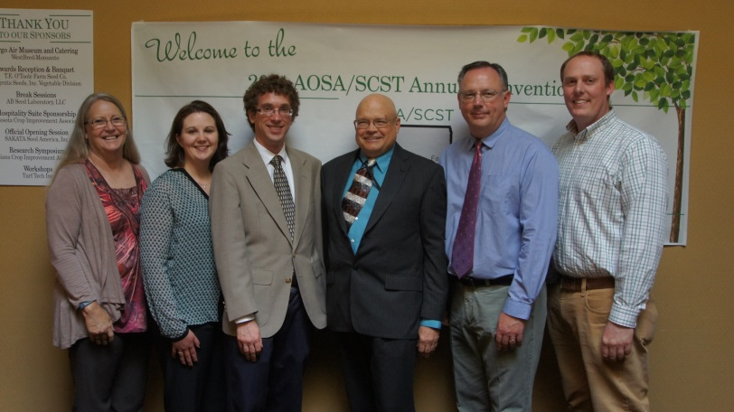
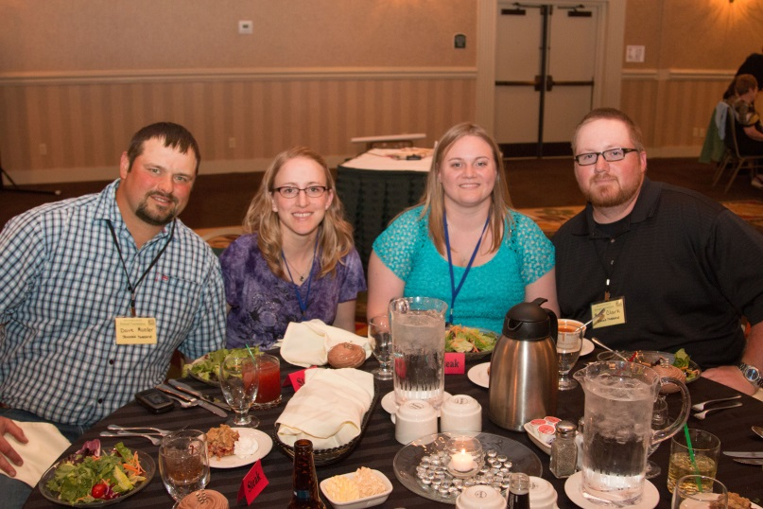
AOSA/SCST Annual Meeting; Fargo, ND

Slide 5
USDA Stakeholders Meeting
USDA Agricultural Marketing Service (AMS) hosted the inaugural “Seed Industry Sector Stakeholder Meeting” on Jan. 12, 2015; goal of continuing inter-industry and inter-agency dialogue.

Slide 6
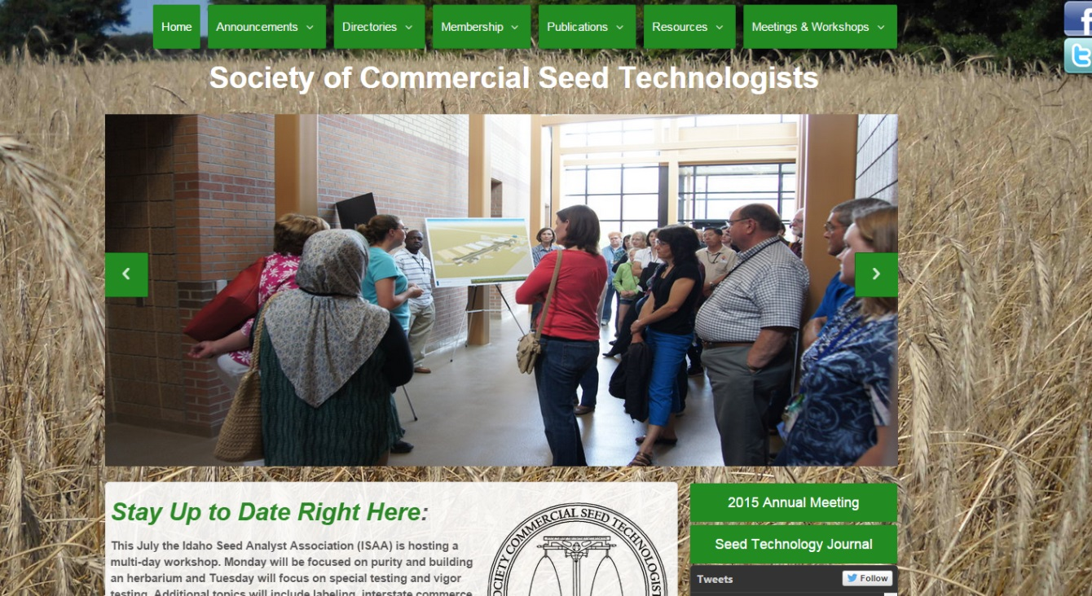
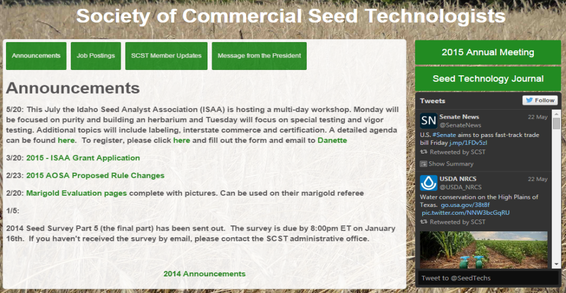
SCST Website
SCST Website Task Force directed the development and August 2014 launch of the redesigned SCST website.

Slide 7
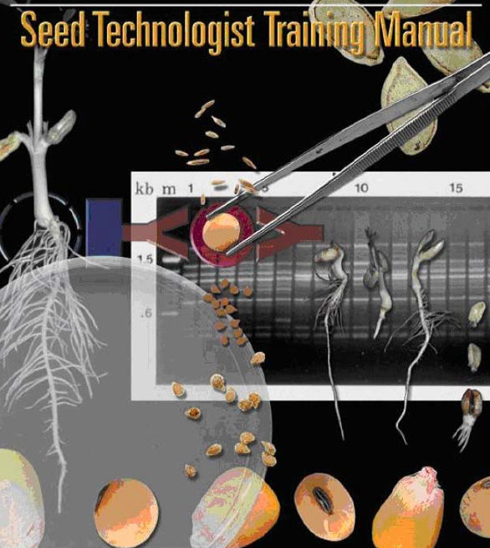
SCST Publications
Seed Technologist Training Manual: 17 orders
What is Seed Vigor?: 2 orders

Slide 8
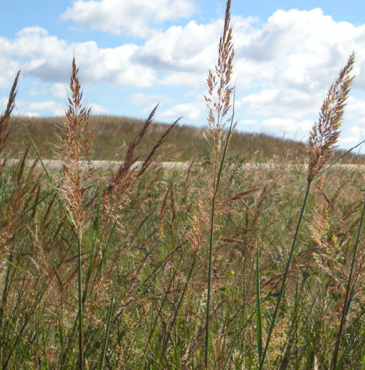
Native Seed Discussion Continues
April 2015: SCST conducted meetings with with ASTA President, Andy LaVigne; VP of Gov’t & Regulatory Affairs Jane DeMarchi; SDSU VP for Research & Economic Development Kevin Kephart
Path forward: A native seed symposium to be hosted by SCST in conjunction with an industry partner meeting/other format

Slide 9
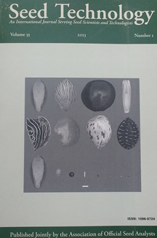
Joint Publications Task Force
AOSA & SCST Publications Task Force created to streamline communication between AOSA & SCST and the Seed Technology Journal Committee.
Task force is comprised of executive board members from both AOSA & SCST and focuses on promptly addressing publications issues.

Slide 10
SCST Membership Numbers
189 RSTs/CVTs/CPTs
10 CGTs/RGTs
49 Associate Members

Slide 11
Keep up with SCST We want to hear from you!
SCST is now on social media!
Connect with us via Twitter and Facebook to stay updated on events, news, and more. Want to share your pictures with the membership? Send them our way. We are here for you.
Society of Commercial Seed Technologists
@SeedTechs

Slide 12
2015 and Beyond
SCST will participate in the following upcoming events/meetings:
2015 OECD Annual Meeting Paris, France, June 4th – 5th
ASTA 132st Annual Convention Washington, DC, June 17th – 20th
2015 ISTA Annual Meeting Montevideo, UY, June 15th – June 18th
2015 AOSCA Annual Meeting Vancouver, BC, June 21st – 24th
2015 AASCO Annual Conference St. Louis, MO, July 12th – 16th
2015 Western Seed Conference Kansas, City, MO, November 7- 10th

Slide 13
2016 AOSA/SCST Annual Meeting
Vancouver, WA June 3-9

