Slide 1
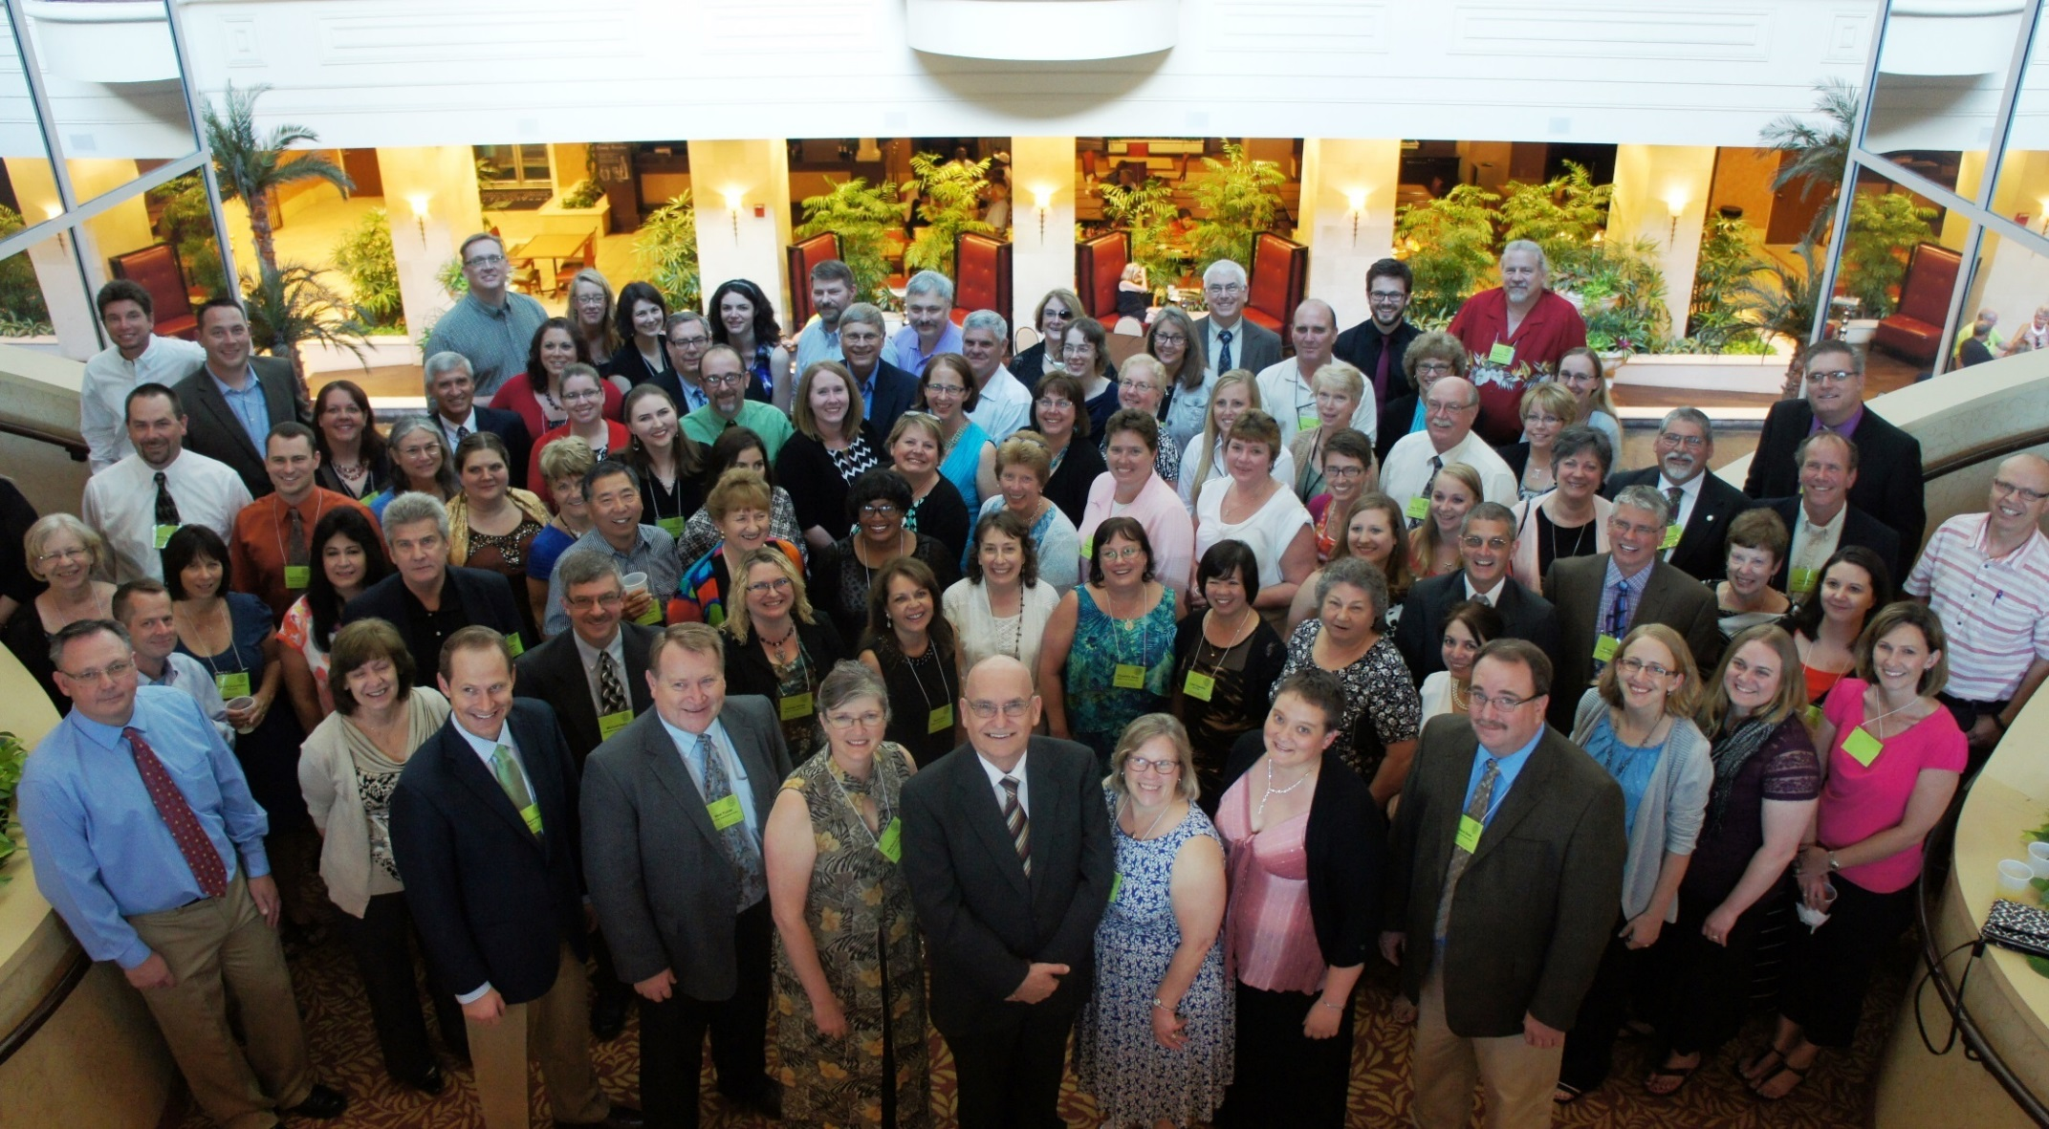
Society of Commercial Seed Technologists
Notes:
Put picture of SCST in here.

Slide 2
2016 SCST
State of the Association
Barbara L. Cleave
President
2016 SCST Annual Meeting
Portland, Oregon

Slide 3
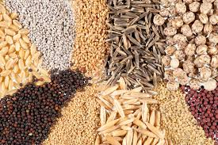
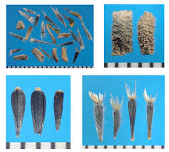
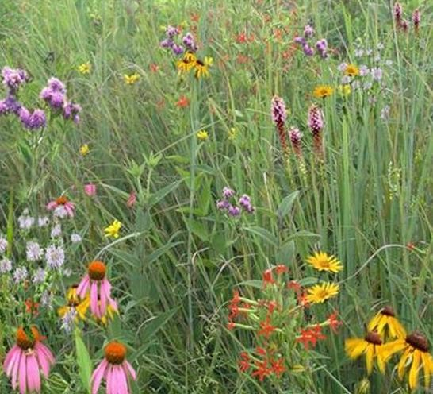
2015 Year in Review

Slide 4
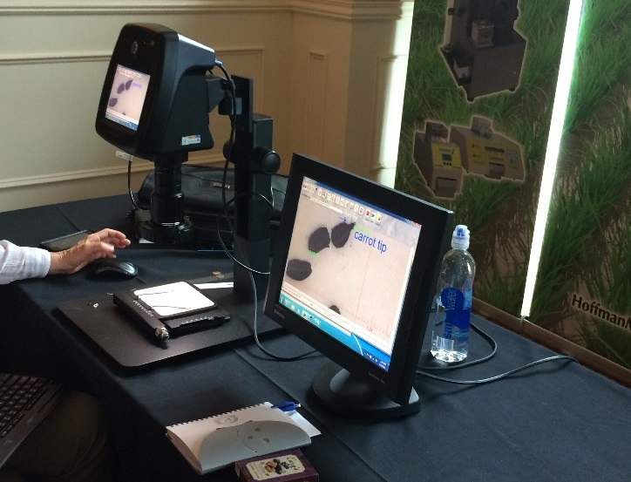
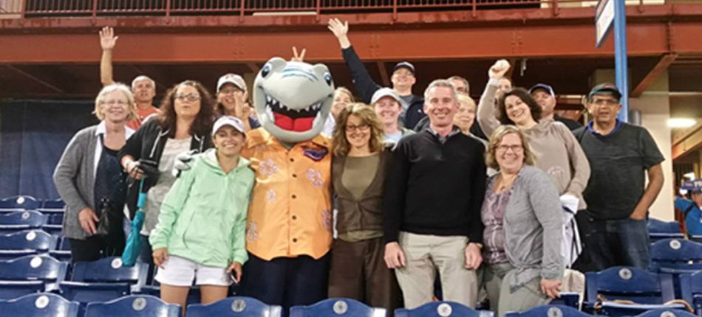
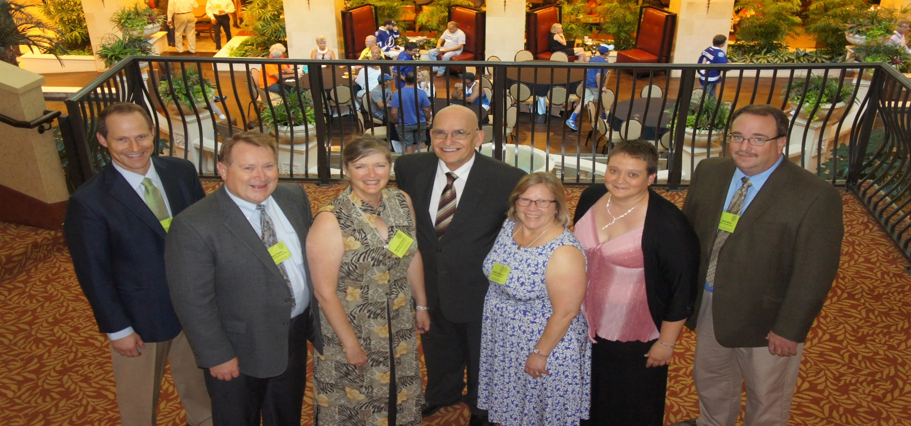
2015 AOSA/SCST Annual Meeting Tampa Bay, FL

Slide 5
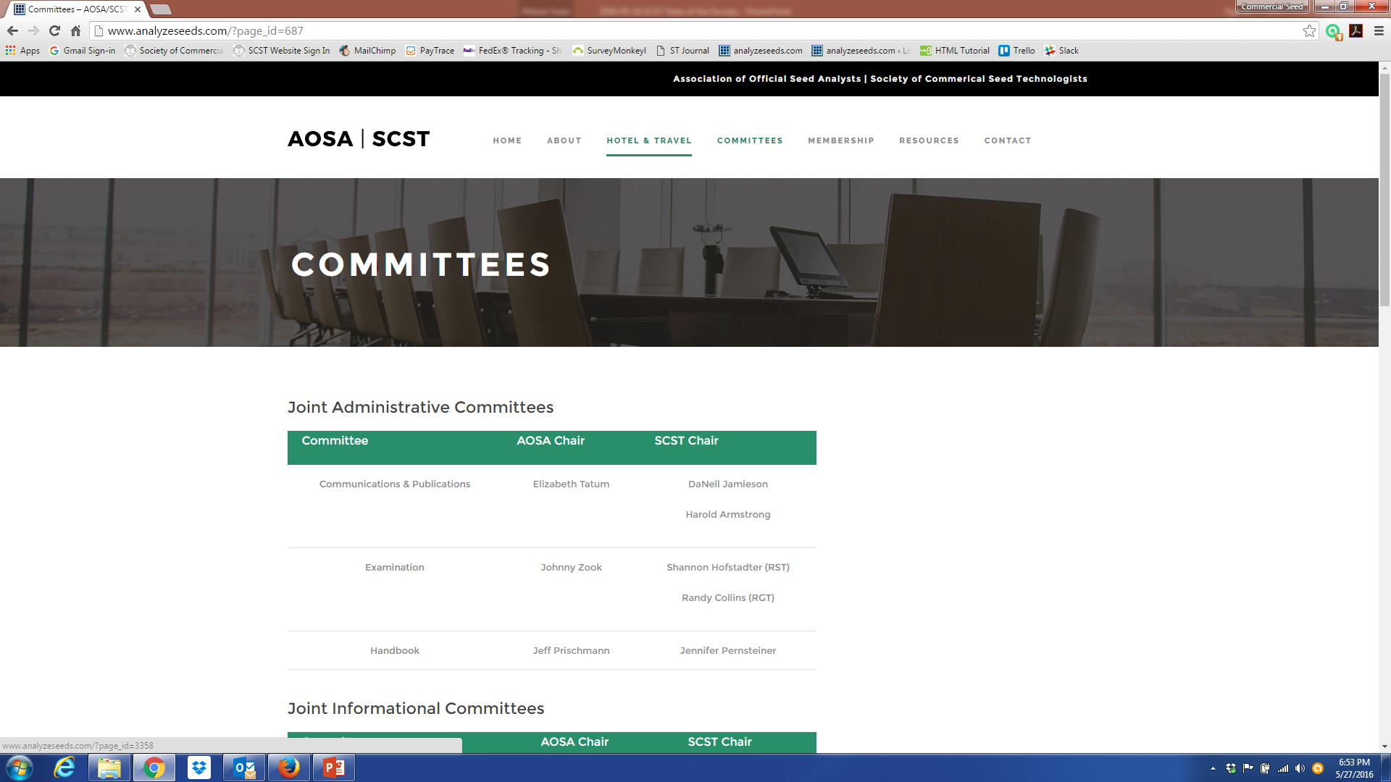
AOSA/SCST Joint Website
The AOSA/SCST
Business office along
with the help of the
Board of Directors
and membership
Directed the
development and
February 2016 launch
of the joint
SCST/AOSA Website.

Slide 6
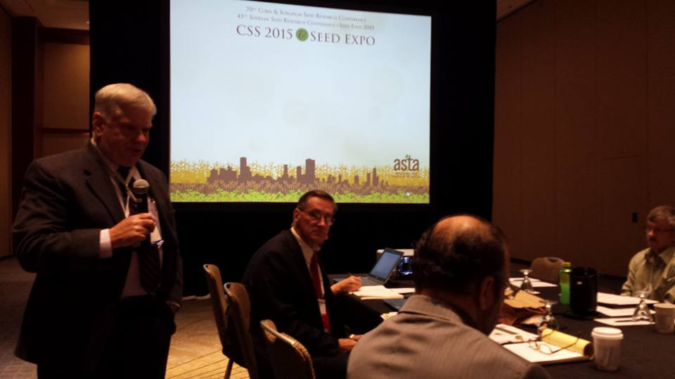
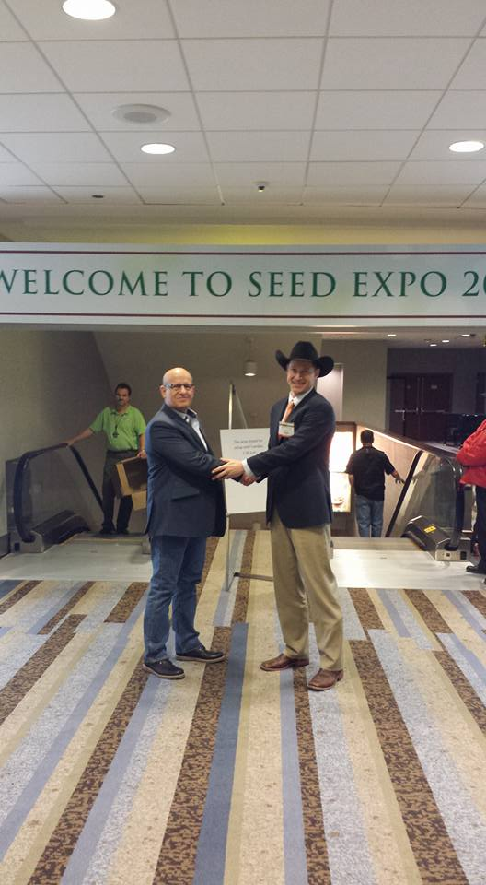
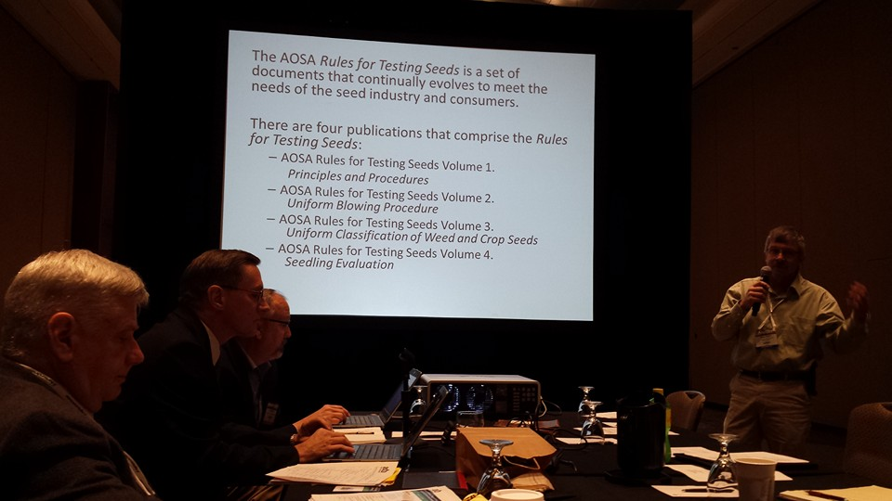
ASTA CSS & Seed Expo

Slide 7
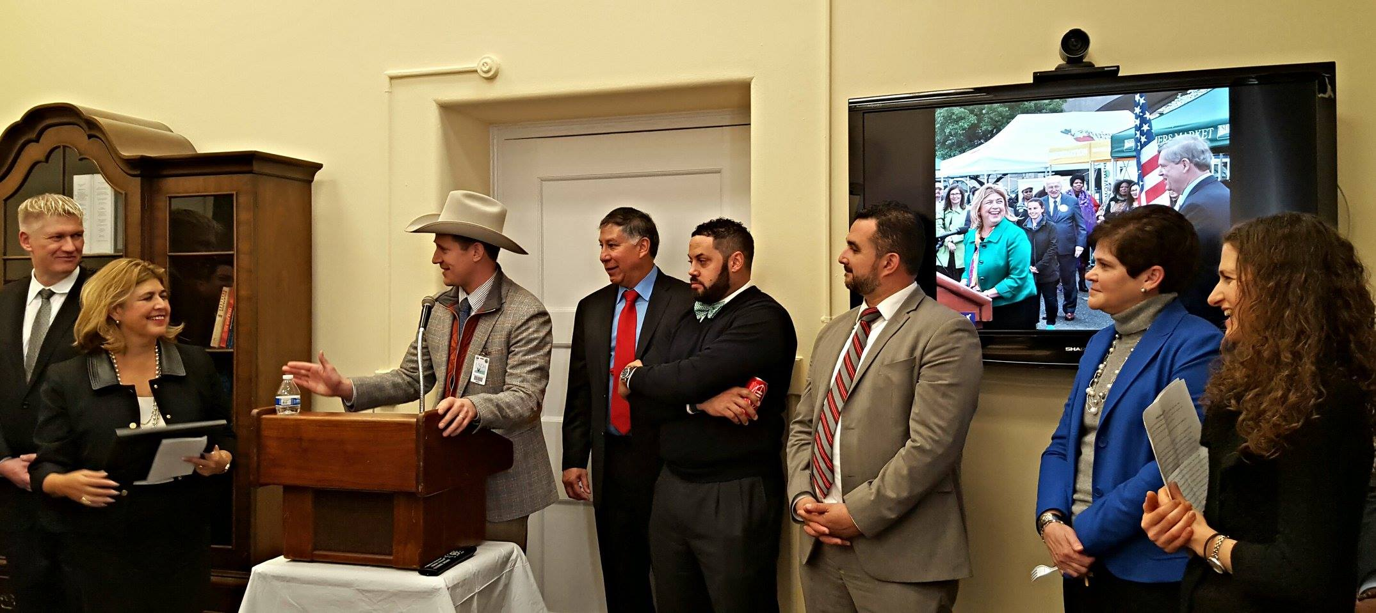
Industry Relations

Slide 8
SCST Publications
Seed Technologist Training Manual: 8 orders
Seed Technologist Training Manual 2016 updated
Chapter 14: 7 orders
Seed Technology DVD four volume set: 1 order

Slide 9
SCST Membership
139 RST
17 CVT/CPT
29 RGT
14 CGT
6 Research Members
44 Associate Members

Slide 10
Keep up with SCST
SCST is now on social media!
Connect with us via Twitter and Facebook to stay updated on events, news, and more. Want to share your pictures with the membership? Send them our way.
We are here for you.
Society of Commercial Seed Technologists
@SeedTechs

Slide 11
2016 and Beyond
AOSA will participate in the following upcoming events/meetings:
2016 OECD Annual Meeting
Paris, France June 9th – 10th
31st ISTA Congress
Tallinn, Estonia, June 15th – 21st
ASTA 133rd Annual Convention
Portland, Oregon, June 18th - 22nd
2016 AOSCA Annual Meeting
Park City, Utah, June 26th - 29th
2016 AASCO Annual Meeting
Kalispell, Montana, July 10th - 14th
2016 Western Seed Conference
Kansas City, Missouri, November 5th – 8th

Slide 12
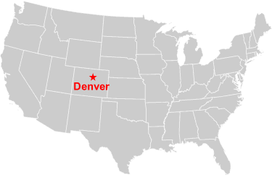
2017 AOSA/SCST/ISTA Annual Meeting
You’re Invited…
When: June 17-22, 2017
Where: Denver Renaissance Hotel
Denver, Colorado
Who: Joint Meeting with AOSA, SCST, & International Seed Testing Association (ISTA)

