Slide 1
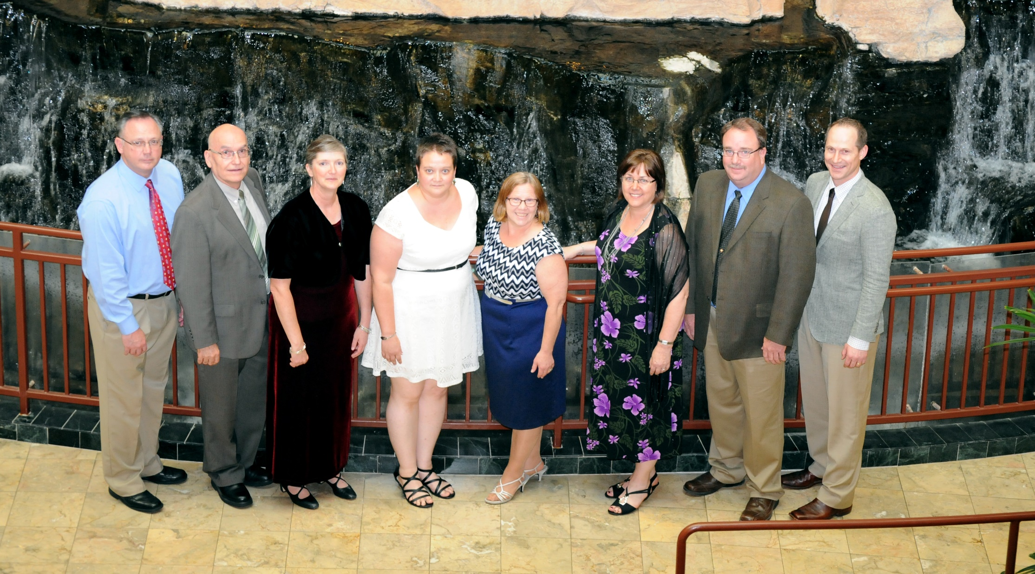
Society of Commercial Seed Technologists
Notes:
Put picture of SCST in here.

Slide 2
2017 SCST
State of the Society
Barbara L. Cleave
President
2017 SCST Annual Meeting
Denver, Colorado

Slide 3
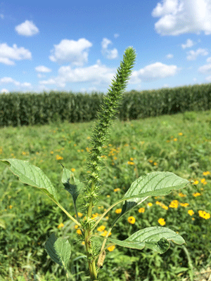
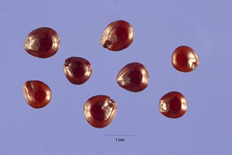
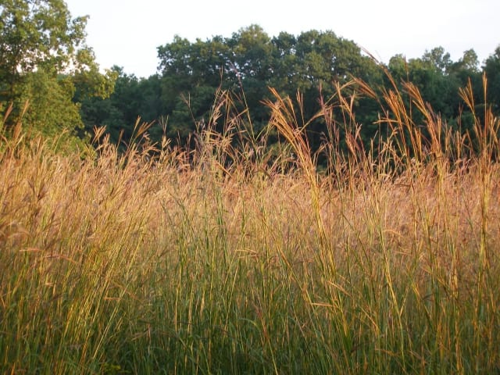
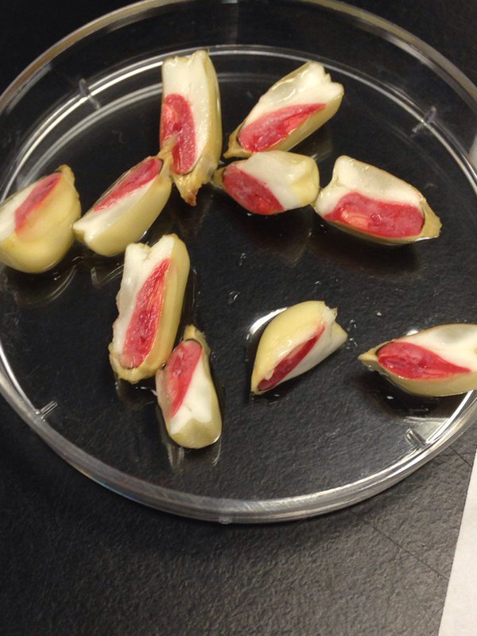
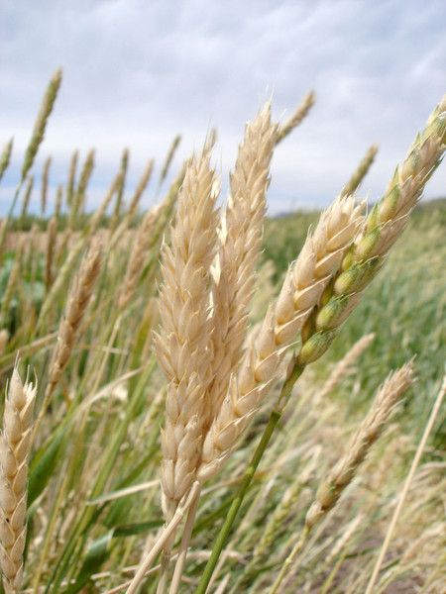
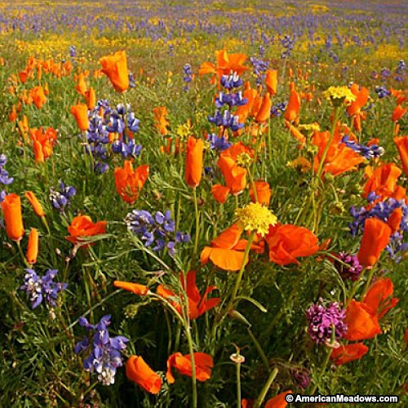
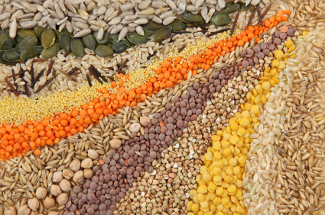
2016 Year in Review

Slide 4
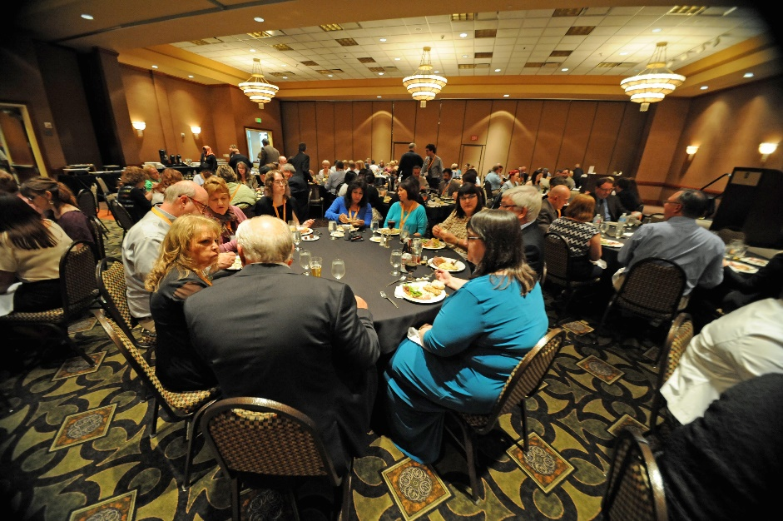
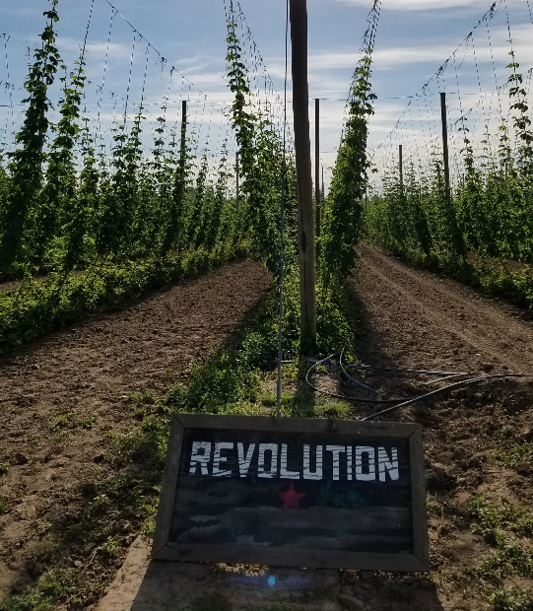
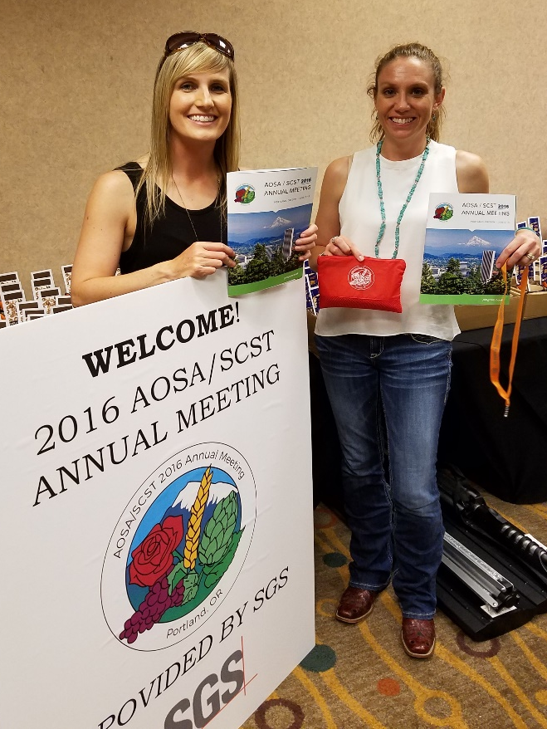
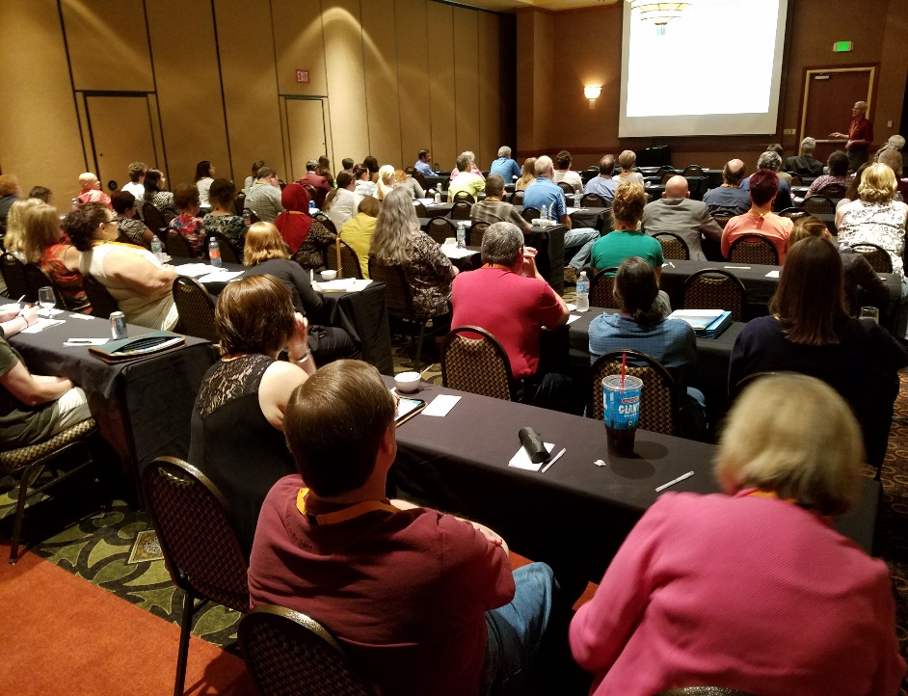
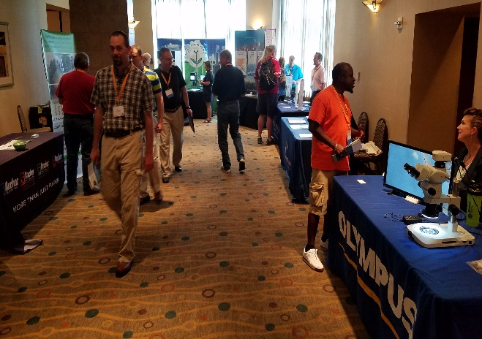
2016 AOSA/SCST Annual Meeting Portland, Oregon

Slide 5
Industry Relations
March 2017 a cooperative agreement
between the Agricultural Marketing Service
United States Department of Agriculture and
AOSA was signed. Funding was provided for
management of all AOSA SCST ISTA 2017
Annual Meeting Logistics and utilization for
the translation of the AOSA Rules.

Slide 6
SCST Events
September 2016
Seed Identification tool that was developed by the Seed Science and Technology section, CFIA Saskatoon Laboratory, was posted on the analyzeseeds.com website for use.
March 2017
Wild Species Working group (an International collaboration) was formed focusing on the 2017 Annual Meeting Native Seed Testing Workshop concentrating on procedures, intricacies and importance of consistency in native seed testing of Native Seed. The focus will now shift to a virtual handbook production.
2017
The revised Seed Technology Training Manual with the 2016 revised Chapter 14 (Genetic Testing) will be available for purchase.

Slide 7
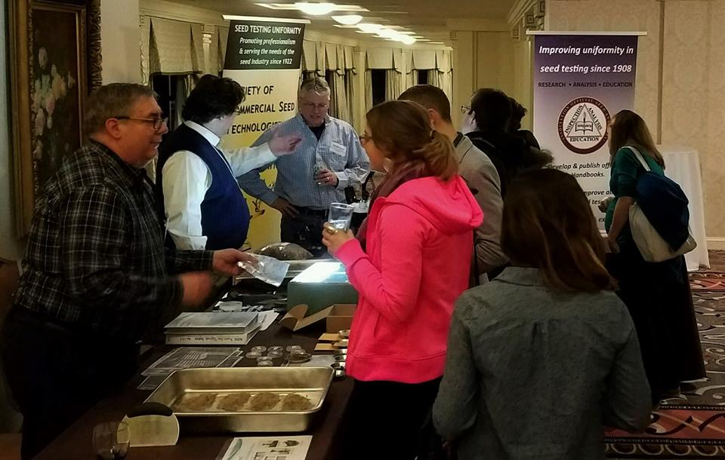
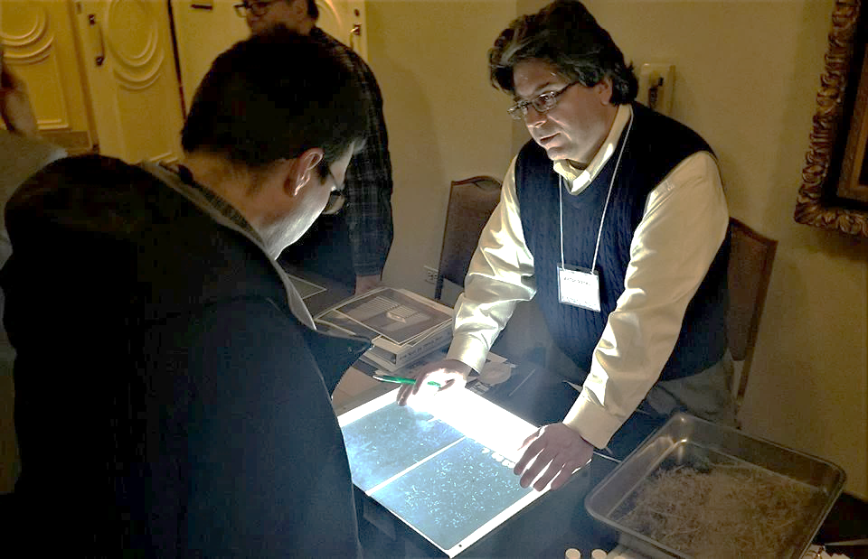
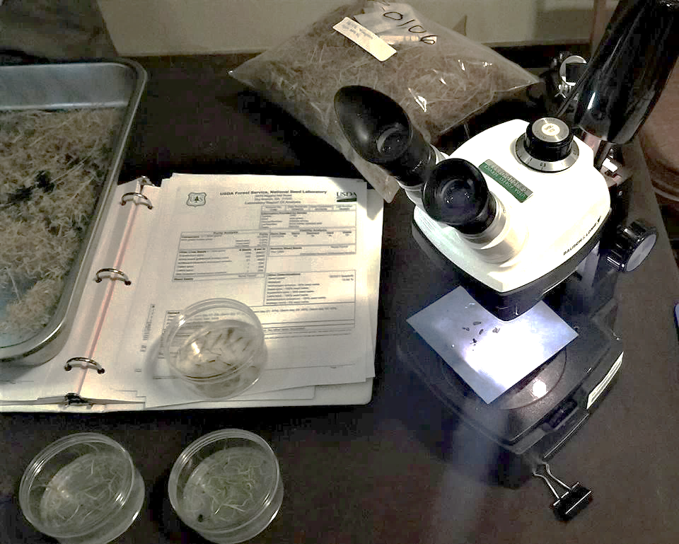
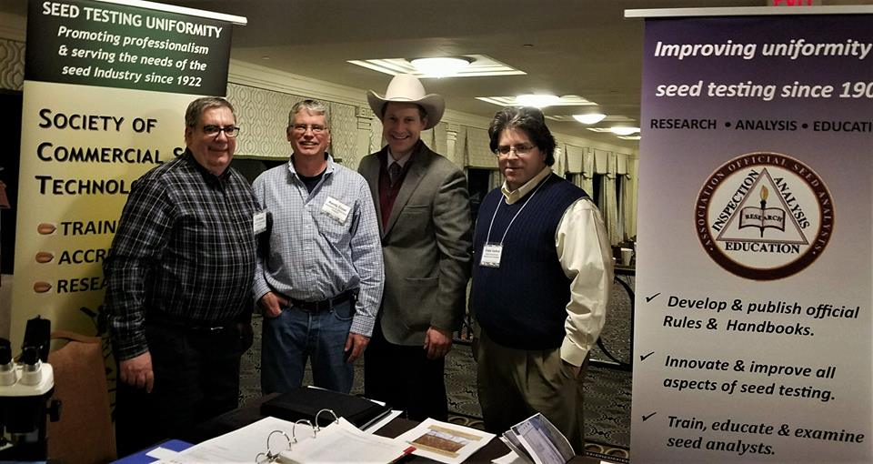
National Native Seed Conference

Slide 8
SCST Publications
Seed Technologist Training Manual: 4 orders
Seed Technologist Training Manual 2016 updated
Chapter 14: 2 orders
Seed Technology DVD four volume set: 2 orders

Slide 9
SCST Membership
136 RST
16 CVT/CPT
30 RGT
10 CGT
5 Research Members
49 Associate Members

Slide 10
Keep up with SCST
Connect with us via Twitter and Facebook to stay updated on events, news, job postings and more.
In 2017, SCST and AOSA will merge into one social media account. Stay tuned for more information.
Follow/Like/Share!
Society of Commercial Seed Technologists
@SeedTechs

Slide 11
2017 and Beyond
AOSA will participate in the following upcoming events/meetings:
Association of American Seed Control Officials (AASCO)
Charlotte, NC July 16th – 20th
Organization for Economic Cooperation and Development (OECD)
Prague, Czech Republic June 26th – 30th
Western Seed Association Conference
Kansas City, MO November 4th – 7th

Slide 12
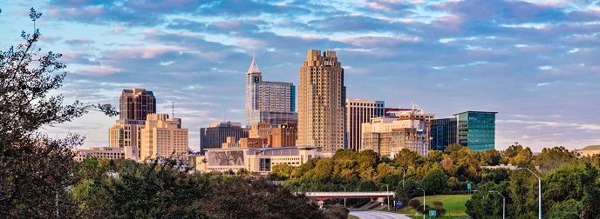
2017 AOSA/SCST Annual Meeting
You’re Invited…
When: June 2-8, 2018
Where: Hilton North Raleigh, North Carolina
Who: AOSA & SCST Members
2018 Annual Meeting

