Slide 1
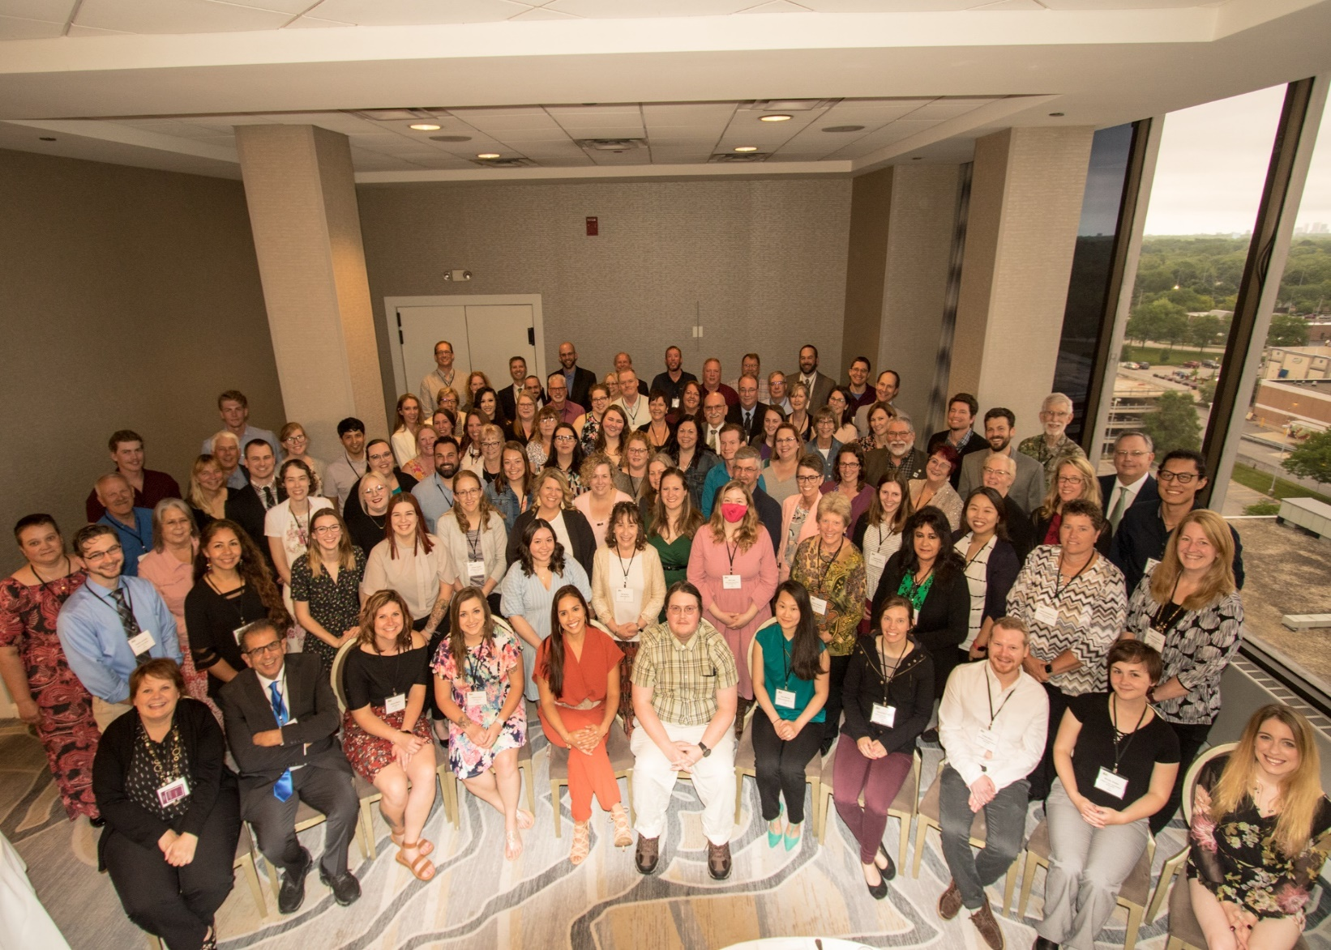
Association of Official Seed Analysts
Society of Commercial Seed Technologists
Notes:
Put picture of SCST in here.

Slide 2
2023 AOSA & SCST
State of the Association
and Society

Slide 3
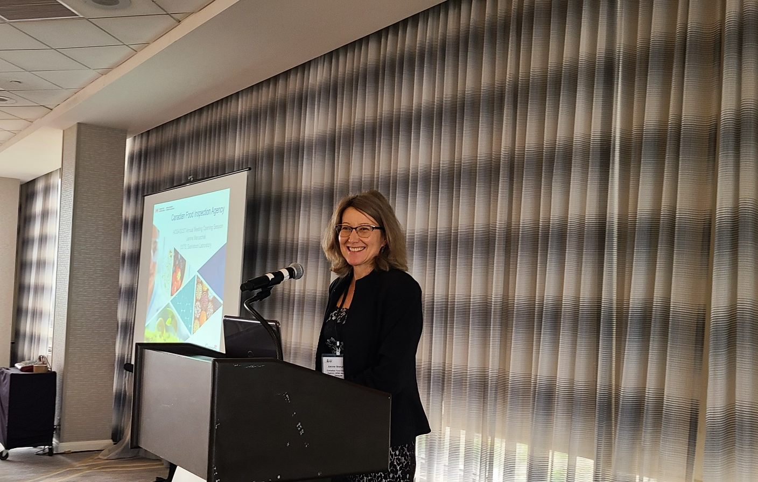
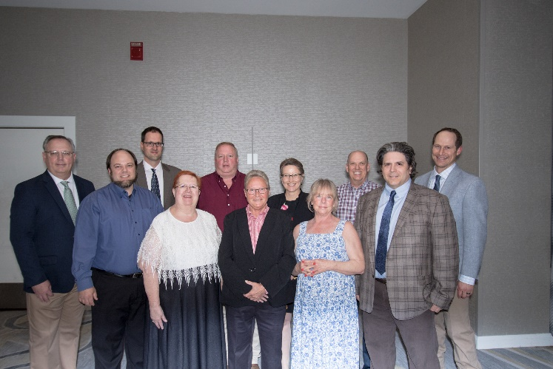
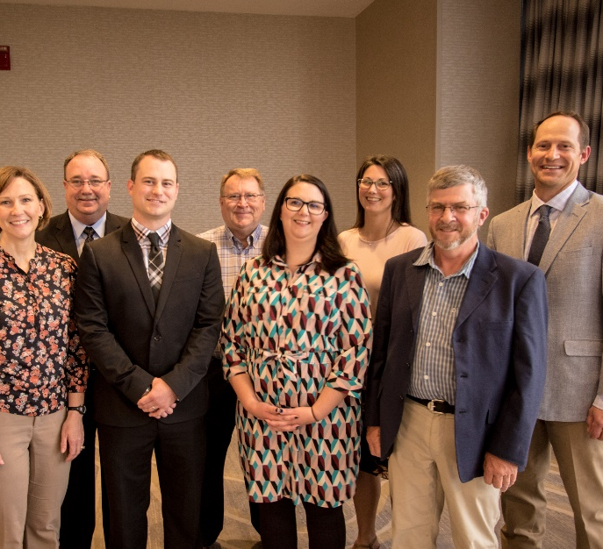
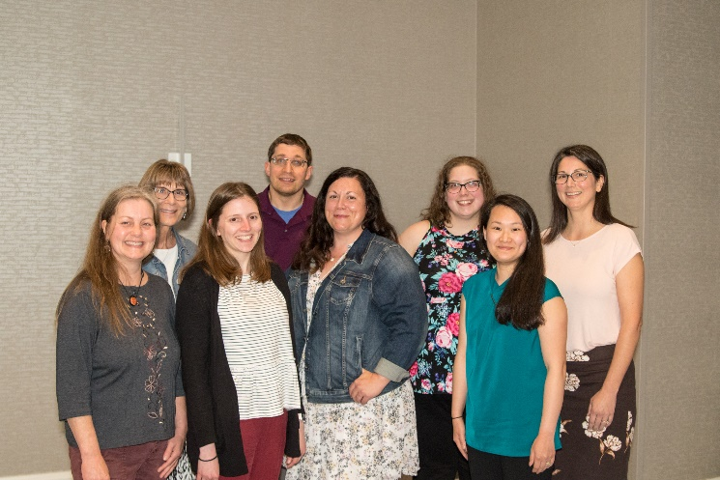

Slide 4
What’s New on www.analyzeseeds.com ?
New and customizable Annual Meeting page(s) along with registration capabilities for years to come
Teaching & Training Committee informational & AOSA Rules Webinars PLUS Practice Questions & Tests
Home Page houses all announcements, quick links, Facebook feed, job posts and the latest newsletter(s)
AOSA Rules Committee page now can comment on proposals directly

Slide 5
Short Films
Visit us on YouTube for Understanding Seed Testing
AOSA and SCST
www.youtube.com
And search Seed Analysts

Slide 6
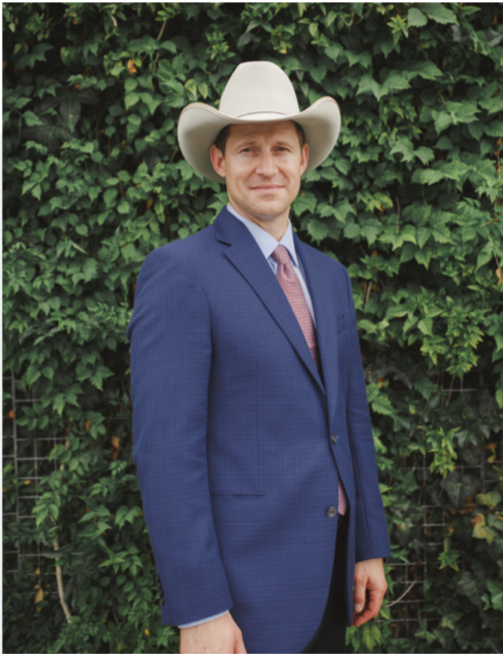
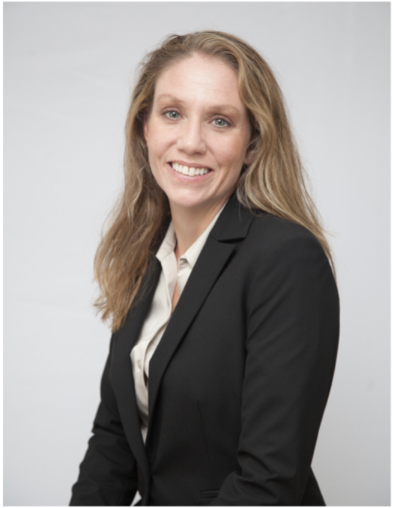
AOSA/SCST Executive Office
Jess Peterson – Executive Director
Oversees SCST Operations
Implements Programs and Policies
Annual Meeting Management
Ensures Budget Compliance
Outreach and Public Relations
Admin Support to Elected Officers
Kelly Polzin – Director of Operations
Maintains Membership Services
Manages and Updates Seed Technologists Training Manual
Processes and Tracks Publication Orders
Manages Social Media and Email Inquiries
Manages Committee Activities
Maintains Exam Candidate Database
Updates and Maintains analyzeseeds.com

Slide 7
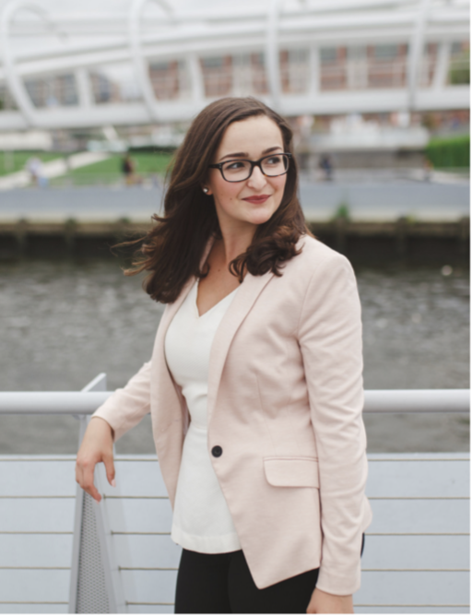
AOSA/SCST Executive Office Cont.
Lia Biondo - Membership & Public Outreach
Maintain Active Presence on Social Media
Job Posting Advertisement on Social Media outlets
Design Public Relations Materials
Draft Press Statements

Slide 8
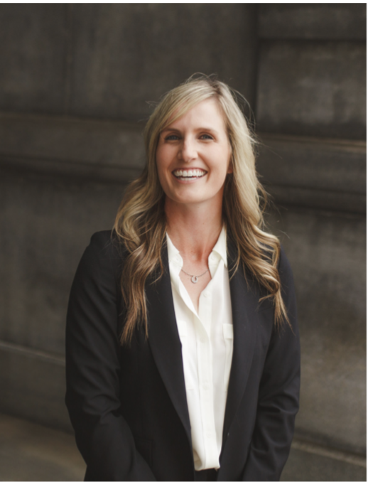
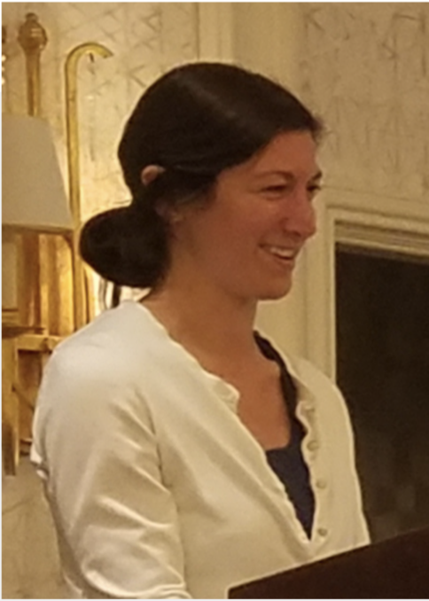
AOSA/SCST Executive Office Cont.
Kelly Fogarty - AOSA Event Operations
Act as Liaison to Host/Local Planning Committees
Manage Negotiations and Requests From Host
Act as Liaison to Hotel Negotiator
Point of Contact for Annual Meeting
Provide Insight in Preparing Bids
Provide Consulting for Annual Meeting Tours
Kristen Robertson - Director of Finance
Manages Online Accounts Payable System
Manages Expense Reports
Scheduling of Outside Audits
Manages Cash Flow
Maintains Payment Information
Vendor Point of Contact

Slide 9
Uniformity Working Group
Purity & Contamination
Report of Analysis
Continued to try to tackle the issue of how to report noxious weeds when found in the purity
Labs are split 50/50 on how it is being done
Admitted defeat on the topic as it is hard to make half the membership change
Worked with the Handbook Committee to update the ROA Handbook
Created a guide for Seed Companies on how to interpret the ROA
Created an Excel generic ROA template for anyone to use
Both groups are on hiatus. However, if issues should arise, they will resume.

Slide 10
Uniformity Working Group Cont.
Germination
Tetrazolium
Focusing on Seedling evaluation database
Website Based
Sending out seedling image surveys
Analyzing data form surveys
Submitted AOSA Rule proposals to address some issues
Focusing on updating TZ handbook with TZ committee
Sent out TZ images to membership for input
Committee reviewing results of image surveys and deciding which photos to incorporate into the handbook
Updating procedures that may need to be changed
Down to Asteraceae and Poaceae families
Goal to have new TZ Handbook out by the end of the year

Slide 11
AOSA Membership
2022
38 State lab members
4 USDA lab members
1 Canadian or CFIA Lab member
5 Associate lab members
2023
36 State lab members
4 USDA lab members
1 Canadian or CFIA Lab member
2 Allied lab members
5 Associate lab members
VS

Slide 12
SCST Membership
2022
VS
2023
108 RST
13 CVT
15 RGT
8 CGT
4 Research Members
3 Professional Members
130 Associate Members
104 RST
13 CVT
16 RGT
8 CGT
5 Research Members
5 Professional Members
127 Associate Members

Slide 13
Sneak Peak… Future Annual Meetings
2024 Rapid City, SD
June 1st - 6th
Holiday Inn Rapid City – Rushmore Plaza
4505 N Fifth St
Rapid City, SD 57701
2025 West Proposed Sites
June 7th - 13th
Grand Junction, CO
Missoula, MT
Salt Lake City, UT
Spokane, WA
2026 East Proposed States
District of Columbia,
Florida
Georgia
Indiana
Kentucky
Maryland
Michigan
New York
South Carolina
Tennessee
Wisconsin
2027 and Beyond: no locations are set but, stay tuned for more information coming your way!

Slide 14
AOSA & SCST will participate in the following upcoming events/meetings:
International Seed Testing Association (ISTA)
May 29 – June 1, 2023, Annual Meeting in Verona, Italy
Association of Seed Certifying Agencies (AOSCA)
June 3-7, 2023 - Annual Meeting in Bloomington, Minnesota
Organization for Economic Co-operation & Development (OECD), Seed Schemes
June 19-23, 2023 – Annual Meeting in Antalya, Turkey
Seeds Canada
July 10-12, 2023 – Annual Meeting in St. John’s, Newfoundland, Canada
Association of American Seed Control Officials (AASCO)
July 11-14, 2023 – Annual Meeting in Lafayette, Indiana
American Seed Trade Association (ASTA)
June 10-14, 2023, Leadership Summit Sacramento, CA
Nov 1, 2023, Forage, Turf & Seed Conference Kansas City, Missouri
Dec 5-8, 2023, Field Crop Convention Orlando, Florida
Jan 27-31, 2024, Vegetable & Flower Seed Conference Orlando, Florida
Western Seed Association Conference (TBD)
November 2023, in Kansas City, Missouri

Slide 15
Seed Today & Seed World
Shout out to Seed Today and Seed World for the collaboration with AOSA/SCST and communicating the importance of our Seed Analysts/Technologists and what they do for not only our food supply but the forests, rangelands, grasslands and backyards.

Slide 16
AOSA Publications
2022
VS
2023
Processed 49 publication orders to 4 different countries (Canada, United Kingdom, South Africa, & Chile)
Processed 59 publication orders to 7 different countries (Canada, Peru, Philippines, New Zealand, Mexico, Germany & Singapore)
2021 AOSA Rules: 22
2021 AOSA Rules Spanish: 0
Seed Vigor Testing Handbook: 5
Seed Moisture Testing Handbook: 3
Purity Testing Handbook: 5
TZ Testing Handbook: 6
Additional Print/ Network Licenses: 51
2022 AOSA Rules: 27
2022 AOSA Rules Spanish: 1
Seed Vigor Testing Handbook: 10
Seed Moisture Testing Handbook: 4
Purity Testing Handbook: 5
TZ Testing Handbook: 3
Additional Print/ Network Licenses: 51

Slide 17
SCST Publications
2022
VS
2023
2002 What Is Seed Vigor CD: 1
2016 Seed Technologist Training Manual Chapter 14: 0
2018 Seed Technologist Training Manual: 10
2018 Seed Technologist Training Manual Spanish: 0
2002 What Is Seed Vigor CD: 0
2016 Seed Technologist Training updated Manual Chapter 14: 0
2018 Seed Technologist Training Manual: 12
2018 Seed Technologist Training Manual Spanish: 1

Slide 18
Job Postings
Visit us on LinkedIn for industry related job postings
AOSA and SCST
www.linkedin.com/analyzeseeds
14 Job posts were utilized on the AOSA/SCST Website and LinkedIn from June 2022 to present. Each post is $130.00 split profit to both AOSA & SCST.
Of those 14, three were a rush at $180.00 split.

Slide 19
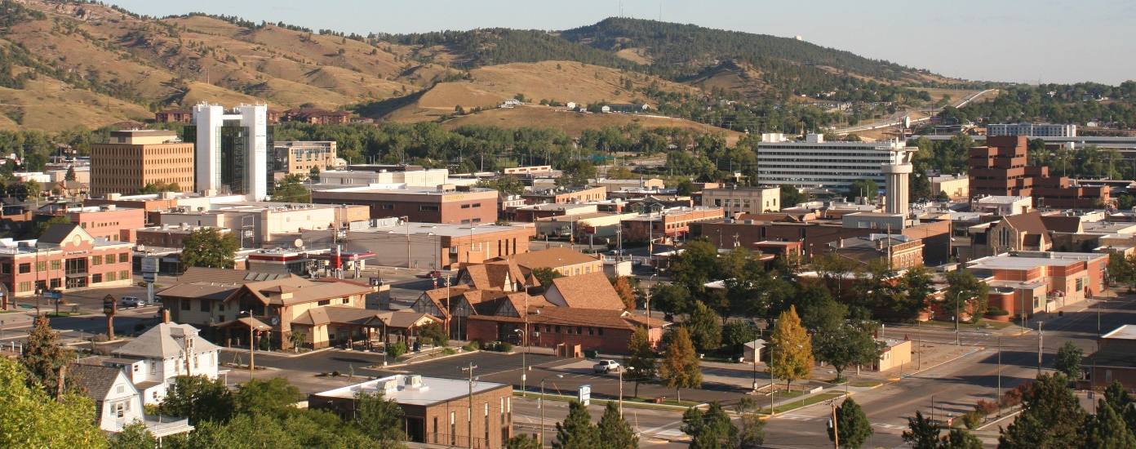
You’re Invited to South Dakota USA
When: June 1-6, 2024
Where: Rapid City, SD
Holiday Inn Rapid City-Rushmore Plaza
Who: AOSA/SCST

Slide 20
Keep up with AOSA/SCST
Follow/Like/Share/Watch!
AOSA and SCST
www.linkedin.com/analyzeseeds
AOSA and SCST
AOSA and SCST
www.youtube.com
Seed Analysts
@analyzeseeds
Connect with us via Twitter and Facebook to stay updated on events, news, job postings and more.

