Slide 1
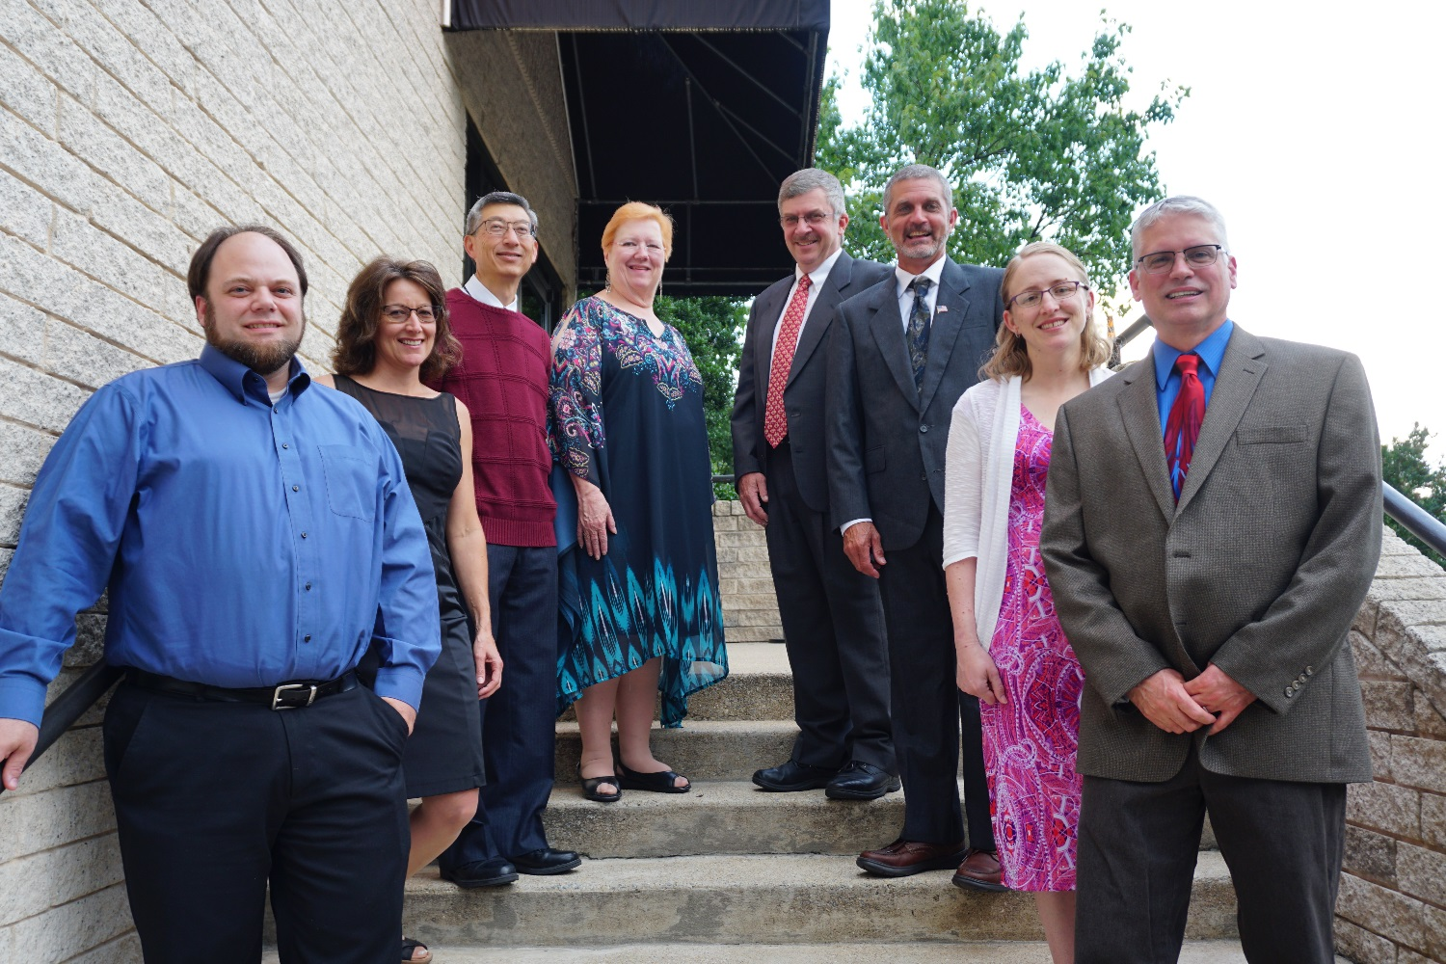
Association of Official Seed Analysts

Slide 2
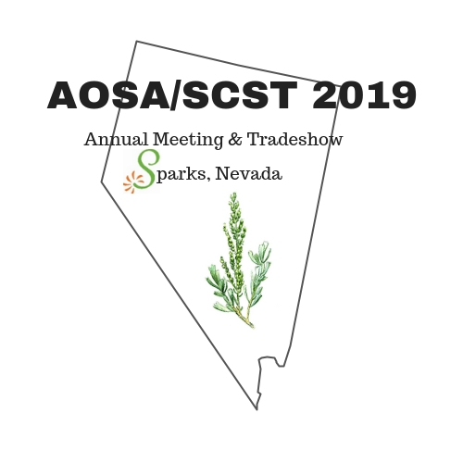
2019 AOSA
State of the Association

Slide 3
2018 Year in Review

Slide 4
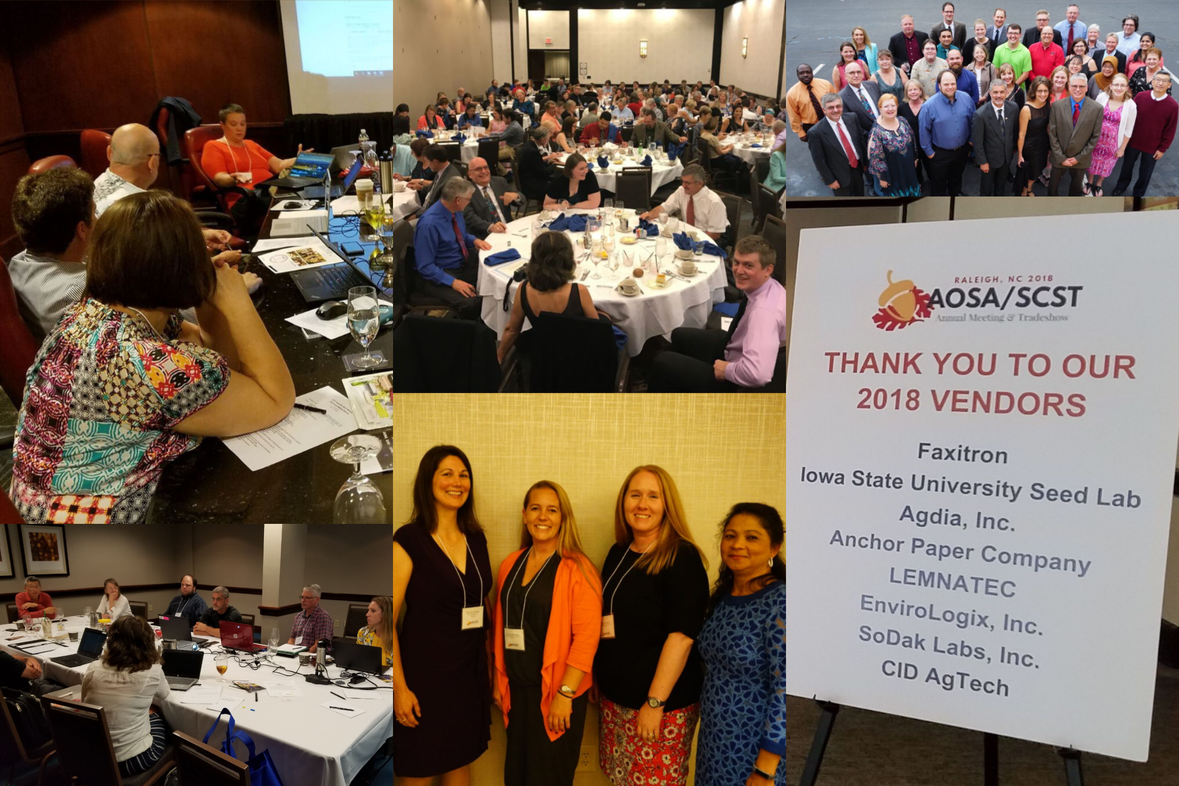
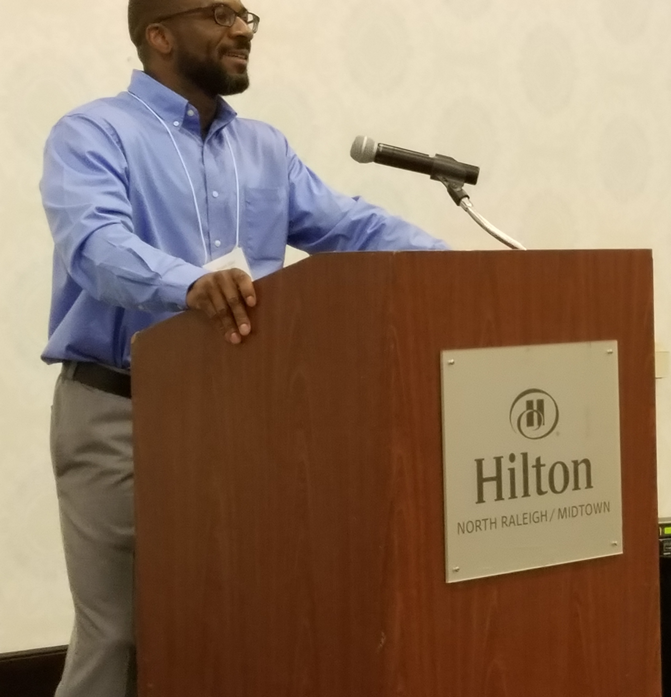
AOSA/SCST Annual Meeting
Raleigh, North Carolina

Slide 5
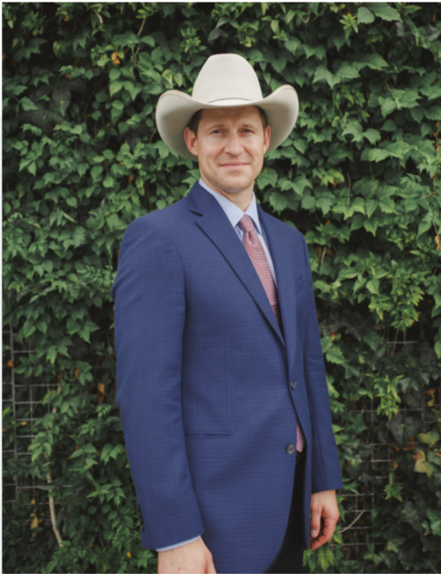
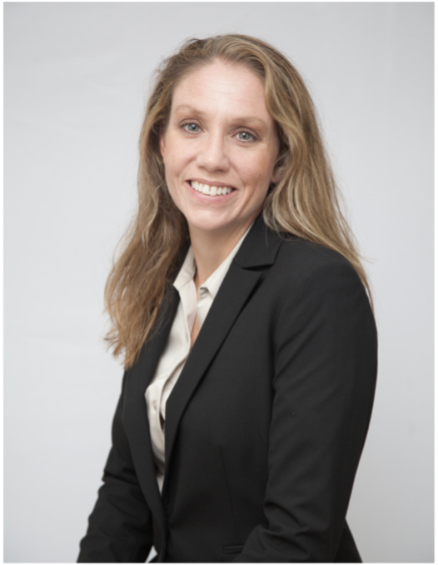
AOSA Executive Office report
Jess Peterson - AOSA Executive Director
Oversees AOSA operations
Implements Programs and Policies
Annual Meeting Management
Ensures Budget Compliance
Outreach and Public Relations
Admin Support to Elected Officers
Kelly Polzin - AOSA Director of Membership Services
Maintains Membership Services
Manages and Updates AOSA Rules for Seed Testing
Processes and Tracks Publication Orders
Manages Social Media and Email Inquiries
Manages Committee Activities
Maintains Exam Candidate Database

Slide 6
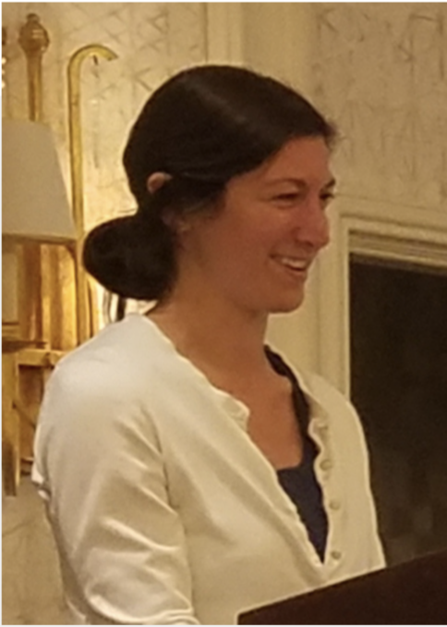
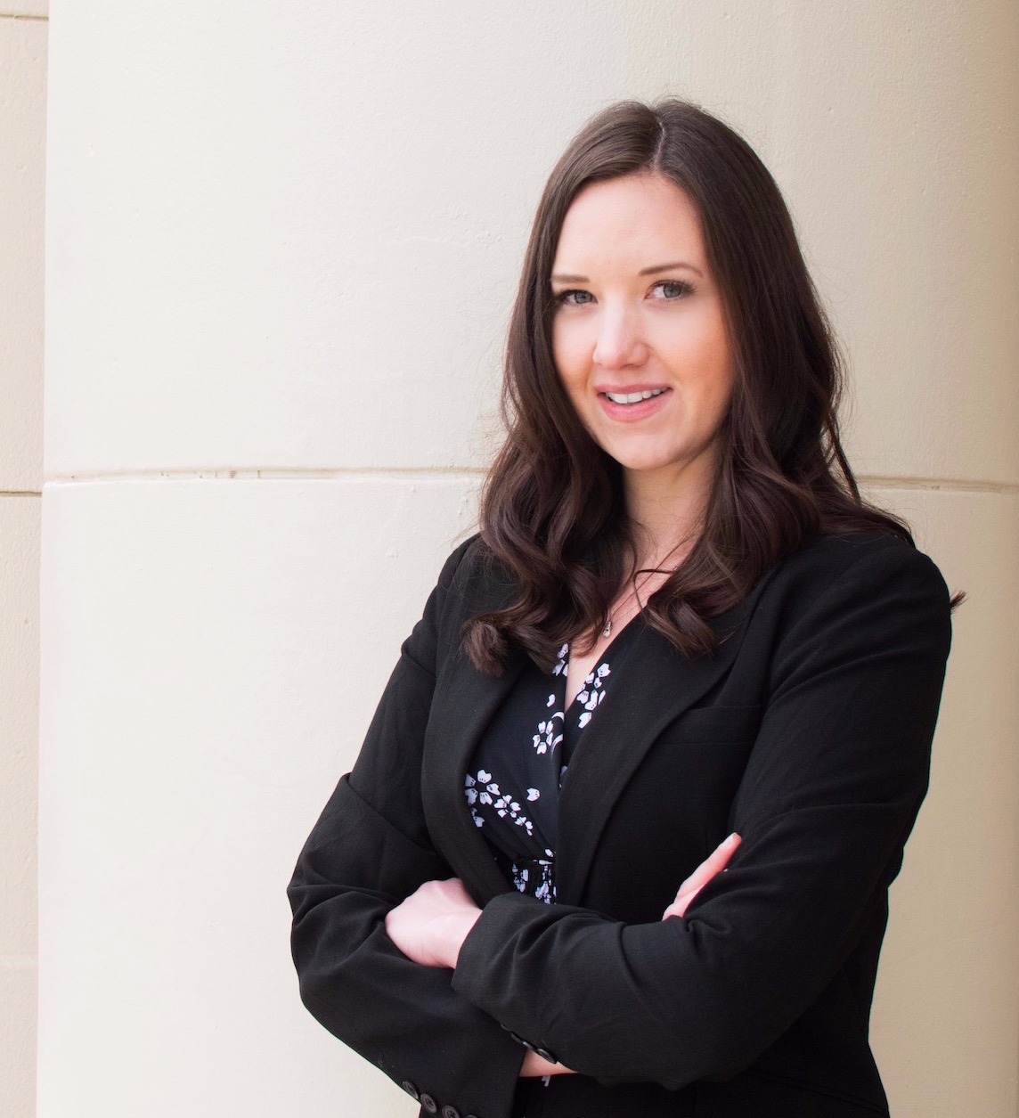
AOSA Executive Office report Cont.
Kristin Albers - AOSA Director of Finance
Oversees AOSA operations
Implements Programs and Policies
Annual Meeting Management
Ensures Budget Compliance
Outreach and Public Relations
Admin Support to Elected Officers
Amanda Miller - Website Manager
Maintains analyzeseeds.com websites
Regulate and Manage Access Rights
Manage Online Membership Services
Troubleshoot Performance Issues and Ensure Functionality
Manage Publication Store
Liaison Between Hosting Company and Organization

Slide 7
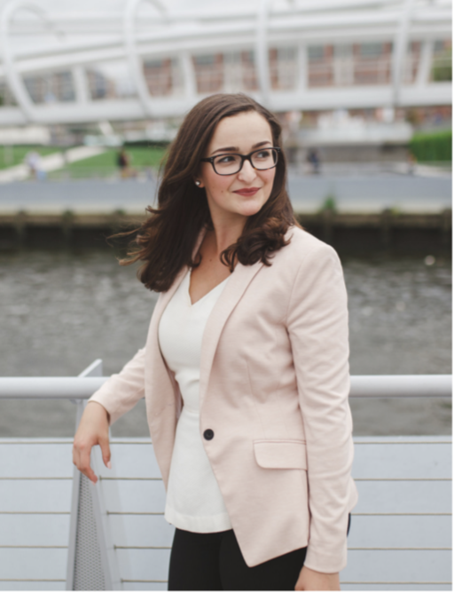
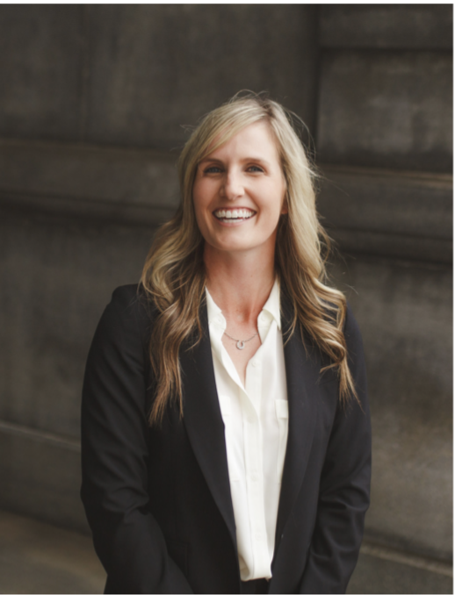
AOSA Executive Office report Cont.
Lia Biondo - AOSA Membership & Public Outreach
Maintain Active Presence on Social Media
Job Posting Advertisement
Oversee Membership Communications
Draft Membership Announcements
Design Public Relations Materials
Draft Press Statements
Kelly Fogarty - AOSA Event Operations
Act as Liaison to Host/Local Planning Committees
Manage Negotiations and Requests From Host
Act as Liaison to Hotel Negotiator
Point of Contact for Annual Meeting
Provide Insight in Preparing Bids
Provide Consulting for Annual Meeting Tours

Slide 8
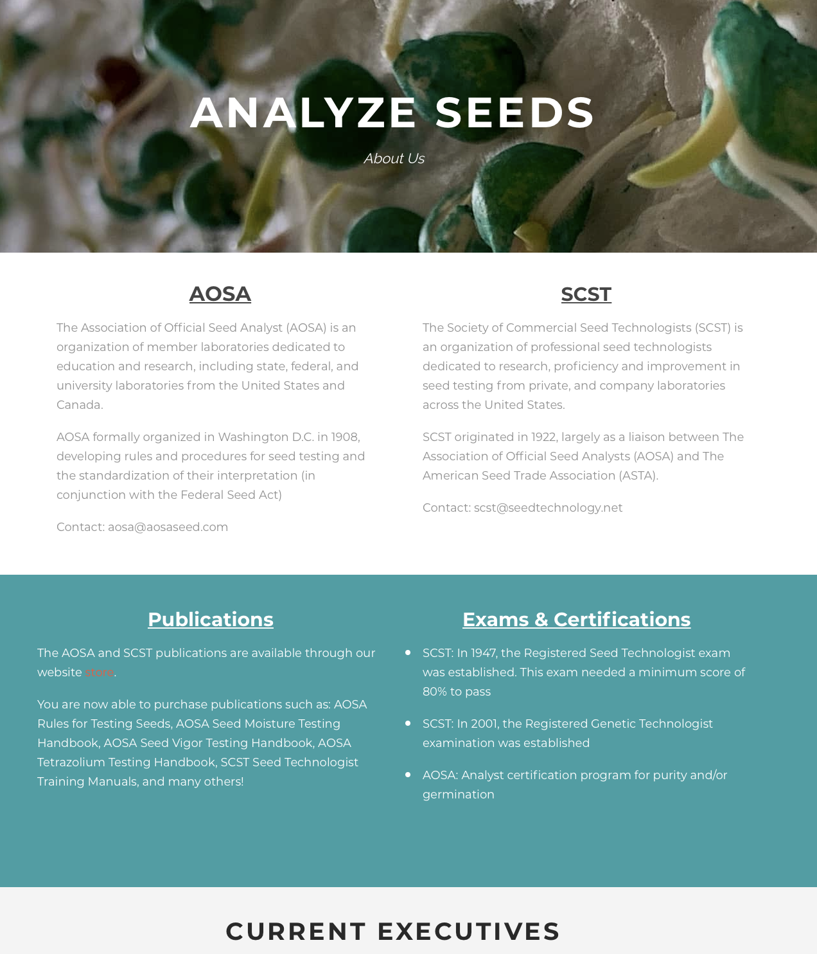
www.analyzeseeds.com
Recent Changes to the AOSA/SCST Website
Home page was updated to enhance the identity of the site
Teachings & Training Page for online Continuing Education Credit
About Us page was created
Highlight the history of both organizations
Showcase current and past executive leadership
Current & Ongoing Outreach
Online Membership
Translations of Manuals and Rules
International Membership Outreach
Mobile App

Slide 9
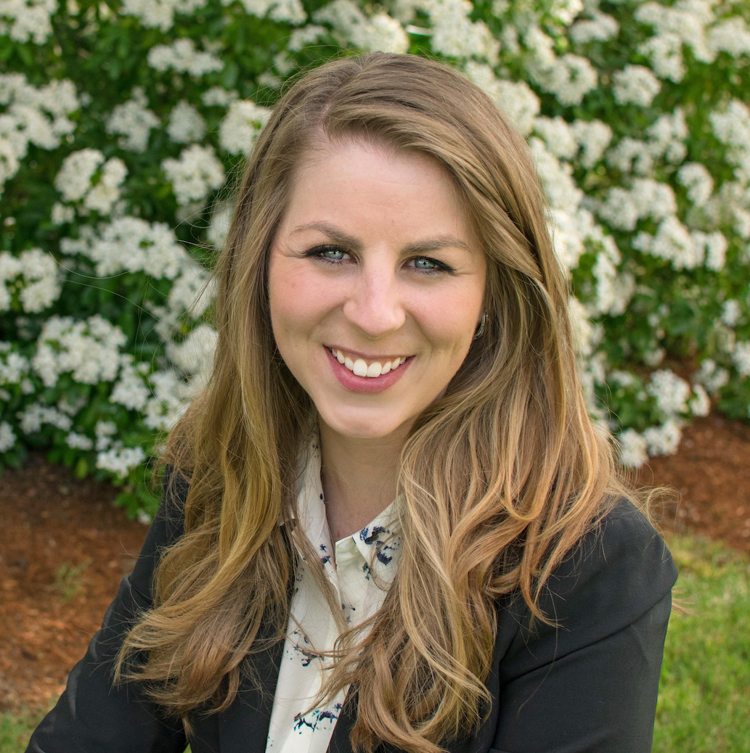
Development of Educational Short Films
Communication and outreach is crucial for building awareness and understanding of the value of seed testing and the service that AOSA/SCST provides to it
Creating modernized communications is essential for viewer interest and engagement, especially younger audiences
Advancing training of seed testing methods
Development of these short films will lend themselves to furthering the recognition and realization of the value of AOSA/SCST through up-to-date modes of communication
AOSA/SCST Staff, Mary Jo Foley-Birrenkott

Slide 10
United Seed testing organization
USTO - Working Group
Currently focusing on critical elements of the proposed USTO bylaws
Long range planning is in the works
We appreciate all the hard work!!

Slide 11
AOSA Membership
2019
38 State lab members
4 USDA lab members
1 Canadian or CFIA Lab member
5 Associate lab members
2018
38 State lab members
5 USDA lab members
1 Canadian or CFIA Lab member
4 Associate lab members
VS

Slide 12
AOSA Publications
2019
VS
2018
Processed over 120 publication orders
to 8 different countries (Australia, Canada, South Korea, Philippines, Germany, China, Uruguay & USA)
Processed over 70 publication orders
2018 AOSA Rules: 55
2017 AOSA Rules: 43
Seed Moisture Testing Handbook: 9
Seed Moisture Testing Handbook: 21
Tetrazolium Testing Handbook: 12
Tetrazolium Testing Handbook: 7
Seed Vigor Testing Handbook: 9
Seed Vigor Testing Handbook: 7
Additional Print/Network Licenses: 39
Additional Print/Network Licenses: 86

Slide 13
2019 and Beyond
AOSA will participate in the following upcoming events/meetings:
Association of Seed Certifying Agencies (AOSCA), 100th Anniversary
June 23-26, 2019 in Chicago, Illinois
Association of American Seed Control Officials (AASCO)
May 31 - June 4, 2019 in Chicago, Illinois
International Seed Testing Association (ISTA)
June 26 - July 3, 2019 in Hyderabad, India
American Seed Trade Association (ASTA)
Dec 9-12, 2019 Chicago, Illinois
Western Seed Association Conference
Nov 2-4, 2019 in Kansas City, Missouri

Slide 14
Sneak Peak…
Future Annual Meetings
2020 Indianapolis, Indiana
June 13th-17th, in conjunction with
American Seed Trade Association (ASTA)
2021 Saskatoon, Saskatchewan, Canada
2022 Mid-West Region (100th Anniversary for SCST)

Slide 15
Job Postings
Visit us on LinkedIn for industry related job postings
AOSA and SCST
www.linkedin.com/analyzeseeds
11 Job posts were utilized on the AOSA/SCST Website and LinkedIn from June 2018 to present. Each post is $130.00 split profit to both AOSA & SCST.

Slide 16
You’re Invited…
When: June 13-17, 2020
Where: Indianapolis, Indiana
Who: AOSA/SCST with ASTA
2020 Annual Meeting

Slide 17
Keep up with AOSA
Follow/Like/Share!
AOSA and SCST
www.linkedin.com/analyzeseeds
AOSA and SCST
@analyzeseeds
Connect with us via Twitter and Facebook to stay updated on events, news, job postings and more. In 2017, SCST and AOSA merged into one social media account.

