Slide 1
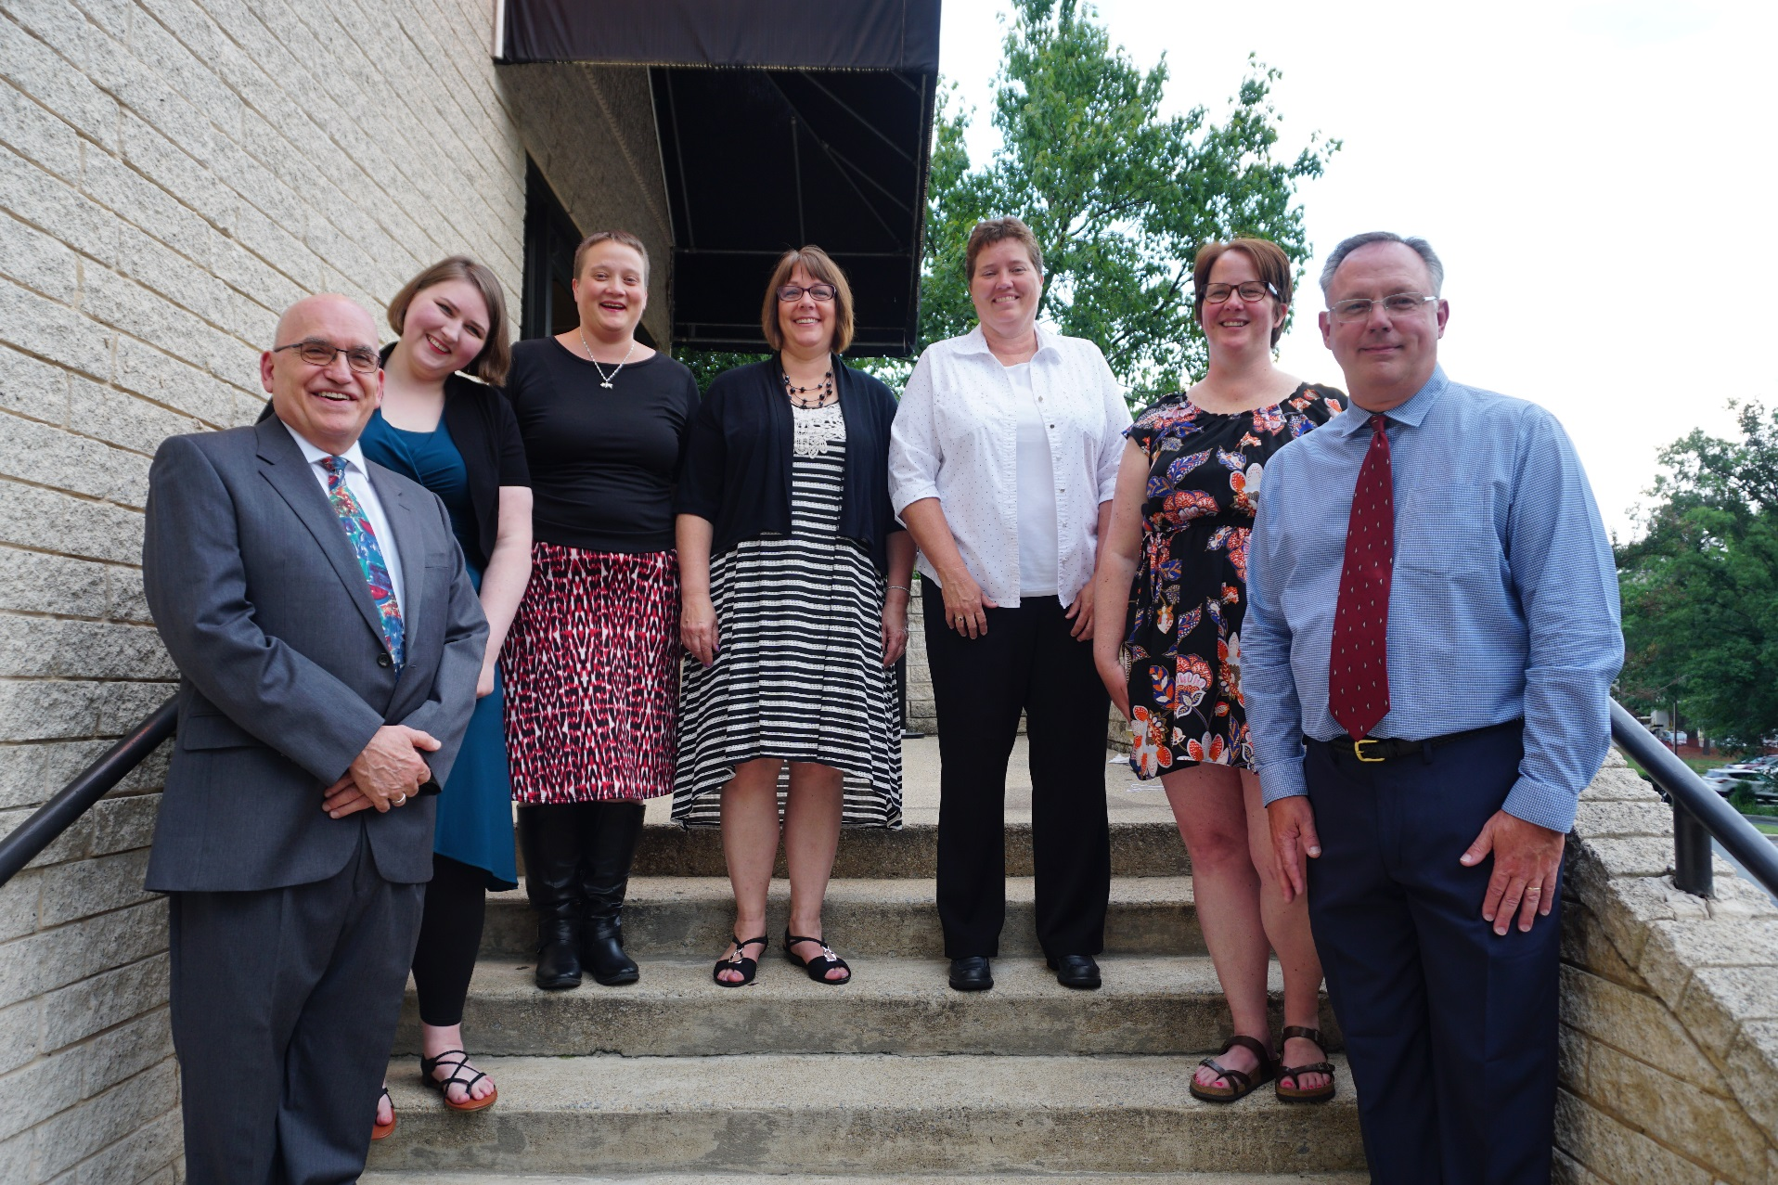
Society of Commercial
Seed Technologists
Notes:
Put picture of SCST in here.

Slide 2
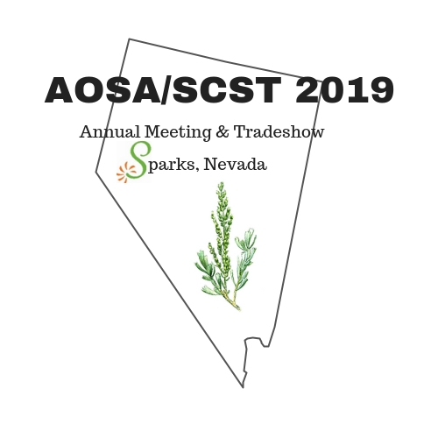
2019 SCST
State of the Society

Slide 3
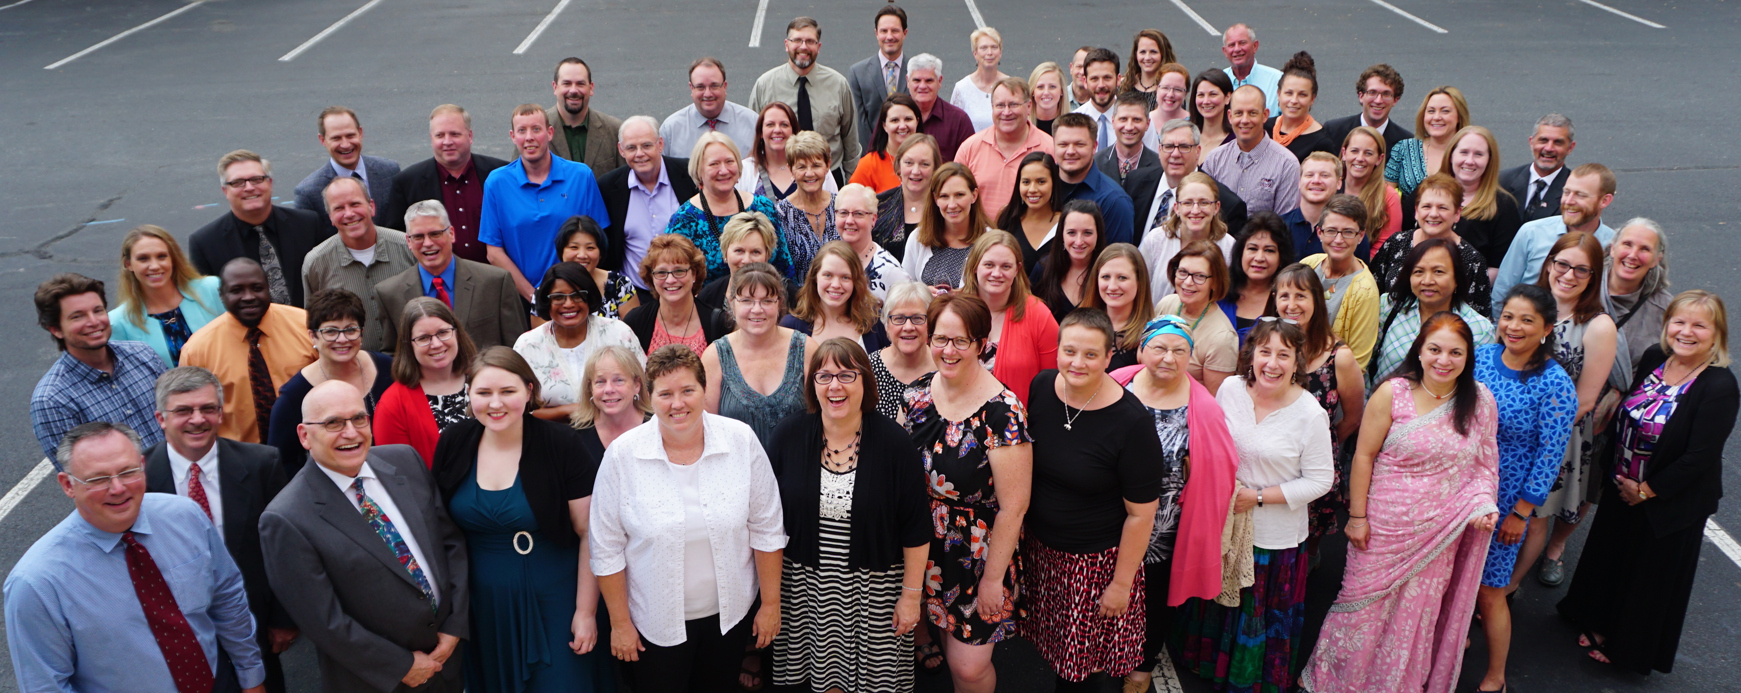
2018 Year in Review

Slide 4
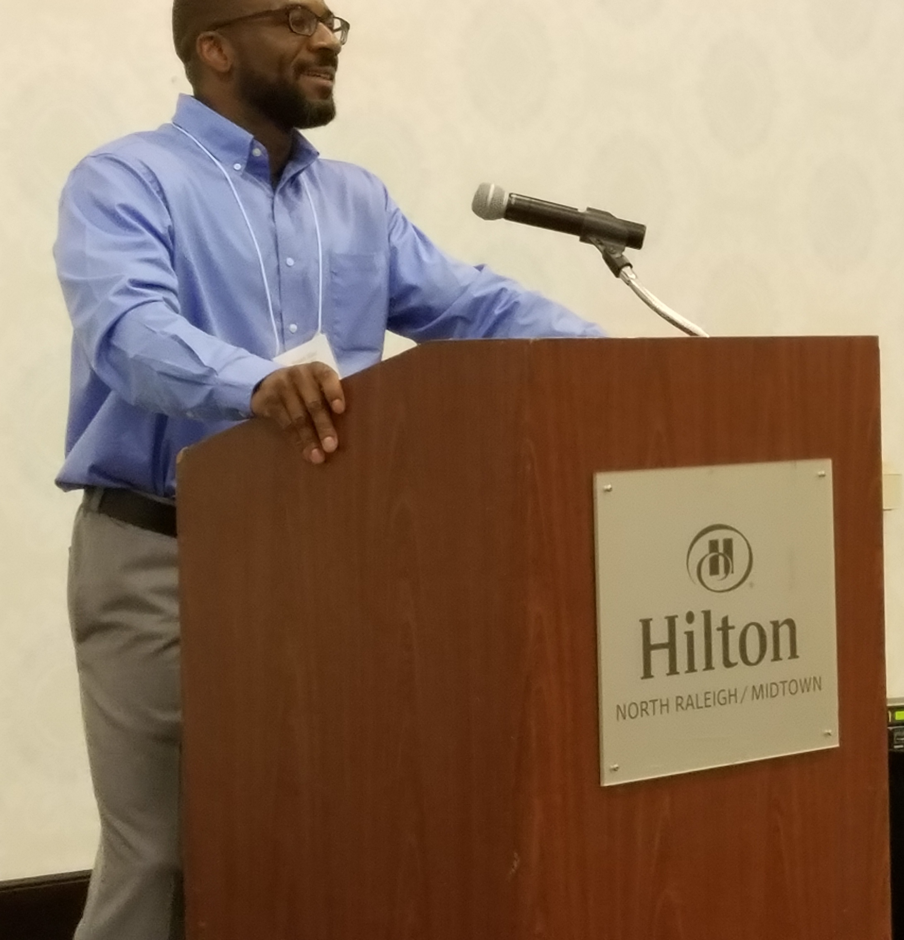
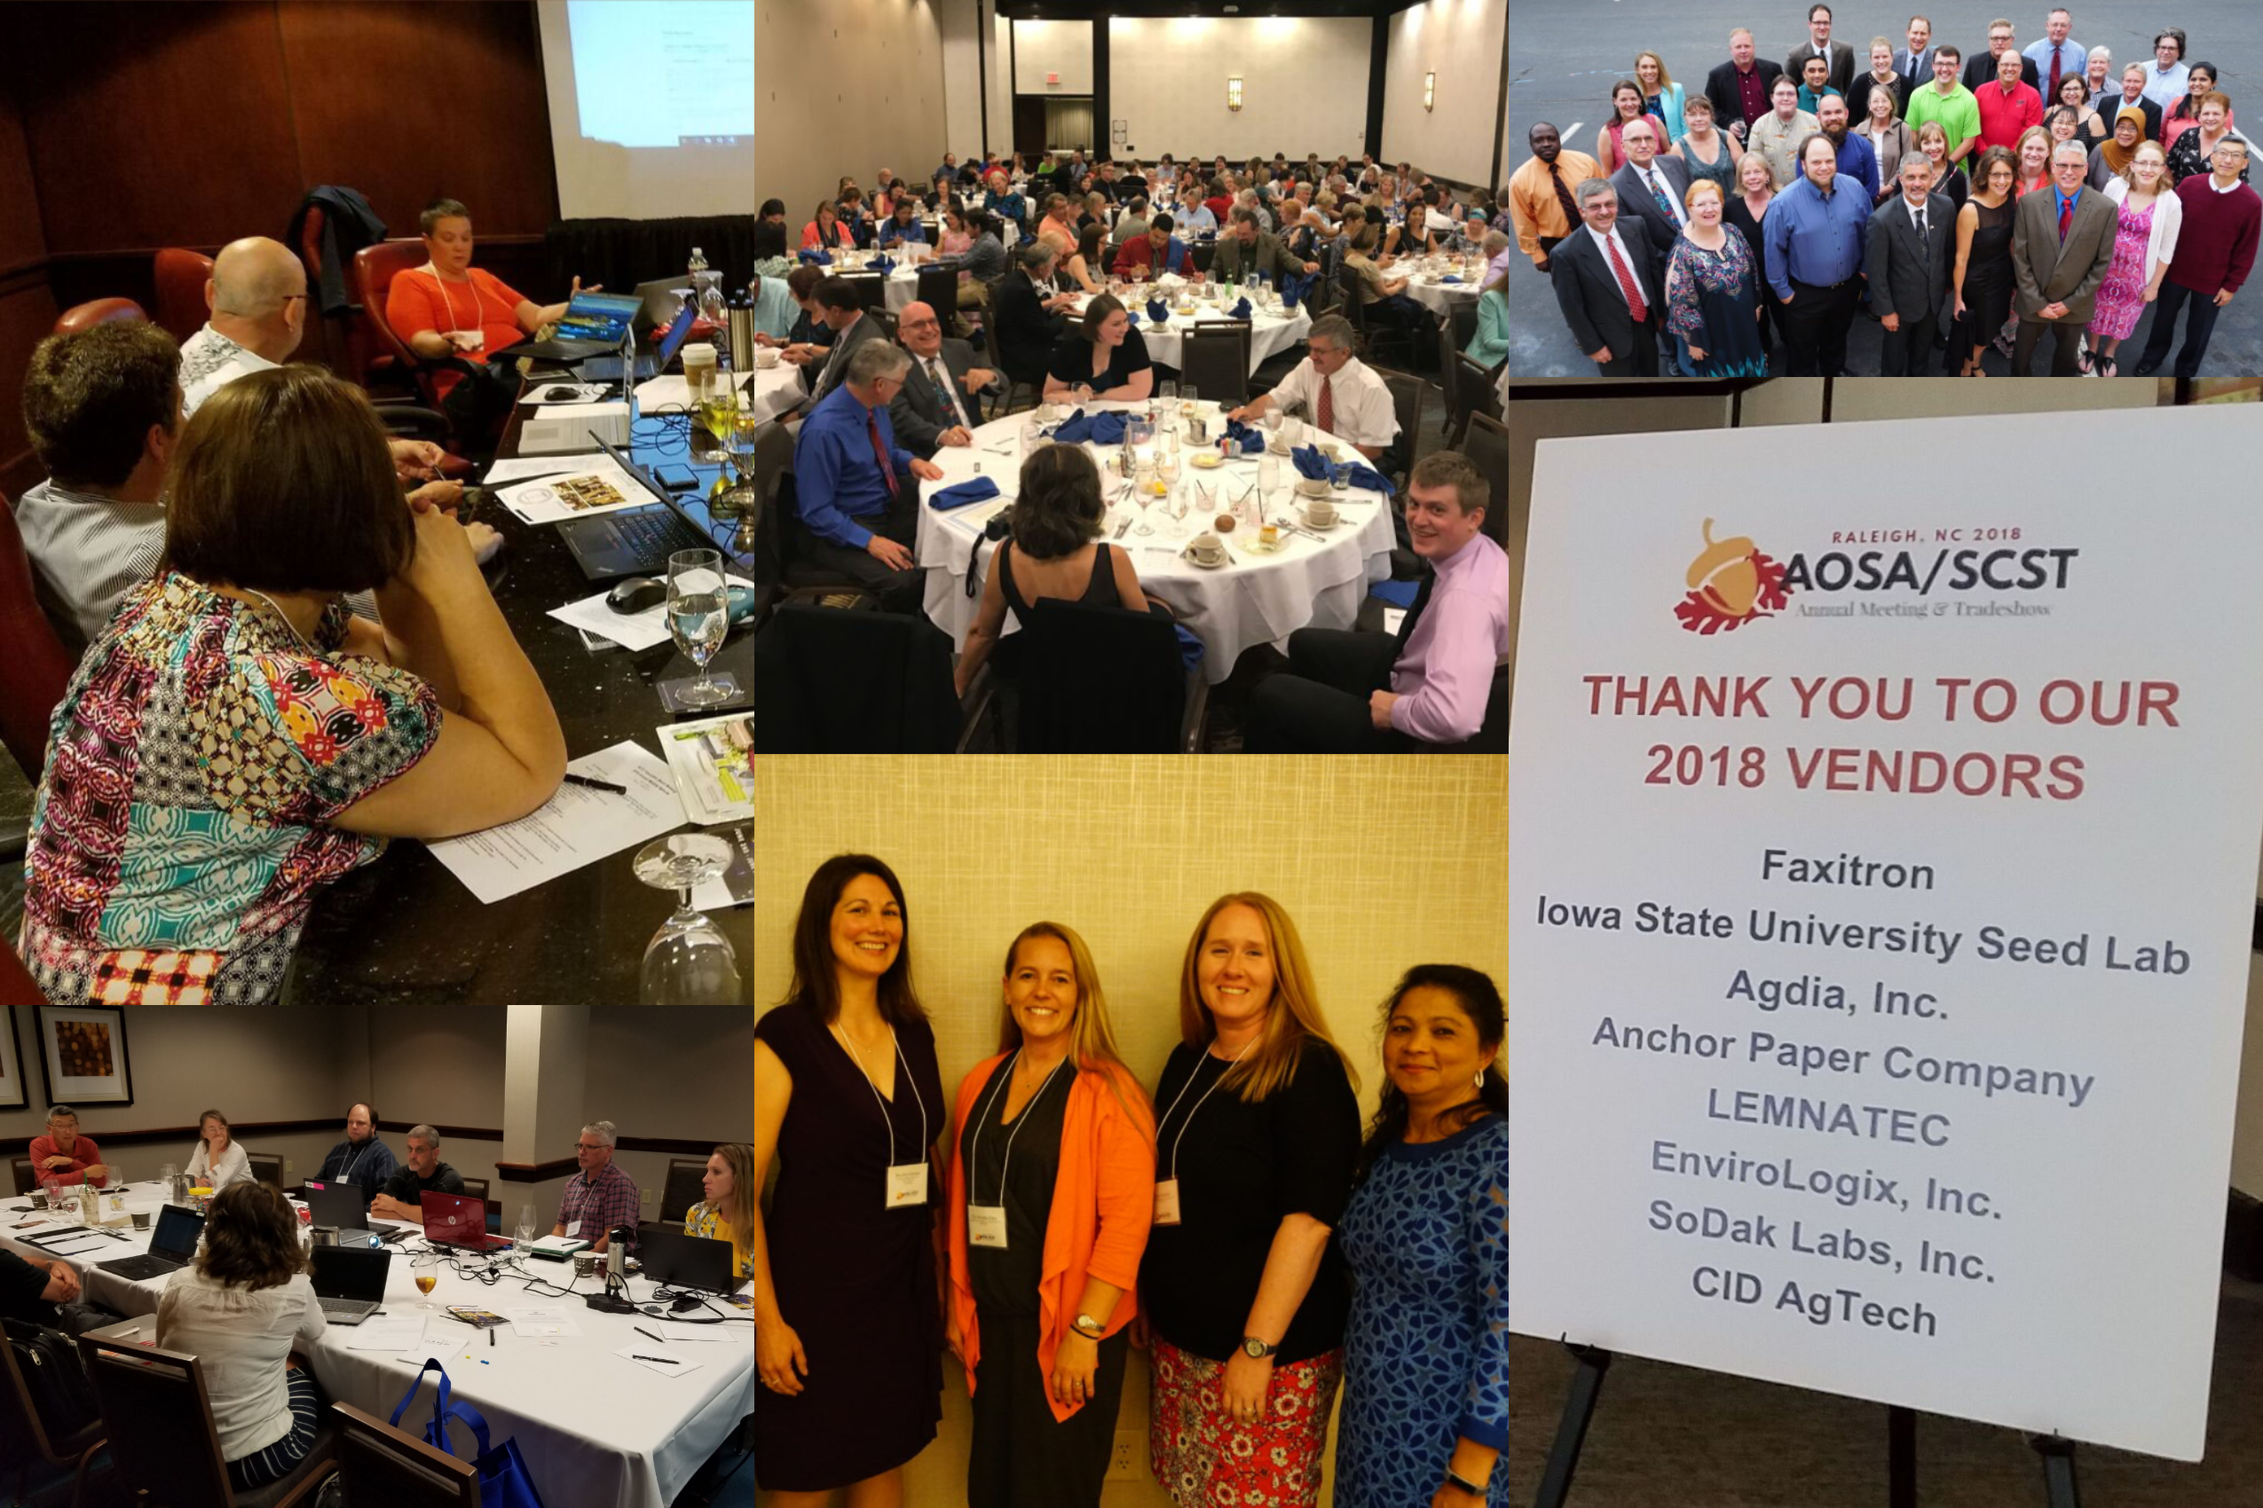
2018 AOSA/SCST Annual Meeting Raleigh, North Carolina

Slide 5
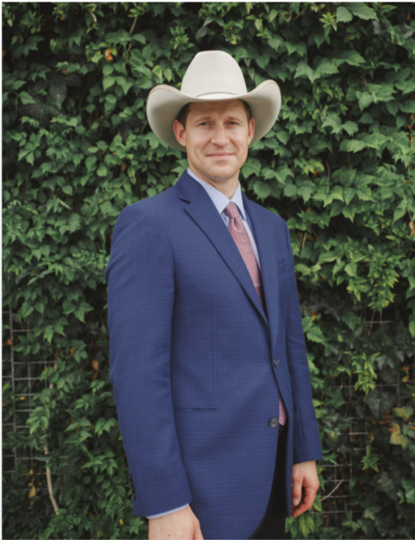
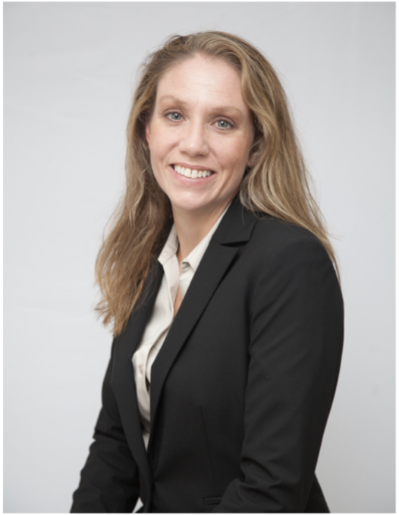
SCST Executive Office Report
Jess Peterson - SCST Executive Director
Oversees SCST Operations
Implements Programs and Policies
Annual Meeting Management
Ensures Budget Compliance
Outreach and Public Relations
Admin Support to Elected Officers
Kelly Polzin - SCST Director of Membership Services
Maintains Membership Services
Manages and Updates Seed Technologists Training Manual
Processes and Tracks Publication Orders
Manages Social Media and Email Inquiries
Manages Committee Activities
Maintains Exam Candidate Database

Slide 6
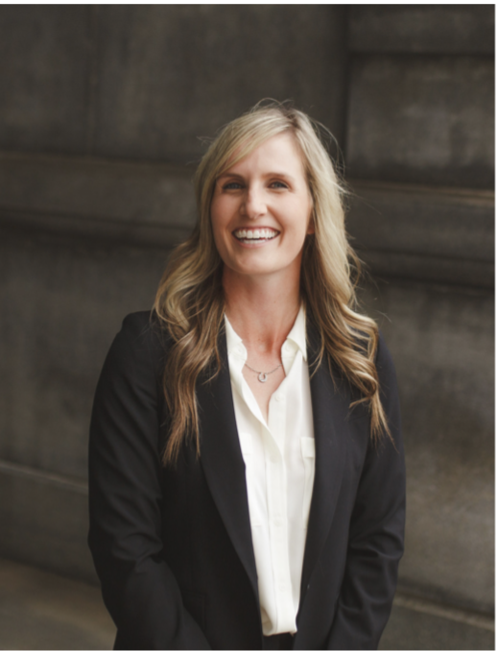
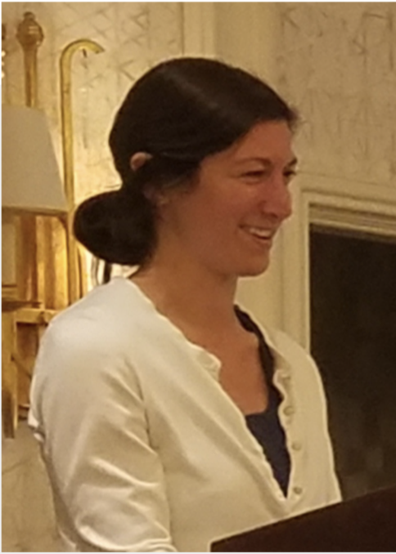
SCST Executive Office Report Cont.
Kelly Fogarty - AOSA Event Operations
Act as Liaison to Host/Local Planning Committees
Manage Negotiations and Requests From Host
Act as Liaison to Hotel Negotiator
Point of Contact for Annual Meeting
Provide Insight in Preparing Bids
Provide Consulting for Annual Meeting Tours
Kristin Albers - SCST Director of Finance
Manages Online Accounts Payable System
Manages Expense Reports
Scheduling of Outside Audits
Manages Cash Flow
Maintains Payment Information
Vendor Point of Contact

Slide 7
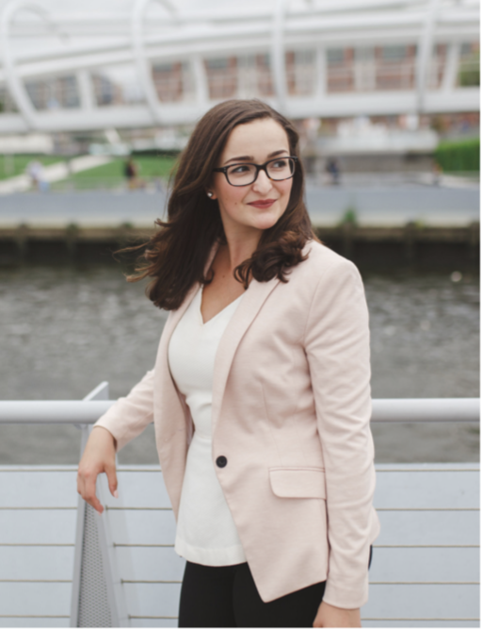
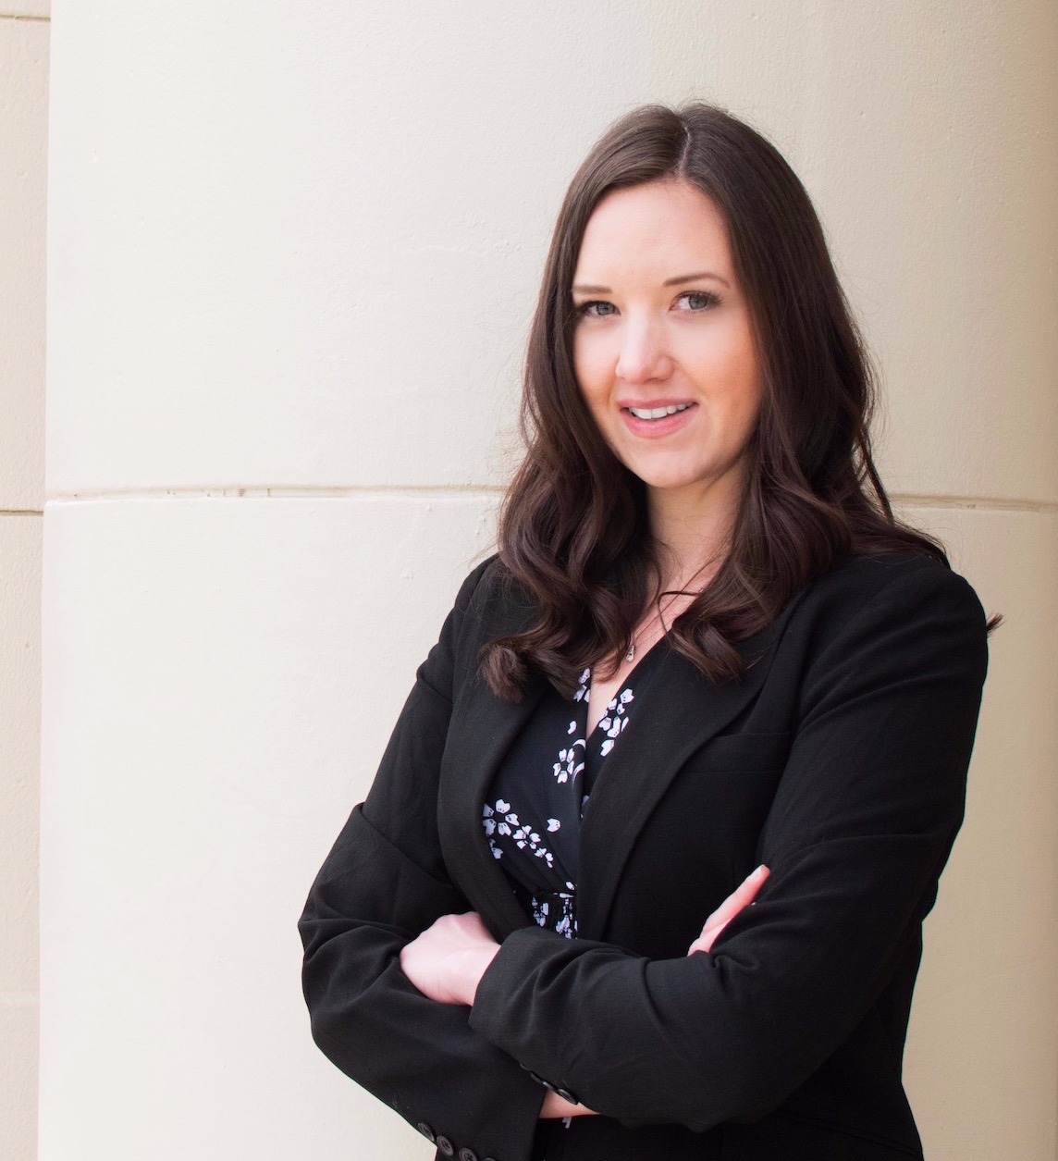
SCST Executive Office Report Cont.
Lia Biondo - SCST Membership & Public Outreach
Maintain Active Presence on Social Media
Job Posting Advertisement
Oversee Membership Communications
Draft Membership Announcements
Design Public Relations Materials
Draft Press Statements
Amanda Miller - Website Manager
Maintains analyzeseeds.com websites
Regulate and Manage Access Rights
Manage Online Membership Services
Troubleshoot Performance Issues and Ensure Functionality
Manage Publication Store
Liaison Between Hosting Company and Organization

Slide 8
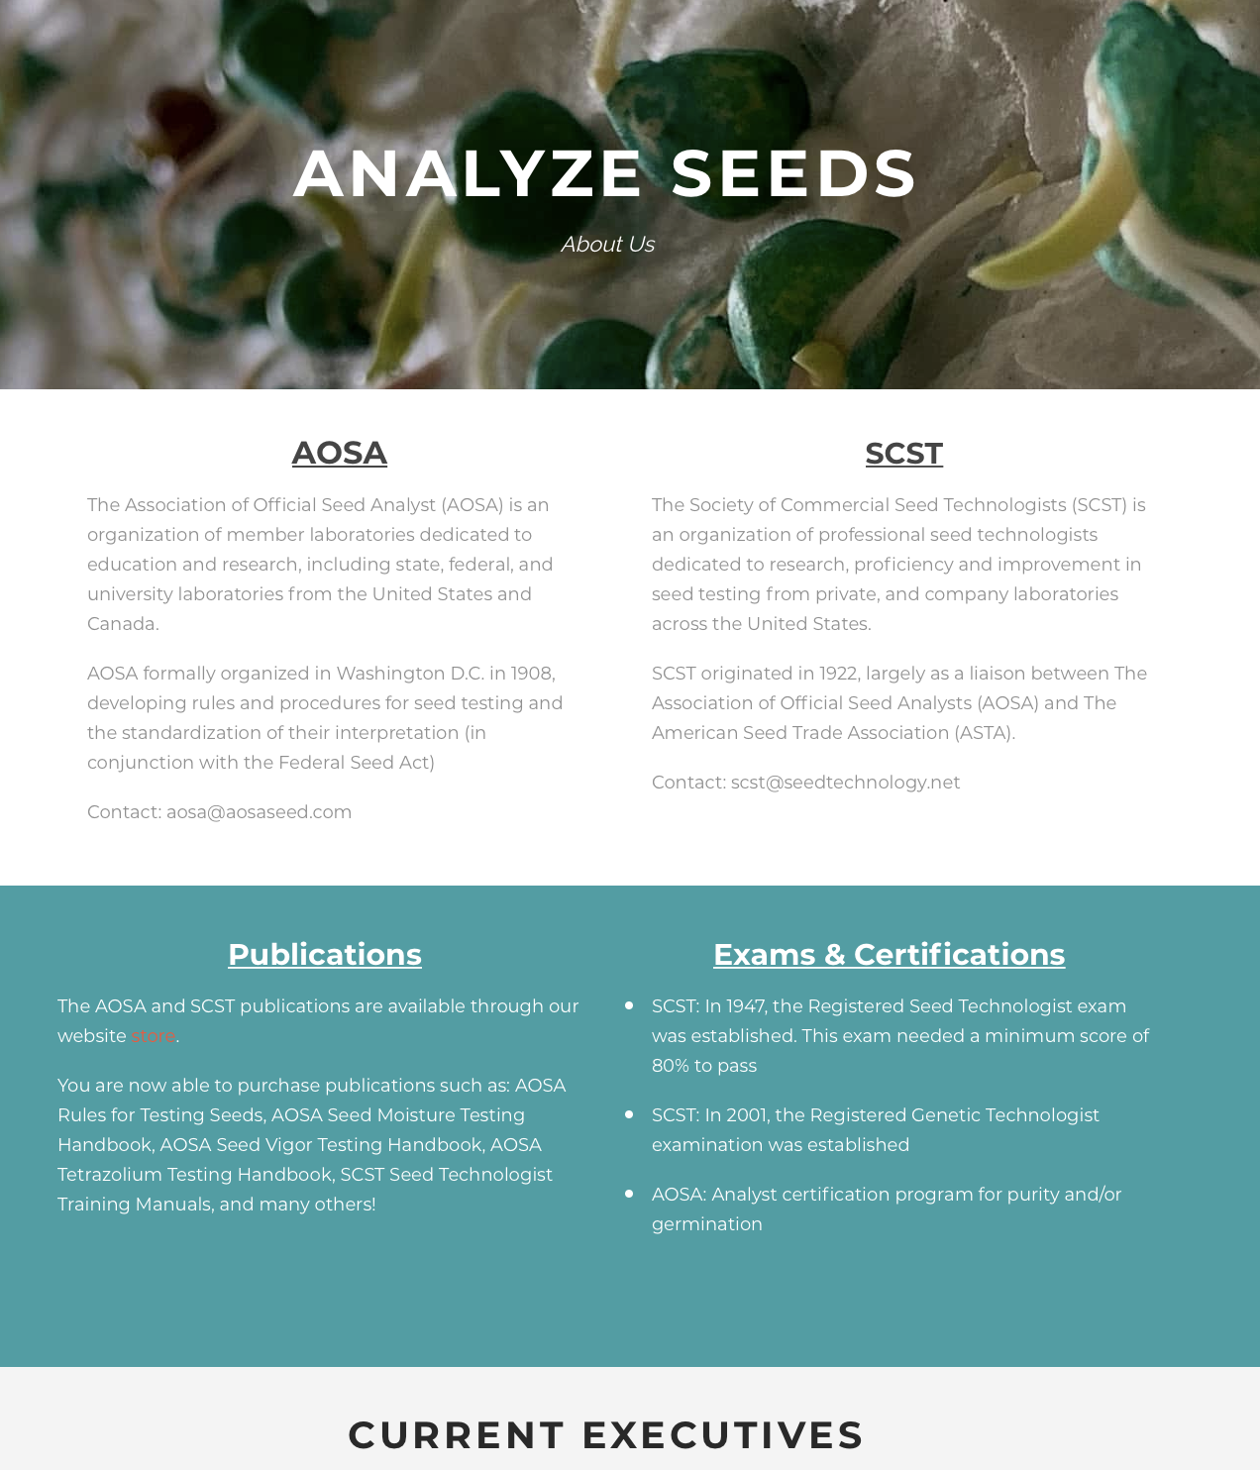
www.analyzeseeds.com
2019 Changes to the AOSA/SCST Website
Home page was updated to enhance the identity of the site
Teachings & Trainings Page for online Continuing Education Credit
About Us page was created
Highlight the history of both organizations
Showcase current and past executive leadership
Current & Ongoing Outreach
Online Membership Management
Translations of Manuals and Rules
International Sales
Mobile App

Slide 9
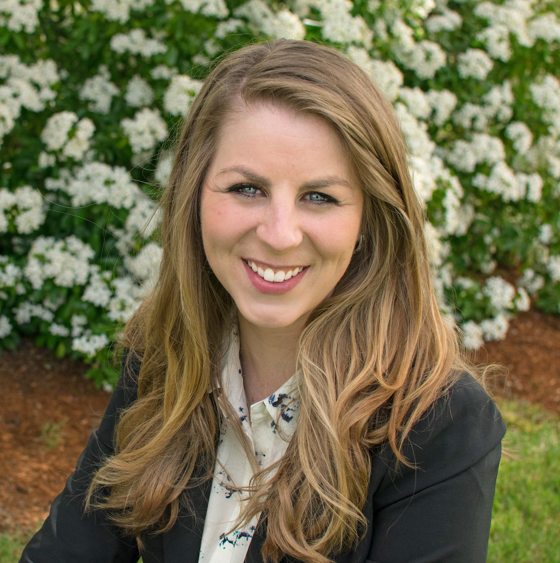
Development of Education Short Films
Communication and outreach is crucial for building awareness and understanding of the value of seed testing and the service that AOSA/SCST provides to it
Creating modernized communications is essential for viewer interest and engagement, especially younger audiences
Advancing training of seed testing methods
Development of these short films will lend themselves to furthering the recognition and realization of the value of AOSA/SCST through up-to-date modes of communication
AOSA/SCST Staff, Mary Jo Foley-Birrenkott

Slide 10
United Seed Testing Organization
USTO - Working Group
Currently focusing on critical elements of the proposed USTO bylaws
Long range planning is in the works
We appreciate all the hard work!!

Slide 11
SCST Publications
2019
VS
2018
2002 What Is Seed Vigor CD: 0
2016 Seed Technologist Training Manual Chapter 14: 0
(No manuals were sold due to the chapter being added to the 2018 edition)
2018 Seed Technologist Training Manual: 10
(This included a price increase from $185 to $300 due to the large content and information this edition holds)
2002 What Is Seed Vigor CD: 3
2016 Seed Technologist Training updated Manual Chapter 14: 4
2018 Seed Technologist Training Manual: 21

Slide 12
SCST Membership
2019
VS
2018
124 RST
16 CVT
26 RGT
10 CGT
4 Research Members
4 Professional Members
86 Associate Members
132 RST
14 CVT
29 RGT
12 CGT
5 Research Members
2 Professional Members
91 Associate Members

Slide 13
2019 and Beyond
Participation in the following upcoming events / meetings:
Association of Seed Certifying Agencies (AOSCA), 100th Anniversary
June 23-26, 2019 in Chicago, Illinois
Association of American Seed Control Officials (AASCO)
May 31 - June 4, 2019 in Chicago, Illinois
International Seed Testing Association (ISTA)
June 26 - July 3, 2019 in Hyderabad, India
American Seed Trade Association (ASTA)
Dec 9-12, 2019 Chicago, Illinois
Western Seed Association Conference
Nov 2-4, 2019 in Kansas City, Missouri

Slide 14
Sneak Peak…
Future Annual Meetings
2020 Indianapolis, Indiana
June 13th-17th, in conjunction with American Seed Trade Association (ASTA)
2021 Saskatoon, Saskatchewan, Canada
2022 Mid-West Region (100th Anniversary for SCST)

Slide 15
Job Postings
Visit us on LinkedIn for industry related job postings
AOSA and SCST
www.linkedin.com/analyzeseeds
11 Job posts were utilized on the AOSA/SCST Website and LinkedIn from June 2018 to present. Each post is $130.00 split profit to both AOSA & SCST.

Slide 16
You’re Invited…
When: June 13-17, 2020
Where: Indianapolis, Indiana
Who: AOSA/SCST with ASTA
2020 Annual Meeting

Slide 17
Keep up with SCST
Connect with us via Twitter and Facebook to stay updated on events, news, job postings and more.
Follow/Like/Share!
AOSA and SCST
AOSA and SCST
www.linkedin.com/analyzeseeds
@analyzeseeds

