Slide 1
Balansa Clover Germ Referee (Trifolium michelianum)
Rachel Henricks, RST

Slide 2
BACKGROUND
Balansa clover is a versatile crop growing in popularity.
“It can be used as a cover crop for nitrogen production and weed control or as a forage in mixtures with other legumes and grasses. It can also be used for hay; silage (by itself, with small grains, or in rotation with corn silage); or for over-seeding warm season grasses. “ https://goseed.com/cover-crops/balansa-clover
Image credit: https://forages.oregonstate.edu/forages/balansa-clover

Slide 3
BACKGROUND
In the past 10 years the market for balansa clover in North America has grown from less than 20,000 pounds to close to 2,000,000 pounds. It is presently the fourth most popular clover by volume following red, crimson, and white clovers. With the growing popularity of cover crops it is estimated that the market for balansa clover could double in size by 2030, putting the volume of seed movement in the future on par with that of white clover.
Jerry Hall, Co-founder, President of Grassland Oregon; BALANSA CLOVER | Cover Crops | Go Seed

Slide 4
Update on purity procedures for Trifolium michelianum
Seed counts for 12 lots conducted by three separate labs over three years have been completed.
PSU of 2 recommended, to harmonize with other agricultural crop clover seeds, based on seed count and to harmonize with ISTA.
Average purity weight of 2 grams, with a bulk weight of 20 grams recommended, based on seed count and to harmonize with ISTA.
Species class of A, Agricultural recommended based on use as a cover crop.
Next Steps:
Seed count data to be analyzed by statistics committee
(Purity committee has been consulted for confirmation of species class and PSU)

Slide 5
CURRENT PURITY RULES for T. michelianum
ISTA
Purity weight: 2 grams
Other Seed Determination weight: 20 grams
AOSA
No Rule
Canada
No Rule

Slide 6
Seed Count Data
 | Lab # | Variety | rep 1 | rep 2 | rep 3 | rep 4 | rep 5 | rep 6 | rep 7 | rep 8 | Mean | Variance | STDEV | CoVar | seeds/# | purity wt.
2020 | 47953 | Taipan | 0.0865 | 0.0831 | 0.0808 | 0.0841 | 0.0851 | 0.0867 | 0.0858 | 0.0791 | 0.0839 | 7.56857E-06 | 0.002751 | 3.279027 | 540643.6 | 2.098
2020 | 51059 | Taipan | 0.0925 | 0.0957 | 0.0927 | 0.0892 | 0.0859 | 0.0912 | 0.0877 | 0.0901 | 0.090625 | 9.585E-06 | 0.003096 | 3.416237 | 500524.1 | 2.266
2020 | 51060 | Taipan | 0.0958 | 0.0944 | 0.0923 | 0.0915 | 0.0975 | 0.0946 | 0.1059 | 0.0948 | 0.09585 | 2.00029E-05 | 0.004472 | 4.666098 | 473239.4 | 2.396
2020 | 51061 | Taipan | 0.0827 | 0.0823 | 0.0819 | 0.0845 | 0.0834 | 0.0929 | 0.0838 | 0.0830 | 0.084313 | 1.27241E-05 | 0.003567 | 4.230792 | 537998.5 | 2.108
2020 | 51062 | Taipan | 0.0918 | 0.0845 | 0.0916 | 0.0957 | 0.0896 | 0.0893 | 0.0896 | 0.0907 | 0.09035 | 9.83714E-06 | 0.003136 | 3.471413 | 502047.6 | 2.259
2020 | 51063 | Taipan | 0.0980 | 0.0980 | 0.0948 | 0.0968 | 0.0973 | 0.1015 | 0.1012 | 0.1005 | 0.098513 | 5.54411E-06 | 0.002355 | 2.390146 | 460449.2 | 2.463
2020 | 51165 | Fixation | 0.1127 | 0.1120 | 0.1139 | 0.1136 | 0.1096 | 0.1109 | 0.1093 | 0.1102 | 0.111525 | 3.19357E-06 | 0.001787 | 1.602382 | 406724.9 | 2.788
2020 | 51656 | Vista | 0.0949 | 0.0938 | 0.0941 | 0.0934 | 0.0955 | 0.0960 | 0.0944 | 0.0973 | 0.094925 | 1.66786E-06 | 0.001291 | 1.360501 | 477850.9 | 2.373
2020 | 51657 | Vista | 0.0877 | 0.0937 | 0.0898 | 0.0910 | 0.0907 | 0.0901 | 0.0861 | 0.0901 | 0.0899 | 5.09429E-06 | 0.002257 | 2.510626 | 504560.6 | 2.248
2020 | 51658 | Vista | 0.0894 | 0.0891 | 0.0882 | 0.0904 | 0.0875 | 0.0940 | 0.0890 | 0.0886 | 0.089525 | 3.99643E-06 | 0.001999 | 2.233015 | 506674.1 | 2.238
2020 | 51659 | Vista | 0.0937 | 0.0962 | 0.0945 | 0.0945 | 0.0994 | 0.0970 | 0.0957 | 0.0929 | 0.095488 | 4.28411E-06 | 0.00207 | 2.167622 | 475036 | 2.387
2020 | 51660 | Vista | 0.0838 | 0.0904 | 0.0896 | 0.0927 | 0.0867 | 0.0901 | 0.0909 | 0.0909 | 0.089388 | 7.93839E-06 | 0.002818 | 3.152024 | 507453.5 | 2.235
2020 | 51725 | VNS | 0.1099 | 0.1127 | 0.1106 | 0.1133 | 0.1147 | 0.1124 | 0.1129 | 0.1169 | 0.112925 | 4.85357E-06 | 0.002203 | 1.950925 | 401682.5 | 2.823
2020 | OSU | ? | 0.1024 | 0.1068 | 0.1038 | 0.1051 | 0.0996 | 0.0921 | 0.0917 | 0.1022 | 0.100463 | 3.24341E-05 | 0.005695 | 5.668876 | 451511.8 | 2.512
2021 | 54307 | Paradana | 0.0813 | 0.0802 | 0.0836 | 0.0832 | 0.0882 | 0.0841 | 0.0851 | 0.0810 | 0.083338 | 6.69696E-06 | 0.002588 | 3.105264 | 544292.8 | 2.083
2021 | 54308 | Paradana | 0.0865 | 0.0825 | 0.0853 | 0.0835 | 0.0893 | 0.0841 | 0.0825 | 0.0852 | 0.084863 | 5.18268E-06 | 0.002277 | 2.682633 | 534511.7 | 2.122
2015 | AGRI | ? | 0.0990 | 0.1030 | 0.1000 | 0.0980 | 0.1020 | 0.1030 | 0.1000 | 0.0980 | 0.100375 | 4.26786E-06 | 0.002066 | 2.058161 | 451905.4 | 2.509
2022 | 67544 | Fixation | 0.1090 | 0.1076 | 0.1098 | 0.1097 | 0.1055 | 0.1087 | 0.1037 | 0.1036 | 0.1072 | 6.68E-06 | 0.002585 | 2.410979 | 423134.3 | 2.68
2022 | 68714 | VNS | 0.0825 | 0.0805 | 0.0804 | 0.0828 | 0.0786 | 0.0793 | 0.0792 | 0.0796 | 0.080363 | 2.38554E-06 | 0.001545 | 1.921939 | 564442.4 | 2.009
2022 | 68563 | VNS | 0.0766 | 0.0796 | 0.0737 | 0.0791 | 0.0715 | 0.0740 | 0.0742 | 0.0738 | 0.075313 | 8.10982E-06 | 0.002848 | 3.781278 | 602290.5 | 1.883
2022 | 68564 | VNS | 0.0813 | 0.0889 | 0.0888 | 0.0901 | 0.0860 | 0.0866 | 0.0883 | 0.0848 | 0.08685 | 8.06571E-06 | 0.00284 | 3.270029 | 522279.8 | 2.171
2022 | 66899 | Fixation | 0.0853 | 0.0926 | 0.0920 | 0.0887 | 0.1046 | 0.0981 | 0.0878 | 0.0942 | 0.092913 | 3.82755E-05 | 0.006187 | 6.658655 | 488201.3 | 2.323
2022 | 66900 | Fixation | 0.0847 | 0.0874 | 0.0877 | 0.0977 | 0.0867 | 0.0875 | 0.0924 | 0.0857 | 0.088725 | 1.82593E-05 | 0.004273 | 4.816104 | 511242.6 | 2.218

Slide 7
Proposed Rule
Voume 1, Table 2A
Pure Seed Unit # | Chaffy (C ) or Super Chaffy (SC)ª | Kind of seed | Minimum weight for purity analysis^{b} | Minimum weight for noxious weed seed or bulk examination | Approximate number of seeds per gram^{c} | Approximate number of seeds per ounce^{d}
 |  |  | Grams | Grams | Number | Number
2 |  | Trifolium michelianum Balansa clover | 2 | 20 | 1081 | 30948
Voume 3, Uniform Classification
NOMEN # | SCIENTIFIC NAME | COMMON NAME | FAMILY | SPP. CLA SS | CONTAMINATING CLASSIFICATION
 |  |  |  |  | A | F | H | R | S | T | V
300620 | Trifolium michelianum Savi | clover, big-flowered; clover, balansa | Fabaceae | W A | W C | W | W | W | W | W | W

Slide 8
Harmonization
This proposal would harmonize with the ISTA Rules for Testing Seeds, which also uses 2 grams for the Purity weight and 20 grams for the bulk weight/Other Seed Determination.
This proposal would not harmonize with the Canada Methods and Procedures or the Canada Grade Tables which do not have testing methods or grade table standards for Trifolium michelianum.

Slide 9
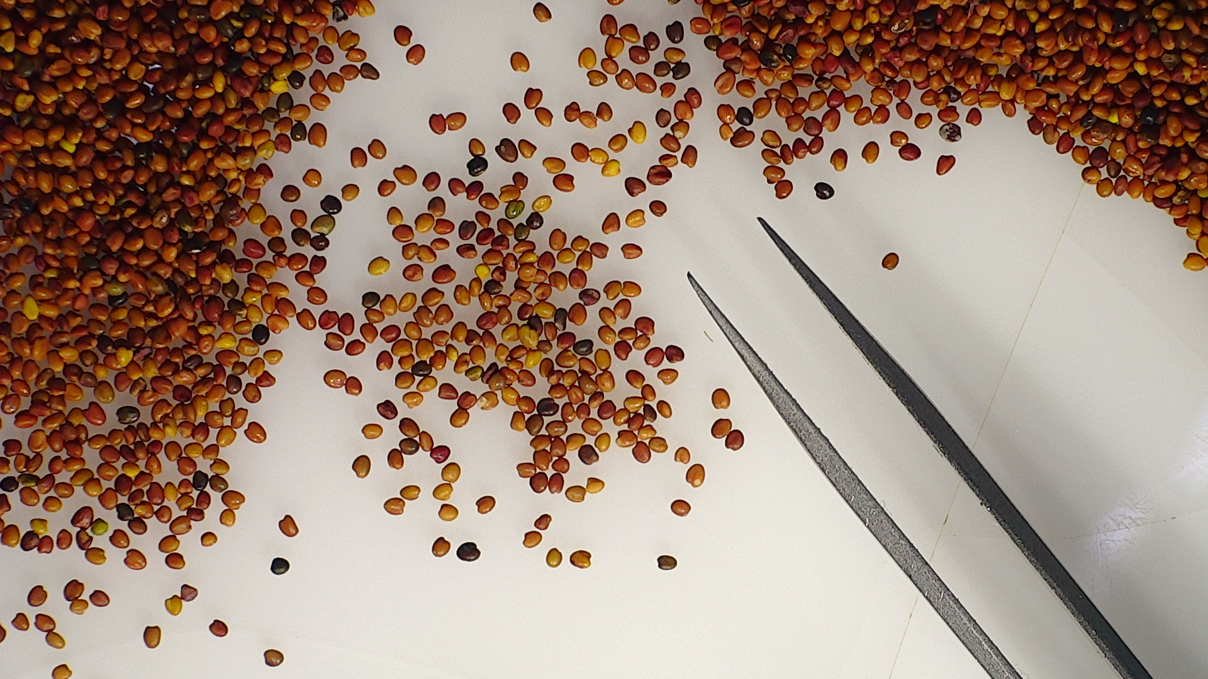
OBJECTIVE
To add Trifolium michelianum to AOSA Rules for Testing Seeds Volume 1; Table 6A. Methods of testing for laboratory germination.

Slide 10
CURRENT GERMINATION RULES for T. michelianum
ISTA
Substrate: Top of Paper
Temperature: 20°C or 15°C
First count: 4 days
Final count 10
Prechill Dormant seed
AOSA
No Rule
Canada
No Rule

Slide 11
CURRENT GERMINATION RULES FOR MAJORITY OF OTHER TRIFOLIUM SPECIES
ISTA
17 Trifolium species listed in Table 5A Part 1
Temperature: 20°C or 15°C
Substrate: Top of Paper or Between Paper
Prechill Dormant seed
AOSA
16 Trifolium species listed in Table 6A.
Temperature @ 20°C
Substrates: B, T, S
Prechill Dormant at 15°C
Canada
10 Trifolium species listed in Table 5
Temperatures @ 20°C or 18°C
Substrates: Between paper; Rolled towel
Prechill Dormant seed

Slide 12
PROPOSED REFEREE STUDY (Summer 2023)
Seed Lots
Test 6 lots of T. michelianum with varying quality.
Temperature
Test using two Temperatures: 20°C and 15 °C
Substrate
Test using 3 substrates:
Top of Blotter
Between Blotter
Rolled Towel

Slide 13
INTERESTED?
Sign up sheet in the back.
Questions? Suggestions?
Contact: Rachel Henricks
Henricks Seed Lab
rachel.henricks@gmail.com

Slide 14
REQUEST FOR INFORMATION
Currently collecting seed count data for T. michelianum.
Would like to add this species to AOSA Rules for Testing Seeds Volume 1 Table 2A.
Please send any data to Rachel:
rachel.henricks@gmail.com

