Slide 1
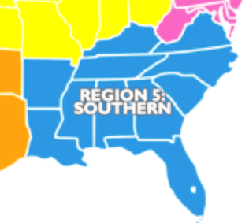
2022-2023 Region 5 Referee Bahiagrass Seed Retrieval & ID
Region 5: AL, AR, FL, GA, KY, LA, MS, NC, SC, TN, VA
(USDA Labs - 2, State Labs – 10, Private Labs – 2, Seed Company Labs - 0)
Prepared by David M. Johnston, CSA/RST
April 28, 2023
Notes:
Region 5: TN – No State Seed Lab; GA – 2 Private Seed Labs; USDA Seed Labs NC & GA - 2

Slide 2
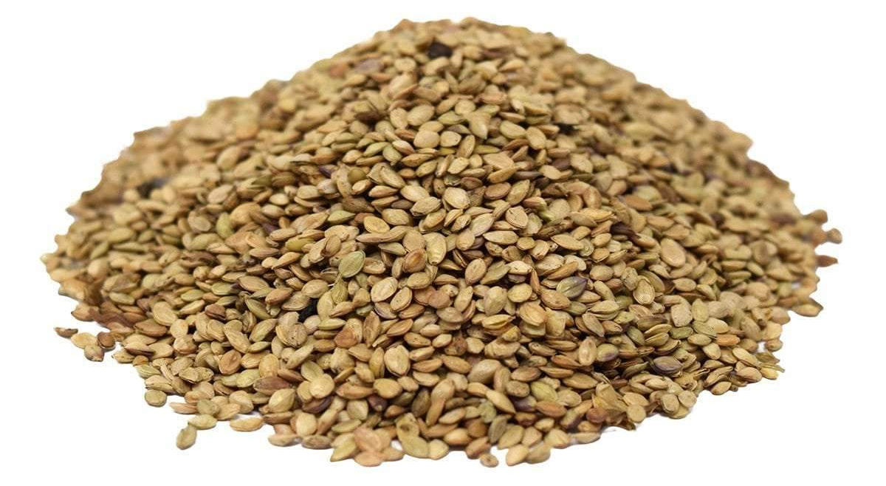
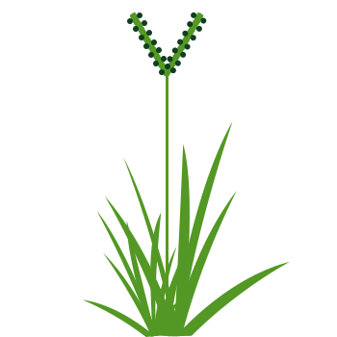
Region 5 Referee – 2022 Buzz Session Discussion
Most of the labs in Region 5 test both ‘Pensacola’ and ‘Argentine’ cultivars of Bahiagrass, as well as other ‘Pensacola-type’ (i.e., smaller-seeded) cultivars.
The question was posed during a Region 5 Referee Buzz Session…
“How well can analysts separate a mixture consisting of both ‘Pensacola’ and ‘Argentine’ Bahiagrass?”
Thus…this referee project was created to help answer this question!!!

Slide 3
Region 5 Referee – 25 Participants
Participants | Lab |  | Participants | Lab
Gordon Baldridge | AR State Seed Lab |  | David Johnston | LA State Seed Lab
JoAnn Hornseth | *CFIA/Canada |  | Perphyria Kador | “
Saliha Rahman | “ |  | Mark Spencer | “
Nicole Wurm | “ |  | Valerie Spencer | “
Cody Bell | FL State Seed Lab |  | Ronwood Harris | NC State Seed Lab
Holly Higgins | “ |  | Crystal Whit | “
Michael Kelley | “ |  | Ashley Thomas | *ND State Univ.
Damaris Rodriguez | “ |  | Jane Penrose | *Agri Seed Testing OR
Amy Gonzales | GA State Seed Lab |  | Tracy Lamb | SC State Seed Lab
Jenny Hall | “ |  | Robin Lambert | “
Nancy Hand | “
Vanesa Richardson | “
Shonda Sears | “
Dedria Smith | “
Amanda Suggs | “
* Non-Region 5 Participants

Slide 4
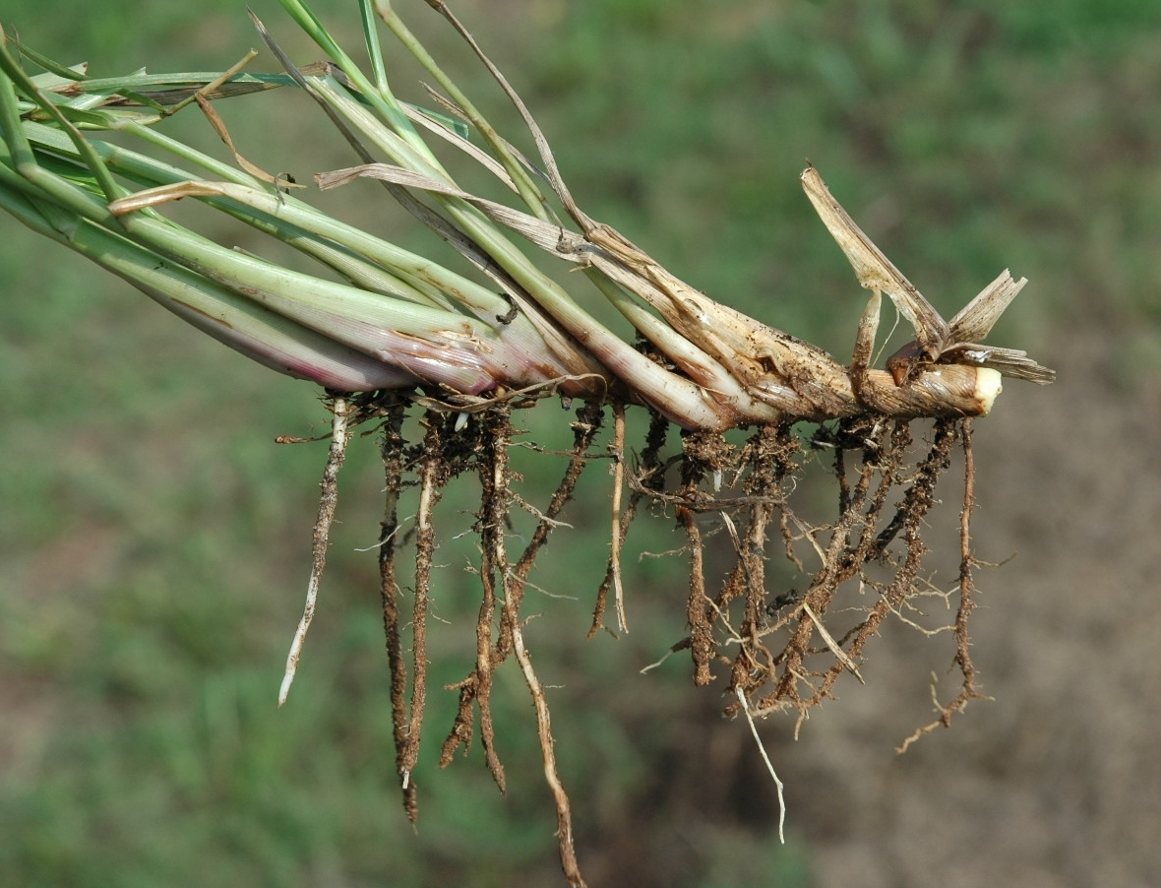
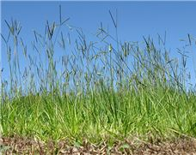
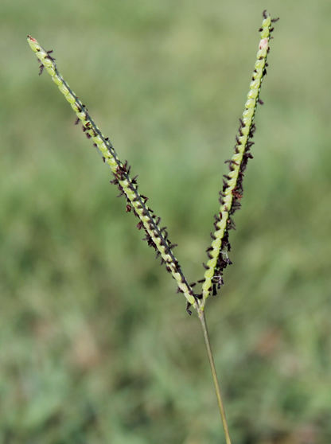
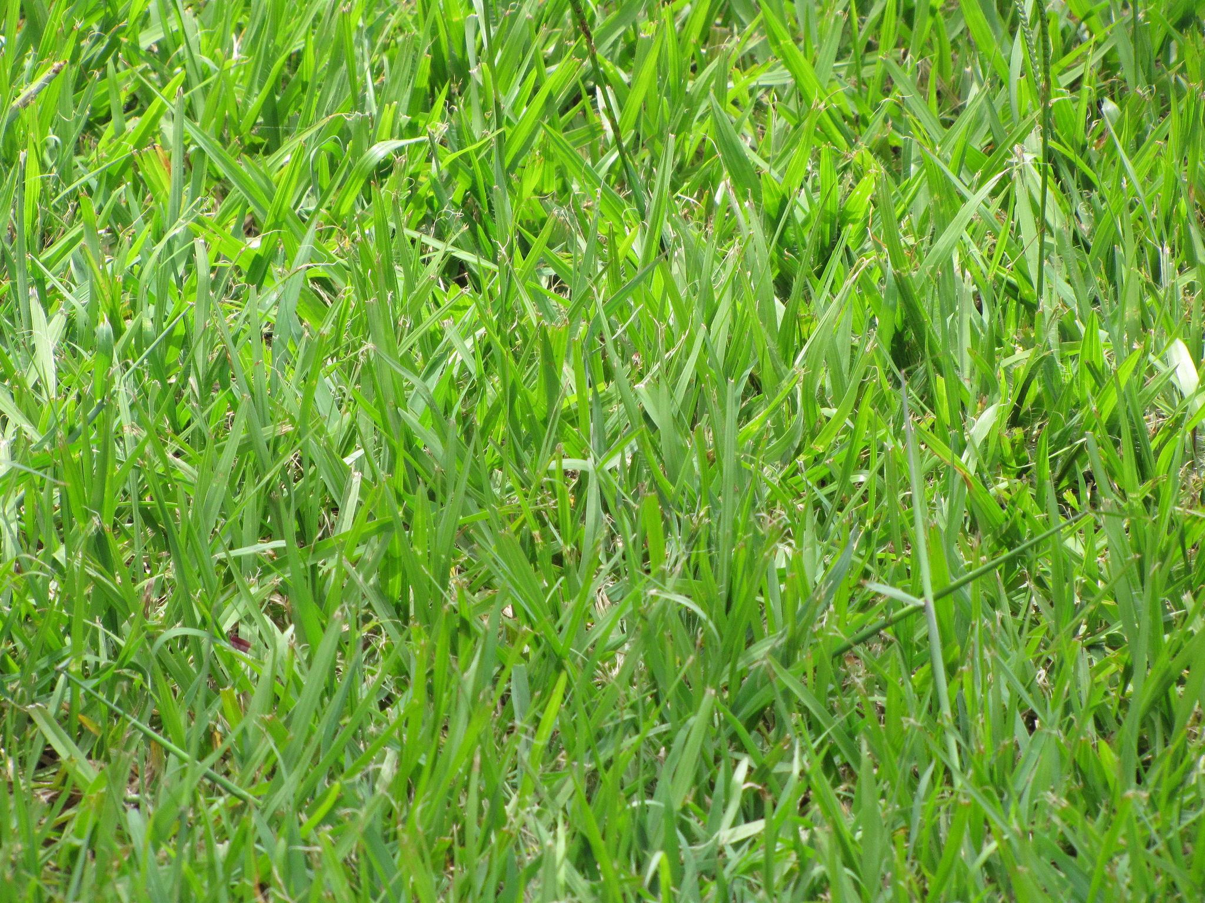
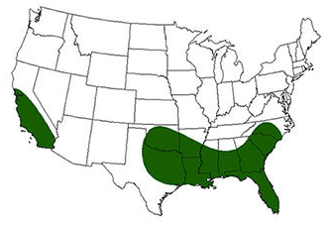
Region 5 Referee – Bahiagrass (Paspalum notatum Flügge′)
Stolons/Roots
Pasture
Turf
V-shaped seed head
Thought to be over 400 species of Paspalum globally. Most are considered weedy species. P. notatum (Bahiagrass) is a low-maintenance wide-bladed thick growing turf/pasture grass. Needs little water or fertilizer and is drought-tolerant and can thrive in nutrient-poor soil. Bahiagrass can tolerate some shade. Spreads by stolons (root-like stems) but does not spread aggressively. It does not like cold. Great grass to grow from Florida to the Texas Gulf Coast.
Cost……..‘Argentine’ seed is typically more expensive than ‘Pensacola’ seed.

Slide 5
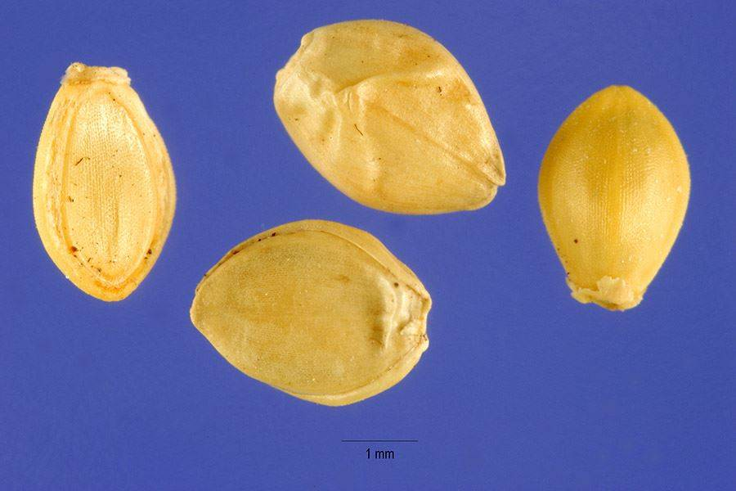
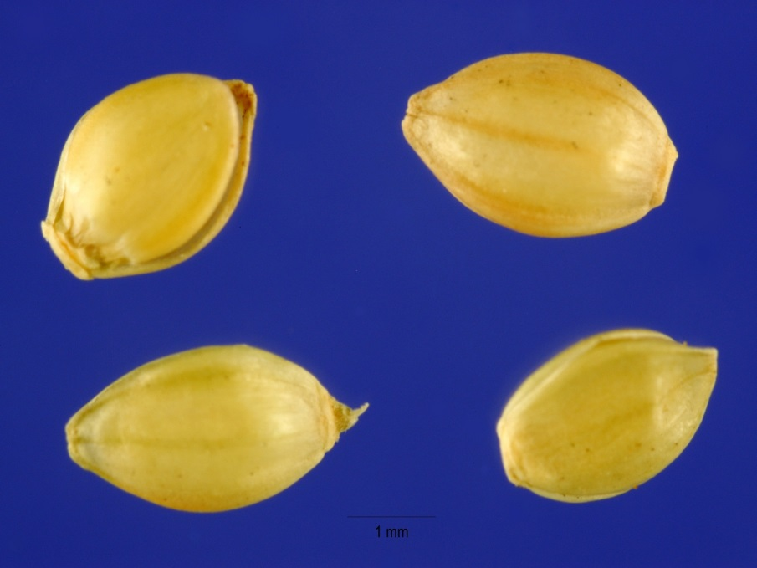
Bahiagrass - (Paspalum notatum Flügge′)
According to USDA Handbook 219, ‘Argentine’ seed tends to be slightly the larger of the two cultivars and typically has a wrinkled lemma, whereas ‘Pensacola’ seed tends to be slightly smaller and have a smooth lemma.
Argentine Bahiagrass
Pensacola Bahiagrass
Photo: Steve Hurst at USDA PLANTS Database
Photo: Steve Hurst at USDA PLANTS Database
Notes:
Images comparing Argentine with Pensacola. Argentine tends to be a slightly larger seed and typically has a wrinkled lemma whereas Pensacola tends to have a smooth lemma.

Slide 6
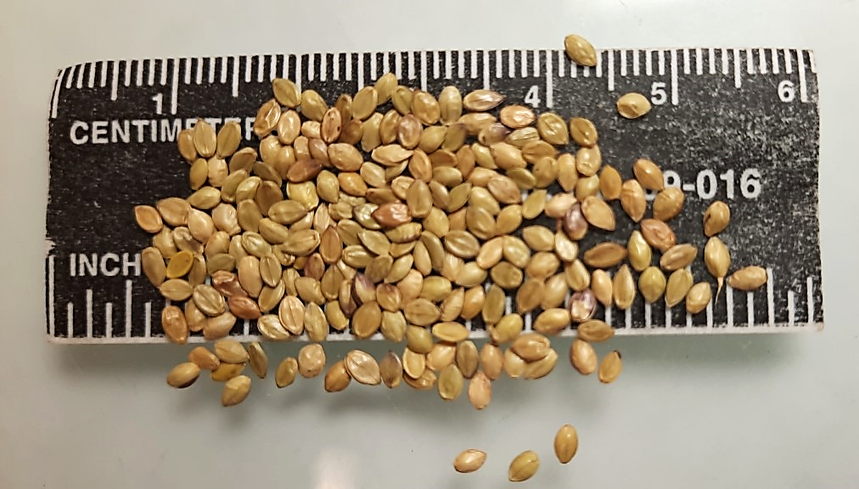
‘Pensacola’ Bahiagrass

Slide 7
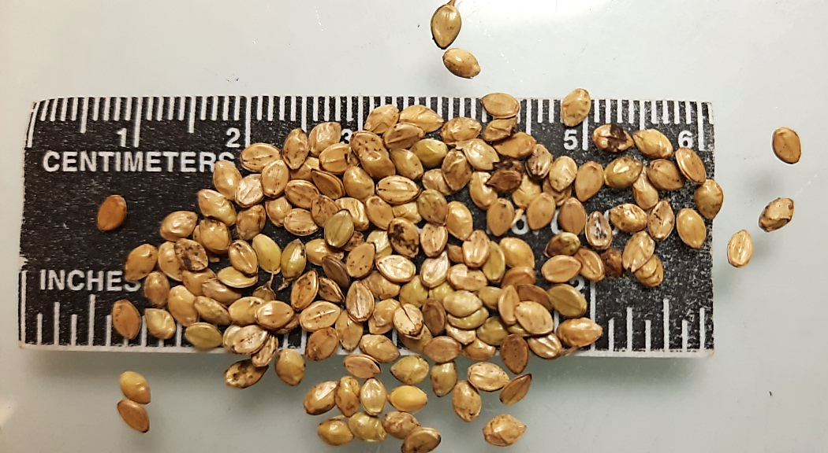
‘Argentine’ Bahiagrass

Slide 8
‘Pensacola’ Bahiagrass
‘Argentine’ Bahiagrass

Slide 9
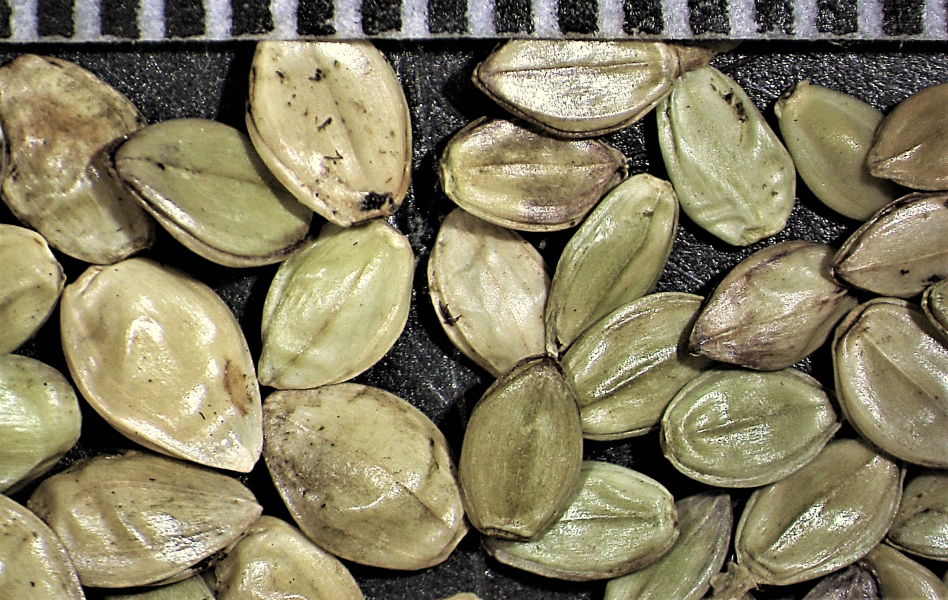
‘Argentine’ Bahiagrass
‘Pensacola’ Bahiagrass

Slide 10
Region 5 Referee – Purpose/Instructions
PURPOSE:
The purpose of this referee was to determine the ability of analysts to retrieve and identify a known number of spiked Bahiagrass seeds in five separate Bahiagrass referee samples. (Note: All referee samples were checked for contaminating Bahiagrass species before they were spiked.)
INSTRUCTIONS:
Retrieve and identify spiked ‘Argentine’ Bahiagrass seeds from four ‘Pensacola’ Bahiagrass referee samples.
Retrieve and identify spiked ‘Pensacola’ Bahiagrass
seeds from one ‘Argentine’ Bahiagrass referee sample.

Slide 11
Region 5 Referee – Purpose/Instructions
INSTRUCTIONS: (cont.)
This is not a purity exam referee; other contaminants are not to be separated from the 5 referee samples; all Bahiagrass seeds found exhibiting ergot are considered PSUs and not inert matter.
Participants will be assigned an ID number for anonymity. Those that returned results will be sent the referee data and awarded one CE Point.
NOTE:
Referee samples and contaminating seeds retrieved and identified by referee participants were NOT returned
to the referee organizers for confirmation.

Slide 12
Region 5 Referee – Analyst Certifications and Referee Participant Rating
Referee Participant Rating Process:
To better analyze the data, participants were asked to self identify using the following criteria via a participant survey:
Range of years of Bahiagrass purity testing experience
(i.e., <2 yrs., 2-5yrs., 6-10 yrs. or >10 yrs.)
Range of Bahiagrass purity samples conducted over their career
(i.e., <50, 50-99, 100-500, or >500)
Analyst Certifications:
RST/CSA 3
RST 1
CSA P/G 3
CSA P 1
CSA G 6
Other (CFIA) 2
None 9
TOTAL 25

Slide 13
Region 5 Referee – Participant Referee Rating
Participant Referee Rating Process:
Using the years of Bahiagrass purity experience and career number
of Bahiagrass purity samples tested, participants were assigned a
“Bahiagrass Purity Experience” (BPE) Value. (Range: high of 8 - low of 0)
BPE Value Rating
BPE 7 to 8 = A+ (Very Experienced)
BPE 5 to 6 = A (Experienced)
BPE 4 to 0 = B (Little to No Experience)
Participant Referee Rating Totals:
A+ 4 Participants
A 16 Participants
B 5 Participants
(***The Participant Referee Ratings can be used to better interpreted the referee data.***)

Slide 14
Region 5 Referee – Data Overview & Graph
Extreme Outlier
(Data not used)
Referee
Samples
Participants
(Did Not Complete)

Slide 15
Region 5 Referee – Data Graph
Number of Spiked Seeds

Slide 16
Spiked
+A
A
B

Slide 17
Lot A by Participant Rating
B
105.75 avg.
Spiked
+A
82.75 avg.

Slide 18
Lot B by Participant Rating
Spiked
A
68.06 avg.
B
127.00 avg.

Slide 19
Lot C by Participant Rating
Spiked
+A
92.25 avg.
A
110.00 avg.
B
173.25 avg.

Slide 20
Lot D by Participant Rating
Spiked
+A
25.00 avg.
A
32.44 avg.
B
47.75 avg.

Slide 21
Lot E by Participant Rating
Spiked
+A
103.25 avg.
A
103.50 avg.
B
197.75 avg.

Slide 22
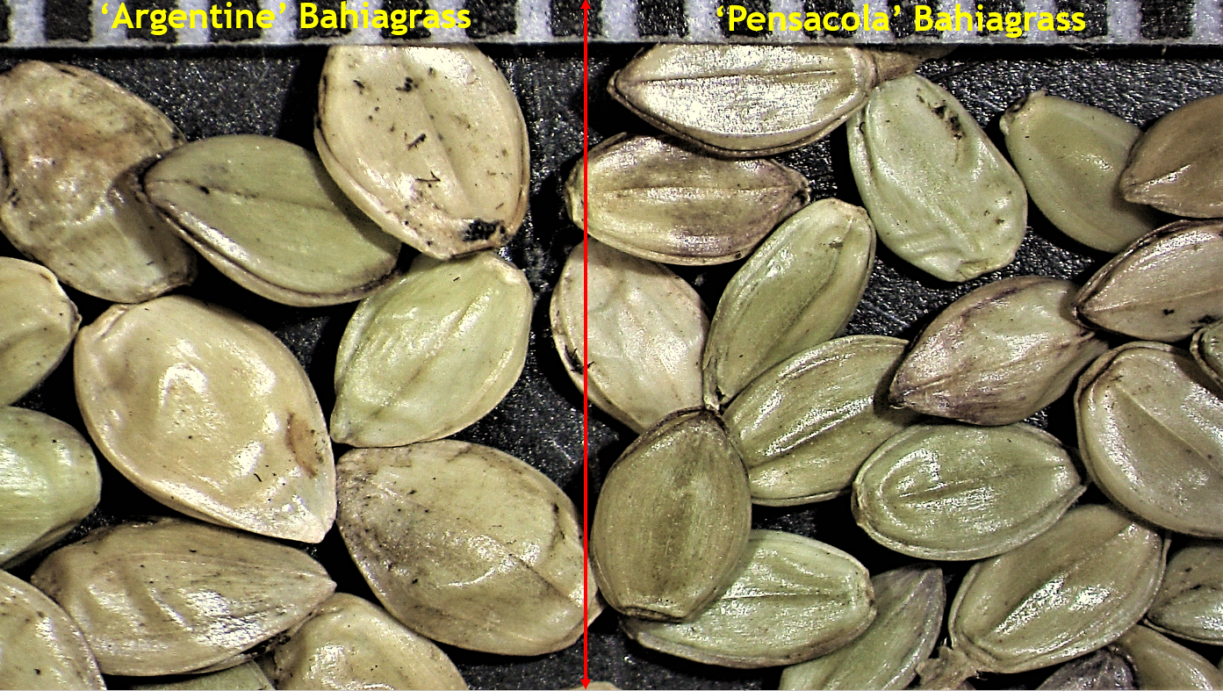
Region 5 Referee – Observations/Conclusions
‘Argentine’ and ‘Pensacola’ seeds can be very difficult to distinguish (impossible?), when they are a contaminate in samples of the other cultivar
Larger seeds of ‘Pensacola’ may be indistinguishable when they are in ‘Argentine’
and smaller seeds of ‘Argentine’ may be
indistinguishable when they are in ‘Pensacola’
Larger seeds of ‘Pensacola’ may be incorrectly classified as ‘Argentine’ when found in a ‘Pensacola’ sample

Slide 23
Region 5 Referee – Observations/Conclusions
Smaller seeds of ‘Argentine’ may be incorrectly classified as ‘Pensacola’ when found in an ‘Argentine’ sample
Analysts with several years of experience conducting purity exams on Bahiagrass, tend to be better at identifying/retrieving ‘Argentine’ and ‘Pensacola’ seeds when they are a contaminate in samples of
the other cultivar
Locate and/or create additional seed identification resources for analysts
Conduct more training sessions and referee projects
Bahia Seed
Identification
Manual

Slide 24
Region 5 Referee – 25 Participants
Participants | Lab |  | Participants | Lab
Gordon Baldridge | AR State Seed Lab |  | David Johnston | LA State Seed Lab
JoAnn Hornseth | *CFIA/Canada |  | Perphyria Kador | “
Saliha Rahman | “ |  | Mark Spencer | “
Nicole Wurm | “ |  | Valerie Spencer | “
Cody Bell | FL State Seed Lab |  | Ronwood Harris | NC State Seed Lab
Holly Higgins | “ |  | Crystal Whit | “
Michael Kelley | “ |  | Ashley Thomas | *ND State Univ.
Damaris Rodriguez | “ |  | Jane Penrose | *Agri Seed Testing OR
Amy Gonzales | GA State Seed Lab |  | Tracy Lamb | SC State Seed Lab
Jenny Hall | “ |  | Robin Lambert | “
Nancy Hand | “
Vanesa Richardson | “
Shonda Sears | “
Dedria Smith | “
Amanda Suggs | “
* Non-Region 5 Participants

Slide 25
Region 5 Referee – Organizers/Contributors
Andrae McMillain, CSA/RST (AL State Seed Lab) – Region 5 Chair
Packed and shipped referee samples to participants.
Kevin Buis, RST (AB Seed Lab, GA) – Referee Co-Organizer
Obtained seed and prepared referee samples.
David Johnston, CSA/RST (LA State Seed Lab) – Referee Co-Organizer
Obtained seed, prepared referee samples, and prepared report.

Slide 26
