Slide 1
AOSA/SCST Rule Proposal – Organic Growing Media for Peas
Kaitlin Houghtby
------------

Slide 2
Introduction
Adding organic growing media as a primary testing platform for Pisum sativum
Using organic growing media can potentially provide faster results
Avoid retesting in organic growing media if decay is present in sample
Potentially faster evaluations
No towel folding and re-folding for first and final counts
No first count necessary in organic growing media
100 seed reps without overcrowding seedlings
More development of seedlings at end of testing period
Less ergonomic risks as it is not as heavy as sand

Slide 3
Design of Experiment
6 lots of Peas were used
6 different varieties
No treatments used
2 lots with quality specs between 83-92%
3 lots with quality specs between 93-99%
1 lot with known issues of decay
6 labs tested each lot on each media type
Each lot was given a letter as identification
Samples were mixed and divided to approximately 550 seeds per packet
3 packets were sent for each lot to be used for each test method
Each lot was tested in Rolled Towel, Sand, and Organic Growing Media at each lab
Each lab was assigned a letter for anonymity during analysis

Slide 4
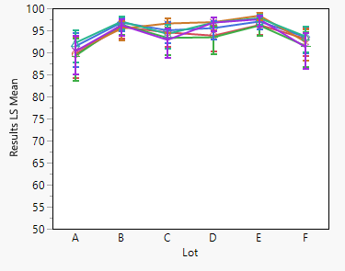
Results
Lab | Lot | Rolled Towel | Sand | Organic Growing Media
Z | A | 84 | 89 | 92
X | A | 90 | 92 | 92
V | A | 90 | 90 | 86
U | A | 92 | 92 | 86
T | A | 85 | 91 | 85
S | A | 90 | 84 | 89
Z | B | 95 | 97 | 97
X | B | 97 | 97 | 98
V | B | 97 | 98 | 86
U | B | 98 | 97 | 96
T | B | 96 | 98 | 95
S | B | 96 | 92 | 98
Z | C | 87 | 93 | 95
X | C | 94 | 93 | 95
V | C | 97 | 98 | 95
U | C | 95 | 97 | 92
T | C | 94 | 94 | 90
S | C | 97 | 93 | 92
Z | D | 97 | 96 | 98
X | D | 97 | 96 | 98
V | D | 97 | 100 | 93
U | D | 92 | 98 | 95
T | D | 94 | 95 | 89
S | D | 94 | 91 | 95
Z | E | 97 | 99 | 97
X | E | 98 | 97 | 99
V | E | 98 | 99 | 99
U | E | 97 | 98 | 97
T | E | 96 | 97 | 96
S | E | 97 | 98 | 93
Z | F | 89 | 90 | 91
X | F | 95 | 90 | 94
V | F | 92 | 92 | 91
U | F | 91 | 94 | 94
T | F | 90 | 89 | 92
S | F | 96 | 90 | 90

Slide 5
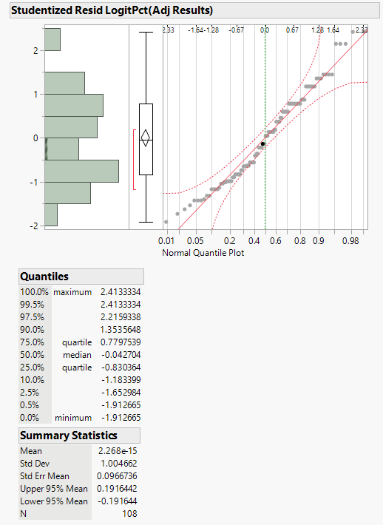
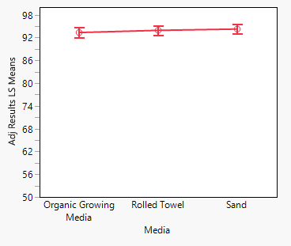
Conclusion
No statistical difference between Primary Methods of Rolled Towel/Sand and proposed method of Organic Growing Media
Analysis provided by Karen Richard from Statistics Committee

Slide 6
Acknowledgements
Bayer Crop Science
Indiana Crop Improvement Association
Nebraska Crop Improvement
Sakata Seed America, Inc.
Seed Check Technologies, Inc.
SGS Brookings
Thank you to the labs that participated in this study!
Thank you, Karen Richard from the Statistics committee, for the data analysis!

