Slide 1
AOSA & SCST
State of the Association
and Society

Slide 2
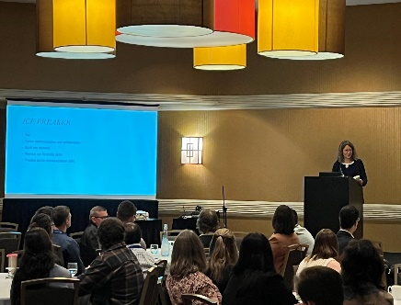
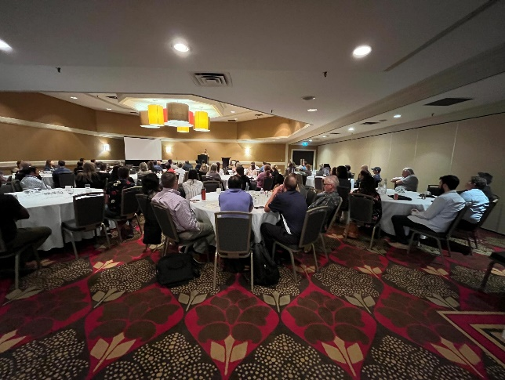
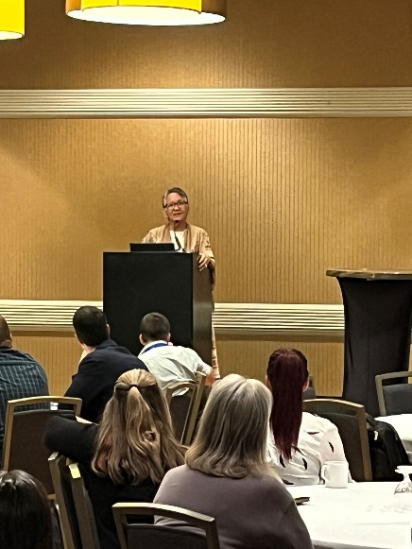
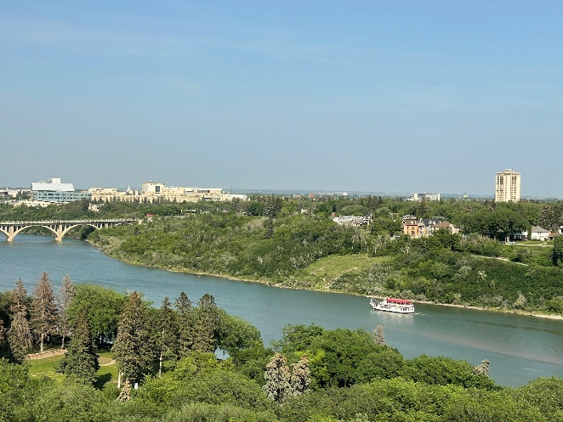
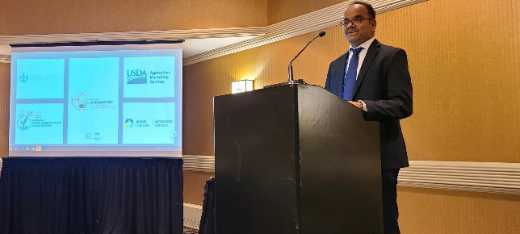

Slide 3
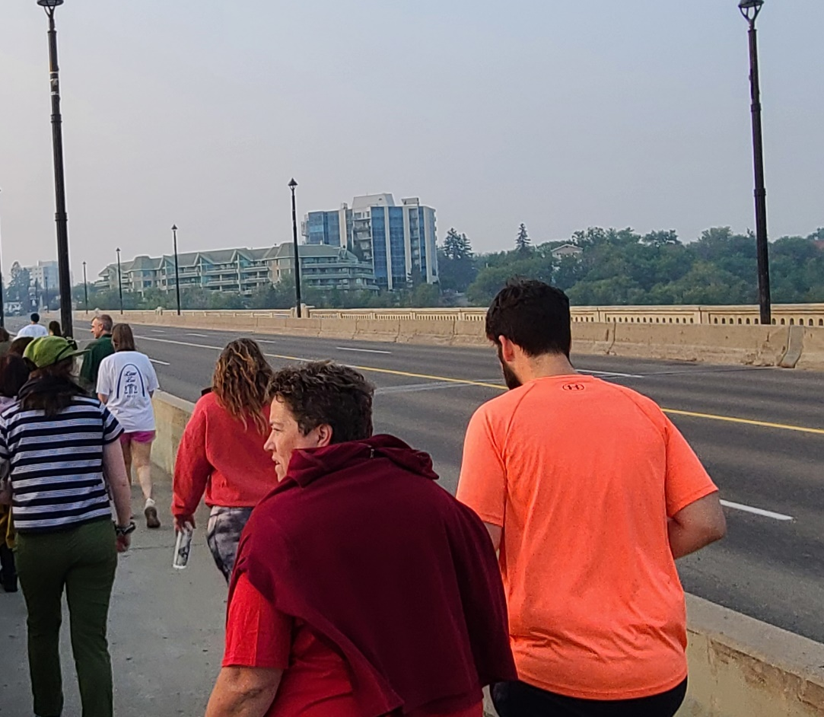
Bean Buddy Walk

Slide 4
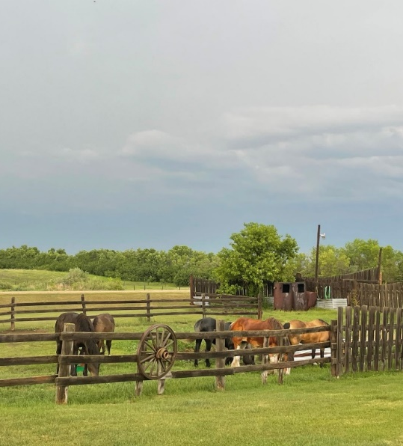
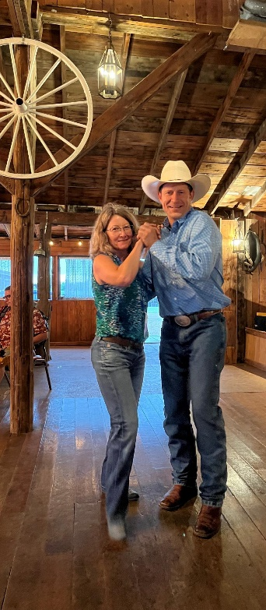
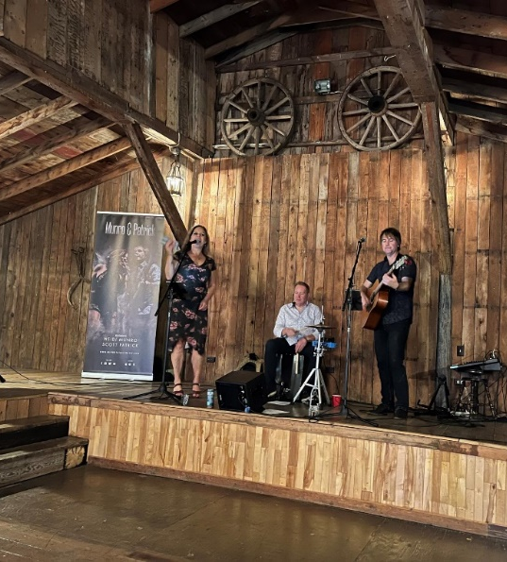
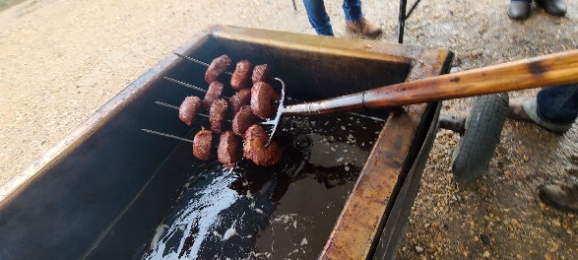

Slide 5
2023 Awards & Accolades
SCST
AOSA
Meritorious Service
Jane Penrose
Distinguished Service
Janine Maruschak 17 years of Service

Slide 6
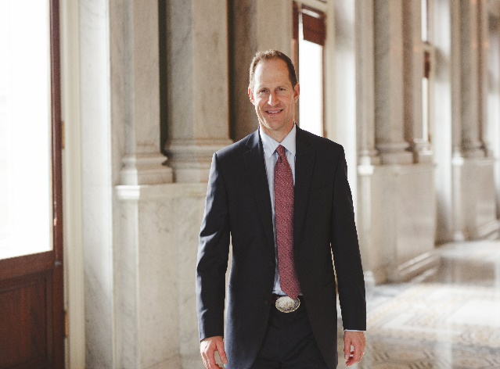
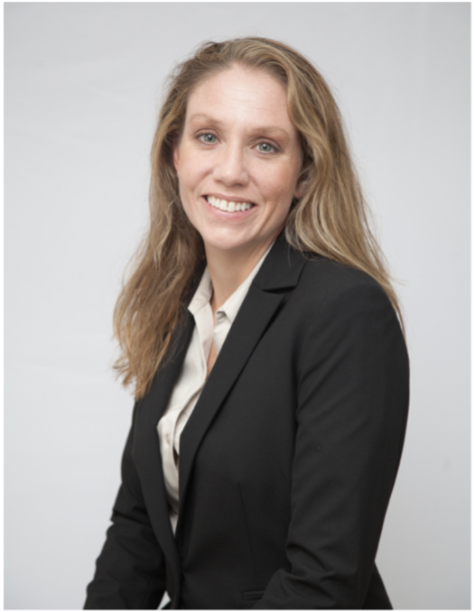
AOSA/SCST Executive Office
Jess Peterson – Executive Director
Oversees AOS & SCST Operations
Implements Programs and Policies
Annual Meeting Management
Ensures Budget Compliance
Outreach and Public Relations
Admin Support to Elected Officers
Kelly Polzin – Director of Operations
Maintains Membership Services
Manages and Updates all Training Manuals & Handbooks
Processes and Tracks Publication Orders
Manages Social Media and Email Inquiries
Manages Committee Activities
Maintains Exam Candidate Database
Updates and Maintains analyzeseeds.com

Slide 7
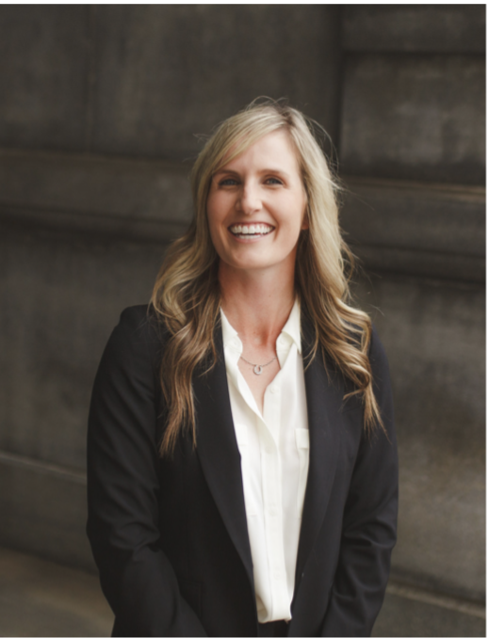
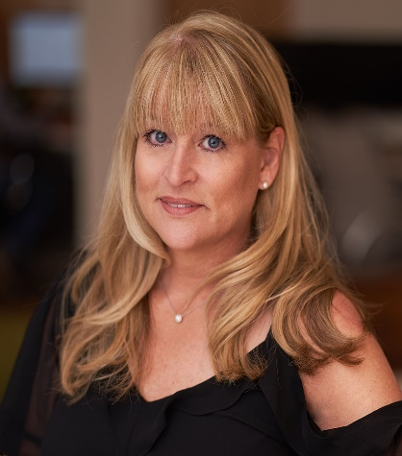
AOSA/SCST Executive Office
Kelly Fogarty - AOSA Event Operations
Act as Liaison to Host/Local Planning Committees
Manage Negotiations and Requests From Host
Act as Liaison to Hotel Negotiator
Point of Contact for Annual Meeting
Provide Insight in Preparing Bids
Provide Consulting for Annual Meeting Tours
Vivian Wintson - Director of Finance
Manages Online Accounts Payable System
Manages Expense Reports
Scheduling of Outside Audits
Manages Cash Flow
Maintains Payment Information
Vendor Point of Contact

Slide 9
AOSA – SCST Consolidation To the Future and Beyond!

Slide 10
Questions, Concerns, Complaints, Comments, Compliments
Spoke directly to a member of the working group?
Found them at the Seed Issues Forum, in the hallway, in the wild or in the hospitality suite….now email and phone or in Montana
Initiative: Consolidation
Todd Erickson
James Smith
Victor Vankus
Kathy Mathiason
Melissa Phillips
Marija Topic
Brenda Johnson

Slide 11
AOSA/SCST Social Media Year in Review
Facebook/Linkedin

Slide 12
LinkedIn
Followers – 783
We have gained 244 followers in the last year.
Impressions (the number of times content is displayed to other users on the platform) – 7,926
816 reactions
28 comments
38 reposts

Slide 13
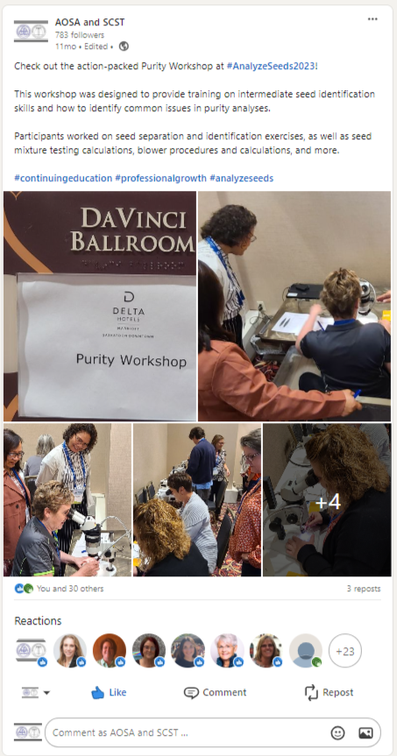
Top 3 LinkedIn Posts:
#3 – 30 likes, 3 reposts

Slide 14
Top 3 LinkedIn Posts:
#2 – 35 likes, 1 repost

Slide 15
Top 3 LinkedIn Posts:
#1 – 81 likes, 2 reposts

Slide 16
Facebook
Followers – 626
We gained 42 followers since last year.
Reach (metric that measures how many people have seen a page, post, or advertisement at least once)- 1.9k
760 content interactions
269 link clicks

Slide 17
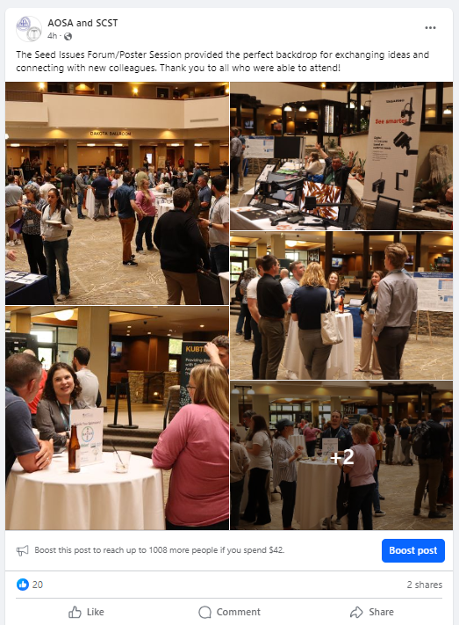
Top 3 Facebook Posts
# 3 – 20 likes, 2 shares

Slide 18
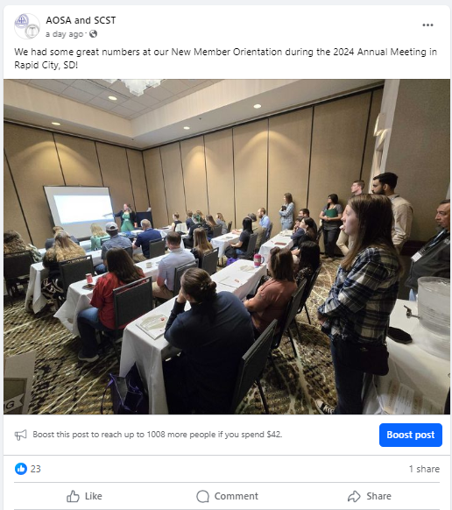
Top 3 Facebook Posts
# 2 – 23 likes, 1 share

Slide 19
Top 3 Facebook Posts
# 1 – 38 likes, 7 comments

Slide 20
Remember this?
We had multiple members reach out to tell us that Rapid City is in fact in South Dakota, not North Dakota.

Slide 21
What’s New on www.analyzeseeds.com ?
The latest news and announcements are current and up-to-date 24-7, 365 days.
Teaching & Training Committee informational & AOSA Rules Webinars PLUS Practice Questions & Tests.
Home Page houses all announcements, quick links, Facebook feed, job posts and the latest newsletter(s) to keep you current and in the know.
Don’t forget that the AOSA Rules Committee page has the capabilities to comment on proposals directly!

Slide 22
AOSA SCST Online Database Portal

Slide 25
AOSA Membership
2023
36 State lab members
4 USDA lab members
1 Canadian or CFIA Lab member
2 Allied lab members
5 Associate lab members
2024
36 State lab members
4 USDA lab members
1 Canadian or CFIA Lab member
2 Allied lab members
8 Associate lab members

Slide 26
AOSA Publications
2024
Processed 92 publication orders to 4 different countries, US, and Canada. That’s up 65% in sales compared to 2023!!
2023 AOSA Rules: 35
2021 or 2023 AOSA Rules Spanish: 0
(2023 available for purchase on 05/06/2024)
2023 Cultivar Purity Testing Handbook: 16
2024 Cultivar Purity Testing Handbook: 2 (available for purchase on 05/23/2024)
Purity Testing Handbook: 4
Seed Vigor Testing Handbook: 14
Seed Moisture Testing Handbook: 6
TZ Testing Handbook: 15
Additional Print/ Network Licenses: 60

Slide 27
SCST Membership
2023
2024
104 RST
13 CVT
16 RGT
8 CGT
5 Research Members
5 Professional Members
127 Associate Members
104 RST
24 CVT
15 RGT
7 CGT
5 Research Members
3 Professional Members
120 Associate Members
3 CPT
** Includes the technologists that passed the April exams**

Slide 28
SCST Publications
2024
2002 What Is Seed Vigor CD: 0
2016 Seed Technologist Training updated Manual Chapter 14: 1
2018 Seed Technologist Training Manual: 9
2018 Seed Technologist Training Manual Spanish: 0

Slide 29
Uniformity Working Group
Purity & Contamination
Report of Analysis
Germination
Tetrazolium
Has turned everything back over to the purity subcommittee
Has stopped meeting with the release of the updated ROA Handbook, Seed Companies guide, & general Template
Working with the Germination Committee to create the Seedling Image Database for the website
Turned over the NEW TZ Handbook to the Handbook Committee for review and publishing. This will be available for purchasing tentatively after the Annual Meeting
If issues should arise, with any or all groups, they will resume.

Slide 30
Job Postings
Visit us on LinkedIn for industry related Job Opportunities
21 Job posts at $130 each for
$2,730 split profit
7 were a Rush at $180.00 each for $1,260 split profit
AOSA and SCST
www.linkedin.com/analyzeseeds

Slide 31
Sponsorships
AOSA
SCST
Kansas City American Royal Collegiate Crops Contest $250.00
Kansas State University’s College of Agriculture the "Feeding Your Future" 2024 summer youth camp $800.00
2023 National Chicago Collegiate Crops Contest $1,000.00

Slide 32
Seed World & Seed Today
Thank You to Seed World (www.seedworld.com) and Seed Today (www.seedtoday.com) for the collaboration with AOSA & SCST and communicating the importance of our Seed Analysts & Technologists on what they do for the food supply, forests, rangelands, and gardens.

Slide 33
Industry Events & Meetings
American Seed Trade Association (ASTA)
June 15 - 19, 2024 – Leadership Summit in Nashville, TN
Association of Official Seed Certifying Agencies (AOSCA)
June 16 - 19, 2024 - Annual Meeting in Miramar Beach, FL
Organization for Economic Co-Operation & Development (OECD), Seed Schemes
June 10 - 14, 2024 – Annual Meeting in Nice, France
International Seed Trade Association (ISTA)
July 1 - 4, 2024 – Annual Meeting in Cambridge, United Kingdom
Seeds Canada
July 8 - 11, 2024 – Annual Conference in Edmonton, AB, Canada
Association of American Seed Control Officials (AASCO)
July 16 - 18, 2024 – Annual Meeting in Salt Lake City, UT
Northern Seed Trade Association (NSTA)
July 16 - 18, 2024 – Annual Meeting in Sioux Falls, SD
Western Seed Association (‘The Western’)
October 28 – 31, 2024 – Annual Convention in Kansas City, Missouri
American Seed Trade Association (ASTA)
Oct 30, 2024, Forage, Turf & Conservation Seed Conference Kansas City, MO
Dec 10 - 13, 2024, Field Crop Seed Convention Orlando, FL
Jan 31 – Feb 4, 2025, Vegetable & Flower Seed Conference Orlando, FL

Slide 34
Sneak Peak… Future Annual Meetings
2025 Missoula, MT
June 6th - 12th
Holiday Inn Missoula Downtown
200 S Pattee St
Missoula, MT 59802
2026 East Proposed Sites
June 6-12 Lexington, KY
June 13-19 Lexington, KY
June 5-11 Rochester, NY
June 12-18 Rochester, NY
2027 Midwest
No locations are set but,
Stay tuned for more information!

Slide 35
AOSA SCST 2025 Annual Meeting Missoula, Montana June 8-12, 2025

Slide 36
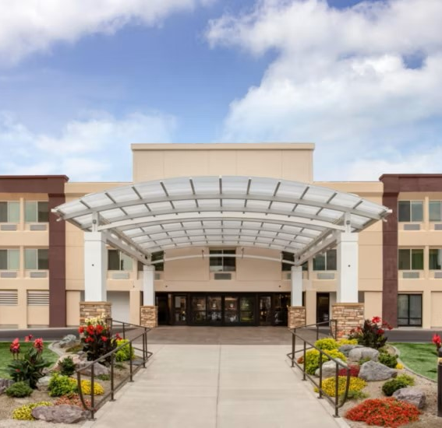
Host Hotel: Holiday Inn Missoula Downtown
$197.00/night + taxes/fees; Per Diem Rates
Complimentary Self-Parking
Complimentary WiFi in Meeting Rooms and Guest Rooms
All meeting events will take place at Host Hotel
Complimentary Airport Shuttle
Located next to Bess Reed Park, along the Clark Fork River; walkable to downtown Missoula

Slide 37
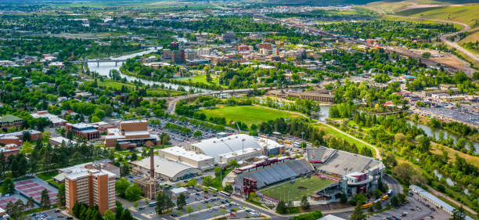
Getting to Missoula & Things to Do
Missoula International Airport
Free hotel shuttle to/from airport
Major hub for multiple airlines
Once you arrive…
Hike the “M”; walk the riverfront trail
Flathead Lake, Bitterroot Valley & More!
Explore downtown Missoula: Museums, restaurants, parks, and more!
Visit: https://destinationmissoula.org/

Slide 38
See you in Missoula—June 2025! Check for updates here: https://analyzeseeds.com/annual-meetings/

Slide 39
Keep up with AOSA/SCST
Follow/Like/Share/Watch!
AOSA and SCST
www.linkedin.com/analyzeseeds
AOSA and SCST
AOSA and SCST
www.youtube.com
Seed Analysts
@analyzeseeds
Connect with us via Twitter and Facebook to stay updated on events, news, job postings and more.

