Slide 1
Seeds, Plants and Grain Sampling, Testing and Statistics
May 20 – 21, 2014
São Paulo, Brazil
Sampling of Seed Production Fields
Notes:
Importance of sampling/testing at beginning of food/feed chain

Slide 2
Traditional of Seed Certification
Breeder seed
eligible seed stock
certified seed*
field inspection
testing and labeling
commodity or Identity Preserved
*Classes
Breeder
Foundation
Registered
Certified
Notes:
Breeder’s work was being lost. Mixtures at the hand of farmers decreased and erased the improvements made in standability, uniformity, harvestibility and most importantly yield. Inspection in the field was no substitute for good seed production practices. Field Inspection is essentially a large growout, a good place to see phenotypic clues and measure a seed company’s ability to maintain a variety.

Slide 3
Phenotypic Standards - Soybean
Class or As Needed Inspection | Number of 500-Plant Counts | Number of Plants Counted | Begin Sequential Sampling
Spray | 6 | 3,000 | NA
Bloom Color | 6 | 3,000 | NA
Foundation | 20 | 10,000 | 10 to 21 OT
Registered | 14 | 7,000 | 12 to 19 OT
Certified | 6 | 3,000 | 9 to 31 OT
QA | 10 | 5,000 | NA
Notes:
Traditional certification and its derivatives rely on a system of limited generations. Each generation has a standard both in the field and in the lab (see table). Traditional Field and Lab relies on phenotypic characteristics described by the breeder.

Slide 4
Modern Interpretations
OECD Seed Schemes and Accreditation
Pre-Foundation
Parent
Commercial
Quality Assurance (QA)
Identity Preservation (IP)
Notes:
In public systems Breeder “release” in private development there are handoffs. Other interpretations and classifications based on the traditional system include…

Slide 5
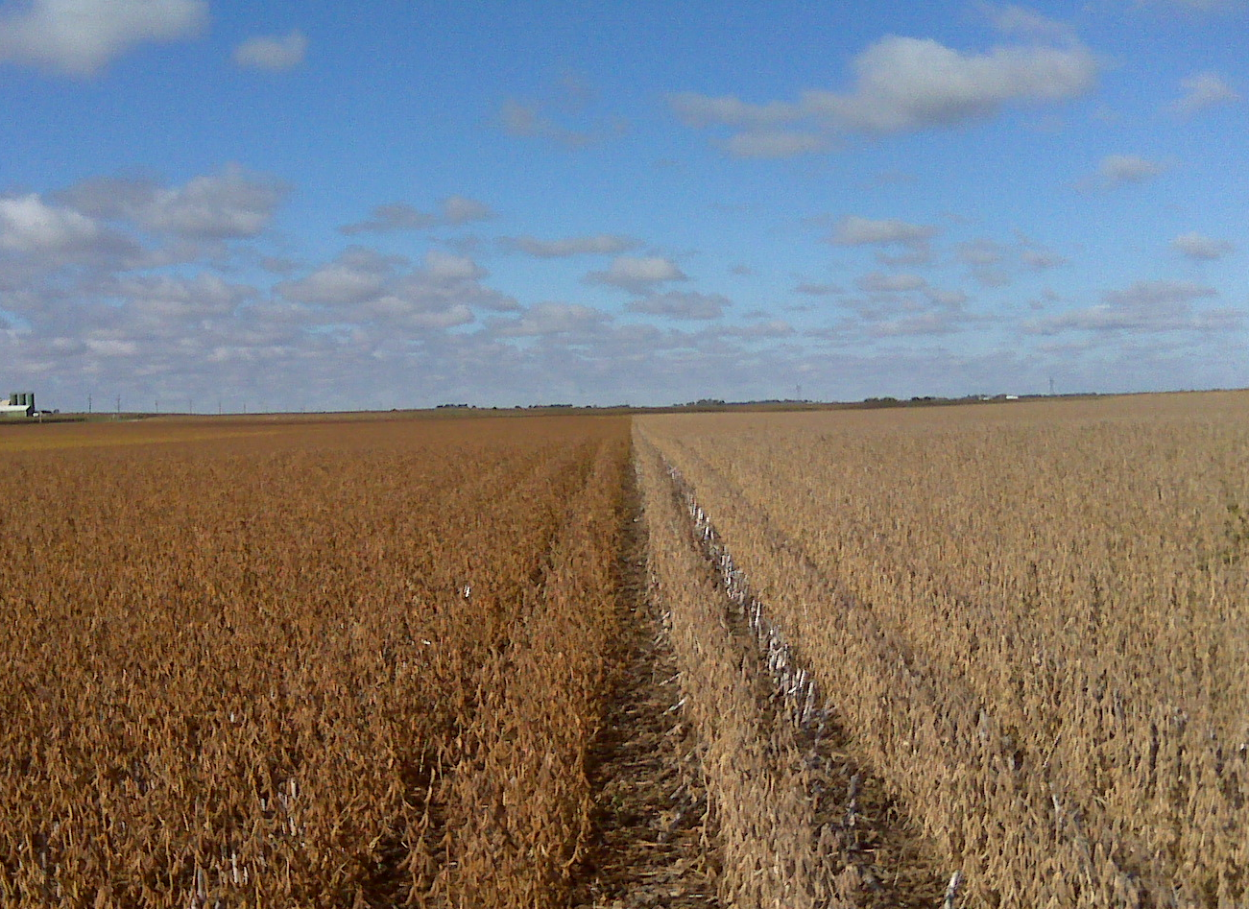
Phenotypic off-types may suggest poor quality control on the part of the breeder, the multiplier or the conditioner.
Notes:
They may say nothing about GMO’s or the new “genetic purity question. The system continues to rely on phenotypic characteristics to “To insure identity and purity [of seed] to the purchaser through certification of seed” – A.L. Lang, 50 Years of Service A History of Seed Certification in Illinois 1922-1972

Slide 6
Testing Continuum
Germplasm
Donors
Recipients
F1 Individuals
Progeny Rows
Bulk Rows
Breeder Seed
Parent Seed
Commercial
Tissue Testing and Census Testing
Bulk Tissue or Seed Sample Screening
Seed Sampling and SeedCalc
Notes:
As biotechnology has come to mean genetic modification, testing in the early phases of crop improvement and crop production continues to be very important.

Slide 7
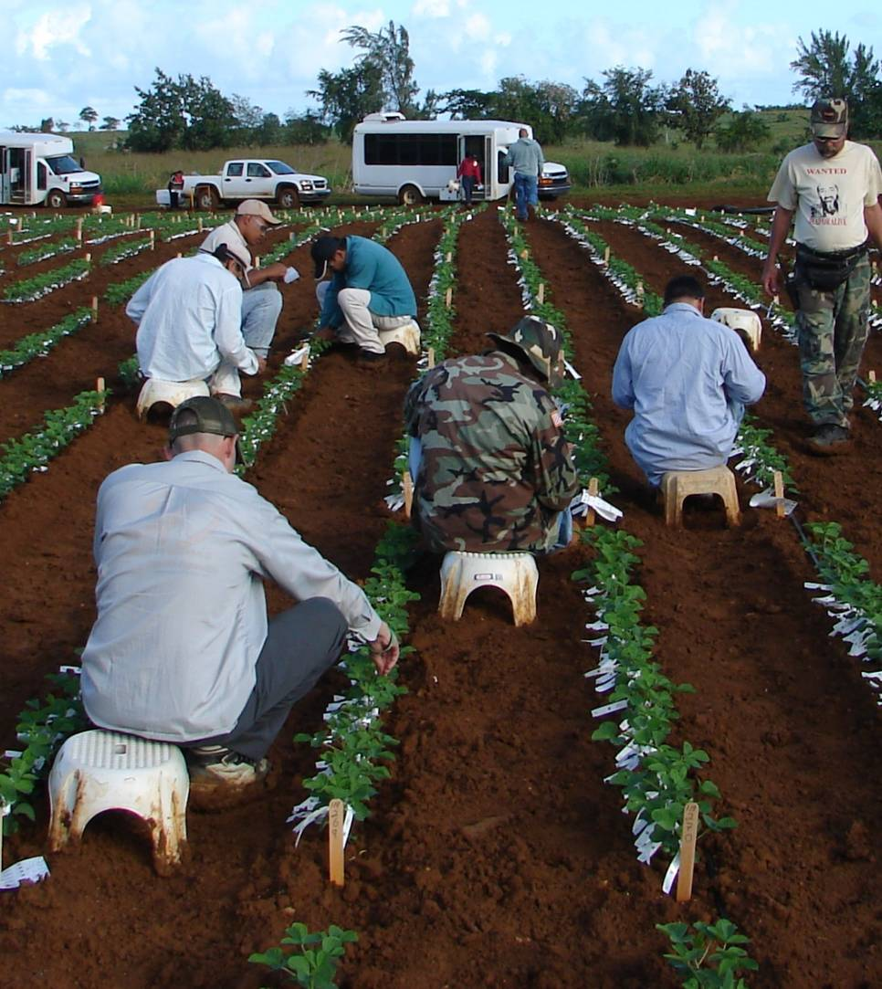
Breeding - Purity and Identity
Census Testing
Parents
F1 Plants
Selfing Selections
Notes:
Breeders must maintain the purity and identity of their materials or face the the expensive and sometimes impossible task of removing unwanted characteristics. This starts with suitable germplasm, however parents used for crossing are often census tested…

Slide 8
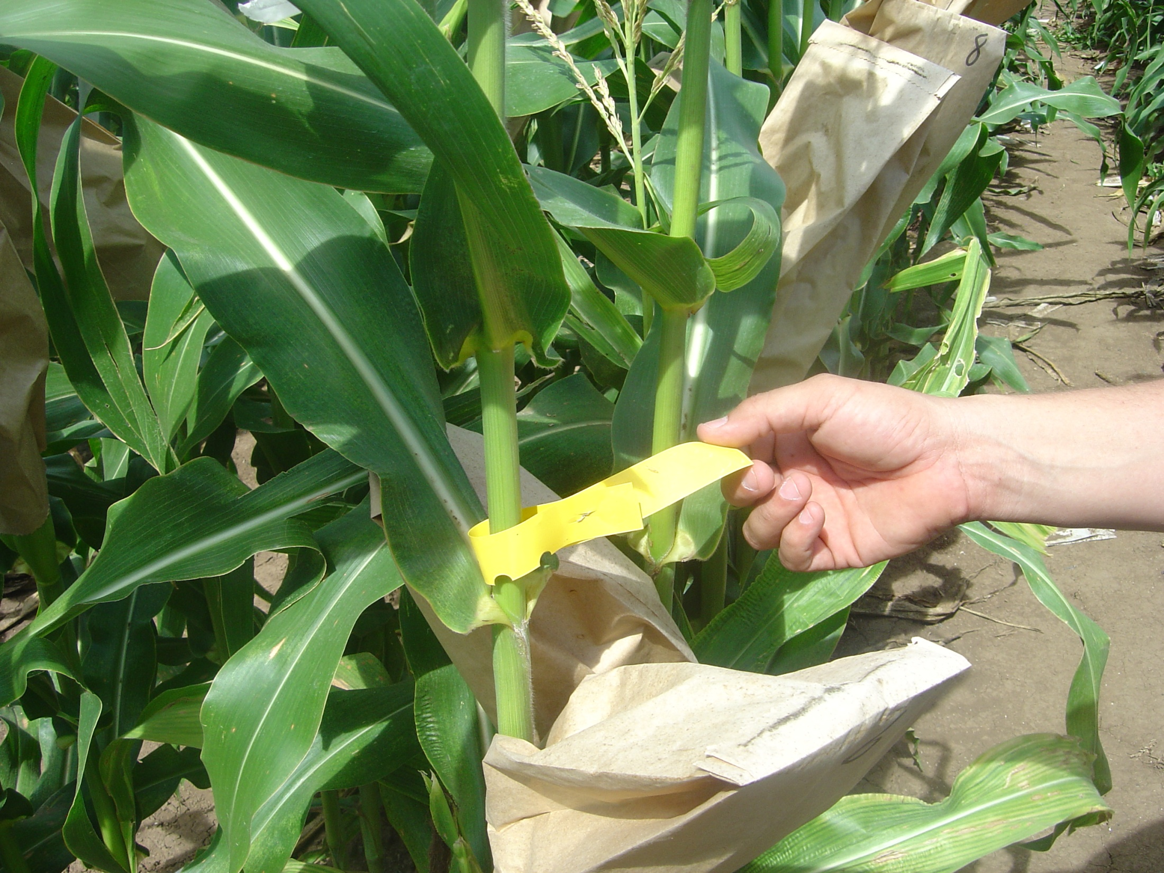
Breeding - Purity and Identity
Census Testing
Parents
F1 Plants
Selfing Selections
Notes:
F1 plants are tested for desired and undesired traits as part of the selection process for further crossing or the beginning of the selfing process.

Slide 9
Breeding - Purity and Identity
Bulk Tissue Screening
Recipient rows
Populations
Breeder seed
Notes:
When working with larger populations of plants bulk tissue screening may be used. Often times recipient rows and populations have been seed tested and bulk tissue screening is used pre-pollination to further purity the materials.

Slide 10
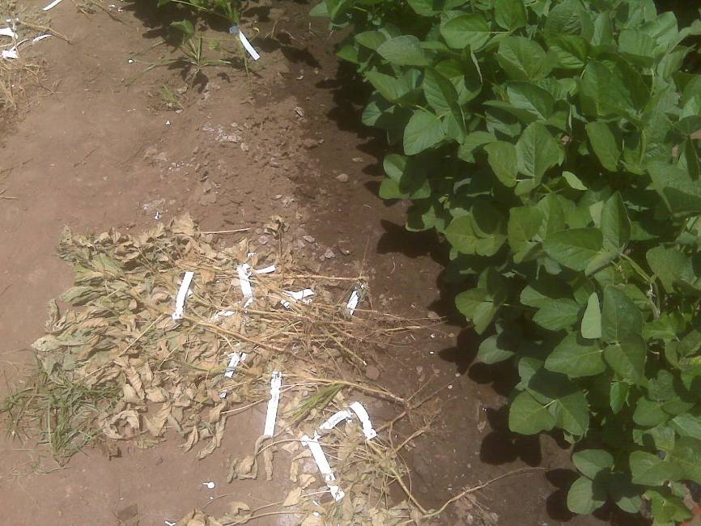
Breeding - Purity and Identity
Bulk Tissue Screening
Recipient rows
Populations
Breeder seed
Prior to parent seed production
Notes:
A positive or negative result calls for the destruction of all plants represented in the bulk. Much less expensive to do this the nursery here than at the breeder or foundation level.

Slide 11
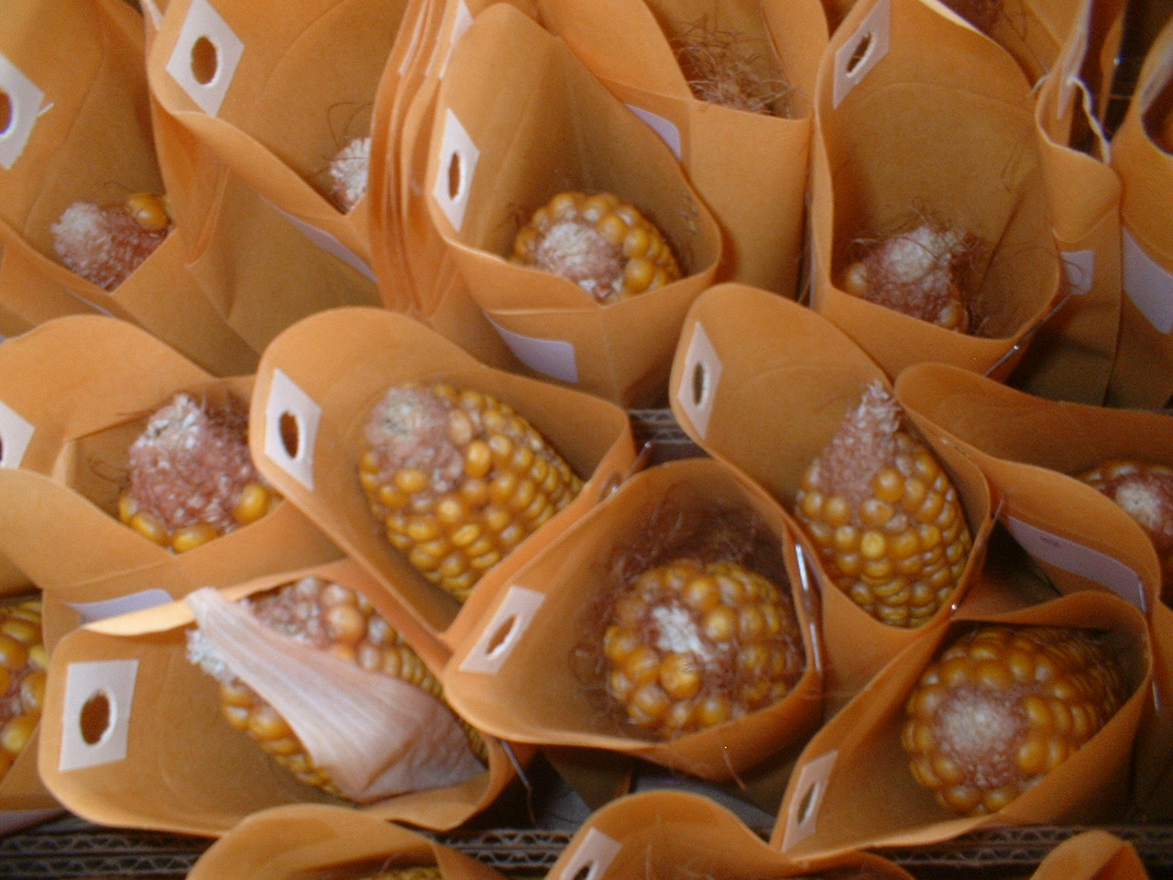
Breeding - Purity and Identity
Seed Sampling
Populations
Pod Picks
Plant to Row
Breeder seed
Notes:
Prior to accepting germplasm breeders may screen seed for desired and undesired traits. While seed chipping is also an option tissue testing parent plants is the most common screening method for parents to be used in trait introgression programs. Once the introgression has been completed selfing begins and more seed is generated. This seed can be sampled and tested as a screening process.

Slide 12
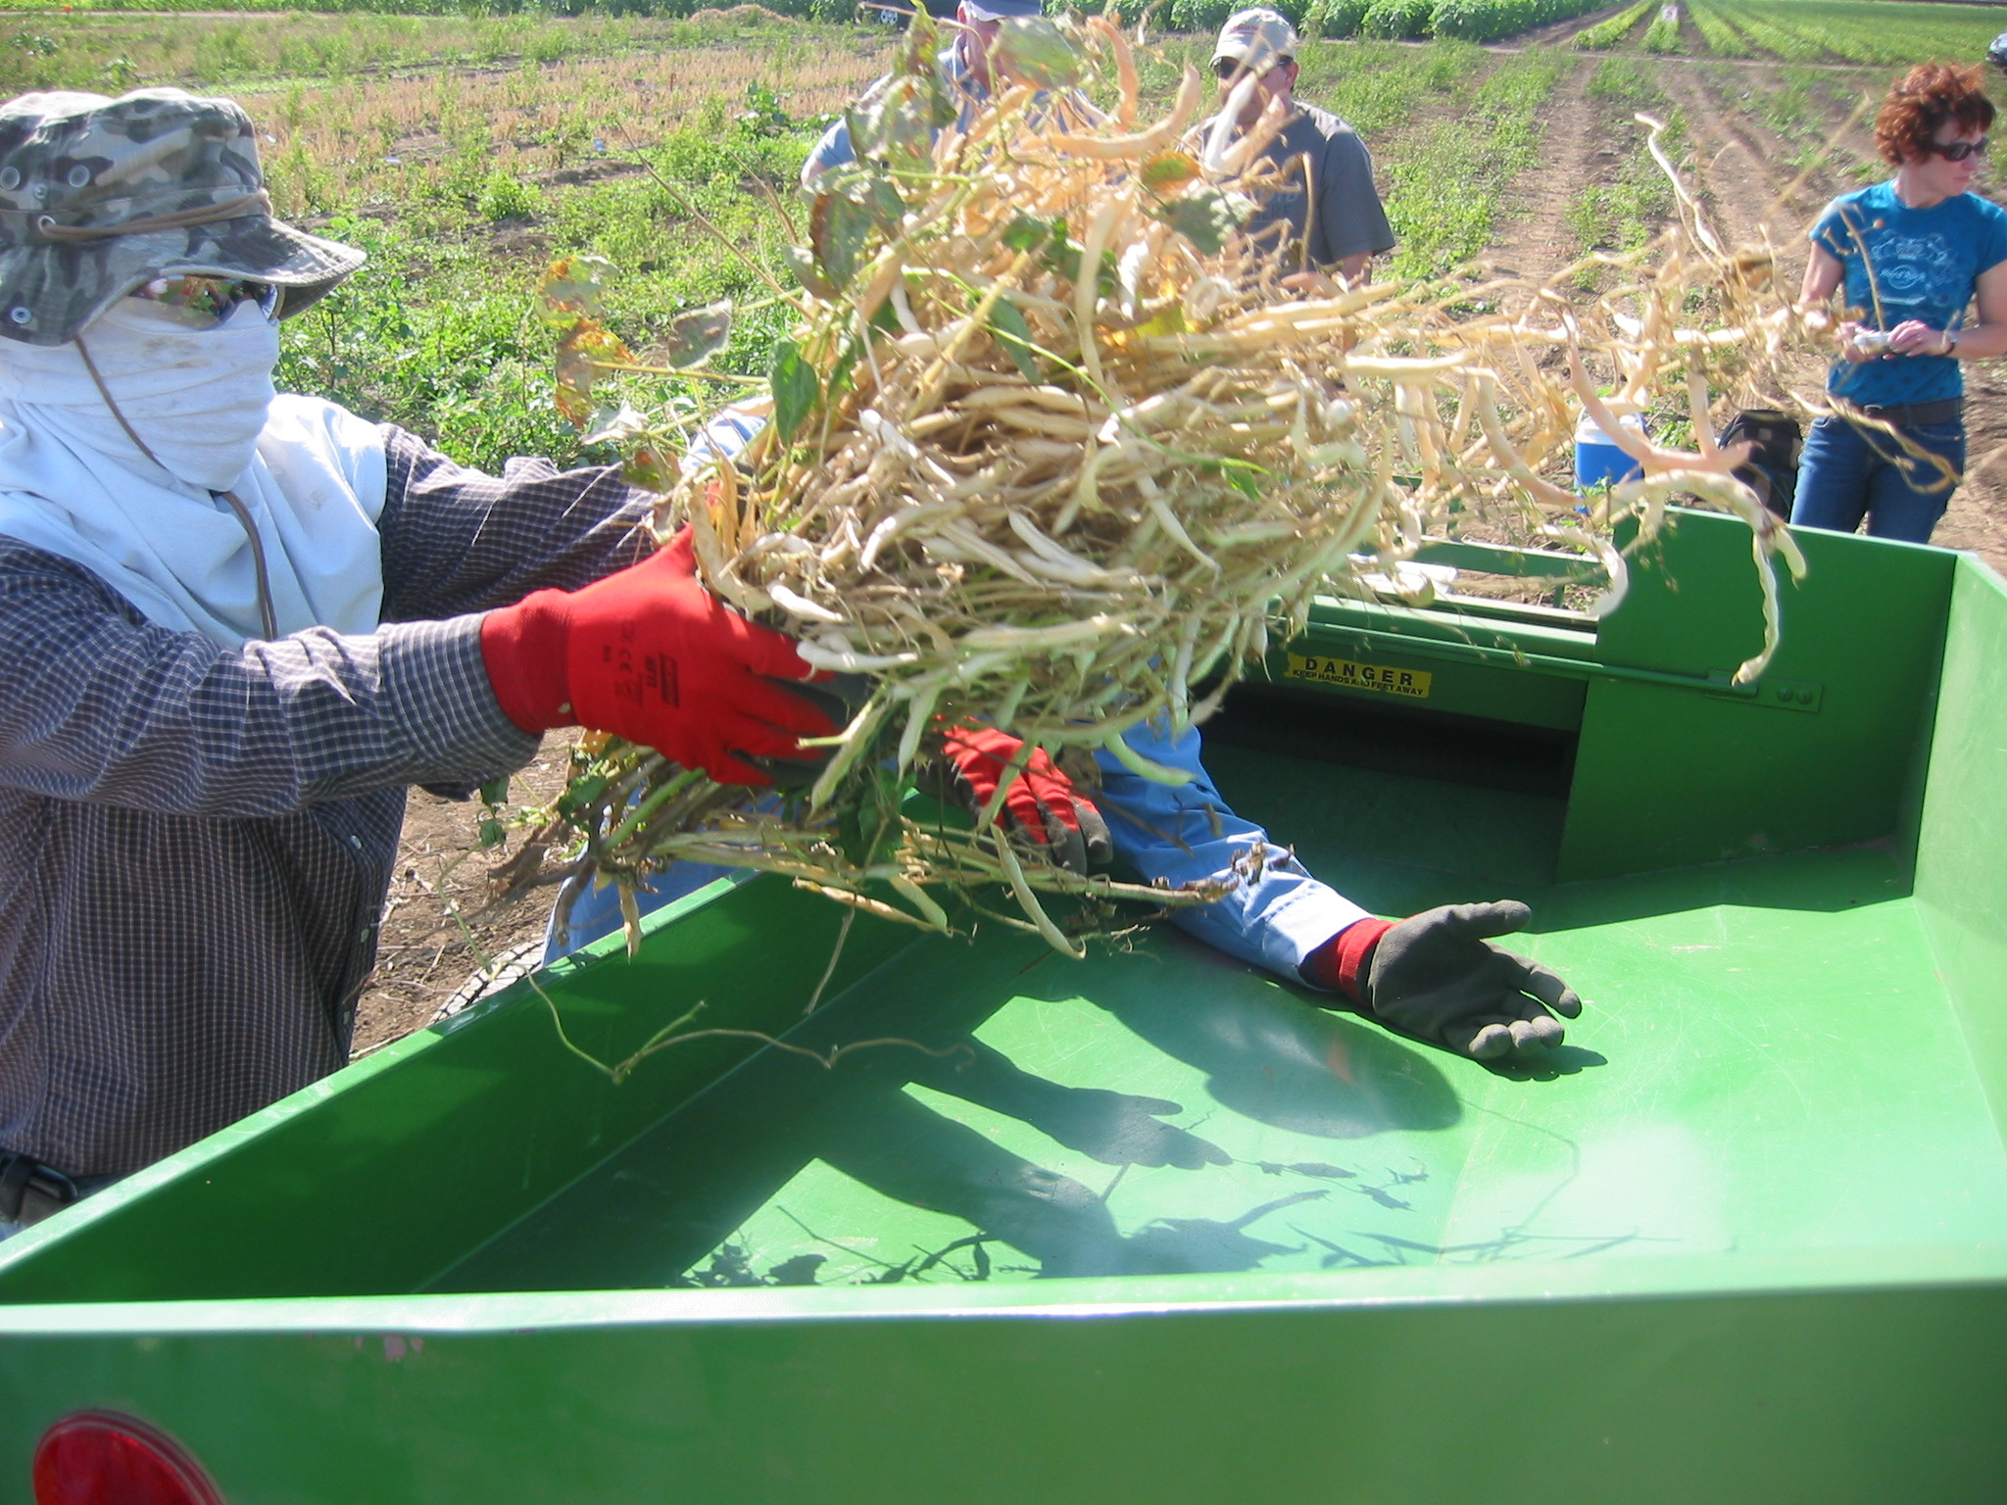
Breeding - Purity and Identity
Seed Sampling
Populations
Pod Picks
Bulk Rows
Breeder seed
Prior to parent seed production
Notes:
This is prior to parent seed production and in some cases violates one of the tenents of SeedCalc by testing more than 10% of the population or seed lot.

Slide 13
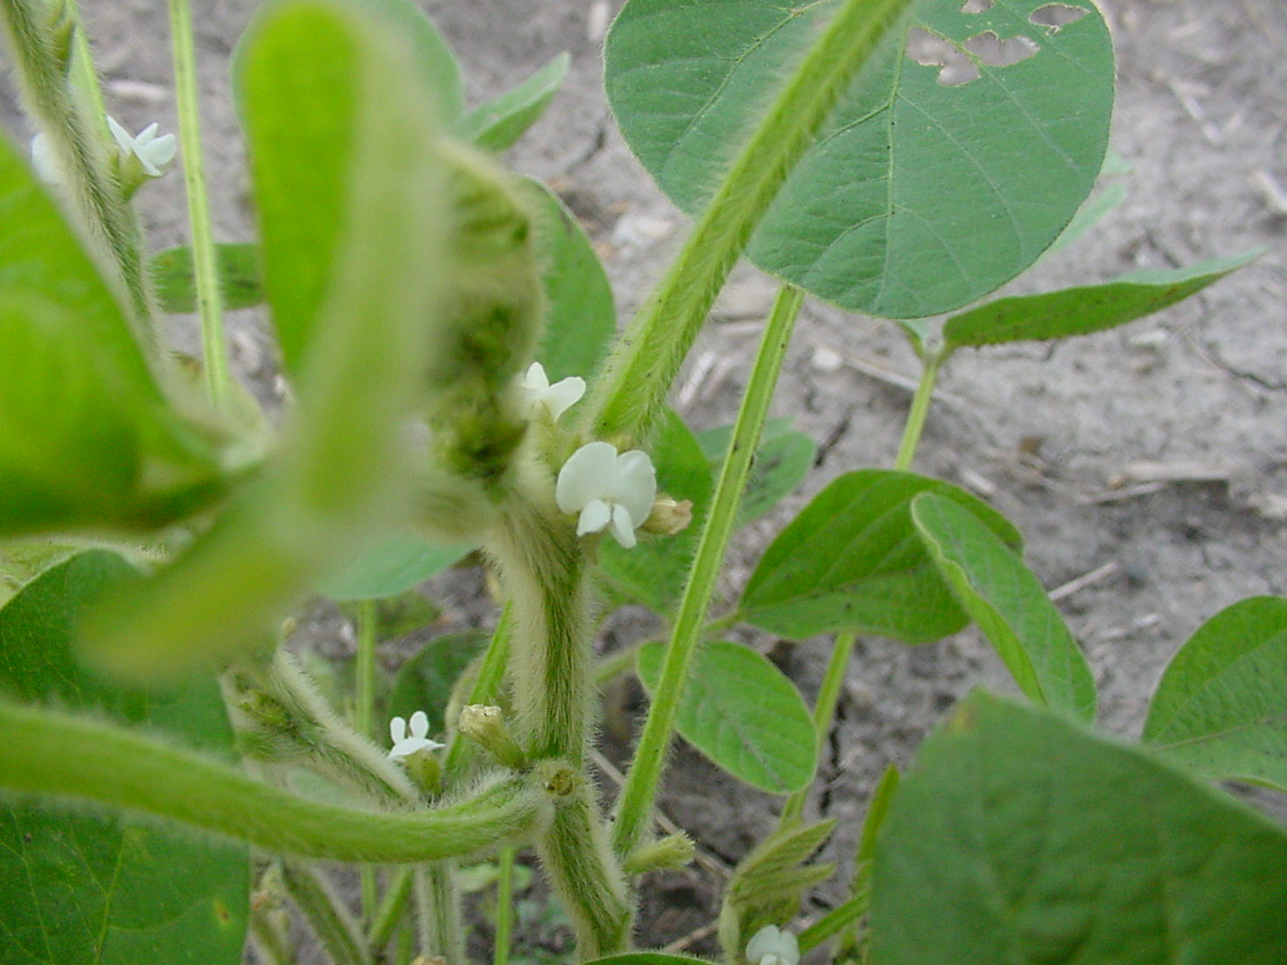
Seed Production – Varieties
Techniques
Generation Limits
Previous crop
Isolation
Equipment cleanout
Storage and handling system
Mechanical mixtures
Notes:
Once seed enters the production phase the primary method for maintaing the identity and purity of the breeder’s work is through traditional seed production techniques and seed samplng. Where “purity” is < 95% the seed cannot be labeled as a variety, < 98% fails to qualify for a foundation inbred…techniques for self pollinated crops are designed to prevent mechanical contamination as opposed to cross pollination

Slide 14
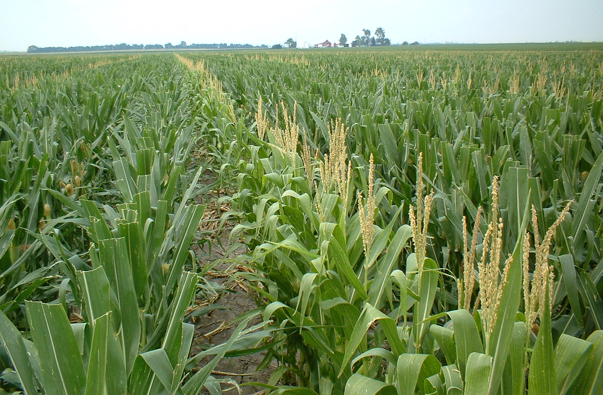
Seed Production - Hybrids
Techniques
Isolation
Roguing
Border rows
Detasseling or Male Sterile
Equipment cleanout
Cross Pollination
Notes:
Examples of techniques in hybrid crops includes… Seed laws require 95% hybridity to be labeled as such…

Slide 15
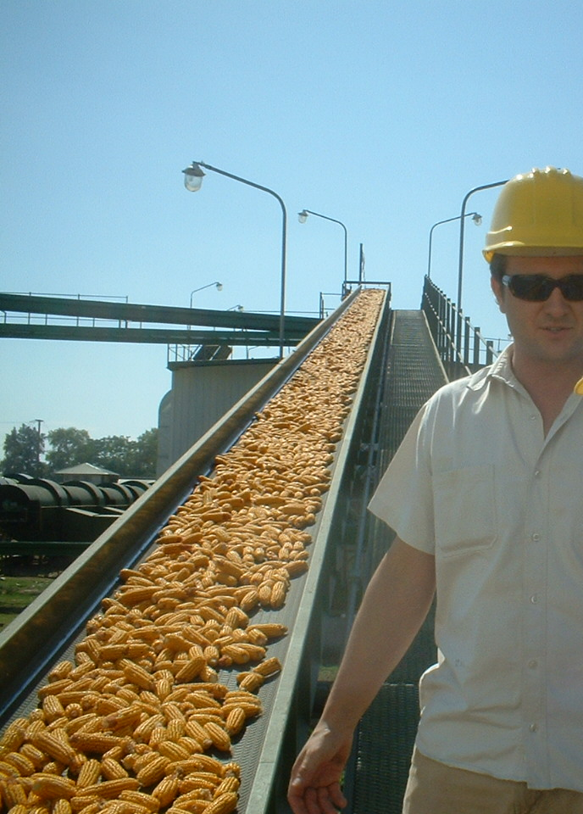
Seed Production - Identity and Purity
Seed Samples
Trait purity
Bulk Screen
Methods
PCR
Immunoassay
Notes:
Field inspections can tell you many things…the primary means of determining the effectiveness of productions practices are seed samples.

Slide 16
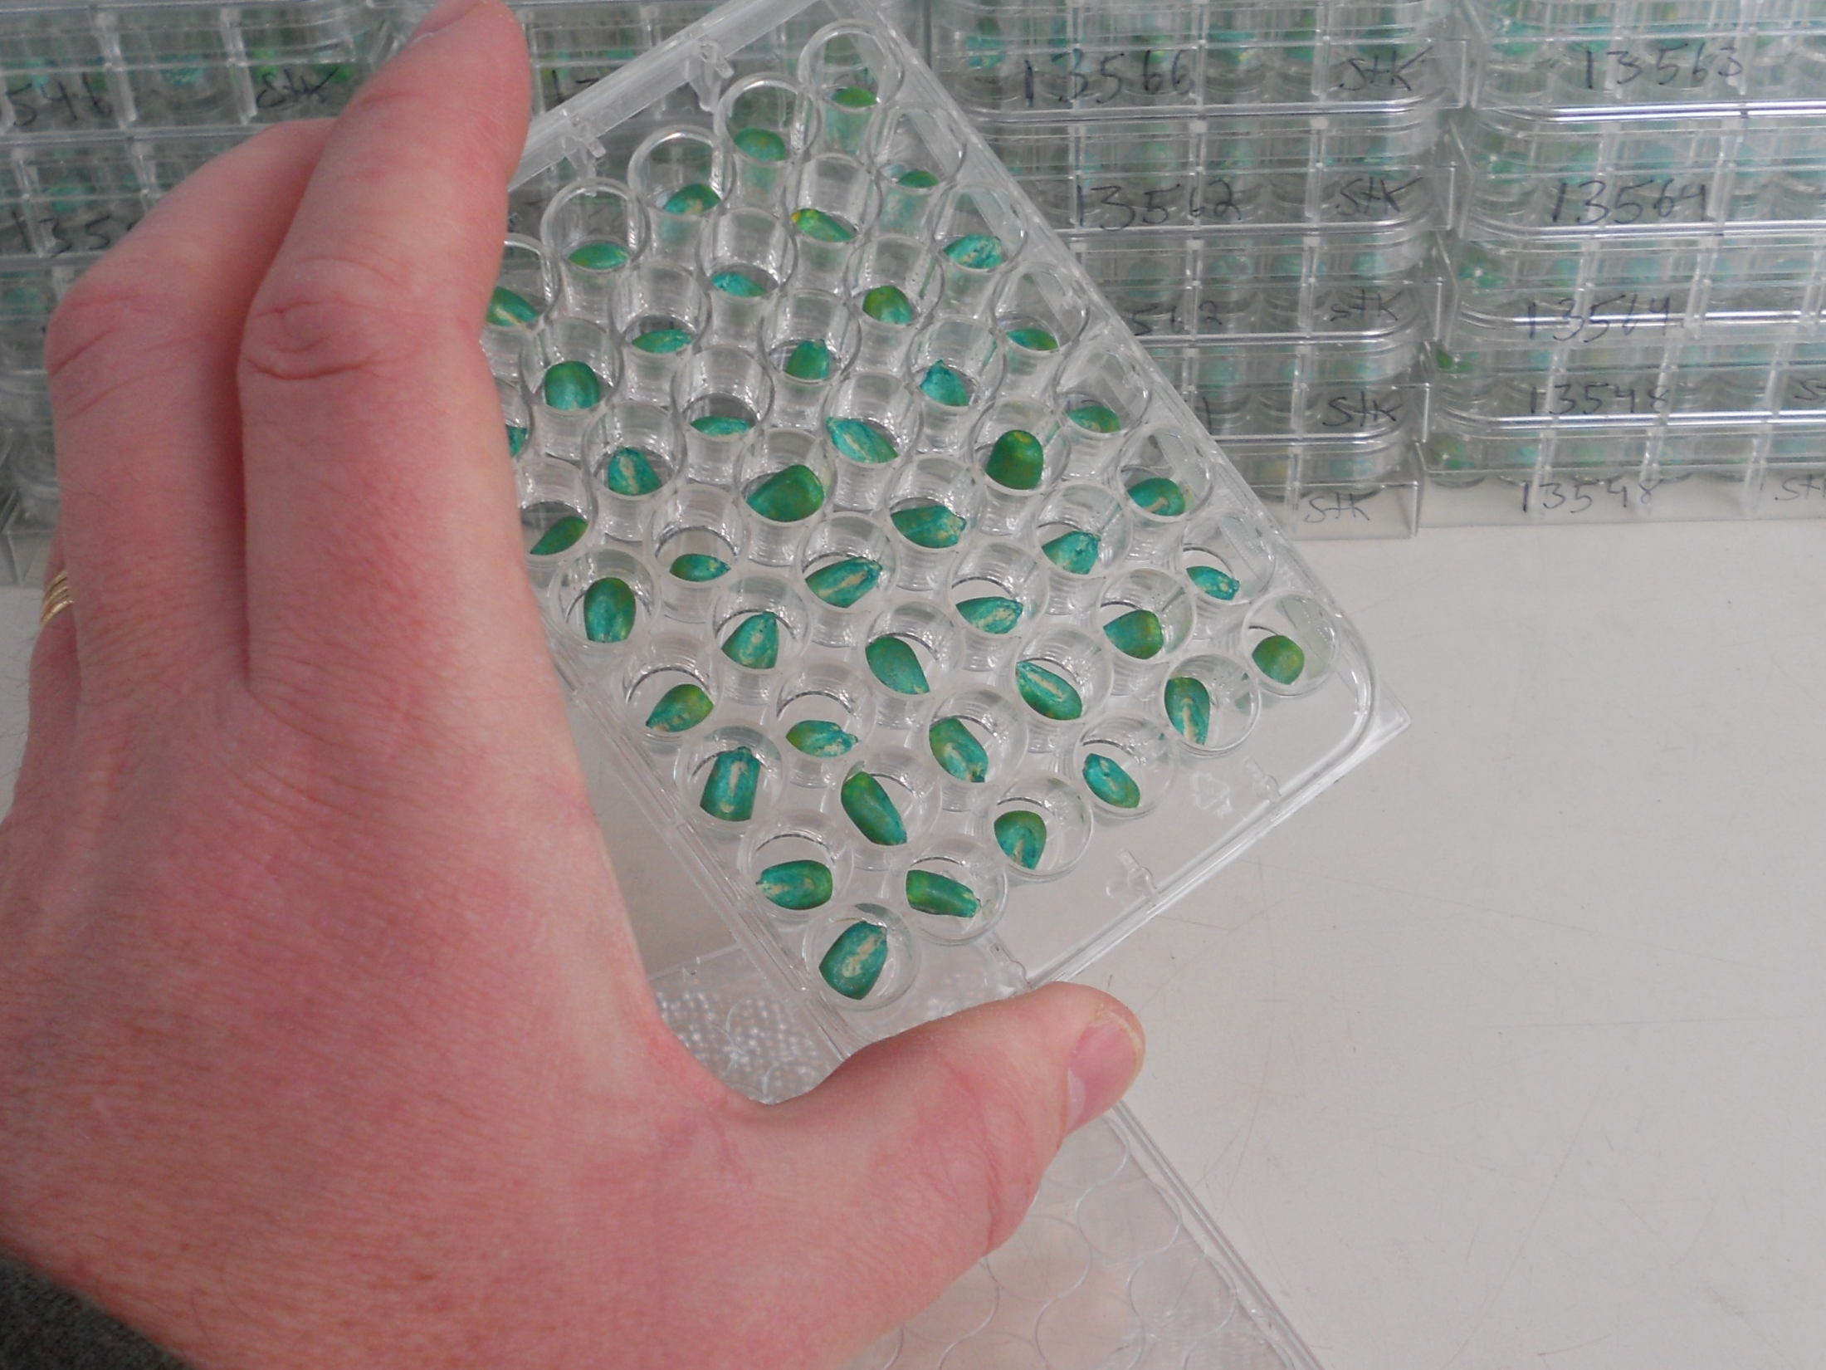
Production - Identity and Purity
Seed Samples
Trait purity
Bulk Screen
Methods
PCR
Immunoassay
Notes:
Sample fall into one of two broad categories…

Slide 17
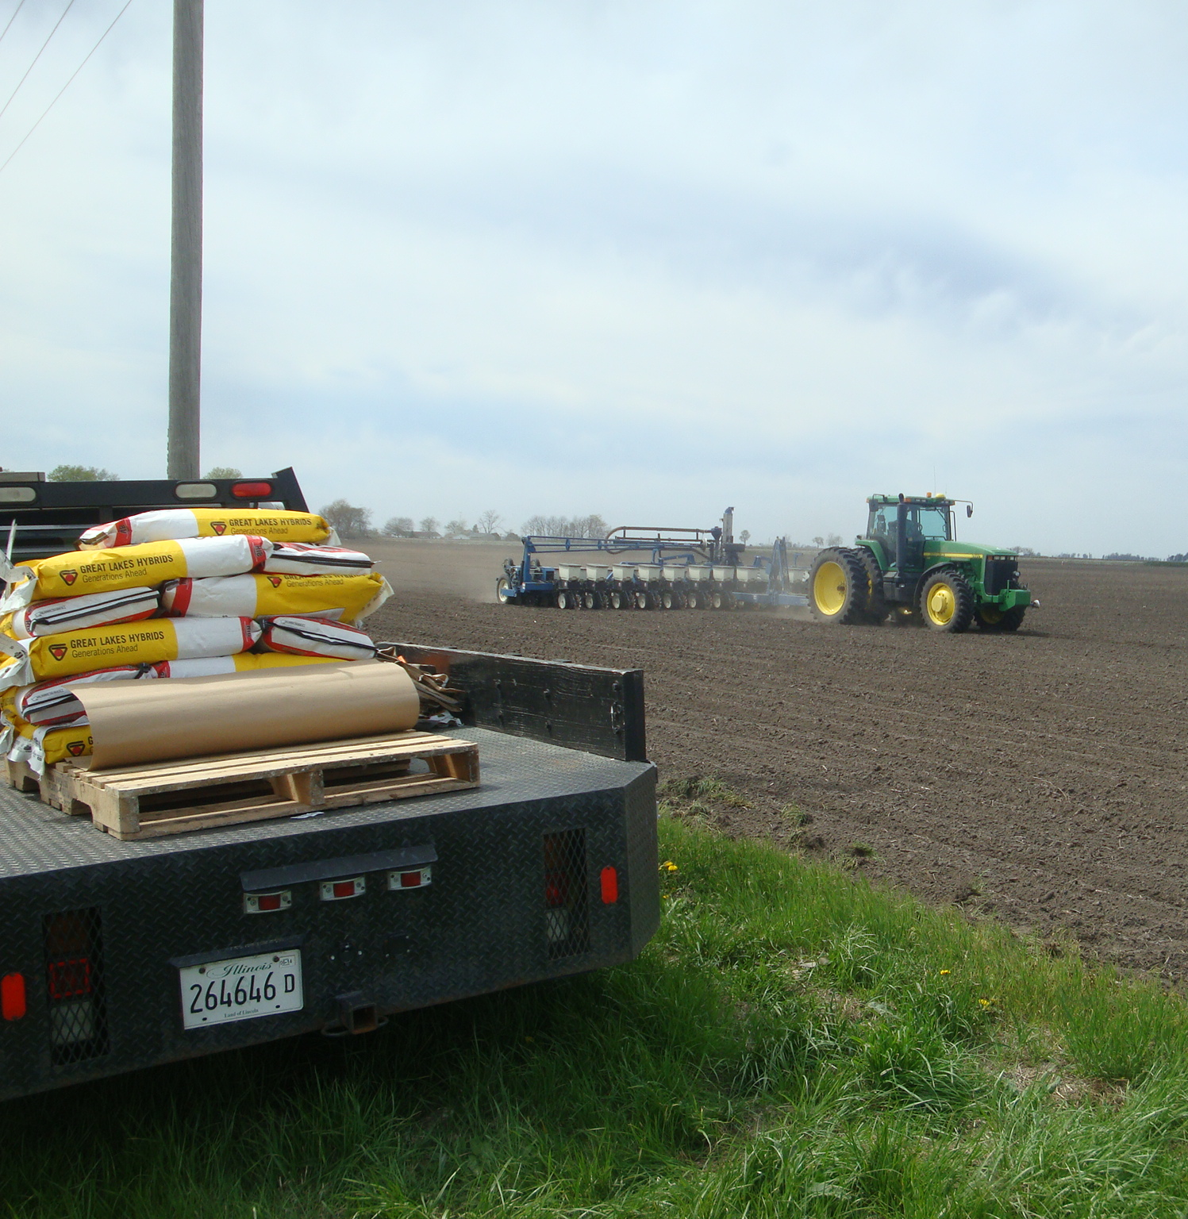
Identity Preserved - IP
Identity Preserved Grains and Oilseeds
Seed Identity
Seed Purity
Isolation
Combine Clean-out
Bulk Handling
Notes:
Specialty production is often patterned after traditional seed production. Farmers follow the traditional seed production practices through…

Slide 18
Testing Continuum
Germplasm
Donors
Recipients
F1 Individuals
Progeny Rows
Bulk Rows
Breeder Seed
Parent Seed
Commercial
Tissue Testing and Census Testing
Bulk Tissue or Seed Sample Screening
Seed Sampling and SeedCalc
Notes:
In my opinion the only way to ensure the indentity and purity of seeds and grains is by managing critical control points with the traditional and new purity practices…

Slide 19
…those not content to do small things well would leave great things undone.
- Ellen Glasgow
Notes:
I have a favorite quote for those charged with the improvement of crops; It was not the matter of the work, but the mind that went into it that counted and…

