Slide 1
Sampling in the Field
Doug Miller
Illinois Crop Improvement Association
10 Feb 2015

Slide 2
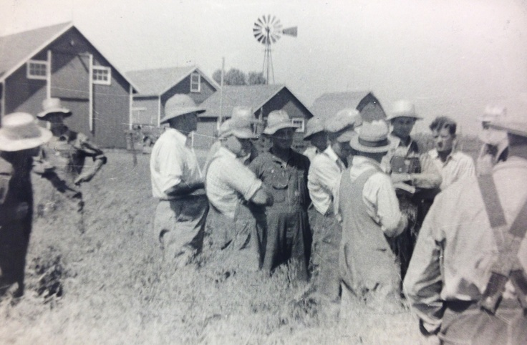
What was the objective?
“To insure identity and purity to the purchaser through certification of seed”
– A.L. Lang, 50 Years of Service A History of
Seed Certification in Illinois 1922-1972
Notes:
Traditional objective of seed certification…”To insure…” What was being lost once seed was provided to the farmer, this is pre-seed company. Standability, harvestability, maturity and most importantly yield.

Slide 3
Traditional of Seed Certification
Breeder seed
eligible seed stock
certified seed*
field inspection
testing and labeling
commodity or Identity Preserved
*Classes
Breeder
Foundation
Registered
Certified
Notes:
Breeder’s work was being lost. Mixtures at the hand of farmers decreased and erased the improvements made by breeders. Inspection in the field was no substitute for good seed production practices. Field Inspection is essentially a large growout, a good place to see phenotypic clues and measure a seed company’s ability to maintain a variety.

Slide 4
Phenotypic Standards - Soybean
Class or As Needed Inspection | Number of 500-Plant Counts | Number of Plants Counted | Begin Sequential Sampling
Spray | 6 | 3,000 | NA
Bloom Color | 6 | 3,000 | NA
Foundation | 20 | 10,000 | 10 to 21 OT
Registered | 14 | 7,000 | 12 to 19 OT
Certified | 6 | 3,000 | 9 to 31 OT
QA | 10 | 5,000 | NA
Notes:
Traditional certification and its derivatives rely on a system of limited generations. Each generation has a standard both in the field and in the lab (see table). Traditional Field and Lab relies on phenotypic characteristics described by the breeder.

Slide 5
Modern Interpretations
OECD Seed Schemes and Accreditation
Pre-Foundation
Parent
Commercial
Quality Assurance (QA)
Identity Preservation (IP)
Notes:
Certification continues but does not directly address the issue of GMO with a specific standard.
In public systems Breeder “release” in private development there are handoffs. Other interpretations and classifications based on the traditional system include…

Slide 6
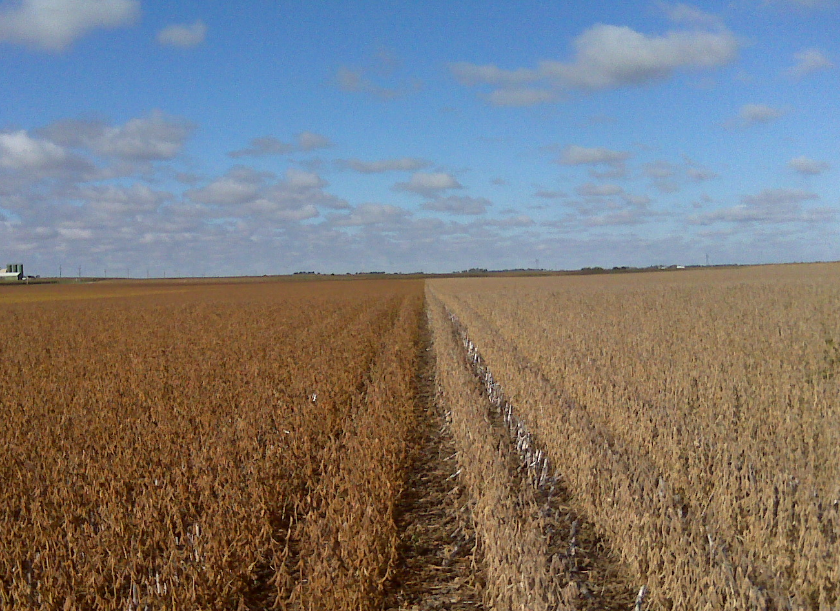
Phenotypic off-types may suggest poor quality control on the part of the breeder, the multiplier or the conditioner.
Notes:
They may say nothing about GMO’s or the new “genetic purity” questions in seed. The system continues to rely on phenotypic characteristics “To insure identity and purity [of seed] to the purchaser through certification of seed” – A.L. Lang, 50 Years of Service A History of Seed Certification in Illinois 1922-1972

Slide 7
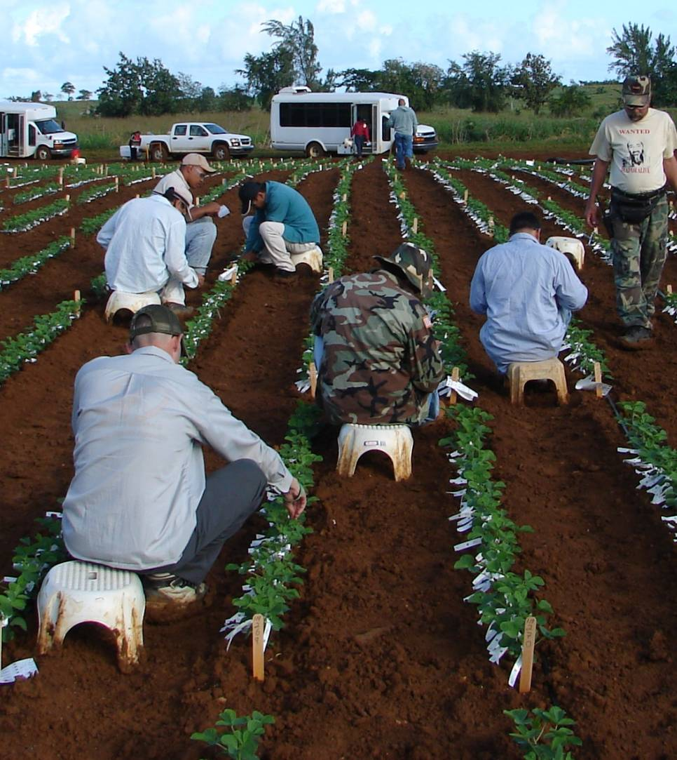
Breeding - Purity and Identity
Census Testing
Parents
F1 Plants
Selections allowed to self
Notes:
Breeders must maintain the purity and identity of their materials or face the expensive and sometimes impossible task of removing unwanted characteristics. This starts with suitable germplasm, however parents used for crossing are often census tested…

Slide 8
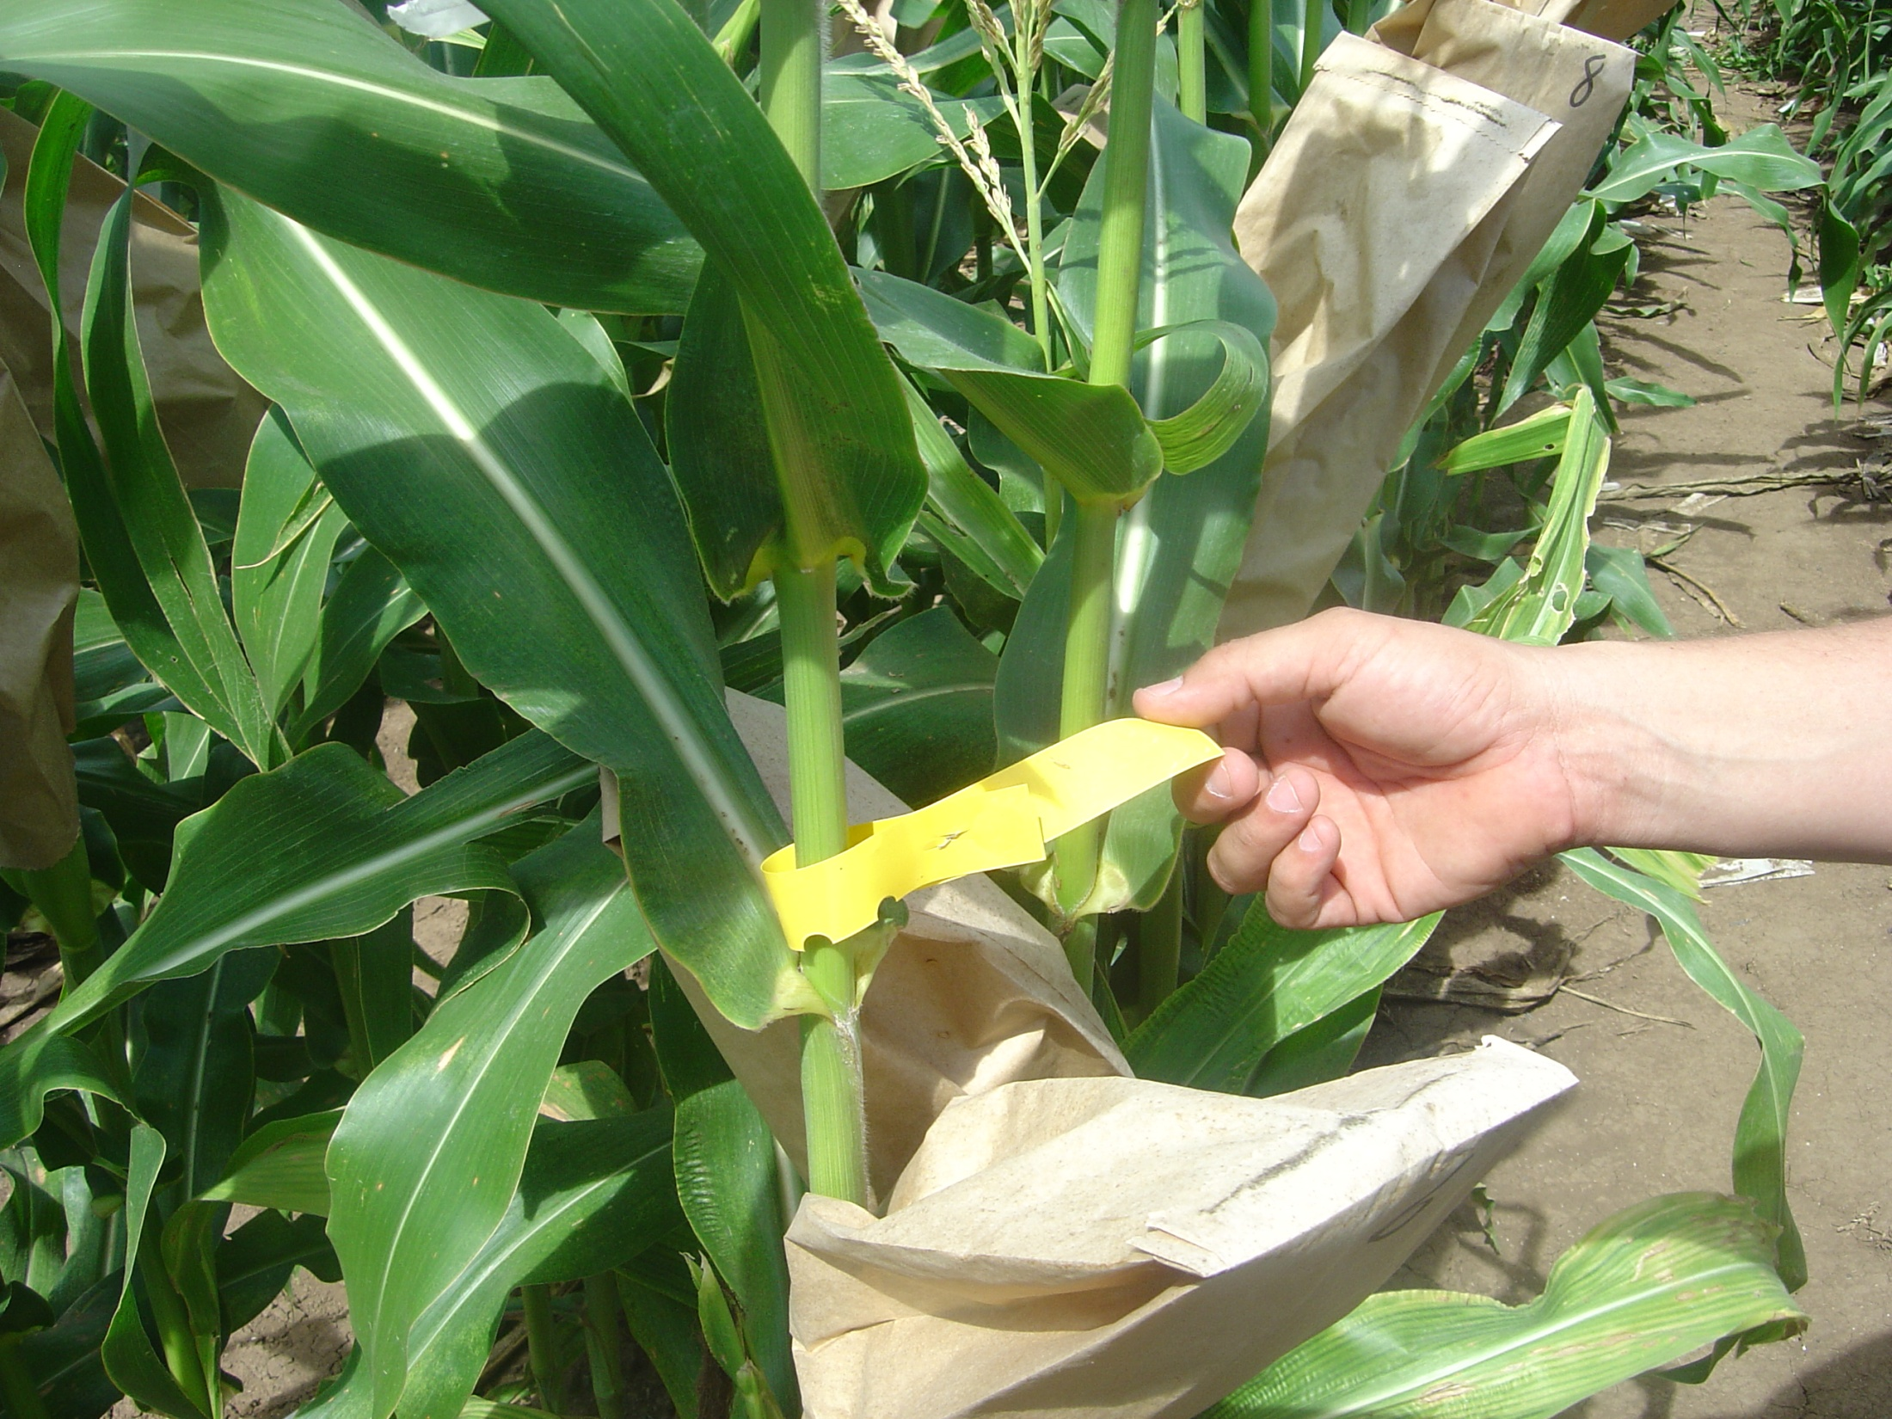
Breeding - Purity and Identity
Census Testing
Parents
F1 Plants
Selfing Selections
Notes:
F1 plants are tested for desired and undesired traits as part of the selection process for further crossing or the beginning of the selfing process.

Slide 9
Breeding - Purity and Identity
Bulk Tissue Screening
Recipient rows
Populations
Breeder seed
Notes:
When working with larger populations of plants bulk tissue screening may be used. Often times recipient rows and populations have been seed tested and bulk tissue screening is used pre-pollination to further purity the materials.

Slide 10
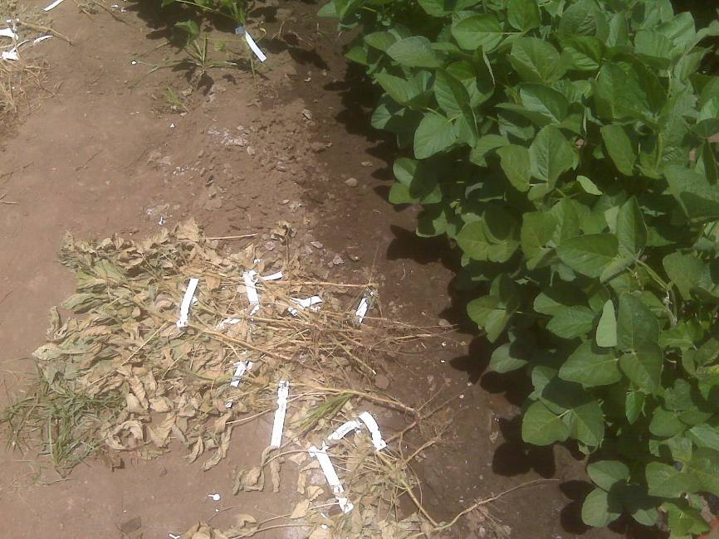
Breeding - Purity and Identity
Bulk Tissue Screening
Recipient rows
Populations
Breeder seed
Prior to parent seed production
Notes:
A positive or negative result calls for the destruction of all plants represented in the bulk. Much less expensive to do this the nursery here than at the breeder or foundation level.

Slide 11
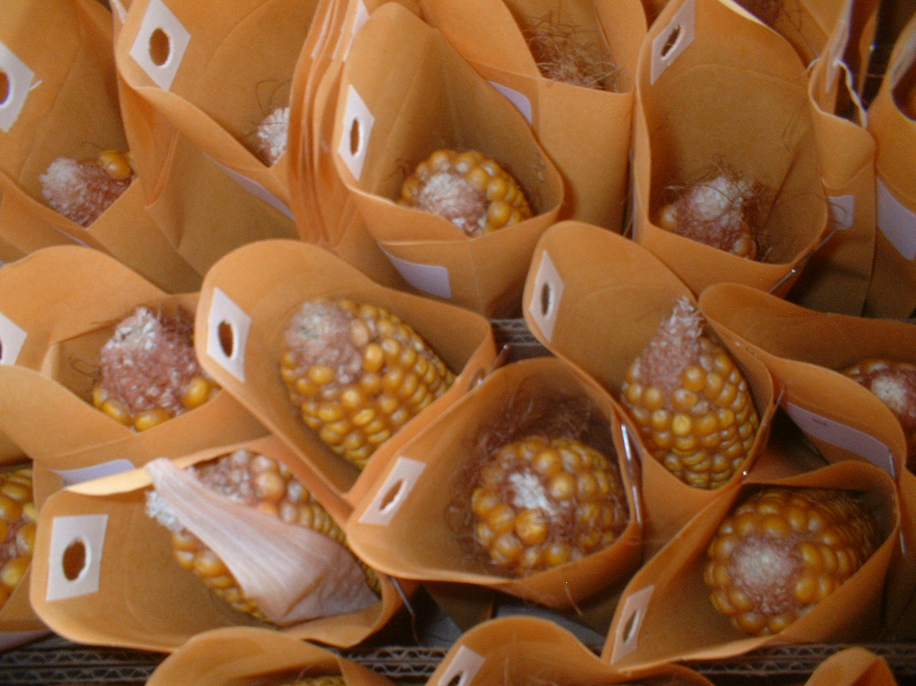
Breeding - Purity and Identity
Seed Sampling
Populations
Pod Picks
Plant to Row
Breeder seed
Notes:
Prior to accepting germplasm breeders may screen seed for desired and undesired traits. While seed chipping is also an option tissue testing parent plants is the most common screening method for parents to be used in trait introgression programs. Once the introgression has been completed selfing begins and more seed is generated. This seed can be sampled and tested as a screening process.

Slide 12
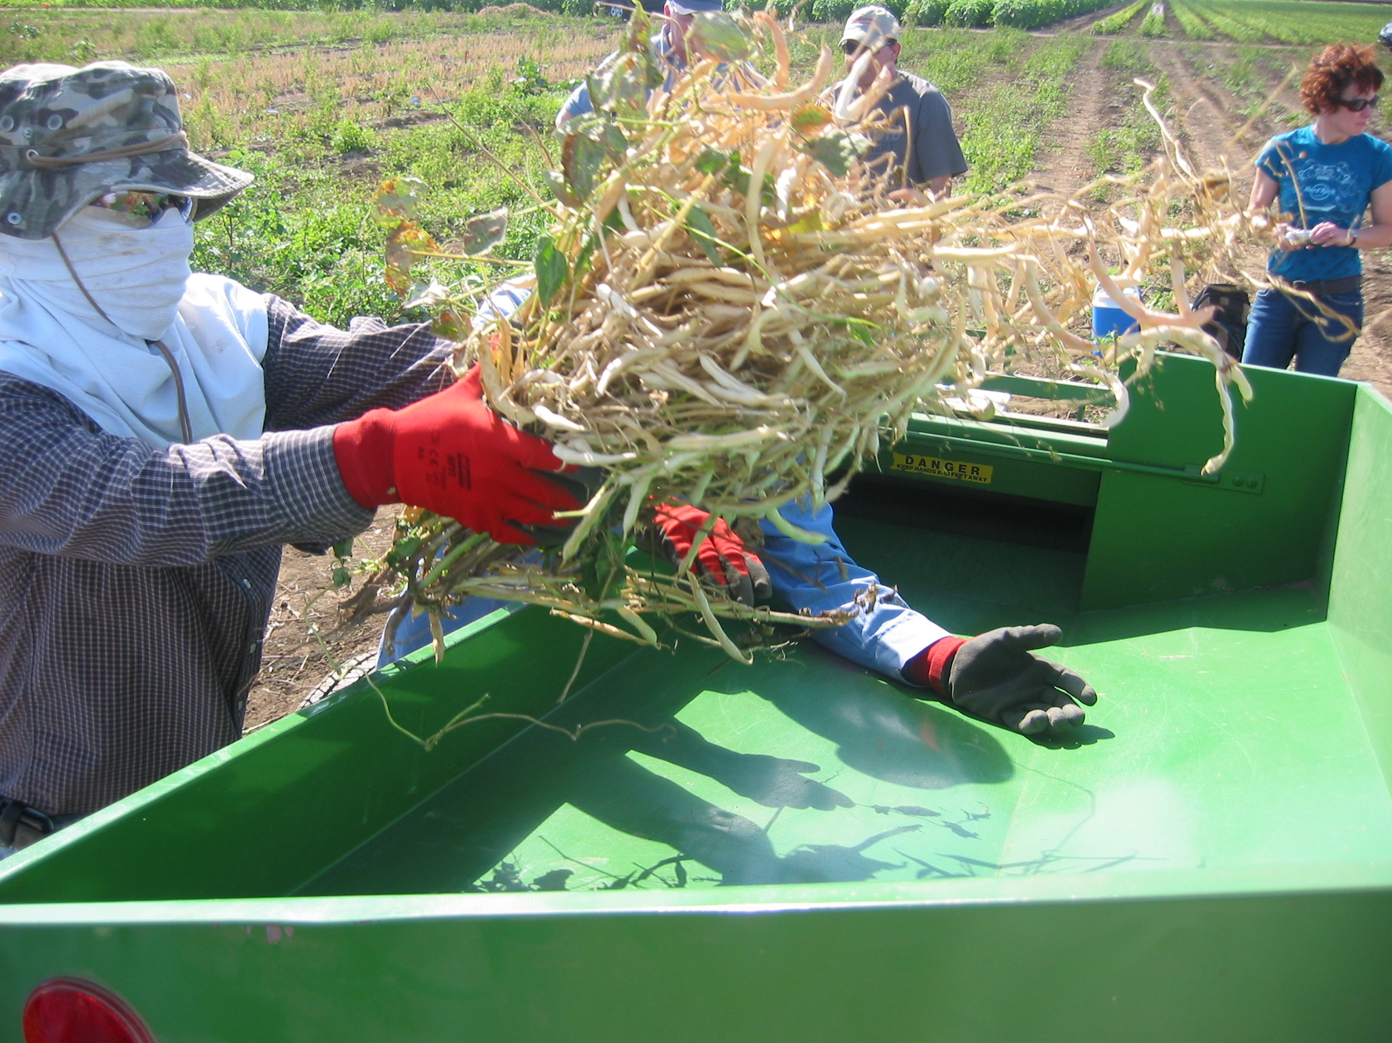
Breeding - Purity and Identity
Seed Sampling
Populations
Pod Picks
Bulk Rows
Breeder seed
Prior to parent seed production
Notes:
This is prior to parent seed production and in some cases violates one of the tenents of SeedCalc by testing more than 10% of the population or seed lot.

Slide 13
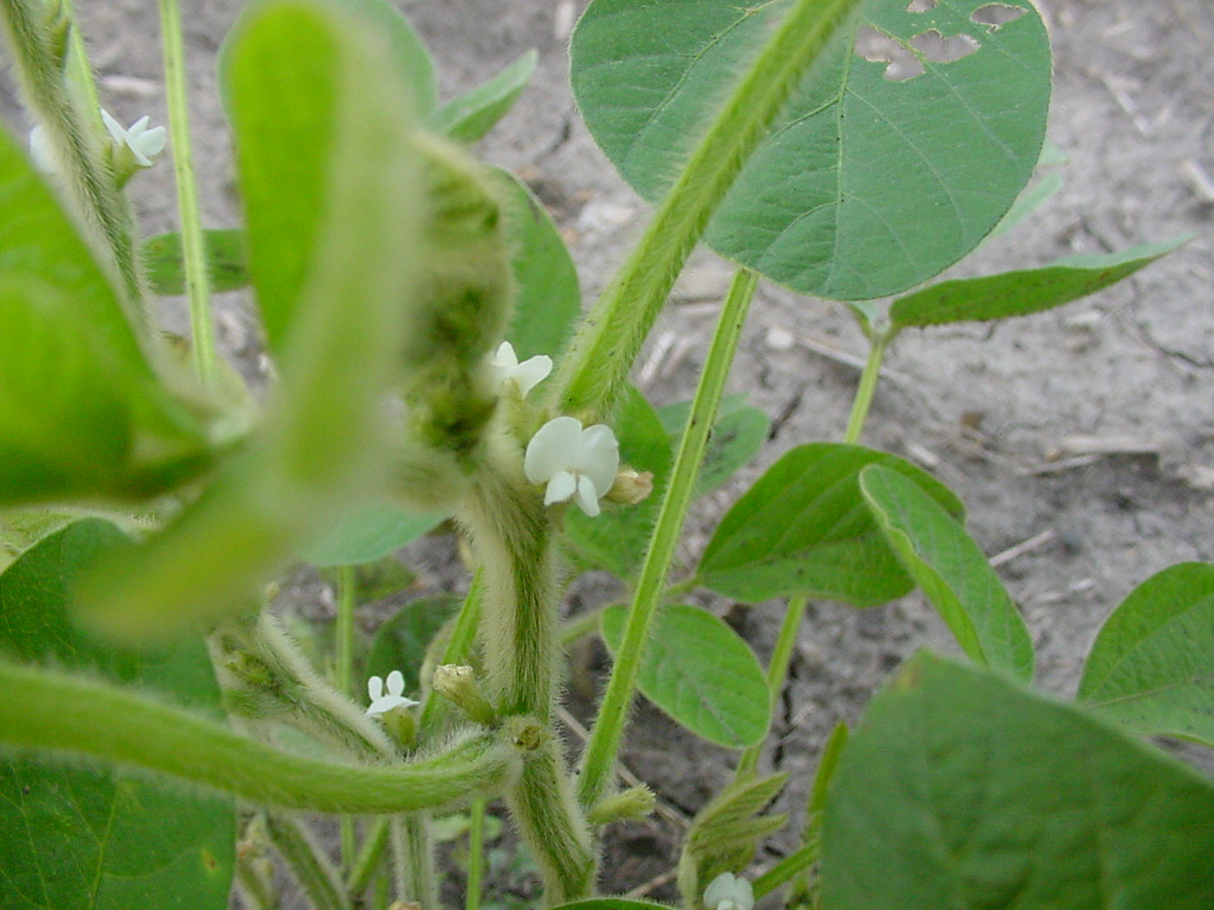
Seed Production – Varieties
Techniques
Generation Limits
Previous crop
Isolation
Equipment cleanout
Storage and handling system
Mechanical mixtures
Notes:
Once seed enters the production phase the primary method for maintaing the identity and purity of the breeder’s work is through traditional seed production techniques and seed sampling. Where “purity” is < 95% the seed cannot be labeled as a variety, < 98% fails to qualify for a foundation inbred…techniques for self pollinated crops are designed to prevent mechanical contamination as opposed to cross pollination

Slide 14
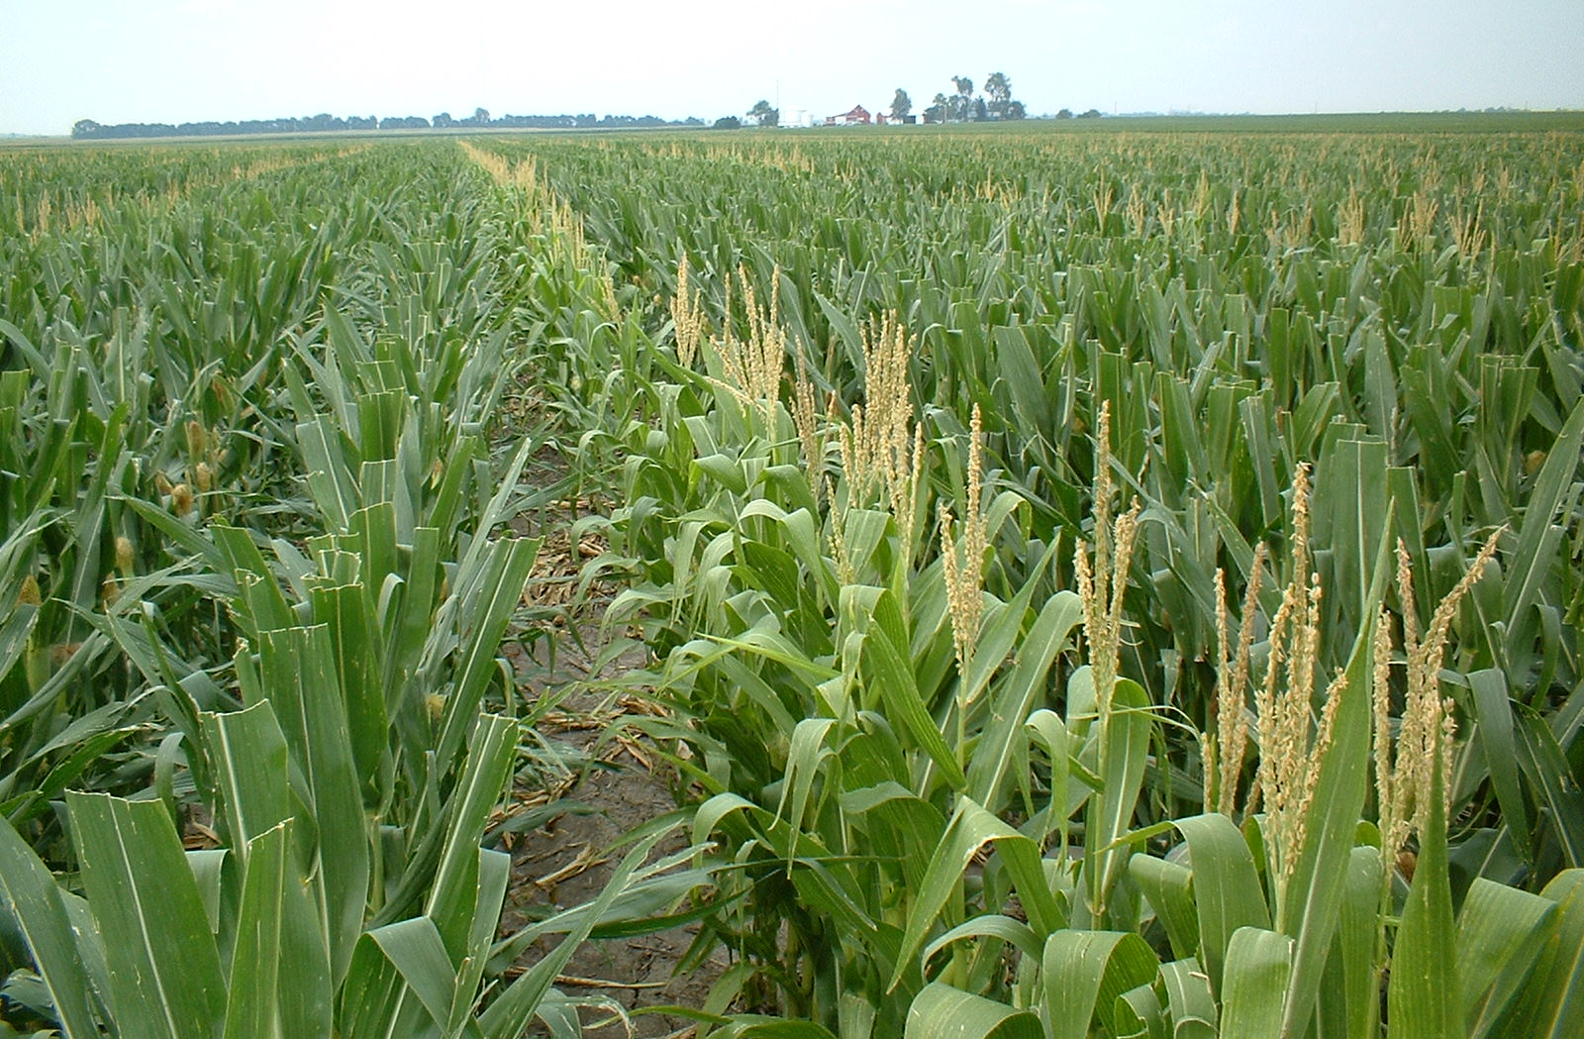
Seed Production - Hybrids
Techniques
Isolation
Rogueing
Border rows
Detasseling or Male Sterile
Equipment cleanout
Cross Pollination
Notes:
Examples of techniques in hybrid crops includes… Seed laws require 95% hybridity to be labeled as such…

Slide 15
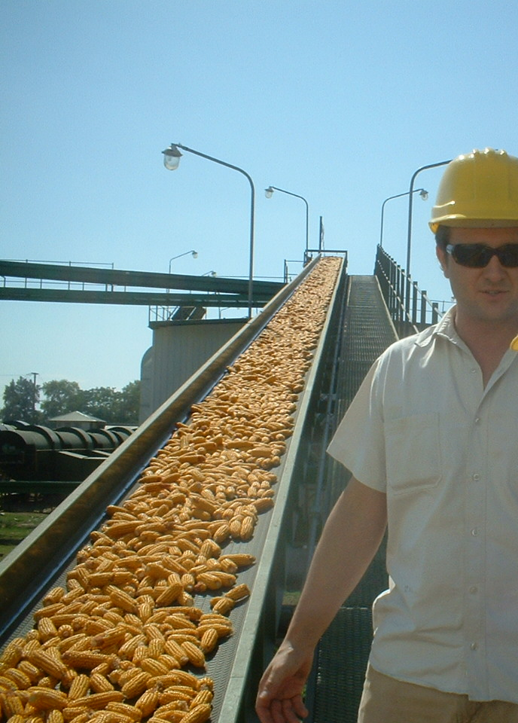
Seed Production - Identity and Purity
Seed Samples
Trait purity
Bulk Screen
Methods
PCR
Immunoassay
Notes:
Field inspections can tell you many things…the primary means of determining the effectiveness of productions practices are seed samples.

Slide 16
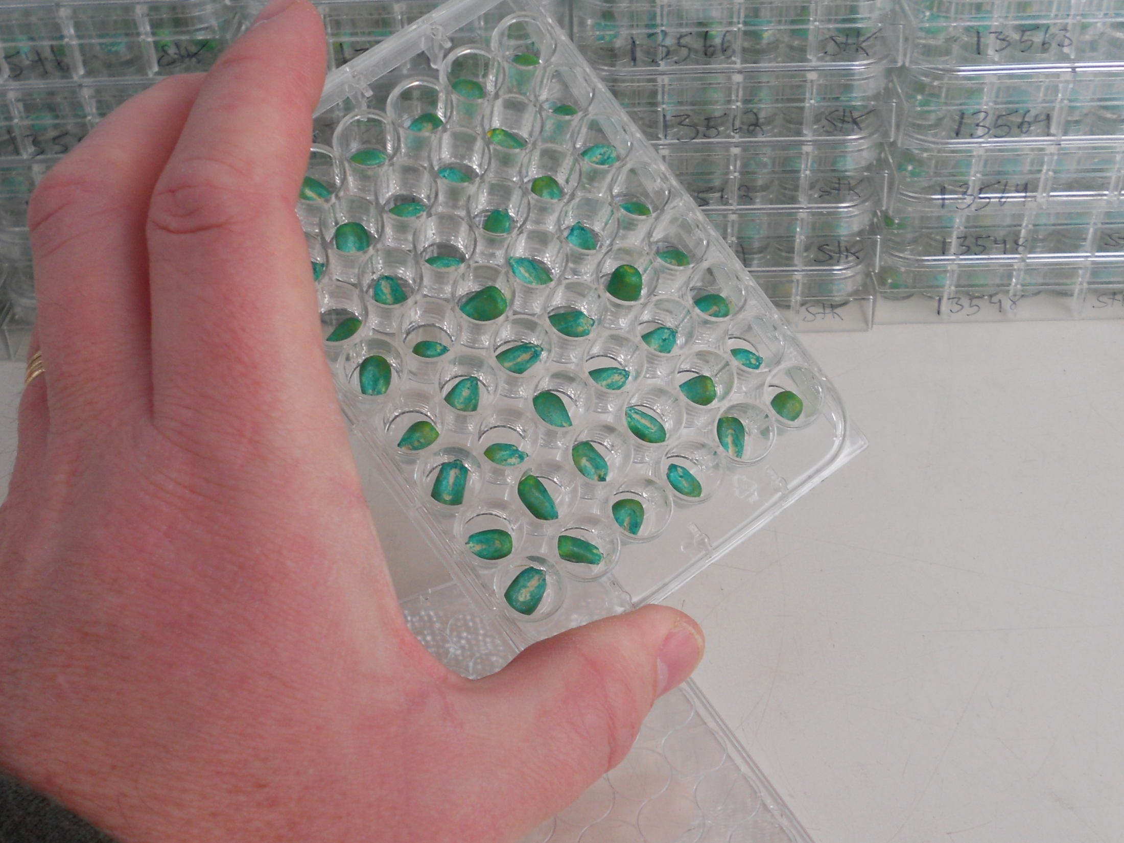
Production - Identity and Purity
Seed Samples
Trait purity
Bulk Screen
Methods
PCR
Immunoassay
Notes:
Sample fall into one of two broad categories…

Slide 17
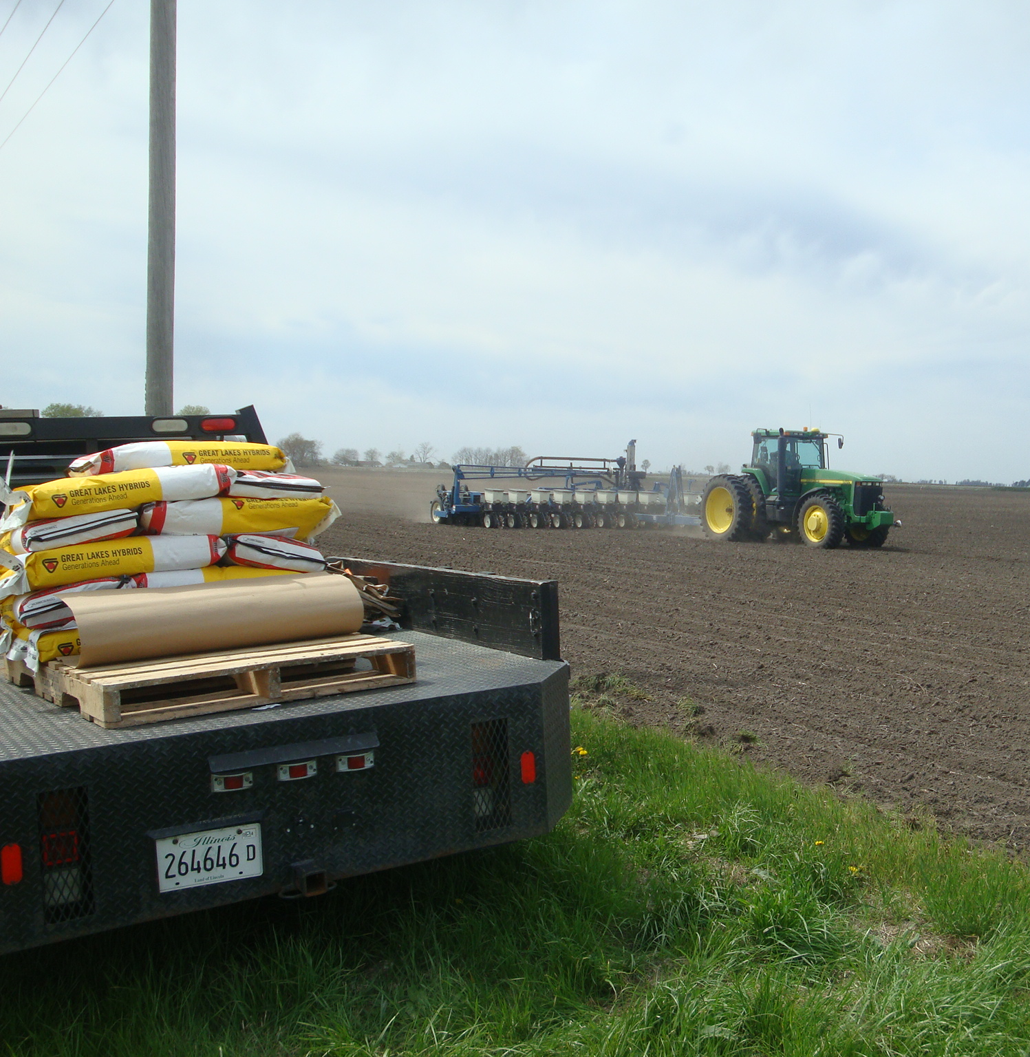
Identity Preserved - IP
Identity Preserved Grains and Oilseeds
Seed Identity
Seed Purity
Isolation
Combine Clean-out
Bulk Handling
Notes:
Specialty production is often patterned after traditional seed production. Farmers follow the traditional seed production practices through, so achievable purity is the seed purity plus the abilities of each farmer to preform like a seed producer and the ability of the handling system that is somewhere between seed and commodity grain…

Slide 18
Testing Continuum
Germplasm
Donors
Recipients
F1 Individuals
Progeny Rows
Bulk Rows
Breeder Seed
Parent Seed
Commercial
Tissue Testing and Census Testing
Bulk Tissue or Seed Sample Screening
Seed Sampling and SeedCalc
Notes:
In my opinion the only way to ensure the indentity and purity of seeds and grains is by managing critical control points with the traditional and new purity practices, there is no one point to test. A continuum is the reality, testing occurs all along the continuum based on risk level, accessibility and economy. …

Slide 19
Common Tissue Sampling Techniques
Tube sampling
Hand sampling
Leaf punch sampling
Eppendorf cap sampling
Entire leaf or leaflet samples
Notes:
There are many techniques…

Slide 20
For Best Results
Select
Young
Actively growing
Turgid
Healthy
Avoid
Mature
Wilted or Hardened
Discolored
Diseased
Note: Lateral Flow and ELISA kits will not work on dead tissue and may not work on degraded, diseased or stressed tissue.
Notes:
All techniques have some underlying best practices…

Slide 21
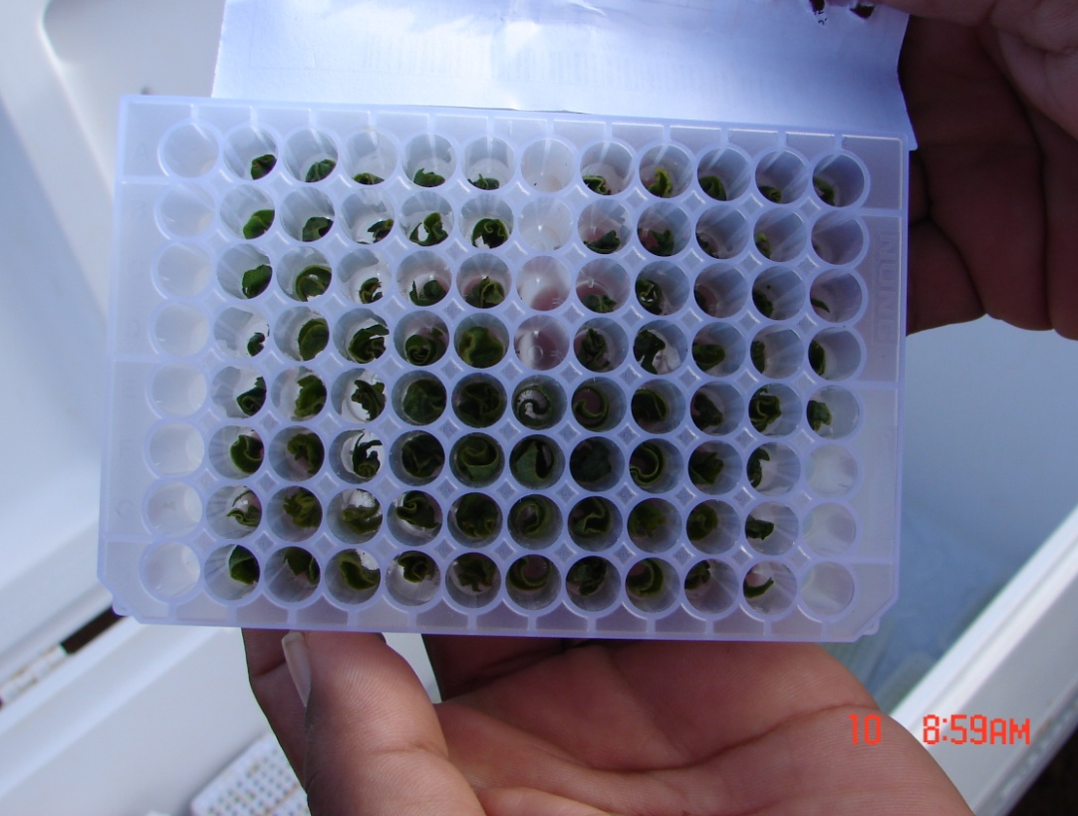
For Best Results
Limit contamination…
Plant Extracts - fluids with a high content of protein and cellular debris
Foreign Material - soil, debris, pesticides, micro-organisms…that may affect testing

Slide 22
For Best Results
Clean
Wipe
Punch
Wash
Disrupt
70% EtOH
2% NaClO
Validate
Known Positive…

Slide 23
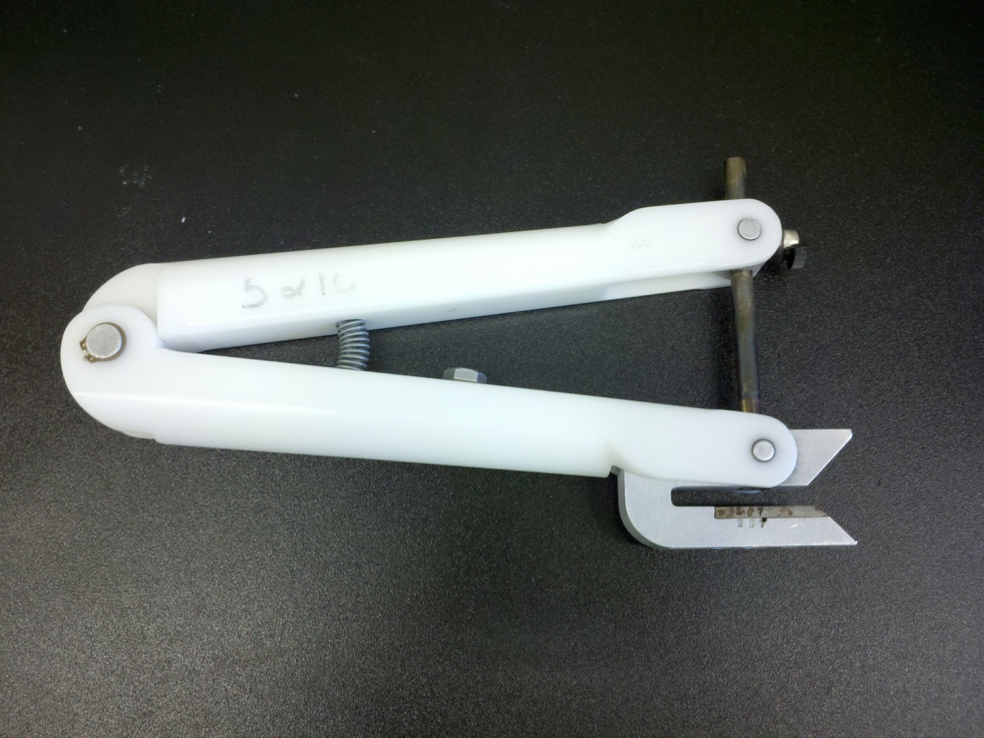
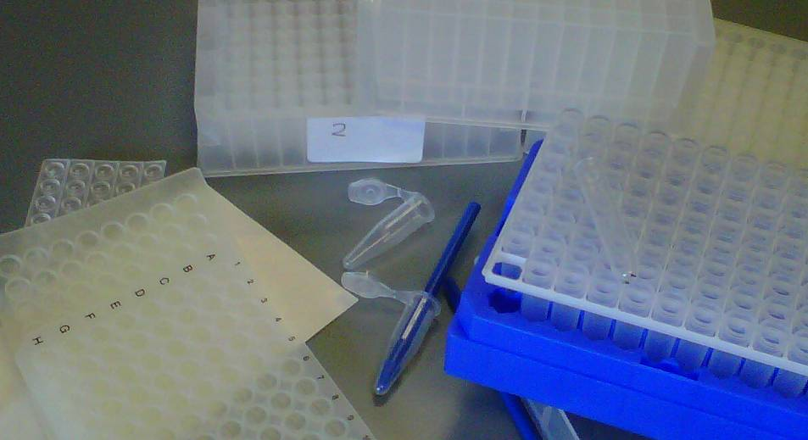
For Best Results
Carefully Consider
Labor
Tools
Containers
Caps/Seals
Field Storage
Transport/Shipping
Establish Procedure
Field to Lab

Slide 24
Safety
Pesticides
Restricted Entry Intervals (REI)
Residues and Hand Sampling
Sharp Tools
Exposure
Ergonomics

Slide 25
Objective
Detect…
Gross Errors of Identity?
Low Level of an Unknown?
Enforce or Report for…
Consumer Protection?
Environmental Protection?
Economic Protection?
Other?
Notes:
Consumer Protection Seed, Food and Feed. Seed Laws in the US: Truth in Labeling, Quality Complaints & Arbitration, Assistance with Variety Protection. Environment: Impact study, controlled release, monitor escape. Domestic concerns and Export protection from an economic prospective.

Slide 26
Realization
Gross
Minor
Lack of Change Over
Erroneous Field/Variety Identification
Isolation Intrusions
Unclean Equipment
Parent Seed Impurities
Hybrid Outcrossing
Varietal Impurities
Low
High
Number Plants or Seeds Required to Identify
Gross to Minor
Notes:
What is your objective? What is the best way to approach and achieve the objective?

Slide 27
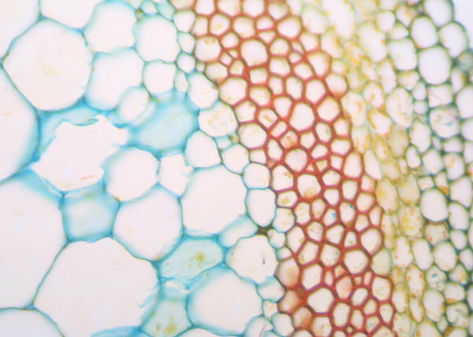
Summary of Selected Tissue Sampling Techniques

Slide 28
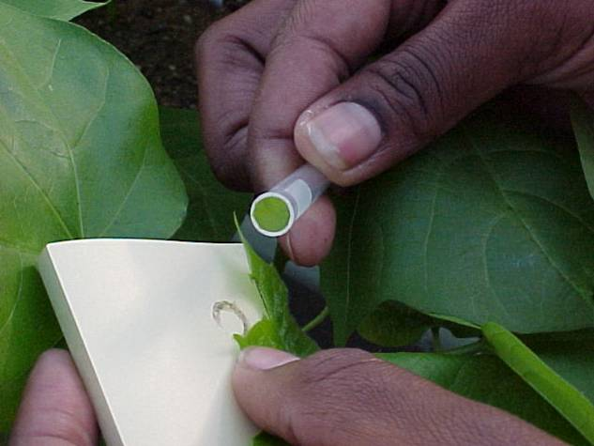
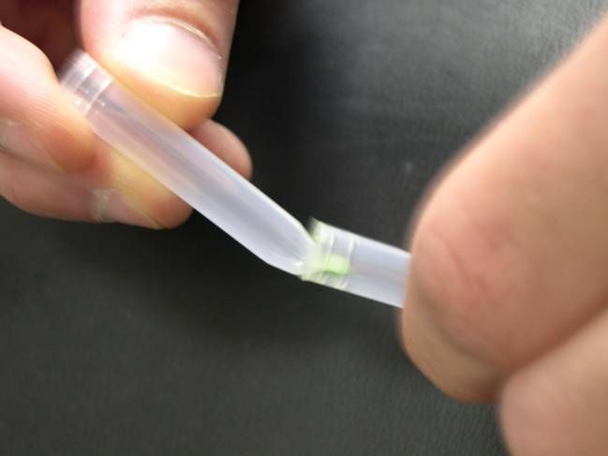
Tube Sampling
Notes:
Place leaf against backer
Press sample tube against leaf
Twist tube to “cut” a leaf disc
Use next tube to displace disc
Use a fresh backer for the next sample

Slide 29
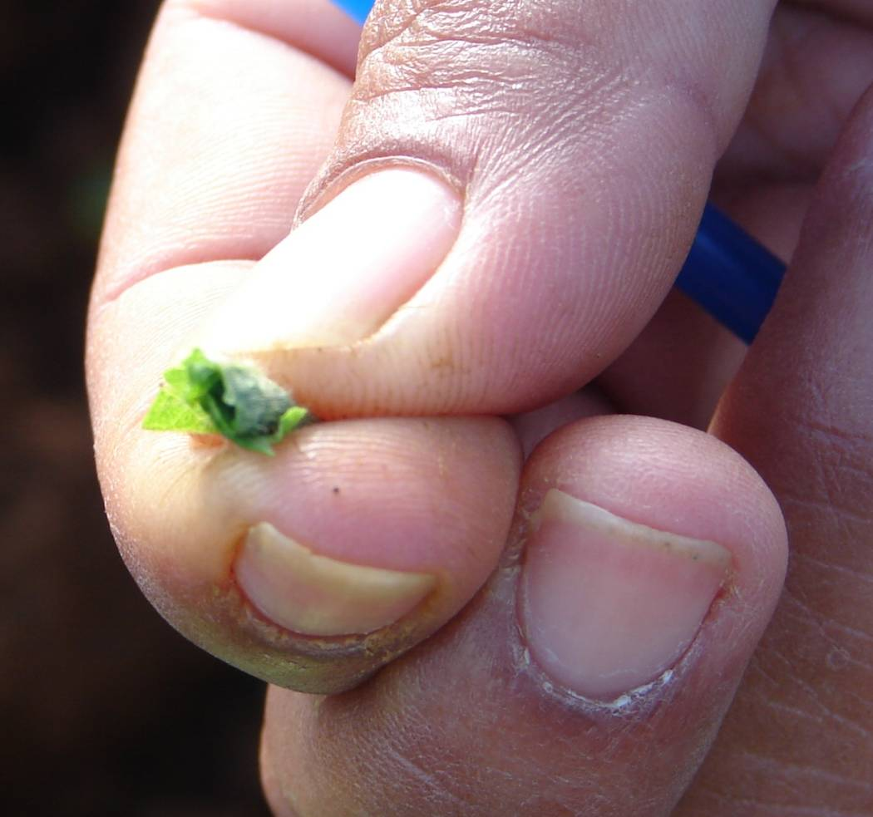
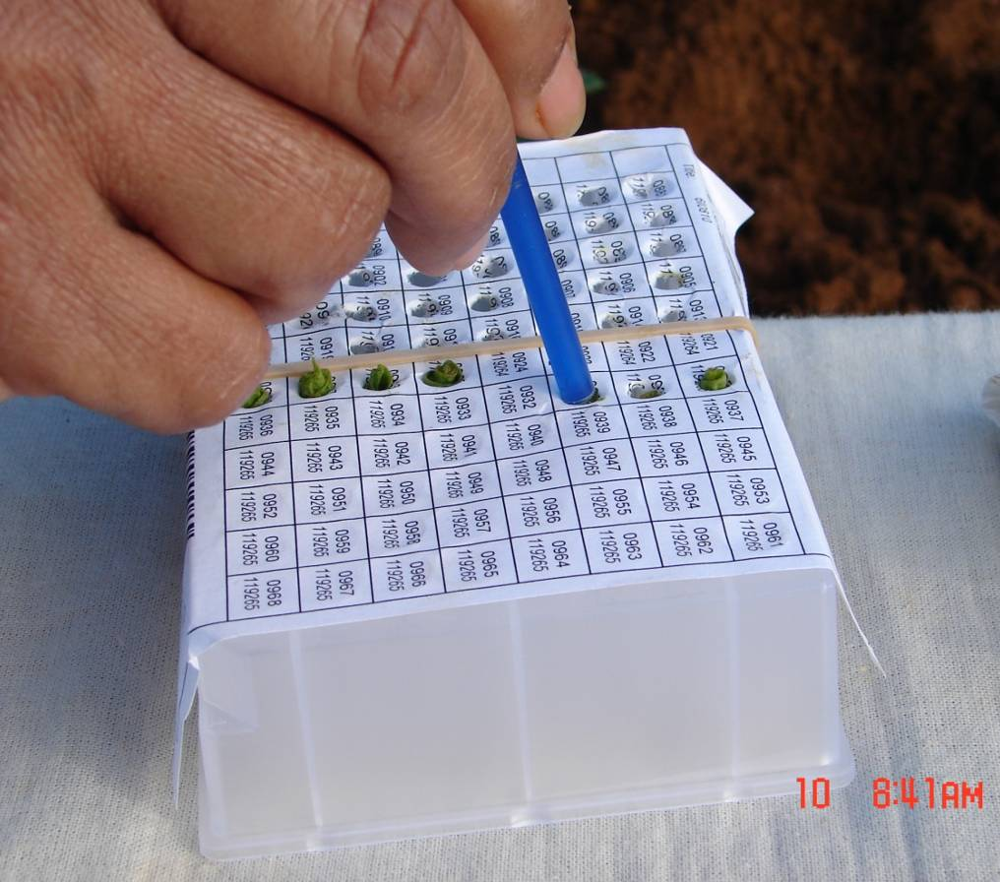
Hand Sample
Notes:
Pinch and tear tissue
Avoid plant extract on hands
Sample size 0,75 cm – Single Sample
Roll the tissue to fit the tube

Slide 30
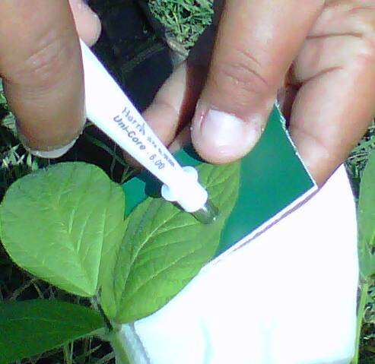
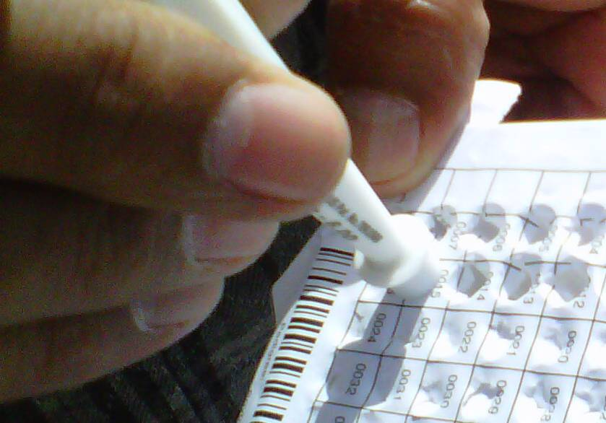
Harris Uni-Core™ Tool
Notes:
Place leaf against Harris Cutting Mat™
Press tool against leaf
Twist the tool to “cut” a leaf disc
Use the plunger to deliver the disc
Clean the tool and cutting mat
Tool is very sharp use care
Discard dull tools!!

Slide 31
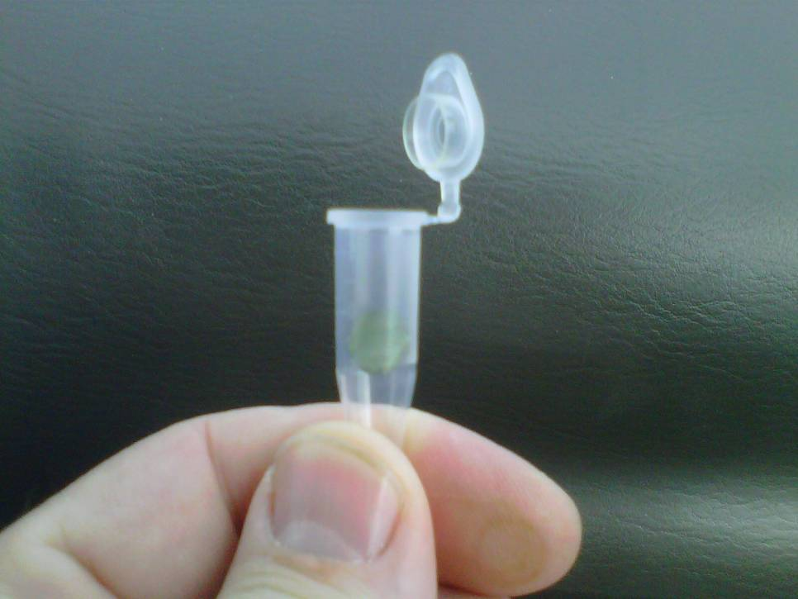
Eppendorf Cap Sampling
Notes:
Place the leaf between the cap and body of the Eppendorf tube.
Note: Fold the leaf to obtain two leaf discs
Snap the tube’s cap closed.
As needed remove excess leaf material from around the closed cap.

Slide 32
Tube Sampling
Advantage
Disadvantage
No equipment to clean
Uniform sample size
Rapid collection of a large number of samples
Crushes tissue creating plant extracts
Plastics must be purchased separately
Requires sampling map
Tubes are not secure in the rack (versus 96-well plate)

Slide 33
Hand Sampling
Advantage
Disadvantage
No equipment to clean
Rapid collection of a large number of samples
Sample size varies
Requires good dexterity
Requires sampling templates/plate map

Slide 34
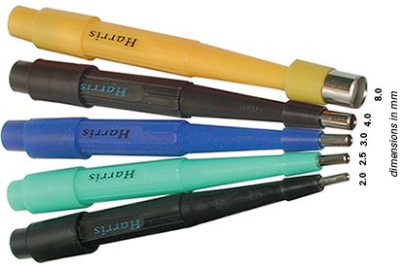
Harris Uni-Core™
Advantage
Disadvantage
Clean cut = less plant extract
Uniform sample size
Rapid collection of a large number of samples
Tool and mat must be cleaned
Sharp tool can cut skin
Requires template/plate map
Operators may not discard dull tools
Added expense, availability?

Slide 35
Eppendorf Cap
Advantage
Disadvantage
No equipment to clean
Uniform sample size
Immediately seals the sample
Plastics included in the kit
Tube can “stay” with the plant being tested
Takes more time
Requires good dexterity
Each tube requires a label if not tested in the field

Slide 36
…those not content to do small things well would leave great things undone.
- Ellen Glasgow
Notes:
I have a favorite quote for those charged with the improvement of crops; It was not the matter of the work, but the mind that went into it that counted and…

