Slide 1
Standard Germination: Planting and Classifying
Michael Stahr
2024 Super Workshop

Slide 2
Seed Germination:
emergence & development from the seed
embryo of those essential structures which,
for the kind of seed in question, are indicative
of the ability to produce a normal plant under
favorable conditions
(AOSA Rules for Testing Seeds)

Slide 3
Volume 4: Seedling Evaluation
PART I. Principles of Seedling Evaluation
1 Introduction
2 Classification, Structure, Development
2.1 Classification of Plants
2.2 Seed Development
2.3 Definition of the Seed
2.4 Seedling Structure
2.5 Seedling Growth Habit
2.6 The Germination Process
3 Seedling Evaluation
3.1 Laboratory Definition of Germination
3.2 Germination vs. Vigor
3.3 Assessment of Seedlings
3.4 Causes of Seedling Abnormalities
3.5 Factors Affecting Seedling Evaluation
PART II. Seedling Descriptions (36 families or types)
Glossary
Index
Use entire Volume 4!

Slide 4
 | Substrata | Temp | 1st Count | Final Count | Spec. Require | Fresh & dormant
Zea mays corn (AOSA) | B, T, S, TC, TCS | 20-30 25 | 4 | 7 | See footnotes
Zea mays (ISTA) | BP, TPS,S | 20-30 25, 20 | 4 | 7
Glycine max Soybean (AOSA) | B,T,S, TC, TCS | 20-30 25 | 4 | 8
Glycine max (ISTA) | BP, TPS,S | 20-30 25 | 5 | 8
Medicago sativa alfalfa (AOSA) | B, T, S | 20 | 4 | 7 | Hard seeds
Medicago sativa (ISTA) | TP, BP | 20 | 4 | 10 |  | Prechill

Slide 5
Germination Terms
Normal: necessary structures are present and are not badly damaged. “Seedling doesn’t have to be vigorous”.
Abnormal: structures missing or are severely damaged.
Dead: no signs of life (“or very little”).
Dormant: Seeds don’t germinate when presented with conditions necessary for germination
Hard: seeds don’t take up moisture due to an impermeable seed coat.

Slide 6
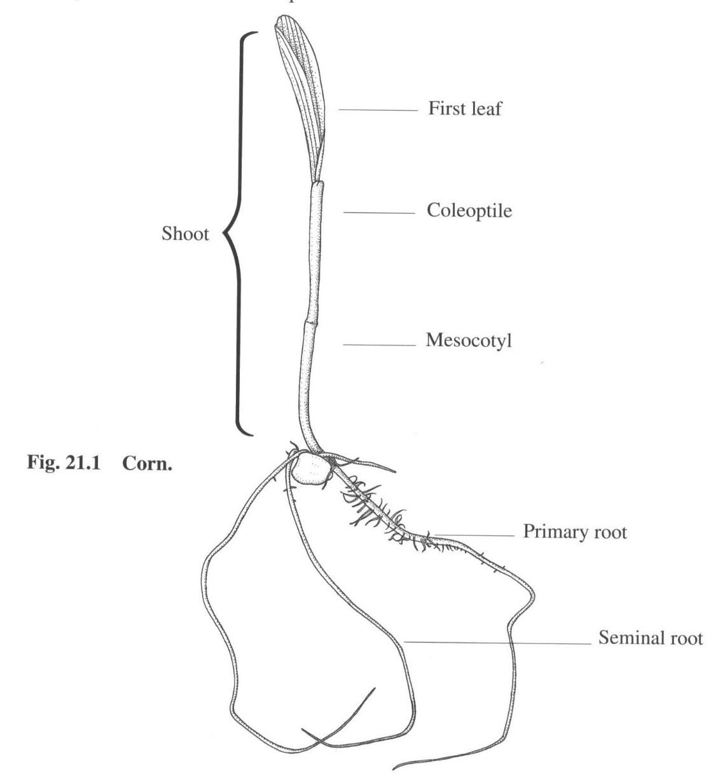
Poaceae, Grass Family III
Corn Normal Seedling:
Vigorous roots -
Primary and seminal
Leaf greater than halfway up
coleoptile (depends)
Leaf not badly shredded or split

Slide 7
Corn Abnormal Seedling Description
Root:
none
weak, stubby or missing primary root with weak seminal roots
Seedling:
decayed at point of attachment to the scutellum
one or more essential structures impaired as a result of decay from primary infection.
Albino

Slide 8
Abnormal Seedling Description
Shoot:
missing
no leaf
leaf extending less than halfway up into the coleoptile
leaf and coleoptile proportionality
Field corn: no evident growth of enclosed leaves that grow from the meristematic region at their base and the mesocotyl (see note 3a)
Sweet corn, popcorn & ornamental corn: leaf extending less than halfway up into the coleoptile (see note 3b)

Slide 9
New with Rule Change (in 2002)
The following damage to coleoptile with
sufficient damage to first leaf (emerged) causes seedlings
to be abnormal:
split more than 1/3 length from tip
strongly bent over
tip damaged or missing
split at any location below the tip.

Slide 10
New with Rule Change (in 2002)
Seedlings are abnormal with following damage to
coleoptile if the first leaf has not emerged at time of
evaluation:
tip damaged or missing
split for more than 1/3 of length from tip

Slide 11
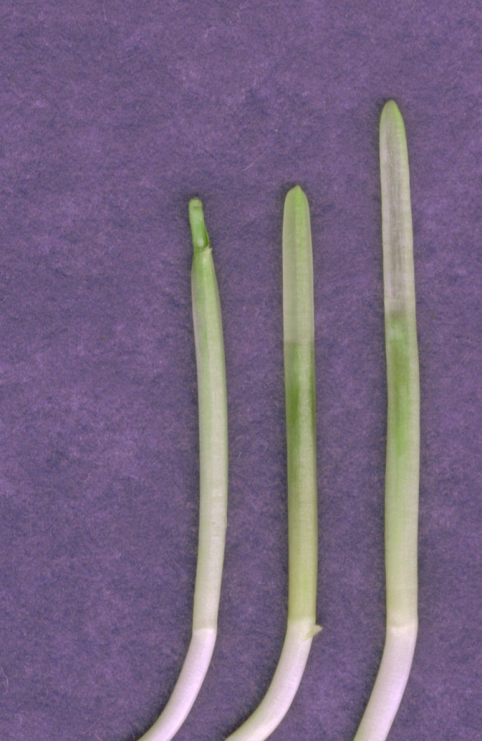
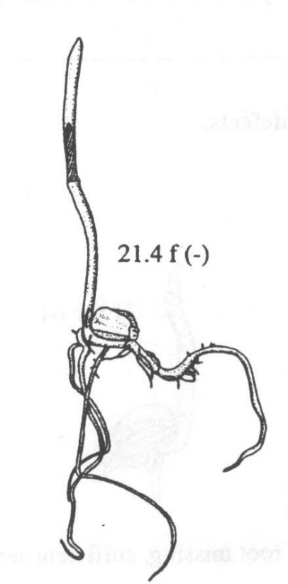
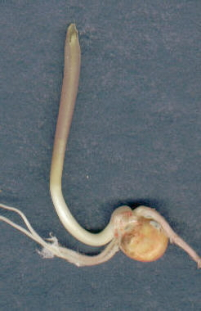
Half-Filled Coleoptiles
The primary leaf must be more than half-way up the coleoptile to be normal.
Measurement is from the node to the tip of the coleoptile.
Node
Doesn’t apply to field corn

Slide 12
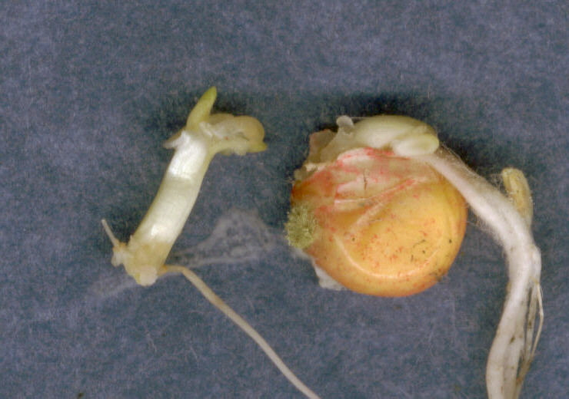
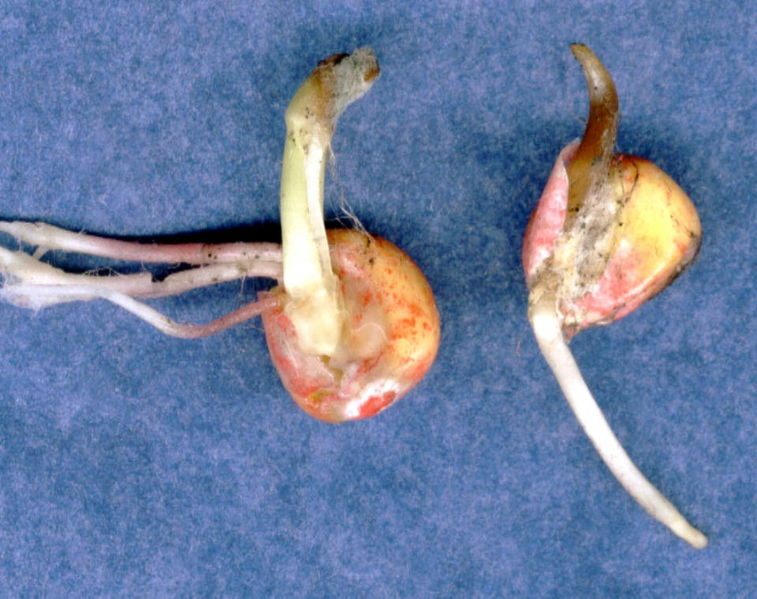
Damaged shoot
All seedlings on this page should be classified as abnormal on a warm germination test.
Decayed shoots (from primary infection).
Typical?
Non-Typical?

Slide 13
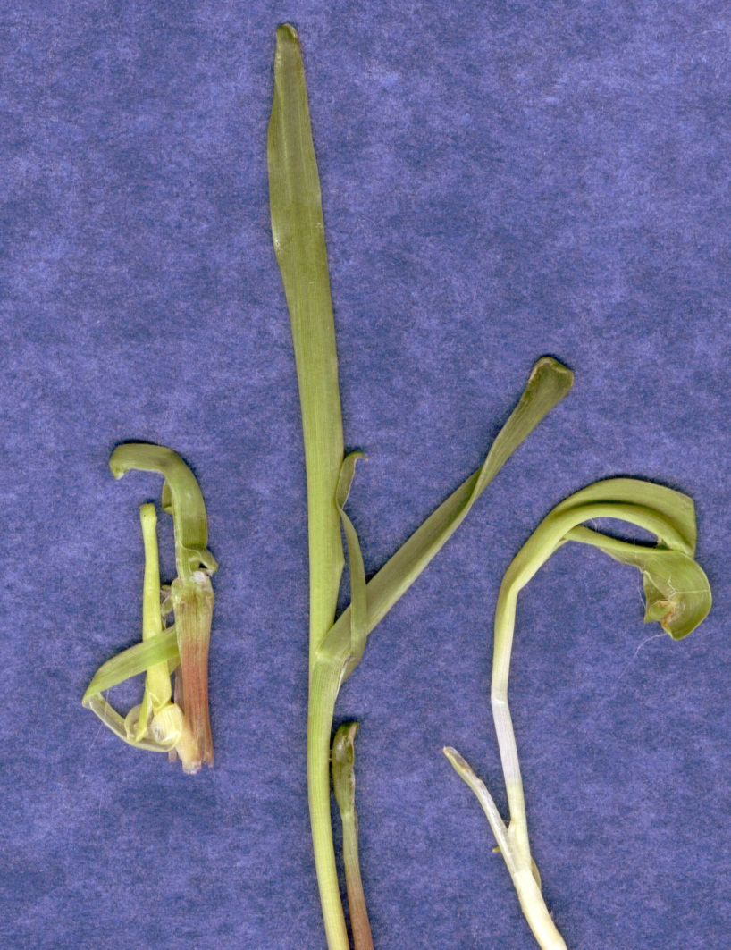
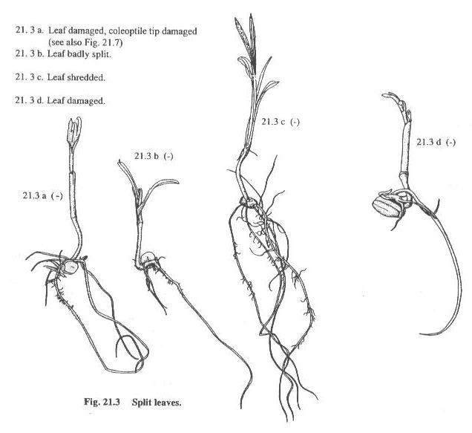
Slight Damage
Badly shredded leaves
Leaves split or shredded
at least one-half.
Amount of split not designated in word description.

Slide 14
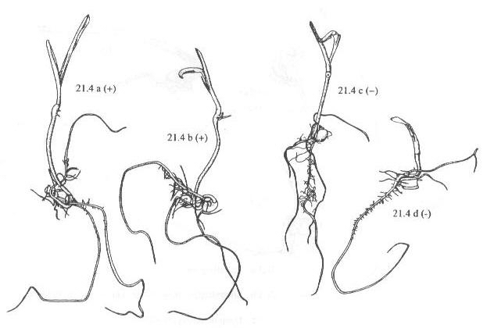
Normal
(leaf curled due to test conditions)
Abnormal
Abnormal
Normal

Slide 15
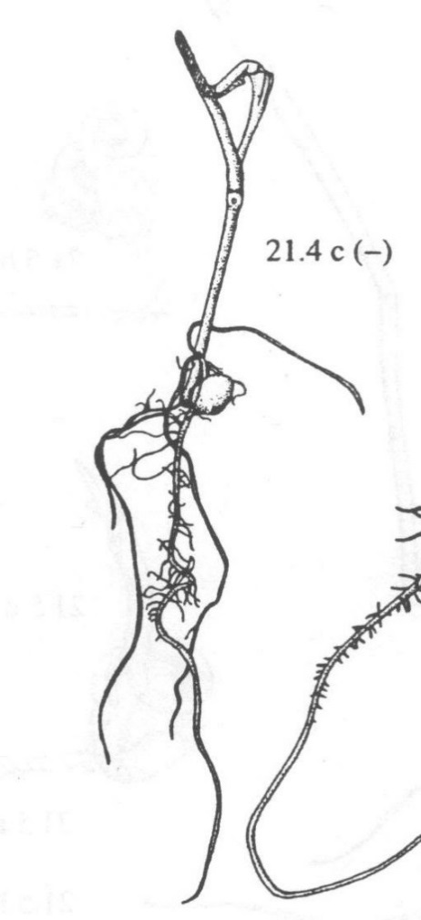
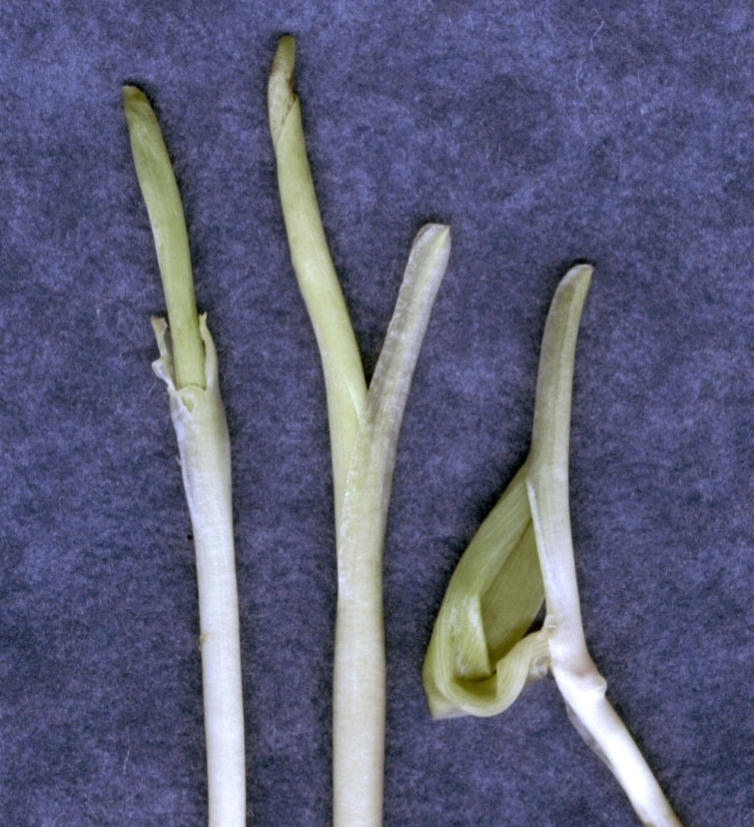
Coleoptile damage
Abnormal
Previously, AOSA was not concerned with the coleoptile damage on any of these seedlings.
ISTA would have called them all abnormal.
Now seedlings 1 & 2 are normal if leaves not badly shredded.
Seedling 3 is always abnormal.
Normal

Slide 16
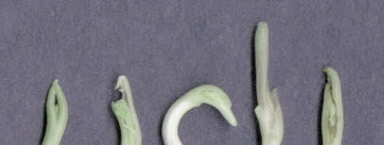
All seedlings abnormal.
First leaf has not emerged:
Coleoptile tip damaged or missing.

Slide 17
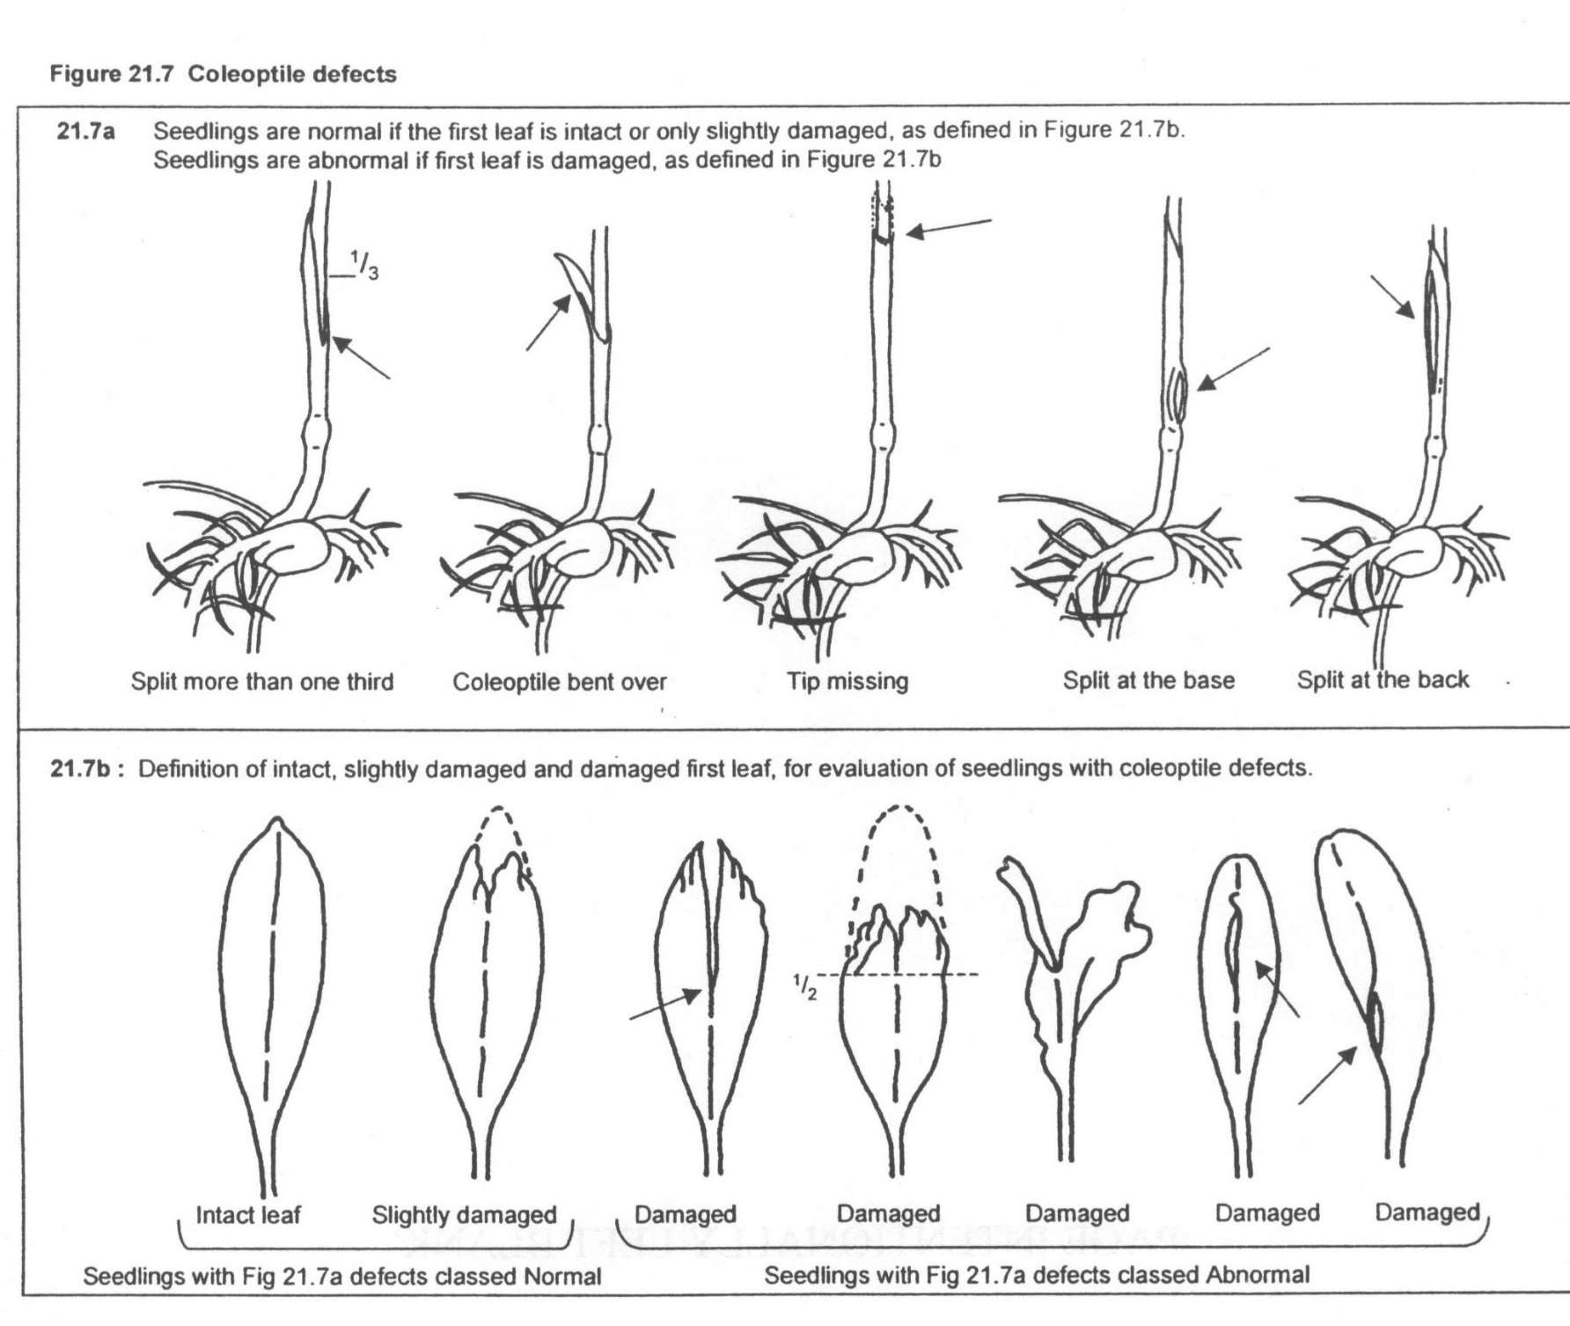
Intact
or
Slight
Damage
<1/3
Intact
Normal
Abnormal?
First two seedlings normal regardless of coleoptile damage

Slide 18
These damaged seedlings are normal if 21.7a coleoptile damage is not present.
1/3 - <1/2
<1/3
If split ½ or more: abnormal regardless of coleoptile

Slide 19
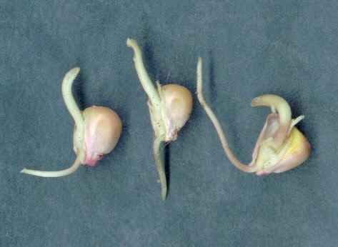
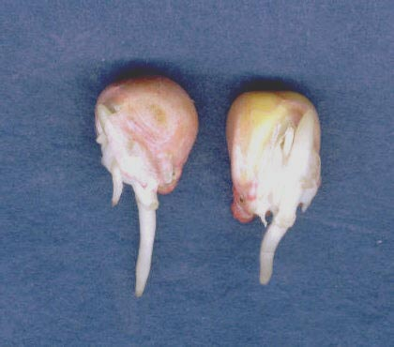
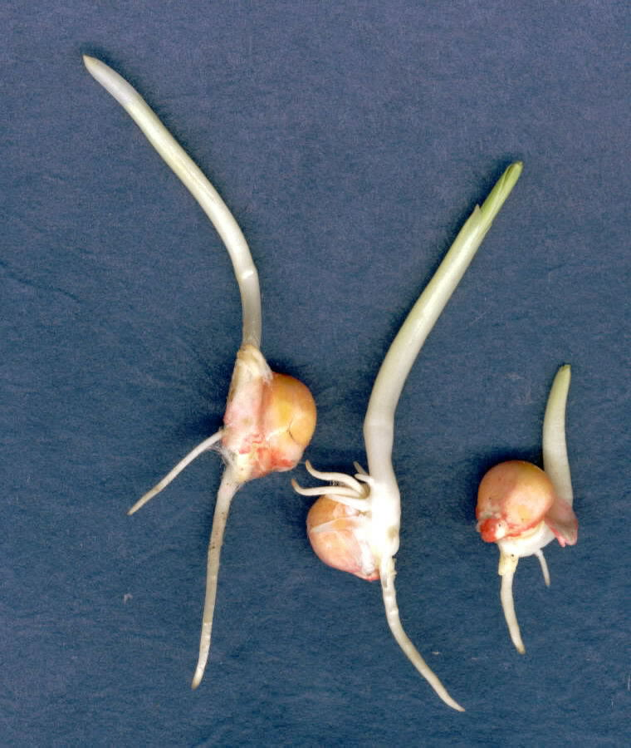
Non-Trait Characteristics - Moncots
Round up: Reduced root development; root(s) stiff. Shoot (or leaves) typically white
Liberty: Reduced root development. Mescotyl necrotic. “Halo” effect. Little shoot growth
Clearfield: Reduced root development
Round up® Non-Trait
Liberty® Non-Trait
Clearfield®Non-Trait

Slide 20
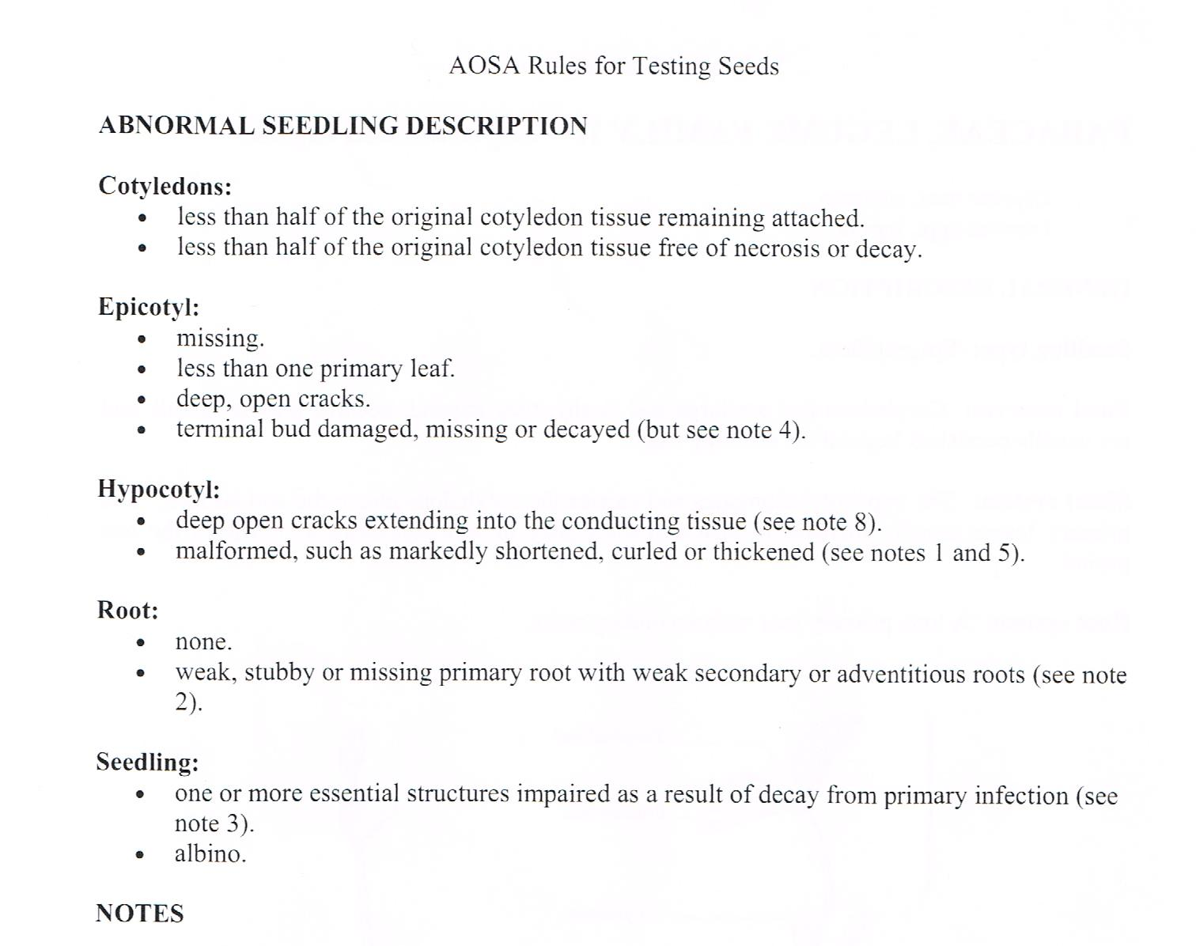
Fabaceae, Legume Family II

Slide 21
Normal Seedling
Roots: vigorous primary or
two or more secondary roots.
Hypocotyl: not markedly shortened or thickened
Cotyledons: one or two halves (50%)
Epicotyl: at least one primary leaf; terminal bud present.

Slide 23
NOTES (Cont.)

Slide 24
Seedlings
No 1º root,
insufficient 2º root

Slide 25
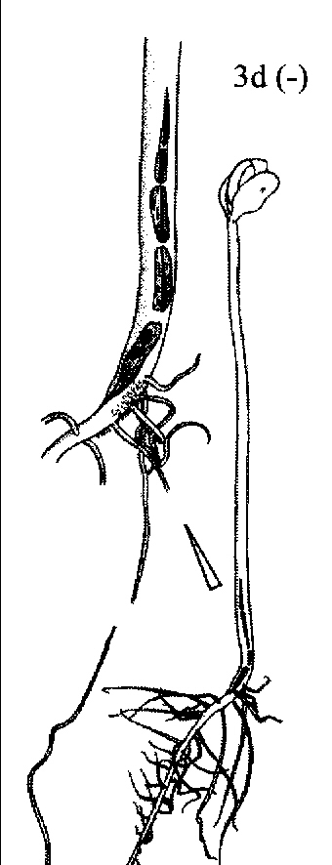
Hypocotyl Lesions
Superficial lesion

Slide 26
Short, Damaged Hypocotyls
No more hypocotyl elongation
ISU

Slide 27
Primary vs. Secondary Infection

Slide 28
Epicotyl
Must have at least one intact primary leaf and an intact terminal bud (growing point).
ISU

Slide 29
Seedlings
ISU
ISU
Damaged point of attachment (abn)
Late-starting seedling (abn)
Extend 2-5 days

Slide 30
How quickly to end a test?
X
X
X
X

Slide 31
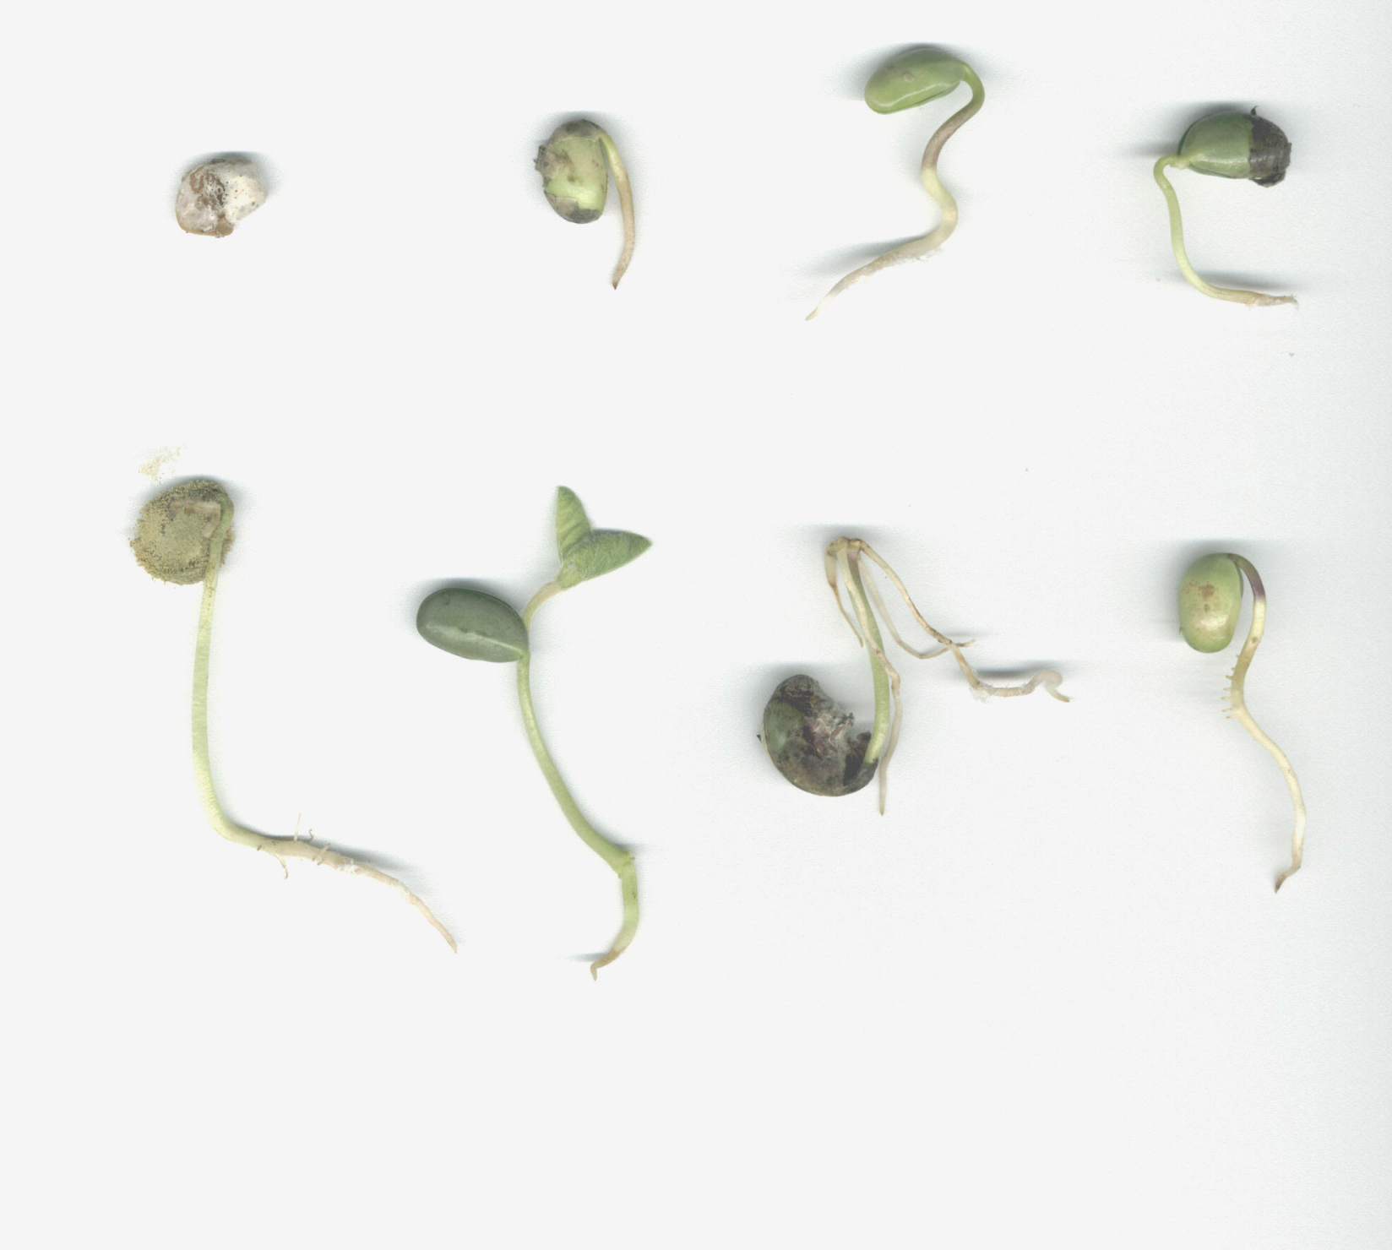
Normal
Normal
?
?
Phomopsis – dead seed
Damaged point of attachment
Damaged point of attachment
Negative geotrophism
Decayed cotyledons –
A. flavus
Negative geotrophism
Normal
Insufficent roots + epicotyl showing
Normal
Insufficent roots + epicotyl showing

Slide 32
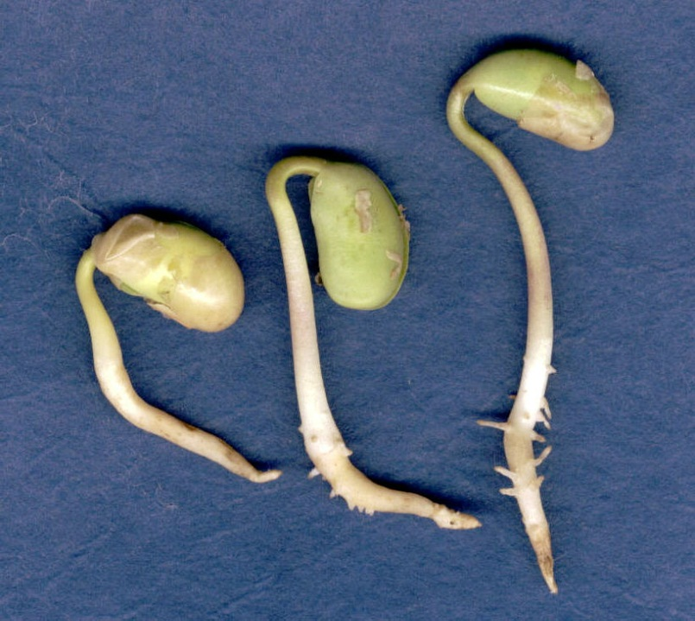
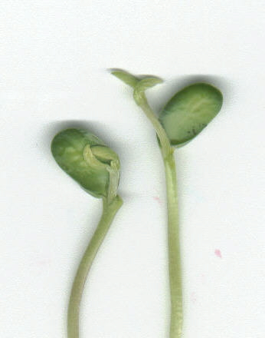
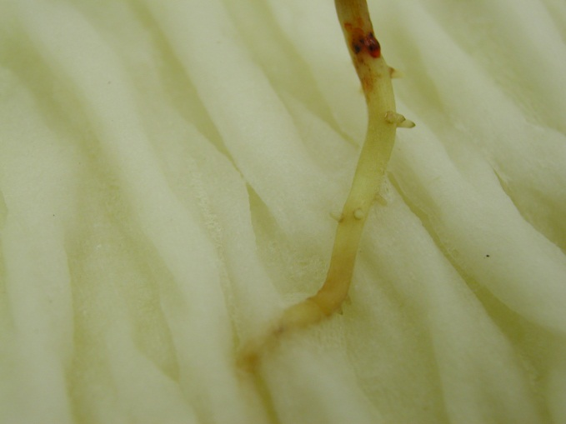
Non-Trait Characteristics - Dicots
Roundup®: 1º root short, thickened and off-color. 2º roots very stubby (if present)
STS®: Unifoliate leaves crossed
Liberty®: Reduced root development
Round up® Susc.
STS® Susc.
Round up® Susc. -spray

Slide 33
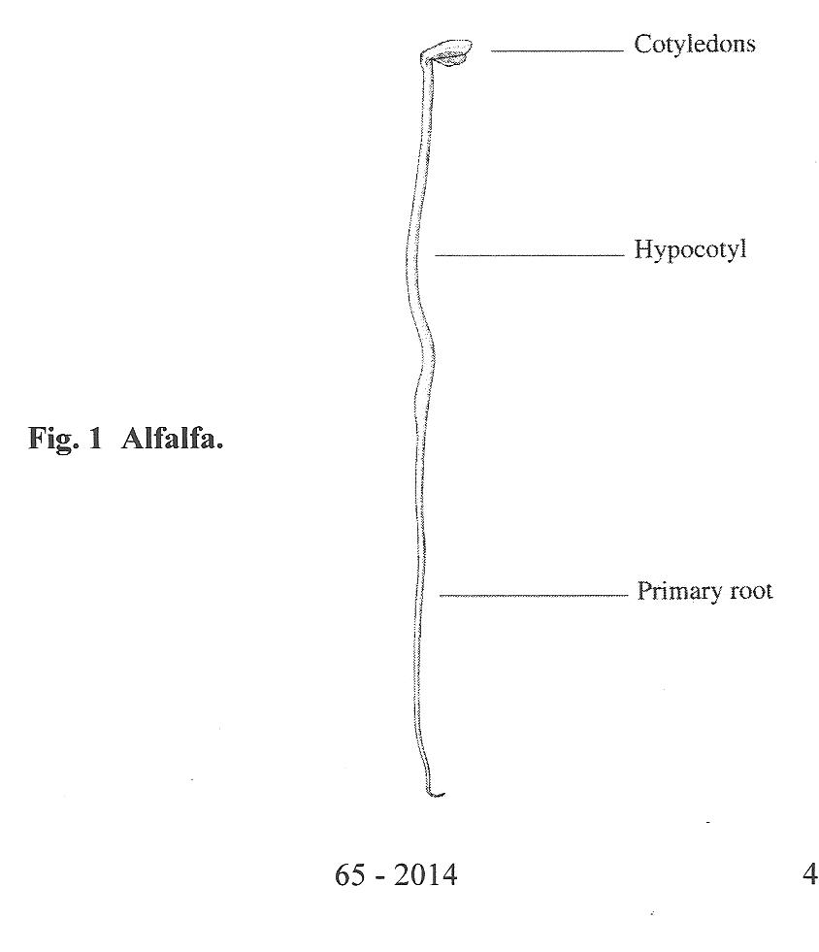
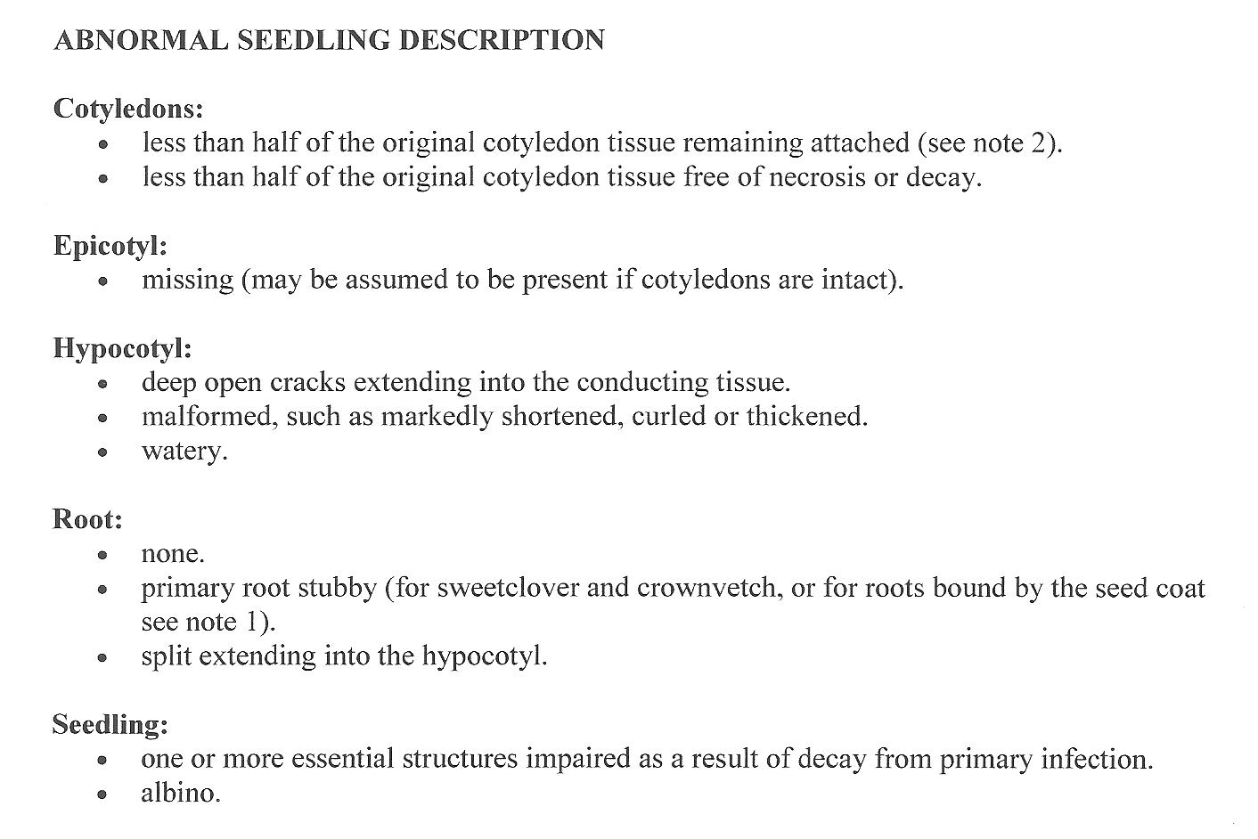
Alfalfa
Fabaceae, Legume Family V
Small-seeded

Slide 34
Alfalfa - Notes
Stubby appearing roots.
Breaks at point of attachment.
Causes of lack of growth.
Sainfoin
Swollen and hard seeds.

Slide 35
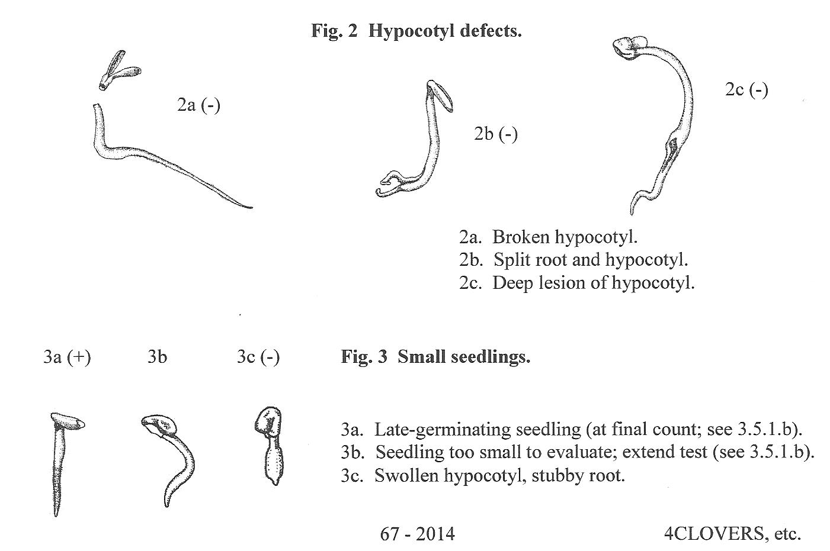
Alfalfa

Slide 36
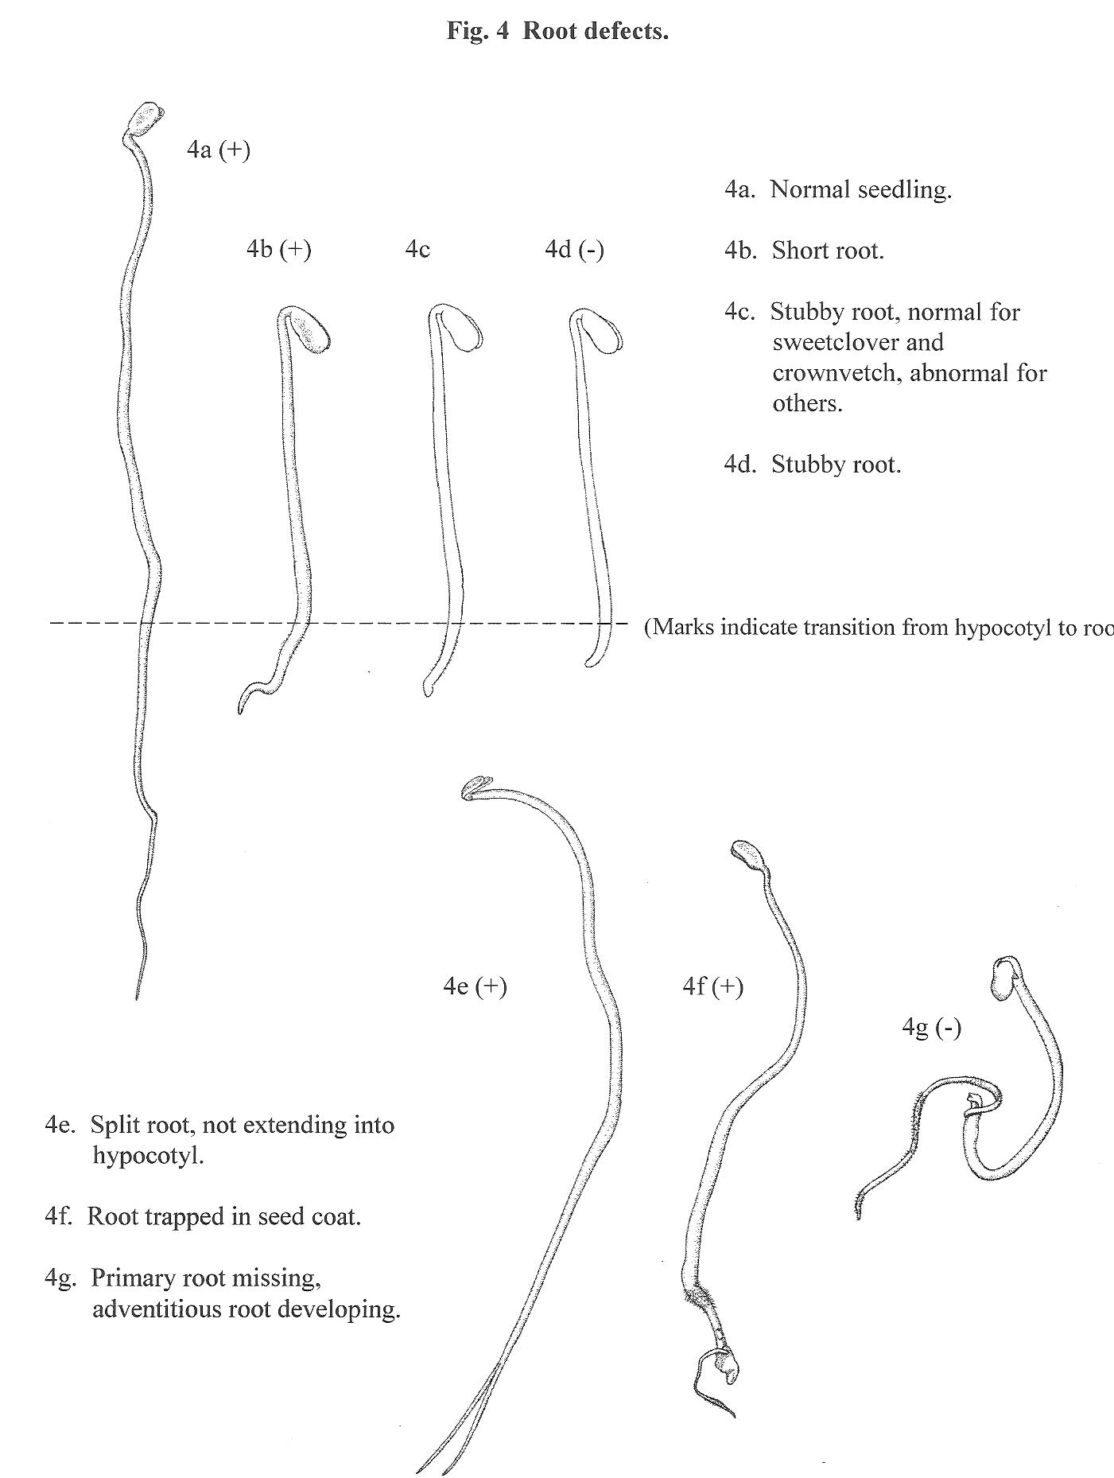
Alfalfa

Slide 37
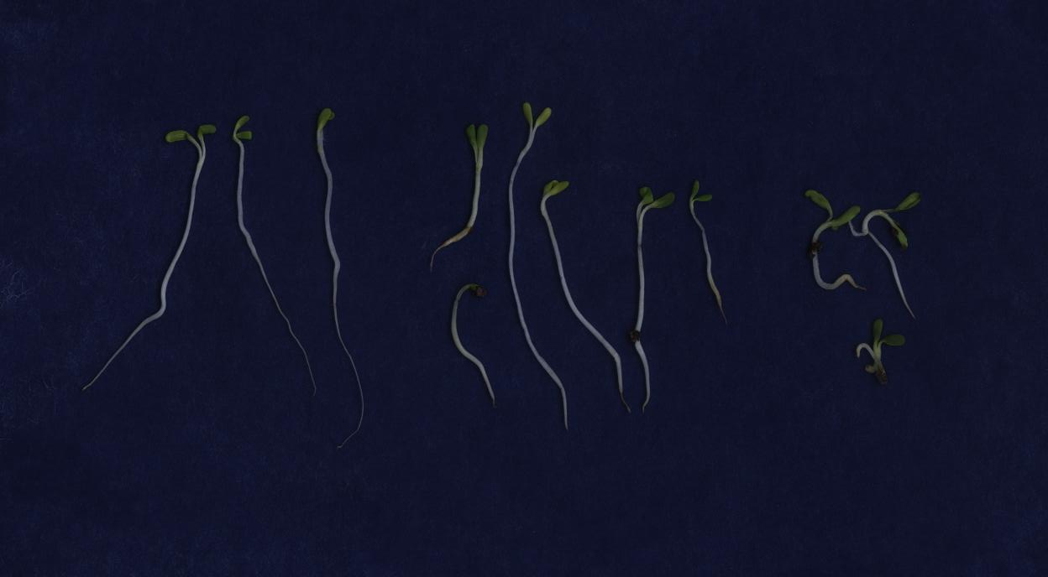
Testing Challenges – RR Alfalfa
Distinguishing tolerant seedlings from non-tolerant seedlings.
Tolerant Seedlings
Abnormal
Non-Tolerant

Slide 38
Questions? Comments?

