Slide 1

Single Nucleotide Polymorphism (SNP) Testing
Don Mittanck, PhD.
Technical Team Lead
North America Genetic Quality Testing Laboratory
Bayer Crop Sciences Product Supply

Slide 2


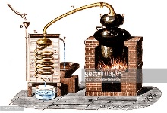


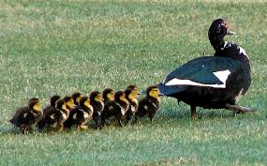






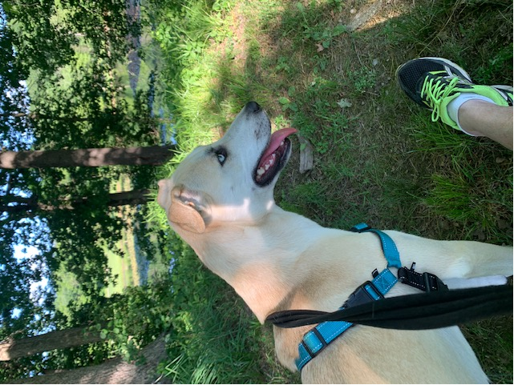

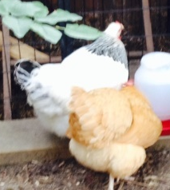
Technical Team Lead, Genetics Seed Quality Testing: St Louis, USA; PS Expert
Don Mittanck
Strengths:
Harmony
Analytical
Consistency
Deliberative
Discipline
Education:
HS in Houston, TX
BS in Chemistry, Texas Tech University (1988)
PhD in Biochemistry/Molecular Biology, Texas Tech University (1992)
Work Experience:
Post Doc, Washington University Medical Center, (1992-1997)
Post Doc, Monsanto Biotechnology, Gene Disc. & Expr. (1997-1998)
Monsanto Regulatory Sciences, Mol. Characterization/Det. Methods, (1998-2013)
Monsanto Supply Chain, Quality Control R/D, (2013-2018)
Bayer Crop Science, Product Supply, (2018-Present)
Life Balance:
Family – Wife, 2 kids, dog, cat, chickens, fish, bee hives,
Hobbies - Running, weight training, classic cars

Slide 3
Single Nucleotide Polymorphism (SNP)
A single-nucleotide polymorphism is a substitution of a single nucleotide at a specific position in the genome.
ATGCCGTAGTACATTGTATGCTAATAGCG
ATGCCGTAGTACAGTGTATGCTAATAGCG
  Technically, to be classified as a SNP, this variation is contained in at least 1% of the population
  SNPs can occur in non-coding or coding regions
  Occur through natural mutation
  Are inherited
  100Ks – 1Ms of SNPs exist in whole genomes (~1 in 1,000 nt)
  May or may not be trait-associated

Slide 4

Uses of SNPs in a Genetic Testing Lab
SNPs are very useful genetic markers:
  Breeding Programs – marker-assisted breeding
  Quality Testing Programs
  Varietal testing
    inbreds
    hybrids
  Trait testing
    traits directly resulting from SNP
    traits co-linked to traits
  Hybridity testing
    hybrid crops

Slide 5
Identifying SNPs
Genome Sequencing
  Populations
  Breeding varieties
Trait Association Studies
Public databases
Reference - ….ATGCCGTAGTACATTGTATGCTAATAGCG….
Variety 1 – ….ATGCCGTAGTACATTGTATGCTAATAGCG….
Variety 2 – ….ATGCCGTAGTACAGTGTATGCTAATAGCG….
Variety 3 – ….ATGCCGTAGTACATTGTATGCTAATAGCG….
Variety 4 – ….ATGCCGTAGTACAGTGTATGCTAATAGCG….
Variety 5 – ….ATGCCGTAGTACAGTGTATGCTAATAGCG….

Slide 6
SNP Panel Design - Fit for Purpose informativity vs. cost
Define the Purpose: Line identification vs Line confirmation
  Breeding program – early in the process - be sure you are advancing the correct lines – smaller number of samples - more markers/higher genome representation.
  Quality control program – later in the process – quality check to confirm production processes – large number of samples - less markers=lower cost
Considerations in Panel design:
Informativity: ability to differentiate between lines within a population
Allele distribution by marker (PIC-value) – ideal 0.5 (50:50 allele) across population
Number of markers needed
Genome representation
Inbred vs hybrid informativity

Slide 7
PIC-value
(Polymorphism Information Content)
SNP : 2 alleles
Line 1 : AGTGACTGA
AGTGACTGA
Line 2 : AGTGGCTGA
AGTGGCTGA
Line 3 : AGTGACTGA
AGTGGCTGA
 | Mk1 | Mk2 | Mk3
Allele 1 | 50 | 90 | 10
Allele 2 | 50 | 10 | 90
Allele1 + Allele 2 | 0 | 0 | 0
total | 100 | 100 | 100
Allele 1 + Allele 2 | 100 | 100 | 100
Allele 1% | 0.50 | 0.90 | 0.10
Allele 2% | 0.50 | 0.10 | 0.90
Allele 1%² | 0.25 | 0.81 | 0.01
Allele 2%² | 0.25 | 0.01 | 0.81
PIC : 1-(Allele 1² + Allele 2²) | 0.50 | 0.18 | 0.18
Max SNP PIC value : 0.5
PIC value - ~0.5 high diversity
PIC value – > 0.25 and <0.5 – intermediate diversity
PIC value - <0.25 low diversity

Slide 8
Marker set selection
SNP Marker Panel Informativity
 | Mk1 | Mk2 | Mk3 | Mk4 | Mk5
Var1 | Allele 1 | Allele 2 | Allele 1 | Allele 2 | Allele 1
Var2 | Allele 1 | Allele 2 | Allele 1 | Allele 2 | Allele 2
Var3 | Allele 1 | Allele 2 | Allele 1 | Allele 2 | Allele 1
Var4 | Allele 1 | Allele 2 | Allele 1 | Allele 2 | Allele 2
Var5 | Allele 1 | Allele 2 | Allele 1 | Allele 2 | Allele 1
Var6 | Allele 1 | Allele 2 | Allele 2 | Allele 1 | Allele 2
Var7 | Allele 1 | Allele 2 | Allele 2 | Allele 1 | Allele 1
Var8 | Allele 1 | Allele 2 | Allele 2 | Allele 1 | Allele 2
Var9 | Allele 1 | Allele 2 | Allele 2 | Allele 1 | Allele 1
Var10 | Allele 2 | Allele 1 | Allele 2 | Allele 1 | Allele 2
Markers 3 and 4 : 2 genotypes and same information as one marker MK3:MK4
MK3 | MK4
Allele 1 | Allele 2
Allele 2 | Allele 1
MK3 | MK5
Allele 1 | Allele 1
Allele 1 | Allele 2
Allele 2 | Allele 2
Allele 2 | Allele 1
Markers 3 and 5 : 4 genotypes
N SNP markers : 2 alleles : 2^{N} : # possible haplotypes
5 SNP markers : 2 alleles : 2⁵ : 32 haplotypes
10 SNP markers : 2 alleles : 2¹⁰ : 1024 haplotypes

Slide 9
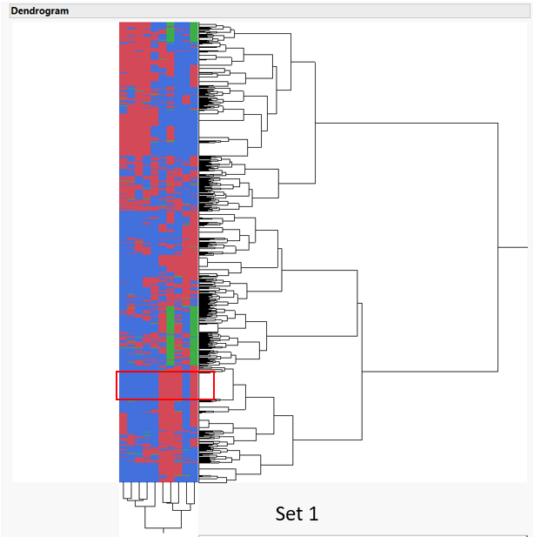
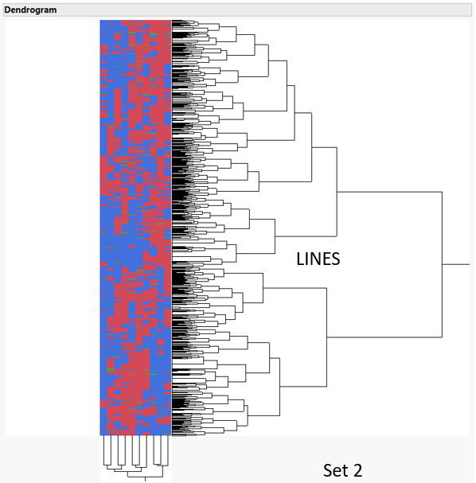
Clustering Tests for Panel Informativity
LINES
Set 1
Set 2

Slide 10
Technologies for SNP marker detection
TaqMan
  Qualitative end-point
  Quantitative real-time
KASP® – Kompetitive Allele-Specific PCR – LGC/Biosearch Technologies
rhAMP® - Integrated DNA Technologies
Microarray-based Detection
Targeted genotyping by sequence (tGBS)

Slide 11
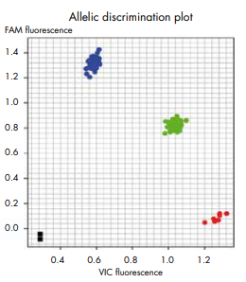
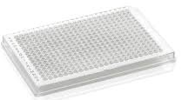

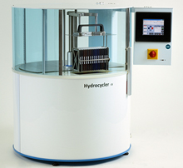
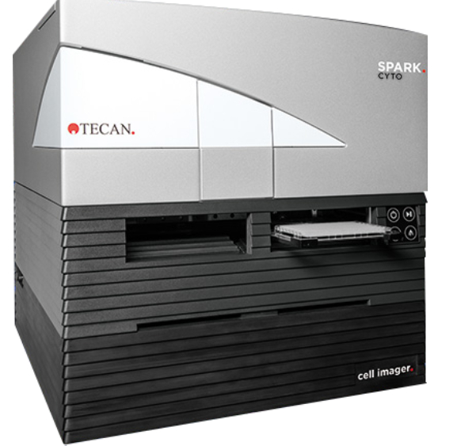
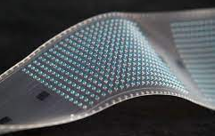
Technologies – Endpoint TaqMan PCR
TAGCGCTAGCTATGCCGTAGTACATTGTATGCTAATAGCGCTGGGATTAAACGT
TAGCGCTAGCTATGCCGTAGTACAGTGTATGCTAATAGCGCTGGGATTAAACGT
*
A
Homozygous Allele 1 (TT)
*
C
Homozygotes (TG)
Homozygous Allele 2 (GG)
Genomic DNA
preparation
No DNA (control)
PCR
Amplify specific DNA
marker targets
Read Fluorescence
PCR reaction
set-up
Type-it® Fast SNP Probe PCR Kit,
product insert (ver.12/2015). Qiagen

Slide 12
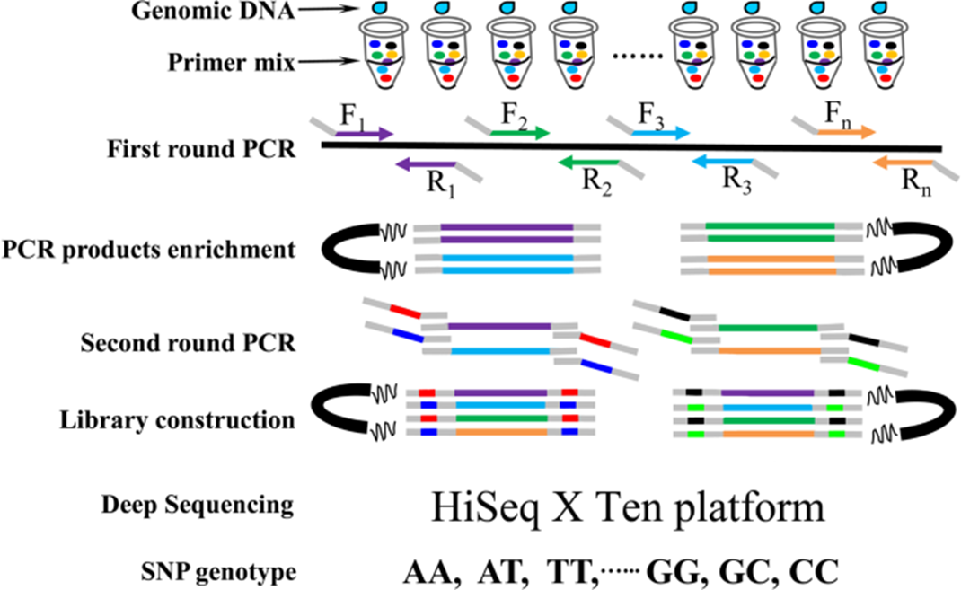
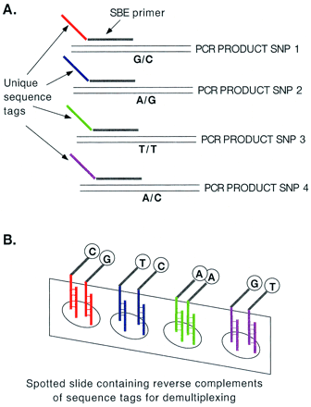
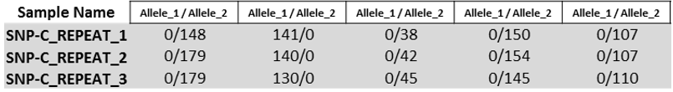
Multiplexing Technologies
Targeted Sequencing
Array-based Detection
Scientific Reports (Sci Rep) ISSN 2045-2322 (online)
SNP 1
SNP 2
SNP 3
SNP 4
SNP 5
PNAS October 24, 2000 97 (22) 12164-12169; https://doi.org/10.1073/pnas.210394597

Slide 13
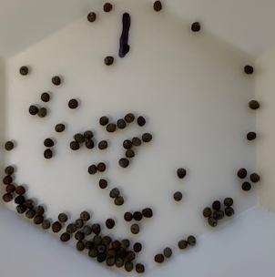
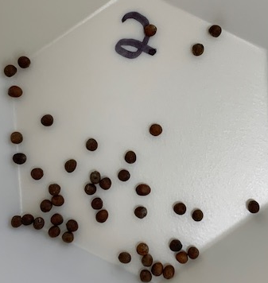
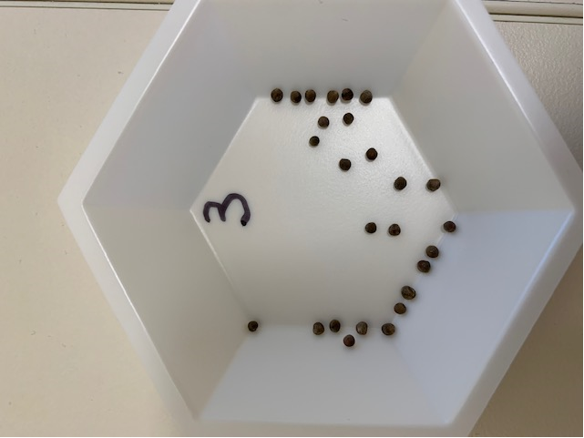
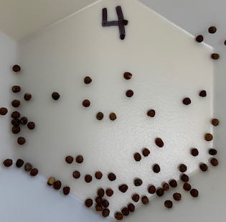
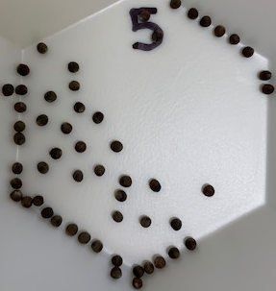
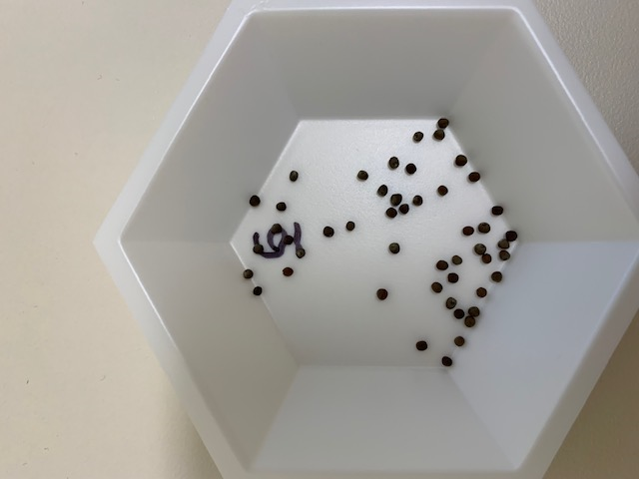
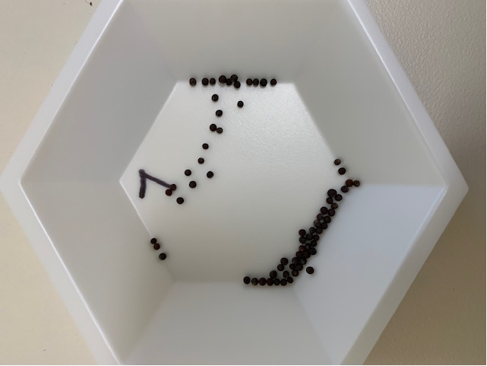
Can You Tell the Difference ?
1
2
3
4
5
6
7

Slide 14


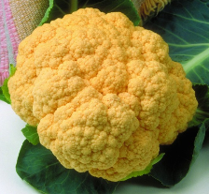
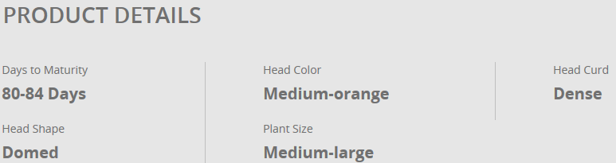
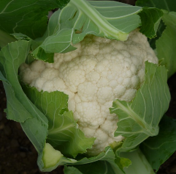
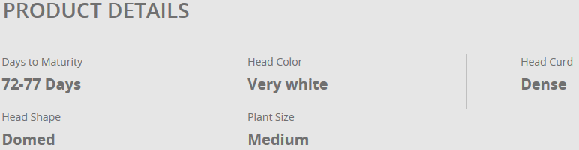


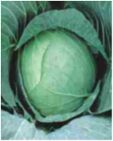
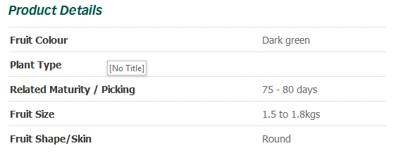
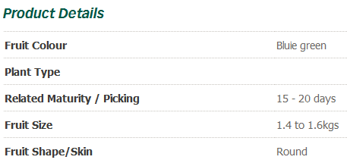
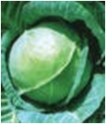


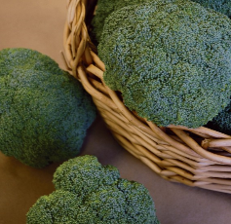
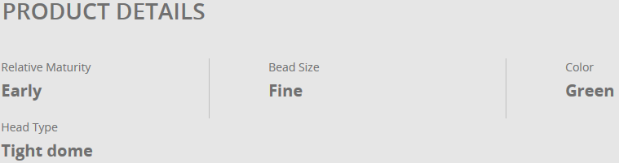
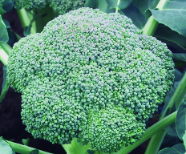
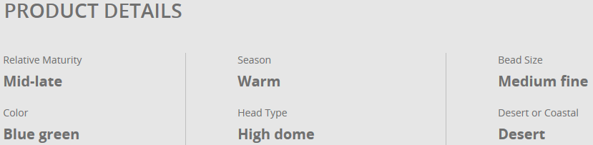
1
6
SNP Profile - H 1 2 H 1 1 2 H 2 1
SNP Profile - 1 1 2 1 H 1 2 1 H 1
4
2
SNP Profile - 2 H H 1 1 H 1 2 H 2
SNP Profile - H H 1 H H H H 2 H 2
3
5
SNP Profile - H 2 1 2 H H 1 H H H
SNP Profile - 1 H 1 H 2 1 2 1 H H

Slide 15
Conclusions
SNPs are powerful genomic markers that can be used to assess line identity and purity
SNPs can be used independently (e.g. trait testing) or in panels (e.g. varietal testing)
Choosing the correct SNP markers and SNP marker panels is critical to the informativity of the results.
Multiple technologies are available to detect SNP markers depending on purpose, throughput, cost constraints

