Slide 1
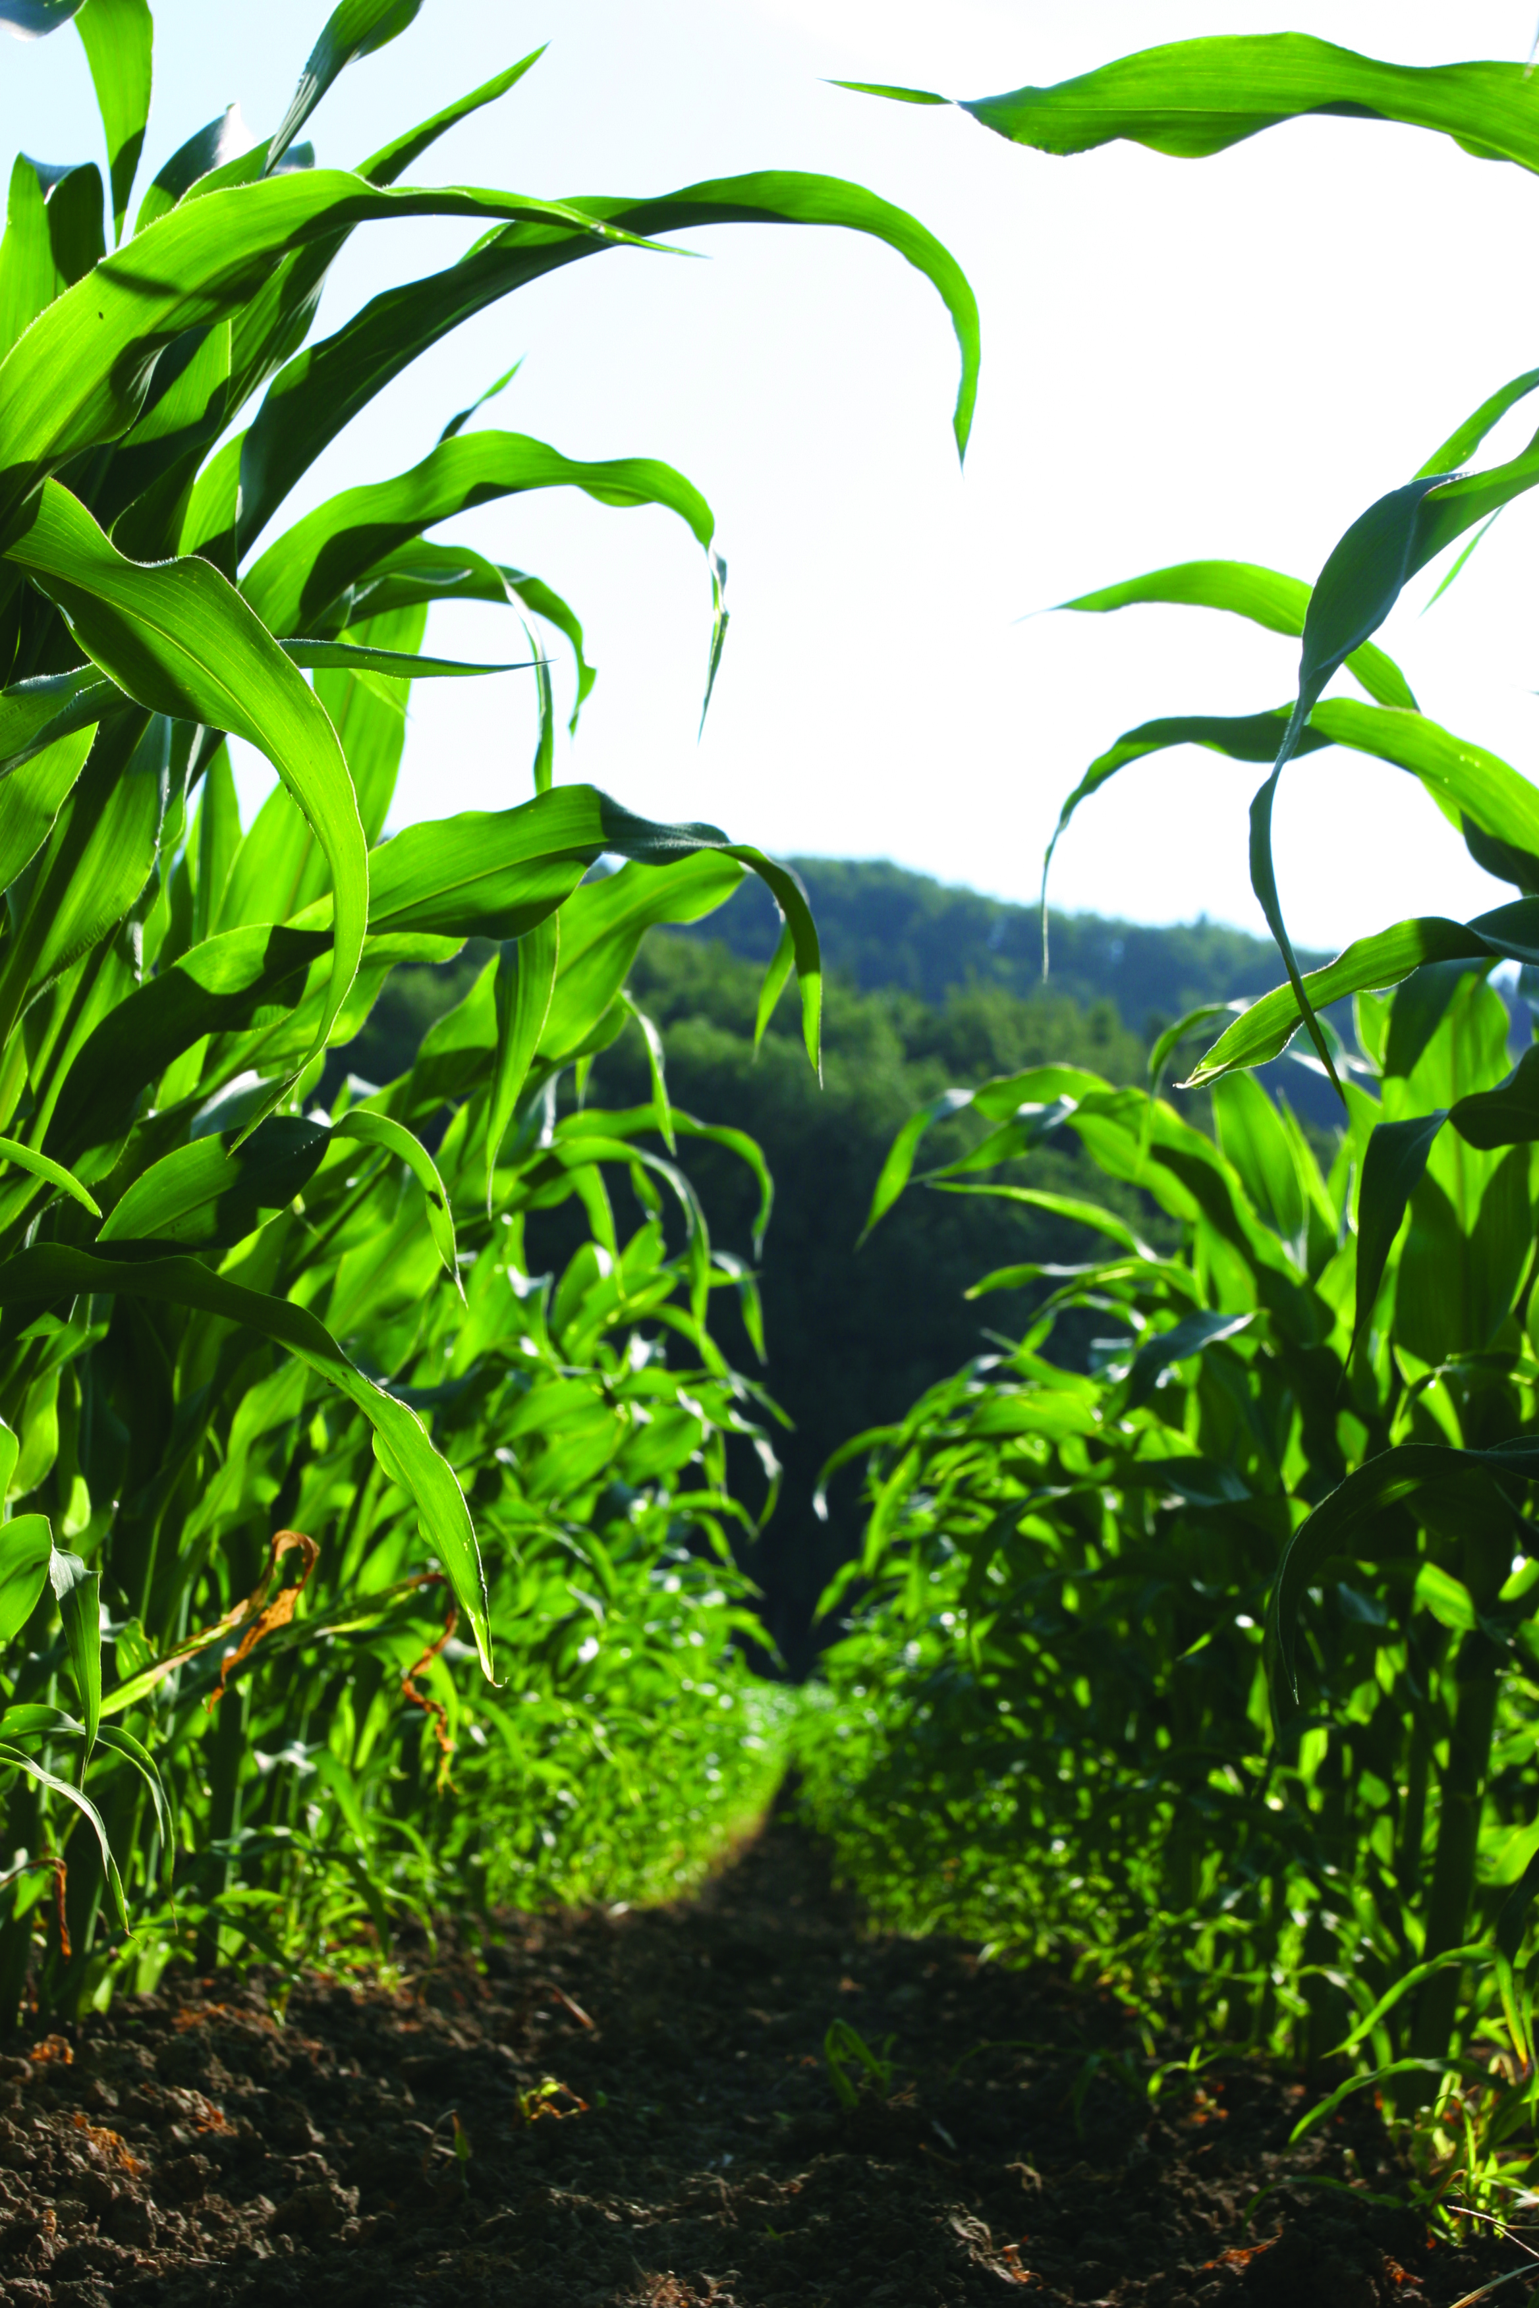
Transgenic Traits
Herbicide Bioassay
March 2022
Amanda Patin
SGS North America, Inc.
Brookings, South Dakota USA
amanda.patin@sgs.com
(605) 692-7611

Slide 2
Seeds – Trait Delivery
Inside the Seed:
Input Traits:
Herbicide Tolerance
Insect Resistance
Abiotic (Drought, yield, nitrogen)
Modified Product Quality:
Oils
Protein
Starches
Notes:
Focusing on what is in the seed

Slide 3
From DNA to Trait
Step 1
DNA inserted into plant genome
Step 2
Plant synthesizes protein from DNA code
Step 3
Protein allows plant to tolerate herbicide, kill insect, produce output trait

Slide 4
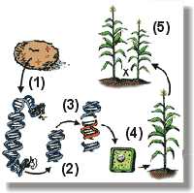
Transgenic Events
Identify DNA for transformation
Clone gene of interest
Gene design
Transformation
Backcrossing

Slide 5
Trait Test Definitions
Trait - a characteristic of an organism, which manifests itself in the phenotype (physically). In the use of a trait, it may be developed through a transgene (a package of genetic material (DNA) that is inserted into the genome of a cell via gene splicing technique or through other breeding methods. The same trait may be produced by different events and may need to be tested in a different manner
Event - each instance a genetically engineered organism is inserted in a gene
May or may not be transgenic
Brand - a trademark that is used to market a product, such as YieldGard®, VT®, Herculex®, Agrisure®, Genuity®, etc
Approved Event - Event that has been approved by the government body as safe and legally allowed in the country

Slide 6
Traits Types
Herbicide Traits-Traits incorporated into corn genome through various events making the corn plants resistant to select herbicides
NK603, GA21 – Glyphosate tolerant events
T25, Bt11 – Liberty Link (Glufosinate) tolerant events
Imidazolinone resistance, mutant identified
Insecticide Resistance Traits- traits incorporated into corn genomes making the plants resistant to select insects
Uses gene from natural soil bacterium, Bacillus thuringiensis (Bt)
Bt gene produces Crystalline proteins (Cry) which are toxic to specific insects

Slide 7
Traits Types page 2
Disease (Virus) Resistance
Papaya
Modified Product Quality-
Soybean – Low linolenic – non transgenic
Carnation –flower color
Maize – Lysine, starch
Abiotic Stress Tolerance
Drought tolerance
Nitrogen use efficiency
Growth/Yield –Alteration
Pollution Control System

Slide 8
Biotech Crops (495 Events)
Others
Carnation, Petunia, Viola, Rose
Rice
Potato
Tomato
Flax
Sugar Cane
Wheat
Sweet Corn
Not Cultivated:
Apple, Bean, Chicory, Eucalyptus, Flax, plum, sweet pepper
Crops
Corn
Soybean
Cotton
Canola
Alfalfa
Sugar Beet
Papaya
Creeping Bentgrass
Eggplant
Melon
Poplar
Squash
Tobacco

Slide 9
Reasons to Test for Traits
Determine genetic purity level of trait/event present- quality assurance
Determine contamination level (adventitious presence)
Trait provider requires
Required by customer

Slide 10
Testing Methods
Method | Tests for
PCR - Polymerase Chain Reaction | DNA
ELISA - Antibody reaction | Protein
Herbicide Bioassay | Trait

Slide 11
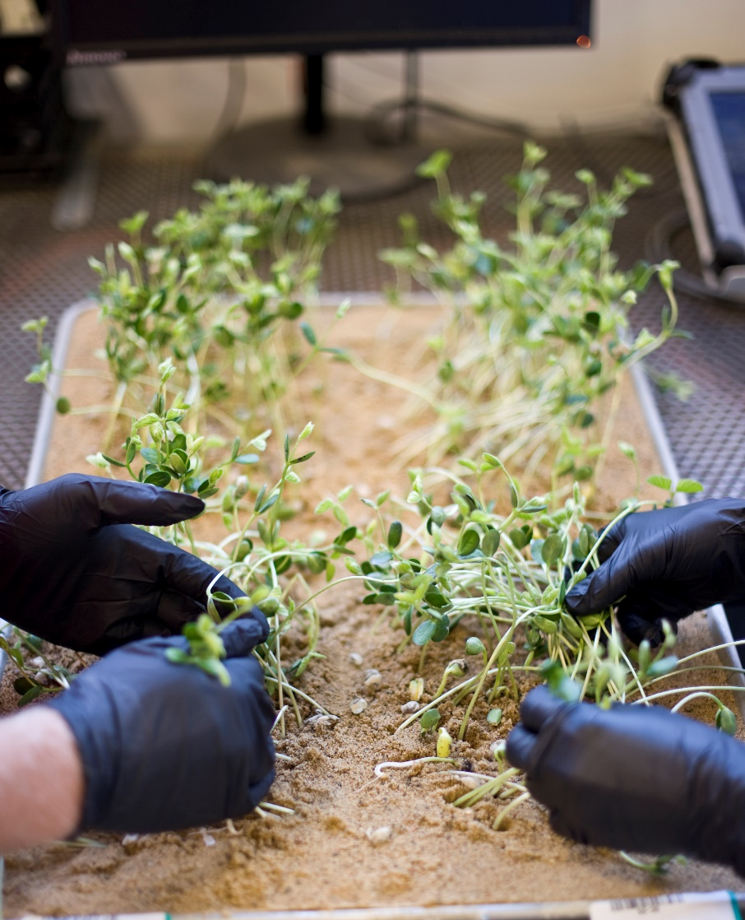
Method Parameters
Valid Method
Sample
Control Samples
Check Seed

Slide 12
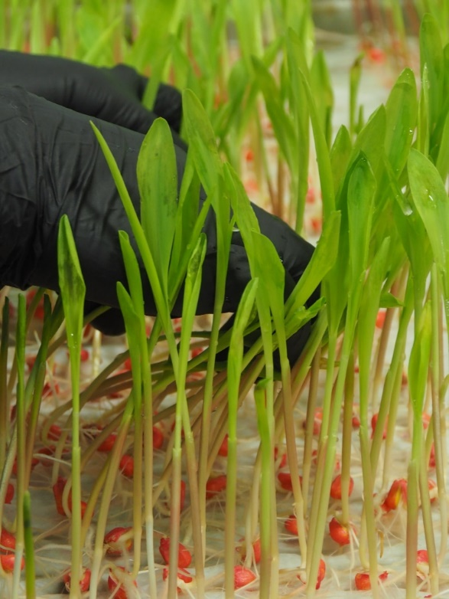
Use a Valid Method
Reliable
Repeatable
Applicable
Use Appropriate Reference Materials
Rapid
Inexpensive
Properly Validated
Accuracy
Precision
Sensitivity
Specificity
Robustness
Ruggedness

Slide 13
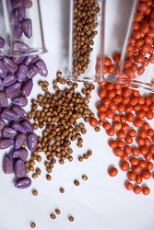
Obtaining the Sample
No matter how accurately an analysis is made, it can show only the quality of the sample submitted.
Commonly an overlooked step in the process
Properly trained sampler

Slide 14
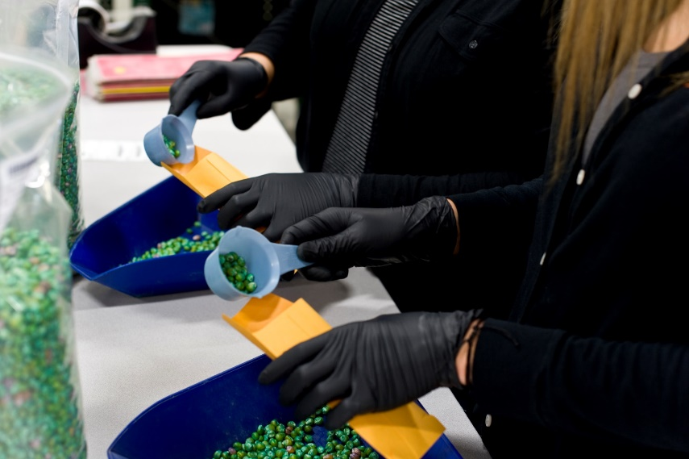
Use of a Good Control Sample
Included with routine samples
Included in every test run
Should not be identified as control or check until test completion
If results fall outside of parameters a problem should be identified

Slide 15
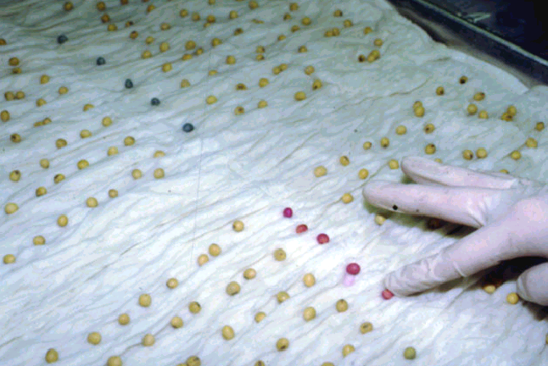
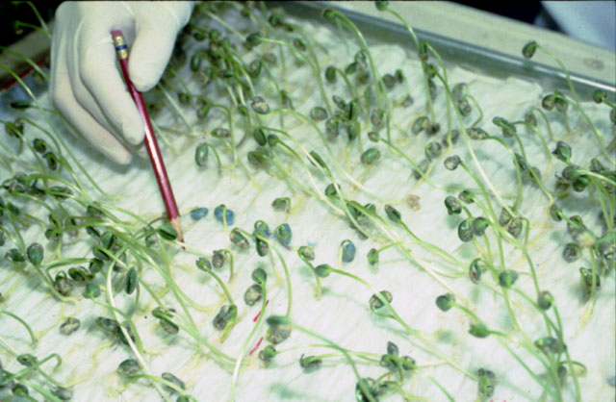
Use of Control Samples
Herbicide Bioassay
Check samples:
Essential to assure test accuracy
Limit liability
Exposed to same conditions
Internal quality control to enable analysts to detect variation in a test procedure
Control required for trait evaluation both positive and negative

Slide 16
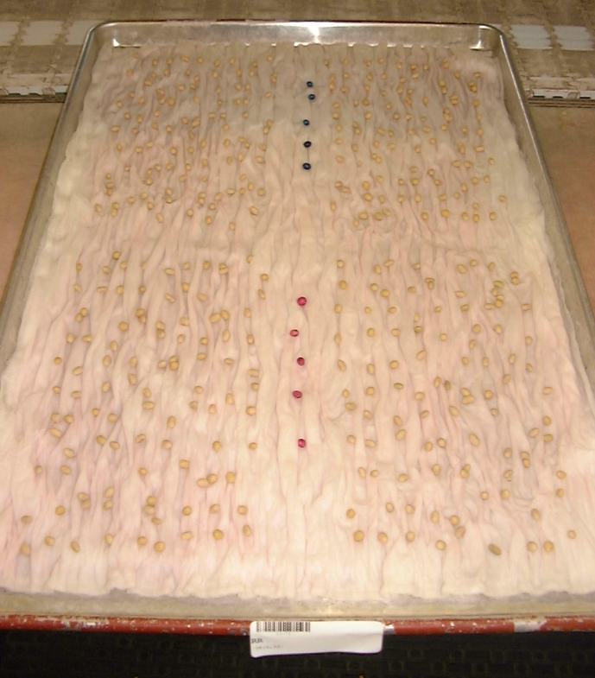
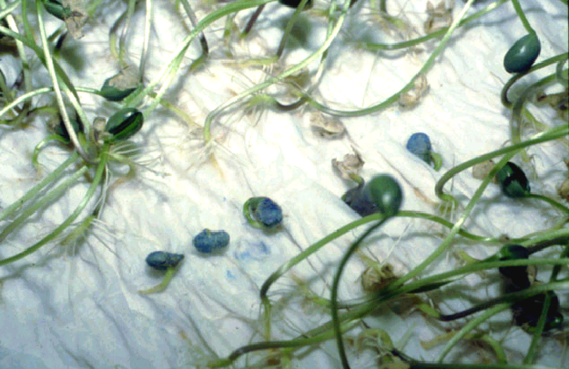
Herbicide Bioassay Positive and Negative Check Seeds
Bioassay – a test using seed or seedling to determine chemical toxicity (or tolerance to) a herbicide
Positive - Tolerant Seed – seed having the desired tolerance
Negative - Non-Tolerant Seed – seed that does not have desired tolerance

Slide 17
Bioassay Terms
CCP – crepe cellulose paper (Versapak)
PPG or PPE– personal protective gear/equipment
Enzyme – BXN (Bromoxynil): bacterial nitrilase enzyme
Gene- CP4 EPSPS gene unaffected by glyphosate herbicides
Inhibitors: translocated apoplast and symplast- ALS containing herbicides: Imidazolinoes and Sulfonylureas

Slide 18
Why Perform a Bioassay?
To determine the expressed percentage of presence or absence of herbicide tolerance in a seed lot
Shows individual seed expression of the tolerance
Cheaper than other methods - ELISA/PCR
Screen to confirm absence of a tolerance

Slide 19
Herbicides with Tolerant Crops
Glyphosate
Glufosinate
Dicamba
2,4 D
Sulfonylurea Tolerant Soybean (STS)
Imidazolinone -Clearfield
Others – Balance and HT3

Slide 20
The Herbicide Solution
Concentration of herbicide must allow all seedlings to grow normally while non-tolerant seedlings express non-tolerant symptoms.
Can be a challenge, as laboratory and field concentrations do not correlate.
May require surfactants, buffers and/or stock solutions.
Calculating and Mixing correct concentration critical step.

Slide 21
Herbicide Concentration Roundup Ultra® 41%
Determining Amount of Herbicide - Calculation
$\frac{(Desired Concentration ppm)(Total mLs desired)}{(ppm of AI)}$ = Amount of Herbicide needed
Example:
Desired Concentration =400ppm
Desired Milliliters of Solution = 500mL
% AI= 41% x 10,000 = 410,000ppm
$\frac{(400 ppm x 500mL)}{410,000 ppm}$ = 0.4878mL
Mix 499.5122 H2O plus 0.4878mL of Roundup Ultra Herbicide 41% to make 400ppm solution of 500mL

Slide 22
Herbicide Testing Methods
Method | ~Length
Seed Soak Seeds soaked in herbicide, then planted on watered media | 16h / 7d
Spray Over Method Seeds grown out and seedlings are sprayed with herbicide | 5d / 5d 10d to 21d
Substrate Imbibition Method Seeds are exposed to herbicide during entire test period | 7d

Slide 23
Tray Bioassay Tests Corn and Soybean LL, GT, STS, CL, Dicamba, 2,4 D

Slide 24
Substrate Imbibition Method
Laboratory bioassays with herbicide solution placed directly into the media. The seed in placed on the media to allow the herbicide solution to imbibe.
Seven-day test
Four hundred seeds tested
Negative and positive check seeds used to verify herbicide presence and appropriate levels.

Slide 25
Herbicide Watering Table

Slide 26
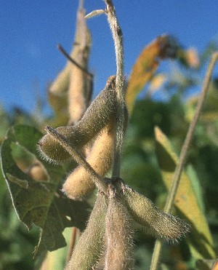
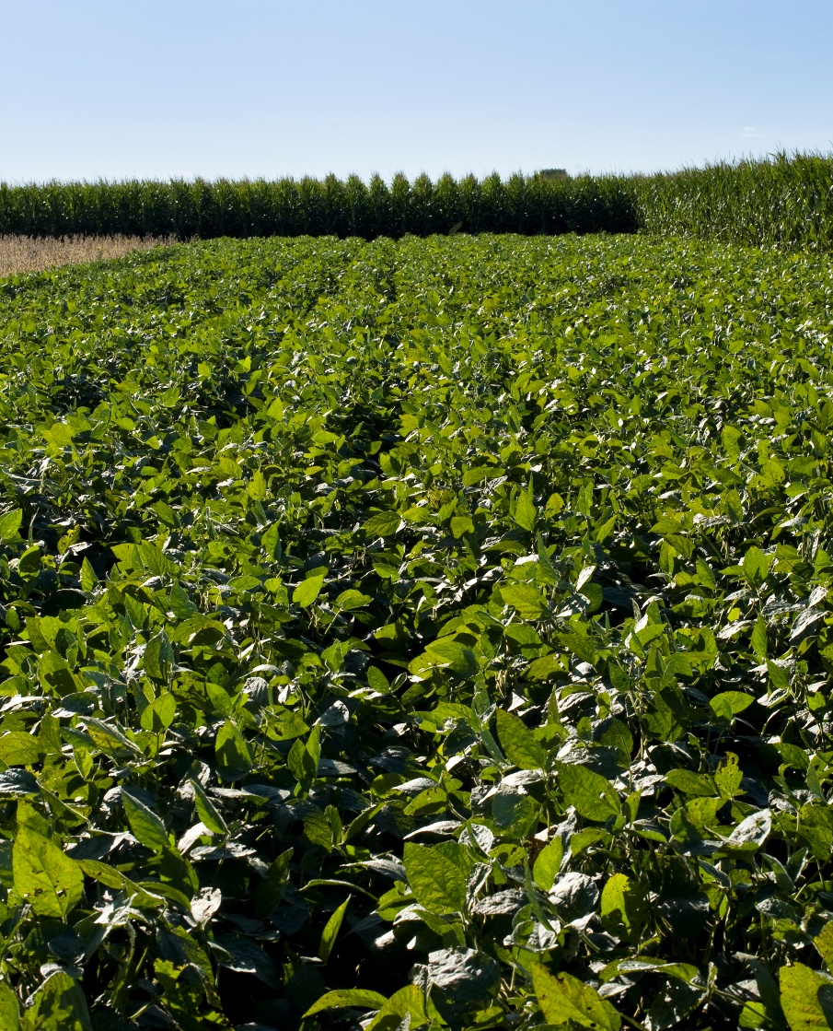
Soybean Herbicide Bioassay Tests

Slide 27
Soybean Herbicide Bioassays: Glyphosate Sulfonylurea Tolerant Soybean

Slide 28
Glyphosate Soybeans
Herbicide inhibits an enzyme involved in synthesis of amino acids (tyrosine, tryptophan, phenylalanine)
Herbicide absorbed through foliage and translocates to growing points
It’s only effective on actively growing plants, not effective as a pre-emergence herbicide
RR Herbicide introduced in 1974
Glyphosate Soybeans introduced in 1995

Slide 29
Glyphosate Soybean Herbicide Trait Bioassay Method
Supplies
Large tray, 14-ply Versapak
Plant 4 replicates of 100 seeds on tray, after wetting Versapak with herbicide solution
Plant 5 check seeds of tolerant and non-tolerant seeds (Positive and Negative) on EVERY TRAY
Grow for 7 days at 25°C
Evaluate for germination following AOSA Rules
Evaluate for tolerance to herbicide

Slide 30
Positive and Negative Check Seeds

Slide 31
Evaluate on Seventh Test Day

Slide 32
Soybean Germination
Seed/Seedling Classification
Normal
Abnormal
Dead
Dormant or Hard
Tolerant
Non-tolerant
Quality Issues
Mechanical Damage
Seed-borne Fungi

Slide 33
Seedling Classification
AOSA normal seedlings
(380/400) = 95.0 %
Tolerant seedlings
(378/380) = 99.5%
Non-tolerant seedlings
(2/380) = 0.5%

Slide 34
Evaluating Herbicide Trait Tests
Find negative and positive check seeds
Evaluate test sample
Count normal seedlings
Count non-trait seedlings
Calculate the percentage of trait seedlings
# trait seedlings
# normal seedlings
375/380 = 98.7%

Slide 35
Evaluating Herbicide Trait Tests
Determining Tolerance - Calculation
$\frac{(Normal−Non tolerant)}{(Normal)}$ X 100 = % Tolerant
Example:
400 seeds planted
4 (abnormal seedlings)
2 (not germinated/dead seed)
394 (normal seedlings)
11 (non-tolerant seedlings)
$\frac{(394−11)}{394}$ x 100= 97.2%

Slide 36
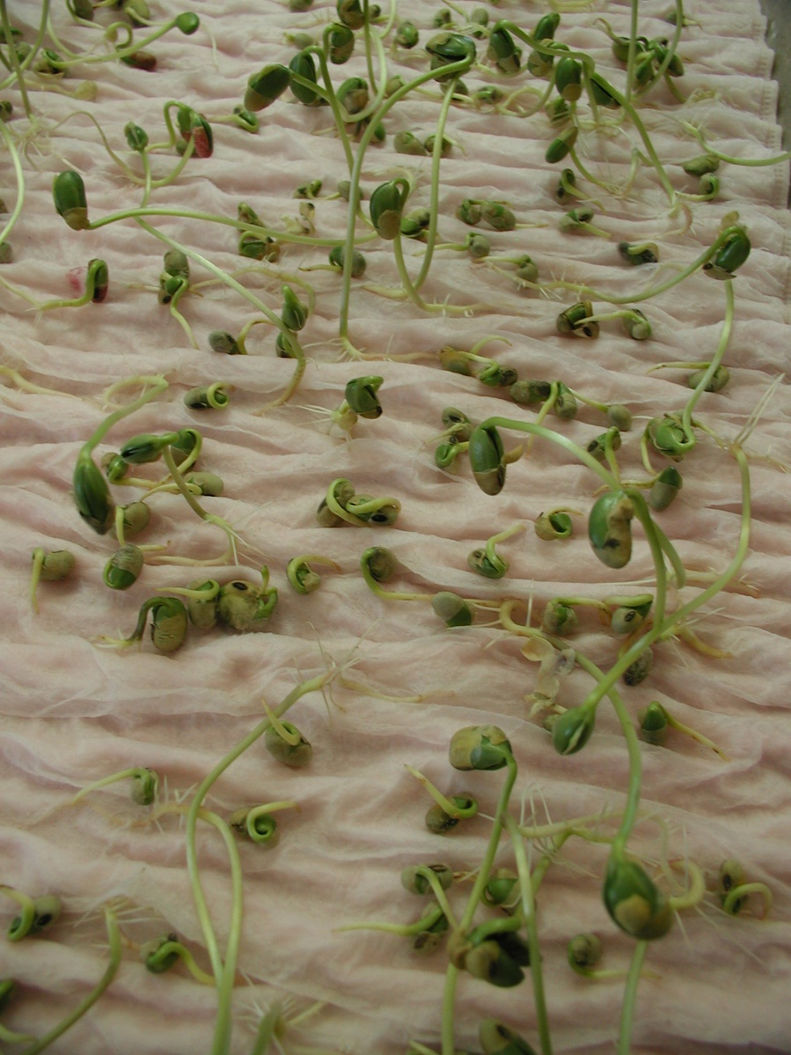
Negative Check Seedlings Expressing Non-Tolerant Symptoms

Slide 37
Glyphosate Soybean Germination
Non-tolerant Symptoms
Inhibition of secondary root growth and root hairs
Shortened hypocotyl growth
Browning of root and hypocotyl tissues
Browning of root tip
Stiff roots
Inhibition of unifoliate leaf development

Slide 38
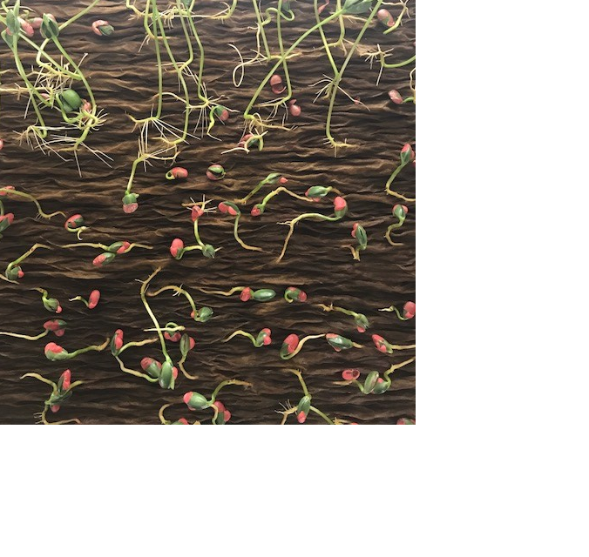
Glyphosate Soybean Germination
Non-tolerant Symptoms
Inhibition of secondary root growth and root hairs
Shortened hypocotyl growth
Check for tolerance

Slide 39
STS Herbicide (Sulfonylurea Tolerant Soybean)
STS soybeans
Provide efficient and economical weed control
Able to thrive in different soil types (especially dry land and hot conditions)
Herbicide
Applied during pre-plant, pre-emerge and post-emerge conditions
STS soybeans are “tolerant” to herbicide, genetics are not a transgenic even

Slide 40
Sulfonylurea Tolerant Soybean (STS)

Slide 41
Sulfonylurea Tolerant Soybean Procedure
Supplies
Large tray, 14-ply Versapak, wax paper
Plant 4 replicates of 100 seeds on tray, after wetting Versapak with herbicide
Plant 5 check seeds of tolerant and non-tolerant seeds on EVERY TRAY
Cover entire tray with dry, warm sand
Grow for 7 days at 25◦C
Evaluate for emergence germination and tolerance to herbicide

Slide 42
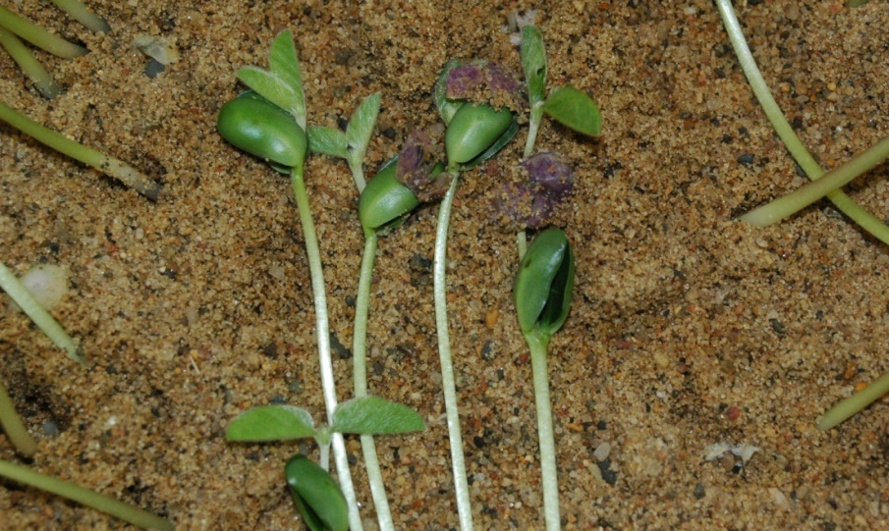
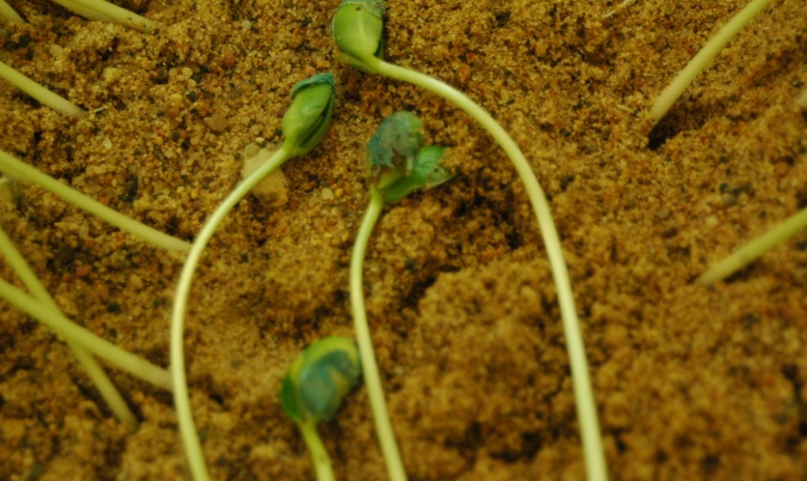
STS Soybean Germination
Symptoms of Non-Trait Seedlings
Stunted root growth
Primary leaves severely stunted
Primary leaves clasping over each other
Find and pull out check seeds prior to evaluation
Count all normal seedlings (including non-trait symptom seedlings)
Pull non-trait out of sand as they are found, to count total later
Record germination, then record number of non-trait found

Slide 43
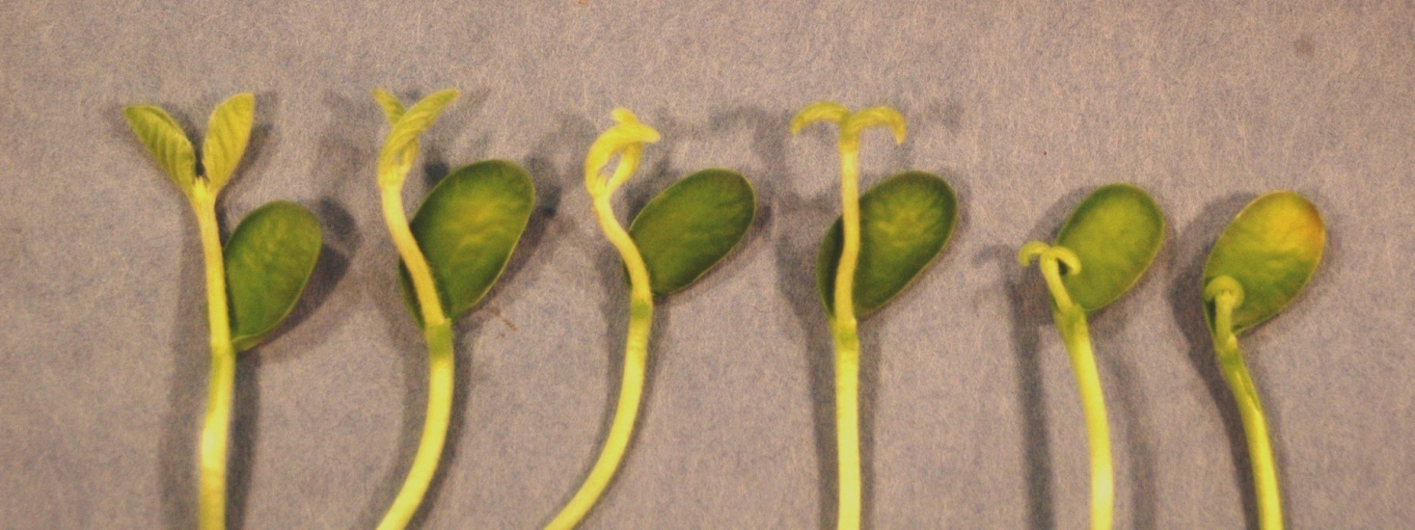
Classification of STS
Soybean Seedlings
Seed/Seedling
Normal
Non-trait
Quality Issues
Mechanical Damage
Seed-borne Fungi

Slide 44
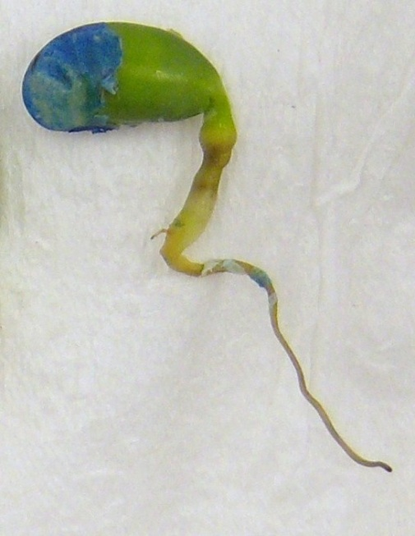
Glufosinate Soybeans
Glufosinate Tolerant Soybeans
Introduced 2008
detection of non-tolerant seedlings requires high level of precision and experience.
- Bioassay and Spray test

Slide 45
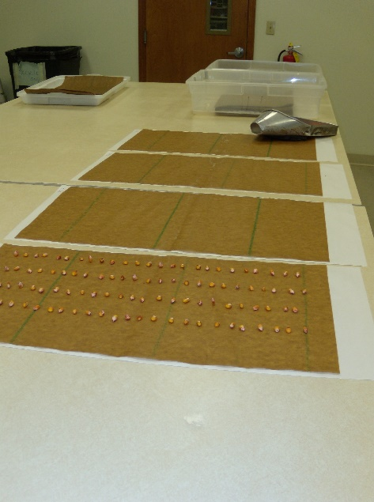
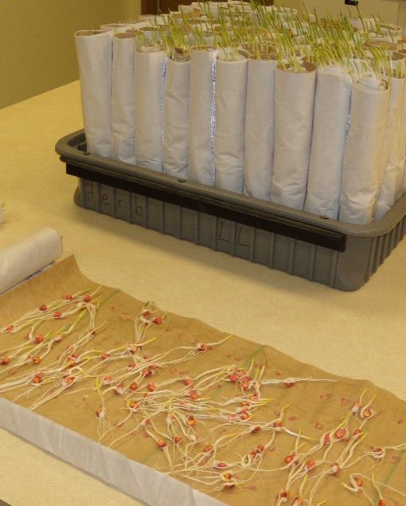
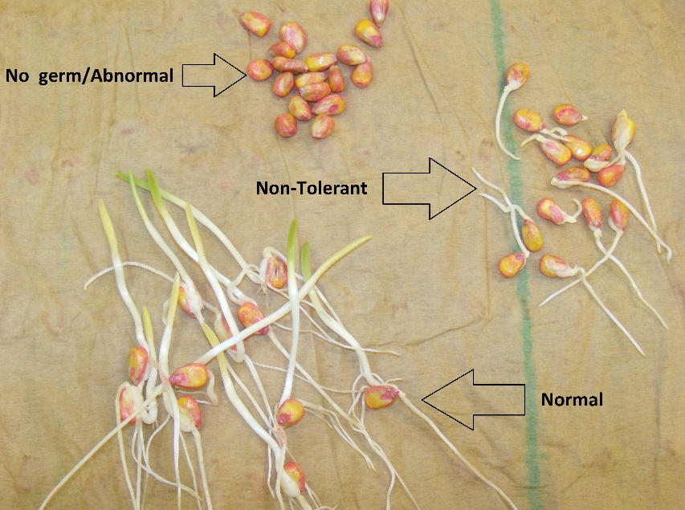
Glufosinate Soybeans Bioassay Rolled towel method
Photos: Indiana Crop Improvement Association

Slide 46
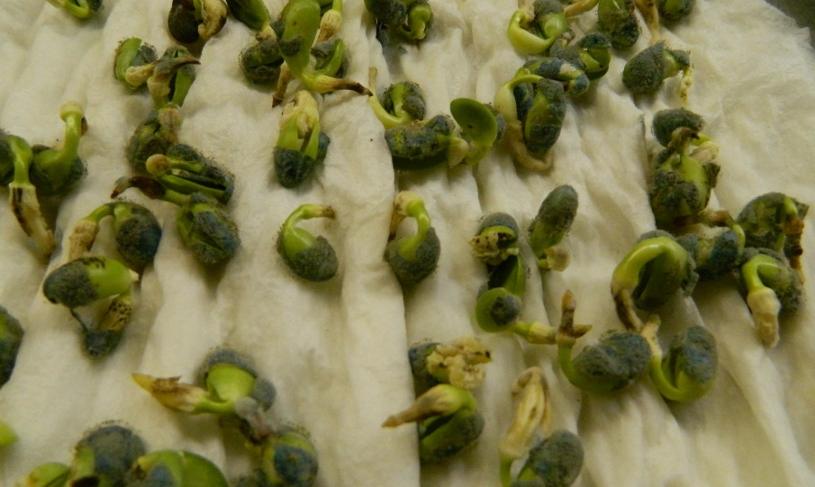
Dicamba Soybeans Bioassay
Non-tolerant Symptoms
Callusing, puffing and curling of the hypocotyls and primary root.
Taproot may appear barky of darker in color (brown)

Slide 47
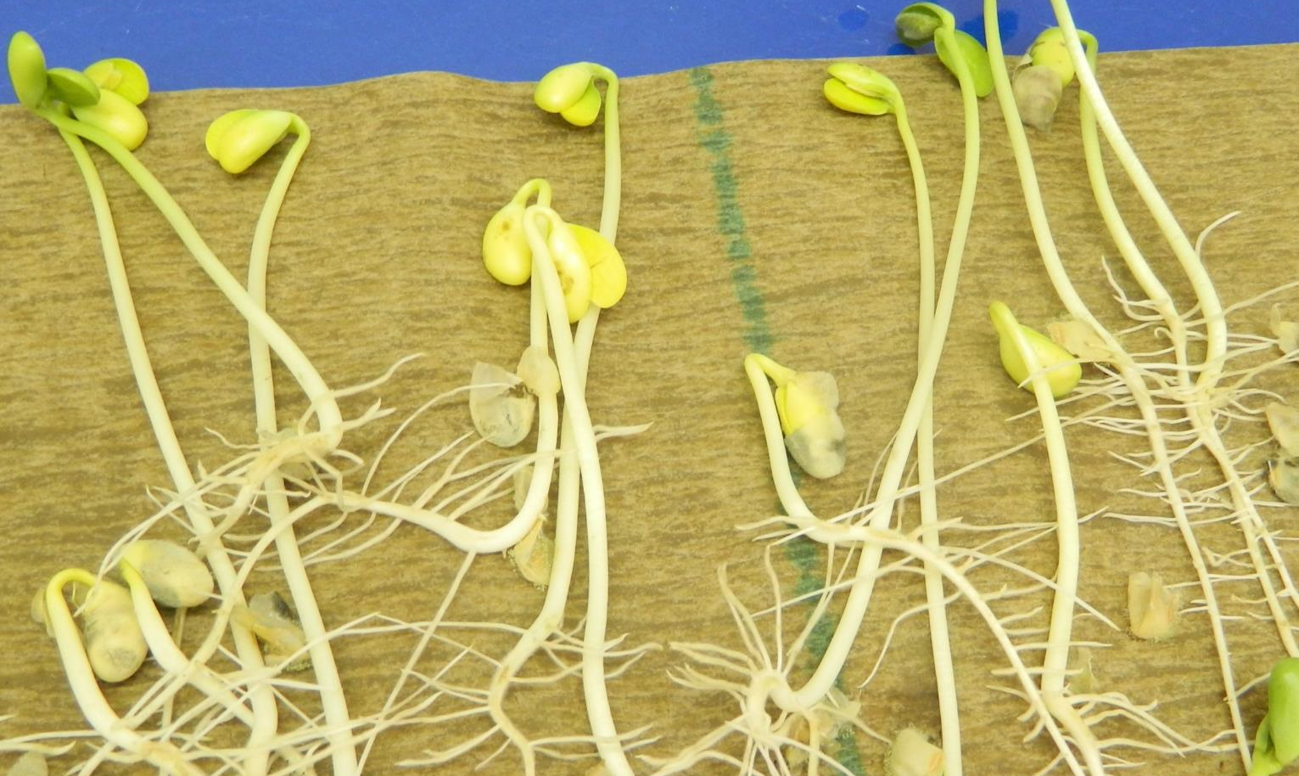
2,4 D Soybeans Bioassay
Non-tolerant Symptoms
Callusing, puffing and curling of the hypocotyls and primary root.
Taproot may appear barky of darker in color (brown)

Slide 48
Corn Herbicide Bioassay Tests

Slide 49
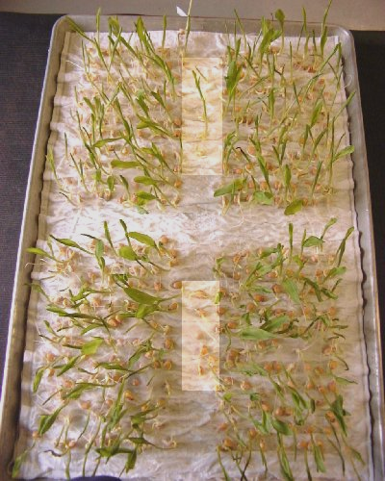
Glyphosate
Laboratory bioassays - herbicide imbibed directly into seed during a seven day test. Include negative and positive checks.
Trait Purity Test - 400 seeds are tested and negative and positive check included.
Gross Contamination Test – 200 seeds are tested post-conditioning, packaging and trait purity testing.

Slide 50
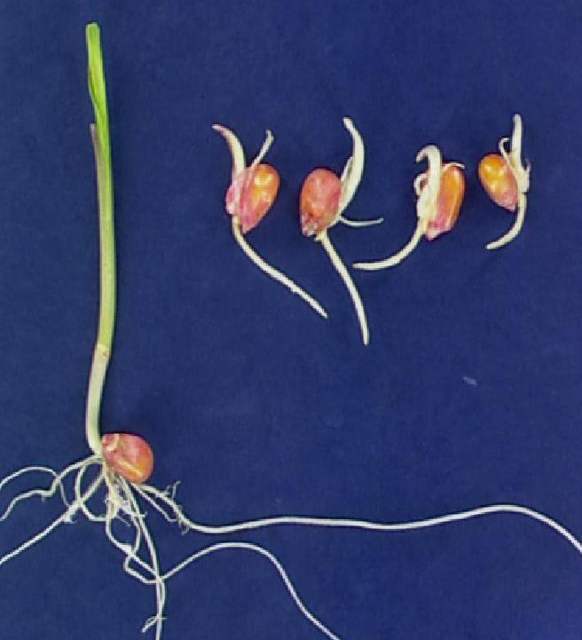
Tolerant and Non-Tolerant Glyphosate Seedlings
Plumule lacking chlorophyll
Plumule not extending to end of coleoptile.
Inhibition of root hairs
Short stiff primary root
Needle eye
Non-trait
Trait

Slide 51
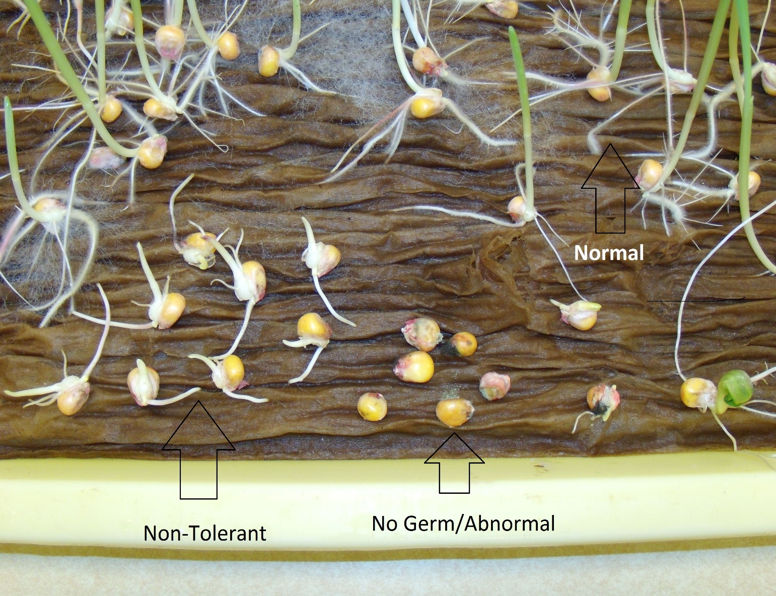
Tolerant and Non-Tolerant Glyphosate Seedlings
Non-trait
Trait
Photo: Indiana Crop Improvement Association

Slide 52
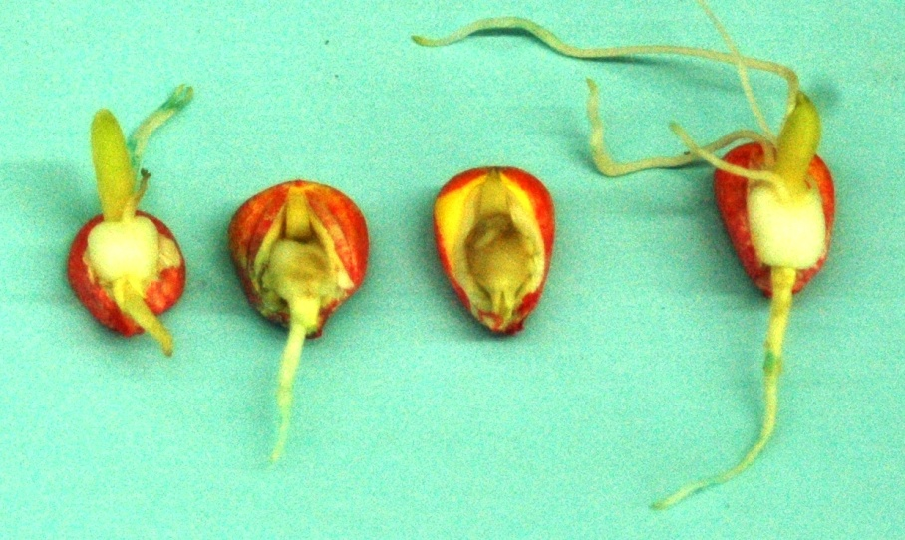
Glufosinate
Corn (1996)
Glutamine synthetase enzyme
PAT
T25 gene
Bt11 gene (also has Cry1ab gene)
96% trait required
Notes:
Inhibition of ammonia to glutamine, so ammonia builds up and destroys cells and inhibits PSYN. Rate of symptom development is increased by bright sunlight, high humidity and moist soil.

Slide 53
Non-Tolerant Glufosinate Corn (96%)
Inhibition of chlorophyll production & shoot development
Grainy shoot
Browning of mesocotyl tissue
Inhibition of root growth and hairs

Slide 54
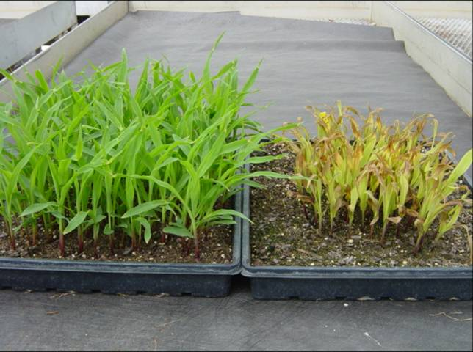
Tolerant and Non-Tolerant Glufosinate Seedlings Sprayover
Non-trait
Trait

Slide 55
Clearfield Bioassay
Corn 1994 (IMI), Pursuit ®(PT), Clearfield ®(CL)
Rice, wheat 2000 (CL)
Sunflower, Canola, Lentils
Imidazolinone
ALS enzyme
ALS1, ALS2 gene
Lightning ®, Pursuit, Beyond, New Path®
97% trait required
Notes:
Not gmo
Developed by Molecular Genetics Pharmaceuticals, Inc. (MGI) under contract with Am Cy. Methods were developed to select for IMI tolerant corn cells that spontaneously arise in corn cell cultures. After several generations of selection, homozygous imi tolerant corn cell lines were id and regenerated into corn plants that exhibit high levels of tolerance to imi herbicides.
IT two recessive genes. IR – one dominant gene, IMT IMItolerance

Slide 56
Tolerant and Non-Tolerant Clearfield Seedlings Corn (97%)
Shortened shoot growth
Inhibition of root growth and hair
Seedling easily removed from media
Non-trait
trait

Slide 57
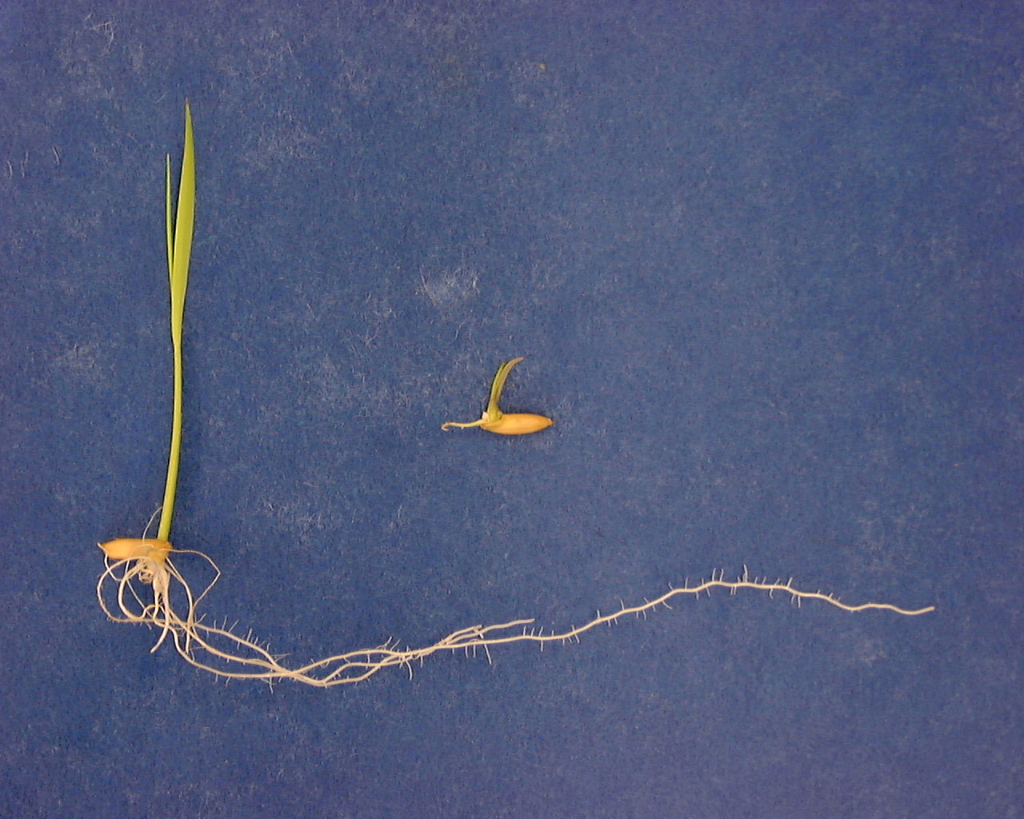
Tolerant and Non-Tolerant Clearfield Seedlings Rice
Shortened shoot growth
Inhibition of root growth and hair
Seedling easily removed from media
Non-trait
trait

Slide 58
Failing sample (less than required for sale)
Determine if the seedling is abnormal due to mechanical injury, physiological decay or fungal infection OR it is non-tolerant.
Verify check samples are reacting as expected and your solution is at the correct concentration.
Lateral flow strip testing for non-tolerant conformation.
Within 1.5% of threshold –additional 400 seeds tested.
Only on 400 seeds tests
200 seed tests results reported
Check sample

Slide 59
References
Seed Technologist Training Manual-Chapter 14
www.seedtechnology.net
Herbicide Bioassay Study Guide
Non-tolerant Seedling Study Guide

Slide 60
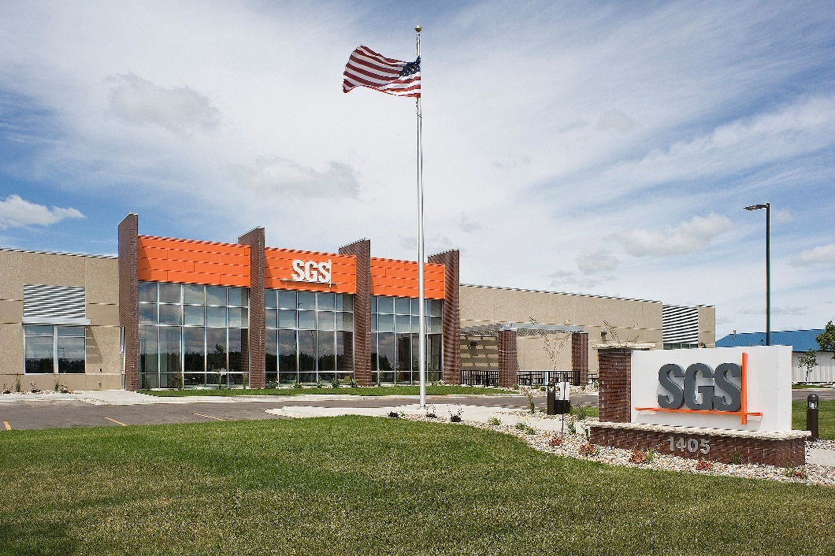
Thank you!
WWW.SGS.COM/SEEDANDCROP

