Slide 1
Intro to PCR
Laura Bohnker
Eurofins BioDiagnostics

Slide 2
Agenda
How does PCR work
Why it is used
How it is used in seed testing?
Questions

Slide 3
PCR Terms
PCR – Polymerase Chain Reaction
Genomic (Template) DNA – DNA isolated from sample
Primer – Short strands (20-25 bp) of single stranded DNA used to target specific DNA sequences
Probe – Short strand (20-25 bp) with fluorescent dye on one end that sits in between primers
Oligos – Collective name for primers and probe
dNTP’s – Nucleotides (A,T,C,G) added to allow for DNA extension during PCR
Taq Polymerase – Enzyme responsible for DNA extension in PCR
Amplification – Process of making copies of a target DNA segment during PCR (amplicon)

Slide 4
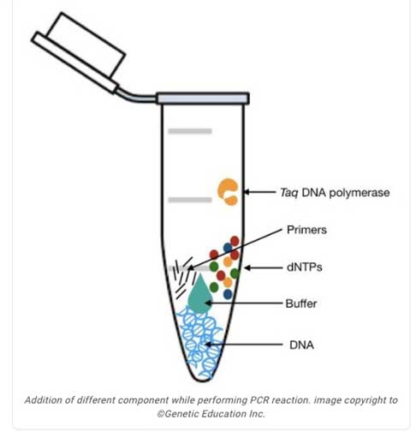
What goes into a PCR reaction
DNA template
Primers/probe
DNA polymerase
dNTPs
Buffer/Cofactors
Or mastermix which is DNA polymerase, dNTPS, and buffer

Slide 5
How does PCR work?

Slide 6
Exponential sequence amplification
Each full cycle doubles the target

Slide 7
PCR testing
COVID
Human Genome Project
Diagnose diseases
Forensic testing

Slide 8
Not all PCR is the same
Endpoint
Quantitative
Digital Droplet PCR
Reverse-Transcriptase PCR

Slide 9
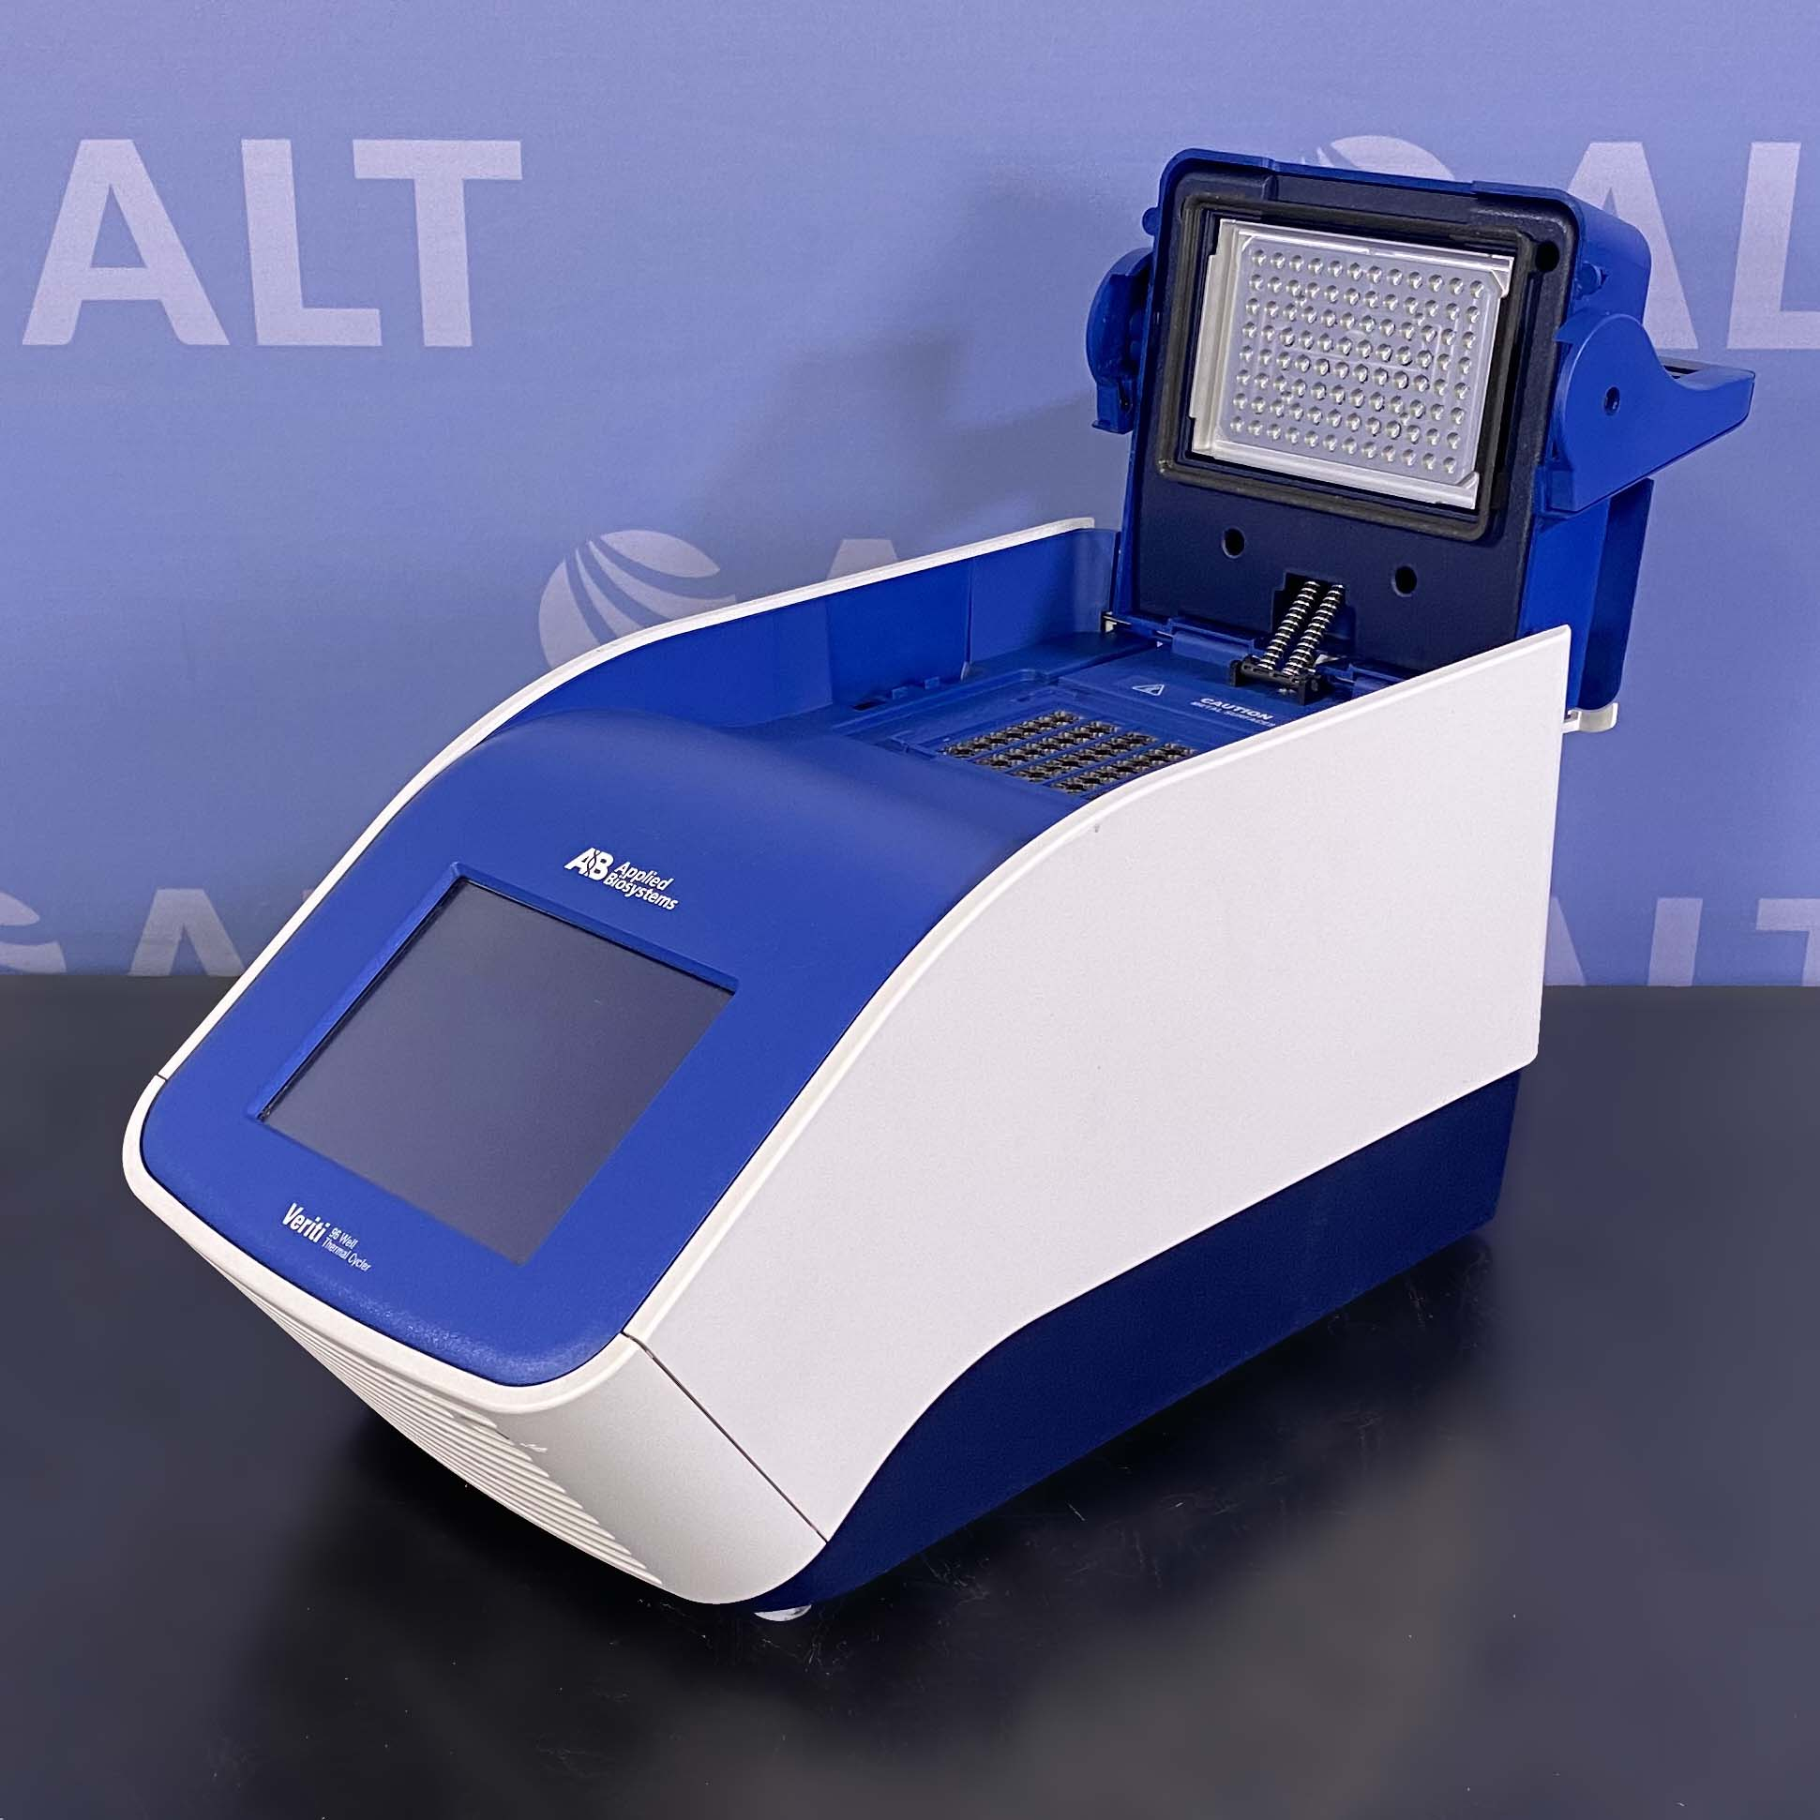
Endpoint PCR
Qualitative presence/ absence
Simple and cost effective
Lower cost of machine and operational cost

Slide 10
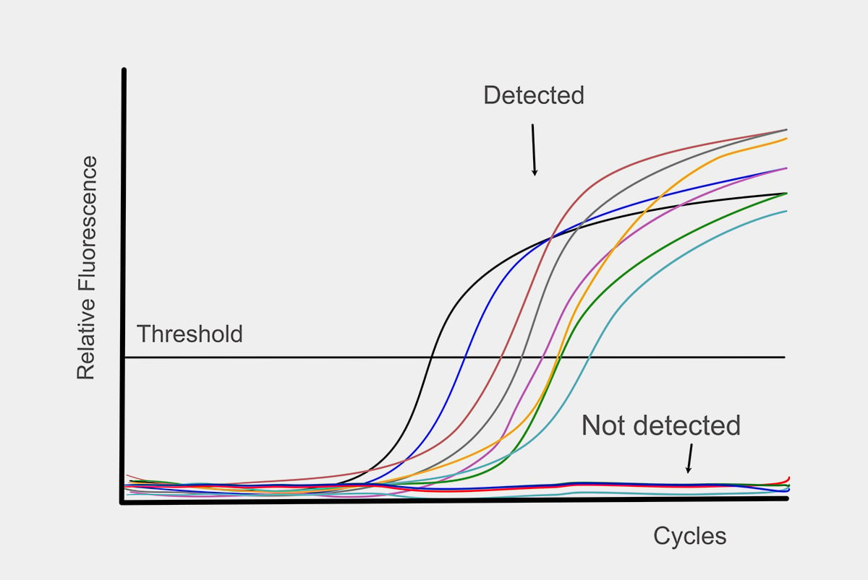
Quantitative PCR
Real-time machines to measure the exponential amplification
Uses a target-specific fluorescent probe
Relative target quantities are measured against a standard curve

Slide 11
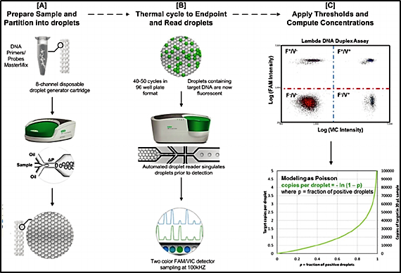
Digital Droplet PCR
Micro reactions using endpoint detection quantitative

Slide 12
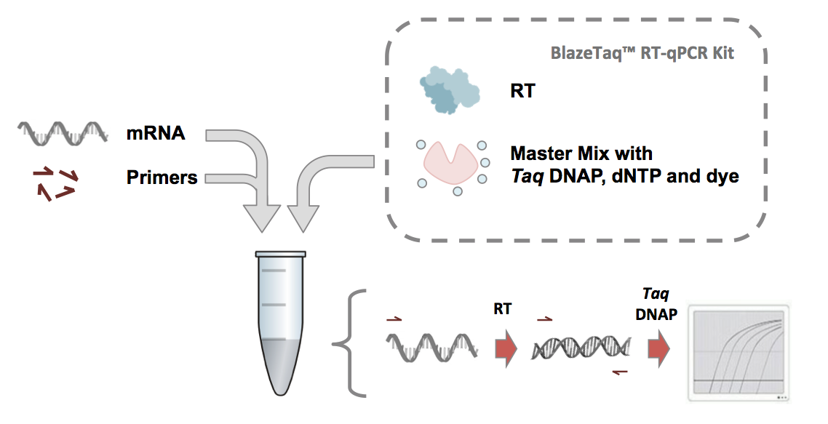
Reverse-Transcriptase PCR
Adds a reverse transcriptase enzyme

Slide 13
Seed Testing PCR
AP (adventitious presence) testing
Endpoint or qPCR
Identifying traits that should not be present
Zygosity testing
Trait confirmation
SNP (Single nucleotide polymorphisms
Functional trait
Genetic markers

Slide 14
Questions?

