Slide 1
Electrophoresis Theory and Basics
Kevin Balvin, RGT
Genetic Testing Supervisor

Slide 2
Outline
Definitions
History
Basics
Gel types
Pouring
Loading
Stains
Troubleshooting

Slide 3
Definitions
Allele- Refers to one of several alternate forms of a gene occupying a given locus on the chromosome, which controls expressions in different ways.
Base Pair (BP)- Two nucleotides that are in different nucleic acid chains and whose bases pair by hydrogen bonding. In DNA the bases are adenine, thymine, guanine and cytosine. In RNA the bases are adenine, uracil, guanine and cytosine.
Chromosomes- Discrete units of the genome carrying many genes, consisting of proteins and a long molecule of DNA. Found in the nucleus of every plant and animal cell.

Slide 4
Definitions continued
Deoxyribonucleic Acid (DNA)- The chemical building block blocks of which genes are constructed. DNA is the carrier of genetic information, which is encoded in the sequence of bases; it is present in chromosomes and chromosomal material of cell organelles such as mitochondria and chloroplasts, and also present in some viruses.
Dominant Allele- A gene that produces the same phenotype when it is heterozygous as it does when it is homozygous. (i.e. the trait or protein is expressed even if only one copy of the gene is present in the genome).

Slide 5
Definitions continued
Electrophoresis- A technique for separating molecules based on the differential movement of charged particles through a matrix when subjected to an electric field.
F1 Hybrids- The first-generation offspring of crossbreeding; also known as first filial hybrids.
Female Self- Protein banding patterns that are identical to the seed parent of a hybrid.
Genotype- The total genetic, or hereditary, constitution that an individual received from its parents.
Heterozygote- An individual organism with different alleles at one or more particular loci.

Slide 6
Definitions continued
Isoelectric point- The pH at which a particular molecule or surface carries no net electrical charge.
Isozymes- Multiple forms of an enzyme that differ from each other in their substrate affinity, in their maximum activity, or in their regulatory properties.
Male self- Protein banding patterns that are identical to the pollen parent of a hybrid.
Nucleic Acids- A large, chain-like molecule containing phosphate groups, sugar groups and purine and pyrimidine bases. Two types are ribonucleic acid (RNA) and deoxyribonucleic acid (DNA).

Slide 7
Definitions continued
Offtype- Isozyme patterns that do not match the hybrid or inbred in two or more loci.
Phenotypic Marker- The outward physical appearance of a particular trait.
Polyacrylamide Gel Electrophoresis (PAGE)- A form of electrophoresis in which large molecules are separated on the basis of size and charge.
Protein- Any of a class of high molecular weight polymer compounds composed of a variety of amino acids joined by peptide linkages.
Recessive allele- An allelic gene whose existence is obscured in the phenotype of a heterozygote by the dominate allele.

Slide 8
Definitions continued
Ribonucleic Acid- Nucleic acid whose primary function is protein synthesis within a cell. The bases of RNA are adenine, cytosine, guanine and uracil. There are a variety of RNA molecules: messenger RNA (mRNA), ribosomal RNA (rRNA) and transfer RNA (tRNA).
Segregation- Gametes from any heterozygous parent separate and propagate in a manner that is independent of the alleles of the same gene and all the other genes in the genome.
Self- A pistol that is fertilized from pollen from the same plant that bears the pistil, the term also refers to the seed resulting from such fertilizations

Slide 9
Definitions continued
Variant- A variant is a plant that comes from a pure line that is not identical to the parent. It occurs at random and therefore, can not be described using the segregation patterns identified in Mendelian genetics. Variants may be identified by a single band difference between the plant in question and the expected pattern of the hybrid or variety, as long as the difference is random.

Slide 10
History of electrophoresis
Electrophoresis was first proposed in the early 19th century
Arne Tiselius won the Nobel Prize in Chemistry in 1948 for his research on electrophoresis.
Since the 1950’s new methods have been developed for specific applications
  Oliver Smithies introduced starch gel in 1955 which simplified the technology to analyze complex protein mixtures and identify small differences.
Stuber, Wendel, Goodman and Smith worked together in the late 1980’s to write a technical bulletin titled: “Techniques and Scoring Procedures for Starch Gel Electrophoresis from Maize (Zea mays L.)”
  This helped the agriculture industry start to uniformly testing samples for genetic purity.

Slide 11
Basics of electrophoresis
Electrophoresis is a techniques commonly used in labs to separate charged molecules (DNA, RNA and proteins) according to size, shape and charge.
Charged molecules migrate through a gel when electricity is applied. One end of the gel needs a positive charge and the other end has a negative charge.
The molecule migrates through the gel towards the end of the gel with it’s opposite charge.
Smaller molecules will migrate through the gel quicker and travel farther than larger molecules.

Slide 12
Types of Gels
Starch gel
Agarose gel
Polyacrylamide gel
IEF gel

Slide 13
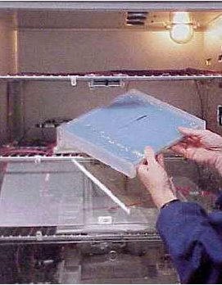
Starch Gel
Gels made from potato starch used for separating proteins.
Advantages
  High throughput
  Gels can be sliced and used to analyze differing isozymes for the same sample
  Non-toxic
  Inexpensive equipment
Disadvantages
  What may be an off-type on the gel may or may not be expressed in the field
  Must use tissue, seeds cannot be used for testing
  Not great for storing gels for long term

Slide 14
Agarose Gel
Gels from agarose commonly used to separate nucleic acids (DNA,RNA) according to their size.
The higher the concentration of agarose, the denser the matrix. Smaller fragments are separated at higher concentrations and larger fragments are separated at lower concentrations.
Advantages
  Agarose can be re-heated and used again.
  Agarose is considered non-toxic
  Easy to prepare (10-15 min)
Disadvantages
  Agarose can be expensive depending on the grade
  Visualizing the gel can include UV or toxic chemicals
  Resolution is less compared to polyacrylamide gels

Slide 15
Polyacrylamide gel
Gels made of cross-linking of acrylamide and a cross linker molecule and is used to separate proteins or nucleic acids.
Increased concentration of acrylamide decreases pore sizes. Small pores sizes is used for smaller molecules, because larger molecules cannot migrate through the gel.
Advantages
  Can be used to separate mixtures of DNA/RNA or proteins
  Sharp bands
  Good for small fragments of DNA
Disadvantages
  Acrylamide in unpolymerized (powder) form is a neurotoxin
  Known control sample must be obtained from producer
  Gels are difficult to prepare

Slide 16
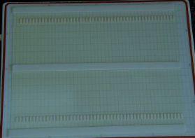
Ief gel
A gel with pH gradients that is used to separate protein molecules based on their pH
Protein molecules migrate until it reaches it isoelectric point (Net 0 charge)
Advantages
  Protein analysis utilizing either total protein and/or enzyme staining
  Versatile to any seed crop
  Adaptable matrix for different pH ranges
  Permanent record of gel
Disadvantages
  Precast gets are expensive compared to starch gels
  Parent seed controls are required on each gel

Slide 17
Pouring
Starch gels
  Mix starch and sucrose with specified quantity of buffer and heat to boiling. Pour the thickened solution into a gel mold and allow it to cool before covering with plastic wrap.
  Different ratio’s of starch to buffer and pH of buffer are possible. Which recipe that is used to prepare gels depends on which stains will be used.
Agarose gels
  Decide on a agarose concentration of the gel needed for your samples.
  Weigh out and dissolve the appropriate volume of Agarose into a buffer. Heat the solution and pour into a mold with a comb.
  Depending on how you plan on reading the gel addition of Ethidium Bromide can be added prior to pouring the gel

Slide 18
Pouring continued
Polyacrylamide
  Polyacrylamide gel is formed as the result of a polymerization reaction between acrylamide and a crosslinker molecule
  Easily customized pore size for specific targets
IEF
  Able to purchase precast gels
  Addition of ampholytes are added to gel mixture prior to pouring the gel to create the necessary pH gradient across the gel
  Some types of IEF gels are polyacrylamide, agar, or agarose

Slide 19
Loading
Starch gels
  Filter paper wicks are placed with the buffer containing the sample.
  The soaked wicks are then place into the gel.
  Be sure to include a control sample with known banding patterns.
        While the sample is running keep it cool by performing electrophoresis in a fridge or cold room at about 5C. Place cold pack on top of the gel for the duration of the run.

Slide 20
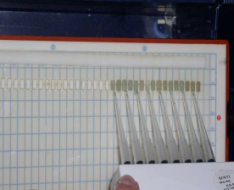
Loading continued
Agarose gel
  Fill the electrophoresis unit with buffer until the gel is covered with a thin layer of buffer
  Add loading buffer to sample, mix and pipette sample into the appropriate well
  Add molecular ladder and controls to help with reading
Polyacrylamide gel
  Similar to Agarose gels, pipette sample and marker into wells
IEF
  Pipette the extraction buffer onto wicks already placed on the gel.
  Depending on the charge of the sample, the location of the wicks can be placed either near the cathode or anode

Slide 21
Running a gel
The time to finish electrophoresis can vary from a short amount of time (30 min) to a long time 10+ hours.
The parameters (time, voltage, wattage, etc.) of a gel run will be dependent on which electrophoresis method used and your target.

Slide 22
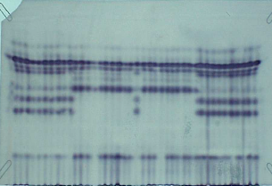
Stains/detection
Starch
  Slice the gel horizontally and place the slice into one of the following stains:
    Acid phosphatase (ACP), alcohol dehydrogenase (ADH), catalase (CAT), diaphorase (DIA), esterase (EST), b-glucosidase (GLU), glutamate-oxaloacetate transaminase (GOT), isocitrate dehydrogenase (IDH), malate dehydrogenase (MDH), phosphoglucomutase (PGM), phosphohexose isomerase (PHI), and 6-phosphogluconate dehydrogenase (PGD).
  These stains are used because they produce the greatest amount of polymorphisms (differences in the banding patterns)
    By increasing the chances of seeing differences these stains help make electrophoresis more valuable to the industry.

Slide 23
Stains/detection
Agarose
  Add Ethidium Bromide to the gel while you pour it or place the gel in a solution containing ethidium bromide for 5 minutes.
    EtBr is highly toxic- Wear proper PPE when handling!
  Several other common dyes include SYBR Gold, SYBR Green, SYBR Safe and Eva Green
    These also work for PAGE gels as well
IEF
  Silver stain or Coomassie stain are commonly used stains that stain all the proteins on the gel.
  Enzyme stains can be used to stain only select protein bands.
    Similar to starch gels- determine which stains produces the most differences for your samples.

Slide 24
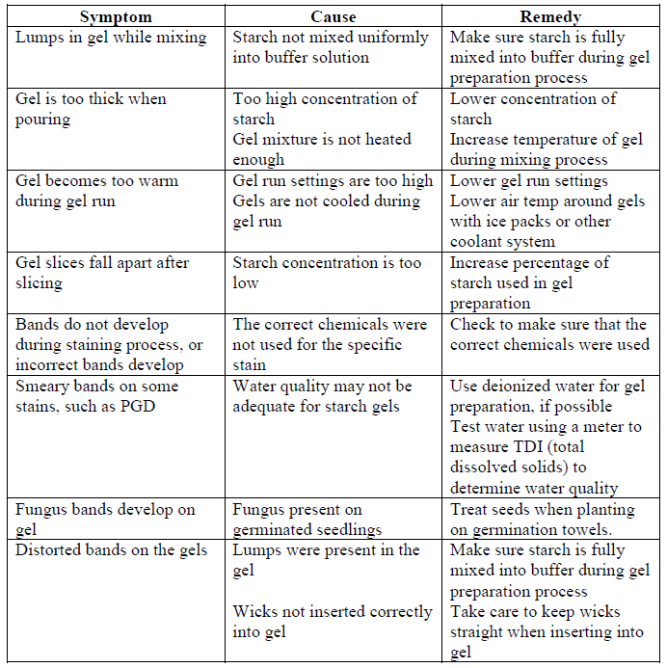
Troubleshooting for starch gels

Slide 25
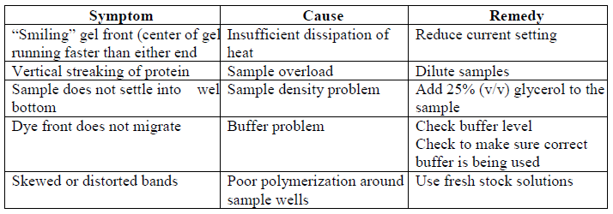
Troubleshooting for page

Slide 26
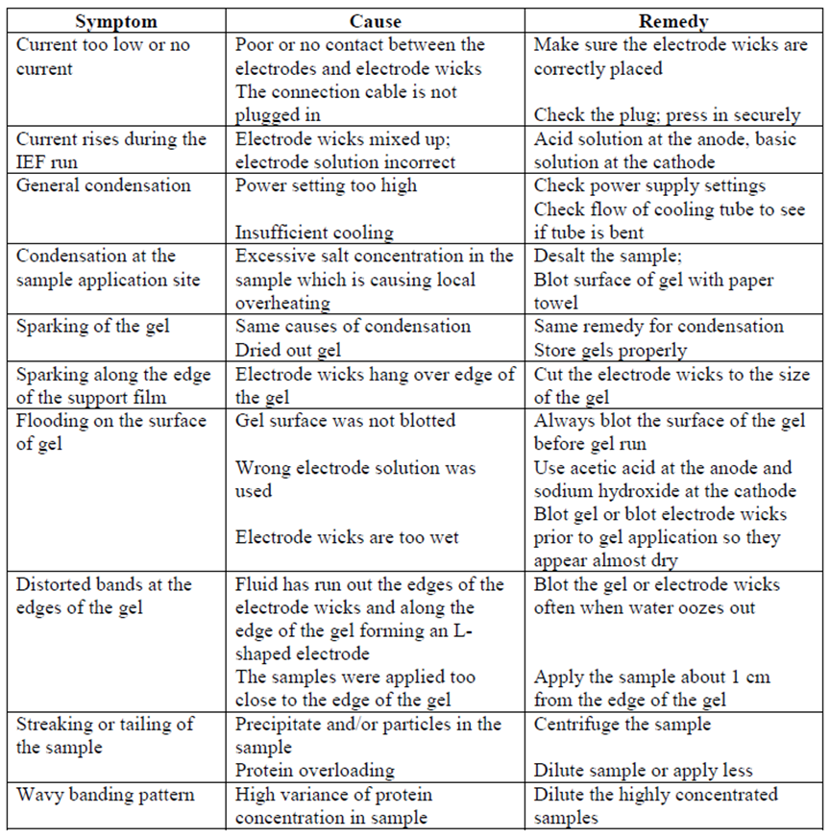
Troubleshooting for ief

Slide 27
Thank you

