Slide 2
Lateral Flow Basics
SCST Superworkshop
Iowa State Seed Science Center

Slide 3




Agenda
Introduction
LFS Benefits
Components
Application
Sample prep
Troubleshooting
Validation
Wrap-up/Hands-on Testing

Slide 4
Introduction
Lateral flow strips are simple cellulose-based devices intended to detect the presence of a target analyte in liquid sample without the need for specialized and costly equipment.
The specificity of the bond between an antibody and antigen makes lateral flow testing formats an excellent tool to meet qualitative and semi quantitative onsite diagnostic requirements.

Slide 5
LFS Benefits
Pre-Screen Tool
Low-cost vs. PCR
Rapid
Rugged
Easy of use
Reliability
Widely accepted in seed testing

Slide 6
Components of LFS
Sample pad
Conjugate pad
Colloidal gold
Nitrocellulose membrane
Card stock
Absorbent pad

Slide 7
Double Antibody Sandwich Assays
Sample flows from the sample pad through the conjugate pad, if any target analyte is present, it will bind to the conjugate.
If the analyte is present in the sample, the colloidal gold reagent will become bound to the capture antibody at the test line.
Sample continues to flow towards control line where remaining conjugate will bind and produce a second visible control line
Double antibody sandwich assays are most suitable for larger analytes

Slide 8
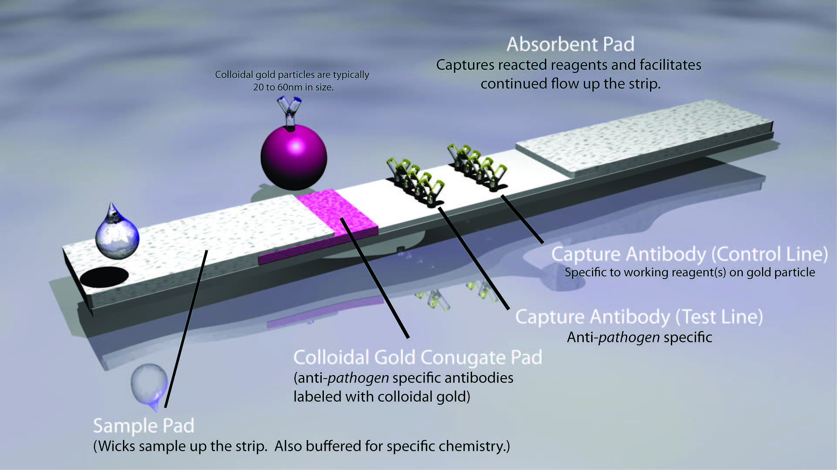

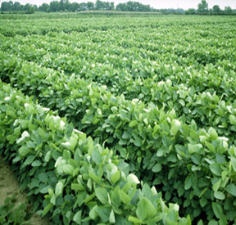


Definitions

Slide 9
Lateral Flow Application
Adventitious Presence (AP)
Testing of a bulk grain sample or seed lot for unintended genetically modified traits
Trait Confirmation
Test to verify if the intended trait is present in single seed/single leaf samples (Quality Assurance)

Slide 10
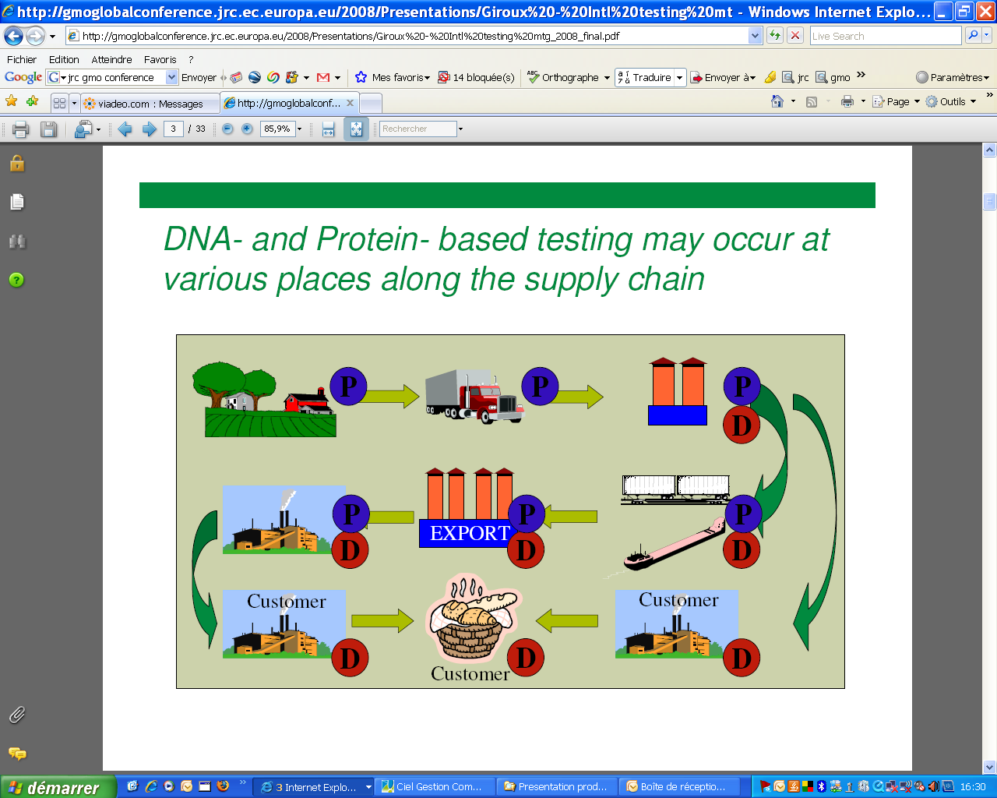

Slide 11
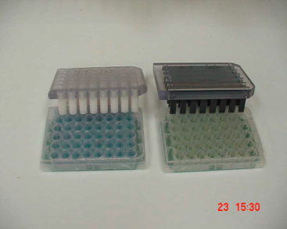
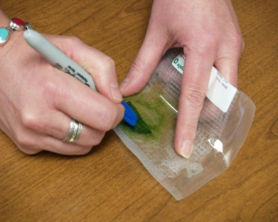
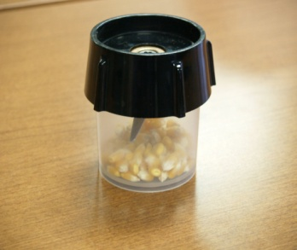
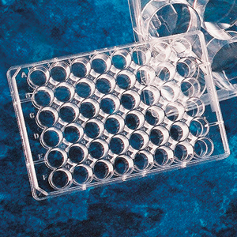
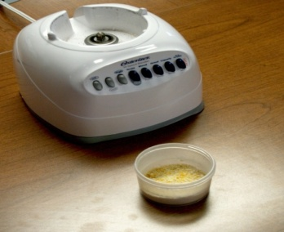
Sample Prep
Single seed/Single leaf
Bulk Grind samples for AP

Slide 12
Extraction Buffer
Optimizes pH
Each company validates in their own specific buffer
Buffers allow strips to flow properly, ensuring no false positives or false negatives
Prevents nonspecific binding of non target partials in sample

Slide 13
False Positive
Potential causes
Sample dilution too low
Wrong extraction buffer
Strips submerged too far in sample extract
Improper storage (avoid moisture and direct heat)
Cross contamination

Slide 14
False Negative
Potential causes
Strips submerged too far in sample extract; certain components of the strip are released into the sample instead of being wicked upward by the strip
Wrong extraction buffer
Sample too thick

Slide 15
LFS Validations
All tests internally validated with select tests externally validated
Statistically-sound experiment using blind positive and negative samples
Tested for robustness
Cross-reactivity experiment performed
Multiple operators involved
Strips optimized for best performance

Slide 16
Final thoughts…
Lateral flow systems are designed to be rugged and easy to use, but they are not fool proof
Every antibody and each plant matrix is different
Know limitations of host material and lateral flow device
Perform validations of test in your lab setting
Don’t assume all lateral flow test function the same
Follow user guides provided with kits
Keep in mind limit of detection when choosing sample sizes

Slide 17

Thank you!
drambow@agdia.com

