Slide 1
Molecular and Cellular Biology
Zach Duray, CGT
SCST Genetics SUPerworkshop 2024
Feb. 12, 2024

Slide 2
Overview
The Central Dogma of Molecular Biology
Molecular terminology
Heritable genetic information
Function
Storage
Location
Breakdown of the Central Dogma
Replication
Transcription
Processing
Translation
Mitosis
Meiosis

Slide 3
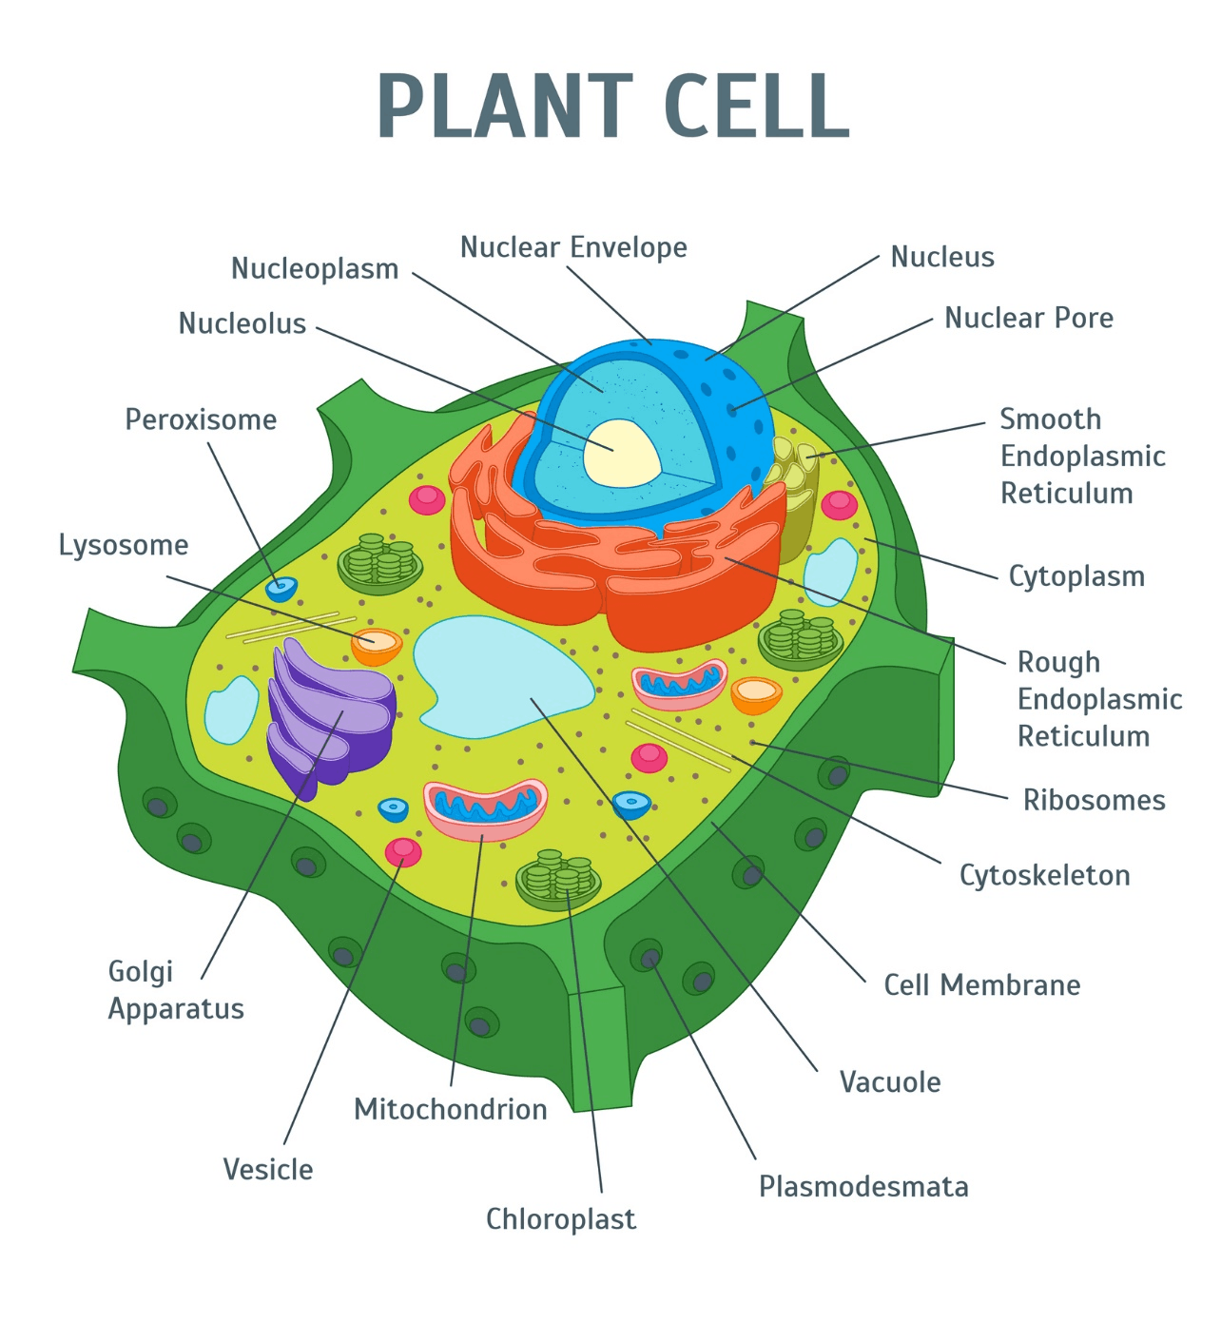
What is Molecular and Cellular Biology?
Molecule = Two or more atoms held together by chemical bonds
Cell = The basic structural unit of all life
Biology = The study of life
The study of molecules that constitute or interact with cells.
Reference: https://cell.actuinde.com/406-plant-cell-diagram-labeled-class-9-labeled/
Notes:
The cell consists of different structures, organelles, lots of different functions, but today the focus is going to be on heritable genetic information and how that information is expressed in different parts of the cell.

Slide 4
An Abbreviated History….
1866 - Gregor Mendel: Concluded that a “heredity molecule” was responsible for passing genetic information through generations by pea plant crossing experiments
1869 – Fredrick Meischer: Ruled out protein as heredity molecule, discovered DNA
1928 – Frederick Griffith: Bacteria capable of transferring heredity molecule
1944 - Avery, McLeod, & McCarthy: Purified heredity molecule, found to be DNA
1950 – Chargaff: Nitrogenous bases occur in specific ratios (A-T, C-G)
1952 – Rosalind Franklin & Maurice Wilkins: Suggested DNA molecule was a helix, determined dimensions of the molecule
1952 – Watson & Crick: The current model of DNA
1961 – Brenner, Jacob & Meselson: Discovery of mRNA
1977 – Sanger & Gilbert: Rapid DNA Sequencing
1983 – Kary Mullis develops PCR
1990-2003 – Human Genome Project: The first completed sequence of a human genome
Notes:
Not all events, but just to illustrate some of the work that went into discovering DNA in the first half of the 20th century. Each individual detail or process we’ll be discussing was once a novel discovery by a different scientist, culminated into what we know today.

Slide 5
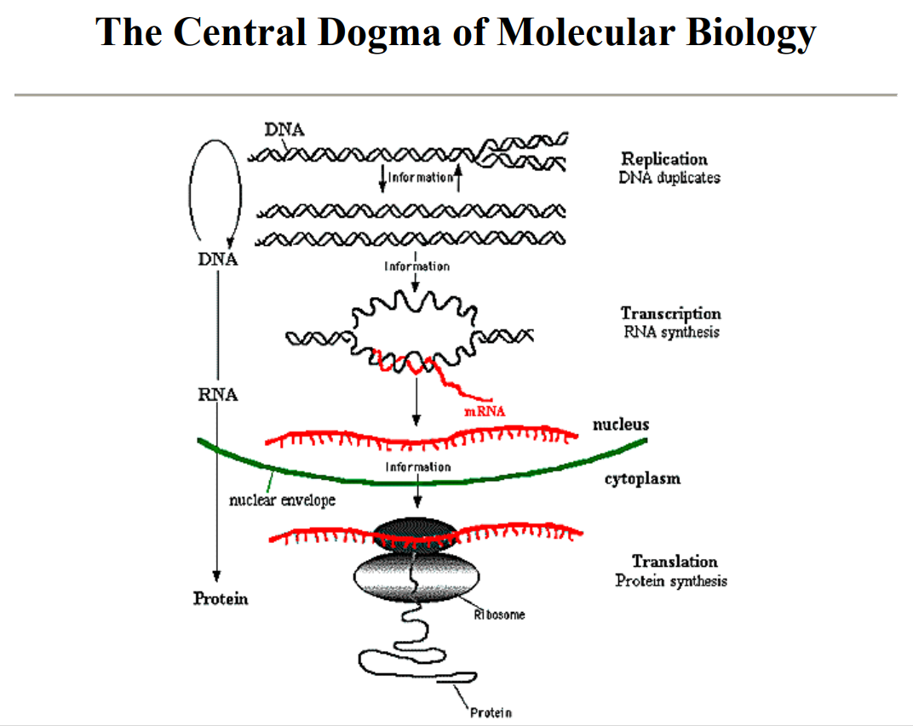
Heritable genetic information is stored as DNA
Express DNA (genotype) in the form of an observable trait (phenotype)
Store complex information that can be replicated reliably
Notes:
The central dogma is the fundamental roadmap of molecular biology. This tells us how heritable genetic information turns into physical traits. This happens in 4 steps. DNA codes for every physical attribute of an organism, so the cell needs a way to store and read a very large amount of complex information repeatedly and reliably.

Slide 6
Molecules within the Cell
DNA: Deoxyribonucleic acid, storage of heritable genetic information.
RNA: Ribonucleic acid
Messenger (mRNA): RNA produced as the result of transcription.
Transfer (tRNA): RNA that carries amino acids to ribosomes for translation
Ribosomal (rRNA): A ribosome is a molecule where translation occurs, the site of protein synthesis.
Proteins: Any class of high-molecular weight polymer compounds composed of amino acids joined by peptide linkages.
Enzymes: Proteins that catalyze biochemical reactions in living organisms.
Structural: Proteins involved in the shape, support, and organization of cell components.
Nucleus
Cytoplasm

Slide 7
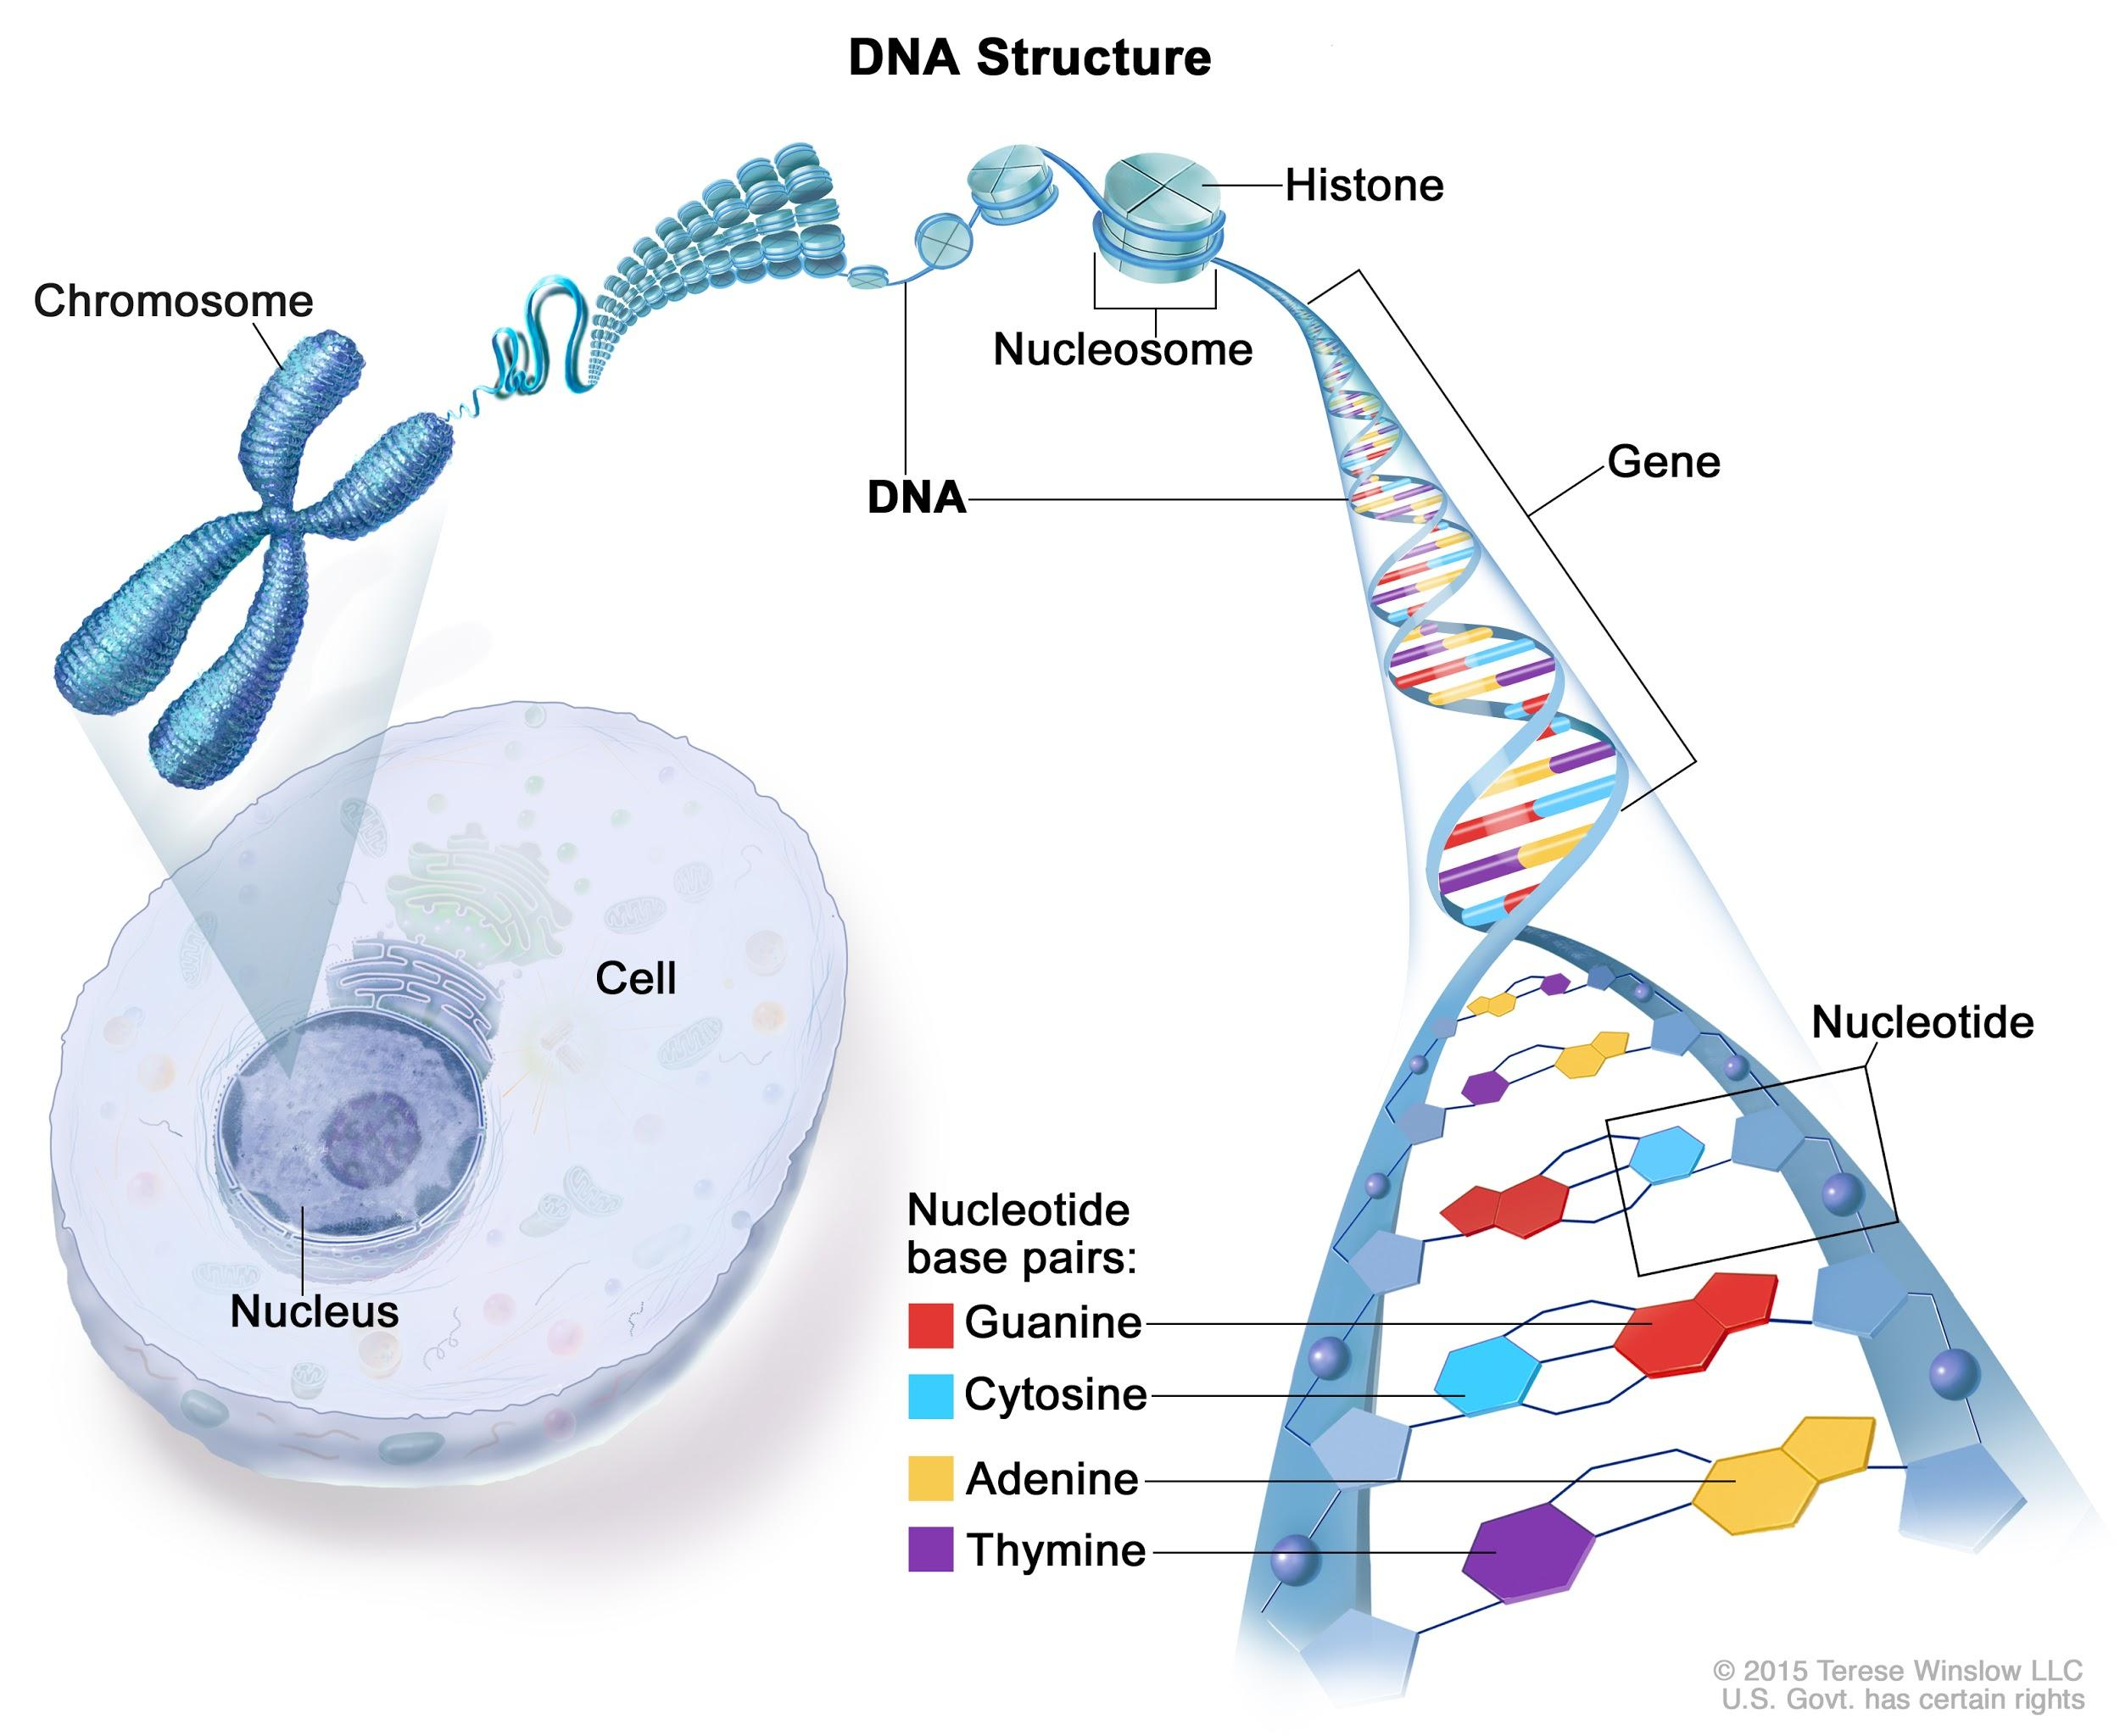
Structural Organization of DNA
Nucleus: A membrane bound organelle that contains a cell’s DNA.
Chromosome: Discrete unit of the genome carrying many genes, consisting of histone proteins and DNA. Found in the nucleus of every plant and animal cell.
Gene: The basic unit of inheritance whose sequence of nucleotides codes for specific proteins.
Double Helix: Spiral, staircase-like structure with a repeating pattern.
Nucleotide: Organic molecules consisting of a nitrogenous base, a pentose sugar, and a phosphate group.
Biotechnology - Basics of Cell, Nucleus, Chromosomes, DNA, RNA, Genes, Codons, Amino acids, etc. - Civilsdaily
Notes:
A human cell has enough DNA when stretched out is about 6 feet long.

Slide 8
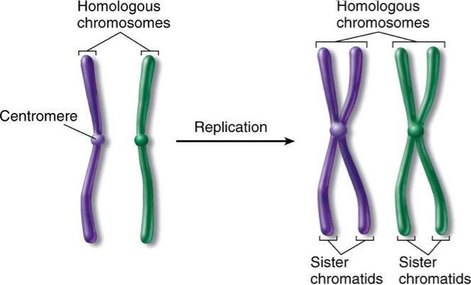
Chromosomes
Chromosome set (ploidy)
A human cell nucleus has 46 chromosomes
These 46 are composed of 23 pairs.
Each chromosome in the pair is received from each parent.
Each pair is a set of homologous chromosomes.
Chromatid: One of two identical halves of a chromosome that has been replicated in preparation for cell division.
https://biology.stackexchange.com/questions/59287/what-are-homologous-chromosomes
Notes:
For an organism to produce more cells, they need to be able to duplicate their DNA so each new cell has as much DNA as the original cell.

Slide 9
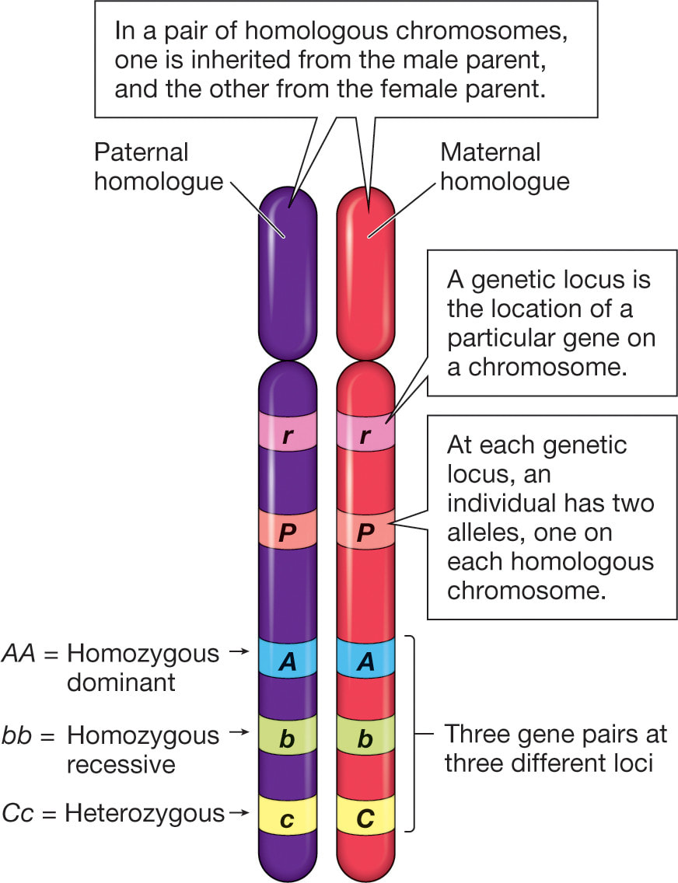
Genes in relation to Chromosomes
Homologous chromosomes contain DNA that codes for the same gene. A version of the DNA sequence at a specific location (locus) is an allele.
Same trait = homozygous
Different trait = heterozygous
Only one version is present = hemizygous
Ex) male mammals are hemizygous for genes on the X chromosome
http://sciencewithmrsb.weebly.com/genetic-variation-and-change.html

Slide 10
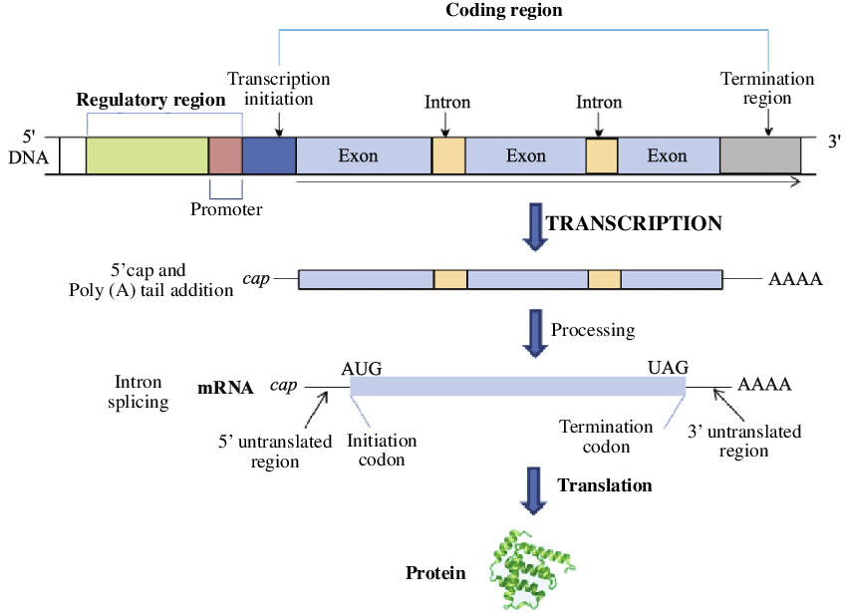
Gene Structure
Promoter: Region of DNA upstream of a gene where proteins bind to initiate transcription.
Coding region: Sequence of a gene that codes for a protein.
Terminator: Marks the end of transcription at the end of a gene.
https://www.researchgate.net/figure/The-structure-of-a-gene-and-the-control-of-gene-expression-in-eukaryotes-Initially-RNA_fig2_263714372

Slide 11
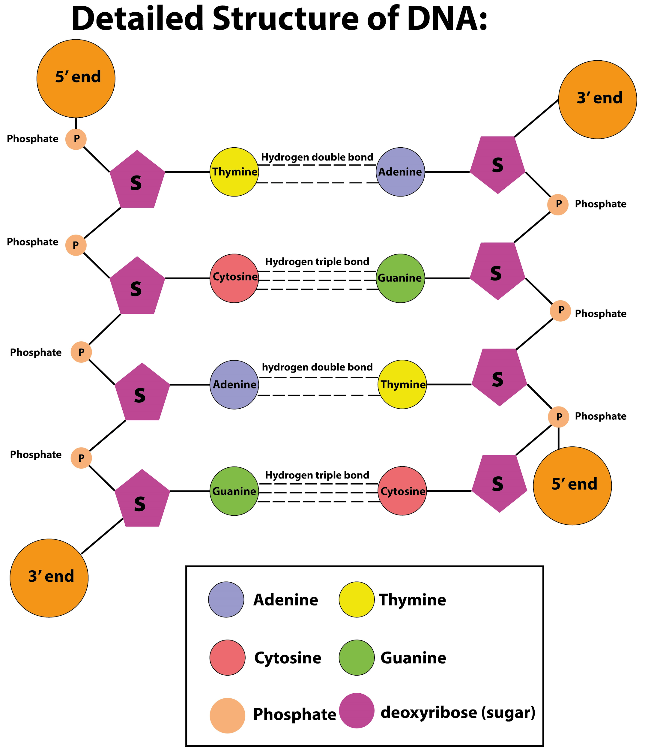
DNA Molecular Structure
Three components of DNA:
Deoxyribose (pentose) sugar
Phosphate group
Nucleic acid
Adenine – Thymine: 2 H-bonds
Cytosine – Guanine: 3 H-bonds
Base pair: 2 nucleotides that are in different nucleic acid chains whose bases pair by hydrogen bonding.
Complimentary
Quantities of DNA measured in base pairs
1 kilobase (kb) = 1000 bp
https://www.vedantu.com/question-answer/peculiarity-of-the-dna-structure-class-12-biology-cbse-5fc47df1287b0f7a3825b4fa
Notes:
3 billion base pairs in the human genome.
2.5 billion base pairs in corn
1.1 million base pairs in soybeans.

Slide 12
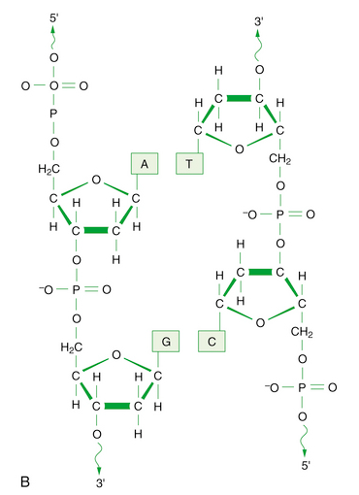
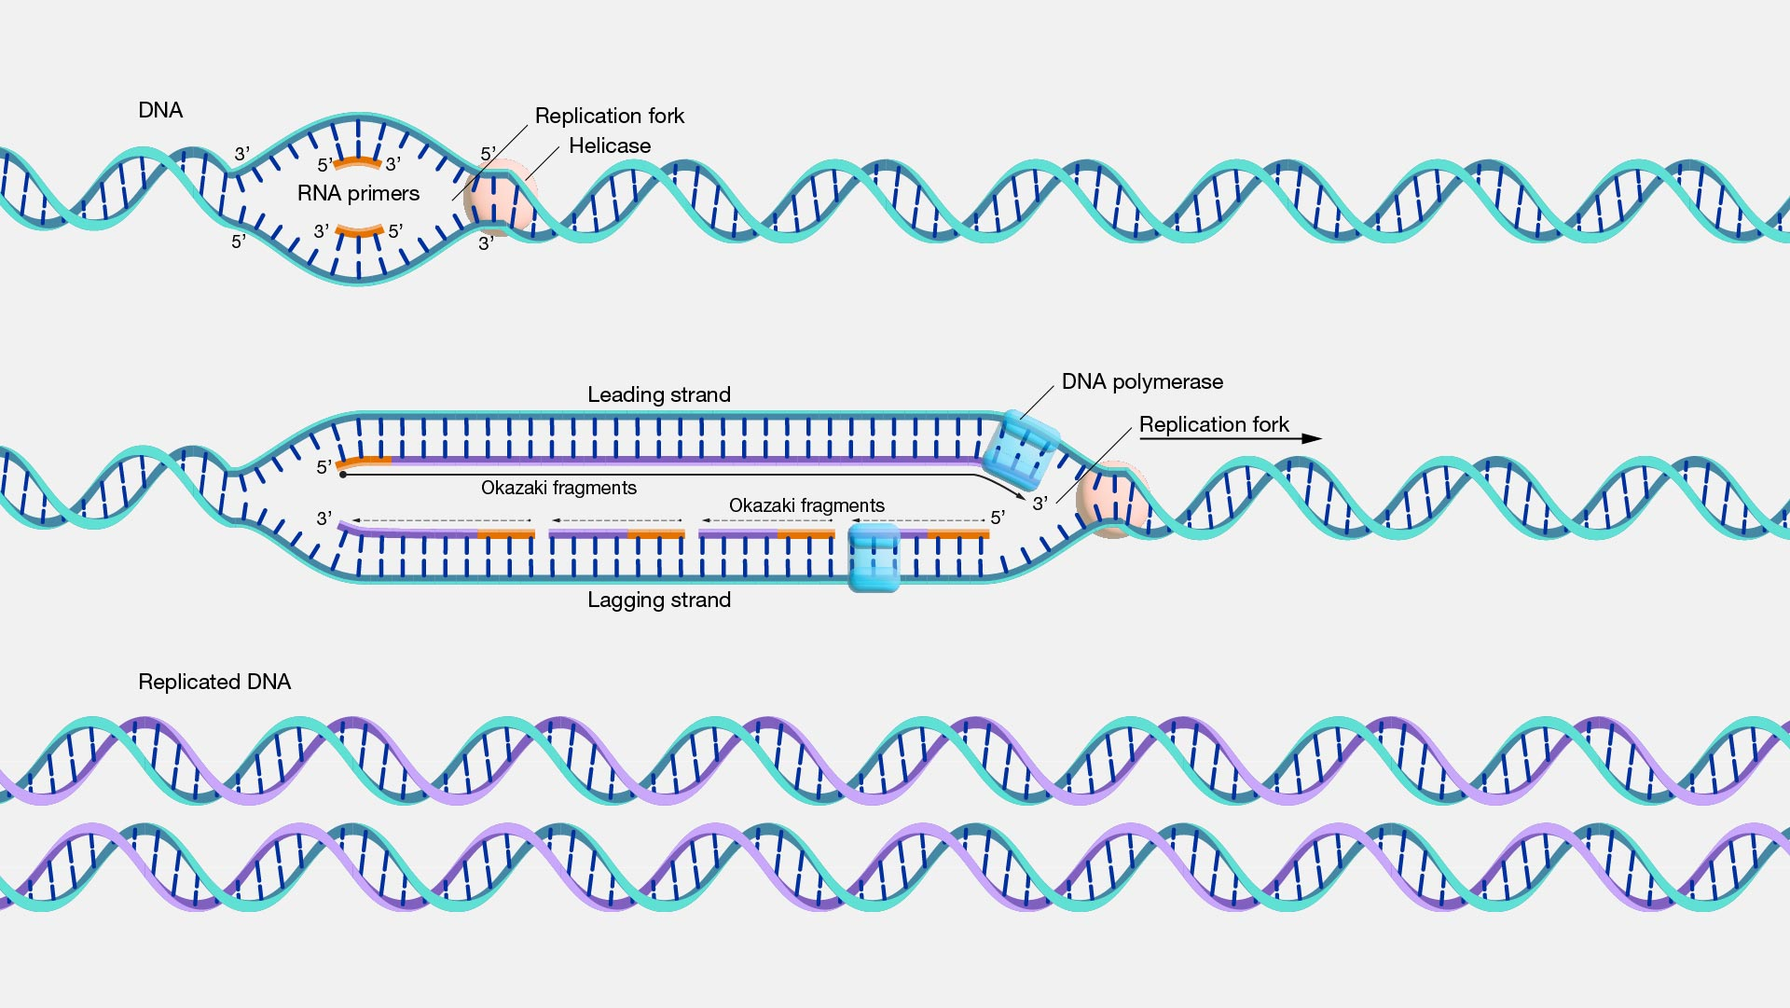
DNA Replication
5’
4’
1’
3’
2’
Semi-conservative
Bi-directional
Multi-enzyme process
DNA synthesized in 5’-3’ direction
https://www.genome.gov/genetics-glossary/DNA-Replication
Notes:
Poly = many, mer = part, ase = enzyme, an enzyme that creates many parts, where the parts are molecules or a molecule chain.
International Union of Pure and Applied Chemistry
RNA primers = DNA pol can only add to an existing nucleotide, it cannot bind directly to a strand to begin synthesis. DNA primers are not available in the cell.

Slide 13
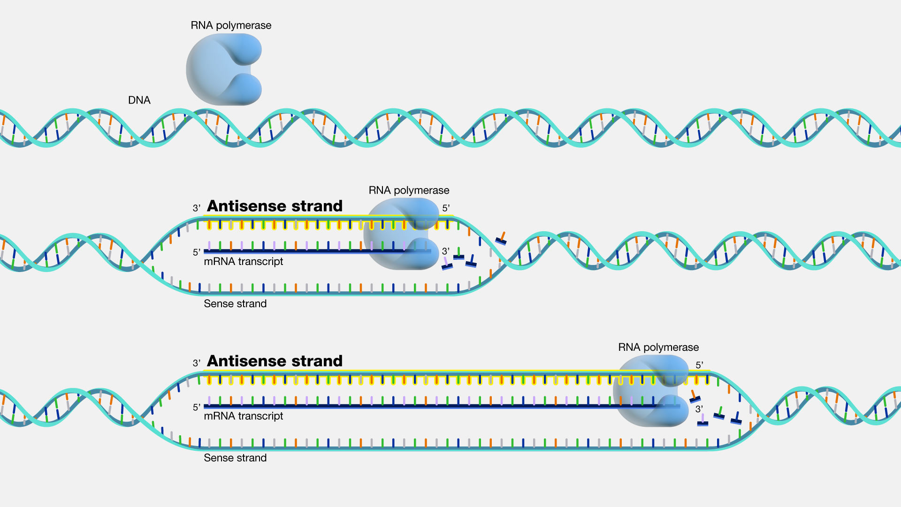
Transcription
An enzyme-catalyzed process where DNA is used as a template to produce complimentary mRNA.
mRNA: messenger RNA. A transcript of RNA that carries information from DNA to protein-making structures in the cell.
Thymine in DNA is replaced with Uracil in RNA.
Uracil – Adenine
Cytosine - Guanine
https://www.genome.gov/genetics-glossary/antisense
Notes:
Single strands of RNA are transcribed from DNA, utilizing free-floating nucleotides and an enzyme called RNA polymerase.
The sense and anti-sense strands are determined relative to wherever the primer binds to in order to begin transcription. Genes can overlap, in strand and on opposite strands, but this is more common in bacteria and viruses than in eukaryotes. Overlapping of Genes in the Human Genome - PMC (nih.gov)

Slide 14
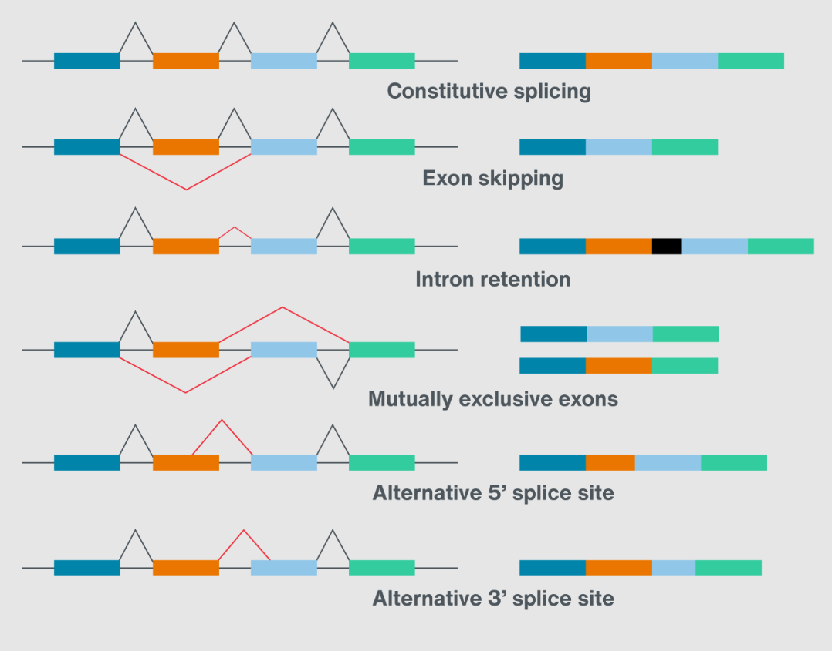
Processing/splicing
After transcription, the mRNA needs to be modified:
Addition of a 5’ cap and 3’ tail
Sequence structure, prevents unraveling and degradation
Introns (non-coding) removed and exons (coding) stuck back together
Alternative combinations of spliced RNA
https://nanoporetech.com/applications/investigations/splice-variation
Notes:
Different isoforms of the same gene

Slide 15
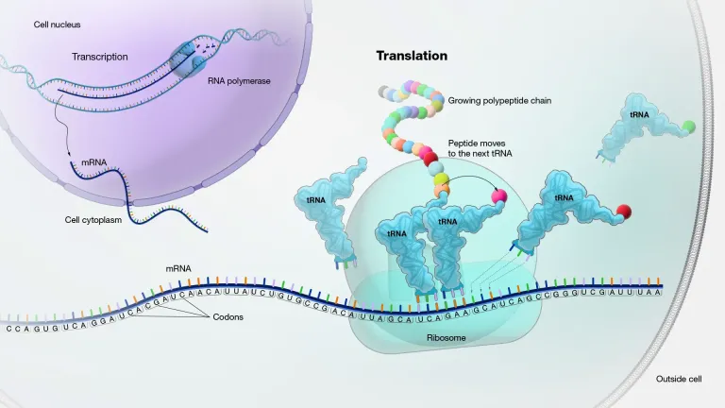
Translation
Protein: Any class of high-molecular weight polymer compounds composed of amino acids joined by peptide linkages.
Amino acid: The building blocks of proteins. There are 20 different amino acids.
tRNA: Small RNA that act as carriers of amino acids during protein synthesis. Binds to a specific amino acid and transports it to the ribosome.
Ribosome: Cellular structure composed of RNA and protein that is responsible for making proteins.
Express: To transcribe and translate DNA into a specific protein.
The process of translating the sequence of messenger RNA molecule into a sequence of amino acids during protein synthesis.
https://microbeonline.com/translation-protein-synthesis/

Slide 16
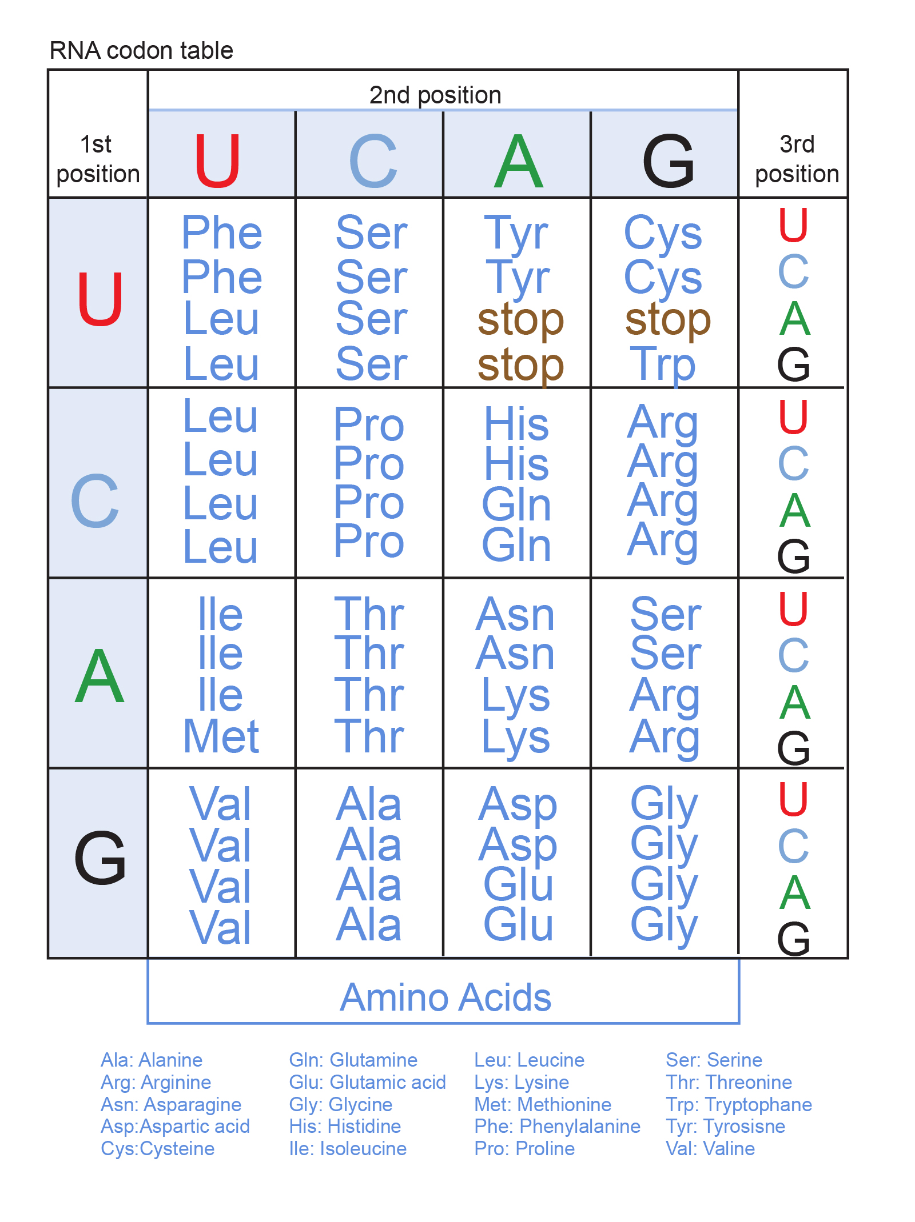
Genetic Code
Codon: A series of three nucleotides that codes for a particular amino acid or signals the termination of protein synthesis.
20 amino acids.
64 possible codons, 3 of which code for termination of protein synthesis: UAA, UAG, UGA
mRNA - AUG - CCG - UCA - AUC - UAA
AA – Methionine - Proline - Serine – Isoleucine - STOP
https://www.genome.gov/genetics-glossary/Genetic-Code
Notes:
The order of nucleotides in sequence corresponds to specific amino acids, this is referred to as the genetic code. Each amino acid is coded for by a series of three nucleotides, this is referred to as a codon. 4 possible nucleotides in combination to create a triplet code means there are 64 possible codons. There are only 20 amino acids, so many of the triplets code for the same amino acid.

Slide 18
Cell Cycle, Mitosis, and Meiosis

Slide 19
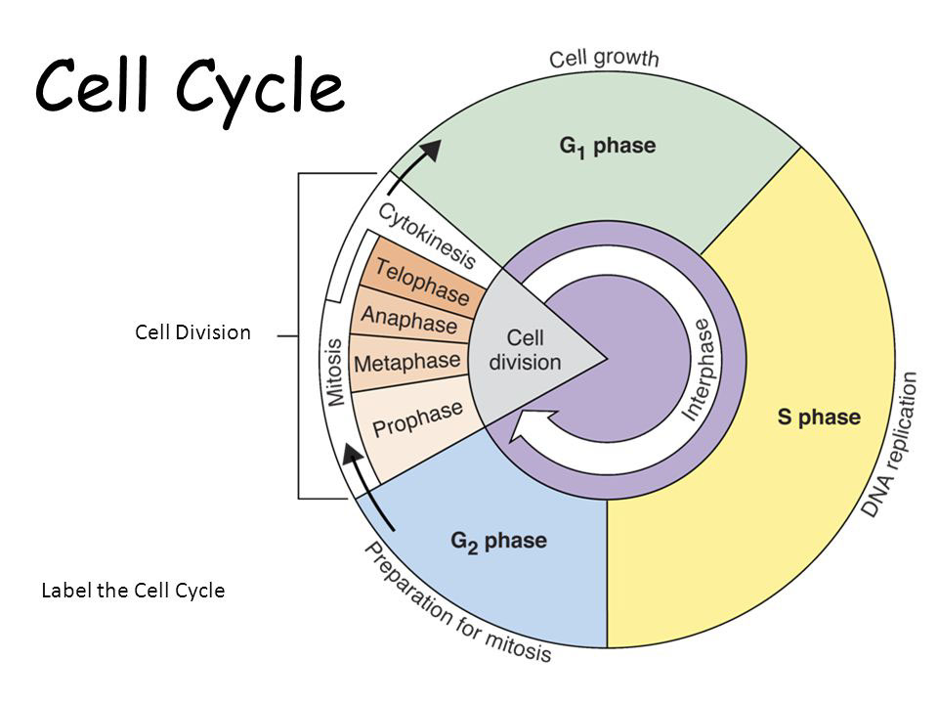
https://www.onlinebiologynotes.com/phases-of-cell-cycle/

Slide 20
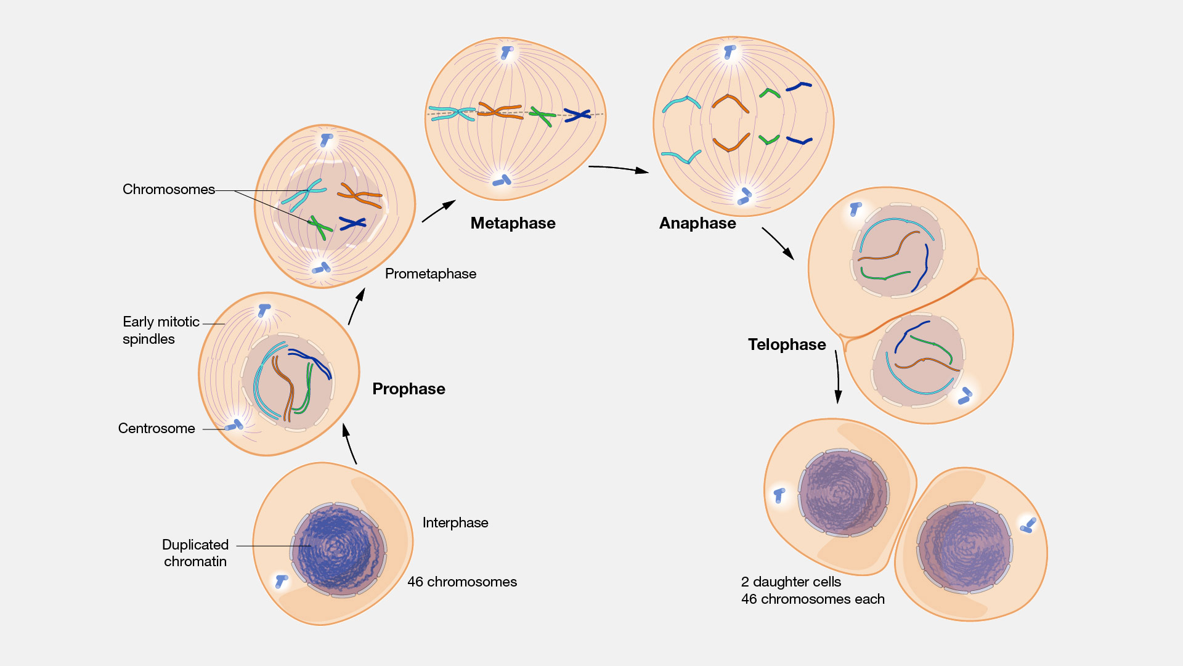
Mitosis
The cellular process in which chromosomes are duplicated, producing two identical nuclei in preparation for cell division, and separated into two daughter cells
End result is 2 cells identical to
the original cell.
2 identical nuclei
Somatic cells: “Soma” = Body
A cell forming the body of an
organism other than gametes or
undifferentiated cells.
In a plant: stems, roots, leaves.
https://www.genome.gov/sites/default/files/media/images/tg/Mitosis.jpg

Slide 21
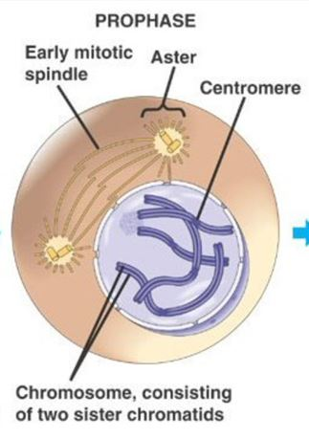
Nuclear membrane disappears, spindle fibers form, and DNA condenses into chromosomes in the form of sister chromatids
Notes:
Microtubules are polymers of a protein called tubulin, structural proteins that give the cell shape and facilitate the movement of objects within the cell.

Slide 22
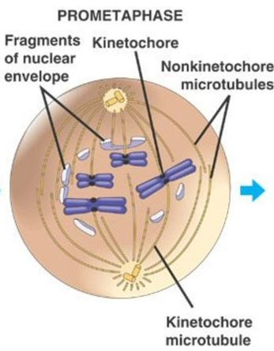
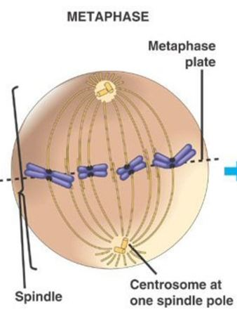
Chromosomes align at the cell’s spindle equator/metaphase plate

Slide 23
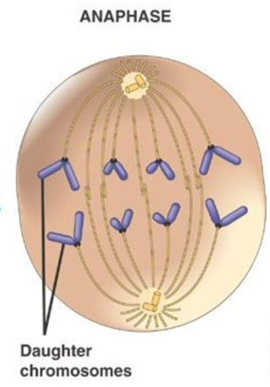
Chromosomes move to poles as the spindle contracts

Slide 24
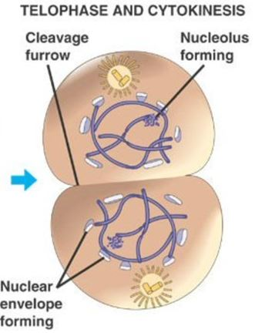
Nuclear membranes form around daughter nuclei. Cell membrane forms creating two new cells.

Slide 26
Meiosis
The process in which a diploid cell gives rise to haploid cells (gamete/sex cells).
In other words, to produce a sex cell (pollen and egg cells) with half the chromosome number of a somatic cell.
Diploid: A cell that carries two copies of each chromosome (2N)
Haploid: A cell that carries one copy of each chromosome (1N)
Start: 1 diploid cell
End: 4 haploid daughter cells
A sex cell from each parent (1N) fertilizes to create a zygote (2N)
Notes:
N = denotes the number of chromosome sets

Slide 27
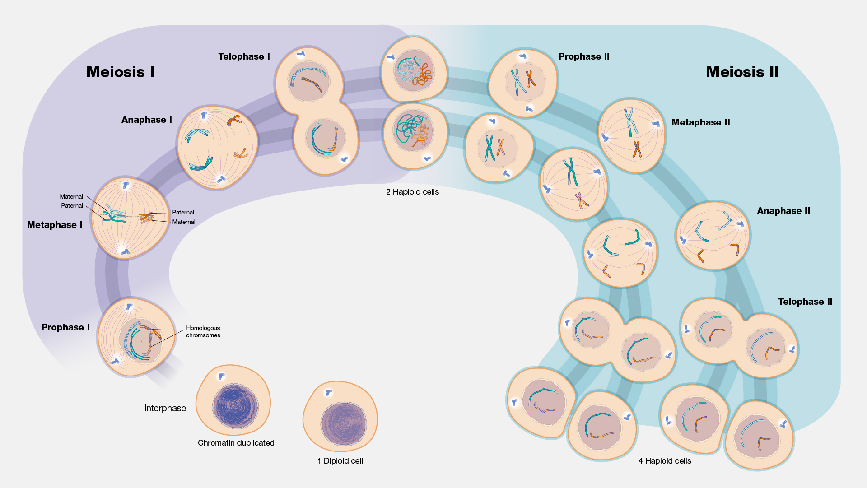
Meiosis
The end result of meiosis is 4 haploid sex cells, each with ½ the chromosomes needed for a complete cell.

Slide 28
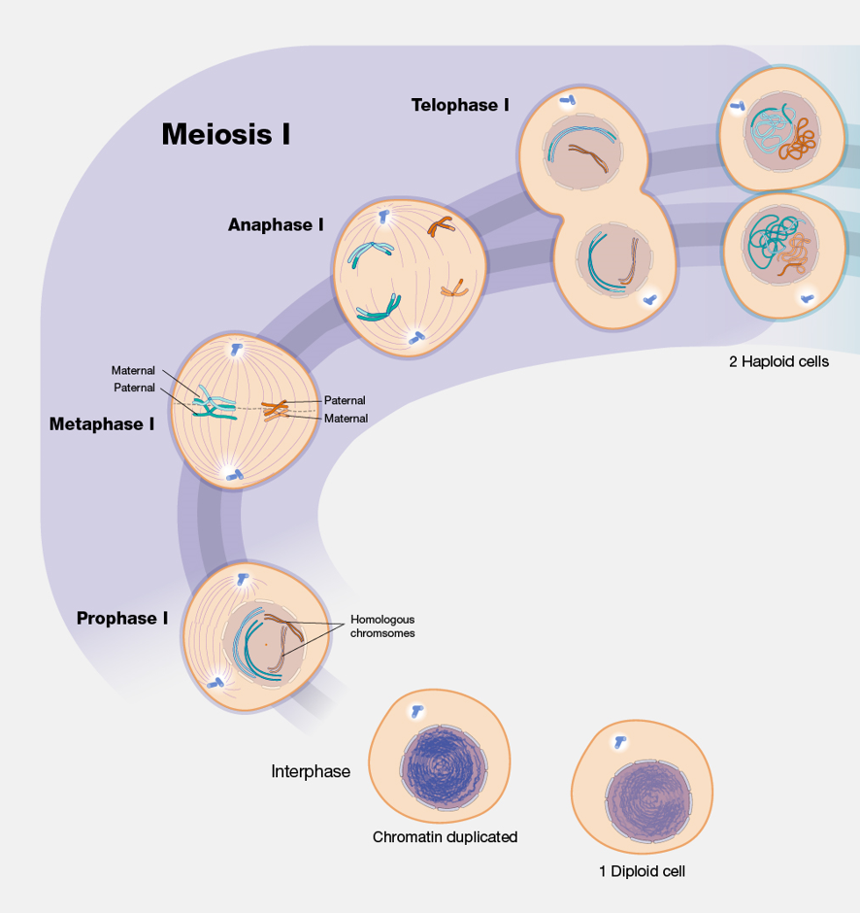
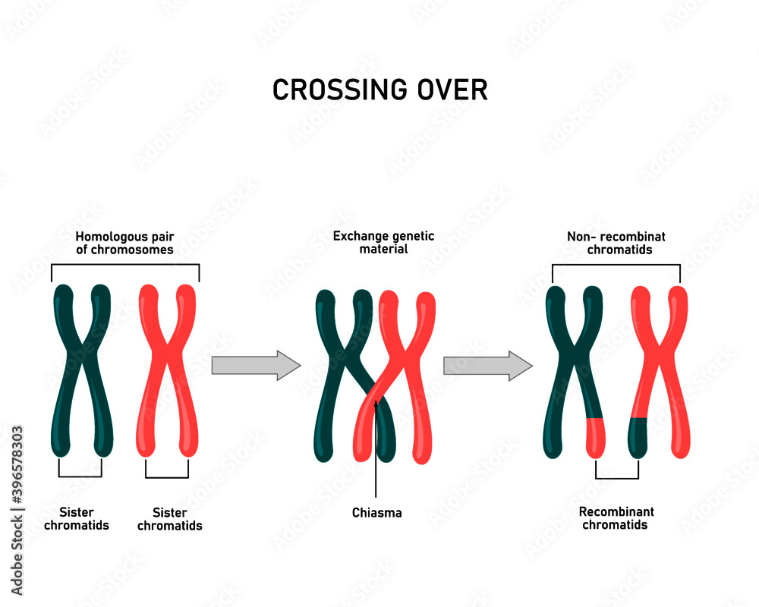
Meiosis I
Start = 1 Diploid cell
End = 2 Haploid cells
Homologous chromosomes separate
Crossing over/recombination: A source of genetic variation where homologous chromosomes swap sections at a specific site/locus prior to separation.

Slide 29
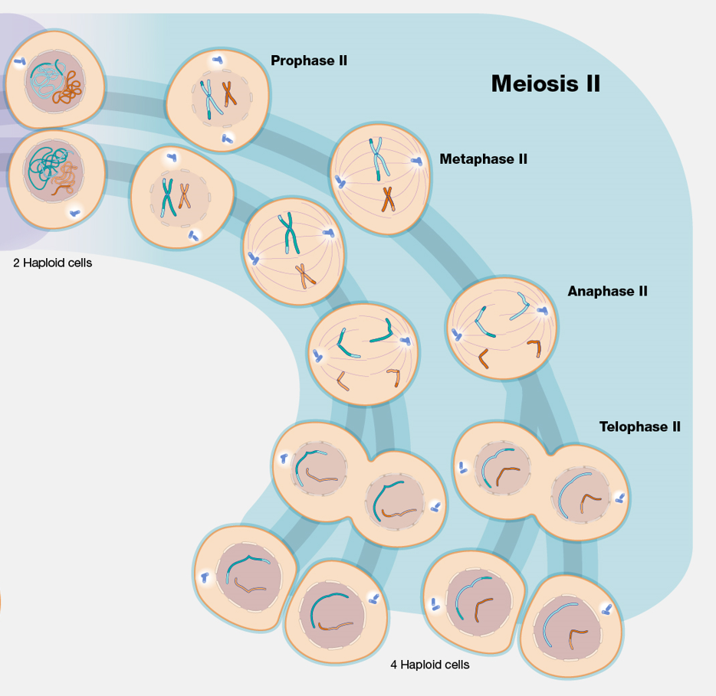
Meiosis II
Start = 2 Haploid cells
End = 4 Haploid cells
Sister chromatids separate
The 4 haploid cells are genetically unique, each having half the number of chromosomes needed to create a somatic cell.

Slide 31
Questions?
References:
RGT/CGT Study guide. Rev. 01.17.2017
Plant Biology. 2010. Smith, A., Coupland, G., Dolan, L., Harberd, N., Jones, J., Marin, C., Sablowski, R., Abigail, A.
https://www.genome.gov/genetics-glossary
Google “NIH Genomics”
https://clinicalgate.com/introduction-to-genetics/
https://microbeonline.com/category/molecular-biology/

