Slide 1

Plant Transformation
2024 Genetic Superworkshop
Kathy Mathiason, RST/CGT, SDSU Seed Testing Lab, Brookings, SD
February 12, 2024

Slide 2
definition
incorporation of (foreign) DNA from one organism into the genome of another organism (plant of interest)
includes the integration and expression of that inserted gene
  transgene – the “package” of genetic material that is inserted
  transgenic – the organism that develops after a successful gene transfer

Slide 3
purpose
in agriculture, improve/impart plant traits:
  yield
  pest, disease, and virus resistance
  stress tolerance (i.e. extreme environments)
  nutrient production (modify lipid, starch, and protein storage in seeds)
  delay fruit decay and extend flower life
  tolerance to chemical herbicide

Slide 4
Improved traits via plant transformation
Plant Trans Biotech. Atiq et al. 2019. Figure 2.

Slide 5
example (RGT/CGT study guide)
herbicide-tolerant crop
  crop plant, cultivated by man, which has been altered to be able to survive application(s) of one or more herbicides by the incorporation of certain gene(s)
    traditional breeding
      corn – tolerant to imidazolinone-containing herbicides by adding the imidazolinone-tolerant trait (T-Gene, IT-Gene, or IR-Gene)
    genetic engineering
      soybean, canola, cotton, corn – tolerant to glyphosate-containing herbicides by insertion of the transgene for CP4 EPSPS

Slide 6
requirements of plant transformation
biological
practical

Slide 7
biological
availability of a target tissue, including cells that are capable of plant regeneration
method to introduce DNA into those regenerable cells
procedure to select and regenerate transformed plants at a satisfactory frequency

Slide 8
practical
high efficiency, economy, and reproducibility to produce many independent transformants for testing
safety to operators
technical simplicity
minimum time in tissue culture
stable uniform transformants for vegetative propagation, or fertile germline transformants for sexual propagation
minimize probability of undesired gene disruption at insertion site
stable expression of introduced genes in the pattern expected

Slide 9
two stages of plant transformation
deliver the DNA into a single cell
regenerate full fertile plants

Slide 10
two classes of delivery
non-biological/direct
biological/indirect
chemical
  PEG
  calcium phosphate
physical
  particle bombardment/biolistics
  microinjection
  ultrasonic waves
  laser microbeam (UV)
  silicon fibers
Agrobacterium mediated
  tumefaciens
  rhizogenes
virus
in planta
  meristem, pollen, embryo
  floral dip/spray
  germinating seeds

Slide 11
methods of delivery
breeding
  selective
  mutation
Agrobacterium
particle bombardment (particle inflow gun / gene gun)
TALENs
CRISPR/Cas9

Slide 12
selective breeding
relies on the natural emergence of variants with a desired trait
  results from occasional random mutations that naturally occur during reproduction
over decades, farmers keep and mix the desired traits together through mating and produce plants with the characteristics/ qualities they want

Slide 13
example
plant a lot of seeds
notice a few rare plants with favorable qualities (juicier kernels)
breed and plant seeds from the plants with the favorable trait, increasing its frequency in the population
repeat process when more beneficial traits are found

Slide 14
disadvantage
naturally occurring DNA changes are rare
This process takes a long time!

Slide 15
mutation breeding
uses techniques to create a high number of random DNA changes
  radiation
  mutagenic chemicals
a variety of results:
  no visible effect on organism
  new but undesirable traits
  new desirable traits
  a desirable trait too closely associated with an undesirable trait

Slide 16
example
Ruby red grapefruit
  1929 – farmers stumbled on a grapefruit in which a natural mutation occurred: the flesh eventually faded to pink
  scientists fired plants with radiation to produce mutants of a deeper color
  1971 – released Star Ruby
  1985 – released Rio Red
  these mutant offspring account for ~75% of all grapefruit grown in Texas

Slide 17
disadvantage
imprecise and uncontrolled
sift through thousands of plants to find individuals with desired traits
breed and propagate plants until obtain a strain that reliably shows the desired trait
This process takes time and space!

Slide 18
methods of delivery
breeding
  selective
  mutation
Agrobacterium
particle bombardment (particle inflow gun / gene gun)
TALENs
CRISPR/Cas9

Slide 19
Agrobacterium tumefaciens (RGT/CGT study guide)
naturally occurring soil bacterium
1980 – Marc van Montagu showed that A. tumefaciens could alter the DNA of a plant by inserting its own DNA into the genome of that host plant
results in an injury to the plant known as crown gall (tumors)
Monsanto developed a way to stop A. tumefaciens from causing crown gall while maintaining its ability to insert DNA into plant cells
  used A. tumefaciens as a vehicle to insert desired genes into plants (e.g., the gene causing overproduction of CP4 EPSP synthase, thus conferring resistance to glyphosate-containing herbicide)

Slide 20
Ti (tumor-inducing) plasmid
plasmid = loop of DNA
modifiable – can add (any?) transgene of interest
vector = piece of DNA used to transfer DNA from one organism to another
  has replication sites that allow it to replicate in host cells
  has marker genes, like antibiotic resistance

Slide 21
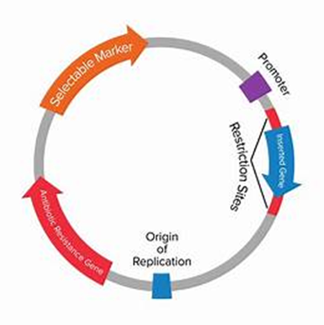
plasmid vector
promoter – 35S, from cauliflower mosaic virus
transgene – gene of interest
terminator – NOS, derived from Agrobacterium
reporter gene - selectable marker
    gene that enables cells to withstand a certain antibiotic
    indicates properly transformed cells
termination

Slide 22
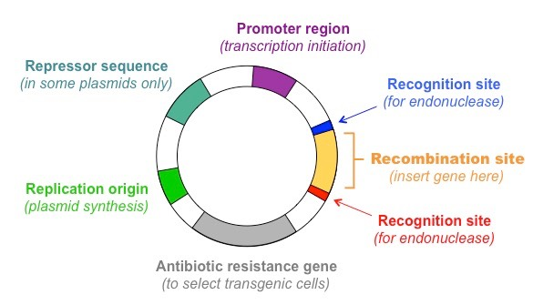
Replication origin
(plasmid synthesis)
Termination region

Slide 23
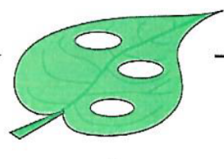
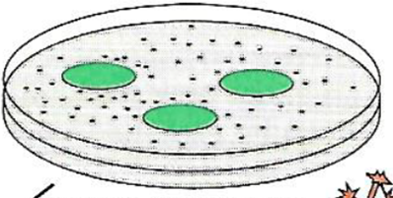

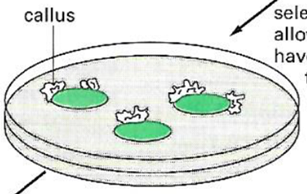
steps
1. incorporate transgene into Agrobacterium
2. inoculate wounded plant tissue explants
3. grow the explants on culture media which contains:
- antibiotic to kill Agrobacterium
- antibiotic that would normally kill plant cells
      gene to be resistant to that antibiotic was inserted into Agro along with transgene
      SO, only cells with foreign DNA successfully integrated into their own DNA can survive on media with that specific antibiotic
Molecular Biology of the Cell. 4th Edition. Alberts, Johnson, Lewis, Raff, Roberts, Walter. 2002. Fig 8-72. p 544.

Slide 24
disadvantage
foreign DNA inserted into random locations in the plant genome
more successful with dicots
  several monocot crops, legumes, and woody plants are recalcitrant to A. tumefaciens-mediated transformation

Slide 25
particle bombardment/particle inflow gun
invented by Sanford, Wolf, and Allen at Cornell University along with Klein at DuPont between 1983 and 1986
originally an air pistol modified to fire tungsten particles
original target = onion (large cell size)
improvements, manufactured and sold
  non-explosive propellant (helium gas)
  multi-disk delivery mechanism to minimize damage to sample tissue
  other heavy metals (gold and silver)

Slide 26
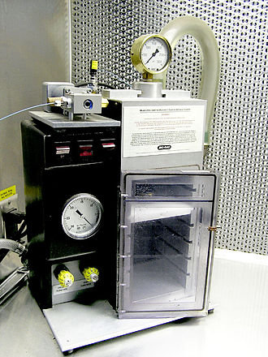
Helium-driven particle gun (BIO RAD
PDS-1000/HeTM)
(PDS = particle delivery system)

Slide 27
coat gold with DNA
put target plant cells/tissue on petri dish
put petri dish on shelf in chamber
cover petri dish with a screen
pipet gold/DNA onto plastic disc and place in holder at the top of the chamber
close door and pressurize with helium
press “release” button, so that a burst of helium propels gold/DNA from disc, through screen, and onto/into tissue
Hagio. 1998. Optim Part Bombard Method for Effic Gen Transform. JARG 32, 239-247

Slide 28
disadvantages
transformation efficiency lower than with Agrobacterium
costly (gold or tungsten)
intracellular targets are random (nuclear vs mitochondrial genomes)
inconsistent copy integration (no transgene to multiple copies)
DNA is not protected from damage

Slide 29
summarize Agrobacterium and particle bombardment

Slide 30
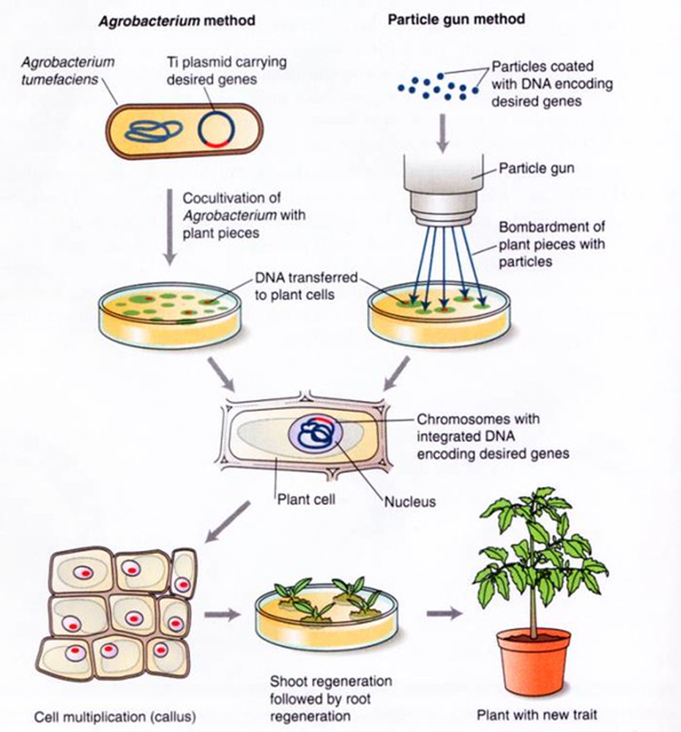

Slide 31
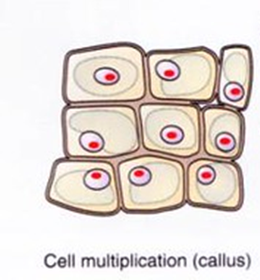
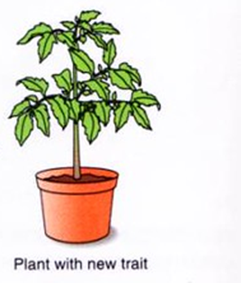
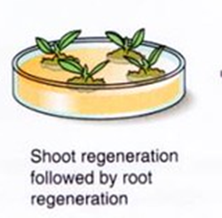

Slide 32
two stages of plant transformation
deliver the DNA into a single cell
regenerate full fertile plants

Slide 33
plant tissue culture
in vitro cultivation of plant cells/tissues under sterile conditions and in the presence of micro- and macro-molecules (nutritive culture medium)
start with plant tissue that has been transformed
callus forms/grows
stimulate shoot and root development
produce daughter plants with same genotype as parent plant

Slide 34
induce shoot and root growth
cytokinin induces cell division and differentiation
auxin
  stimulates elongation growth of shoots
  initiates production of adventitious and lateral roots
higher ratio of cytokinin = growth of shoot buds
higher ratio of auxin = root formation

Slide 35
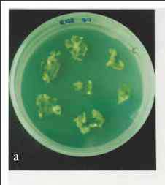
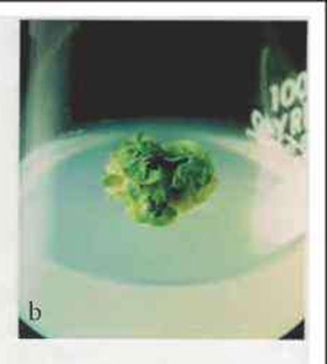
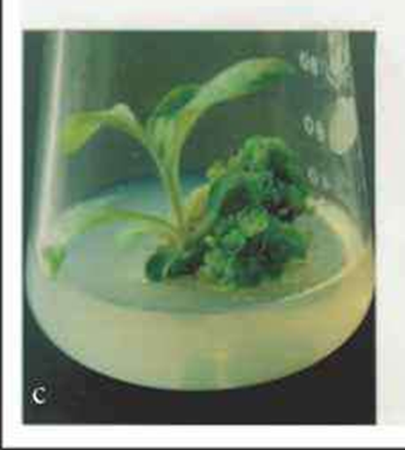
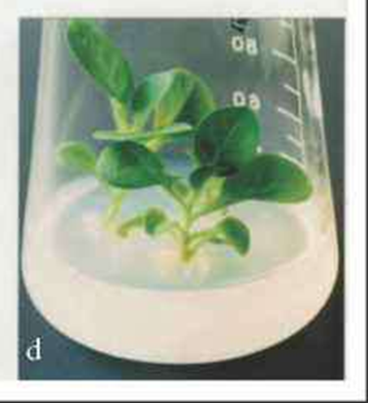

Slide 36
methods for plant transformation
breeding
  selective
  mutation
Agrobacterium
particle bombardment (particle inflow gun / gene gun)
TALENs
CRISPR/Cas9

Slide 37
Site Directed Nucleases (SDN)
meganucleases (MNs)
zinc-finger nucleases (ZFNs)
transcription activator-like effector nucleases (TALENs)
CRISPR-Cas systems

Slide 38
zinc finger nucleases (ZFNs)
enzymes engineered to create DNA double-strand breaks at specific loci
produced herbicide-resistant plants in 2009
  targeted the tobacco acetolactate synthase genes, for which specific mutations are known to confer resistance to imidazolinone and sulphonylurea herbicides

Slide 39
TALENs
transcription activator-like effector nucleases
restriction enzymes that can be engineered to cut specific sequences of DNA
more flexible than ZFNs

Slide 40
CRISPR
Clustered
Regularly
Interspaced
Short
Palindromic
Repeats
family of DNA sequences found in the genomes of some prokaryotes
derived from DNA fragments of bacteriophages (infections)
antiviral defense mechanism

Slide 41
Cas9
CRISPR-associated protein 9
enzyme
uses CRISPR sequences as guide to recognize and open up specific DNA strands that are complementary to CRISPR sequence

Slide 42
CRISPR/Cas9
insert and/or delete targeted traits
transform more than one gene at a time in one plant
specific target location = precise and accurate
make changes to plant DNA without adding any foreign DNA

Slide 43
Bessoltane, Charlot, Guyon-Debast, Charif, Mara, Collonnier, Perroud, Tepfer, Nogue. 2022. Genome-wide specificity of plant genome editing by both CRIPSR-Cas9 and TALEN. Scientific Reports 12:9330. Fig 1. doi.org/10.1038/s41598-022-13034-2

Slide 44
disadvantage
can cause undesired off-target mutations and mosaicism
cannot yet efficiently replace older transgenic tools

Slide 45
references
https://www.jic.ac.uk/blog/what-is-plant-transformation/
CRISPR in Agriculture - CRISPRpedia (innovativegenomics.org)
Keshavareddy, G, ARV Kumar and Vemanna S Ramu. 2018. Methods of Plant Transformation- A Review Int.J.Curr.Microbiol.App.Sci. 7(07): 2656-2668. doi: https://doi.org/10.20546/ijcmas.2018.707.312
Gulshan Atiq, N, S Kanwal, MA Raheem and RK Iqbal. 2019. Plant Transformation in Biotechnology. M.E.J.Appl.Sci&Tech. 2(3): 103-123.
Ying-Hua, S, YB Liu and XS Zhang. 2011. Auxin-Cytokinin Interaction Regulates Meristem Development. Molecular Plant. 4(4): 616-625.
Townsend JA, Wright DA, Winfrey RJ, Fu F, Maeder ML, Joung JK, Voytas DF. 2009. High-frequency modification of plant genes using engineered zinc-finger nucleases. Nature. 459: 442-445.

Slide 46
the end questions/comments
plant transformation vs genome editing
  fill out survey at the end of the workshop

