Slide 1

T&T Committee
(+ Webinar & CE) Meeting
Monday
June 9, 2025
1:30 pm

Slide 2
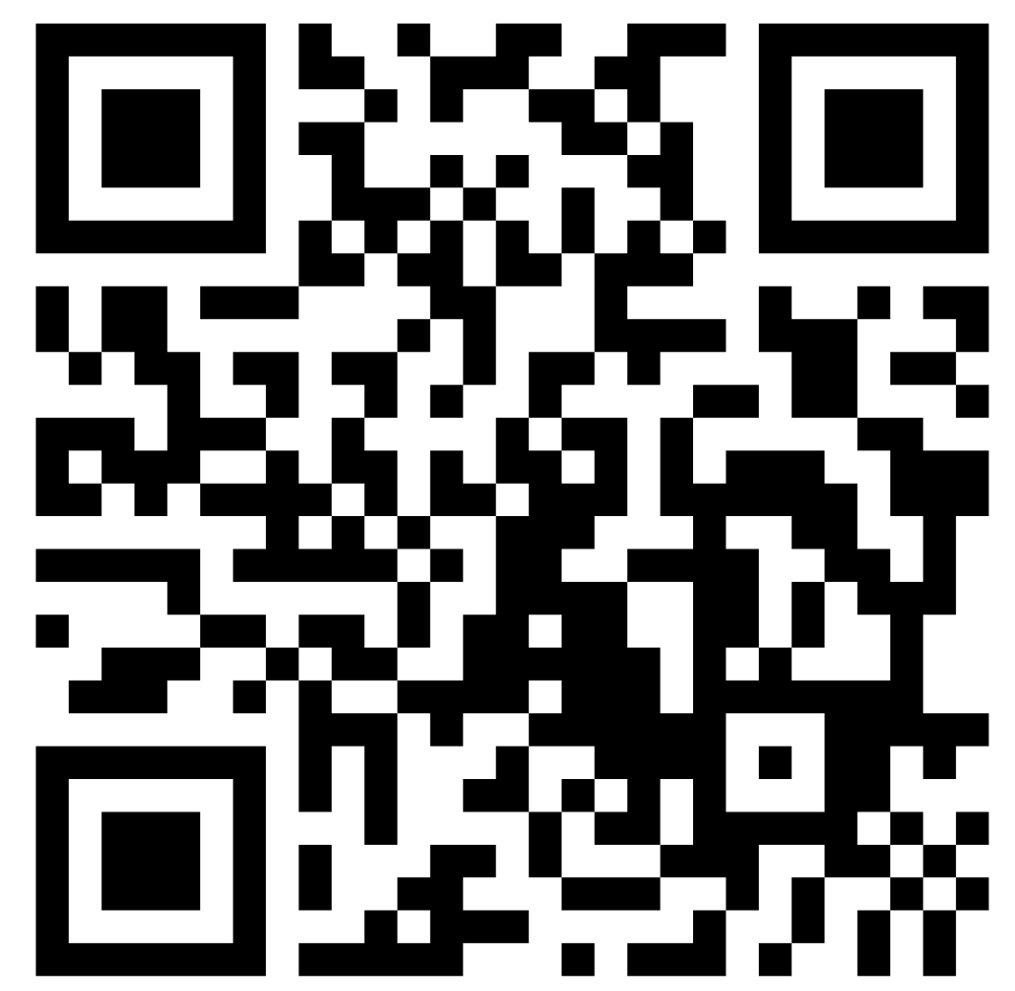

AOSA/SCST
2025 Annual Meeting
Committee Sign-In
https://www.surveymonkey.com/r/TY3PXNQ

Slide 3
Agenda
Webinars
Questions from analysts about future training needs
Points to take exam vs CE points to maintain membership
Continuing education points
  Graphs of where members are at for points
  Receiving points for attending the annual meeting
  Watching the recorded webinars
  Watching with someone else (on their log-in)
  Application for CE points for a workshop/webinar
New SOP for the merger

Slide 4
Webinar subcommittee – Chi Trinh
3 webinars this year:
  2024 Rules changes
  2025 Rules proposals
  On the Road to Consolidation
Struggling to find presenters and topics
  THE FIRST ASK: ideas/suggestions for webinar content
  THE BIG ASK: volunteers to be presenters for webinars
Request for new webinar moderator!
  lan-chin.trinh@usda.gov

Slide 5
Webinar subcommittee
Purpose: This SOP describes the purpose and functions of the Webinar Subcommittee.
Scope: This process applies to the purpose, structure, duties and meetings.
References: NA
Procedure:
Purpose: to facilitate the presentation of webinars for AOSA and SCST members
Structure: chair
Duties:
  Recruit subjects and presenters
  Provide a power point template
  Set up webinar time and date
  Send out webinar announcement
  Assist with the live presentation
  Provide the list of attendees (generated by webinar platform) to the CE point chairs
  Forward recorded webinar to be posted on T&T website
  Forward submission form from members who view the recorded webinars to the CE point chairs
Meetings:
  The subcommittee will communicate by email, meeting by conference call if necessary
  The subcommittee will be part of the Teaching & Training Committee’s open meeting at the annual meeting
    give committee report during business meeting in June
b. send report for the Proceedings shortly after the annual meeting

Slide 6
Future training needs
There is always a need for mentors/tutors!
  There have been more and more analysts working for companies that do not have skilled analysts on-site to train.
  On the Consolidated Exam Committee website there is an explanation of expectations for mentors.
    Go to Consolidated Exam Content & Preparation
    RST-CVT-CPT-CSA Study Guide, pages 54-63
    The same information will be linked separately on the T&T page after the annual meeting conclusion to make it easier to find.
  If you are interested in being a mentor/tutor please contact:
  Executive Director, Angie Croft, or Anitra Walker

Slide 7
Points to take examination
Examination Committee
    AOSA Chair: Leanne Duncan leanne.Duncan@inspection.gc.ca
    SCST Chair: Sarah Graybill sarah.graybill@sgs.com
Current qualifications to be eligible to take the consolidated exam:
  minimum of two years of work experience
  an accumulation of 100 points from:
    direct/indirect supervision (work experience)
    seed school/workshop/webinar (max 20 pt)
    AOSA/SCST annual meeting attendance (max 5 pt)
    accredited college courses (max 50 pt)
You should keep track of your points!
Note: an exam application must be completed and approved
Points are reviewed and approved by the Exam committee, the Continuing Education committee, and/or the Teaching and Training committee.

Slide 8
CE points to maintain membership
Continuing Education Committee:
    AOSA Chair: Leanna Leach lleach@scda.sc.gov
    SCST Chair: Kathy Mathiason katherine.mathiason@sdstate.edu
Current qualifications to remain an active member:
  minimum of 5 points every 3 years from:
    Annual meeting/seed trade meetings (max 3 pt)
    seed school/workshop attendees and presenters (points predetermined depending on hands-on programming)**
    Individualized training Committee chair
    College credits Referee
    AOSA/SCST approved webinar AOSA/SCST officer
    proficiency tests (AOSA only)
** a point approval application must be completed and approved to receive CE points

Slide 9
CE point graph - AOSA
62 AOSA analysts, not including dual members

Slide 10
CE point graph - SCST
142 certified and registered technologists and professional members, not including dual members with Canada

Slide 11
How to get points for the annual meeting
**Sign in before the beginning of the Joint Business Meeting
AOSA
SCST
Every AOSA member who will be casting their lab’s vote on the Rules will sign in when they pick up their ballot
Other members need to sign an attendance sheet
Every SCST member who is eligible to vote on the Rules will sign in when they pick up their ballot
Other members need to sign an attendance sheet

Slide 12

Watching recorded webinars
analyzeseeds.com

Slide 13

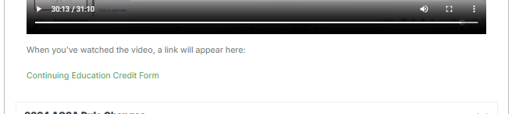
Watching recorded webinars

Slide 14
Watching with your buddy
GoToWebinar records the names and email addresses of those who log-in
If you watch with someone at their desk/cubicle/conference room, GoToWebinar doesn’t know that
The person who is logged in should report to the CE Point chairs who watched on their log-in

Slide 15
Application for points for workshop/webinar

Slide 16
Application for points for workshop/webinar

Slide 17
Application for points for workshop/webinar

Slide 18
Application for points for workshop/webinar

Slide 19
SOP for merger
Purpose: This SOP describes how continuing education points will be assigned by the Continuing Education Subcommittee.
Scope: To maintain membership status, each member shall obtain five (5) continuing education points every three (3) years. A fiscal year of the Association shall be from June first (1st) to May thirty first (31st).
References: Application for Continuing Education Points for a Workshop/Webinar; Continuing Education Points Worksheet
Points will be assigned as follows:
1. WORKSHOPS, SEED SCHOOLS or INDIVIDUALIZED TRAINING:
The host must complete an ‘Application for Continuing Educations Points for a Workshop/Webinar’, including an agenda and certificate of attendance after completion.
• One (1) point for each half day (minimum of 3 hours) that comprises of at least a 50% “hands-on” type program.
• A half (1/2) point will be given for each half day (minimum of 3 hours) that does not comprise of at least a 50% “hands-on” type program.
2. INSTRUCTOR, SPEAKER, OR TRAINER
• One (1) point will be given for participation in a T&T approved workshop, seed school, individualized training, or webinar, as an instructor, speaker or trainer.
3. MENTOR
• Two (2) points will be given for each mentee.
4. MEETINGS:
A maximum of three (3) points from verified attendance at qualified meetings.
a. Annual meeting of the AOSA-SCST
• One (1) point is obtained for each day of attendance; one of which shall include attendance at the business meeting portion. Attendance at the business meeting portion is required to earn any continuing education points.
b. National, regional, local or other seed trade meetings
• One (1) point is obtained for each meeting attended.
5. WEBINARS:
It is the responsibility of each analyst to notify the CE co-chairs of webinar attendance.
a. AOSA-SCST sponsored: (live or recorded on official website)
• One (1) point per webinar completed.
• Note: Recorded webinars on the official website must be watched in entirety. The attendance form will not display if the recording is paused, skipped forward or reversed while watching.
b. Other institution sponsored:
The host must receive approval from the T&T Committee to offer points. The host must complete an ‘Application for Continuing Educations Points for a Workshop/Webinar’, including an agenda and certificate of attendance after completion.
• One (1) point per webinar completed.
6. COLLEGE CREDITS:
Satisfactory completion of seed related courses, including distance learning courses, from an accredited institution. Evidence of attendance must be submitted to the Continuing Education chair or his/her designee to receive the appropriate credit. Must have been completed within the last three fiscal years to qualify for continuing education purposes.
• Three (3) points for each college credit and two (2) points for each quarter hour will be credited
7. REFEREE:
An eligible referee shall consist of five or more participants from three or more laboratories and provide comparative results to the participant.
• One (1) point for individual participation in an eligible referee.
8. EXECUTIVE BOARD MEMBER, OFFICER, OR COMMITTEE CHAIR
• One (1) point will be credited for each year served.
*Proficiency Testing: No points will be awarded. Participation is expected.

Slide 20
To maintain membership status…
AOSA | SCST | Proposed merger
Shall maintain 5 points every three years | Shall maintain 5 points every three years | Shall maintain 5 points every three years

Slide 21
WORKSHOPS, SEED SCHOOLS
AOSA | SCST
1 point for each half day (3 hours) that is at least 50% hands-on | 1 point for each half day (3 hours) that is at least 50% hands-on
1. WORKSHOPS, SEED SCHOOLS AND INDIVIDUALIZED TRAINING
Proposed merger
1 point for each half day (3 hours) that is at least 50% hands-on ½ point for each half day (3 hours) that is not at least 50% hands-on
INDIVIDUALIZED TRAINING
AOSA | SCST
1 point for every 3 hours | 1 point for every 3 hours

Slide 22
2. INSTRUCTOR, SPEAKER, OR TRAINER
AOSA | SCST | Proposed merger
1 point | 1 point | 1 point

Slide 23
3. MENTOR
AOSA | SCST | Proposed merger
None | 1 point for each mentee | 2 points for each mentee, per year

Slide 24
4. MEETINGS
 | AOSA | SCST | Proposed Merger
a. Annual meeting | 1 point for each day; 3 points max *Attendance at business meeting required | Must attend three days; 3 points *Attendance at business meeting required | Must attend three days; 3 points *Attendance at business meeting required
b. National, regional, or local meeting | ½ point for each meeting attended | 1 point for each meeting attended | 1 point for each meeting attended

Slide 25
5. WEBINARS
AOSA | SCST | Proposed merger
1 point per webinar completed | 1 point per webinar completed | 1 point per webinar completed

Slide 26
6. COLLEGE CREDITS
AOSA | SCST | Proposed merger
3 points for each college credit | 3 points for each semester hour, 2 points for each quarter hour *up to half of required CE points | 3 points for each semester hour, 2 points for each quarter hour *up to half of required CE points

Slide 27
7. REFEREE
AOSA | SCST | Proposed merger
1 point for each referee | 1 point for each referee | 1 point for each referee

Slide 28
8. EXECUTIVE BOARD MEMBER, OFFICER,
OR COMMITTEE CHAIR
AOSA | SCST | Proposed merger
1 point per duty, for each year served | 1 point per duty, for each year served | 1 point per duty, for each year served

Slide 29
9. PROFICIENCY TESTING
AOSA | SCST | Proposed merger
1 point if within tolerances | None | None?

Slide 30
Questions or comments?
CE points:
Leanna Leach lleach@scda.sc.gov
Kathy Mathiason katherine.mathiason@sdstate.edu
Teaching & Training:
Anitra Walker Anitra.Walker@usda.gov
Angela Croft acroft@growmark.com

