Slide 1
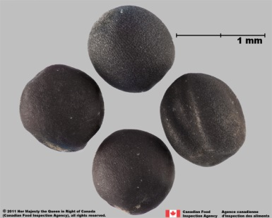
Referee Study on Germination of Canarygrass (Phalaris canariensis)
Lei Ren
2023 AOSA Annual Meeting
June 14, 2022

Slide 2
Objectives
To promote uniformity, standardization, and precision among seed laboratories.
To provide data to be used as supporting evidence harmonization of Canadian M&P, AOSA and ISTA rules.
To identify specific areas in the Canarygrass germination test in which investigation or research is needed.
Notes:
To promote uniformity, standardization, and precision among seed laboratories with regard to the evaluation of temperatures equivalency specified in three sets of rules.
To provide data to be used as supporting evidence for future seed testing procedures and rule changes, such as harmonization of Canadian M&P, AOSA and ISTA seed testing procedures and rules.
To identify specific areas in the rapeseed germination test in which investigation or research is needed to promote uniform results among laboratories.

Slide 3
Germination Rule Comparison
Testing Rules | Substrata | Temperatures (ºC) | Counting days
M&P | BP, RT | 15-25 | 7 and 10
ISTA | BP, TP | 15-25; 20-30 | 7 and 21
AOSA | B, T | 20-30 | 3 and 7
Notes:
We analyzed the rule difference and hypothesized that temperature and counting dates are the potential factors that could cause the difference of germination results

Slide 4
Testing Method
Temperatures (ºC) | Substrata | Seeds X Reps | Counting days
15-25 | BP/B* | 100 X 4 | 3, 7, 10, 14 and 21
20-30 | BP/B* | 100 X 4 | 3, 7, 10, 14 and 21
* BP substrata is following the M&P Rule; B substrata is following the AOSA Rule. Both are between blotters

Slide 5
Pre-trial Within SSTS
Notes:
Non dormant seeds for this test

Slide 6
Referee study: Inter-Laboratory Study
Lot 2, 4 and 8
10 samples for homogeneity test
15-25ºC
20-30ºC
13.5 g (2000 seeds) 60 samples
Mixing and dividing
28 samples
Notes:
Sample variation are randomly and evenly distributed in each temperature and participant when the homogeneity test is passed, therefore sample factor to all samples and participants are equivalent statistically.
3 seed lots, 60 samples were used in the referee study

Slide 7
Participants
In total, there are 28 labs attending this referee study
11 from Canada
17 from USA
This presentation includes 27 labs data
All 27 labs provided 15-25 ºC data
24 out of 27 labs provided 20-30 ºC data
Final report will include 28 labs data

Slide 8
Result: Source of Variation
ANOVA table |  | Normal Seedlings |  |  |  |  | AB seedlings | Ungerminated seeds
 |  | Day 3 | Day 7 | Day 10 | Day 14 | Day 21
Source | DF | Pr > F | Pr > F | Pr > F | Pr > F | Pr > F | Pr > F | Pr > F
temperature | 1 | 0.0117 | 0.2346 | 0.816 | 0.6003 | 0.2843 | 0.378 | 0.0164
seedlot | 2 | 0.0443 | <.0001 | <.0001 | <.0001 | <.0001 | <.0001 | <.0001
temperature*seedlot | 2 | 0.1833 | 0.2956 | 0.0101 | 0.0288 | 0.0724 | 0.0005 | 0.8418
Notes:
All data was analyzed by Glimmix Model using SAS 9.4
Sources of variation that impact the result (significant)
Fvalue – higher indicates more variation
Pr>F (p value) is significant less than 0.05 is significant
No significant different for Tem effect

Slide 9
Germination of Each Seed Lot
In line with pre-trial results

Slide 10
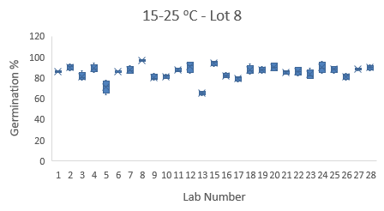
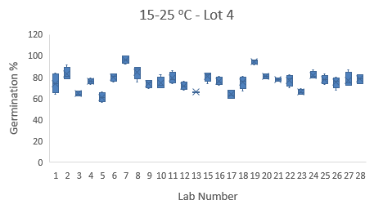
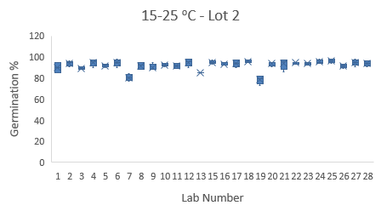
Result - Lab Variation

Slide 11
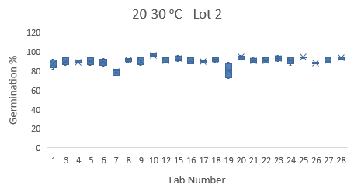
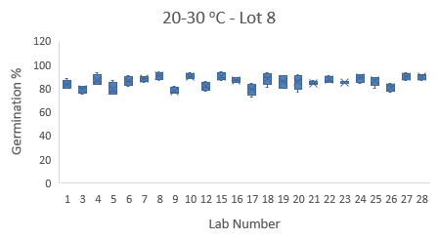
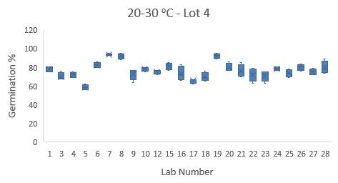
Result - Lab Variation (Con.)
Lowest germination lot has the highest variation among lab testing

Slide 12
Temperature Effect on Germination
a
a
a
a
a
a
No differences between the two tested temperatures
Notes:
20 C is consistent highest result and the least range.

Slide 13
Normal Seedling Germ Trend
Notes:
Same information. Visual representation of temperature difference. Same color bar mean not significantly different. It should be one color bar if the temps gave equivalent results.

Slide 14
Counting Dates Effect on Germination
a
a
ab
b
c

Slide 15
Result: Lab performance rating
Result rating against mean
Mean
Z-score. The Z-score compares the distance of the participant’s result from the overall sample
mean, to the average difference from the mean of all participants. A Z-score of zero indicates the
participant’s result equaled the overall mean. A high number indicates the participant’s result
was far away from the mean.
D
C
B
A
B
C
D
Notes:
a. Z-score. The Z-score compares the distance of the participant’s result from the overall sample
mean, to the average difference from the mean of all participants. A Z-score of zero indicates the
participant’s result equaled the overall mean. A high number indicates the participant’s result
was far away from the mean. Evaluated the same way we would do a PT. Sum of z score over 3 lots.

Slide 16
Lab performance
Testing uniformity are variable in different temperatures
Notes:
Category standards used for performance evaluation
Σ absolute
z- Score
Performance
rating
Feedback Action Suggestions
0.00 – 3.49 A Acceptable, no action needed.
3.50- 5.29 B Review of methods is recommended.
5.30 – 6.99 C Lab should investigate possible problem
> 6.99 D Lab should investigate possible problem. It is Below
Minimum Performance of expected as Canadian or ISTA
accredited laboratory

Slide 17
Discussion
Lab is a large variable influencing testing uniformity. Lab variation is larger for the seed lot with lower germination.
Training?
Proficiency monitoring?
Clarities in rules or assistance on seedling evaluation?
Two tested temperatures did not have significant effects on germination % in this referee study.
Suggested counting dates vary among the three rules
Is 7 day counting long enough to capture the final germination?
Is 21 day counting needed?
10 or 14 day counting is good enough?
A method validation study needed?

Slide 18
Validation Study Plan
Follow ISTA validation process:
Participants:
ISTA accredited labs in U.S., Canada, others who are interested in
AOSA lab and Canadian labs
Experience: experienced labs
Seed lots: 6 seed lots with a wider germination range from 75-95%

Slide 19

Acknowledgement
Germination group
Research group
Jo Ann Hornseth
Maria Cumming
Nicole Wurm
Julie Lu
Ruojing Wang

Slide 20
Questions?

